Slide 1

A Systematic Knowledge Mining Approach towards Mobile Apps Analysis and Rate Prediction
Ruchi Mantri 20mca0132
Dev Sharma 20mca0129
Arka Seal 20MCA0126

Slide 2
Abstract
Data Mining is a vast domain to extract useful knowledge from a set of data. It has its huge application in mobile app rating prediction for the developers to acquire knowledge about which apps are prioritized over which others. Keeping that is mind we in this paper describes a systematic knowledge for mobile app ratings as a data mining approach. Here, we have tried to develop a noble algorithm modifying KNN for predicting the ‘Rating’ of Apps from Google App-store. For that we’ve required to split our dataset in two phases first one is train dataset and the other one is test dataset. We analysed a pattern from the trained phase and applied it on the test phase to get the ratings on the scale of 0 to 5.
We have modified the KNN algorithm by considering a range of values starting from lest distance for each element instead of pre defining K value of KNN with any constant number. In this way the difference will be maintained thoroughly instead of jumping from a smaller distance to a relatively larger one. For better visualization a graphical representation is being presented.

Slide 3
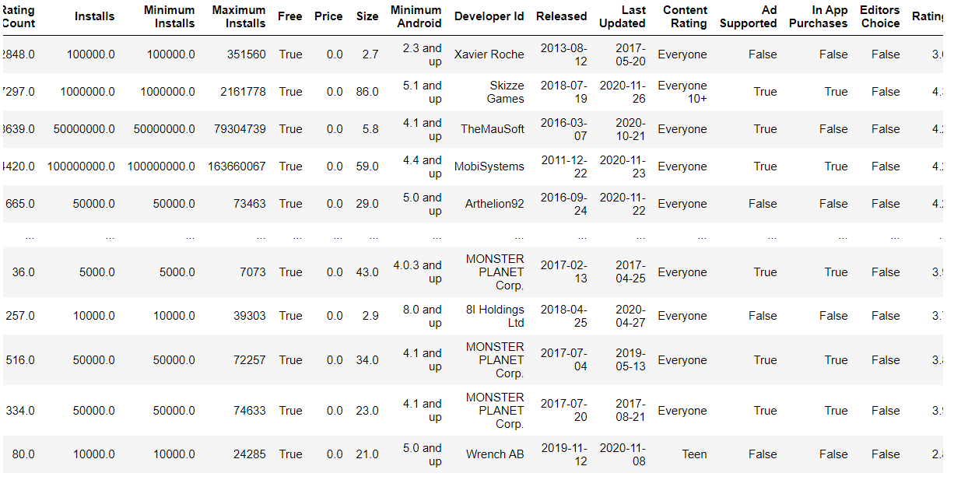
Dataset

Slide 4
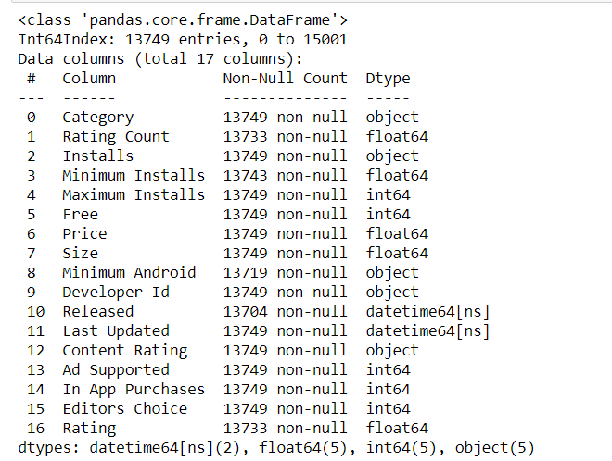
Dataset info

Slide 5
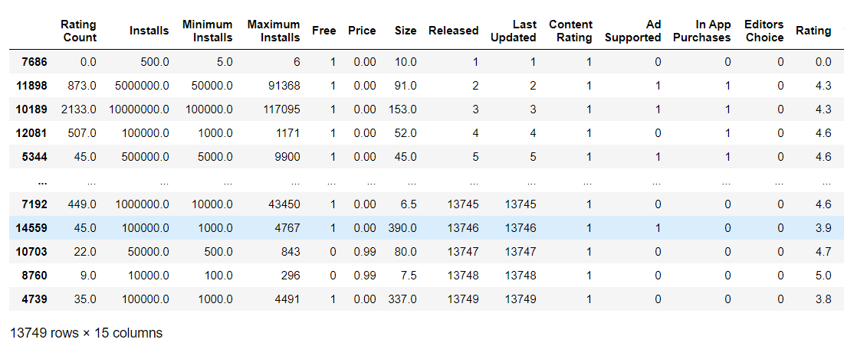
Cleaned DATASET

Slide 6
Modified KNN
If k=3
L=[10 20 60 70 80…]-> 10 20 60
But with modification we can change it to: min(L) + a range

Slide 7
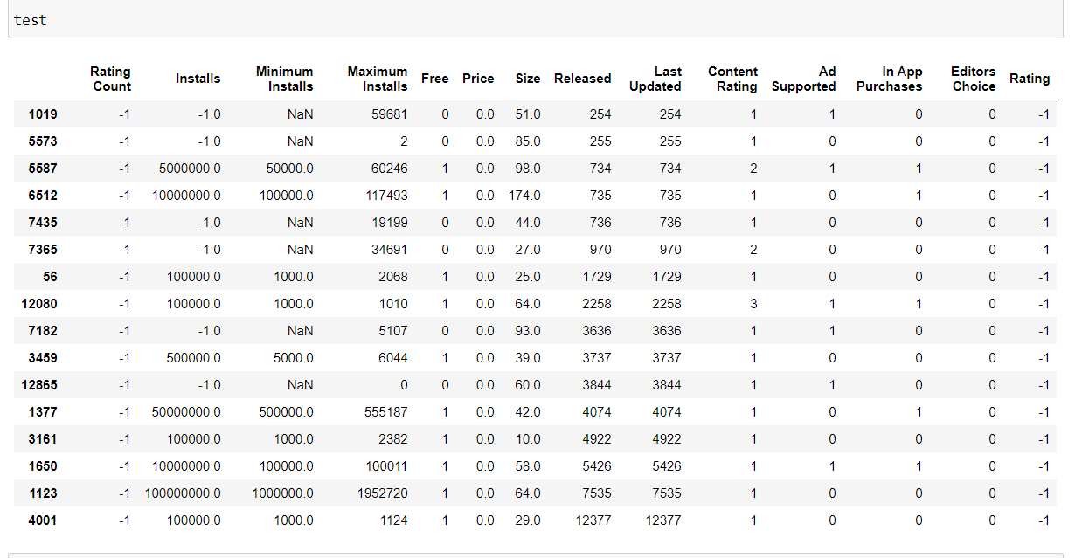
Test subset

Slide 8
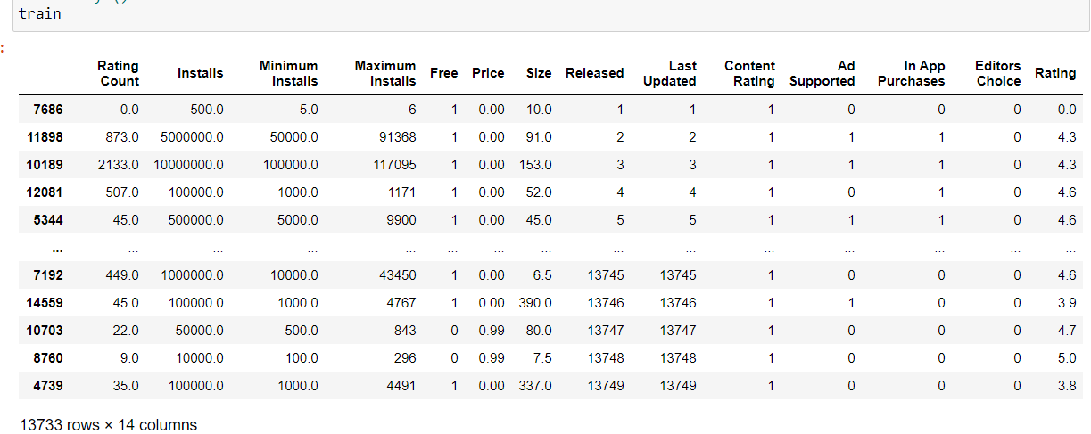
Train subset

Slide 9
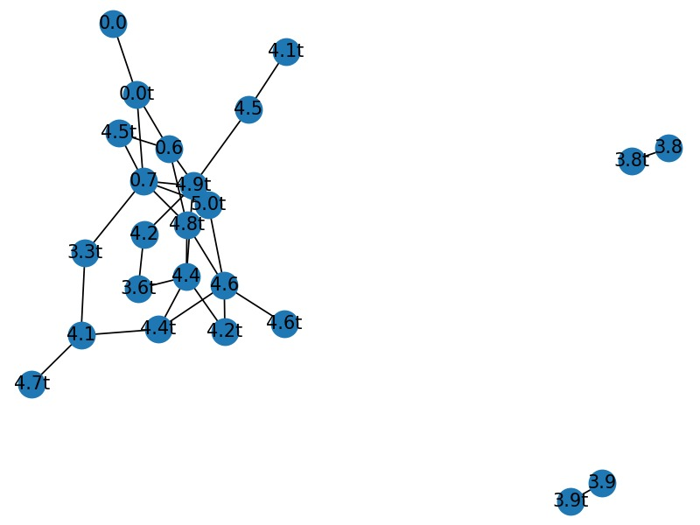
Graphical Representation

Slide 10
Thank You

