Slide 1

By ALM Team

Slide 2
Agenda
Why Confluence?
Team collaboration
Agile development
Knowledge base

Slide 3






Why Confluence? | Team Collaboration | Agile Development | Knowledge Base
Centralize
Organize
Create
Discuss
Search
Get answers
JIRA Integration
Capturing the knowledge is too often lost in email inboxes and shared network drives

Slide 4

Why Confluence? | Team Collaboration | Agile Development | Knowledge Base
Centralize
Organize
Create
Discuss
Search
Get answers
JIRA Integration
Capturing the knowledge is too often lost in email inboxes and shared network drives
Use Confluence instead – where it's easy to find, use, and update.

Slide 5
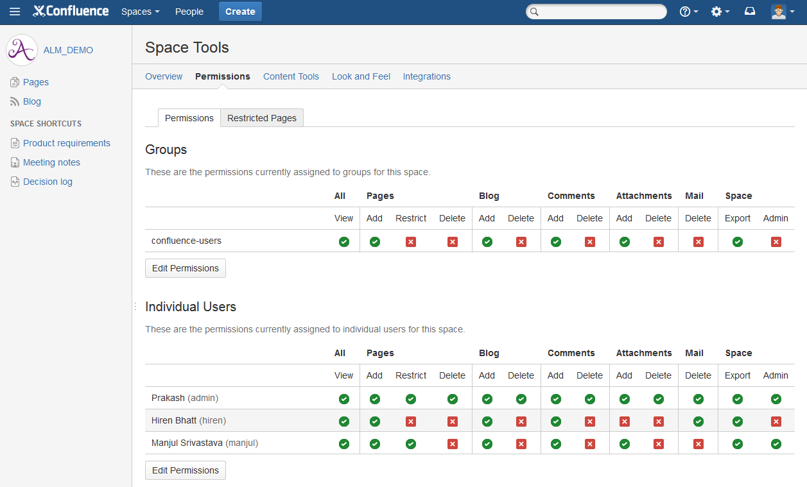
Why Confluence? | Team Collaboration | Agile Development | Knowledge Base
Centralize
Organize
Create
Discuss
Search
Get answers
JIRA Integration
Organize Team: Give every team, project or department its own space with its own permissions and theme.

Slide 6
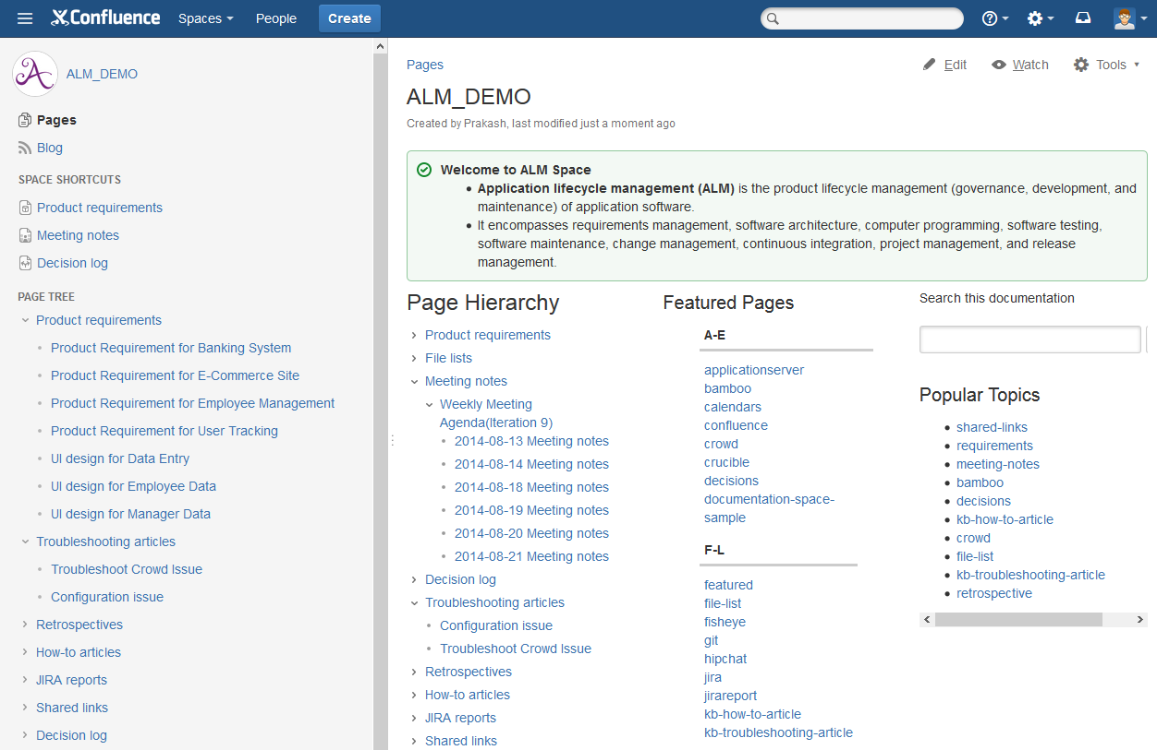
Why Confluence? | Team Collaboration | Agile Development | Knowledge Base
Centralize
Organize
Create
Discuss
Search
Get answers
JIRA Integration
Organize Information: Keep information organized and accessible with a flexible page hierarchy.

Slide 7
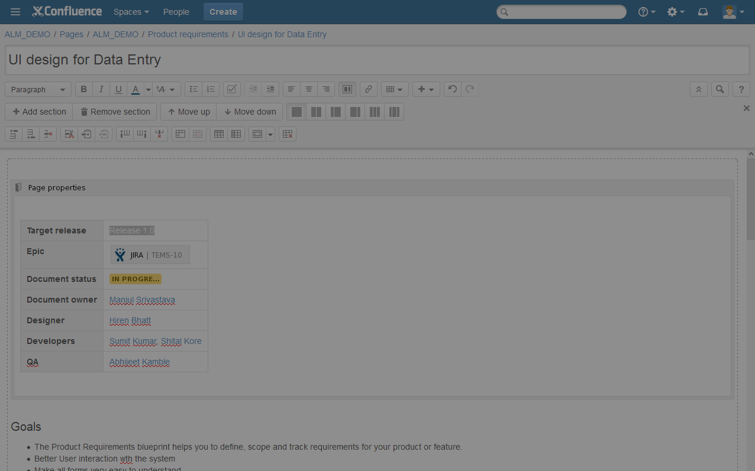
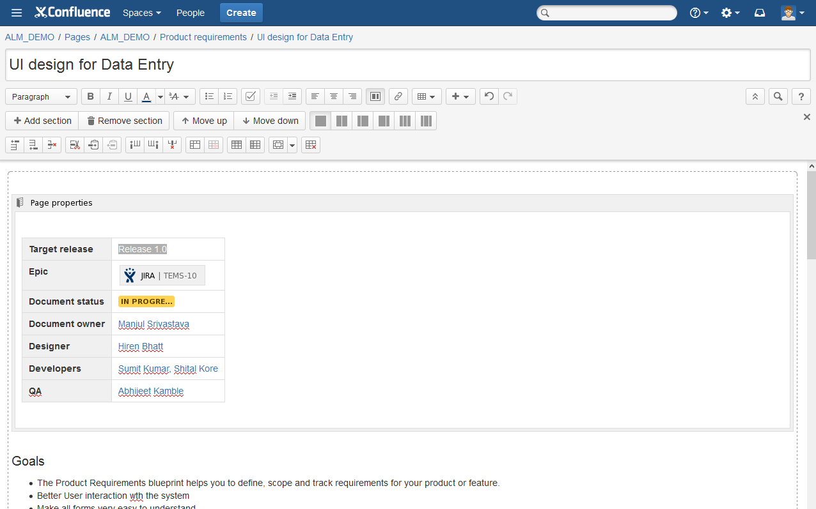
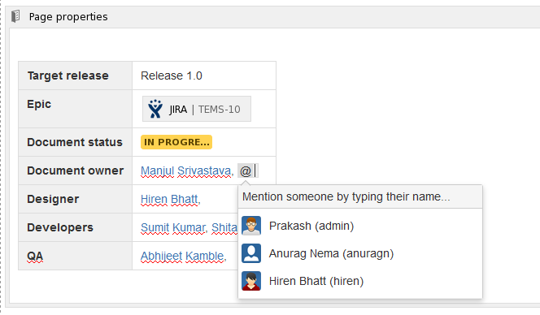
Why Confluence? | Team Collaboration | Agile Development | Knowledge Base
Centralize
Organize
Create
Discuss
Search
Get answers
JIRA Integration
Create anything with a rich content editor in your web browser.

Slide 8
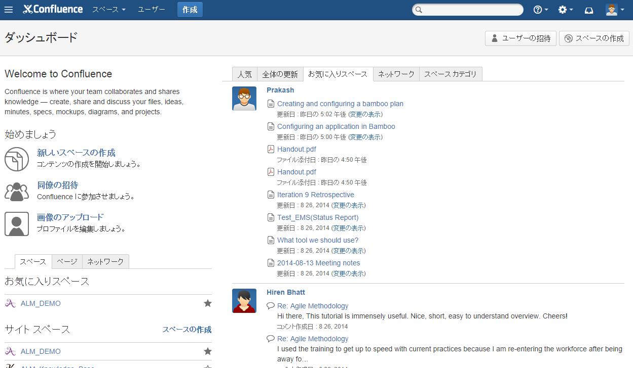
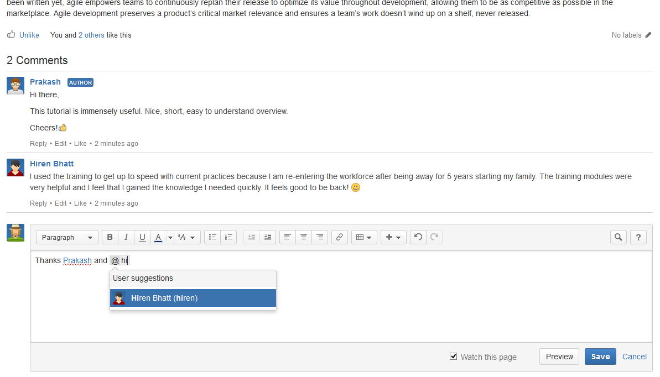
Why Confluence? | Team Collaboration | Agile Development | Knowledge Base
Centralize
Organize
Create
Discuss
Search
Get answers
JIRA Integration
Engage everyone: Whether you're in the same office or across the globe, it's easy to work together using Confluence.

Slide 9
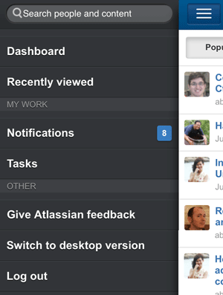
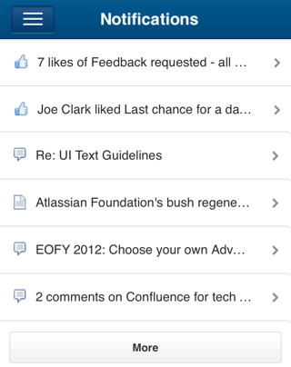
Why Confluence? | Team Collaboration | Agile Development | Knowledge Base
Centralize
Organize
Create
Discuss
Search
Get answers
JIRA Integration
Engage everyone: Whether you're in the same office or across the globe, it's easy to work together using Confluence.

Slide 10
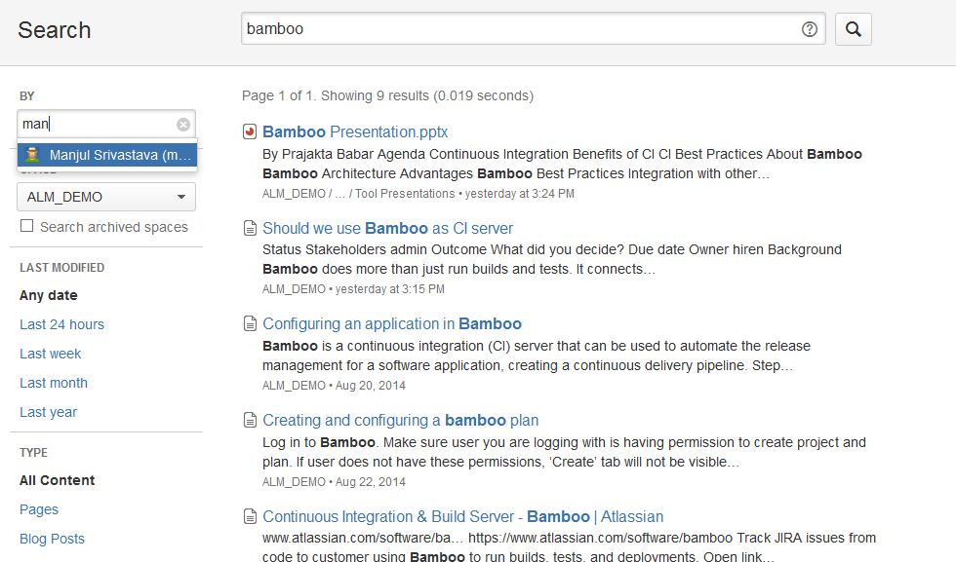
Why Confluence? | Team Collaboration | Agile Development | Knowledge Base
Centralize
Organize
Create
Discuss
Search
Get answers
JIRA Integration
Find what you need: When everything is in one place, you stop looking and start finding.

Slide 11
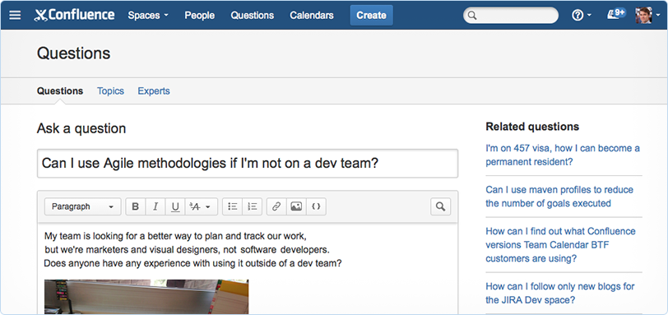
Why Confluence? | Team Collaboration | Agile Development | Knowledge Base
Centralize
Organize
Create
Discuss
Search
Get answers
JIRA Integration
Look, search, ask: Capture, learn from, and retain the collective knowledge of your organization as it grows.

Slide 12
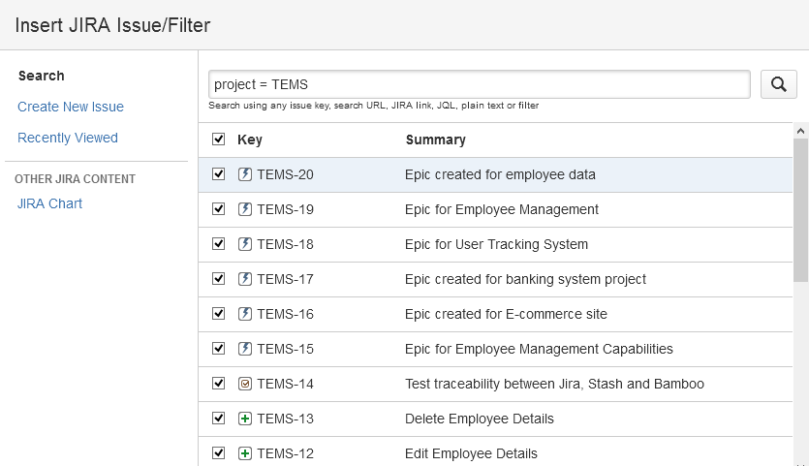
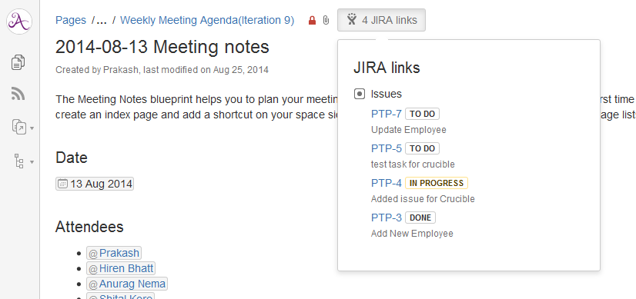
Why Confluence? | Team Collaboration | Agile Development | Knowledge Base
Centralize
Organize
Create
Discuss
Search
Get answers
JIRA Integration
Add clarity to JIRA: Transparency between the issues tracked in JIRA and related content in Confluence.

Slide 13
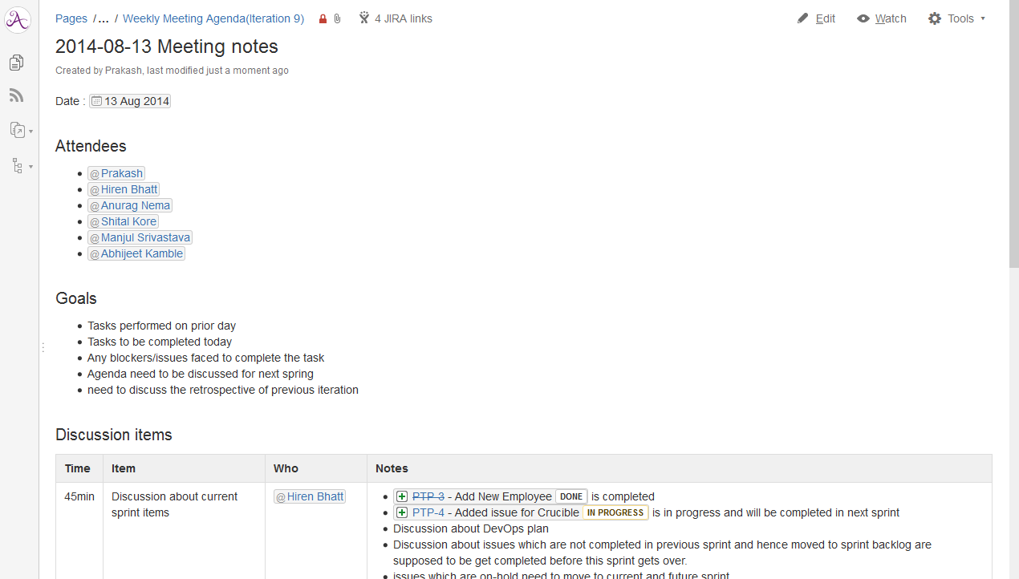
Why Confluence? | Team Collaboration | Agile Development | Knowledge Base
Meeting Notes
Share Files
Make Decisions
Share Links
Assign Tasks
Share Calendars
Make meetings count: With all your notes and action items in one place, you can give email a break.

Slide 14
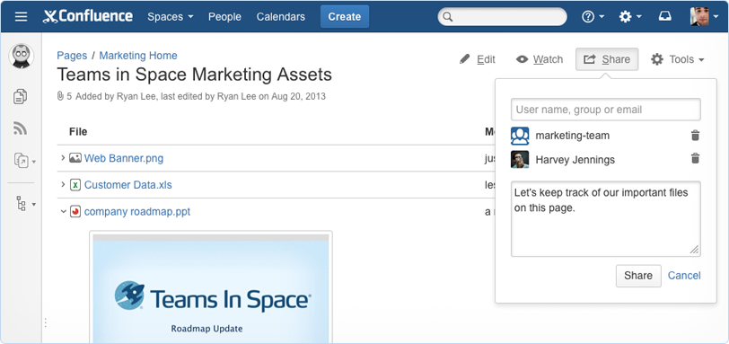
Why Confluence? | Team Collaboration | Agile Development | Knowledge Base
Meeting Notes
Share Files
Make Decisions
Share Links
Assign Tasks
Share Calendars
Engage everyone: Whether you're in the same office or across the globe, it's easy to work together using Confluence.

Slide 15
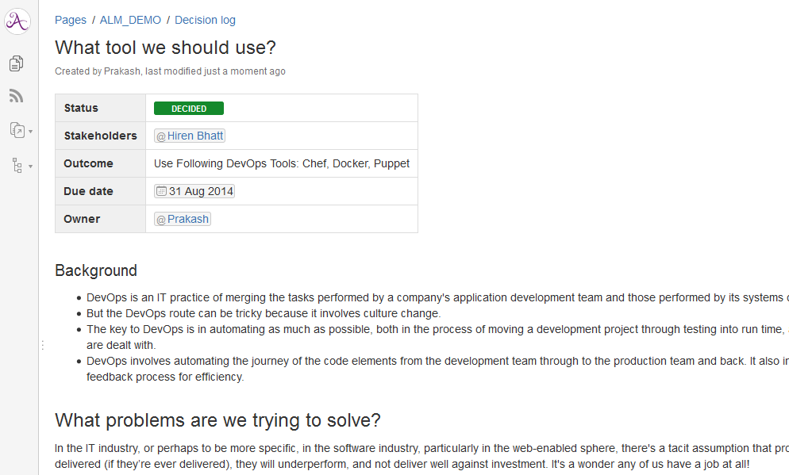
Why Confluence? | Team Collaboration | Agile Development | Knowledge Base
Meeting Notes
Share Files
Make Decisions
Share Links
Assign Tasks
Share Calendars
Decide faster, record forever: Save your team from endless loops of long meetings and frustrating email threads.

Slide 16
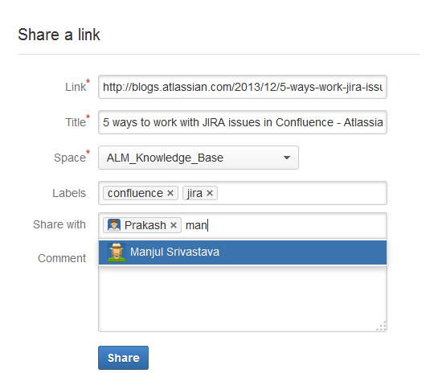
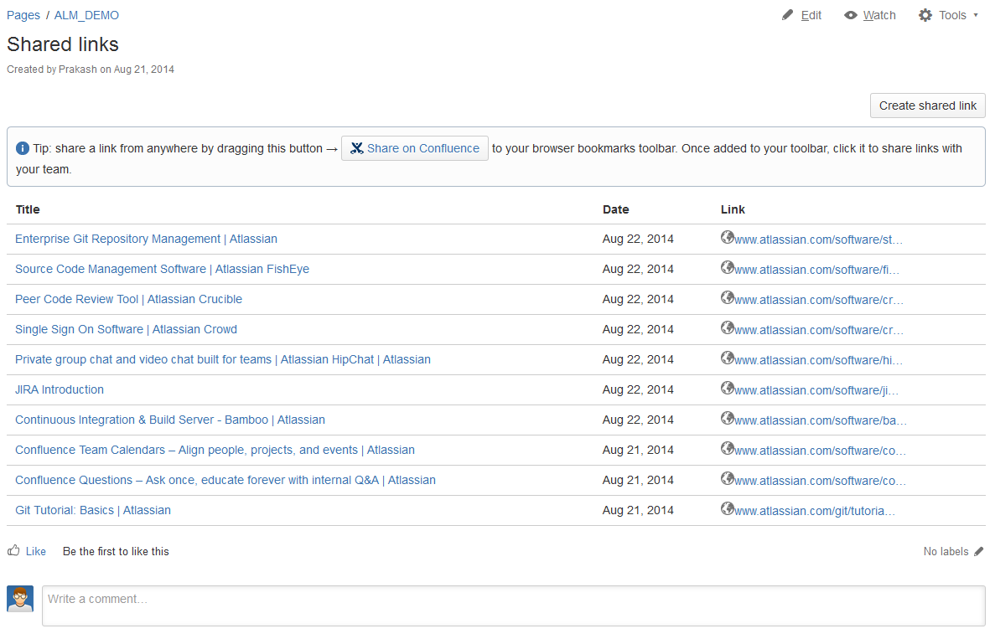
Why Confluence? | Team Collaboration | Agile Development | Knowledge Base
Meeting Notes
Share Files
Make Decisions
Share Links
Assign Tasks
Share Calendars
Share and build knowledge: Share anything you find on the web – articles, tweets, videos – and discuss it with your team.

Slide 17
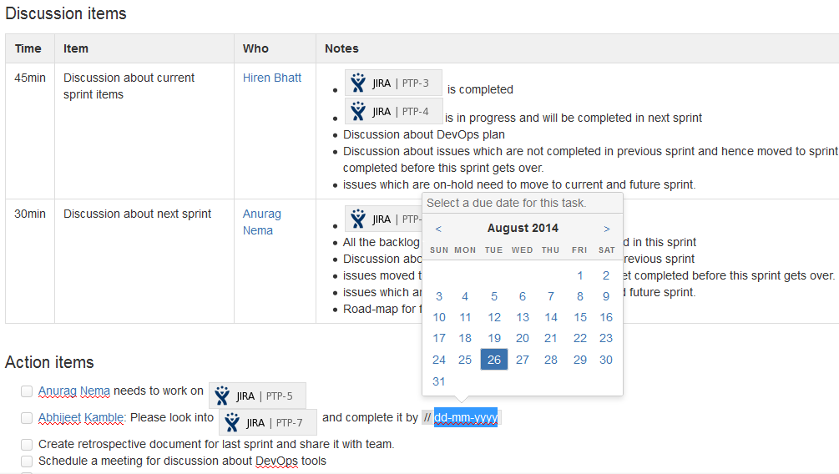
Why Confluence? | Team Collaboration | Agile Development | Knowledge Base
Meeting Notes
Share Files
Make Decisions
Share Links
Assign Tasks
Share Calendars
Stay on task: Assign tasks to teammates to keep work moving forward.

Slide 18
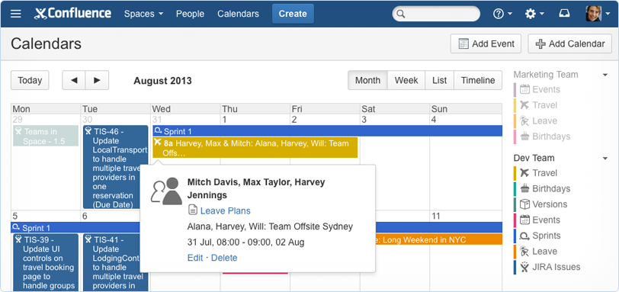
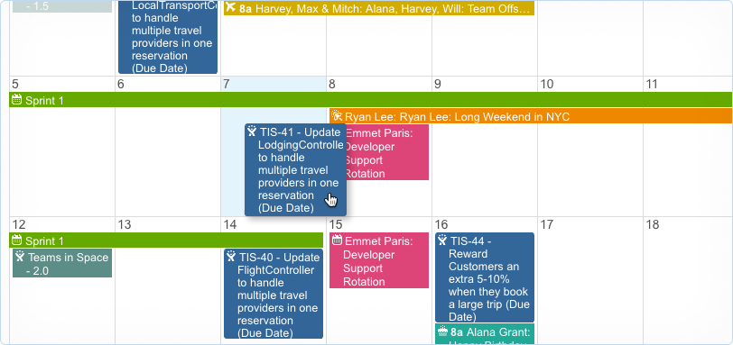
Why Confluence? | Team Collaboration | Agile Development | Knowledge Base
Meeting Notes
Share Files
Make Decisions
Share Links
Assign Tasks
Share Calendars
Schedule people, projects, and events: Manage team leave, track JIRA projects, and plan events with Confluence Team Calendars.

Slide 19
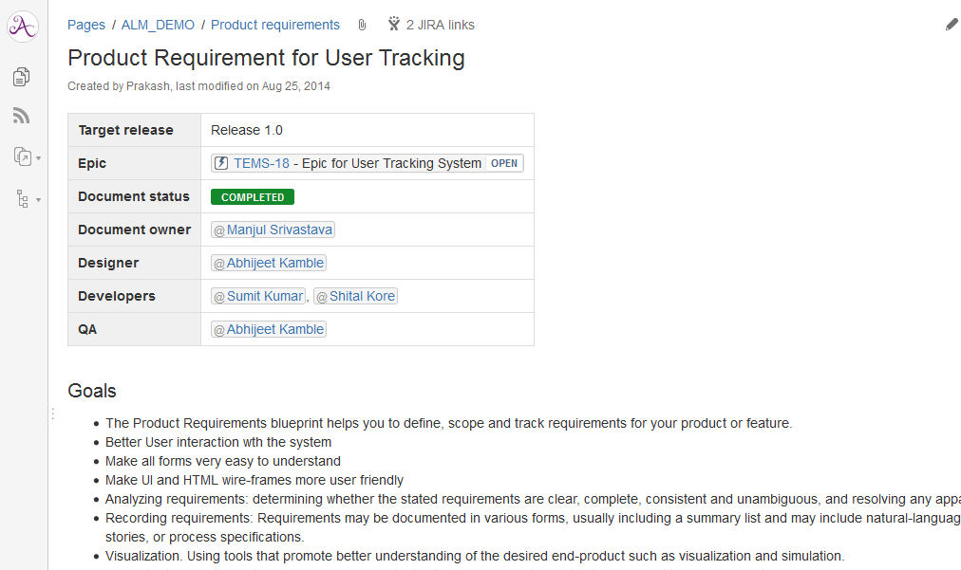
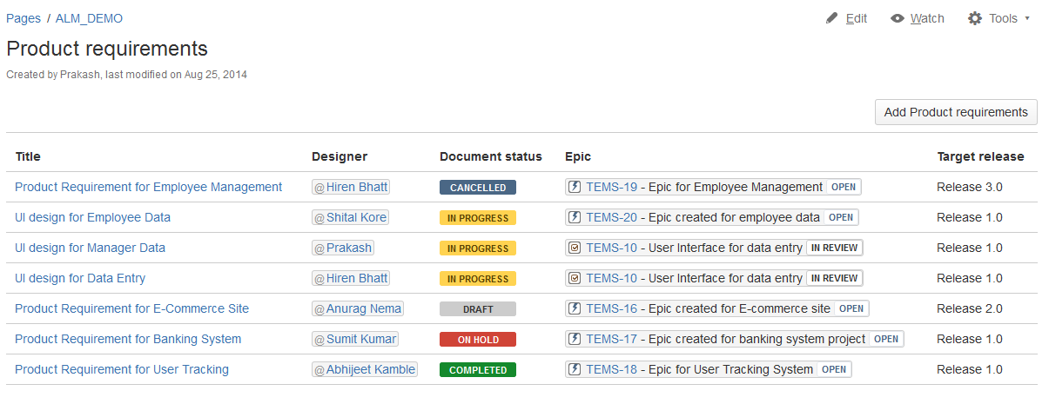
Why Confluence? | Team Collaboration | Agile Development | Knowledge Base
Requirement
Create JIRA Issues
Link to JIRA
Publish Reports
Track Releases
Retrospectives
Define product requirements: Document, discuss, and track product requirements so your developers can hit the ground running.

Slide 20
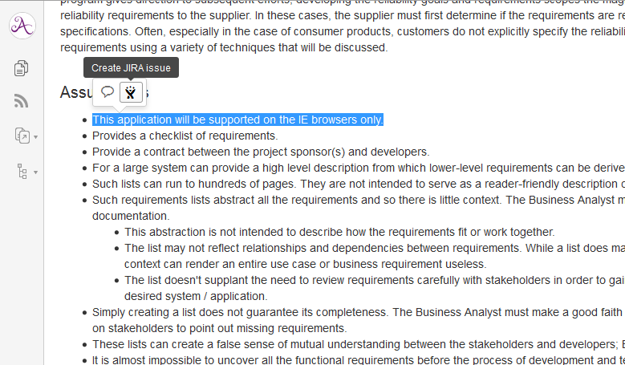
Why Confluence? | Team Collaboration | Agile Development | Knowledge Base
Requirements
Create JIRA Issues
Link to JIRA
Publish Reports
Track Releases
Retrospectives
Engage everyone: Whether you're in the same office or across the globe, it's easy to work together using Confluence.

Slide 21
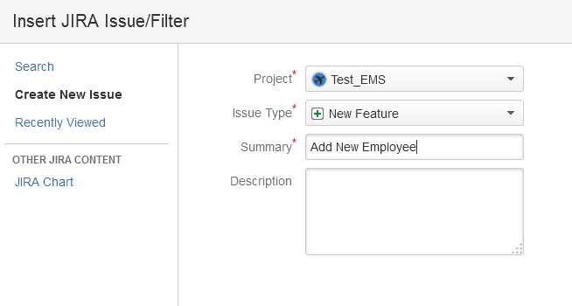
Why Confluence? | Team Collaboration | Agile Development | Knowledge Base
Requirements
Create JIRA Issues
Link to JIRA
Publish Reports
Track Releases
Retrospectives
Requirements → Backlog: Take your user stories in Confluence and put them in your backlog in JIRA without leaving Confluence.

Slide 22
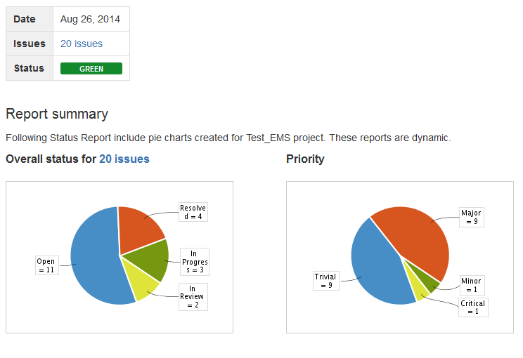
Why Confluence? | Team Collaboration | Agile Development | Knowledge Base
Requirements
Create JIRA Issues
Link to JIRA
Publish Reports
Track Releases
Retrospectives
Communicate progress: Keeping key stakeholders informed of the work your development team is doing in JIRA has never been this easy.

Slide 23
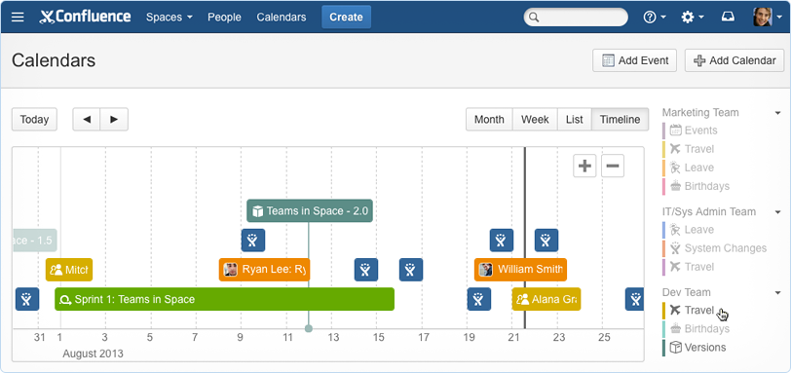
Why Confluence? | Team Collaboration | Agile Development | Knowledge Base
Requirements
Create JIRA Issues
Link to JIRA
Publish Reports
Track Releases
Retrospectives
Add Team Calendars: Surface everything your team is working on in JIRA to everyone else that lives in Confluence with Team Calendars.

Slide 24
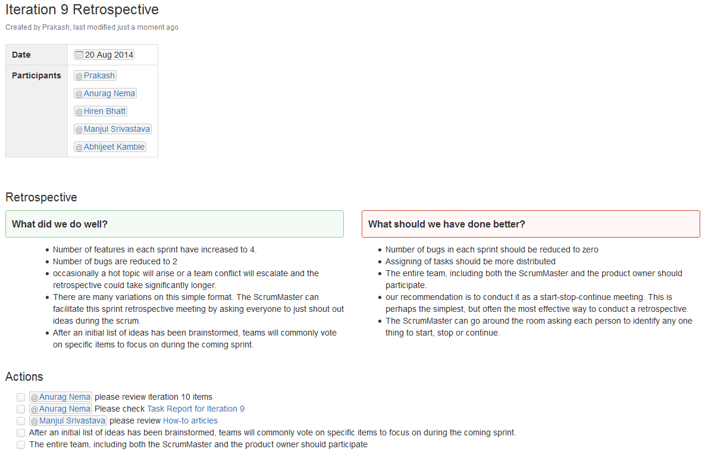
Why Confluence? | Team Collaboration | Agile Development | Knowledge Base
Requirements
Create JIRA Issues
Link to JIRA
Publish Reports
Track Releases
Retrospectives
Reflect and improve: Invite your team to reflect and improve – the agile way.

Slide 25
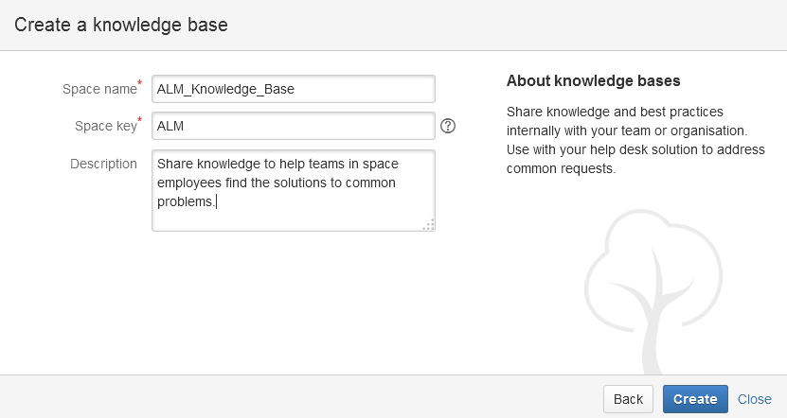
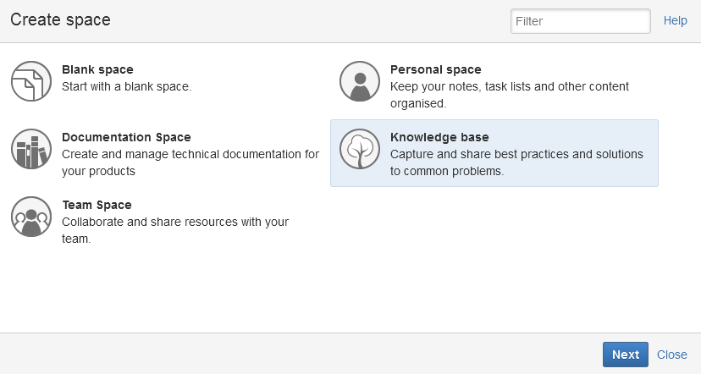
Why Confluence? | Team Collaboration | Agile Development | Knowledge Base
Simple Set up
Create Knowledge Articles
Instant structure
Connect to Service Desk
Set up in seconds: Set up your fully functional knowledge base space in a few clicks.

Slide 26
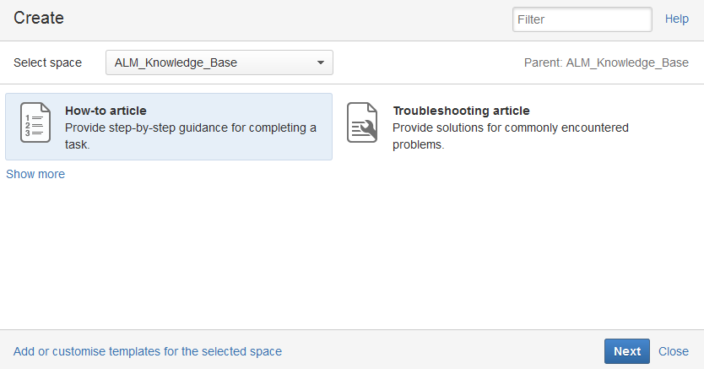
Why Confluence? | Team Collaboration | Agile Development | Knowledge Base
Simple Set up
Create Knowledge Articles
Instant structure
Connect to Service Desk
Bundled best practices: Quickly document solutions to known issues with the bundled how-to and troubleshooting article Blueprints.

Slide 27
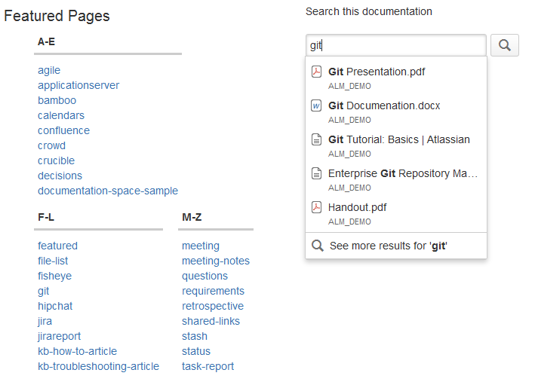
Why Confluence? | Team Collaboration | Agile Development | Knowledge Base
Simple Set up
Create Knowledge Articles
Instant structure
Connect to Service Desk
Structured and searchable: Help users find what they need by categorizing articles with labels.

Slide 28
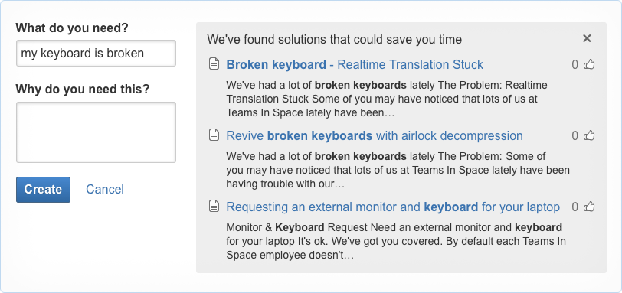
Why Confluence? | Team Collaboration | Agile Development | Knowledge Base
Simple Set up
Create Knowledge Articles
Instant structure
Connect to Service Desk
Connect to JIRA Service Desk: Confluence helps deflect requests by recommending relevant how-to and troubleshooting articles.

Slide 29

Any Questions?

Slide 30
Glossary
Confluence : https://www.atlassian.com/software/confluence
Confluence Questions : https://www.atlassian.com/software/confluence/questions
Confluence Team Calendars : https://www.atlassian.com/software/confluence/team-calendars

Slide 31
Thank You!

