Slide 1

By ALM Team

Slide 2
Agenda
What & Why Jira?
JIRA Products
Project Tracking
Code Integration
Get Started Fast
JIRA Hierarchy
Agile Methodology with JIRA
ALM Tools Integration (Open source)
Demo

Slide 3
Basic Questions
What is JIRA?
In simple terms: “JIRA is an issue tracker with Project Management Capabilities”
Is it web based? Yes
Is it open source? No
Is it a licensed product? Yes
Whose product is JIRA? www.atlassian.com

Slide 4



JIRA Products
JIRA Core
JIRA Software
JIRA ServiceDesk

Slide 5
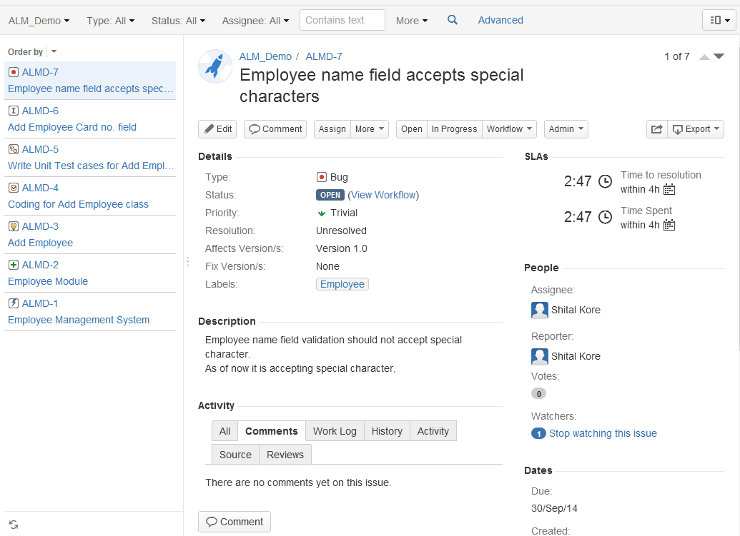
Why Jira? | Project Tracking | Code Integration | Get Started Fast
Issues
Process
Planning
Collaboration
Visibility
Issues are everywhere: Use JIRA to capture and organize team's issues, prioritize and take action on what's important.
Spend less time managing the work and more time building great software.

Slide 6
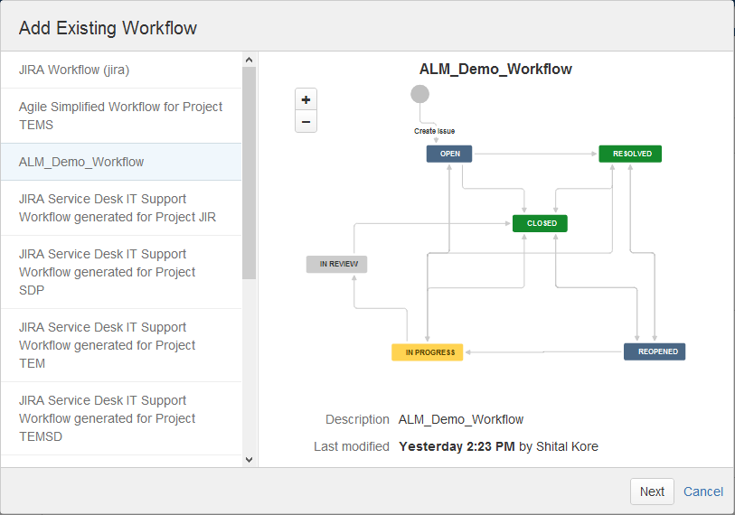
Why Jira? | Project Tracking | Code Integration | Get Started Fast
Issues
Process
Planning
Collaboration
Visibility
Work the way you want: Match your existing processes with Jira workflow, that you can easily adapt as your team evolves.
Use the tool that fits your team, don't change your team to fit your tool.

Slide 7
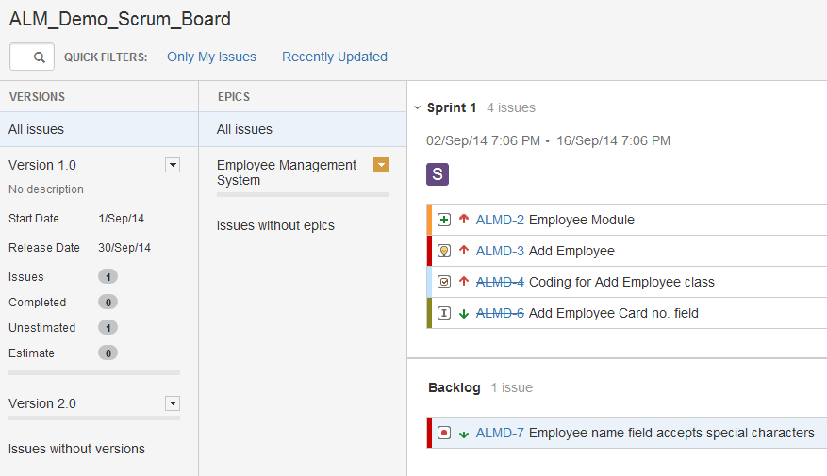
Why Jira? | Project Tracking | Code Integration | Get Started Fast
Issues
Process
Planning
Collaboration
Visibility
Productive, powerful planning: With the JIRA Agile add-on – you can plan agile sprints! And with Agile Ready, better plan sprints and releases while easily sharing development progress with stakeholders.

Slide 8
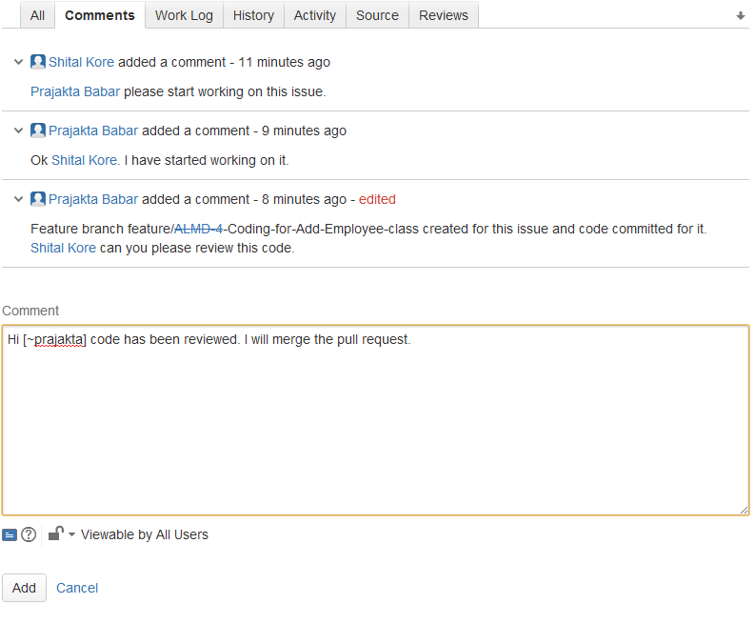
Why Jira? | Project Tracking | Code Integration | Get Started Fast
Issues
Process
Planning
Collaboration
Visibility
Collaborate easily: JIRA's simple, intuitive interface allows you to collaborate with teammates and get the job done more efficiently.
People can easily share information and reach out for help when they need it.

Slide 9
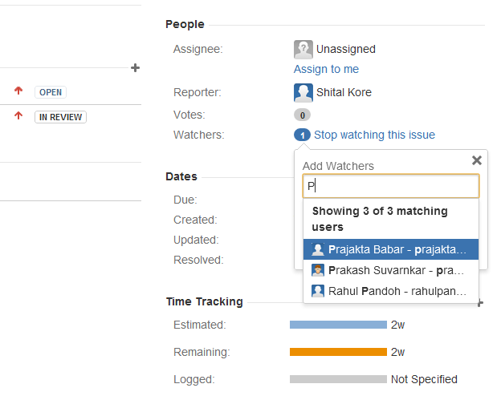
Why Jira? | Project Tracking | Code Integration | Get Started Fast
Issues
Process
Planning
Collaboration
Visibility
Visibility at the speed of light: Watch the issues that are most important to you, monitor activity streams, and share information with powerful dashboards, wallboards, and more.
Receive updates via email, chat, or by checking in on your mobile device.

Slide 10
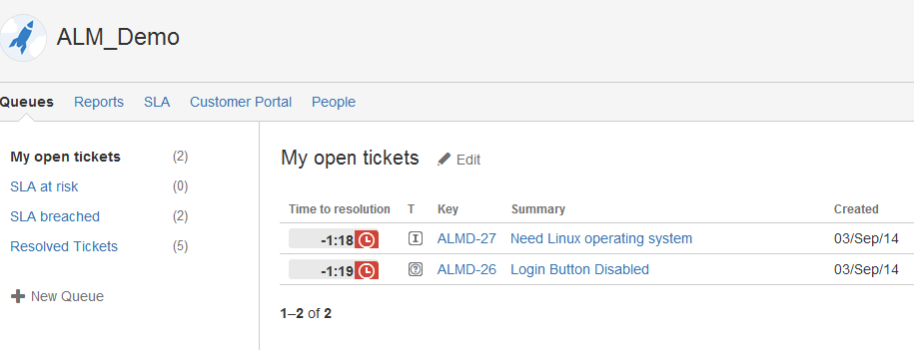
Why Jira? | Project Tracking | Code Integration | Get Started Fast
Service Desk
Workflow
Agile
Mobile
Collect, service, and report: JIRA Service Desk delivers an intuitive interface, a revolutionary new take on SLAs, customizable team queues, real-time reporting, and more.
Service desk streamlines customer requests and boosts team's efficiency.

Slide 11
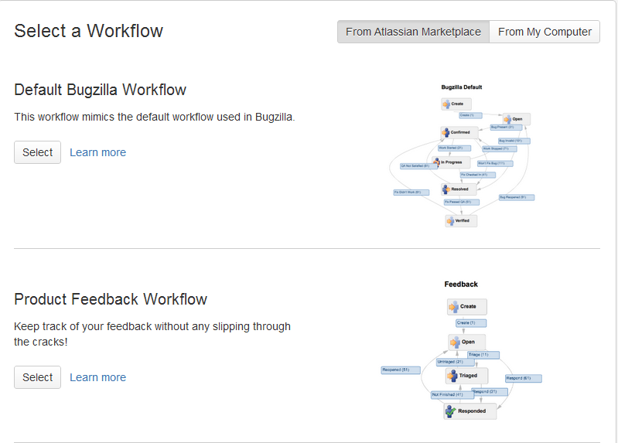
Why Jira? | Project Tracking | Code Integration | Get Started Fast
Service Desk
Workflow
Agile
Mobile
Workflows for teams of every size: Workflow is one of the most crucial ingredients to your success. JIRA lets you take advantage of the best practices of leading software teams by importing a JIRA workflow from the Atlassian Marketplace.

Slide 12
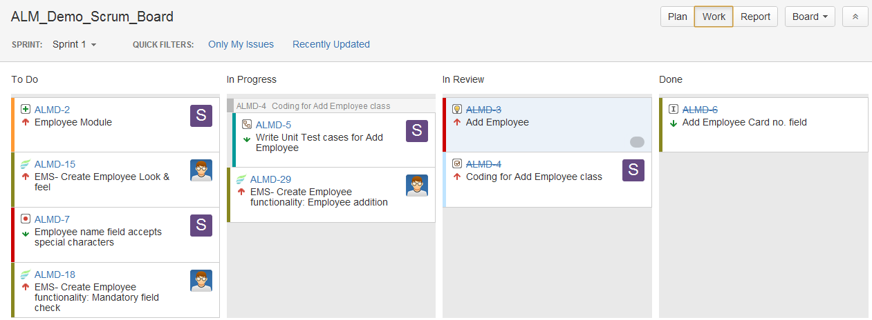
Why Jira? | Project Tracking | Code Integration | Get Started Fast
Service Desk
Workflow
Agile
Mobile
Agile project management: JIRA Agile adds agile project management to the power of JIRA.
Scrum teams can plan their sprints and kanban teams can manage the flow of their work.

Slide 13
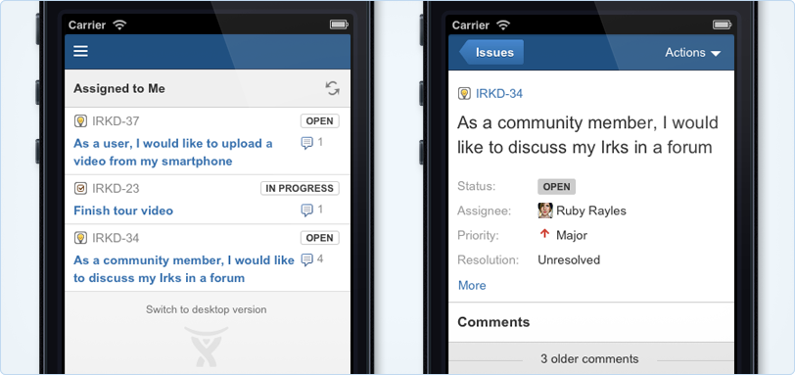
Why Jira? | Project Tracking | Code Integration | Get Started Fast
Service Desk
Workflow
Agile
Mobile
Effortlessly mobile: JIRA's mobile interface works in phone's web browser via HTML5 – no separate download or installation .
JIRA's new mobile interface to quickly find the most critical information and activity at fingertips.

Slide 14
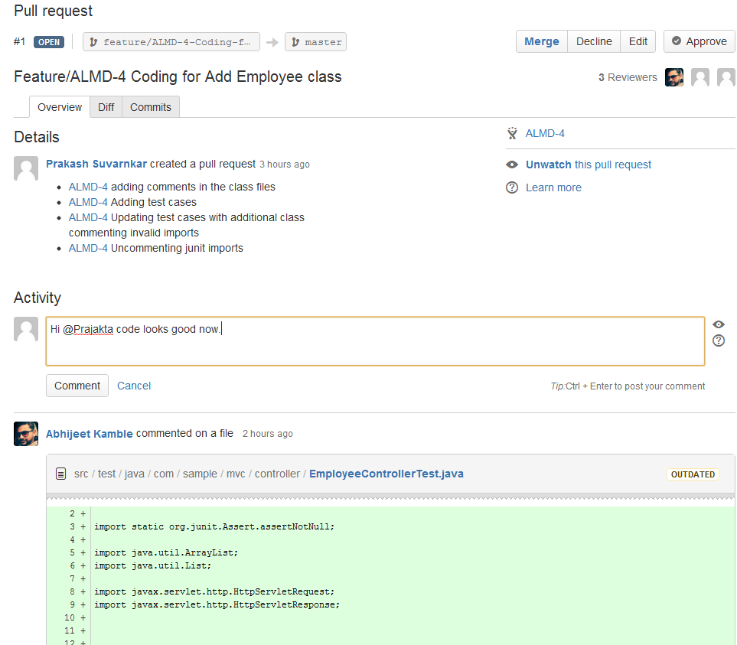
Why Jira? | Project Tracking | Code Integration | Get Started Fast
Development Workflow
Git
Hosted Code
Subvesrion
Build and Release
Flow through your software development: Upgrade software development workflow with JIRA, Stash, and Bamboo. No longer will you fret over naming branches, creating pull requests, and running builds.
Less focus on non-development tasks and get back to your code.

Slide 15
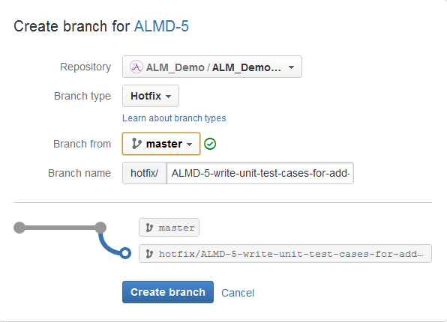
Why Jira? | Project Tracking | Code Integration | Get Started Fast
Development Workflow
Git
Hosted Code
Subvesrion
Build and Release
JIRA + Stash = Git at the speed of light: JIRA and Stash have come together to boost the speed of Git workflows.
Easy for team to create, name, and merge your branches.
Speed ups the development process.

Slide 16
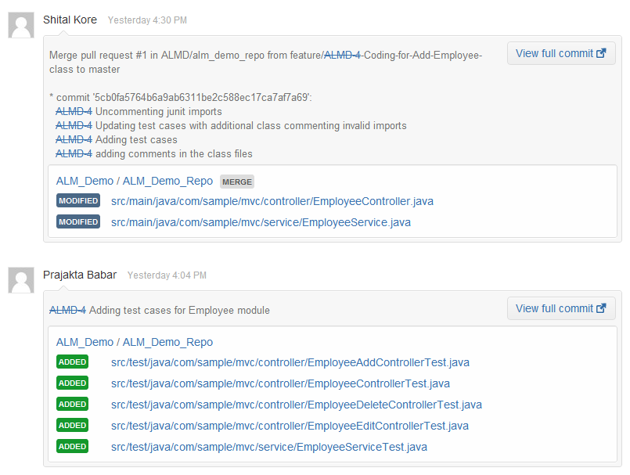
Why Jira? | Project Tracking | Code Integration | Get Started Fast
Development Workflow
Git
Hosted Code
Subvesrion
Build and Release
Up your Git with Stash and JIRA: Stash with JIRA provides an unparalleled development workflow for hosted Git repositories.
Integration between Stash and JIRA leads you from issue to code to merge in seconds.

Slide 17
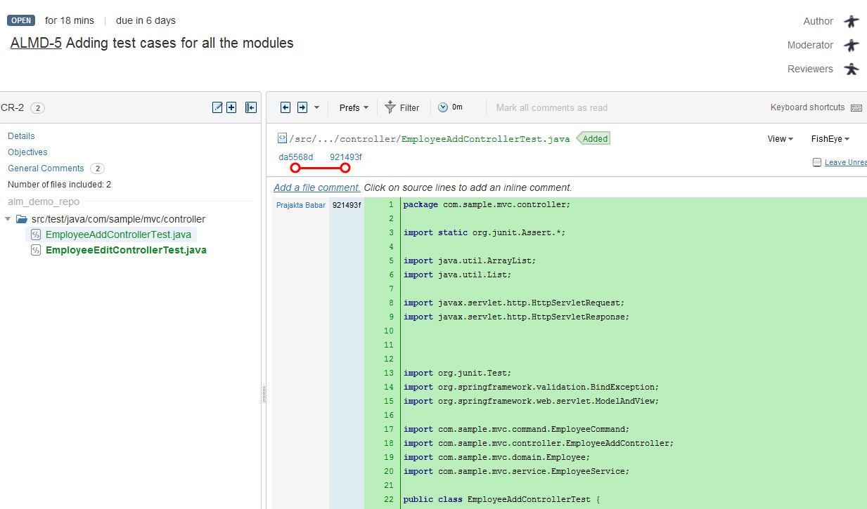
Why Jira? | Project Tracking | Code Integration | Get Started Fast
Development Workflow
Git
Hosted Code
Subvesrion
Build and Release
JIRA + SVN, Perforce, or CVS: Use FishEye for enhanced SCM integration with Subversion, Git, Mercurial, and Perforce including detailed commit graphs and statistics, recent code activity, and simple source code browsing. With Crucible's flexible review workflow review code, discuss changes, share knowledge, and identify defects .

Slide 18
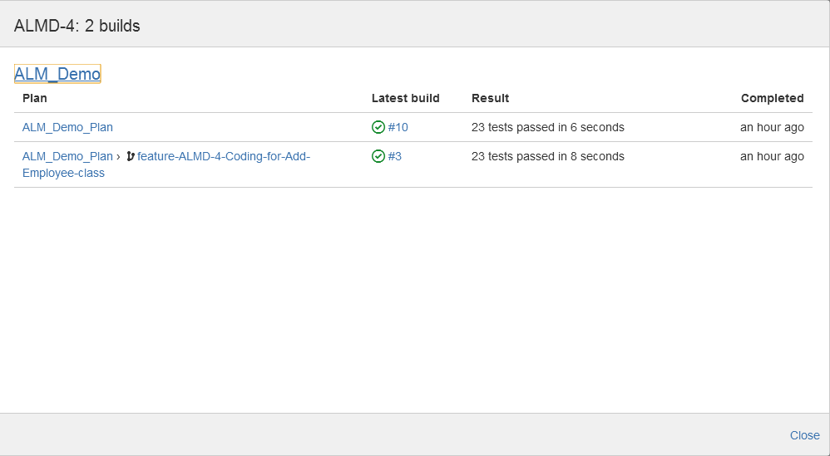
Why Jira? | Project Tracking | Code Integration | Get Started Fast
Development Workflow
Git
Hosted Code
Subversion
Build and Release
Build notifications and release management: Link continuous integration server like Bamboo or Jenkins to connect issues with builds.
Bamboo displays latest build status on dashboard and with on click release management streamlines the development process.

Slide 19
JIRA Hierarchy

Slide 20
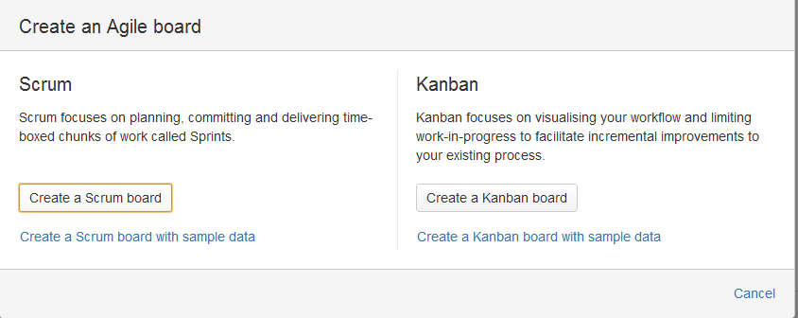
Why Jira? | Project Tracking | Code Integration | Get Started Fast
Scrum and Kanban
Projects
Workflows
Importing
Scrum or kanban in seconds: With Jira Agile get scrum or kanban boards instantly when you create a new project.

Slide 21
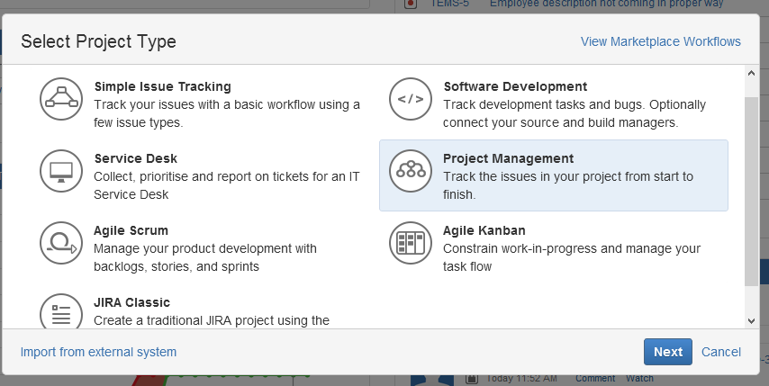

Why Jira? | Project Tracking | Code Integration | Get Started Fast
Scrum and Kanban
Projects
Workflows
Importing
Creating projects is a breeze: Creating a new project in JIRA is as easy as selecting from a list. You'll be ready to work in just a few clicks!

Slide 22
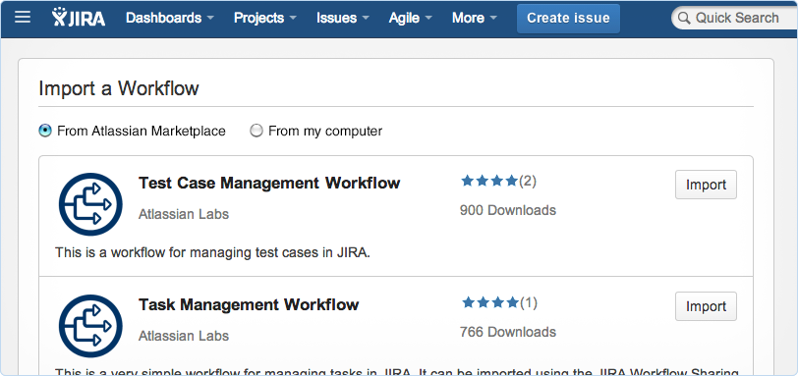
Why Jira? | Project Tracking | Code Integration | Get Started Fast
Scrum and Kanban
Projects
Workflows
Importing
Find your perfect workflow: No need to create your workflow from scratch. Choose a workflow that's right for you from the Atlassian Marketplace.

Slide 23
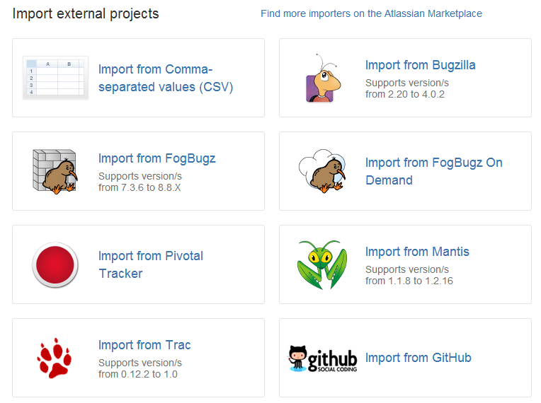
Why Jira? | Project Tracking | Code Integration | Get Started Fast
Scrum and Kanban
Projects
Workflows
Importing
Import from your legacy tracker: JIRA imports issues and projects from virtually any bug tracker including Bugzilla, GitHub , Trac and more.

Slide 24








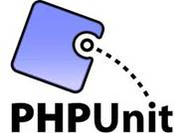




















ALM Tools Integration (Open source)
Requirements management
Project
management
Architecture & Design
Cloud provider
Development
Testing
Development
Development
Test case management
Unit
testing
SCM
SCA
Continuous Integration
or
or
Build
CI server
or
Artifactory
management
or
Repository management
or
ANT
or
or
or
&
or
or
Automation
testing
Continuous Delivery/Deployment using DevOps
Configuration management
Containerization
Continuous Monitoring
or
or
ELK
Sysdig
cadvisor
Note: Solution offering for on-premise & on-cloud
24

Slide 25

Any Questions?

Slide 26
Thank You!

