Slide 1


CODEQUEST
Team Name: Tech Connect
Team Members:
Aishita(co21305)
Khushbu(co21336)
Ruchika Thakur(co21352)
Vanshika Bhardwaj(co21366)
College Name: CCET

Slide 2

CONTENT
01
PROBLEM STATEMENT
02
APPROACH
03
ARCHITECTURE
04
GRAPHICAL USER INTERFACE
05
CHALLENGES
06
FUTURE SCOPE
07
HANDLING DATA INCONSISTENCIES IN SQUAD DATASET

Slide 3

PROBLEM STATEMENT
TITLE: Mini Chatbot using SQuAD Question-Answer Database Problem Statement: Build a mini chatbot that can answer user questions using the SQuAD (Stanford Question Answering Dataset) question-answer database. The chatbot should be able to interact with users, understand their queries, and provide accurate and relevant answers based on the information available in the SQuAD dataset.
Dataset Link :- https://rajpurkar.github.io/SQuAD-explorer/

Slide 4



APPROACH
A chatbot named "Tech Connect" is created using python programming language.The data preprocessing approach in the code involves lowercasing, punctuation removal, and tokenization.
The answer retrieval approach in the code first checks for direct matches in the FAQ database. If no match is found, it uses TF-IDF to calculate the similarity between the user's question and the knowledge base questions.
The user interface in the code uses a text-based interaction with Flask framework. The chatbot greets the user and enters a loop to await questions. The loop ends on 'exit' input, printing 'Goodbye'.
DATA PREPROCESSING
ANSWER RETRIEVAL
USER INTERFACE

Slide 5
ARCHITECTURE
TF-IDF (Term Frequency-Inverse Document Frequency) technique is used as an information retrieval method to find the most relevant question-answer pair from the SQuAD dataset based on the user's query.
A language model based on BERT (Bidirectional Encoder Representations from Transformers) and fine-tuning it on the SQuAD (Stanford Question Answering Dataset) dataset is implemented.
The code implements an NLP pipeline using the TF-IDF (Term Frequency-Inverse Document Frequency) approach for understanding and processing user questions effectively.

Slide 6
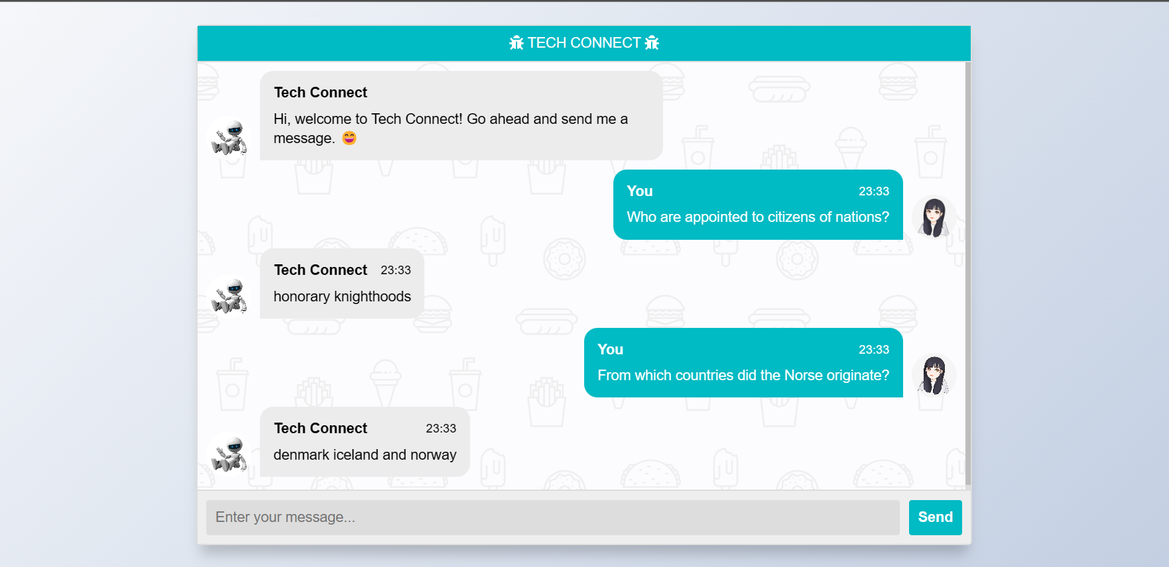
GRAPHICAL USER INTERFACE

Slide 7
CHALLENGES
It cannot infer anything deeper than the information that is already in the dataset.
It is not able to generate responses on its own, it either gives you the direct answer or displays the message that it doesn’t have a specific answer to our question.
Our chatbot is trained with a limited dataset and hence, is able to answer the direct questions only.

Slide 8

FUTURE SCOPE
01
02
03
04
IMPROVED CONTEXTUAL UNDERSTANDING
EXTERNAL INTEGRATION
EXPANDED KNOWLEDGE BASE
USER FEEDBACK AND KNOWLEDGE EXPANSION
Enhance the chatbot's capabilities by integrating it with additional databases or APIs, allowing it to access and utilize information beyond the SQuAD dataset, thereby expanding its knowledge base.
Integrate sentiment analysis into the chatbot to comprehend user emotions and provide suitable responses based on different emotional contexts.
Enhance the chatbot's contextual understanding to maintain coherence in follow-up questions during conversations.
Develop a system that enables users to offer feedback and contribute new question-answer pairs to enhance the chatbot's knowledge base.

Slide 9
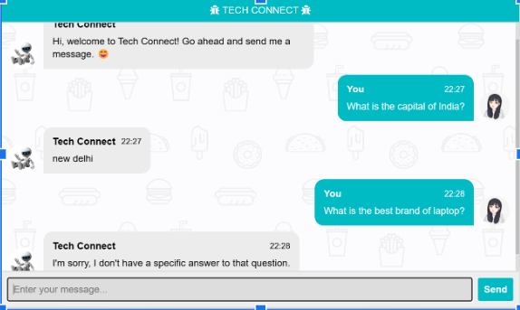
HANDLING DATA INCONSISTENCIES IN SQUAD DATASET

