Slide 1
B.Tech, Computer Science & Engineering, 3rd Sem , 2nd year
CS-303: Data Structure
Unit-3
Topic: Red Black Tree-Part 2
Lecture Number:49
Jul –Dec, 2020-21
Rakhi Arora
Assistant Professor , Department of Computer Science & Engineering

Slide 2
Outlines
Prerequisite
Objective
Red Black Tree
Red Black Tree – Insertion Example
Red Black Tree - Deletion
Assignment
Learning Outcomes
References

Slide 3
Prerequisite
Red Black Tree
Red Black Tree -Properties
Red Black Tree -Insertion

Slide 4
Objective
Red Black Tree - Deletion

Slide 5
Red Black Tree
A red-black tree is a binary search tree.
One extra attribute for each node: the colour, which is either red or black.
The Red-Black Trees are self-balancing binary search tree.
SELO:8,12 <Reference:1>

Slide 6
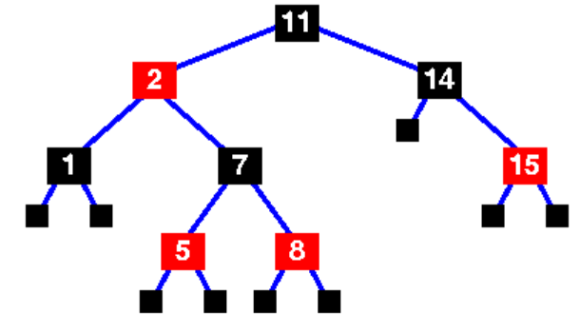
Red Black Tree
SELO:8,12 <Reference:1>

Slide 7
Red Black Tree - Insertion
Create a Red Black Tree by inserting following sequence of numbers
3,21,32,17
Insert 3
3
SELO:8,12 <Reference:1>

Slide 8
Red Black Tree - Insertion
Create a Red Black Tree by inserting following sequence of numbers
3,21,32,17
Insert 21
3
21
SELO:8,12 <Reference:1>

Slide 9
Red Black Tree - Insertion
Create a Red Black Tree by inserting following sequence of numbers
3,21,32,17
21
3
Insert 32
21
RR Rotation
32
21
3
3
32
SELO:8,12 <Reference:1>

Slide 10
Red Black Tree - Insertion
Create a Red Black Tree by inserting following sequence of numbers
3,21,32,17
Insert 17
21
32
3
32
3
17
SELO:8,12 <Reference:1>

Slide 11
Red Black Tree - Deletion
Recoloring and rotations are used to maintain the Red-Black properties.
In delete operation, we check color of sibling to decide the appropriate case.
In delete, the main violated property is, change of black height in subtrees as deletion of a black node may cause reduced black height in one root to leaf path.
SELO:8,12 <Reference:1>

Slide 12
Red Black Tree - Deletion
Perform BST delete.
v be the node to be deleted and u be the child that replaces v
SELO:8,12 <Reference:1>

Slide 13
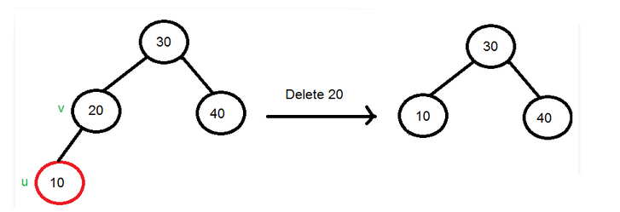
Red Black Tree - Deletion
Case 1
If either u or v is red
SELO:8,12 <Reference:1>

Slide 14
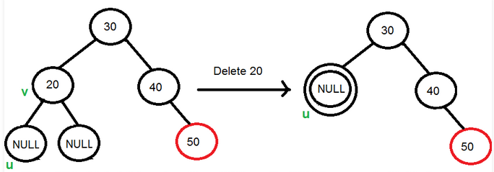
Red Black Tree - Deletion
Case 2
If Both u and v are Black.
SELO:8,12 <Reference:1>

Slide 15
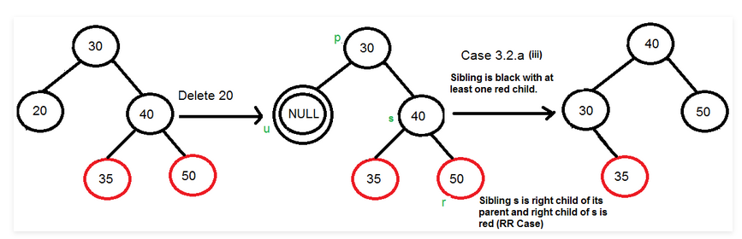
Red Black Tree - Deletion
Case 2
If sibling s is black and at least one of sibling’s children is red,
SELO:8,12 <Reference:1>

Slide 16
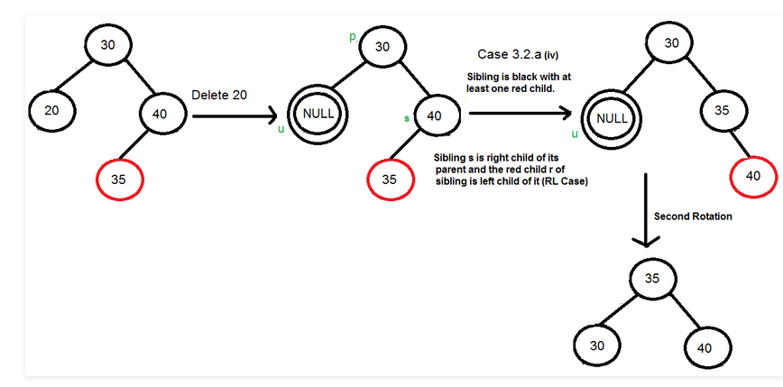
Red Black Tree - Deletion
Case 2
If sibling s is black and one of sibling’s children is red,
SELO:8,12 <Reference:1>

Slide 17
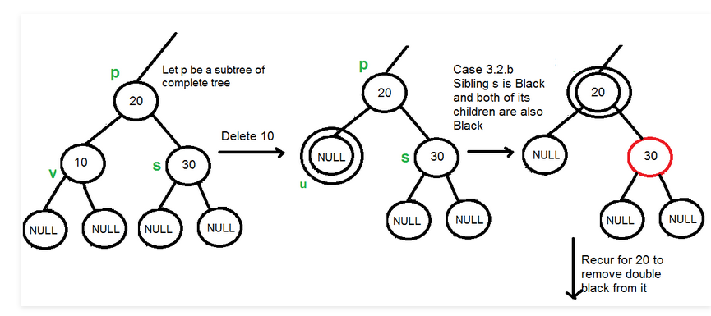
Red Black Tree - Deletion
Case 2
If sibling is black and its both children are black
SELO:8,12 <Reference:1>

Slide 18
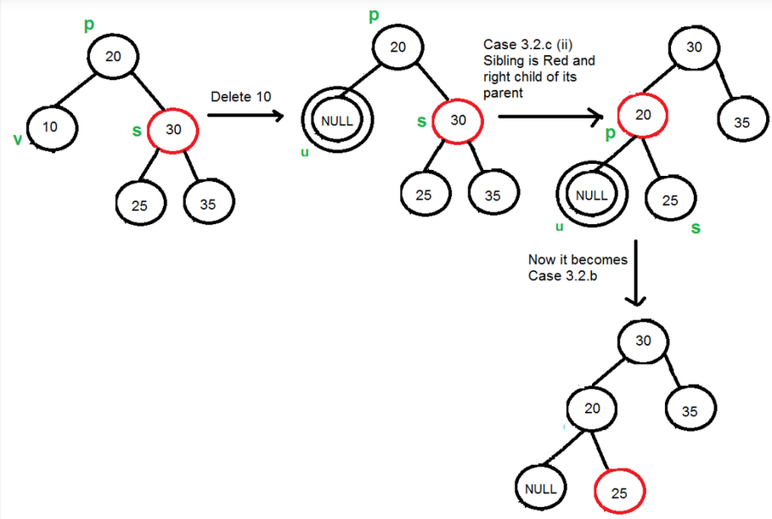
Red Black Tree - Deletion
Case 2
If sibling is red
SELO:8,12 <Reference:1>

Slide 19
Red Black Tree - Deletion
Case 3
If u is root, make it single black and return
SELO:8,12 <Reference:1>

Slide 20
Assignment
Perform the following deletions
Delete 90
Delete 80
Delete 70
65
50
80
10
60
70
90
62
SELO:8,12 <Reference:1>

Slide 21
Student Effective Learning Outcomes
1. Ability to solve problems through application of theoretical & practical concept.
6. Ability to observe and develop sense making, logical skills for abstract concepts.
8. Ability to understand subject related concepts clearly along with contemporary issues
12. Computational thinking ability

Slide 22
Learning Outcomes
Red Black Tree
Red Black Tree – Properties
Red Black Tree –Deletion

Slide 23
References
Seymour Lipschutz; Data Structures; Schaum’s Outlines, Tata McGraw Hill Publishing.

Slide 24


