Slide 1
CLINICAL NCLEX REVIEW SERIES
The Endocrine System
Anatomy, Physiology, Pharmacology & Clinical Disorders
A comprehensive clinical review covering:
Hormonal physiology & feedback regulation
Adrenal, pituitary, thyroid, parathyroid & pancreatic disorders
Endocrine pharmacology & nursing implications
Acute complications — DKA, HHNS, thyroid storm, adrenal crisis
Reference: Saunders Comprehensive Review for NCLEX-RN® Examination

Slide 2
COURSE OUTLINE
What This Review Covers
I
Anatomy & Organization
II
Hormones by Class
Glands, hormone chemistry, feedback regulation
Steroids, catecholamines, ADH, thyroid, PTH, insulin, glucagon
III
Adrenal Disorders
IV
Pituitary / ADH Disorders
Addison's, Cushing's, Conn's, Pheochromocytoma
Diabetes Insipidus, SIADH
V
Thyroid Disorders
VI
Parathyroid Disorders
Hypothyroidism, Hyperthyroidism, Graves', Thyroid Storm
Hypoparathyroidism, Hyperparathyroidism
VII
Diabetes Mellitus
VIII
Pharmacology
Type 1, Type 2, DKA, HHNS, Hypoglycemia
Steroids, insulins, orals, antithyroids, hormone replacements
Course Outline
Endocrine NCLEX Review
2 / 56

Slide 3
PART I
Anatomy &
Physiology
The glands, hormones, and feedback mechanisms that regulate homeostasis, metabolism, growth, and reproduction.

Slide 4
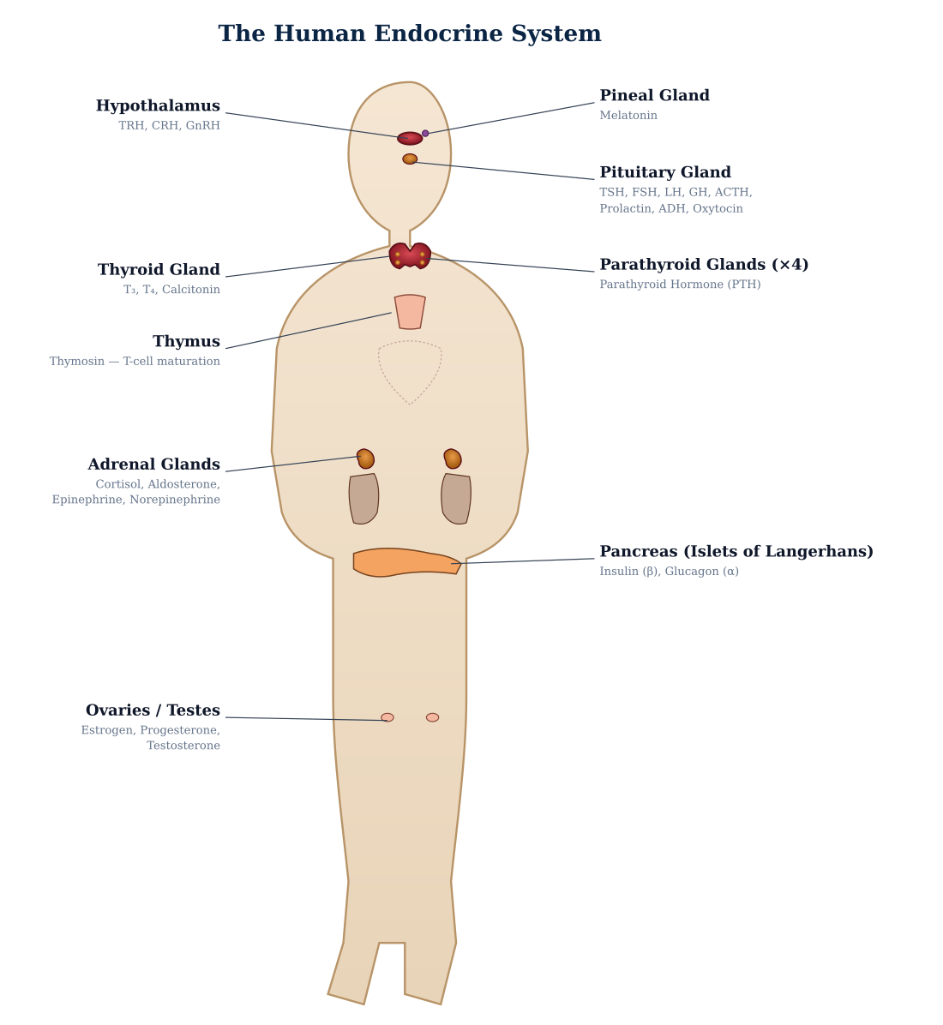




SECTION I · INTRODUCTION
What Is the Endocrine System?
Definition
The endocrine system is a network of ductless glands that secrete chemical messengers called hormones directly into the bloodstream. Hormones travel to distant target tissues where they bind to specific receptors and regulate cellular activity.
Four Core Functions
Homeostasis
Maintain optimal blood glucose, fluid, electrolyte, and pH balance
Growth & Metabolism
Control cellular metabolism, growth, and energy use
Reproduction
Coordinate male and female reproductive systems
Stress Response
Mobilize glucose & raise BP in emergencies (fight-or-flight)
Section I · Introduction
Endocrine NCLEX Review
4 / 56

Slide 5
HORMONE CATALOG
Glands & Their Hormones — Master Reference
Gland | Location | Hormones Secreted | Primary Function
Hypothalamus | Brain — above pituitary | TRH, CRH, GnRH, GHRH, Somatostatin, Dopamine | Controls anterior pituitary release
Anterior Pituitary | Base of brain (sella turcica) | TSH, ACTH, FSH, LH, GH, Prolactin | "Master gland" — regulates other glands
Posterior Pituitary | Base of brain | ADH (Vasopressin), Oxytocin | Stores & releases hypothalamic hormones
Thyroid | Anterior neck, below larynx | T₃ (Triiodothyronine), T₄ (Thyroxine), Calcitonin | Metabolism, growth, Ca²⁺ regulation
Parathyroid (×4) | Posterior surface of thyroid | Parathyroid Hormone (PTH) | Raises serum Ca²⁺ from bone, kidney, gut
Adrenal Cortex | Superior to each kidney | Cortisol, Aldosterone, Androgens | Stress response, Na/K balance, sex hormones
Adrenal Medulla | Core of adrenal gland | Epinephrine, Norepinephrine | Fight-or-flight sympathetic response
Pancreas (Islets) | Behind stomach | Insulin (β), Glucagon (α), Somatostatin (δ) | Blood glucose homeostasis
Gonads | Ovaries / Testes | Estrogen, Progesterone, Testosterone | Reproduction & secondary sex characteristics
Hormone Catalog
Endocrine NCLEX Review
5 / 56

Slide 6
BIOCHEMISTRY
Hormone Chemistry — Three Classes
Peptide / Protein
Steroid
Amine / Amino-Acid
EXAMPLES
EXAMPLES
EXAMPLES
Insulin, Glucagon, ADH, Oxytocin, GH, TSH, ACTH, FSH, LH, Prolactin, PTH, Calcitonin
Cortisol, Aldosterone, Estrogen, Progesterone, Testosterone, Vitamin D
T₃, T₄ (tyrosine-based), Epinephrine, Norepinephrine, Dopamine, Melatonin, Serotonin
PROPERTIES
PROPERTIES
PROPERTIES
Water-soluble. Bind surface receptors. Fast onset, short duration. Cannot cross cell membrane.
Lipid-soluble (cholesterol-derived). Bind intracellular/nuclear receptors. Slow onset, long duration.
Varied: thyroid hormones lipid-soluble (nuclear), catecholamines water-soluble (surface).
ROUTE
ROUTE
ROUTE
Given parenterally — stomach acid would destroy them.
Oral, IV, IM, topical. Cross cell membrane freely.
Thyroid hormones oral; catecholamines IV only (destroyed orally).
Hormone Chemistry
Endocrine NCLEX Review
6 / 56

Slide 7
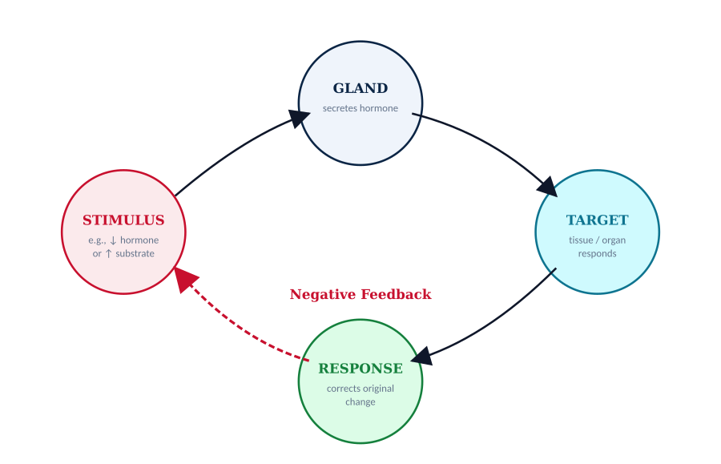
HORMONE CONTROL
Negative Feedback Regulation
How Hormones Stay in Range
Most endocrine systems are regulated by negative feedback — rising hormone levels (or the response they produce) shut off further secretion, keeping values within a narrow range.
Clinical Example — Thyroid
1
↓ T₃/T₄ in blood
2
Hypothalamus releases TRH
3
Pituitary releases TSH
4
Thyroid secretes T₃/T₄
5
↑ T₃/T₄ inhibits TRH & TSH
Rare exception: positive feedback drives oxytocin release during labor & milk let-down.
Feedback Regulation
Endocrine NCLEX Review
7 / 56

Slide 8

SYSTEM OVERVIEW
The Endocrine Glands — Labeled Anatomy
System Overview
Endocrine NCLEX Review
8 / 56

Slide 9
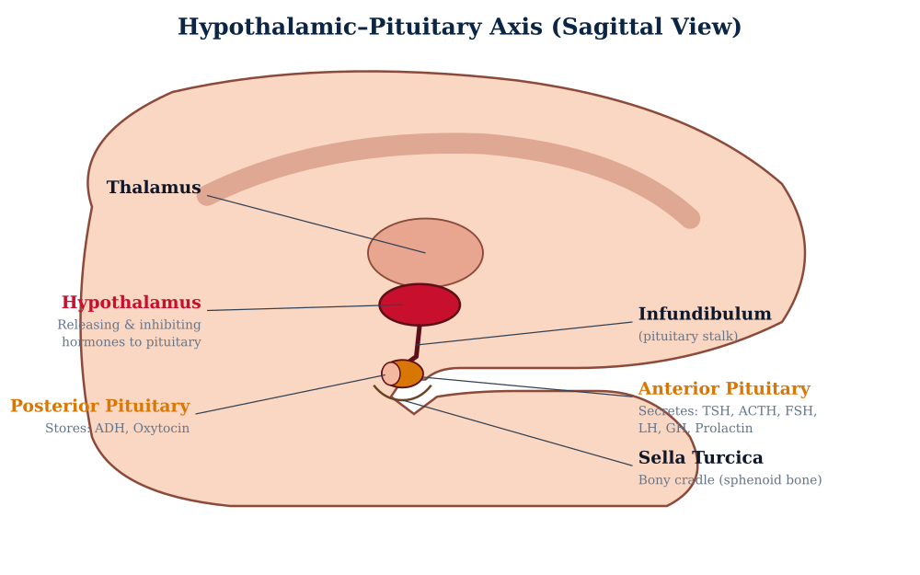
MASTER GLANDS
Hypothalamus & Pituitary Gland
Hypothalamus
Neuroendocrine command center linking the nervous and endocrine systems.
Releases: TRH · CRH · GnRH · GHRH · Dopamine · Somatostatin
Also regulates: temperature, thirst, hunger, sleep-wake cycle, emotion.
Pituitary Gland
Anterior (adenohypophysis): TSH, ACTH, FSH, LH, GH, Prolactin
Posterior (neurohypophysis): Stores & releases ADH + Oxytocin (made in hypothalamus)
⚠ Head trauma, sinus/pituitary surgery → risk of ADH disturbance (DI/SIADH)
Hypothalamus & Pituitary
Endocrine NCLEX Review
9 / 56

Slide 10
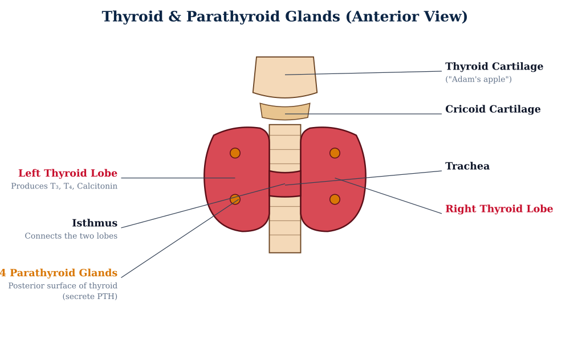
THYROID
Thyroid & Parathyroid Glands — Anatomy
Thyroid Gland
Butterfly-shaped — two lobes connected by isthmus
Anterior to trachea, inferior to larynx
Highly vascular (one of most vascular organs)
Hormones: T₃, T₄ (iodine-dependent), Calcitonin
Parathyroid Glands
4 tiny glands on posterior thyroid surface
Size of grains of rice (~6 mm)
Secrete Parathyroid Hormone (PTH) — raises serum Ca²⁺
⚠ At risk during thyroidectomy → hypocalcemia
Thyroid Anatomy
Endocrine NCLEX Review
10 / 56

Slide 11
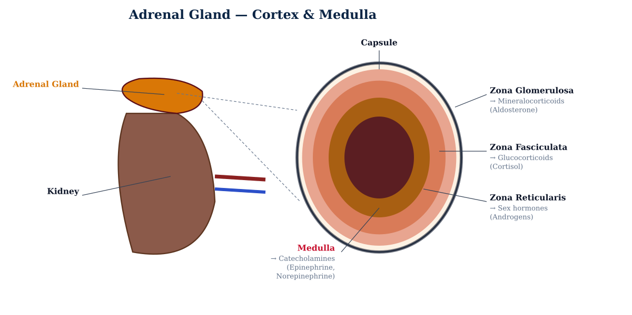
ADRENAL GLANDS
Cortex, Medulla & Their Hormones
Adrenal CORTEX (outer)
"Salt, Sugar, Sex" — from outer to inner:
• Zona glomerulosa → aldosterone
• Zona fasciculata → cortisol
• Zona reticularis → androgens
Adrenal MEDULLA (inner)
Modified sympathetic ganglion — secretes catecholamines
• Epinephrine (80%) — metabolic + cardiac
• Norepinephrine (20%) — vasoconstriction
GFR = Glomerulosa · Fasciculata · Reticularis
Mineralocorticoid · Glucocorticoid · Gonadocorticoid
Adrenal Anatomy
Endocrine NCLEX Review
11 / 56

Slide 12
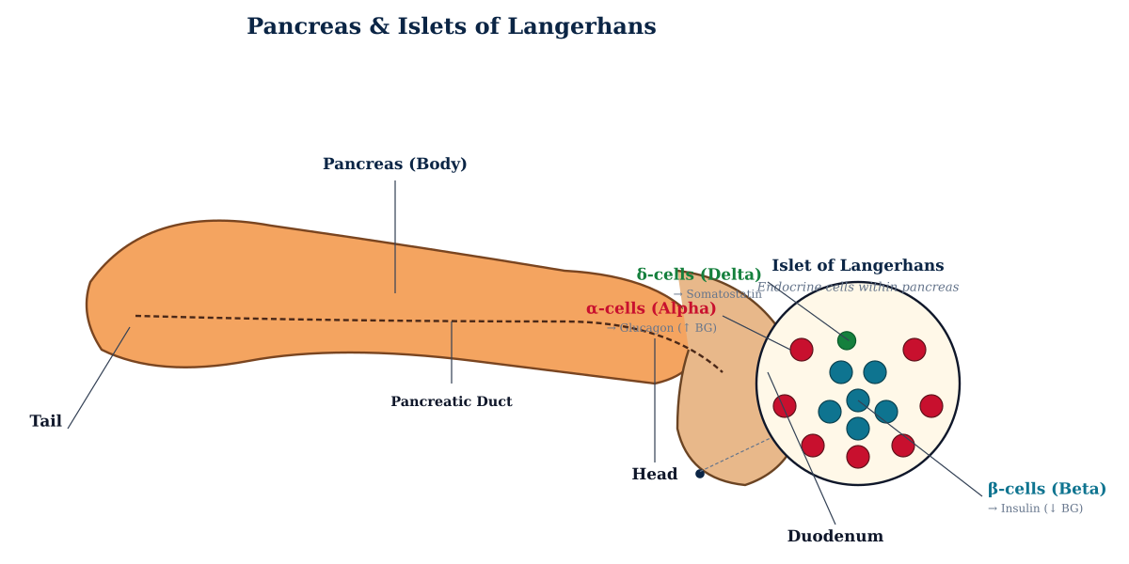

PANCREAS
Endocrine Function — Islets of Langerhans
α-cells
~20% of islet
Secrete GLUCAGON
Raise blood glucose
(glycogenolysis in liver)
β-cells
~70% of islet
Secrete INSULIN
Lower blood glucose
(glucose into cells, glycogen storage)
Normal Fasting Blood Glucose: 70–110 mg/dL
Insulin and glucagon operate in opposition to maintain tight glucose control.
Pancreas
Endocrine NCLEX Review
12 / 56

Slide 13



STEROID HORMONES
Produced by the Adrenal Cortex
Glucocorticoids
Mineralocorticoids
Sex Hormones
Cortisol (main)
Aldosterone
Androgens, small amounts estrogen
KEY ACTIONS
KEY ACTIONS
KEY ACTIONS
Raise blood glucose (gluconeogenesis)
Retain sodium & water in kidneys
Adrenal androgens: DHEA, androstenedione
Break down fats & proteins for energy
Excrete potassium & hydrogen ions
Supplement gonadal output
Suppress inflammation & immune response
Raise blood volume & blood pressure
Drive pubic & axillary hair in females
Affect mood, cognition, sleep
Part of the RAAS pathway
Excess → hirsutism, virilization
Inhibit insulin action
Key link to renal system
Converted to testosterone / estrogen peripherally
Steroid Hormones
Endocrine NCLEX Review
13 / 56

Slide 14
CATECHOLAMINES
Epinephrine & Norepinephrine — Fight-or-Flight
Released from adrenal MEDULLA during stress. Activate α- and β-adrenergic receptors throughout the body to mobilize glucose and raise cardiac output.
Norepinephrine (Noradrenaline)
Epinephrine (Adrenaline)
Primary effect: α₁ adrenergic — potent VASOCONSTRICTOR
Mixed α + β effects — cardiac, metabolic, bronchodilator
↑ Blood pressure
↑ Metabolism
Vasoconstriction of arteries
Rapid energy mobilization
Pupil dilation
↑ Blood glucose
Mydriasis
Glycogenolysis + lipolysis
↑ Cardiac contractility
Inhibits insulin release
Stronger heart contraction
Preserves circulating glucose
↓ GI motility
Bronchodilation
Diverts blood from gut
β₂ — opens airways
Clinical use:
Clinical use:
IV pressor in septic/neurogenic shock
Anaphylaxis, cardiac arrest, severe asthma
Catecholamines
Endocrine NCLEX Review
14 / 56

Slide 15
ADH / VASOPRESSIN
Antidiuretic Hormone — Water Balance
Source & Action
⚠ Conditions That Disrupt ADH
Synthesized: hypothalamus (supraoptic nuclei)
Craniotomy / neurosurgery
Stored/released: posterior pituitary
Traumatic brain injury (TBI)
Trigger: ↑ plasma osmolality or ↓ blood volume/BP
Pituitary tumor or apoplexy
Transsphenoidal/sinus surgery
Primary Effects
Meningitis, encephalitis
Water reabsorption ↑
Acts on V2 receptors in renal collecting ducts → inserts aquaporin-2 channels
↓ ADH
↑ ADH
Urine volume ↓ / concentration ↑
Diabetes
Insipidus
SIADH
Small volume of concentrated urine produced
Water retention, hyponatremia, ↓ UOP
Vasoconstriction (high doses)
V1 receptors on arteriolar smooth muscle — raises BP
Polyuria, dilute urine, dehydration
ADH Physiology
Endocrine NCLEX Review
15 / 56

Slide 16
CALCIUM REGULATION
Parathyroid Hormone (PTH) — ↑ Serum Ca²⁺
Source & Regulation
Calcitonin — Opposing Hormone
Secreted by: 4 parathyroid glands (posterior thyroid)
Secreted by: parafollicular C-cells of thyroid
Trigger: ↓ serum calcium (hypocalcemia)
Trigger: ↑ serum Ca²⁺ (hypercalcemia)
Suppressed by: ↑ serum Ca²⁺ (negative feedback)
Action: ↓ serum Ca²⁺ (opposite of PTH)
Normal Ca²⁺: 8.6–10.0 mg/dL (total)
Mechanism
Inhibits osteoclasts → ↓ bone resorption
Three Target Sites
↑ urinary Ca²⁺ excretion
BONE
Stimulates osteoclasts → releases Ca²⁺ into blood
Therapeutic use: hypercalcemia of malignancy, Paget's disease
KIDNEY
↑ Ca²⁺ reabsorption, ↑ phosphate excretion, ↑ calcitriol production
Clinical pearl
GUT (indirect)
PTH and calcitonin work in opposition — a calcium thermostat keeping Ca²⁺ between 8.6–10.0 mg/dL.
Via active vitamin D → ↑ dietary Ca²⁺ absorption
PTH & Calcitonin
Endocrine NCLEX Review
16 / 56

Slide 17
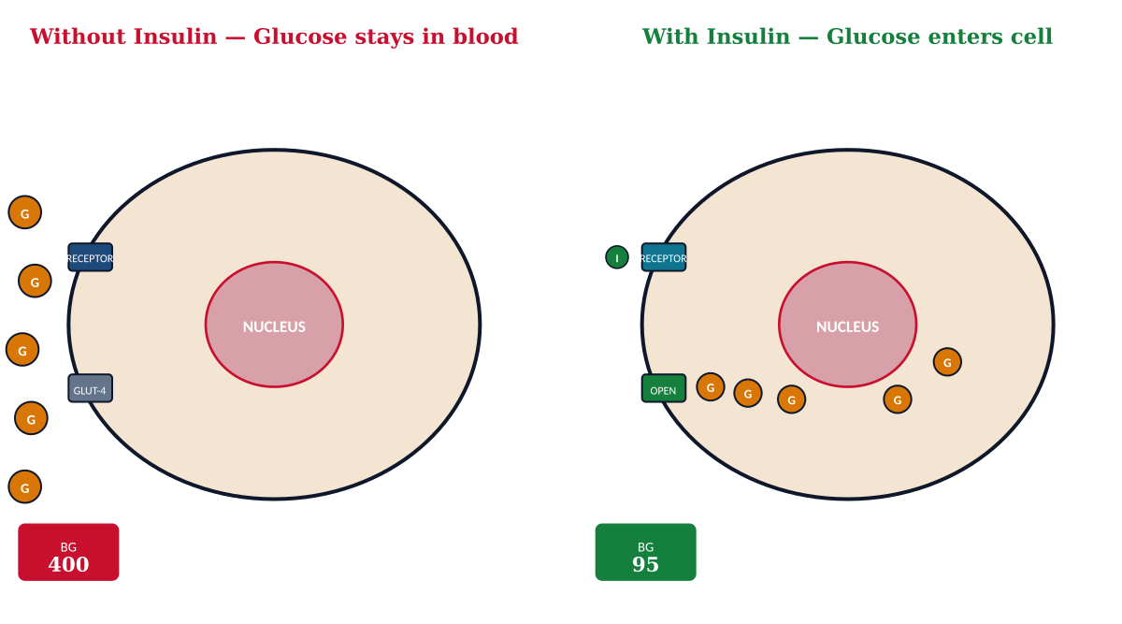



GLUCOSE CONTROL
Insulin — The Only Hormone That Lowers BG
Glucose Uptake
Glycogen Storage
Anabolic Effects
Opens GLUT-4 transporters in muscle & fat cells, allowing glucose entry
Liver converts glucose → glycogen for storage (glycogenesis)
Promotes protein synthesis, lipogenesis, K⁺ shift into cells
Insulin Physiology
Endocrine NCLEX Review
17 / 56

Slide 18

GLUCOSE CONTROL
Glucagon — Raises BG During Fasting
Source & Trigger
Clinical Use — Emergency Hypoglycemia
Secreted by: α-cells of pancreatic islets
Glucagon 1 mg IM/SC/IN
Trigger: ↓ blood glucose, fasting, exercise, stress
Given when patient is UNCONSCIOUS and cannot swallow safely.
Opposes insulin — acts to raise blood glucose
Nursing Essentials
Mechanisms of Action
Turn patient on side — vomiting is a common response
Glycogenolysis
Expect response within 15 minutes; may repeat × 1
Breaks liver glycogen → glucose released into blood (fast)
Once conscious → give complex carbohydrate (crackers + protein)
Gluconeogenesis
Liver synthesizes new glucose from amino acids, lactate, glycerol
Requires adequate liver glycogen — ineffective in chronic alcoholism
Ketogenesis
Check BG every 15 min until stable above 70 mg/dL
Prolonged fasting → liver produces ketones as alternate fuel
Glucagon
Endocrine NCLEX Review
18 / 56

Slide 19
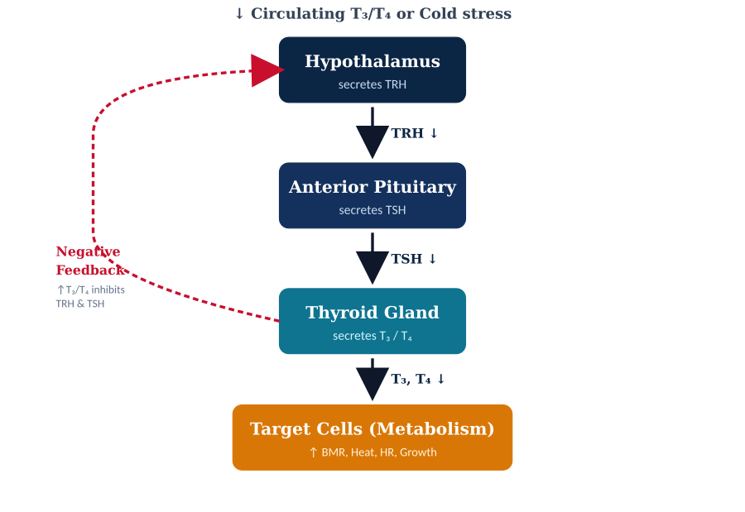
HPT AXIS
Thyroid Feedback Loop — TRH · TSH · T₃ · T₄
Key Lab Values
TSH
0.4 – 4.0 mIU/L
↑ in hypothyroid, ↓ in hyperthyroid
Free T₄
0.8 – 1.8 ng/dL
Active unbound form
Total T₃
80 – 200 ng/dL
Metabolically most active
Anti-TPO Ab
Negative normally
Positive in Hashimoto's / Graves'
Key Principle — Inverse Relationship
TSH is inversely proportional to T₃/T₄.
↑ T₃/T₄ ⇒ ↓ TSH (hyperthyroid)
↓ T₃/T₄ ⇒ ↑ TSH (hypothyroid)
HPT Axis
Endocrine NCLEX Review
19 / 56

Slide 20
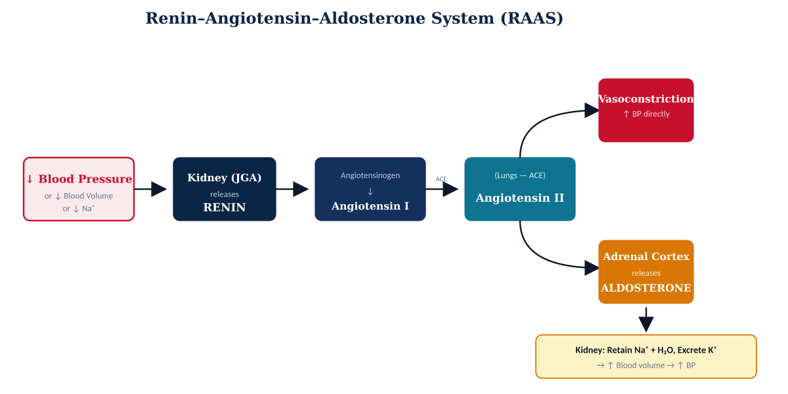
BP & FLUID CONTROL
Renin–Angiotensin–Aldosterone System (RAAS)
Addison's Disease
Conn's Syndrome
ACE Inhibitors
↓ Aldosterone → Na/H₂O loss, K⁺ retention, hypotension
↑ Aldosterone → Na/H₂O retention, hypokalemia, hypertension
Block angiotensin II → vasodilation, lower BP (-pril drugs)
RAAS Pathway
Endocrine NCLEX Review
20 / 56

Slide 21
PART II
Disorders &
Pharmacology
Clinical presentations, diagnostic work-up, medical management, nursing interventions, and acute complications across all endocrine glands.

Slide 22
DISEASE MAP
Endocrine Disorders — Deficit vs. Excess
Gland / Hormone
DEFICIT (↓)
EXCESS (↑)
Cortisol (Adrenal Cortex)
Addison's — fatigue, hypotension, bronze skin, hypoNa, hyperK
Cushing's — moon face, buffalo hump, striae, hyperglycemia
Aldosterone
Hypoaldosteronism — hyperK, hypoNa, acidosis
Conn's — hypertension, hypokalemia, alkalosis
Catecholamines (Medulla)
Rare — orthostatic hypotension
Pheochromocytoma — episodic HTN, palpitations, sweating, HA
Thyroid Hormones
Hypothyroidism — fatigue, weight gain, cold, bradycardia
Hyperthyroidism / Graves' — weight loss, heat, tachycardia
PTH
Hypoparathyroidism — tetany, Chvostek/Trousseau, hypocalcemia
Hyperparathyroidism — stones, bones, groans, moans
ADH
Diabetes Insipidus — polyuria (>3 L/day), polydipsia, hyperNa
SIADH — water retention, hyponatremia, concentrated urine
Insulin
Diabetes Mellitus — hyperglycemia, polyuria/dipsia, DKA, HHNS
Hypoglycemia — shaky, sweaty, confused, seizures, coma
Disease Overview
Endocrine NCLEX Review
22 / 56

Slide 23
ADRENAL INSUFFICIENCY
Addison's Disease — Primary Adrenal Failure
Autoimmune destruction (most common) or TB/hemorrhage destroys adrenal cortex → deficiency of CORTISOL + ALDOSTERONE + adrenal androgens.
Signs & Symptoms
Diagnosis & Management
Hypotension, orthostatic
↓ Sodium (hyponatremia)
Diagnostic Tests
• ACTH stimulation test (gold standard)
• ↓ cortisol, ↓ aldosterone, ↑ ACTH (primary)
• ↓ Na⁺, ↑ K⁺, ↓ glucose, metabolic acidosis
↑ Potassium (hyperkalemia)
Hypoglycemia
Fatigue, muscle weakness
Weight loss, anorexia
Treatment (Lifelong)
N/V, abdominal pain
Bronze hyperpigmentation
• Hydrocortisone (glucocorticoid) PO daily
• Fludrocortisone (mineralocorticoid) daily
• Increase dose during illness/surgery ("stress dosing")
• Diet: high sodium, adequate fluids
• Wear medical ID bracelet
↓ Aldosterone → Na/H₂O loss
Salt craving
Menstrual changes
Depression, irritability
Addison's Disease
Endocrine NCLEX Review
23 / 56

Slide 24

EMERGENCY
Addisonian Crisis — Life-Threatening
MEDICAL EMERGENCY — ACUTE ADRENAL CRISIS
Life-threatening cortisol deficiency. Can follow acute illness, trauma, abrupt steroid withdrawal, or surgery in untreated Addison's.
Triggers
Presentation
Immediate Rx
Abrupt steroid stop
Acute infection/sepsis
Severe hypotension
Profound weakness
IV hydrocortisone 100 mg STAT, then q6h
IV normal saline (0.9% NS) for volume
Abdominal pain, N/V
High fever
Severe trauma
Major surgery
Dextrose IV for hypoglycemia
Confusion → coma
Shock
Treat hyperkalemia if severe
GI bleed
Dehydration
Identify & treat underlying cause
Hyponatremia
Hyperkalemia
ICU monitoring
Addisonian Crisis
Endocrine NCLEX Review
24 / 56

Slide 25


NCLEX QUESTION
IV Fluid of Choice for Addisonian Crisis
Clinical Vignette
A patient with Addison's disease presents to the ED with BP 76/44, pulse 132, mental status changes, and a recent viral illness. The provider suspects acute adrenal crisis. Which IV fluid should the nurse anticipate administering first?
A
D5W (5% dextrose in water)
Hypotonic — worsens hyponatremia
B
0.45% Normal Saline (½ NS)
Hypotonic — inadequate volume support
C
0.9% Normal Saline (NS)
CORRECT
Isotonic — restores volume AND corrects hyponatremia
Rationale: 0.9% NS is isotonic — provides rapid volume replacement without worsening the hyponatremia.
D
Lactated Ringer's (LR)
Contains K⁺ — worsens hyperkalemia
NCLEX Question
Endocrine NCLEX Review
25 / 56

Slide 26
CORTISOL EXCESS
Cushing's Syndrome / Disease
Cushing's SYNDROME — any chronic cortisol excess (most often exogenous steroid therapy). Cushing's DISEASE — pituitary adenoma → ↑ ACTH → ↑ cortisol.
Classic Signs & Symptoms
Diagnosis
Moon face
Buffalo hump
• 24-hr urinary free cortisol (↑)
• Late-night salivary cortisol (↑)
• Dexamethasone suppression test
• Plasma ACTH level → localize source
Truncal obesity
Thin extremities
Purple striae
Skin fragility, bruising
Treatment — By Cause
Hyperglycemia
Hypertension
• Iatrogenic → taper steroids slowly
• Pituitary adenoma → transsphenoidal surgery
• Adrenal tumor → adrenalectomy (lifelong replacement may be needed)
• Ectopic ACTH → treat primary tumor
• Ketoconazole or mitotane to block cortisol synthesis
Hypokalemia, hypernatremia
Osteoporosis, fractures
Immunosuppression → infections
Mood changes, psychosis
Cushing's Syndrome
Endocrine NCLEX Review
26 / 56

Slide 27
PHARMACOLOGY
Corticosteroids — Nursing Implications
Hydrocortisone
Prednisone
Methylprednisolone
Dexamethasone
Short-acting
Intermediate-acting
Intermediate-acting
Long-acting
Replacement dose in Addison's. Preferred in acute adrenal crisis.
Most common PO steroid. Used for inflammation, autoimmune, asthma.
IV Solu-Medrol in acute exacerbations (asthma, MS, anaphylaxis).
Cerebral edema, chemo-induced N/V, dexamethasone suppression test.
Half-life: 8–12 h
Half-life: 12–36 h
Half-life: 12–36 h
Half-life: 36–54 h
⚠ Adverse Effects (Long-term)
Nursing Teaching
Hyperglycemia
Hypokalemia, hypernatremia
NEVER stop abruptly — taper gradually to avoid adrenal crisis
Osteoporosis
Cushingoid features
Take with food — reduces GI irritation
Immunosuppression
Delayed wound healing
Take in AM to mimic natural cortisol rhythm
Peptic ulcer
Mood changes, insomnia
Monitor BG, BP, weight, signs of infection
Stress doses needed for illness, surgery, trauma
Cataracts, glaucoma
Adrenal suppression
Carry medical ID, wear bracelet
Corticosteroids
Endocrine NCLEX Review
27 / 56

Slide 28
ALDOSTERONE EXCESS
Conn's Syndrome (Primary Hyperaldosteronism)
Adrenal adenoma or hyperplasia produces EXCESS ALDOSTERONE → kidney retains Na⁺ and water, excretes K⁺ and H⁺. Classic secondary cause of hypertension in young adults.
Signs & Symptoms
Diagnostic Work-up
Hypertension (resistant to Rx)
Hypokalemia — muscle weakness, cramps
• Plasma aldosterone/renin ratio — ↑ ratio suggests Conn's
• Serum K⁺ < 3.5 mEq/L
• 24-hr urine aldosterone (↑)
• CT/MRI adrenals to localize adenoma
• Adrenal venous sampling if needed
Hypernatremia
Metabolic alkalosis
Polyuria & polydipsia
Headache, cardiac arrhythmias
Treatment
Unilateral adrenalectomy (curative for adenoma)
Aldosterone antagonists — spironolactone or eplerenone
Potassium replacement, low-sodium diet, BP control (multiple agents)
Conn's Syndrome
Endocrine NCLEX Review
28 / 56

Slide 29
CATECHOLAMINE EXCESS
Pheochromocytoma — Adrenal Medullary Tumor
Catecholamine-secreting tumor of the adrenal medulla (chromaffin cells). Episodic release of epinephrine/norepinephrine causes paroxysmal hypertensive crises.
The "5 P's"
Diagnostic Tests
Critical Rx Order
Pressure
24-hr urine VMA (vanillylmandelic acid) — ↑
1. α-blocker FIRST
Hypertension (episodic or sustained)
(phenoxybenzamine)
Pain
24-hr urine metanephrines — ↑
Severe headaches
2. β-blocker AFTER
Plasma free metanephrines — most sensitive
only once α-blockade is effective
Perspiration
Diaphoresis, flushing
3. Adrenalectomy (curative)
CT/MRI adrenals to localize tumor
Palpitations
⚠ WHY THE ORDER MATTERS
Tachycardia, arrhythmias
MIBG scan for metastases
β-blocker first would allow unopposed α-stimulation → severe hypertensive crisis. α-blocker must be in place to prevent this.
Pallor
Genetic testing (MEN 2, VHL syndromes)
Vasoconstriction
Pheochromocytoma
Endocrine NCLEX Review
29 / 56

Slide 30
QUICK REFERENCE
Adrenal Disorders — Side-by-Side Comparison
Disorder
Hormone
Key S/S
Labs
Rx
Addison's
↓ Cortisol
↓ Aldosterone
Hypotension, bronzing, fatigue, hypoNa, hyperK, hypoglycemia
↓ cortisol
↑ ACTH
Steroids
+ Na diet
Addisonian Crisis
Acute cortisol loss
Shock, coma, severe hypotension, fever
↓ Na, ↑ K
↓ BG
IV HC
+ 0.9% NS
Cushing's
↑ Cortisol
Moon face, buffalo hump, striae, HTN, hyperglycemia
↑ urine cortisol
Surgery / taper
Conn's
↑ Aldosterone
HTN, hypokalemia, muscle weakness, alkalosis
↑ aldosterone
↓ K⁺
Surgery
+ spironolactone
Pheochromocytoma
↑ Catecholamines
Paroxysmal HTN, HA, sweating, palpitations, pallor
↑ urine VMA
↑ metanephrines
α-block
then β
Adrenal Summary
Endocrine NCLEX Review
30 / 56

Slide 31
↓ ADH
Diabetes Insipidus (DI)
Central DI: ↓ ADH production/release (pituitary damage, tumor, surgery). Nephrogenic DI: kidneys unresponsive to ADH (lithium toxicity, hypercalcemia).
Signs & Symptoms
Diagnosis & Treatment
Polyuria (>3 L/day, up to 20 L)
Extreme polydipsia (thirst)
Diagnostic Tests
• Water deprivation test (no ↑ urine osmolality)
• Desmopressin challenge — distinguishes central vs nephrogenic
• ↑ serum Na (>145), ↑ serum osm, ↓ urine osm/SG
Dilute urine (SG < 1.005)
↑ Serum sodium (hypernatremia)
↑ Serum osmolality
Dehydration, weight loss
Treatment
• DESMOPRESSIN (DDAVP) — synthetic ADH (intranasal, PO, SC)
Hypotension, tachycardia
Neuro changes if severe
• Strict I&O monitoring
• Daily weights (1 kg = 1 L fluid)
• Nephrogenic DI: thiazides, low-salt diet, NSAIDs
Fatigue, constipation
Nocturia, preference for cold water
⚠ Watch for water intoxication with desmopressin
Diabetes Insipidus
Endocrine NCLEX Review
31 / 56

Slide 32

DRUG SPOTLIGHT
Desmopressin (DDAVP) — Synthetic ADH
Desmopressin
Nursing Monitoring
(DDAVP, Stimate)
Strict I&O every 1–2 hours
Daily weights at same time
CLASS
Serum Na⁺ q6–12h initially
Synthetic vasopressin (ADH) analog
Urine specific gravity → should normalize (1.010–1.025)
MECHANISM
Blood pressure & heart rate
Binds V2 receptors in renal collecting ducts → inserts aquaporin-2 channels → ↑ water reabsorption.
⚠ Side Effects & Warnings
INDICATIONS
Central DI · Nocturnal enuresis · von Willebrand disease (mild) · Hemophilia A
HYPONATREMIA (water intoxication) — most serious
Headache, nausea, facial flushing
Hypertension in sensitive patients
ROUTES
Seizures if severe hyponatremia
Intranasal · PO tablet · SC/IV injection
Restrict fluid intake if Na⁺ falls below 135 mEq/L
Avoid in coronary artery disease (vasoconstriction)
Desmopressin
Endocrine NCLEX Review
32 / 56

Slide 33
↑ ADH
Syndrome of Inappropriate ADH (SIADH)
Excessive ADH secretion → water retention, dilutional hyponatremia, and concentrated urine. Common causes: small-cell lung cancer (ectopic ADH), head injury, meningitis, SSRIs, chemotherapy.
Signs & Symptoms
Treatment
↓ Urine output (oliguria)
Concentrated urine (SG > 1.030)
Fluid restriction
500–1000 mL/day — cornerstone of therapy
↓ Serum Na⁺ (<135 mEq/L)
↓ Serum osmolality
Hypertonic saline (3% NaCl)
Only for severe hyponatremia with neuro symptoms. Raise Na slowly (<12 mEq/L/24h)
Weight gain (without edema)
Headache, confusion
Vasopressin receptor antagonists
Tolvaptan, conivaptan — "vaptans" block V2 receptors
Irritability, lethargy
Nausea, vomiting
Demeclocycline
Induces nephrogenic DI (backup option)
Muscle cramps, weakness
Seizures, coma if severe
Treat underlying cause
Stop offending drugs, treat infection/tumor
SIADH
Endocrine NCLEX Review
33 / 56

Slide 34
SIDE BY SIDE
Diabetes Insipidus vs SIADH — Quick Compare
Parameter
DIABETES INSIPIDUS (↓ ADH)
SIADH (↑ ADH)
Urine output
↑↑↑ (3–20 L/day)
↓ (oliguria)
Urine concentration
Dilute (SG < 1.005)
Concentrated (SG > 1.030)
Serum sodium
↑ (hypernatremia >145)
↓ (hyponatremia <135)
Serum osmolality
↑
↓
Body weight
↓ (dehydration)
↑ (water retention)
Thirst
Intense polydipsia
May be suppressed
BP / HR
↓ BP, ↑ HR
Normal or ↑ BP
Treatment
Desmopressin, fluids
Fluid restrict, 3% NS, vaptans
DI vs SIADH
Endocrine NCLEX Review
34 / 56

Slide 35
THYROID DISORDERS
Hypothyroidism — Insufficient Thyroid Hormone
Underactive thyroid gland fails to produce adequate T₃ and T₄ → slowed cellular metabolism throughout every body system.
Causes & Diagnostic Labs
Clinical Manifestations — Slowed Everything
P R I M A R Y C A U S E S
CONSTITUTIONAL
INTEGUMENTARY
• Hashimoto thyroiditis (autoimmune — most common in US)
• Fatigue, lethargy
• Dry, coarse skin
• Iodine deficiency (most common worldwide)
• Weight gain
• Brittle hair, hair loss
• Post-thyroidectomy or post-radioactive iodine therapy
• Cold intolerance
• Loss of outer eyebrows
• Medications: lithium, amiodarone, interferon
• ↓ basal metabolic rate
• Periorbital edema (myxedema)
• Congenital hypothyroidism (cretinism in newborns)
L A B O R A T O R Y F I N D I N G S
CARDIAC / GI
NEURO / REPRO
TSH
↑ elevated (primary)
• Bradycardia
• Slow mentation
Free T₄
↓ low
• Hypotension
• Depression
Free T₃
↓ low or normal
• Constipation
• Menorrhagia
Cholesterol
↑ elevated
• ↑ LDL cholesterol
• Infertility
Anti-TPO antibodies
+ (Hashimoto)
Hypothyroidism
Endocrine NCLEX Review
35 / 56

Slide 36


DRUG SPOTLIGHT
Levothyroxine (Synthroid) — Thyroid Replacement
Levothyroxine
Patient Teaching (Critical)
(Synthroid, Levoxyl, Unithroid)
Take EARLY MORNING on empty stomach — 30–60 min before breakfast
Take same time daily · Do not skip doses · Lifelong therapy
C L A S S
Synthetic T₄ hormone (thyroid replacement)
Separate from iron, calcium, antacids, soy, high-fiber foods (≥4 h)
Report: chest pain, palpitations, insomnia, tremor (→ overdose)
M E C H A N I S M
Never discontinue abruptly · Do not switch brands without MD approval
Replaces endogenous T₄ → peripheral conversion to active T₃ → restores cellular metabolism
Monitoring & Adverse Effects
I N D I C A T I O N S
Primary/secondary hypothyroidism · Myxedema coma · Post-thyroidectomy · Thyroid cancer (TSH suppression)
TSH level every 6–8 weeks until therapeutic, then every 6–12 months
Monitor HR, BP, weight, resolution of hypothyroid symptoms
D O S I N G
Pregnancy: dose typically ↑ 25–30% in first trimester
Start low in elderly/cardiac (25 mcg) · Usual adult 1.6 mcg/kg/day · Adjust every 6–8 weeks by TSH
Overdose s/sx: thyrotoxicosis — tachycardia, tremor, weight loss, heat intolerance
Caution: CAD (may precipitate angina), osteoporosis (long-term)
Levothyroxine
Endocrine NCLEX Review
36 / 56

Slide 37
THYROID DISORDERS
Hyperthyroidism — Excess Thyroid Hormone
Overactive thyroid produces excessive T₃/T₄ (thyrotoxicosis) → hypermetabolism in every body system. Graves disease is the most common cause (autoimmune).
Causes & Laboratory Profile
Clinical Manifestations — Accelerated Everything
E T I O L O G Y
CONSTITUTIONAL
CARDIOVASCULAR
• Graves disease — TSH-receptor autoantibodies (TRAb) stimulate thyroid (#1 cause)
• Heat intolerance, ↑ sweating
• Tachycardia, palpitations
• Toxic multinodular goiter / toxic adenoma
• Weight loss despite ↑ appetite
• Atrial fibrillation
• Thyroiditis (subacute, postpartum, silent)
• Fine tremor
• Systolic hypertension
• Excess exogenous thyroid hormone (factitious)
• Fatigue, weakness
• Widened pulse pressure
• Iodine-induced (amiodarone, contrast media)
L A B O R A T O R Y F I N D I N G S
NEURO / PSYCH
GRAVES-SPECIFIC
TSH
↓ suppressed (primary)
• Nervousness, anxiety
• Exophthalmos (proptosis)
Free T₄ / Free T₃
↑ elevated
• Irritability, restlessness
• Goiter with bruit
TRAb / TSI antibodies
+ positive (Graves)
• Insomnia
• Pretibial myxedema
RAIU scan
↑ diffuse uptake (Graves)
• Hyperreflexia
• Lid lag, stare
Cholesterol
↓ decreased
Hyperthyroidism / Graves
Endocrine NCLEX Review
37 / 56

Slide 38
EMERGENCY • LIFE-THREATENING
Thyroid Storm — Thyrotoxic Crisis
MEDICAL EMERGENCY — Mortality 10–30% even with treatment. Extreme, life-threatening exacerbation of hyperthyroidism.
Common Triggers
Hallmark Signs
Treatment — The 4 B's
• Untreated / undertreated hyperthyroidism
↑↑ Temp
> 40°C (104°F) — hyperthermia
Block synthesis
• Recent thyroid surgery (manipulation releases hormone)
PTU or methimazole
↑↑ HR
> 130 bpm (can exceed 200)
Block release
• Infection or sepsis (most common trigger)
Iodine (Lugol, SSKI) — ≥1 h after PTU
• Trauma, surgery, or childbirth
Atrial fib
High-output cardiac failure
Block conversion
• DKA or severe illness
CNS
Agitation → delirium → coma
Propranolol, corticosteroids, PTU
• Iodine contrast exposure
Beta-blockade
• Abrupt withdrawal of antithyroid meds
GI
N/V, diarrhea, abdominal pain
Propranolol (controls HR, tremor)
↑ BP
Followed by hypotension, shock
Supportive
Cooling, O₂, IV fluids, treat cause
Thyroid Storm
Endocrine NCLEX Review
38 / 56

Slide 39
PHARMACOLOGY
Antithyroid Medications
Methimazole
Propylthiouracil
Iodine (Lugol / SSKI)
Radioactive Iodine
(Tapazole)
(PTU)
(I-131)
CLASS
CLASS
CLASS
CLASS
Thionamide
Thionamide
Iodine solution
Radiopharmaceutical
MECHANISM
MECHANISM
MECHANISM
MECHANISM
Inhibits thyroid peroxidase → blocks T₃/T₄ synthesis
Blocks synthesis + blocks peripheral T₄→T₃ conversion
↓ thyroid vascularity & hormone release (Wolff-Chaikoff)
Concentrates in thyroid → destroys cells (ablation)
INDICATIONS
INDICATIONS
INDICATIONS
INDICATIONS
First-line for Graves disease (non-pregnant)
Pregnancy (1st trimester) · Thyroid storm
Pre-op thyroidectomy · Thyroid storm
Definitive Rx for Graves / toxic nodule
NURSING / SE
NURSING / SE
NURSING / SE
NURSING / SE
• Agranulocytosis (fever, sore throat!)
• Severe hepatotoxicity (black box)
• Metallic taste, brown stain teeth
• CONTRAINDICATED in pregnancy/lactation
• Hepatotoxicity
• Agranulocytosis
• Mix in juice, use straw
• Radiation precautions 3–7 d
• Rash, arthralgia
• Vasculitis
• Short-term use only
• Hypothyroidism expected
• Teratogenic 1st trim
Antithyroid Medications
Endocrine NCLEX Review
39 / 56

Slide 40

SURGICAL CARE
Thyroidectomy — Post-op Nursing Priorities
Partial (subtotal) or total removal of thyroid. Total thyroidectomy requires lifelong levothyroxine replacement.
Respiratory Distress
Hemorrhage
Tetany / Hypocalcemia
• Laryngeal nerve damage → vocal cord paralysis
• Check BEHIND the neck — blood pools there
• Accidental parathyroid removal → ↓ Ca²⁺
• Tracheal compression from hematoma or edema
• Unexplained ↑ HR, ↓ BP, restlessness
• Tingling around mouth/fingers, muscle cramps
• Stridor, hoarseness, dyspnea
• Feeling of tightness or fullness at incision
• +Chvostek · +Trousseau sign
• BEDSIDE: tracheostomy tray + suction
• Keep HOB at 30–45° — supports venous return
• BEDSIDE: IV calcium gluconate
Routine Post-op Nursing Care
Long-term / Discharge
✓ Semi-Fowler's position with neck supported (sandbags) · avoid neck flexion/extension
✓ Lifelong levothyroxine if total thyroidectomy
✓ Assess voice q2h · minimal talking first 24 h
✓ Monitor TSH every 6–8 weeks during titration
✓ Monitor for S/S thyroid storm (rare but possible)
✓ Report: weight change, fatigue, palpitations
✓ Pain management · ice collar to reduce edema
✓ ID bracelet · carry medication list
Thyroidectomy Care
Endocrine NCLEX Review
40 / 56

Slide 41
QUICK COMPARISON
Hypothyroidism vs Hyperthyroidism
CLINICAL PARAMETER
HYPOTHYROIDISM
HYPERTHYROIDISM
TSH level
↑ elevated
↓ suppressed
Free T₃ / T₄
↓ decreased
↑ elevated
Heart rate
Bradycardia
Tachycardia, atrial fib
Blood pressure
Hypotension
Systolic hypertension
Temperature
Cold intolerance, ↓ temp
Heat intolerance, ↑ temp, sweating
Weight
Weight gain despite ↓ appetite
Weight loss despite ↑ appetite
GI function
Constipation
Diarrhea, ↑ motility
Mental status
Lethargy, depression, slow speech
Anxiety, nervousness, insomnia
Skin / hair
Dry, coarse · hair loss · myxedema
Warm, moist · fine hair · pretibial myxedema (Graves)
Reflexes
Diminished, delayed
Hyperreflexia, tremor
Treatment
Levothyroxine (lifelong)
Methimazole / PTU / I-131 / surgery
Thyroid Comparison
Endocrine NCLEX Review
41 / 56

Slide 42

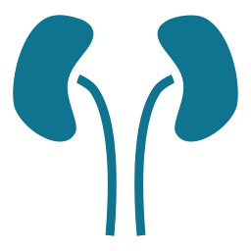

PARATHYROID GLANDS
Calcium Regulation — PTH Axis
Four parathyroid glands on the posterior thyroid secrete PTH to regulate serum calcium. Calcium and phosphorus exist in an inverse (reciprocal) relationship.
Bone
Kidneys
GI Tract
Stimulates OSTEOCLASTS → releases Ca²⁺ and phosphate from bone into blood
↑ Ca²⁺ reabsorption · ↑ phosphate EXCRETION · activates vitamin D (calcitriol)
Via activated vit D → ↑ calcium & phosphate absorption from intestine
Net effect of PTH: ↑ Serum Calcium ↓ Serum Phosphate
Calcitonin — The Opposer
Normal Serum Values
Produced by thyroid parafollicular (C) cells.
Total Calcium
8.6 – 10.2 mg/dL
• Released when serum calcium is HIGH
Ionized Calcium
4.5 – 5.6 mg/dL
• Inhibits osteoclasts → stops Ca²⁺ release from bone
Phosphate
2.5 – 4.5 mg/dL
• Protects against hypercalcemia
Intact PTH
10 – 65 pg/mL
• Directly opposes PTH
Vitamin D (25-OH)
30 – 100 ng/mL
Parathyroid / Calcium Axis
Endocrine NCLEX Review
42 / 56

Slide 43
PARATHYROID DISORDERS
Hypoparathyroidism — ↓ PTH → Hypocalcemia
Low PTH → ↓ serum calcium + ↑ serum phosphate. Most common iatrogenic cause: accidental removal/damage during thyroidectomy.
Etiology & Lab Profile
Clinical Signs — Hypocalcemic Tetany
C A U S E S
Chvostek Sign
• Post-thyroidectomy (most common) — inadvertent gland removal
Tap facial nerve (CN VII) anterior to the ear → ipsilateral twitching of lip/nose/cheek
• Autoimmune destruction of parathyroids
• Radiation to neck
• DiGeorge syndrome (congenital absence)
Trousseau Sign
• Severe hypomagnesemia (impairs PTH release)
Inflate BP cuff above systolic × 3 min → carpopedal spasm (flexion of wrist & MCP)
L A B O R A T O R Y F I N D I N G S
PTH
↓ decreased
Additional Manifestations
Serum Calcium
↓ < 8.6 mg/dL
• Perioral / fingertip paresthesia
• Muscle cramps, hyperreflexia
Ionized Calcium
↓ < 4.5 mg/dL
• Laryngospasm, bronchospasm
• Seizures (severe hypocalcemia)
Serum Phosphate
↑ > 4.5 mg/dL
Magnesium
often ↓
• Cardiac arrhythmias
• Anxiety, depression, confusion
ECG
Prolonged QT interval
Hypoparathyroidism
Endocrine NCLEX Review
43 / 56

Slide 44
PARATHYROID DISORDERS
Hyperparathyroidism — ↑ PTH → Hypercalcemia
Excess PTH → ↑ serum calcium + ↓ serum phosphate. Classic mnemonic: "Stones, Bones, abdominal Groans, psychic Moans, Thrones (polyuria)."
Classification & Lab Profile
Clinical Manifestations
C L A S S I F I C A T I O N
STONES
Renal calculi · nephrocalcinosis · polyuria, polydipsia
• PRIMARY — Parathyroid adenoma (~85%) · hyperplasia · carcinoma (rare)
• SECONDARY — CKD with ↓ calcium · vitamin D deficiency
BONES
Bone pain · osteoporosis · pathologic fractures · osteitis fibrosa cystica
• TERTIARY — Autonomous PTH secretion after long-standing secondary
GROANS
Anorexia · N/V · constipation · peptic ulcer · pancreatitis
L A B O R A T O R Y F I N D I N G S
PTH
↑ elevated (primary)
Serum Calcium
↑ > 10.2 mg/dL
MOANS
Fatigue · depression · memory loss · confusion · psychosis
Serum Phosphate
↓ < 2.5 mg/dL
Urine Calcium
↑ hypercalciuria
THRONES
Polyuria (Ca²⁺ impairs renal concentrating ability) → dehydration
Alkaline Phosphatase
↑ (bone turnover)
ECG
Shortened QT interval
Hyperparathyroidism
Endocrine NCLEX Review
44 / 56

Slide 45


PHARMACOLOGY
Calcium Regulation — Medications
To RAISE Calcium (for Hypocalcemia / Hypoparathyroidism)
To LOWER Calcium (for Hypercalcemia / Hyperparathyroidism)
Calcium Gluconate IV
IV 0.9% NS + Loop Diuretic
Emergency IV for severe hypocalcemia / tetany / laryngospasm. Give slowly via central line preferred. Cardiac monitor. Less tissue-irritating than CaCl.
First-line acute hypercalcemia. Aggressive hydration promotes Ca²⁺ excretion; furosemide enhances renal clearance (NOT thiazides — they retain Ca²⁺).
Calcium Chloride IV
Bisphosphonates
3× more elemental Ca than gluconate. Highly vesicant — CENTRAL line only. Reserved for cardiac arrest with hypocalcemia.
Alendronate, risedronate (PO) · zoledronic acid, pamidronate (IV). Inhibit osteoclasts. Take PO upright × 30 min, empty stomach, full glass water.
Oral Calcium (carbonate/citrate)
Calcitonin (Miacalcin)
Maintenance for chronic hypocalcemia. Take with meals (carbonate) / without food (citrate). Separate from levothyroxine & iron.
Rapid onset but short-lived (tachyphylaxis). IM or nasal spray. Useful as temporizing agent while bisphosphonates take effect.
Calcitriol (Vitamin D)
Cinacalcet (Sensipar)
Active form of vit D. ↑ intestinal Ca²⁺ absorption. Used with oral Ca for chronic hypoparathyroidism.
Calcimimetic — ↑ calcium-sensing receptor sensitivity → ↓ PTH. Used in secondary HPT (dialysis) and parathyroid carcinoma.
Calcium Pharmacology
Endocrine NCLEX Review
45 / 56

Slide 46
PANCREAS DISORDERS
Diabetes Mellitus — Overview & Diagnosis
Group of metabolic disorders characterized by chronic hyperglycemia resulting from defects in insulin secretion, insulin action, or both. Affects ~537 million adults worldwide (IDF 2021).
ADA Diagnostic Criteria for Diabetes Mellitus
Any ONE of the following criteria confirms diabetes (repeat on separate day unless unequivocal hyperglycemia):
Test
Threshold
Notes
HbA1c
≥ 6.5%
Reflects 2–3 month avg glucose
Fasting Plasma Glucose
≥ 126 mg/dL
No caloric intake ≥ 8 hours
2-hr OGTT
≥ 200 mg/dL
After 75-g oral glucose load
Random Plasma Glucose
≥ 200 mg/dL
+ classic symptoms (polyuria, polydipsia, weight loss)
Prediabetes (Increased Risk)
Long-term Complications
HbA1c
5.7 – 6.4%
• Retinopathy → blindness
• CAD · stroke · PAD
Impaired Fasting Glucose
100 – 125 mg/dL
• Nephropathy → ESRD / dialysis
• Diabetic foot ulcers, amputation
Impaired Glucose Tolerance
140 – 199 mg/dL (2-h OGTT)
• Neuropathy (peripheral, autonomic)
• Gastroparesis, erectile dysfunction
Lifestyle modification (diet + exercise) can reduce progression to DM by 58%.
HbA1c goal: <7% for most adults · <6.5% for younger/healthier · <8% for elderly/CV disease
DM Overview & Diagnosis
Endocrine NCLEX Review
46 / 56

Slide 47
PANCREAS DISORDERS
Type 1 vs Type 2 Diabetes Mellitus
TYPE 1 DIABETES MELLITUS
TYPE 2 DIABETES MELLITUS
Insulin-dependent · Autoimmune β-cell destruction
Insulin resistance + relative insulin deficiency
Prevalence
Prevalence
5–10% of DM cases
90–95% of DM cases
Typical onset
Typical onset
Childhood/adolescence (can occur any age)
Adults >40 y (now in children due to obesity)
Body habitus
Body habitus
Usually thin/normal weight at diagnosis
Typically overweight/obese, central adiposity
Pathophysiology
Pathophysiology
Autoimmune destruction of β-cells → absolute insulin deficiency
Insulin resistance + progressive β-cell failure
Symptom onset
Symptom onset
Abrupt (days–weeks) · 3 P's prominent
Gradual (months–years) · often asymptomatic
Ketoacidosis risk
Ketoacidosis risk
HIGH — may be presenting feature
Low (HHNS is more typical)
C-peptide
C-peptide
Low/absent
Normal/elevated early, declines late
Autoantibodies
Autoantibodies
GAD65, IA-2, ZnT8, insulin (IAA)
Absent
Treatment
Treatment
INSULIN from diagnosis (lifelong)
Lifestyle → oral agents → insulin as needed
Cure possible?
Cure possible?
No (unless islet/pancreas transplant)
Possible remission with weight loss/bariatric surgery
Type 1 vs Type 2 DM
Endocrine NCLEX Review
47 / 56

Slide 48
EMERGENCY • TYPE 1 DM
Diabetic Ketoacidosis (DKA)
ACUTE LIFE-THREATENING EMERGENCY — Primarily in Type 1 DM. Triad: hyperglycemia + ketosis + metabolic acidosis.
Pathophysiology
Clinical Presentation
Treatment Priorities
1. Absolute insulin deficiency
Onset: hours to 1–2 days (rapid)
1. FLUIDS
• Polyuria, polydipsia
0.9% NS bolus → 0.45% NS once stable · Replace deficit over 24 h
Osmotic diuresis
2. ↑ counter-regulatory hormones (glucagon, cortisol, catecholamines)
• Kussmaul respirations
2. INSULIN
Deep, rapid breathing (compensation)
• Fruity breath (acetone)
Regular insulin IV continuous drip (0.1 u/kg/h) — lowers BG gradually
3. Cells can't uptake glucose → starvation mode
Ketone excretion
• N/V, abdominal pain
3. POTASSIUM
Acidosis, gastroparesis
Replace even if normal (insulin drives K⁺ into cells — prevent hypokalemia)
4. Lipolysis → free fatty acids → liver converts to ketones (β-OH-butyrate, acetoacetate)
• Dehydration
Dry mucosa, poor turgor, ↓ BP
• Altered LOC
4. DEXTROSE
5. Ketones are acidic → metabolic acidosis (pH < 7.35)
Drowsy → stupor → coma
Add D5 to IVF when BG ≤ 200 (prevent hypoglycemia while continuing insulin)
• BG > 250 mg/dL
Usually 300–800
6. Hyperglycemia → osmotic diuresis → profound dehydration + electrolyte loss
• pH < 7.35, HCO₃ < 18
5. BICARB
Anion gap metabolic acidosis
Only if pH < 6.9 (controversial)
• Ketones in urine & serum
Key distinction from HHNS
DKA
Endocrine NCLEX Review
48 / 56

Slide 49
EMERGENCY • TYPE 2 DM
Hyperosmolar Hyperglycemic State (HHS / HHNS)
LIFE-THREATENING EMERGENCY — Primarily in Type 2 DM (often elderly). Mortality 10–20% (higher than DKA). Extreme hyperglycemia + severe dehydration WITHOUT significant ketosis.
Pathophysiology & Triggers
Presentation & Management
P A T H O P H Y S I O L O G Y
Develops over DAYS to WEEKS (vs hours for DKA)
• Enough circulating insulin to suppress ketogenesis but NOT enough to control hyperglycemia
C L I N I C A L F I N D I N G S
• BG > 600 mg/dL · Serum osm > 320 mOsm/kg · pH > 7.3
• BG often 600 – 1200 mg/dL → extreme hyperosmolarity
• Profound dehydration — hypotension, tachycardia, shock
• Massive osmotic diuresis → severe dehydration (10–20% body water deficit)
• Neurological signs PROMINENT — lethargy → seizures → coma
• Serum osmolality > 320 mOsm/kg → CNS dysfunction
• No Kussmaul · no fruity breath · minimal/no ketones
• Minimal/absent ketones & acidosis (key distinction from DKA)
T R E A T M E N T
• AGGRESSIVE IV fluid resuscitation (0.9% NS) — priority #1
C O M M O N T R I G G E R S
• Regular insulin IV drip (lower doses than DKA)
• Infection (pneumonia, UTI — most common) · sepsis
• Electrolyte replacement — esp. potassium
• MI, stroke, pancreatitis
• Medications (steroids, thiazides, atypical antipsychotics)
• Identify & treat underlying cause (sepsis, MI, etc.)
• Poor oral intake (elderly/institutionalized) · dialysis
• ICU monitoring · frequent neuro checks
HHNS / HHS
Endocrine NCLEX Review
49 / 56

Slide 50
QUICK COMPARISON
DKA vs HHS — Side-by-Side
PARAMETER
DKA
HHS / HHNS
Typical patient
Type 1 DM (young)
Type 2 DM (elderly)
Onset
Hours to days (rapid)
Days to weeks (insidious)
Blood glucose
250 – 800 mg/dL
> 600 mg/dL (often > 1000)
Serum pH
< 7.35 (acidosis)
> 7.3 (normal)
Serum bicarbonate
< 18 mEq/L
> 15 mEq/L (normal)
Ketones (serum/urine)
POSITIVE, large
Negative / minimal
Anion gap
↑ elevated (>12)
Normal or mildly ↑
Serum osmolality
Variable 300–320
> 320 mOsm/kg
Kussmaul breathing
Yes (compensation)
No
Fruity breath
Yes (acetone)
No
Dehydration
Moderate (3–6 L deficit)
Severe (8–12 L deficit)
Mental status
Alert → drowsy
Lethargy → coma (prominent)
Mortality
~1–5%
~10–20%
DKA vs HHS
Endocrine NCLEX Review
50 / 56

Slide 51
INSULIN THERAPY
Insulin Types — Onset, Peak, Duration
Basal-bolus regimen mimics physiologic insulin secretion: long-acting "basal" + rapid/short "bolus" with meals.
Category
Generic (Brand)
Onset
Peak
Duration
Clinical Notes
Rapid
Lispro (Humalog)
10–15 min
1–2 h
3–5 h
Give WITH meal · clear
Rapid
Aspart (Novolog)
10–15 min
1–3 h
3–5 h
Give WITH meal · clear
Rapid
Glulisine (Apidra)
10–15 min
1–2 h
3–4 h
Give WITH meal · clear
Short
Regular (Humulin R)
30–60 min
2–4 h
6–8 h
ONLY insulin given IV · clear · 30 min AC
Intermed.
NPH (Humulin N)
1–2 h
4–12 h
14–24 h
CLOUDY — must gently roll · only insulin that is cloudy
Long
Glargine (Lantus, Basaglar)
1–2 h
NO peak
24 h
Give once daily same time · NEVER mix · clear
Long
Detemir (Levemir)
1–2 h
6–8 h flat
up to 24 h
Once or twice daily · NEVER mix · clear
Ultra-long
Degludec (Tresiba)
1 h
NO peak
42 h
Once daily · very flat profile · clear
Premixed
70/30 (NPH/Regular)
30 min
2–4 + 6–12 h
14–24 h
Cloudy · twice daily 30 min AC · less flexible
✓ Regular is the ONLY insulin given IV ✓ NPH is the ONLY cloudy insulin ✓ NEVER mix long-acting insulin (glargine, detemir, degludec) with any other type
Insulin Types
Endocrine NCLEX Review
51 / 56

Slide 52
INSULIN THERAPY
Administration, Mixing & Storage
Administration
Mixing Insulin — "RN" / Clear → Cloudy
✓ Subcutaneous route for all insulins EXCEPT Regular (IV compatible)
Only Regular + NPH may be mixed. Long-acting insulins are NEVER mixed.
✓ Insulin syringes measured in UNITS — use only insulin syringes
1. Inject air into NPH vial (= dose of NPH), do NOT withdraw
✓ SubQ sites: abdomen (fastest absorption), thigh, upper arm, buttock
2. Inject air into Regular vial (= dose of Regular)
✓ Rotate WITHIN the same anatomic region (consistent absorption)
3. Withdraw Regular (clear) FIRST
✓ Do not massage site · 45° or 90° angle based on body habitus
4. Then withdraw NPH (cloudy) SECOND
✓ Never use insulin that is expired, discolored, or clumped
5. Administer immediately after mixing
✓ Gently roll NPH vial (never shake) to resuspend
Memory: "R before N" · RN (Regular, then NPH)
SubQ Injection Sites — Absorption Rates
Storage Guidelines
Abdomen
Fastest · most consistent · preferred for meal-time doses
• UNOPENED vials — refrigerate at 36–46°F (2–8°C) until expiration date
Upper arm (lateral)
Intermediate absorption
• IN-USE vials — room temperature up to 28 days (except NPH: 30 d)
• NEVER freeze · discard if frozen
Thigh (anterior/lateral)
Slower · good for bedtime NPH/long-acting
• Keep away from direct sunlight and heat (>86°F / 30°C)
Buttocks / hips
Slowest absorption
• Insulin pens: 28 days at room temp after first use (check package)
• Do not store in car, glove box, or bathroom
Insulin Administration
Endocrine NCLEX Review
52 / 56

Slide 53
PHARMACOLOGY
Oral & Non-Insulin Antidiabetic Agents (Type 2 DM)
Biguanides
Metformin (Glucophage)
Sulfonylureas
Glipizide, Glyburide, Glimepiride
MOA: ↓ hepatic gluconeogenesis · ↑ insulin sensitivity · ↓ intestinal glucose absorption
MOA: Stimulate pancreatic β-cells to secrete more insulin
CLIN: 1st-line Rx · no hypoglycemia · GI upset common · HOLD 48 h before & after IV contrast (lactic acidosis risk) · avoid in renal/hepatic impairment
CLIN: HYPOGLYCEMIA risk · weight gain · avoid alcohol (disulfiram-like) · caution in elderly & sulfa allergy
Meglitinides
Repaglinide, Nateglinide
Thiazolidinediones
Pioglitazone, Rosiglitazone
MOA: Stimulate insulin release (faster, shorter-acting than sulfonylureas)
MOA: ↑ peripheral insulin sensitivity (PPAR-γ agonist)
CLIN: Take 15–30 min AC · skip dose if skipping meal · hypoglycemia risk (less than sulfonylureas)
CLIN: Weight gain, fluid retention · BLACK BOX: CHF exacerbation · bladder cancer risk · hepatotoxicity
DPP-4 Inhibitors
Sitagliptin, Saxagliptin, Linagliptin
SGLT-2 Inhibitors
Empagliflozin, Dapagliflozin, Canagliflozin
MOA: ↑ incretin (GLP-1) levels → ↑ insulin release, ↓ glucagon
MOA: Block renal glucose reabsorption → glucosuria
CLIN: Weight-neutral · low hypoglycemia risk · pancreatitis risk · renal dose adjust
CLIN: Weight loss · ↓ BP · CV/renal benefit · UTI/GU infections · euglycemic DKA · amputation risk (canagliflozin)
GLP-1 Agonists
Liraglutide, Semaglutide, Dulaglutide, Exenatide
α-Glucosidase Inhibitors
Acarbose, Miglitol
MOA: Mimic incretin: ↑ insulin, ↓ glucagon, ↓ gastric emptying, ↑ satiety
MOA: Delay intestinal carbohydrate absorption
CLIN: SubQ injection (daily/weekly) · weight loss · N/V common · pancreatitis risk · BLACK BOX: thyroid C-cell tumors
CLIN: Take with FIRST BITE of meal · flatulence, diarrhea · treat hypoglycemia with GLUCOSE (not sucrose — blocked absorption)
Oral Antidiabetic Agents
Endocrine NCLEX Review
53 / 56

Slide 54
ACUTE COMPLICATION
Hypoglycemia — Recognition & Treatment
BG < 70 mg/dL · Severe: BG < 54 mg/dL or requiring assistance · Life-threatening — the brain depends on glucose for energy.
Causes
Symptoms — "TIRED"
15-15-15 Rule
• Too much insulin or oral hypoglycemic
ADRENERGIC (early)
CONSCIOUS patient
• Missed or delayed meal
• Tachycardia, palpitations
1. Give 15 g fast carbs
• Tremor, shakiness
2. Recheck BG in 15 min
• Excessive exercise without carb adjustment
• Diaphoresis (cold, clammy)
3. Repeat if still < 70
• Hunger, irritability
• Alcohol intake (inhibits gluconeogenesis)
• Anxiety, pallor
4. Follow with protein + complex carb once stable
• Vomiting or diarrhea
NEUROGLYCOPENIC (late)
15 g = any of these:
• Confusion, blurred vision
• 4 oz juice / regular soda
• Renal impairment (drug accumulation)
• Headache, dizziness
• 3–4 glucose tablets
• Slurred speech
• 1 Tbsp honey or sugar
• Beta-blocker use (masks symptoms!)
• Seizures → coma
• 8 oz non-fat milk
• Hard candies (6–8 pieces)
UNCONSCIOUS Patient
IV access: D50W 25–50 mL IV push | No IV access: Glucagon 1 mg IM or SubQ (turn patient to side — N/V common on waking) | Recheck BG in 15 min · recovery in 5–15 min
Hypoglycemia
Endocrine NCLEX Review
54 / 56

Slide 55



LONG-TERM MANAGEMENT
Lifestyle, Monitoring & Patient Teaching
Nutrition
Exercise
Monitoring
Preventive Care
• Consistent carbohydrate counting
• ≥ 150 min/week moderate aerobic
• SMBG — fingerstick as prescribed
• Annual dilated eye exam
• Complex carbs (whole grains, legumes)
• Resistance training 2–3×/week
• Typical: fasting, pre-meals, bedtime
• Annual urine microalbumin
• ↑ fiber (25–38 g/day)
• Check BG BEFORE exercise
• CGM — continuous glucose monitoring
• Annual comprehensive foot exam
• Lean protein, healthy fats
• Snack if BG < 100 mg/dL
• HbA1c every 3 months
• Daily foot self-inspection
• Limit saturated fat & sodium
• Avoid if BG > 250 + ketones
• Goal: HbA1c < 7% (most adults)
• Dental exams every 6 months
• Moderate alcohol (with food)
• Carry fast-acting carbs
• BP < 130/80 · LDL < 100
• Flu · pneumococcal vaccines
• No concentrated sweets if poorly controlled
• Wear ID bracelet · proper footwear
• Log: BG, food, activity, meds
• Sick day plan · glucagon on hand
Long-term DM Management
Endocrine NCLEX Review
55 / 56

Slide 56




CLINICAL SUMMARY
Key Clinical Takeaways — Endocrine NCLEX Essentials
Feedback Loops
ADH Disorders
Thyroid Crises
• Hormone excess → ↓ trophic hormone
• DI: ↑ dilute UOP · ↑ serum Na⁺ · hypotension
• Storm: ↑↑ T, HR, BP · PTU + iodine + β-block
• Target-gland disease ≠ pituitary disease
• SIADH: ↓ concentrated UOP · ↓ serum Na⁺
• Myxedema coma: bradycardia · hypothermia
• TSH is the best screen for thyroid
• DI → replace fluids · vasopressin/DDAVP
• Levothyroxine: empty stomach AM
• Always interpret labs together
• SIADH → fluid restrict · 3% NS if severe
• Post-thyroidectomy: tetany + airway watch
Calcium Balance
Insulin Rules
Emergencies
• PTH ↑ Ca²⁺ · ↓ PO₄³⁻ (inverse relationship)
• Regular is the ONLY IV insulin
• DKA: Type 1 · ketones · pH < 7.35 · Kussmaul
• Chvostek + Trousseau = hypocalcemia
• NPH is the ONLY cloudy insulin
• HHS: Type 2 · BG > 600 · no ketones
• "Stones, bones, groans" = hypercalcemia
• Never mix long-acting (glargine, detemir)
• Both: IVF → insulin drip → replace K⁺
• Hypercalcemia Rx: IVF + loop diuretic
• Mixing: CLEAR before CLOUDY (R → N)
• Hypoglycemia (<70): 15-15-15 rule · glucagon IM if unconscious
Prepared for clinical NCLEX-RN® review — Saunders Comprehensive Review framework
End of Presentation • 56 / 56

