Slide 1
CLINICAL NCLEX REVIEW SERIES
The Endocrine System
Anatomy, Physiology, Pharmacology & Clinical Disorders
A comprehensive clinical review covering:
Hormonal physiology & feedback regulation
Adrenal, pituitary, thyroid, parathyroid & pancreatic disorders
Endocrine pharmacology & nursing implications
Acute complications — DKA, HHNS, thyroid storm, adrenal crisis
Reference: Saunders Comprehensive Review for NCLEX-RN® Examination

Slide 2
COURSE OUTLINE
What This Review Covers
I
Anatomy & Organization
II
Hormones by Class
Glands, hormone chemistry, feedback regulation
Steroids, catecholamines, ADH, thyroid, PTH, insulin, glucagon
III
Adrenal Disorders
IV
Pituitary / ADH Disorders
Addison's, Cushing's, Conn's, Pheochromocytoma
Diabetes Insipidus, SIADH
V
Thyroid Disorders
VI
Parathyroid Disorders
Hypothyroidism, Hyperthyroidism, Graves', Thyroid Storm
Hypoparathyroidism, Hyperparathyroidism
VII
Diabetes Mellitus
VIII
Pharmacology
Type 1, Type 2, DKA, HHNS, Hypoglycemia
Steroids, insulins, orals, antithyroids, hormone replacements
Course Outline
Endocrine NCLEX Review
2 / 56

Slide 3
PART I
Anatomy &
Physiology
The glands, hormones, and feedback mechanisms that regulate homeostasis, metabolism, growth, and reproduction.

Slide 4
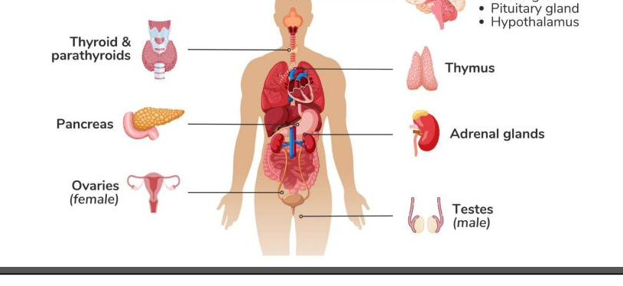




SECTION I · INTRODUCTION
What Is the Endocrine System?
Definition
The endocrine system is a network of ductless glands that secrete chemical messengers called hormones directly into the bloodstream. Hormones travel to distant target tissues where they bind to specific receptors and regulate cellular activity.
Four Core Functions
Homeostasis
Maintain optimal blood glucose, fluid, electrolyte, and pH balance
Growth & Metabolism
Control cellular metabolism, growth, and energy use
Reproduction
Coordinate male and female reproductive systems
Stress Response
Mobilize glucose & raise BP in emergencies (fight-or-flight)
Section I · Introduction
Endocrine NCLEX Review
4 / 56

Slide 5
ANATOMY
Organs of the Endocrine System
Eight Major Glands
Hypothalamus, pituitary, pineal, thyroid, parathyroids (×4), thymus, adrenals (×2), pancreas, gonads.
Master Gland
The pituitary is called the "master gland" because it controls the thyroid, adrenals, and gonads — but it answers to the hypothalamus.
Mixed Function Organs
Pancreas, ovaries, testes, and placenta are BOTH endocrine (internal secretion) AND exocrine or reproductive.
Why This Matters
Disorders rarely stay isolated. A pituitary tumor can disrupt thyroid, adrenal, and gonadal function all at once.
Anatomy · Organ Overview
Endocrine NCLEX Review
5 / 56

Slide 6
ANATOMY · REFERENCE
Master Hormone Chart
Gland
Hormone(s)
Target
Main Action
Hypothalamus
TRH, CRH, GnRH, GHRH
Ant. pituitary
Release/inhibit anterior pituitary hormones
Ant. Pituitary
TSH, ACTH, FSH, LH, GH, PRL
Thyroid, adrenal cortex, gonads, bone, breast
Control other endocrine glands
Post. Pituitary
ADH (vasopressin), Oxytocin
Kidneys, uterus, breast
Water retention; labor & milk let-down
Thyroid
T3, T4, Calcitonin
Every body cell; bones
Metabolic rate ↑; lower serum Ca²⁺
Parathyroid (×4)
Parathyroid Hormone (PTH)
Bone, kidney, gut
Raise serum Ca²⁺; lower phosphate
Adrenal Cortex
Cortisol, Aldosterone, Androgens
All tissues
Stress response, Na⁺/water retention, sex characteristics
Adrenal Medulla
Epinephrine, Norepinephrine
Heart, vessels, lungs
Fight-or-flight (↑HR, ↑BP, ↑BG)
Pancreas
Insulin (β), Glucagon (α), Somatostatin (δ)
Liver, muscle, fat
Lower (insulin) / raise (glucagon) blood glucose
Gonads
Estrogen, Progesterone, Testosterone
Reproductive organs
Sex characteristics, reproduction
Anatomy · Master Chart
Endocrine NCLEX Review
6 / 56

Slide 7



ANATOMY · COMPARE
Endocrine vs. Nervous System
Endocrine System
Nervous System
Messenger
Hormones (chemical)
Messenger
Neurotransmitters (electrical + chemical)
Pathway
Bloodstream
Pathway
Neurons / synapses
Speed
SLOW (seconds to hours to days)
Speed
FAST (milliseconds)
Duration
LONG-lasting effect
Duration
BRIEF effect
Target
Distant tissues; widespread
Target
Specific, localized
Example
Insulin lowers blood glucose over minutes
Example
Sympathetic nerves accelerate heart in < 1 sec
Clinical pearl: The two systems work together — e.g., the sympathetic nervous system triggers the adrenal medulla to release epinephrine during stress. This is why endocrine "emergencies" (adrenal crisis, thyroid storm) present like neurologic crises.
Anatomy · Compare
Endocrine NCLEX Review
7 / 56

Slide 8

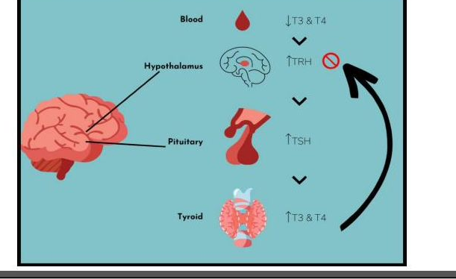

ANATOMY · MASTER CONTROLLER
The Hypothalamus–Pituitary Axis
Hypothalamus
Example: Thyroid Negative Feedback
Links nervous system to endocrine system. Senses internal state (temp, osmolality, nutrients) and commands the pituitary.
Releases: TRH • CRH • GnRH • GHRH • Dopamine (inhibits prolactin)
Pituitary Gland
Anterior: TSH, ACTH, FSH, LH, GH, Prolactin Posterior: ADH (vasopressin), Oxytocin — stored here, made in hypothalamus
⚠ Post-craniotomy, pituitary surgery, or head injury → monitor for ADH imbalance (DI or SIADH) — watch UOP, Na⁺, and neuro status.
Anatomy · HPA Axis
Endocrine NCLEX Review
8 / 56

Slide 9
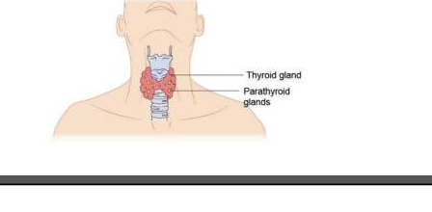
ANATOMY
Thyroid & Parathyroid Glands
Anterior Neck Anatomy
Thyroid Gland
• Butterfly-shaped, anterior neck, below larynx • Two lobes connected by isthmus; highly vascular • Secretes: T3, T4 (metabolism), Calcitonin (↓ Ca²⁺) • Needs dietary iodine to make T3/T4 — deficiency → goiter
Parathyroid Glands
• FOUR tiny glands behind the thyroid • Secrete Parathyroid Hormone (PTH) • PTH raises serum Ca²⁺ (pulls Ca from bone, absorbs in gut, reabsorbs in kidney) • Risk of damage during thyroidectomy → post-op hypocalcemia!
Anatomy · Thyroid/Parathyroid
Endocrine NCLEX Review
9 / 56

Slide 10
ANATOMY
Adrenal Glands — Cortex vs. Medulla
Anatomy & Structure
💡 GFR Mnemonic (cortex layers, superficial → deep)
G lomerulosa → Salt (aldosterone) F asciculata → Sugar (cortisol — anti-inflammatory, ↑BG) R eticularis → Sex (androgens — small amount)
ADRENAL
G
Zona Glomerulosa
Mineralocorticoids (aldosterone)
F
Zona Fasciculata
Glucocorticoids (cortisol)
Kidney
Medulla = SNS Gland
R
Zona Reticularis
Acts as a modified sympathetic ganglion. Secretes epinephrine (80%) and norepinephrine (20%) into the bloodstream during stress. Effects: ↑HR · ↑BP · ↑BG · bronchodilation · pupil dilation · ↓GI motility
Sex hormones (androgens)
M
Medulla
Catecholamines (Epi, NorEpi)
Anatomy · Adrenal
Endocrine NCLEX Review
10 / 56

Slide 11

ANATOMY
The Pancreas — Islets of Langerhans
α
β
δ
α-cells
β-cells
δ-cells
≈ 20%
≈ 75%
≈ 5%
GLUCAGON
INSULIN
SOMATOSTATIN
Raises blood glucose
Lowers blood glucose
Regulator
Stimulates liver glycogenolysis & gluconeogenesis. Released when BG is LOW.
"Key" that opens cells to take up glucose. Released when BG is HIGH. Destroyed in Type 1 DM.
Inhibits both insulin AND glucagon. Fine-tunes glucose homeostasis.
Endocrine + Exocrine Gland
The pancreas is BOTH: endocrine islets (1%) make insulin & glucagon → bloodstream; acinar cells (99%) make digestive enzymes → duodenum. Normal fasting blood glucose: 70–110 mg/dL. Normal HbA1c: < 5.7%.
Anatomy · Pancreas
Endocrine NCLEX Review
11 / 56

Slide 12
PHYSIOLOGY
How Hormones Are Regulated: Negative Feedback
The Thermostat Analogy
Just like your home thermostat: when it gets cold, the heater turns ON. When it's warm enough, the heater turns OFF. Hormones work the same way.
1
Low T3/T4 in blood
The thermostat senses "cold"
2
Hypothalamus releases TRH
Signal goes OUT
3
Anterior pituitary releases TSH
Thyroid is told to "turn ON"
4
Thyroid secretes T3, T4
Metabolism fires up
5
High T3/T4 shuts off TRH & TSH
Heater turns OFF — loop closes
Physiology · Feedback
Endocrine NCLEX Review
12 / 56

Slide 13
HORMONES · CLASS
Steroids — the Adrenal Cortex Hormones
All steroid hormones are made from cholesterol in the adrenal CORTEX (the outer layer of the adrenal gland).
Glucocorticoids
Mineralocorticoids
Sex Hormones
Cortisol
Aldosterone
Androgens (small amounts)
↑ Blood glucose (gluconeogenesis)
Retain sodium (Na⁺) + water
Testosterone (M + F small amt)
Break down fats & proteins
Excrete potassium (K⁺)
Estrogen / Progesterone (F)
Suppress immune system
Raises blood pressure
Secondary sex characteristics
Anti-inflammatory
Part of the RAAS system
Libido
Mood effects (euphoria → depression)
Links endocrine ↔ renal
Most sex hormones come from gonads, not adrenal
Hormones · Steroids
Endocrine NCLEX Review
13 / 56

Slide 14

HORMONES · CLASS
Catecholamines — Epinephrine & Norepinephrine
Secreted by the adrenal MEDULLA during stress ("fight-or-flight" hormones)
Norepinephrine
Epinephrine
α-receptor dominant
α + β receptor (mixed)
Vascular
Powerful VASOCONSTRICTION → ↑ BP
Heart
Strong ↑ HR + ↑ contractility (β1)
Heart
↑ Contractility and rate (modest)
Lungs
BRONCHODILATION (β2)
Pupils
DILATE (mydriasis)
Metabolism
↑ Glucose (glycogenolysis); inhibits insulin
GI
INHIBIT gut motility & secretions
Skin/Gut
Vasoconstriction to redirect blood
Use
Drug of choice for septic shock / hypotension
Use
Anaphylaxis, cardiac arrest, severe asthma
Hormones · Catecholamines
Endocrine NCLEX Review
14 / 56

Slide 15


HORMONES · KEY
Antidiuretic Hormone (ADH / Vasopressin)
Mechanism
High-Risk Situations for ADH Disruption
• Craniotomy / pituitary surgery • Head injury or traumatic brain injury (TBI) • Sinus surgery near the sella turcica • Brain tumor, stroke, infection ALWAYS monitor: UOP, serum Na⁺, LOC
Source
Made in the hypothalamus, stored and released by the POSTERIOR pituitary.
Trigger
Released when blood is too concentrated (high serum osmolality) or BP drops.
Too LITTLE ADH
Too MUCH ADH
Action
Diabetes Insipidus
SIADH
Tells the kidneys to hold onto WATER (not sodium!). More ADH = concentrated urine, dilute blood.
Massive dilute urine → dehydration, hypernatremia, shock
Water retention → hyponatremia, seizures (Na⁺ < 125)
Name
Also called vasopressin because at high doses it causes VASOCONSTRICTION → ↑ BP.
Hormones · ADH
Endocrine NCLEX Review
15 / 56

Slide 16

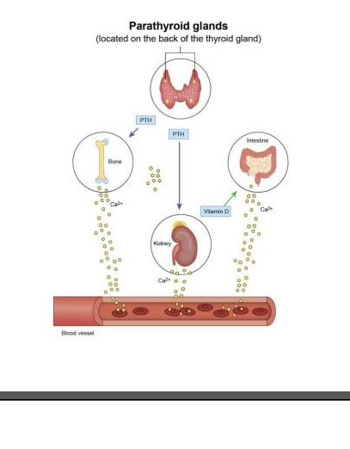
HORMONES · KEY
Parathyroid Hormone (PTH)
Source & Target
Calcium–Phosphorus Relationship
Made by: The four parathyroid glands (behind thyroid) Main job: RAISE serum calcium when it's too low. Three target organs: 1. BONES → pulls Ca²⁺ out into blood 2. KIDNEYS → reabsorb Ca²⁺; excrete phosphate 3. INTESTINES → activate Vit D to absorb dietary Ca²⁺
⚖ Remember: Ca²⁺ and phosphate have an INVERSE relationship. When one goes UP, the other goes DOWN.
Hormones · PTH
Endocrine NCLEX Review
16 / 56

Slide 17
HORMONES · KEY
Calcitonin — the "Ca-tone-down" Hormone
How It Works
Yin & Yang: PTH vs. Calcitonin
Made by: The THYROID gland (parafollicular C cells) Released when: Serum Ca²⁺ is HIGH Action: Inhibits osteoCLASTS (cells that break down bone) → Stops bone from releasing Ca²⁺ → Promotes Ca²⁺ deposit into bone → Lowers serum Ca²⁺ Clinical use: Salmon calcitonin — treatment of hypercalcemia, Paget's disease, osteoporosis
Feature
PTH
Calcitonin
Gland
Parathyroid
Thyroid
Trigger
Low Ca²⁺
High Ca²⁺
Bone
↑ breakdown
↓ breakdown
Serum Ca²⁺
↑ RAISES
↓ LOWERS
Nickname
"Ca-Ptake"
"Ca-tone-down"
💡 Memory cue
Calci-TONIN tones DOWN calcium. PTH PUTS calcium into the blood (P = UP).
Hormones · Calcitonin
Endocrine NCLEX Review
17 / 56

Slide 18

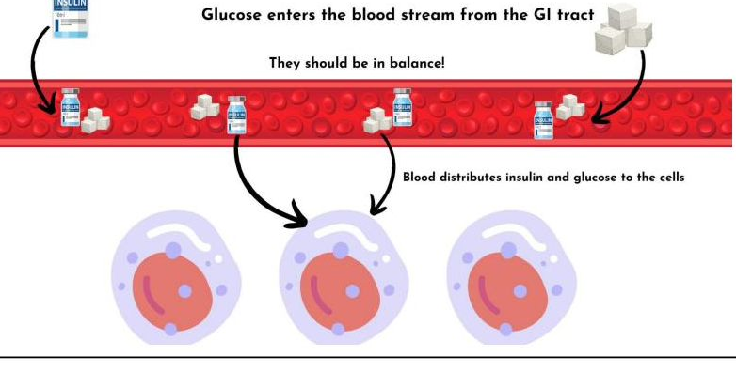
HORMONES · KEY
Insulin — the Glucose "Key"
Insulin is the KEY that unlocks cells so glucose can enter and be used as fuel
Insulin Fast Facts
Made by: β-cells of the Islets of Langerhans (pancreas) Released when: Blood glucose rises (after a meal) Main actions: • Moves glucose from blood → cells • Promotes glycogen storage in liver • Builds protein & fat (anabolic) • Moves K⁺ into cells Normal fasting BG: 70–110 mg/dL Normal HbA1c: < 5.7% (diabetes ≥ 6.5%)
Hormones · Insulin
Endocrine NCLEX Review
18 / 56

Slide 19
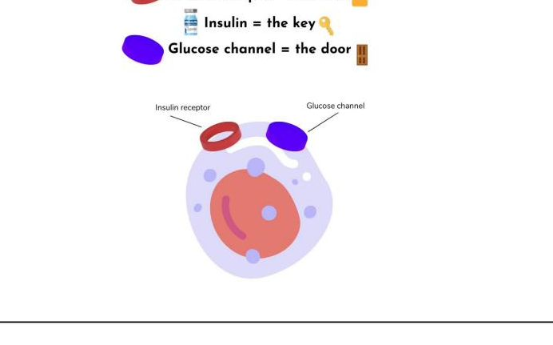



MNEMONIC
Lock & Key — How Insulin Lets Glucose In
Insulin receptor
Insulin
Glucose channel
= the LOCK
= the KEY
= the DOOR
Mnemonic · Lock & Key
Endocrine NCLEX Review
19 / 56

Slide 20
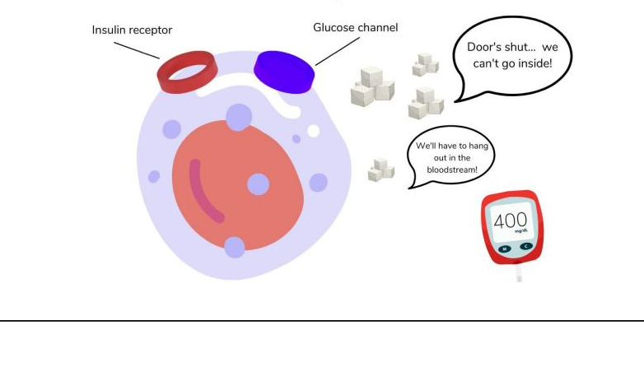
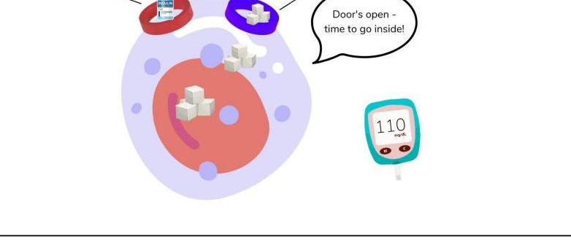
CONCEPT · DIABETES
With vs. Without Insulin
NO INSULIN → Door is SHUT
WITH INSULIN → Door is OPEN
BG reads 400 mg/dL — glucose can't enter cells → Cells STARVE even though blood is flooded with sugar → This is Type 1 Diabetes (no β-cells)
BG reads 110 mg/dL — glucose enters cells → Cells get fuel; blood glucose returns to normal → Healthy pancreas + working receptors
Concept · Insulin Action
Endocrine NCLEX Review
20 / 56

Slide 21


HORMONES · KEY
Glucagon — Insulin's Partner
Raise the Blood Sugar!
Made by α-cells of the pancreas. Released when blood glucose drops LOW. Glucagon tells the liver to: Glycogenolysis (break down glycogen into glucose) · Gluconeogenesis (make new glucose from amino acids) → Blood glucose RISES
Clinical Use: Hypoglycemia Rescue
💡 Memory Trick
Glucagon → "Glucose gone? Give some back!"
If patient is unconscious and has NO IV access, give GLUCAGON 1 mg IM or SubQ. If IV is in, push D50W IV instead. • Place patient on their side (risk of vomiting on awakening) • Recheck BG in 15 min • Give complex carb snack once conscious
Opposite of insulin: • Insulin → LOWERS blood glucose • Glucagon → RAISES blood glucose Together they keep BG in a tight range: 70–110 mg/dL
Hormones · Glucagon
Endocrine NCLEX Review
21 / 56

Slide 22
PART II
Disorders &
Nursing Care
Adrenal, pituitary, thyroid, parathyroid, and pancreatic diseases — with emphasis on NCLEX priorities: assessment, labs, medications, and patient education.

Slide 23

ADRENAL · HYPO
Addison's Disease
"ADD-i-son → you ADD steroids because your adrenals AREN'T making them"
↓ Glucocorticoids
↓ Mineralocorticoids
↓ Sex Hormones
(cortisol)
(aldosterone)
(androgens)
Fatigue, weakness
Lose Na⁺ + water → HYPOnatremia
Women: loss of axillary & pubic hair
Hypoglycemia (can't mobilize glucose)
Retain K⁺ → HYPERkalemia
Decreased libido
Weight loss, anorexia
Dehydration, hypovolemia
Menstrual irregularities
Confusion, depression
HYPOtension (orthostatic)
Men: less affected (testes dominant)
Poor stress response
Salt cravings
Usually a minor symptom
Common Causes
• Autoimmune destruction (most common) • Abrupt stop of long-term steroids • Infection (TB, HIV) • Adrenal hemorrhage • Metastatic cancer
Adrenal · Addison's
Endocrine NCLEX Review
23 / 56

Slide 24
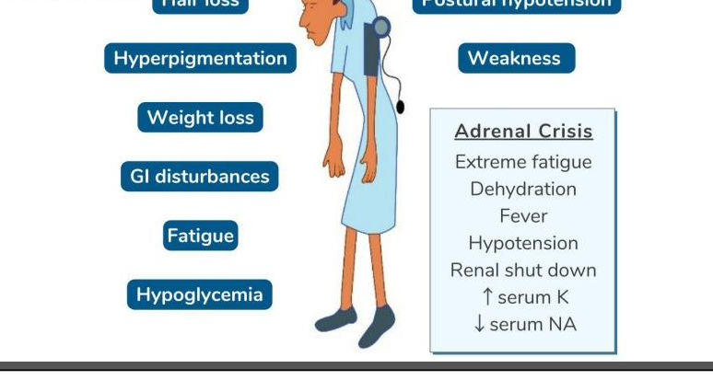
ADRENAL · ASSESSMENT
Addison's Disease — Clinical Picture
Hallmark Labs
↓ Na⁺ (hyponatremia) ↑ K⁺ (hyperkalemia) ↓ Glucose ↓ Cortisol (confirmatory) ↑ ACTH (primary) ↑ BUN (dehydration)
Unique Sign
BRONZED, hyperpigmented skin especially on knuckles, elbows, scars, gums. Why? Low cortisol → pituitary makes LOTS of ACTH. ACTH shares a precursor with melanocyte-stimulating hormone (MSH) → extra skin pigment.
Adrenal · Addison's
Endocrine NCLEX Review
24 / 56

Slide 25

ADRENAL · EMERGENCY
Addisonian Crisis
Life-Threatening — Think SHOCK!
🚑 Emergency Treatment
Triggered by:
1
IV Normal Saline (0.9% NS)
• Stress (infection, surgery, trauma) • Abruptly stopping steroids • Addison's patient who misses doses • Sepsis, MI, severe vomiting/diarrhea
Rapid bolus — replace fluid + Na⁺ deficit
2
IV Hydrocortisone
100 mg bolus, then drip — replaces cortisol
Presents with:
3
D50W if hypoglycemic
• Severe hypotension, hypovolemic shock • Severe hyponatremia & hyperkalemia • Hypoglycemia • Severe N/V, abdominal pain • Fever, extreme weakness • Confusion, coma, renal shutdown
Correct blood glucose
4
Treat hyperkalemia
Insulin + D50, calcium gluconate, kayexalate
5
Monitor closely
I&O, hourly VS, daily weight, ECG, Na⁺/K⁺
Adrenal · Addisonian Crisis
Endocrine NCLEX Review
25 / 56

Slide 26

ADRENAL · HYPER
Cushing's Disease / Syndrome
EXCESS cortisol — "too much steroid" (endogenous tumor OR exogenous steroid therapy)
↑ Glucocorticoids
↑ Mineralocorticoids
↑ Sex Hormones
(cortisol)
(aldosterone)
(androgens)
Hyperglycemia / steroid-induced DM
Retain Na⁺ + water
Women: hirsutism (facial hair)
Immunosuppression (infection risk!)
Excrete K⁺ → HYPOkalemia
Menstrual irregularities
Fat redistribution → moon face, buffalo hump, truncal obesity, thin limbs
HYPERtension
Acne, oily skin
Thin, fragile skin, bruising, striae
Fluid overload, edema
Male pattern baldness (women)
Osteoporosis, muscle wasting
Weight gain
Deepening voice
Mood swings, euphoria, psychosis
Metabolic alkalosis
Clitoral enlargement
Adrenal · Cushing's
Endocrine NCLEX Review
26 / 56

Slide 27
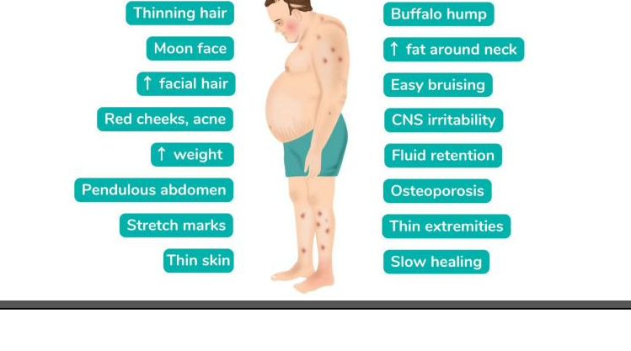
ADRENAL · ASSESSMENT
Cushing's — The Classic Look
Hallmark Labs
↑ Cortisol (24-hr urine) ↑ Glucose (hyperglycemia) ↑ Na⁺ (hypernatremia) ↓ K⁺ (hypokalemia) ↑ WBC (but ↓ immunity!) Dexamethasone suppression: no ↓ in cortisol
Nursing Priorities
• Infection prevention (handwashing, limit visitors) • Skin protection (thin, fragile) • Fall / fracture prevention (osteoporosis) • Low Na, high K, high protein diet • Emotional support (body image) • Monitor glucose regularly
Adrenal · Cushing's
Endocrine NCLEX Review
27 / 56

Slide 28



ADRENAL · TREATMENT
Cushing's — Treatment & Post-op Care
If Drug-Induced
If Pituitary Tumor
If Adrenal Tumor
Most common cause is long-term steroid use (prednisone, etc.). TAPER the steroid slowly — never stop abruptly (risk of Addisonian crisis). Teach medication-alert bracelet & "stress doses" during illness.
Transsphenoidal hypophysectomy — remove tumor through nose/sphenoid sinus. Post-op priorities: • Do NOT brush teeth, cough, sneeze, bend over (4–6 weeks) • Watch for CSF leak (clear drainage, halo sign, glucose+) • Monitor for DI or SIADH
Adrenalectomy — remove one or both adrenal glands. Post-op priorities: • Lifelong steroid replacement if BOTH removed • Infection prevention (still immunosuppressed) • Monitor BP and blood glucose closely • Teach stress-dose steroid schedule
Adrenal · Cushing's Treatment
Endocrine NCLEX Review
28 / 56

Slide 29
ADRENAL · RARE
Conn's Syndrome (Primary Aldosteronism)
What It Is
Symptoms
A tumor (usually benign adenoma) in the adrenal cortex that secretes too much aldosterone — and only aldosterone. Mechanism: • ↑ Aldosterone → Na⁺ + H₂O retention • ↑ Aldosterone → K⁺ + H⁺ excretion Clinical clue: the classic "triad" 1. Persistent HYPERTENSION (often resistant) 2. HYPOkalemia 3. Metabolic ALKALOSIS
• Hard-to-control high BP (often despite 3+ meds) • Muscle weakness, cramps, fatigue (from low K⁺) • Headache, palpitations • Polyuria, polydipsia • Paresthesia, tetany, cardiac arrhythmias
Treatment
1. Surgical removal of the tumor (adrenalectomy) — curative if unilateral 2. Spironolactone (aldosterone antagonist) — K⁺-sparing diuretic 3. Replace potassium; monitor BP, K⁺, BUN/creatinine
Adrenal · Conn's
Endocrine NCLEX Review
29 / 56

Slide 30
ADRENAL · RARE
Pheochromocytoma
Rare tumor of the adrenal MEDULLA that dumps epinephrine + norepinephrine into the blood — think "adrenal storm"
The 5 P's · Classic Presentation
Diagnosis
• 24-hour urine catecholamines and metanephrines (↑↑) • Plasma free metanephrines • CT/MRI of adrenal glands ⚠ DO NOT palpate the abdomen — can trigger catecholamine release & HTN crisis!
P
Pressure
Paroxysmal HYPERtension (sudden, severe, often > 200/140)
P
Pain
Severe, throbbing headache
P
Palpitations
Tachycardia, arrhythmias, chest pain
Treatment
P
Perspiration
1. Alpha-blocker FIRST (phenoxybenzamine) — 10–14 days pre-op 2. Beta-blocker AFTER (propranolol) — never give β before α (unopposed α = severe HTN) 3. Adrenalectomy — definitive cure 4. Quiet environment, avoid stimulation, monitor BP every 15 min pre-op
Profuse, drenching diaphoresis
P
Pallor
Intense vasoconstriction → skin pale, cold
Adrenal · Pheochromocytoma
Endocrine NCLEX Review
30 / 56

Slide 31
ADH · HYPO
Diabetes Insipidus (DI)
NOT enough ADH → Kidneys dump HUGE amounts of dilute urine → dehydration & hypernatremia
Pathophysiology
Causes & Triggers
Low ADH
Central DI (↓ ADH production): head injury, brain tumor, craniotomy, pituitary surgery Nephrogenic DI (kidney doesn't respond): lithium toxicity, chronic kidney disease, hypokalemia, hypercalcemia
1
Hypothalamus or posterior pituitary dysfunction
2
Kidneys ignore water
Collecting ducts don't reabsorb H₂O
3
Dilute urine flood
Up to 4–30 L/day! ("insipid" = tasteless/colorless)
Key Labs & Diagnostics
URINE = dilute • Specific gravity < 1.005 • Urine osmolality < 200 BLOOD = concentrated • Serum Na⁺ > 145 • Serum osmolality > 295 • Hct > 40%
4
Blood concentrates
↑ serum Na⁺, ↑ osmolality, dehydration
5
Shock risk
Hypotension, tachycardia if fluid not replaced
ADH · DI
Endocrine NCLEX Review
31 / 56

Slide 32
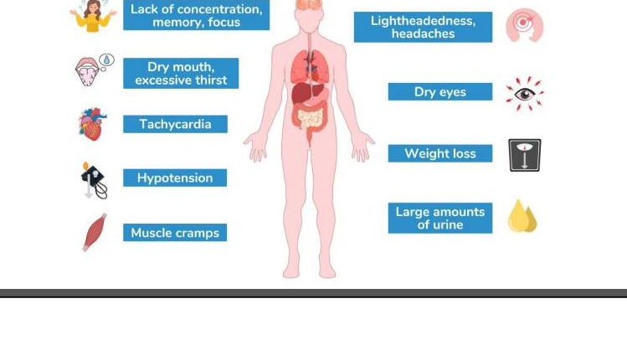
ADH · DI ASSESSMENT
DI — Signs, Symptoms & Treatment
💊 Treatment
Monitor neuro status
Confusion & seizures from hypernatremia
Hourly I & O
UOP can exceed 4 L/day — replace volume
Daily weight
Best indicator of fluid status
IV hypotonic fluids
D5W or 0.45% NS to rehydrate + dilute Na⁺
DESMOPRESSIN (DDAVP)
Synthetic ADH — intranasal, SC, or PO. Watch for water intoxication.
Patient teaching
Wear medical alert bracelet; never skip dose
ADH · DI Assessment
Endocrine NCLEX Review
32 / 56

Slide 33
ADH · HYPER
Syndrome of Inappropriate ADH (SIADH)
TOO MUCH ADH → Kidneys HOLD water (not Na⁺) → dilutional hyponatremia & water intoxication
Mechanism
Signs & Symptoms
• Excess ADH → kidneys reabsorb WATER only (not Na⁺) • Blood volume ↑ → euvolemic hyponatremia • Urine becomes very concentrated • No peripheral edema (water is intracellular) • Brain cells swell → seizures, coma if Na⁺ < 125
• Weight GAIN (no edema) • Anorexia, nausea, vomiting • Headache, muscle cramps • Confusion, irritability, hallucinations • Seizures when serum Na⁺ < 125
Common Causes
Labs: OPPOSITE of DI
• Small-cell lung cancer (ectopic ADH) • Head trauma, stroke, brain tumor, meningitis • Post-pituitary surgery • Drugs: SSRIs, carbamazepine, chemotherapy, NSAIDs • Positive pressure ventilation, pneumonia
URINE = concentrated • Specific gravity > 1.030 • Urine osmolality > 1200 • Decreased UOP BLOOD = diluted • Serum Na⁺ < 135 (often < 125) • Serum osmolality < 275
ADH · SIADH
Endocrine NCLEX Review
33 / 56

Slide 34
ADH · COMPARE
DI vs. SIADH — Know the Difference
Feature
Diabetes Insipidus (DI)
SIADH
ADH level
LOW ↓
HIGH ↑
Urine output
HIGH (4–30 L/d)
LOW
Urine osmolality
LOW (dilute)
HIGH (concentrated)
Urine specific gravity
LOW (< 1.005)
HIGH (> 1.030)
Serum Na⁺
HIGH (> 145)
LOW (< 135)
Serum osmolality
HIGH (> 295)
LOW (< 275)
Blood volume
LOW (dehydrated)
HIGH (euvolemic)
Blood pressure
LOW
Normal / high
Weight
Loss
GAIN (no edema)
Big risk
Hypovolemic shock
Seizures (Na⁺ < 125)
Treatment
Desmopressin + fluids
Fluid restrict + hypertonic saline
💡 Mnemonic: DI = "D-iuresis!" (too little ADH, pee a lot) | SIADH = "S-ave water" (too much ADH, hold water)
ADH · DI vs SIADH
Endocrine NCLEX Review
34 / 56

Slide 35

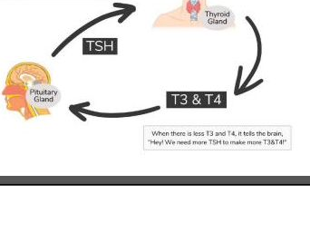
THYROID · HYPO
Hypothyroidism — the Slowed Metabolism
Thyroid makes TOO LITTLE T3/T4 → metabolism slows to a crawl → "everything is sluggish"
Broken Feedback Loop
Common Causes
• Hashimoto's thyroiditis (autoimmune — #1 cause in US) • Iodine deficiency (global #1 cause) • After thyroidectomy or radioactive iodine • Lithium, amiodarone • Pituitary failure (secondary)
Key Labs
Primary hypothyroidism: ↑ TSH (pituitary tries to stimulate) ↓ Free T3 / ↓ Free T4 Also expect: ↑ Cholesterol / LDL · ↓ Na⁺ · ↓ glucose · ↓ Hgb
Thyroid · Hypothyroidism
Endocrine NCLEX Review
35 / 56

Slide 36
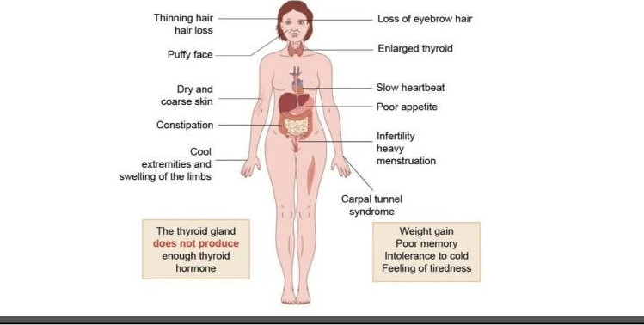
THYROID · ASSESSMENT
Hypothyroidism — Clinical Picture
Systems Review
Everything slows down: • ↓ HR (bradycardia) • ↓ BP, ↓ temperature • ↓ Energy, fatigue • ↓ GI motility → constipation • ↓ Reflexes (DTRs) • Weight GAIN despite no appetite
🚨 Myxedema Coma
Life-threatening form of hypothyroidism: • Severe hypothermia • Hypotension, bradycardia • Hypoventilation → respiratory failure • Hyponatremia, hypoglycemia • Stupor or coma Tx: IV levothyroxine, warming, airway support
Thyroid · Hypothyroidism
Endocrine NCLEX Review
36 / 56

Slide 37
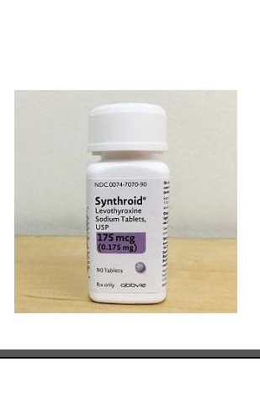
PHARMACOLOGY
Levothyroxine (Synthroid®) — Drug Spotlight
The Medication
Mechanism & Use
Class: Synthetic T4 (thyroid hormone replacement) Use: Lifelong replacement therapy for hypothyroidism, congenital hypothyroidism, and after thyroidectomy or RAI ablation. Onset: Full effect takes 4–6 WEEKS — don't expect overnight improvement.
📚 Patient Teaching (Saunders-style priorities)
✓ Take on an EMPTY stomach, same time every morning ✓ Wait 30–60 min before eating ✓ Avoid calcium, iron, antacids within 4 hours (reduce absorption) ✓ LIFELONG therapy — never stop suddenly ⚠ Report signs of OVERDOSE = hyperthyroid symptoms: tachycardia, palpitations, weight loss, heat intolerance, tremors
Pharm · Levothyroxine
Endocrine NCLEX Review
37 / 56

Slide 38

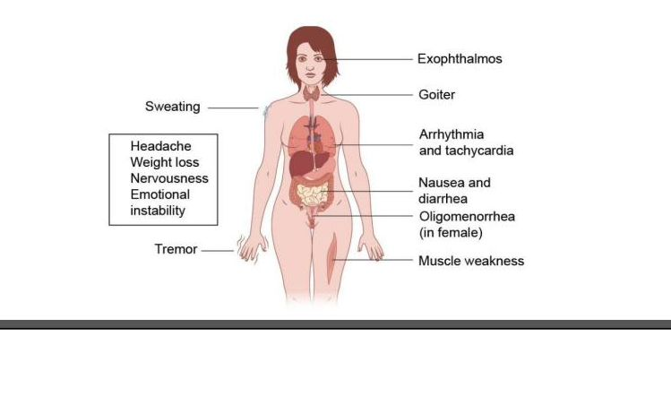
THYROID · HYPER
Hyperthyroidism & Graves' Disease
TOO MUCH T3/T4 → metabolism goes into overdrive → "everything speeds up and burns hot"
Graves' Disease
Autoimmune — antibodies stimulate the TSH receptor (TSI) as if it were TSH, making the thyroid overproduce. Hallmark signs: • Exophthalmos (bulging eyes) • Enlarged thyroid (goiter) • Pretibial myxedema
Key Labs
Primary hyperthyroidism: ↓ TSH (pituitary suppressed) ↑ Free T3 / ↑ Free T4 ↑ Radioactive iodine uptake TSI positive in Graves'
Thyroid · Hyperthyroidism
Endocrine NCLEX Review
38 / 56

Slide 39
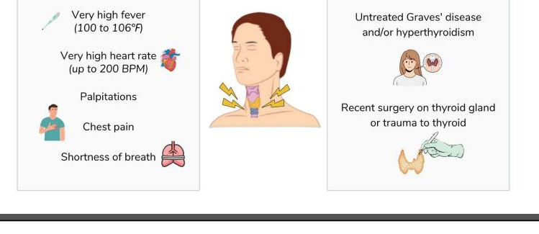
THYROID · EMERGENCY
Thyroid Storm (Thyrotoxic Crisis)
LIFE-THREATENING — extreme hyperthyroidism; triggered by infection, surgery, trauma, or untreated disease
🚑 Emergency Management
1
COOL the patient
Cooling blanket, ice packs, antipyretics (no aspirin — displaces T4!)
2
PTU or Methimazole
Blocks new thyroid hormone synthesis
3
Beta-blocker (propranolol)
Controls HR, tremor, anxiety; blocks T4 → T3
4
Iodine (SSKI / Lugol's)
Given AFTER antithyroid drugs; inhibits release
5
IV hydrocortisone
Blocks peripheral T4 → T3 conversion; treats adrenal stress
6
Supportive care
O₂, IV fluids, continuous cardiac monitor, quiet room
Thyroid · Thyroid Storm
Endocrine NCLEX Review
39 / 56

Slide 40
PHARMACOLOGY
Antithyroid Drugs & Radioactive Iodine
Methimazole
Propylthiouracil
Lugol's / SSKI
Radioactive Iodine
(Tapazole®)
(PTU)
(iodine solution)
(I-131, RAI)
Class: Thioamide Action: Inhibits T3/T4 synthesis Dose: Daily, PO Watch: Agranulocytosis (report fever, sore throat), hepatotoxicity Note: NOT in 1st trimester of pregnancy
Class: Thioamide Action: Blocks synthesis AND T4 → T3 conversion Use: Thyroid storm, 1st-trimester pregnancy Watch: Hepatotoxicity > methimazole Saunders: Preferred when pregnancy is a concern
Class: Strong iodine Action: Inhibits thyroid hormone RELEASE, shrinks vascularity pre-op How: Dilute in juice or water; use a straw (stains teeth) Saunders: Give AFTER antithyroid drug, not before
Action: Destroys thyroid tissue over 6–18 wks Result: Most patients become hypothyroid → lifelong levo Safety: Avoid pregnancy 6 months • Flush toilet twice • Limit close contact (esp. children/pregnant) several days • Use separate utensils
Pharm · Antithyroid Drugs
Endocrine NCLEX Review
40 / 56

Slide 41
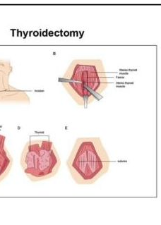
THYROID · SURGICAL
Thyroidectomy — Post-op Nursing Care
The Procedure
✅ At Bedside — ALWAYS
• Tracheostomy tray • Suction + O₂ • IV calcium gluconate • Semi-Fowler's position, support head with pillows • Voice check q 2 hr (hoarseness = laryngeal nerve injury)
⚠ Watch For 3 Big Complications
1. Hemorrhage Check BEHIND the neck (blood pools there, not on pillow) 2. Laryngeal nerve damage Hoarseness, stridor, weak voice 3. Tetany / hypocalcemia Trousseau's & Chvostek's signs — parathyroids injured
Indications: large goiter, thyroid cancer, severe Graves' unresponsive to therapy, pregnancy complications. Types: subtotal (part removed) or TOTAL (all removed — lifelong levothyroxine).
Thyroid · Thyroidectomy
Endocrine NCLEX Review
41 / 56

Slide 42
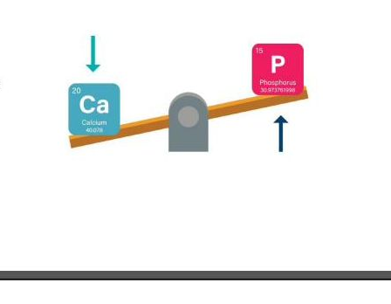
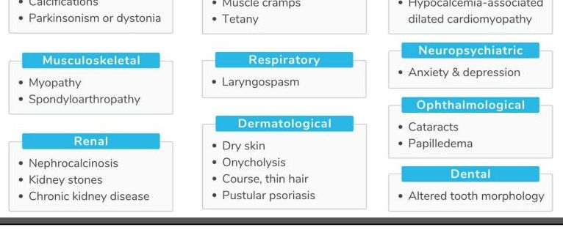
PARATHYROID · HYPO
Hypoparathyroidism
LOW PTH → LOW serum Ca²⁺ + HIGH phosphate → neuromuscular irritability (tetany)
Ca–Phosphate Seesaw
Assessment Findings
Parathyroid · Hypoparathyroidism
Endocrine NCLEX Review
42 / 56

Slide 43
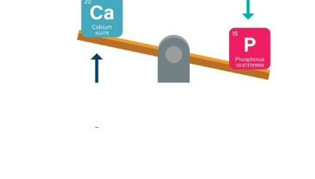
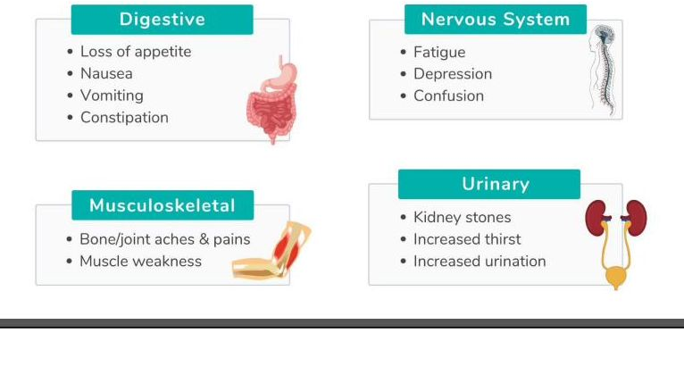
PARATHYROID · HYPER
Hyperparathyroidism
HIGH PTH → HIGH serum Ca²⁺ + LOW phosphate → bones leak calcium into blood
Ca–Phosphate Seesaw (Reversed)
Assessment Findings
Parathyroid · Hyperparathyroidism
Endocrine NCLEX Review
43 / 56

Slide 44


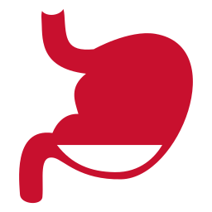

MNEMONIC
Stones · Bones · Groans · Moans
Classic 4-part mnemonic for HYPERcalcemia (and hyperparathyroidism)
STONES
BONES
GROANS
MOANS
Kidney Stones
Bone Problems
Abdominal Groans
Psychiatric Moans
Excess Ca²⁺ is filtered by kidneys → calcium stones in kidney & urinary tract. Flank pain, hematuria, frequency.
PTH pulls Ca²⁺ out of bone → osteoporosis, fractures, bone pain, deformities. Bones become "hollow."
Constipation, anorexia, nausea, PUD, pancreatitis from calcium in GI system. Severe abdominal pain.
Fatigue, depression, confusion, anxiety, memory loss, psychosis. "Not feeling myself."
Mnemonic · SBGM
Endocrine NCLEX Review
44 / 56

Slide 45
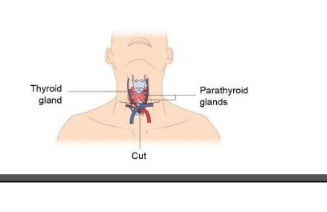
PARATHYROID · SURGICAL
Parathyroidectomy
The Procedure
Pre-op & Intra-op
• Lower serum Ca²⁺ first (IV NS + furosemide, bisphosphonates, calcitonin) • Intra-op PTH monitoring — drops rapidly when adenoma is removed • Removal of 1 or more of the 4 glands (usually the overactive one) • Consent, baseline vitals, labs (Ca, P, Mg, albumin, creatinine)
⚠ Post-op — Rebound HYPOcalcemia
After removing overactive gland(s), remaining glands may be suppressed & slow to "wake up." Assess: • Chvostek's & Trousseau's (tetany) • Numbness/tingling around mouth, fingers • Muscle cramps, positive DTRs IV calcium gluconate at bedside — same as thyroidectomy.
Parathyroid · Parathyroidectomy
Endocrine NCLEX Review
45 / 56

Slide 46

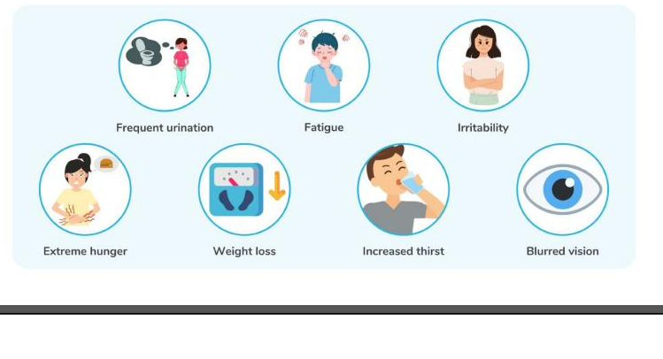
DIABETES · TYPE 1
Diabetes Mellitus Type 1
AUTOIMMUNE destruction of pancreatic β-cells → NO insulin produced → requires lifelong insulin therapy
Pathophysiology
• Autoimmune T-cell attack on β-cells • Genetic + viral triggers (HLA genes) • Onset typically childhood/young adult (often < 30) • "Lean" body type; abrupt onset • Prone to DKA
Classic "3 P's"
1. Polyuria — excess urination (glucose pulls water) 2. Polydipsia — excessive thirst (dehydration) 3. Polyphagia — excessive hunger (cells starved) + weight loss, fatigue, blurred vision, frequent infections, slow wound healing
Diabetes · Type 1
Endocrine NCLEX Review
46 / 56

Slide 47
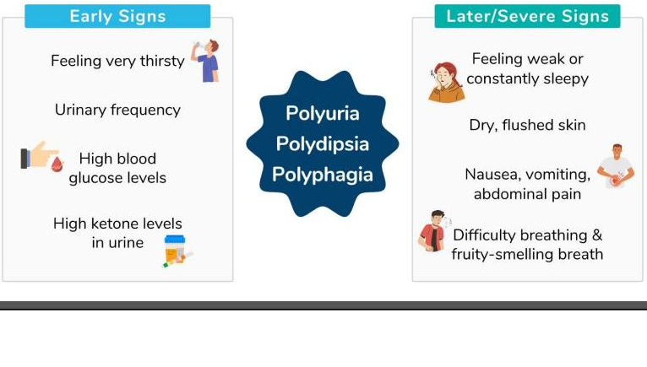
DIABETES · EMERGENCY
Diabetic Ketoacidosis (DKA)
Complication of T1DM — NO insulin → fat breakdown → ketones → metabolic acidosis (pH < 7.35)
Hallmark Findings
• BG > 300 mg/dL (often 500+) • pH < 7.35 (metabolic acidosis) • HCO₃⁻ < 15 • + Ketones in urine & blood • Kussmaul respirations (deep & rapid) • Fruity (acetone) breath • Dehydration (3 P's + N/V)
🚑 Emergency Management
1. IV NS FIRST — rehydrate aggressively 2. Regular insulin IV drip (only IV insulin used) 3. Replace K⁺ — initially high, drops as insulin drives K⁺ into cells 4. When BG reaches 250 → switch to D5 + ½NS (prevent hypoglycemia & cerebral edema)
Diabetes · DKA
Endocrine NCLEX Review
47 / 56

Slide 48

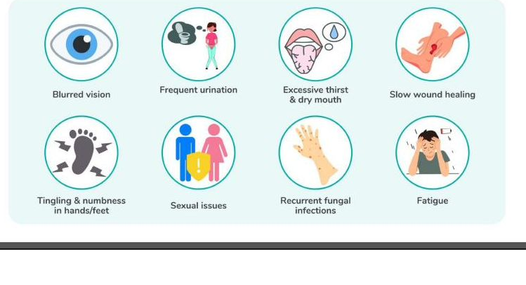
DIABETES · TYPE 2
Diabetes Mellitus Type 2
Insulin RESISTANCE + relative deficiency — most common form of diabetes (90–95% of cases)
Pathophysiology
• Insulin is produced but cells don't respond (resistance) • Pancreas eventually tires out • Strong genetic + lifestyle component • Adult onset (rising in children/teens) • Often obese; gradual onset
Risk Factors (metabolic syndrome)
• Obesity (especially central/abdominal) • Sedentary lifestyle, poor diet • Age > 45 • Family history • HTN, ↑ triglycerides, ↓ HDL • GDM history or baby > 9 lbs • PCOS, acanthosis nigricans
Diabetes · Type 2
Endocrine NCLEX Review
48 / 56

Slide 49
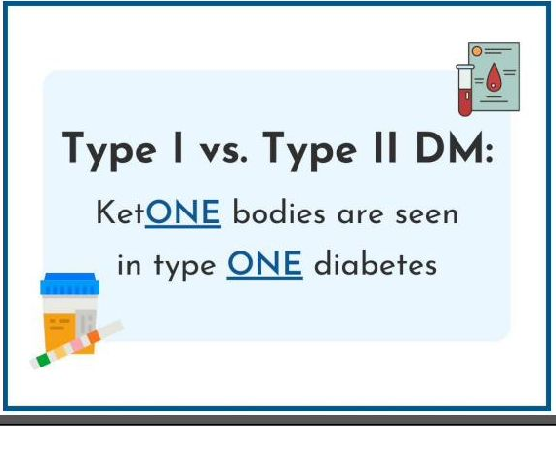
DIABETES · EMERGENCY
DKA vs. HHNS — Compare & Contrast
Feature
DKA
HHNS
Seen in
Type 1 DM
Type 2 DM (elderly)
Onset
Rapid (hours–days)
Slow (days–weeks)
BG level
> 300
> 600 (often > 1000)
Ketones
Positive
Negative / minimal
pH
< 7.35 (acidotic)
Normal
HCO₃⁻
< 15
Normal
Dehydration
Moderate
SEVERE
Mental status
Alert → coma
Confusion, coma
Breath
Fruity (acetone)
No odor
Respirations
Kussmaul (deep)
Normal / shallow
Mortality
~1–2%
15–20% (much higher)
Tx key point
Insulin + fluids + K
FLUIDS first; less insulin
Diabetes · DKA vs HHNS
Endocrine NCLEX Review
49 / 56

Slide 50
PHARM · INSULIN
Insulin Types — Onset · Peak · Duration
Category
Examples
Appearance
Onset
Peak
Duration
Rapid-acting
Lispro (Humalog)
Aspart (NovoLog)
Glulisine (Apidra)
Clear
10–15 min
1 hr
3–5 hr
Short-acting
Regular (Humulin R)
(only IV-safe insulin)
Clear
30 min–1 hr
2–3 hr
5–7 hr
Intermediate
NPH (Humulin N)
CLOUDY
1–2 hr
4–12 hr
16–24 hr
Long-acting
Glargine (Lantus)
Detemir (Levemir)
Degludec (Tresiba)
Clear
1 hr
NO peak
~24 hr
Premixed
70/30, 75/25, 50/50
(NPH + regular)
Cloudy
30 min
Variable (2 peaks)
~24 hr
💡 Memory: "Clear before Cloudy" when mixing · Regular insulin is the ONLY insulin that can be given IV · Never mix Glargine (Lantus) with anything
Pharm · Insulin Types
Endocrine NCLEX Review
50 / 56

Slide 51
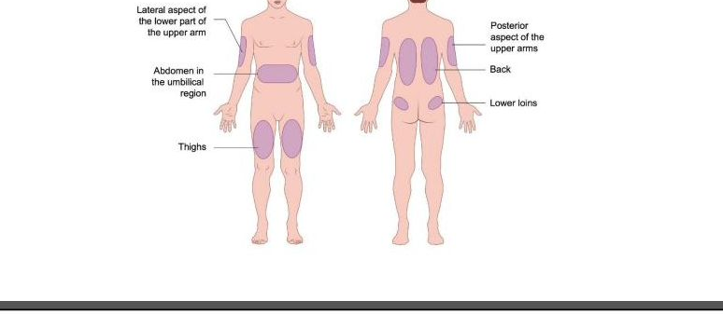
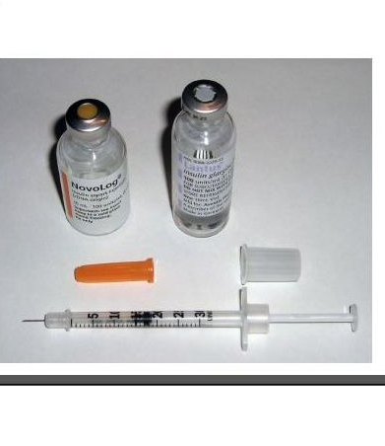
PHARM · ADMIN
Insulin Administration — Sites, Storage, Safety
Storage & Handling
• UNOPENED: refrigerate (2–8 °C) • OPENED: room temp up to 28 days • Never freeze; never shake (roll NPH) • Check appearance & expiry each dose • Use U-100 syringe with U-100 insulin
Site Rotation
Best absorption ➜ slowest absorption: Abdomen → arm → thigh → buttock. Rotate within one area (don't jump around areas → inconsistent absorption). Space sites ≥ 1 inch apart. Avoid scars, moles, bony areas, lipohypertrophy.
Pharm · Insulin Administration
Endocrine NCLEX Review
51 / 56

Slide 52
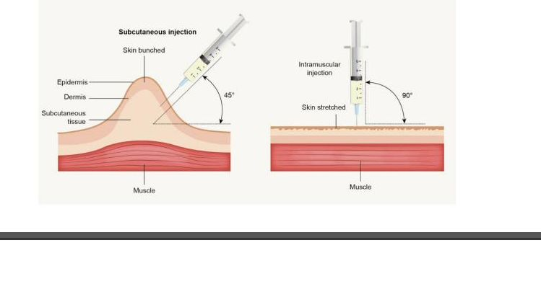
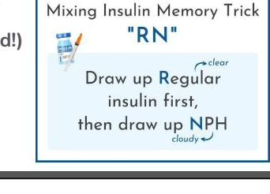
PHARM · TECHNIQUE
Injection Angles & Mixing Insulin
Needle Angles by Route
Mixing Insulin · "R-N" Rule
1. Inject air into NPH (cloudy) vial 2. Inject air into Regular (clear) vial 3. Withdraw Regular FIRST (clear before cloudy) 4. Then withdraw NPH (cloudy) "R-N" — so R insulin doesn't contaminate N vial. Never mix Glargine (Lantus) with any other insulin.
SubQ (insulin): 45° or 90° (depends on body fat and needle length) IM: 90° · ID: 5–15° (bleb forms)
Pharm · Injection Technique
Endocrine NCLEX Review
52 / 56

Slide 53
PHARM · ORAL AGENTS
Oral Antidiabetic Drugs
METFORMIN
GLIPIZIDE / GLYBURIDE
PIOGLITAZONE
Biguanide
Sulfonylurea
TZD / Glitazone
Action: ↓ hepatic glucose, ↑ insulin sensitivity Key pearl: First-line for T2DM. HOLD 24–48 hr before/after iodinated contrast (risk of lactic acidosis + AKI). Take with food.
Action: Stimulates pancreas to release more insulin Key pearl: HIGH risk of HYPOGLYCEMIA. Avoid alcohol (disulfiram reaction). Take 30 min before meals.
Action: ↑ insulin sensitivity in muscle & fat Key pearl: Slow onset. Watch for WEIGHT GAIN, edema, heart failure. Contraindicated in NYHA III–IV HF.
SITAGLIPTIN
EMPAGLIFLOZIN
SEMAGLUTIDE / LIRAGLUTIDE
DPP-4 inhibitor
SGLT-2 inhibitor
GLP-1 agonist
Action: Enhances incretin → ↑ insulin, ↓ glucagon Key pearl: Weight-neutral. Low hypoglycemia risk unless combined with sulfonylurea. Watch pancreatitis.
Action: Blocks glucose reabsorption → pee out sugar Key pearl: Benefits: weight loss, BP ↓, CV protection. Watch: genital yeast/UTI, euglycemic DKA, dehydration.
Action: ↑ insulin, ↓ glucagon, slows gastric emptying Key pearl: Significant weight loss. SC injection. Watch: nausea, pancreatitis, thyroid C-cell tumors (black box).
Pharm · Oral Antidiabetics
Endocrine NCLEX Review
53 / 56

Slide 54
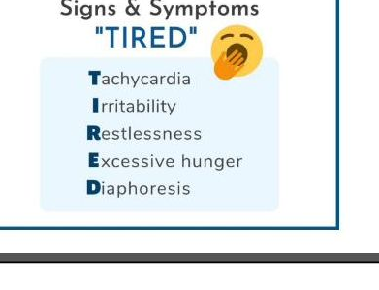
DIABETES · COMPLICATION
Hypoglycemia — BG < 70 mg/dL
Signs & Symptoms (early → late)
The 15 – 15 – 15 Rule
EARLY (sympathetic) • Shaky, sweating, pale • Hunger, tachycardia • Anxiety, irritability LATE (neuroglycopenia) • Confusion, slurred speech • Seizures, loss of consciousness
15
→
15
→
BG
grams
minutes
check
FAST carb
WAIT
RECHECK
Repeat up to 3 times. If still < 70 mg/dL, escalate.
🎯 Rule of 15 (conscious patient)
15 g carbs → wait 15 min → recheck BG. Repeat up to 3 times. If still low, call MD. Once BG normal, give complex carb snack with protein (cheese + crackers). Fast 15-g carb sources: ½ cup juice/regular soda · 4 glucose tabs · 1 Tbsp honey · 8 oz skim milk
🚨 Unconscious Patient
IV access: push D50W 25 mL IV No IV: GLUCAGON 1 mg IM or SC → turn patient on side (vomiting risk). NEVER give anything by mouth to an unconscious patient!
Diabetes · Hypoglycemia
Endocrine NCLEX Review
54 / 56

Slide 55





DIABETES · EDUCATION
Long-Term Management & Patient Teaching
Tight glucose control PREVENTS complications: retinopathy, nephropathy, neuropathy, CV disease
Nutrition
Exercise
A1c Goals
Consistent carb counting. Plate method: ½ veggies, ¼ protein, ¼ complex carb. Limit simple sugars, saturated fat. Don't skip meals if on insulin.
150 min/week moderate activity. Check BG before exercise; snack if BG < 100. Carry fast carb. Exercise = "natural insulin."
Target HbA1c < 7% (individualized — less strict in elderly). Reflects average BG over 3 months. Test every 3–6 months.
Foot Care
Sick Day Rules
Self-Monitoring
Inspect feet DAILY with mirror. Never walk barefoot. Cut nails straight across. Well-fitting shoes. Report cuts, ulcers, numbness immediately.
NEVER skip insulin even if not eating. Check BG + ketones q4h. Drink fluids. Call provider for vomiting, ketones, BG > 250, or inability to keep fluids.
BG log, CGM use, site rotation, recognize hypo/hyper symptoms. Carry medical alert ID. Always carry fast-acting carb.
Diabetes · Long-term Management
Endocrine NCLEX Review
55 / 56

Slide 56
END OF REVIEW
Key Takeaways
Feedback is everything
Hormone crises are life-threatening
Know the drug pearls
Most endocrine labs follow a "high one, low the other" pattern (TSH↑↓ vs T3/T4↓↑, PTH vs Ca/phosphate). Trace the feedback loop — diagnosis follows.
Addisonian crisis, thyroid storm, DKA, myxedema coma, SIADH-induced seizures — recognize early, act fast with fluids, drugs, monitoring.
Levothyroxine → empty stomach, lifelong. Metformin → hold for contrast. PTU in pregnancy. Regular is the only IV insulin. Clear before cloudy.
Ca & phosphate seesaw
Patient teaching SAVES lives
ABCs still win
PTH raises Ca²⁺ and lowers phosphate. Calcitonin tones DOWN calcium. Watch Chvostek & Trousseau after any neck surgery.
Insulin rotation, sick-day rules, foot care, medical-alert ID, steroid tapers, stress dosing — nurses are the "feedback loop" for the patient at home.
When in doubt — airway, fluids, electrolytes first. Then treat the hormone. Hypotension + hyperkalemia + hypoglycemia = steroids + saline NOW.
Primary reference: Saunders Comprehensive Review for NCLEX-RN® Examination
56 / 56

