Slide 1

Airline Satisfaction Survey
ISDS574- Data Mining Project
Under the guidance of Dr. Yinfei Kong
Group Members: (Group 2)
Ruchika Narang
Sophia Kelly
Xinbei Zhu
Mikhil Mistry
Melissa Tran
Sanchit Singh

Slide 2

Background
When was the data collected?
Airline Satisfaction Survey – US Domestic Flights, Date Period – (Jan 2014- Mar 2014)
What is the source of our data?
IBM Data Analytics Website.
How many attributes and records our data have?
Original – 30 variables, 129K records.
14 –Categorical variables
10 – Continuous variables
6 – Character variables.

Slide 3
Background
Categorical Variables
Satisfaction
Continuous Variables
Age
Character Variables
Airline Code
Airline Status
Age Range
Gender
Price Sensitivity
Year of First Flight
No of Flights p.a. grouped
Type of Travel
No. of other Loyalty Cards
Class
Day of Month
Flight date
Flight cancelled
No of Flights p.a.
% of Flight with other Airlines
Shopping Amount at Airport
Eating and Drinking at Airport
Scheduled Departure Hour
Departure Delay in Minutes
Arrival Delay in Minutes
Flight time in minutes
Flight Distance
Airline Name
Origin City
Origin State
Destination City
Destination State

Slide 4
Literature Review (Consulted Research Papers)
“Measurement of Airline Passenger Satisfaction: A Comparison of Methodology” by Jason A. Mlady, John P. Young, Purdue University, 12 April 2013
“The Quality – Profitability Link in the US Airline Business: A Study Based on the Airline Quality Rating Index” by Nicole Kalemba, Fernando Campa-Planas, University Rovira and Virgili, Reus, Spain
“Customer satisfaction in the airline industry: the role of service quality and price” by Dwi Suhartanto, the department of business administration, Bandung state polytechnic, any Ariani Noor, the department of business administration, Bandung state polytechnic

Slide 5

Objective of our Analysis
Selection of Output Variable – Satisfaction Score
Categorical variable
Value ranges between 0 to 5
Question of Interest
What are the factors determining good or bad satisfaction score?
Dichotomization of output variable satisfaction score:
0 – 3 : Bad or ‘0’
4-5 : Good or ‘1’

Slide 6
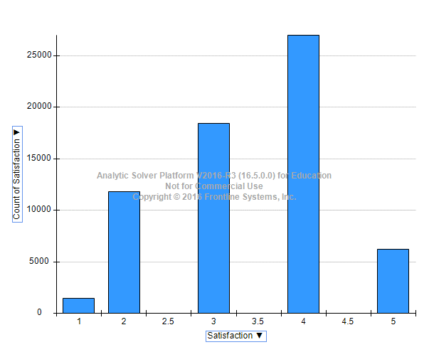
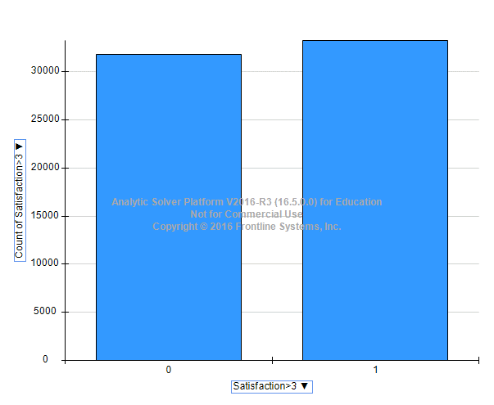

Dichotomization
Before Dichotomization:
After Dichotomization:

Slide 7


Next step: Data Cleaning
Challenge
Almost every time data has to be cleaned
Use exploratory tools to find anomalies/missing values; survey data
Challenge was to have an unbiased dataset that represents the original dataset
Original record count – ~129K
Data mining on the huge data set would be a complex task
Data analysis through XLMiner
XLminer supports only 10K records for model building and 65K records for missing data handling. Used R for producing the data
Solution
Use an unbiased subset of the original data and build models on that subset.
Data mining tasks would be less complex
Xlminer would be able to support the reduced data count more efficiently.

Slide 8
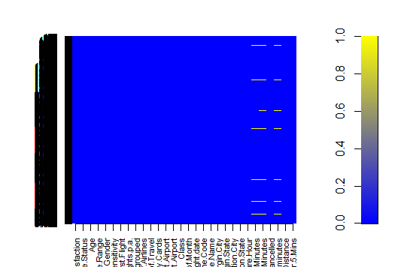
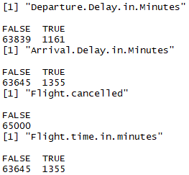
Data Cleaning
Missing records identification and removal
Three columns had missing records.
Departure.Delay.in.Minutes – 1161 records
Arrival.Delay.in.Minutes – 1355 records
Flight.time.in.minutes – 1355 records
Complete row with missing values was removed.
Revised record count of the data – 63K

Slide 9


Data Cleaning
Selecting a subset
Partitioned data using R
Training - 13.985% (8900 records)
Test – 86% (remaining..)
Next step: Transformation of Data
Creation of Dummies using XLMiner and dichotomization of variables for the purpose of categorization.
Dichotomization of output variable – Satisfaction Score (less than 3 = 0, rest = 1)
Variable Reduction
Removing non-significant categorical and character columns (Airline Codes, Name)
Removing columns based upon collinearity.

Slide 10
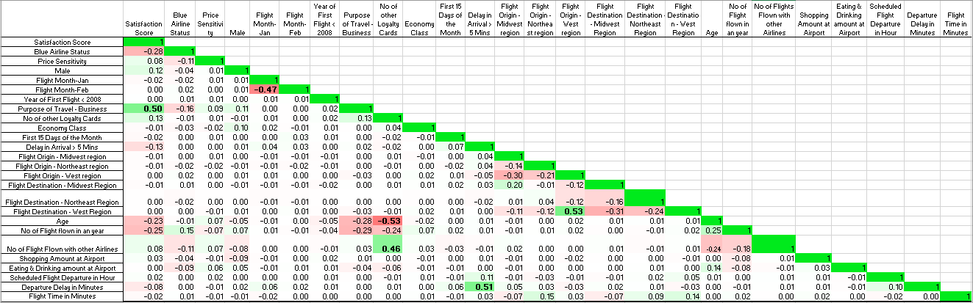
Data Cleaning
Correlated Columns:
Positive Correlation
“Flight Origin - West region” and “Flight Destination - West Region”
“No of other Loyalty Cards” and “No of Flight Flown with other Airlines”
Negative Correlation
“No of other Loyalty Cards” and “Age”
Correlation Matrix

Slide 11
Data Cleaning
Data Statistics:
 | Original | Final
Total Records | 129K | 8.9K
Variables count | 30 | 26
Categorical Variables | 14 | 18 - binary
Continuous Variables | 10 | 8
Character Variables | 6 | 0

Slide 12

Data Mining Techniques
Classification Techniques to be used:
Output variable is categorical
Data Partition
Training - 13.985% (8900 records)
Test – 86% (remaining..)
Techniques used:
Logistic Regression:
Forward
Backward
Stepwise
KNN – Interpretation
Classification Tree

Slide 13
Logistic Regression- Forward Selection
Variables | Odds Ratio | CL Lower | CL Upper | P-Value
Intercept | 1.68 | 1.244 | 2.272 | 0.0007
Airline Status: Blue | 0.29 | 0.256 | 0.330 | 1.77E-83
Price Sensitivity | 1.19 | 1.062 | 1.350 | 0.003
Gender: Male | 1.52 | 1.357 | 1.702 | 3.64E-13
Type of Travel | 8.32 | 7.36 | 9.411 | 1.1E-252
Class: Economy | 0.84 | 0.732 | 0.969 | 0.017
Arrival Delay in Minutes | 0.42 | 0.379 | 0.481 | 1.73E-45
Age | 0.98 | 0.979 | 0.986 | 4.38E-22
No of Flight | 0.98 | 0.979 | 0.987 | 4E-15
Scheduled Departure Hour | 1.02 | 1.010 | 1.034 | 0.0005

Slide 14
Logistic Regression- Forward Selection
Number of Variables Selected- 10
Cut off Value- 0.5
 | Forward Selection | Backward Elimination | Stepwise Selection
Error Rate | 24.18% | 24.74% | 25.20%
Sensitivity | 0.8194 | 0.8021 | 0.7989
Specificity | 0.6844 | 0.6991 | 0.6933

Slide 15

KNN – Interpretation
Number of Input variables – 25
Output Variable – Satisfaction_>3
Score on – Best k between 1 and 20
Normalized Input

Slide 16
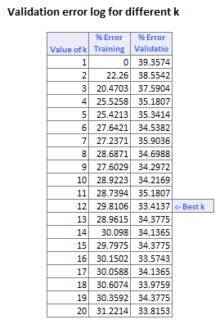
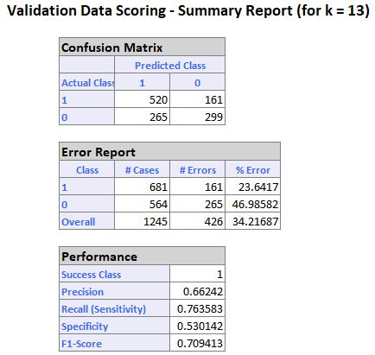
Best K - 12
Choose k = 13
Error – 34.2%

Slide 17
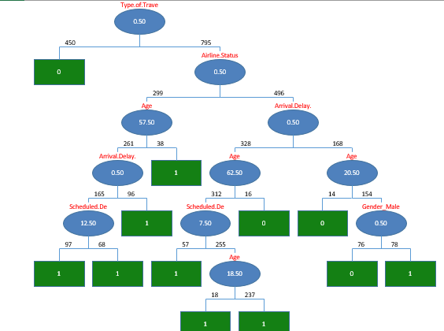
Classification Tree – Minimum Error Tree
- Input Variables: 25
- Output Variable:
Satisfaction>3 : 1 ,0
- Cutoff Threshold: 0.5
Error: 24.49%
Number of Decision nodes: 11

Slide 18
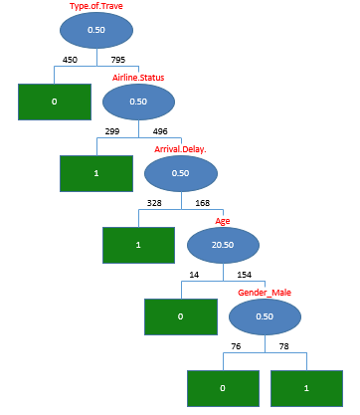
Classification Tree – Best Prune Tree
Error – 24.58%
Number of Decision nodes – 5
Decision nodes :
Type of Travel Business
Airline Status Blue
Arrival Delay > 5 mins
Age
Gender_male

Slide 19
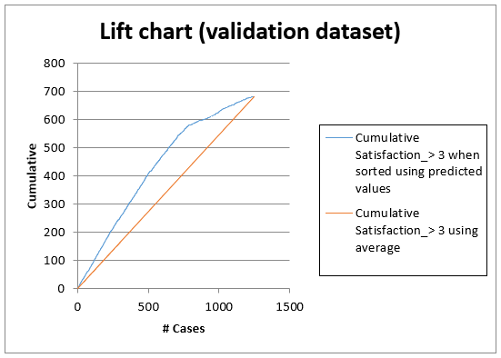
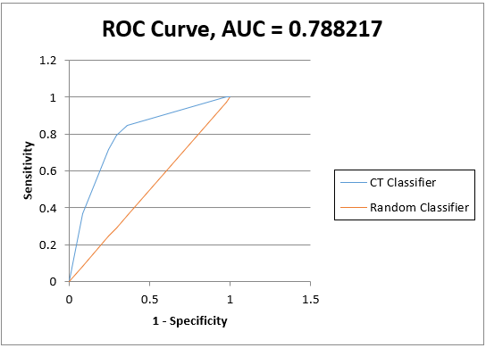
Sensitivity and Specificity
Sensitivity- 0.7929
Specificity- 0.7074

Slide 20
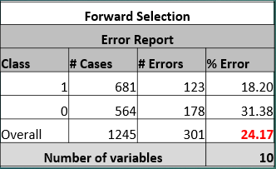
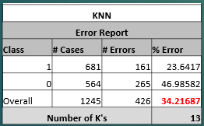
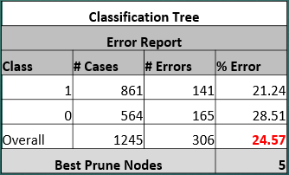
Model Comparison

Slide 21
Best Model: Logistic Regression- Forward Selection
Variables | Odds Ratio | CL Lower | CL Upper | P-Value
Intercept | 1.68 | 1.244 | 2.272 | 0.0007
Airline Status: Blue | 0.29 | 0.256 | 0.329 | 1.77E-83
Price Sensitivity | 1.19 | 1.062 | 1.349 | 0.003
Gender: Male | 1.52 | 1.357 | 1.702 | 3.64E-13
Type of Travel | 8.32 | 7.36 | 9.411 | 1.1E-252
Class: Economy | 0.84 | 0.732 | 0.969 | 0.016
Arrival Delay in Minutes | 0.42 | 0.379 | 0.480 | 1.73E-45
Age | 0.98 | 0.979 | 0.986 | 4.38E-22
No of Flight | 0.98 | 0.979 | 0.987 | 4E-15
Scheduled Departure Hour | 1.02 | 1.009 | 1.034 | 0.0004

Slide 22
Conclusion and Recommendations
Forward selection logistic regression model gives us the best error rate of 24.177 %
Accuracy rate with forward selection is 75.823 %
Most impactful variables : Type of Travel / Airline Membership Status / Price Sensitivity / Arrival Delays
Recommendations :
Focus on the needs of business travelers
Improve services for Blue Membership Class
Competitive airfare pricing
Alleviate stress resulting from Arrival Delays

Slide 23
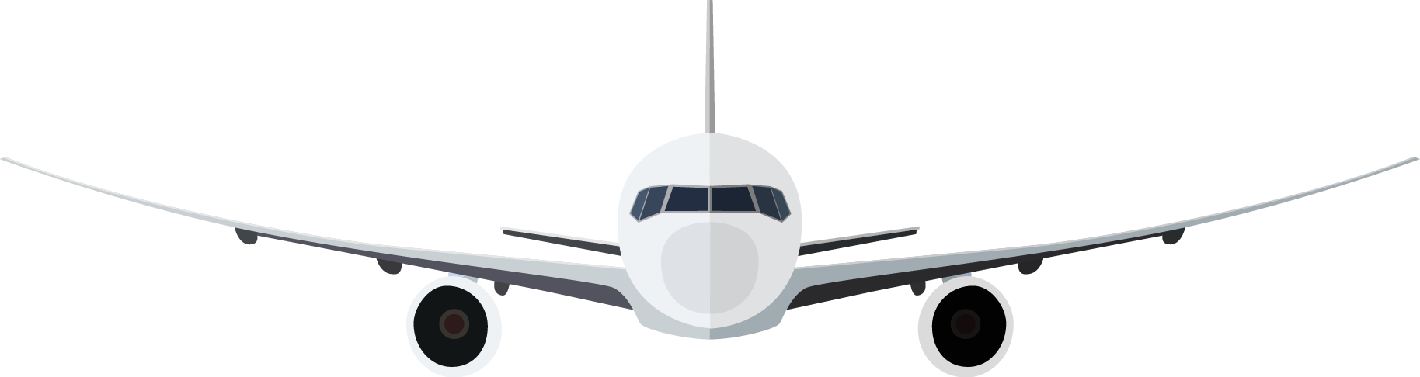
THANK YOU!

Slide 24


