Slide 1
Spring Boot
Shalini Mittal
Corporate Trainer

Slide 2
Topics to be covered
What is Spring Boot
What is it not
Features
Starter Project
Spring Rest with Boot

Slide 3
Spring Boot
Spring Boot does not compete with Spring or Spring MVC.
At core spring Framework , DI is the core and helps build complex applications.
Spring uses programming configurations
It handes all the common concerns like : handling requests, JDBC connections etc.
Spring MVC provides a decoupled way of developing web applications. With simple concepts like Dispatcher Servlet, ModelAndView, and View Resolver, it makes it easy to develop web applications.
Easy to create production-grade Spring Based Application that you can just run.

Slide 4
Problems with Spring
Huge Framework
Amount of configuration needed
Multiple setup steps
Multiple deploy and build steps
Capability and flexibility of Spring comes with a cost
Need someone to abstract the common concerns

Slide 5
Spring Boot Features
Create stand-alone Spring applications
Embed Tomcat, Jetty or Undertow directly (no need to deploy WAR files)
Opinionated 'starter' dependencies to simplify your build configuration
Automatically configure Spring and 3rd party libraries whenever possible
Provide production-ready features such as metrics, health checks and externalized configuration
Absolutely no code generation and no requirement for XML configuration
Notes:
https://dzone.com/articles/7-things-to-know-getting-started-with-spring-boot

Slide 6
Spring Boot installation
JDK 8
Spring STS - https://spring.io/tools/sts/all
Notes:
https://docs.spring.io/spring/docs/current/spring-framework-reference/web.html#mvc-introduction
https://stackoverflow.com/questions/11815339/role-purpose-of-contextloaderlistener-in-spring

Slide 7
Maven Based Spring Boot Project
Create a simple maven project. [Select create a simple project]
In pom file add the following :
    <parent>
      <groupId>org.springframework.boot</groupId>
      <artifactId>spring-boot-starter-parent</artifactId>
      <version>2.0.0.RELEASE</version>
    </parent>
Parent POMs allow you to manage the following things for multiple child projects and modules :
Configuration: Java version and other properties
Depedency Management: Version of dependencies
Default plugin configuration
Starters are templates that contain a collection of all the relevant transitive dependencies that are needed to start a particular functionality. Each starter has a special file, which contains the list of all the provided dependencies Spring provides.:
Notes:
http://www.springboottutorial.com/spring-boot-starter-parent

Slide 8
STARTER | DEPENDENCIES
spring-boot-starter | spring-boot, spring-context, spring-beans
spring-boot-starter-jersey | jersey-container-servlet-core, jersey-container-servlet, jersey-server
spring-boot-starter-actuator | spring-boot-actuator, micrometer-core
spring-boot-starter-aop | spring-aop, aspectjrt, aspectjweaver
spring-boot-starter-data-rest | spring-hateoas, spring-data-rest-webmvc
spring-boot-starter-hateoas | spring-hateoas
spring-boot-starter-logging | logback-classic, jcl-over-slf4j, jul-to-slf4j
spring-boot-starter-log4j2 | log4j2, log4j-slf4j-impl
spring-boot-starter-security | spring-security-web, spring-security-config
spring-boot-starter-test | spring-test, spring-boot,junit,mockito, hamcrest-library, assertj, jsonassert, json-path
spring-boot-starter-web-services | spring-ws-core
Notes:
http://www.springboottutorial.com/spring-boot-starter-parent

Slide 9
Add maven dependency
For creating a web project , we need a bunch of web dependencies. So add the following that adds all the web related dependencies for the project
<dependencies>
<dependency>
<groupId>org.springframework.boot</groupId>
<artifactId>spring-boot-starter-web</artifactId>
</dependency>
</dependencies>
To specify java version add :
<properties>
<java-version>1.8</java-version>
</properties>

Slide 10
Code to start Spring boot
Create a App class and add the main method.
To make this class as starting point of application add the annotation SpringBootApplication
Need to tell spring boot to start the application and create a servlet container and host the application.
    @SpringBootApplication
    public class App {
    public static void main(String[] args) {
    SpringApplication.run(App.class, args);
    }
    }
Run this class and spring boot starts up

Slide 11
Create a Bean
    @Component("hello")
    public class HelloWorld {
    public String sayHello() {
    return "Hello";
    }
    }
Access this bean as normally in a spring application
ApplicationContext context = SpringApplication.run(App.class, args);
HelloWorld bean = (HelloWorld) context.getBean(HelloWorld.class);
String s=bean.sayHello();
System.out.println(s);

Slide 12
Create a rest controller
Make sure the controller is created in the same package or the subpackage of spring boot main method.
Spring boot automatically scans for all the classed by default.
@RestController
public class HelloController {
@RequestMapping("/hello")
public String sayHi()
{
return "Hi, Isn't Boot Cool!!";
}
}

Slide 13
Return objects from controller
@Service
class TopicService {
private List<Topic> topics = new ArrayList<>( Arrays.asList(new Topic("1","Spring","Spring Description"),
new Topic("2","JAVASCRIPT","JAVASCRIPT Description"),
new Topic("3" ,"HTML5","HTML5 Description") ));
public List<Topic> getAllTopics()
{ return this.topics; }
public Topic getTopic(String id) {
return topics.stream().filter(t -> t.getId().equals(id)).findFirst().get();}
public void addTopic(Topic topic)
{ topics.add(topic); }
public void updateTopic(Topic topic,String id)
{ for(int i=0;i<topics.size();i++){
Topic t=topics.get(i);
if(t.getId().equals(id)) {
topics.set(i, topic);
break; }
}}
public void deleteTopic(String id)
{ topics.removeIf(t->t.getId().equals(id));}}
public class Topic {
private String id;
private String name;
private String description;
//getters and setters
//…

Slide 14
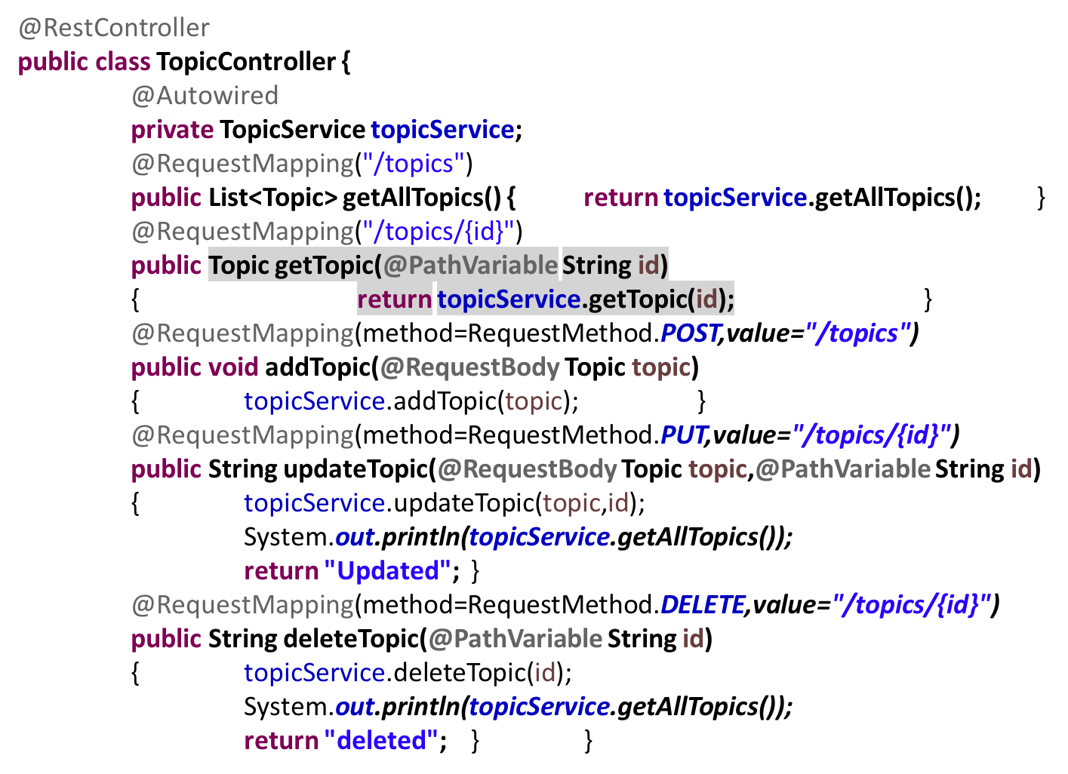
TopicController
Notes:
2.0.3

Slide 15
Ways to start Spring Boot
Spring Initializr
  https://start.spring.io/
  Generate a maven or gradle project
  Add group and artifact id
  Add dependencies either searching or switch to full version
  Select the web dependency and click on generate project
  It generates a spring project
Spring Boot CLI
STS IDE

Slide 16
Spring Boot CLI
Spring Boot software to run and test Spring Boot applications from command prompt. When we run Spring Boot applications using CLI, then it internally uses Spring Boot Starter and Spring Boot AutoConfigurate components to resolve all dependencies and execute the application.
It internally contains Groovy and Grape (JAR Dependency Manager) to add Spring Boot Defaults and resolve all dependencies automatically
Install CLI : https://docs.spring.io/spring-boot/docs/current/reference/html/getting-started-installing-spring-boot.html

Slide 17
CLI Usage
Extract spring-boot-cli-1.2.3.RELEASE.zip file into our local FileSystem. [Remember your path should not have spaces].
Create a groovy file :
Run this command form the bin folder of spring cli :
nano app.groovy
Create a controller as follows :
@RestController
class App{
@RequestMapping("/")
String welcome(){
"Welcome to CLI"
}
}
Save the file and run using following command :
./spring run app.groovy
Notes:
https://www.journaldev.com/8195/spring-boot-cli-setup-and-helloworld-example

Slide 18
Spring STS
Open STS and File -> New -> Spring Starter Project
Add name to the project
Next screen select the modules
Click finish and a quick start project is created
Notes:
https://www.journaldev.com/8195/spring-boot-cli-setup-and-helloworld-example

Slide 19
Customize application properties
Spring boot uses opinionated way of configuring the appliation
To change the defaults, override values in application.properties file
Eg : server.port=8081
    spring.datasource.url=jdbc:mysql://localhost:8889/shalini
    spring.datasource.username=root
    spring.datasource.password=root
    spring.jpa.generate-ddl=true
    spring.jpa.properties.hibernate.dialect = org.hibernate.dialect.MySQL5Dialect
    spring.datasource.driverClassName = com.mysql.jdbc.Driver
    spring.datasource.platform=mysql
    spring.mvc.view.prefix=/WEB-INF/jsp/
    spring.mvc.view.suffix=.jsp
    welcome.message= Hello Shalini
https://docs.spring.io/spring-boot/docs/current/reference/html/common-application-properties.html
Notes:
https://www.journaldev.com/8195/spring-boot-cli-setup-and-helloworld-example

Slide 20
Add Data API
Create a spring boot project and select web and from SQL select JPA, Derby or MySQL (if mysql then mysql driver)
Update Topic to act as an entity
Create a TopicRepository as follows :
CrudRepository of spring JPA provides with all basic crud operations
@Entity
public class Topic {
@Id
private String id;
public interface TopicRepository extends CrudRepository<Topic,String>{ }
Notes:
Add the mysql specific information in application.properties as specified in previous slide

Slide 21
CRUD operations
Update the TopicService as follows :
@Service
public class TopicService {
@Autowired
private TopicRepository topicRepository;
public List<Topic> getAllTopics()
{ List<Topic> topics = new ArrayList<>();
topicRepository.findAll().forEach(topics::add);
return topics;
}
public Topic getTopic(String id) {
//return topicRepository.findById(id).get();
return topicRepository.findOne(id);
}
public void addTopic(Topic topic)
{ topicRepository.save(topic); }
public void updateTopic(Topic topic,String id)
{ topicRepository.save(topic); }
public void deleteTopic(String id)
{ //topicRepository.deleteById(id);
topicRepository.delete(id); }
}
Notes:
findOne is replaced by

Slide 22
Building and Packaging
Open terminal and go to your project root folder
Run mvn install command
Run java -jar target/course-api-data-0.0.1-SNAPSHOT.jar
Your application Is up and running .
To deploy as a war change the packaging in the pom.xml to war
Notes:
https://www.journaldev.com/8195/spring-boot-cli-setup-and-helloworld-example

Slide 23
Actuator
In spring-initializr, down the screen there is Ops and select Actuator
It adds different endpoints
By default, spring security is enabled for all actuator endpoints. Add following in application.properties :
management.port:9000# to change the port of actuator
management.security.enabled=false # to disbale the default security
ENDPOINT | USAGE
/env | Returns list of properties in current environment
/health | Returns application health information.
/auditevents | Returns all auto-configuration candidates and the reason why they ‘were’ or ‘were not’ applied.
/beans | Returns a complete list of all the Spring beans in your application.
/trace | Returns trace logs (by default the last 100 HTTP requests).
/dump | It performs a thread dump.
Notes:
https://howtod
It is inbuilt form-based authentication with the userid as the user and a randomly generated password
oinjava.com/spring-boot/actuator-endpoints-example/

Slide 24
Spring Boot MVC
Create a spring boot project by selecting web module
We want to use JSP as the view. Default embedded servlet container for Spring Boot Starter Web is tomcat. To enable support for JSP’s, we would need to add a dependency on tomcat-embed-jasper.
  <dependency>
    <groupId>org.apache.tomcat.embed</groupId>
    <artifactId>tomcat-embed-jasper</artifactId>
    <scope>provided</scope>
  </dependency>
Notes:
https://www.journaldev.com/8195/spring-boot-cli-setup-and-helloworld-example

Slide 25
Spring Boot MVC - Configuration
Spring Boot Starter Web auto configures the basic things we needed to get started.
Spring Boot Starter Web auto-configures:
  Dispatcher Servlet.
  Error Page.
  Web Jars to manage your static dependencies.
  Embedded Servlet Container - Tomcat is the default.
Configure view resolver in application.properties
  spring.mvc.view.prefix=/WEB-INF/jsp/
  spring.mvc.view.suffix=.jsp
If webapp folder is not there, change the packaging in pom file to war
Add a controller, run the application and access from the url.
Notes:
https://www.journaldev.com/8195/spring-boot-cli-setup-and-helloworld-example

Slide 26
ThankYou
shalini06mittal@gmail.com
7738460004

