Slide 1
Spring Framework
Shalini Mittal
Corporate Trainer

Slide 2
What we will Cover?
Setter Injection
Constructor Injection
Autowiring
Collection Iinjection
Bean Scope
Bean LifeCycle
Java based Configuration

Slide 3
Dependency Injection
We will explore different types of DI
  Setter injection
  Constructor injection
  Field injection
    only possible using annotations approach
  Method injection
    Using Spring API
Notes:
http://www.wrox.com/WileyCDA/Section/Why-Use-the-Spring-Framework-.id-130098.html

Slide 4
Setter Injection
public void setMessageProvider(MessageProvider provider) {
this.messageProvider = provider;
}
We need a MessageProvider object to be injected

Slide 5
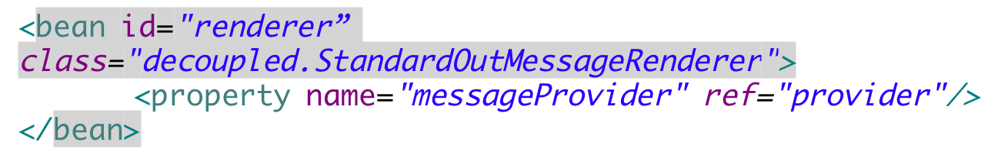
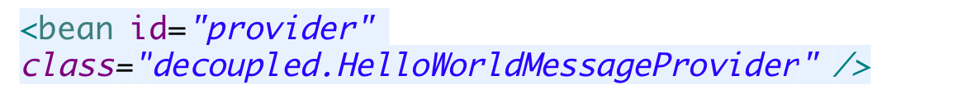
XML Configuration
That’s the setter method of the bean class we are referring to

Slide 6
Annotation Style Configuration
@Resource(name="provider")
public void setMessageProvider(MessageProvider provider) {
this.messageProvider = provider;
}
Here we are injecting a MessageProvider using annotations. To activate use of annotations for DI, we need to inform the container about the same
<context:annotation-config />
Notes:
Annotation injection is performed before XML injection, thus the latter configuration will override the former for properties wired through both approaches.

Slide 7
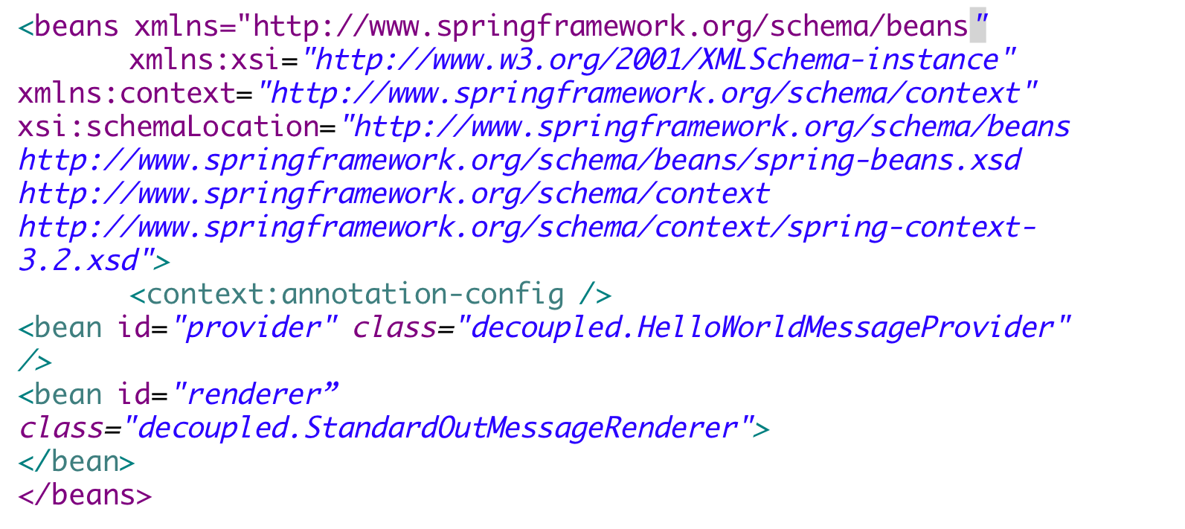
Annotation XML Configuration

Slide 8
@Resource
@Resource is a JSR standard annotation. Apart from this we can use @Autowired annotation provided by Spring for DI.
@Resource takes a name attribute, and by default Spring interprets that value as the bean name to be injected
@Inject which is part of the CDI (Context and Dependency Injection) specification is also supported by default from Spring 3 onwards
Using the above annotations only enables DI, we still need to add the bean entries in the xml file
@Autowired applies to fields, constructors, and multi-argument methods, allowing for narrowing through qualifier annotations at the parameter level.
By contrast, @Resource is supported only for fields and bean property setter methods with a single argument.
As a consequence, stick with qualifiers if your injection target is a constructor or a multi-argument method.
Notes:
https://stackoverflow.com/questions/4093504/resource-vs-autowired
@Autowired + @Qualifier will work only with spring DI, if you want to use some other DI in future @Resource is good option.
other difference which I found very significant is @Qualifier does not support dynamic bean wiring, as @Qualifier does not support placeholder, while @Resource does it very well.
For example: if you have an interface with multiple implementations like this
interface parent { } @Service("actualService") class ActualService implements parent{ } @Service("stubbedService") class SubbedService implements parent{ }with @Autowired & @Qualifier you need to set specific child implementation like
@Autowired @Qualifier("actualService") or @Qualifier("stubbedService") Parent object;which does not provide placeholder while with @Resource you can put placeholder and use property file to inject specific child implementation like
@Resource(name="${service.name}") Parent object; where service.name is set in property file as
#service.name=actualService service.name=stubbedService

Slide 9
@Component
To avoid using the <bean> tag in the xml file, we need to use @Component annotation
Any bean marked as @Component can be scanned by the IoC container on startup and will be loaded dynamically
To make it more clear as to what type of components are we building, Spring introduced @Service, @Repository, @Controller and many other stereotypes to distinguish between the same
Alternatively @Named CDI annotation be used instead of @Component
@CDI (Context & Dependency Injection) is a JSR standard for DI in Java. Spring framework supports CDI. Benefit of using CDI will be our code will remain the same if we shift from one DI Container to another in future

Slide 10
@Component Type
@Component("provider")
public class HelloWorldMessageProvider implements MessageProvider {
public HelloWorldMessageProvider() {
System.out.println( "message provider constructor");
}
public String getMessage() {
return "Hello World. welcome to spring!";
}
}
Needed in the xml file to tell the container about fully annotated components. To provide an id the bean, it can be done somewhat like this @Component("provider")

Slide 11
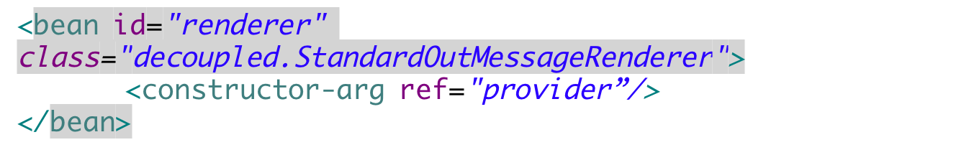
Constructor Injection
public StandardOutMessageRenderer(MessageProvider p) {
messageProvider =p;
}
This time the dependencies are bound to a constructor
Informing the container to invoke a parameterized constructor
Notes:
https://docs.spring.io/spring/docs/3.0.0.M3/reference/html/ch04s11.html

Slide 12
Inject Dependencies via constructor
If a constructor has multiple arguments, then ambiguities among constructor arguments can be dealt with in two ways :
  by index
  by type
Default
<constructor-arg><value>44.25</value></constructor-arg>
By Index
<constructor-arg index="0"><value>44.25</value></constructor-arg>
By Type
<constructor-arg type="double"><value>44.25</value></constructor-arg>

Slide 13
Constructor Annotation Configuration
@Autowired
public StandardOutMessageRenderer(MessageProvider p) {
messageProvider =p;
}
Informing the container that we need to inject a DataSource by calling this constructor

Slide 14
@Autowired
@Autowired annotation can be applied on variables and methods for autowiring byType.
We can also use @Autowired annotation on constructor for constructor based spring autowiring.
By default, the autowiring fails whenever zero candidate beans are available; the default behavior is to treat annotated methods, constructors, and fields as indicating required dependencies
@Autowired(required=false)

Slide 15

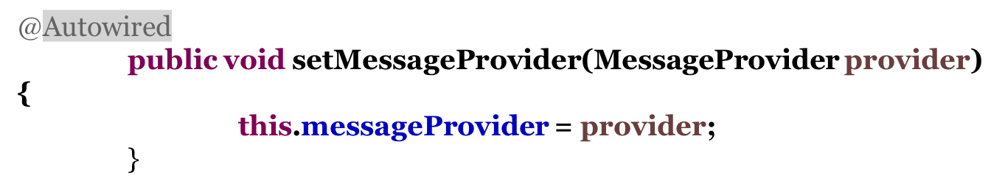
@Autowired Setter
Possible ways of using autowiring by type on fields or setters.

Slide 16
@Qualifier
This annotation is used to avoid conflicts in bean mapping and we need to provide the bean name that will be used for autowiring.
This way we can avoid issues where multiple beans are defined for same type.
This annotation usually works with the @Autowired annotation.
For constructors with multiple arguments, we can use this annotation with the argument names in the method.
@Autowired
public StandardOutMessageRenderer(@Qualifier("provider") MessageProvider p) {
messageProvider =p; }
Possible ways of using autowiring by name explicitly
@Autowired
@Qualifier("provider")
public void setMessageProvider(MessageProvider provider) {
this.messageProvider = provider; }
Notes:
https://martinfowler.com/articles/injection.html

Slide 17

Autowiring using XML
Autowiring can be enabled for beans configured in the xml file so that we don’t need to use <property /> or <constructor-arg /> tag again and again
Employee DAO
Customer DAO
DataSource
Order
DAO
We should use autowiring in scenarios similar to this where many beans depend on a common shared bean
Notes:
Spring is non-intrusive; objects in a Spring-enabled application typically have no dependencies on Spring-specific classes.
2 mb size min

Slide 18
Autowiring ways :
autowire byName – For this type of autowiring, setter method is used for dependency injection. Also the variable name should be same in the class where we will inject the dependency and in the spring bean configuration file.
autowire byType – For this type of autowiring, class type is used. So there should be only one bean configured for this type in the spring bean configuration file.
autowire by constructor – This is almost similar to autowire byType, the only difference is that constructor is used to inject the dependency.
Notes:
Spring is non-intrusive; objects in a Spring-enabled application typically have no dependencies on Spring-specific classes.
2 mb size min

Slide 19
Autowiring ByType
<bean id="provider" class="decoupled.HelloWorldMessageProvider" />
<bean id="renderer" class="decoupled.StandardOutMessageRenderer" autowire="byType" >
</bean>
As you can see, we are informing the container that automatically search for bean of type MessageProvider and inject it in the Renderer class
Notes:
The core module’s BeanFactory makes Spring a container, but the context module is what makes it a framework.

Slide 20
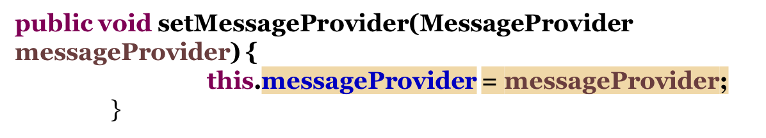
Autowiring ByName
<bean id="messageProvider" class="decoupled.HelloWorldMessageProvider" />
<bean id="renderer" class="decoupled.StandardOutMessageRenderer" autowire="byName">

Slide 21
Collection Injection
4 major collection types are supported :
  List – <list/>
  Set – <set/>
  Map – <map/>
  Properties – <props/>

Slide 22
Sample Code for Collection
public class Employee
{
  private List<Object> lists; private Set<Object> sets; private Map<Object, Object> maps; private Properties pros;
//... }

Slide 23
List Injection
<property name="lists">
<list>
<value>1</value>
<ref bean=”address" />
</list>
</property>
<bean id=“address” class=”com.collection.Address">
<property name=”city" value=”Mumbai" />
<property name=”state" value=”Mah" />
<property name=”country" value=”India" />
</bean>
Notes:
Spring is non-intrusive; objects in a Spring-enabled application typically have no dependencies on Spring-specific classes.
2 mb size min

Slide 24
Set Injection
<property name="sets">
<set>
<value>1</value>
<ref bean=”address" />
</set>
</property>
<bean id=“address” class=”com.collection.Address">
<property name=”city" value=”Mumbai" />
<property name=”state" value=”Mah" />
<property name=”country" value=”India" />
</bean>
Notes:
Spring is non-intrusive; objects in a Spring-enabled application typically have no dependencies on Spring-specific classes.
2 mb size min

Slide 25
Map Injection
<property name="maps">
<map>
<entry key="Key 1" value="1" />
<entry key="Key 2" value-ref=”address" />
</map>
</property>
<bean id=“address” class=”com.collection.Address">
<property name=”city" value=”Mumbai" />
<property name=”state" value=”Mah" />
<property name=”country" value=”India" />
</bean>
Notes:
Spring is non-intrusive; objects in a Spring-enabled application typically have no dependencies on Spring-specific classes.
2 mb size min

Slide 26
Property Injection
<property name="pros">
<props>
<prop key="admin">admin@nospam.com</prop>
<prop key="support">support@nospam.com</prop> </props>
</property>
Notes:
if key and value both are Strings, go for Properties as follows

Slide 27
Bean Scope
singleton (default) - Scopes a single bean definition to a single object instance per Spring IoC container.
prototype (non singleton) - Scopes a single bean definition to any number of object instances.
Request - Scopes a single bean definition to the lifecycle of a single HTTP request; that is, each HTTP request has its own instance of a bean created off the back of a single bean definition. Only valid in the context of a web-aware Spring ApplicationContext.
Session - Scopes a single bean definition to the lifecycle of an HTTP Session. Only valid in the context of a web-aware Spring ApplicationContext.
Global session -Scopes a single bean definition to the lifecycle of a global HTTP Session. Typically only valid when used in a portlet context. Only valid in the context of a web-aware Spring ApplicationContext.
Notes:
Spring is non-intrusive; objects in a Spring-enabled application typically have no dependencies on Spring-specific classes.
2 mb size min

Slide 28
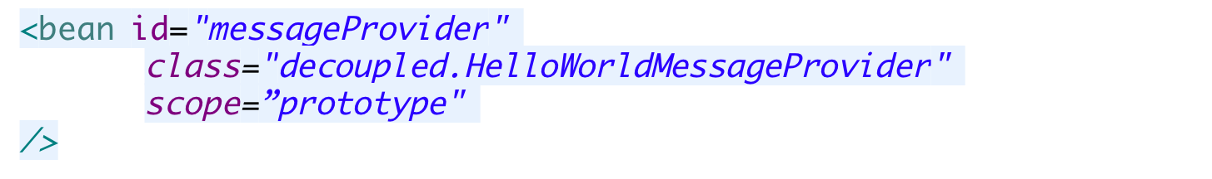

Change the scope
We use the scope attribute in the xml to change the scope of a bean
We use @Scope annotation as an alternative to xml approach
Notes:
Spring's concept of a singleton bean differs from the Singleton pattern as defined in the Gang of Four (GoF) patterns book. The GoF Singleton hard-codes the scope of an object such that one and only one instance of a particular class is created per ClassLoader. The scope of the Spring singleton is best described as per container and per bean. This means that if you define one bean for a particular class in a single Spring container, then the Spring container creates one and only one instance of the class defined by that bean definition.

Slide 29
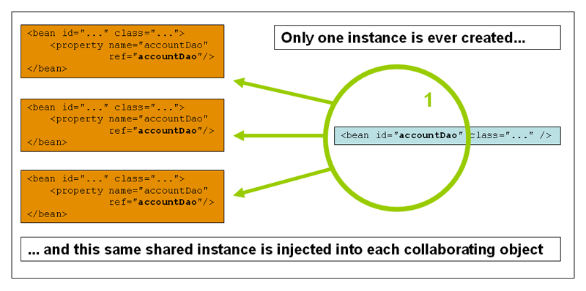
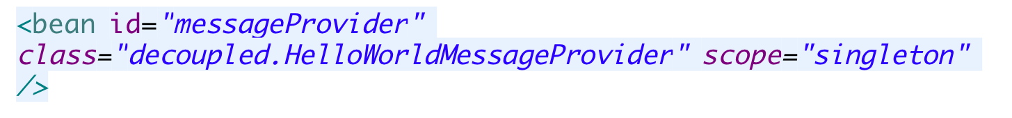
Singleton
Notes:
Spring's concept of a singleton bean differs from the Singleton pattern as defined in the Gang of Four (GoF) patterns book. The GoF Singleton hard-codes the scope of an object such that one and only one instance of a particular class is created per ClassLoader. The scope of the Spring singleton is best described as per container and per bean. This means that if you define one bean for a particular class in a single Spring container, then the Spring container creates one and only one instance of the class defined by that bean definition.

Slide 30
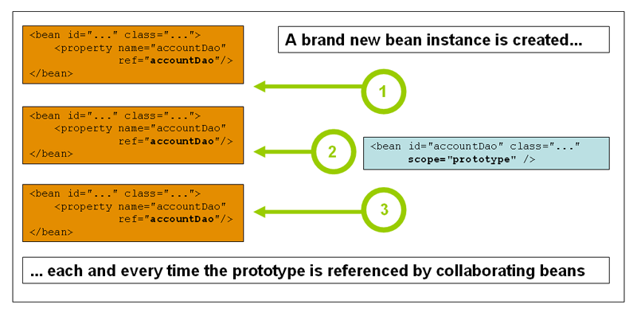
Prototype
Notes:
In contrast to the other scopes, Spring does not manage the complete lifecycle of a prototype bean: the container instantiates, configures, and otherwise assembles a prototype object, and hands it to the client, with no further record of that prototype instance. Thus, although initialization lifecycle callback methods are called on all objects regardless of scope, in the case of prototypes, configured destruction lifecycle callbacks are not called. The client code must clean up prototype-scoped objects and release expensive resources that the prototype bean(s) are holding. To get the Spring container to release resources held by prototype-scoped beans, try using a custom bean post-processor, which holds a reference to beans that need to be cleaned up.

Slide 31
Inner Beans
A <bean/> element inside the <property/> or <constructor-arg/> elements defines a so-called inner bean.
<bean id="outer" class="...">
<!-- instead of using a reference to a target bean, simply define the target bean inline -->
<property name="target">
<bean class="com.example.Person">
<!-- this is the inner bean -->
<property name="name" value="Fiona Apple"/>
<property name="age" value="25"/>
</bean>
</property>
</bean>

Slide 32
Inheritance Between Beans
It’s obvious that we will use inheritance for reusing common behavior across. From Spring perspective, those beans which share common set of dependencies, will share a common base class
For example, all repository classes require a DataSource, so instead of declaring the DataSource again and again, we can have a base class containing the DataSource .
A child bean definition inherits scope, constructor argument values, property values, and method overrides from the parent, with the option to add new values. Any scope, initialization method, destroy method, and/or static factory method settings that you specify will override the corresponding parent settings.
Notes:
A bean definition can contain a lot of configuration information, including constructor arguments, property values, and container-specific information such as initialization method, static factory method name, and so on. A child bean definition inherits configuration data from a parent definition. The child definition can override some values, or add others, as needed. Using parent and child bean definitions can save a lot of typing. Effectively, this is a form of templating

Slide 33
Inheritance Example
<bean id="inheritedTestBean" abstract="true" class="org.springframework.beans.TestBean">
<property name="name" value="parent"/>
<property name="age" value="1"/>
</bean>
<bean id="inheritsWithDifferentClass" class="org.springframework.beans.DerivedTestBean" parent="inheritedTestBean">
<property name="name" value="override"/>
<!-- the age property value of 1 will be inherited from parent --> </bean>
Notes:
https://docs.spring.io/spring/docs/1.2.x/reference/beans.html

Slide 34
Namespaces in Spring
By now you must be familiar with the xml file which we have been writing every time.
Older versions of Spring configuration relied on dtd based validation.
From version 2.0, xml schemas (xsd) were introduced making the configuration of different resources in spring much easier
Also we can create custom schemas of our own and use that in the configuration file of Spring
Notes:
https://docs.spring.io/spring/docs/3.2.x/spring-framework-reference/html/beans.html

Slide 35
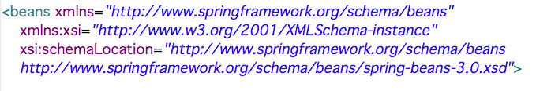
Default Namespace
We use the beans namespace as the default one. So most of the tags we have seen so far in the xml was defined in this namespace

Slide 36
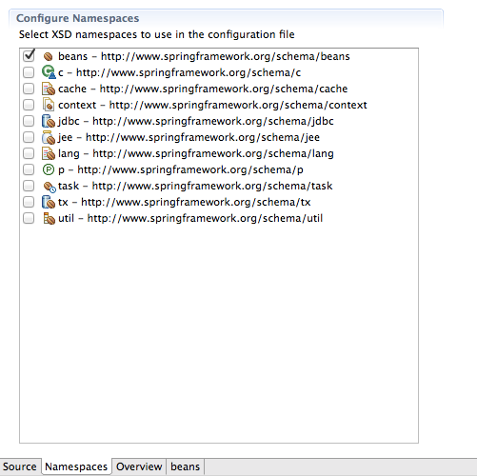
Some of the Namespace

Slide 37
Why so many Namespace
Since in Spring any resource is configured as a bean in the xml file, whether it is a DataSource or JNDI resource or user defined beans. Sometimes this leads to confusions since the xml file is less verbose
With namespaces it becomes easy to identify what type of bean have we configured in the xml file
We will see some examples to understand the difference and discuss about the best option

Slide 38
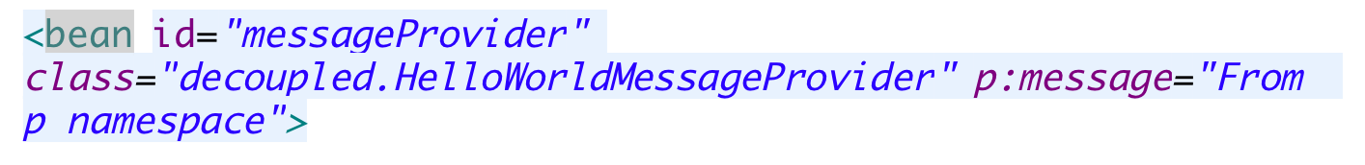
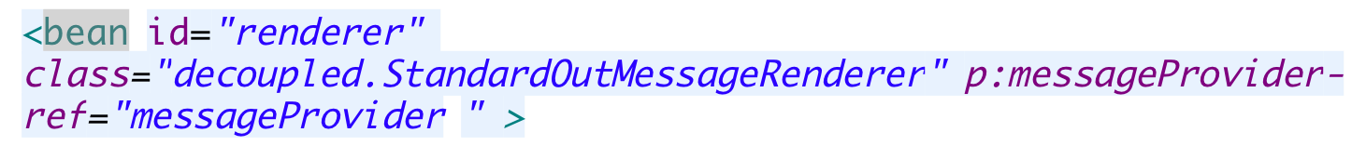
P Namespace
The p-namespace enables you to use the bean element's attributes, instead of nested <property/> elements, to describe your property values and/or collaborating beans.
public class HelloWorldMessageProvider implements MessageProvider {
String message;
public void setMessage(String message) {
this.message = message;
}
public String getMessage() {
return this.message;
}
}
Use the property name as
Attribute name for p:
<property name=“message” value=“”/>
For bean reference

Slide 39
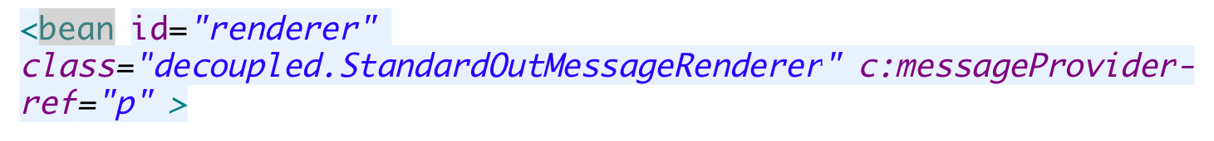
C Namespace
Configuring the constructor arguments rather then nested constructor-arg elements.
public StandardOutMessageRenderer(MessageProvider messageProvider) {
this.messageProvider =messageProvider;
}
Use the argument name as
Attribute name for c:

Slide 40
ThankYou

