Slide 1
Spring Framework
Shalini Mittal
Corporate Trainer

Slide 2
What we will Cover?
Spring JDBC
Spring Hibernate

Slide 3
Role of Spring while accessing data
Provide comprehensive data access support
  To make data access easier to do it effectively
Enable a layed application architecture
  To isolate an application’s business logic from the complexity of data access
Spring manages resources for you
  Eliminates boilerplate code
  Reduces likelihood of bugs

Slide 4
Cont’d…
Declarative transaction management
  Transaction boundaries declared via configuration
  Enforced by a Spring transaction manager
Automatic connection management
  Connections acquired/released automatically
Intelligent exception handling
  Root cause failures always reported
  Resources always released properly

Slide 5
Layered Architecture
Service Layer
Data Access Layer
Infrastructure Layer

Slide 6
The Service Layer
Defines the public functions of the application
  Clients call into the application through this layer
Encapsulates the logic to carry out each application function
  Delegates to the infrastructure layer to manage transactions
  Delegates to the data access layer to map persisent data into a form needed to execute the business logic

Slide 7
The Data Access Layer
Used by the service layer to access data needed by the business logic
Encapsulates the complexity of data access
  The use of data access API
    JDBC, Hibernate, etc
  The mapping of data into a form suitable for business logic
    A JDBC ResultSet to a domain object graph

Slide 8
The Infrastructure Layer
Exposes low-level services needed by other layers
  Infrastructure services are provided by Spring
  Developers typically do not write them
Likely to vary between environments
  Production vs. test

Slide 9
Layers working together
Client calls a function of the service layer
A service initiates a function of the application
  By delegating to the transaction manager to begin a transaction
  By delegating to repositories to load data for processing
    All data access calls participate in a transaction
    Repositories oftern return domain objects that encapsulate domain behaviors
A service continues processing
  By executing business logic
  Often by coordinating between domain objects loaded by repositories
And finally, completes processing
  By updating changed data and committing the transaction

Slide 10
Introducing Spring JDBC Support
Introduction to Spring JDBC
  Problems with traditional JDBC
    Results in reduntant, error prone code
    Leads to poor exception handling
  Spring’s JdbcTemplate API
    Configuration
    Query execution
    Working with result sets
    Exception handling

Slide 11
Redundant, error prone code
public List<Flight> getAvailableFlights() {
Connection conn = null;
PreparedStatement pst = null;
ResultSet rs = null;
try {
conn = dataSource.getConnection();
pst = conn.prepareStatement("select * from flights_test");
rs = pst.executeQuery();
List<Flight> rows = new ArrayList<Flight>();
while(rs.next()) {
Flight f = new Flight();
f.setFlightNo(rs.getString(1));
f.setCarrier(rs.getString(2));
f.setFrom(rs.getString(3));
f.setTo(rs.getString(4));
rows.add(f);
}
return rows;
}
catch(SQLException e) {
throw new RuntimeException(e);
}
finally {
try { rs.close(); pst.close(); conn.close(); } catch(Exception e) { }
}
}

Slide 12
Spring’s JdbcTemplate
Greatly simplifies use of the JDBC API
  Eliminates repetitive boilerplate code
  Alleviates common causes of bugs
  Handles SQLExceptions properly
Without sacrificing power
  Provides full access to the standard JDBC constructs

Slide 13
Introduction to JdbcTemplate API
public int getTotalFlights() {
return jdbcTemplate.queryForObject(
"select count(*) from flights_test”, Integer.class);
}
Acquisition of the connection
Participation in the transaction
Execution of the statement
Processing of the result set
Handling any exceptions
Release of the connection
All the steps managed by the Template class

Slide 14
Spring JDBC – Who does what?
Action | Spring | You
Define the connection parameters |  | X
Open the connection | X
Specify the SQL statement |  | X
Declare parameters and provide parameter values |  | X
Prepare and execute the statement | X
Setup the loop to iterate through the results (if any) | X
Do the work for each iteration |  | X
Process any exception | X
Handle transactions | X
Close the connection, statement and resultset | X

Slide 15
Creating a JdbcTemplate
JdbcTemplate class requires a DataSource to be supplied for successful creation.
NamedParameterJdbcTemplate class allows the usage of named parameters ‘:name’ rather than traditional ‘?’ similar to Hibernate
jdbcTemplate = new JdbcTemplate(dataSource);
jdbcTemplate = new NamedParameterJdbcTemplate(dataSource);

Slide 16
Example
public class FlightRepositoryImpl implements FlightRepository {
private JdbcTemplate jdbcTemplate;
public void setDataSource(DataSource dataSource) {
jdbcTemplate = new JdbcTemplate(dataSource);
}

Slide 17
Cont’d…
public class FlightRepositoryImpl extends JdbcDaoSupport implements FlightRepository {
public List<Flight> getAvailableFlights() {
JdbcTemplate jdbcTemplate = getJdbcTemplate();
Alternatively we can extend JdbcDaoSupport/SimpleJdbcDaoSupport/NamedParameterJdbcDaoSupport class which will create the respective template object and provide convenient access to it.
Such support classes are not used now a days

Slide 18
Using JdbcTemplate class methods
Simple select query
public int getTotalFlights() {
return jdbcTemplate.queryForObject(
"select count(*) from flights_test”, Integer.class);
}
Query with bind parameters
public int getTotalFlights(String carrier) {
return jdbcTemplate.queryForObject(
"select count(*) from flights_test where carrier =?",
new Object[]{carrier}, Integer.class);
}
Notes:
https://docs.spring.io/spring/docs/4.0.x/spring-framework-reference/html/jdbc.html
https://www.dineshonjava.com/using-jdbctemplate-in-spring-chapter-33/

Slide 19
Cont’d…
JdbcTemplate class supports varargs
Query for a single row
public int getTotalFlights(String carrier) {
return jdbcTemplate.queryForObject(
"select count(*) from flights_test where carrier =?",
Integer.class, carrier);
}
public Map getFlightInfo(String flightNo) {
return jdbcTemplate.queryForMap(
"select * from flights_test where flightno= ? ",
flightNo);
}

Slide 20
Cont’d…
Query for multiple rows
returns a List where each element of the List contains a Map object holding column name, column value pair data
pubic List getFlights(String carrier) {
return jdbcTemplate.queryForList(
"select * from flights_test where carrier = ?", carrier);
}

Slide 21
Cont’d…
Query for single domain objects
public Flight getFlight(String flightno)
{
class FlightMapper implements RowMapper<Flight> {
@Override
public Flight mapRow(ResultSet rs, int index) throws SQLException {
Flight flight = new Flight();
flight.setFlightNo(rs.getString(1));
flight.setCarrier(rs.getString(2));
flight.setFrom(rs.getString(3));
flight.setTo(rs.getString(4));
return flight;
}
}
Flight flight = jdbcTemplate.queryForObject("select * from flights_test where flightno=? ", new Object[]{flightno}, new FlightMapper());
return flight;
}

Slide 22
Cont’d…
Query for domain objects
public List<Flight> getAvailableFlights(String carrier) {
class FlightMapper implements RowMapper<Flight> {
@Override
public Flight mapRow(ResultSet rs, int index) throws SQLException {
Flight flight = new Flight();
flight.setFlightNo(rs.getString(1));
flight.setCarrier(rs.getString(2));
flight.setFrom(rs.getString(3));
flight.setTo(rs.getString(4));
return flight;
}
}
return jdbcTemplate.query(
"select * from flights_test where carrier = ?", new FlightMapper(), carrier);
}

Slide 23
Cont’d…
For all other DML operations
public void newFlight(Flight flight) {
jdbcTemplate.update(
"insert into flights_test values(?, ?, ?, ?)",
flight.getFlightNo(), flight.getCarrier(), flight.getFrom(), flight.getTo());
}
Please check the reference and API documentation for further usages of JdbcTemplate API

Slide 24
Spring JDBC Support

Slide 25
Topics in this Session
Spring and Hibernate integration
  Configure Hibernate SessionFactory in Spring
  Using HibernateTemplate class for managing Hibernate Session object
Spring and JPA integration
  Confure EntityManagerFactory in Spring
  Using JpaTemplate class for managing JPA EntityManager object

Slide 26
About Spring and Hibernate
Hibernate is one of the most powerful ORM technology used widely today
Hibernate is 100% JPA compliant ORM
Spring supports native Hibernate integration as well as integration via JPA
The real benefit of Spring used along with Hibernate/JPA would be:
  Delegating SessionFactory creation to Spring
  Use DI wherever we need the SessionFactory
  Manage transactions using Spring’s declarative TransactionManager

Slide 27
Possible ways of writing Repository class
public class HibernateProductRepository implements ProductRepository {
private SessionFactory sessionFactory;
public void setSessionFactory(SessionFactory sessionFactory) {
this.sessionFactory = sessionFactory;
}
Configure the SessionFactory in the xml like any other bean and then inject it in the repository like normal

Slide 28
Cont’d…
Generally we write:
But then we also need take care of binding the Session with a transaction. In the past we use to a helper class provided by Spring called as HibernateTemplate
HibernateTemplate class is not required anymore, because Spring provides transactional session objects directly, so no need to use HibernateTemplate at all
Session session = sessionFactory.getCurrentSession();

Slide 29
Example using HibernateTemplate
public class HibernateProductRepository implements ProductRepository {
private HibernateTemplate hibernateTemplate;
public void setSessionFactory(SessionFactory sessionFactory) {
hibernateTemplate = new HibernateTemplate(sessionFactory);
}
HibernateTemplate needs a SessionFactory object. Similar to JdbcTemplate, HibernateTemplate can be configured in the xml file and injected directly in the repository class as well

Slide 30
Basic configuration
<bean id="exampleSessionFactory" class="org.springframework.orm.hibernate3.LocalSessionFactoryBean">
<property name="dataSource"><ref local="exampleDataSource"/></property>
<property name="hibernateProperties">
<value>
hibernate.dialect=org.hibernate.dialect.MySQLDialect
</value>
</property>
<property name="mappingResources">
<list>
<value>Product.hbm.xml</value>
</list>
</property>
</bean>
<bean id="productRepository" class="ex1.HibernateProductRepository">
<property name="sessionFactory” ref local="exampleSessionFactory"/>
</bean>
Configuring the SessionFactory and injecting it in the Repository class
<!-- Transactional settings required for the Hibernate example to work. -->
<bean id="txManager" class="org.springframework.orm.hibernate3.HibernateTransactionManager">
<property name="sessionFactory" ref="exampleSessionFactory" />
</bean>
<tx:annotation-driven transaction-manager="txManager" />

Slide 31
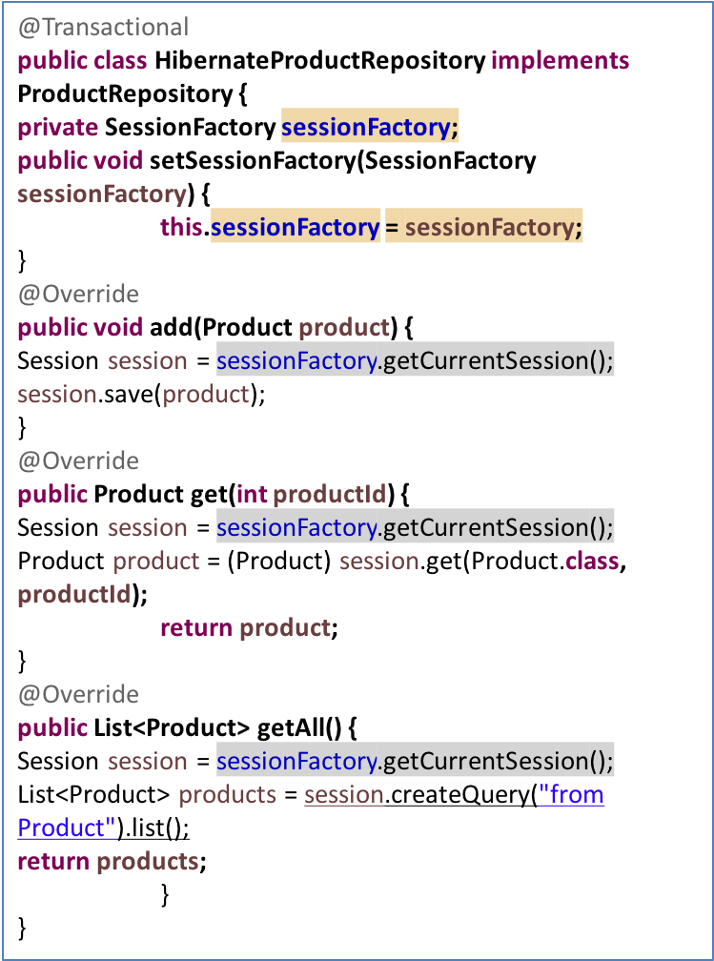
Sample Code
public interface ProductRepository {
public void add(Product product);
public Product get(int productId);
public List<Product> getAll();
}
ApplicationContext context = new ClassPathXmlApplicationContext("ex1/ex1-config.xml");
ProductRepository productRepository = (ProductRepository)context.getBean("productRepository");
Product p = new Product();
p.setName("Majrul's Hackbook");
p.setDescription("Hackintosh is fun!");
p.setPrice(20000.0);
p.setQuantity(99); productRepository.add(p);

Slide 32
Spring JPA Support
In JPA, a persistent unit is represented as an object of EntityManagerFactory interface similar to SessionFactory interface in Hibernate
To persist/load object graph we need to use EntityManager interface and it’s method similar to Session interface in Hibernate

Slide 33
Example
public class JpaProductRepository implements ProductRepository {
private EntityManagerFactory entityManagerFactory;
public void setEntityManagerFactory(
EntityManagerFactory entityManagerFactory) {
this.entityManagerFactory = entityManagerFactory;
}
@Override
public void add(Product product) {
EntityManager entityManager =
entityManagerFactory.createEntityManager();
…
Once again we will have to deal with transactional issues in this code

Slide 34
Cont’d…
public class JpaProductRepository implements ProductRepository {
@PersistenceContext
private EntityManager entityManager;
Spring support the standard @PersistenceContext annotation, so you can directly inject the EntityManager object. Much

Slide 35
JPA related configuration
<bean id="entityManagerFactory" class=”o.s.orm.jpa.LocalContainerEntityManagerFactoryBean">
<property name="dataSource” ref local="exampleDataSource” />
</bean>
<bean id="productRepository" class="ex2.JpaProductRepository">
<property name="entityManagerFactory" ref="entityManagerFactory" />
</bean>
Instead of configuring the EntityManagerFactory, we can also lookup and access the EntityManagerFactory instance provided by the Application Server

Slide 36
ThankYou

