Slide 1
Spring MicroServices
Shalini Mittal
Corporate Trainer

Slide 2
Topics to be covered
What is Microservice

Slide 3
Before Microservices
Monolithic architecture
  It is a big container wherein all software components of an application are assembled together and tightly packaged
  They are interconnected and inter dependent
  All components are dependent on each other and designed in a single piece to be able to execute and compile
Notes:
https://spring.io/blog/2007/01/25/why-the-name-acegi

Slide 4
Monilithic Architecture
Use Case of an Media Service Provider – Netflix etc
Client Browser
Search
Service
Recommended
Service
Trending
Service
COntent
Service
Single Instance
Notes:
Only 1 instance of these 3 services coupled together and deploy.
To scale we can have multiple instances of this application

Slide 5
Advantages
Simple to develop
Simple to deploy – executable files deployed as war
To scale run multiple instances behind a load balancer
DisAdvantages
Large and complex applications – size increases with complexity
Modularity break down
Quality breaks down
Larger code base loading takes time
Only update in 1 component the whole application needs to be deployed
Unscalable – Each component eg: cart service cannot be scaled. Whole product has to be scaled
Unreliable – 1 component fails whole application has the downfall
Inflexible – to integrate with new framework
Notes:
For example, in a corporate application, there are some parts of an application where only admin have access and to some parts all the employees have access. These access rules are determined by the access rights given to each user of the system.
ometimes you need to also differentiate security based on the way a principal is interacting with your application. For example, you might want to ensure requests only arrive over HTTPS, in order to protect passwords from eavesdropping or end users from man-in-the-middle attacks. This is especially helpful to protect password recovery processes from brute force attacks, or simply to make it harder for people to duplicate your application’s key content. To help you achieve these goals, Spring Security fully supports automatic “channel security”, together with JCaptcha integration for human user detection.

Slide 6
Microservice Architecture ?
An architectural style that structures an application as a collection of small autonomous services, modelled around a Business Domain
Each service is self contained and implements a single Business capability
In previous example all services are independent transactions
Each microservice is responsible of its data
Notes:
https://dzone.com/articles/7-things-to-know-getting-started-with-spring-boot

Slide 7
Microservice Architecture
C
L
I
E
N
T
Identity Provider
A
P
I
G
A
T
E
W
A
Y
Microservices
Service 1
Remote Service
Service 2
Service 3
Service 4
Management
Service Discovery
CDN
Static Content
Notes:
Each service will have its own code base created with different technology
Services need to manage their own data
API gateway – endpoint/entry point for all the clients and forward the call to respective API
Management – for fault tolerance, placing services on nodes, identifying failures, rebelancing services across nodes
Service Discovery – maintain list of services, lookup service find mode of communication to communicate between the servcies via message bus or rest api
CDN – distributed network of proxy setters
Static – host all the content from sys
Most trending service loooks up for the most searched word types by the user.
Alice searches for a particular show and request goes to search servcie,

Slide 8
Features
Small focussed
Loosely coupled
Language Neutral
Bounded Context

Slide 9
Advantages
Independent development
Independent deployment
Fault isolation
Mixed technology stack
Granular scaling
Amazon
Netflix
Uber
Ebay
soundcloud
Notes:
/** matched everything
If user not logged in display the form, form-login displays the default spring login form and validates the used with credentials provided in the in-memory database under seurity authentication manager
In spring-security-core:5.0.0.RC1, the default PasswordEncoder is built as a DelegatingPasswordEncoder. When you store the users in memory, you are providing the passwords in plain text and when trying to retrieve the encoder from the DelegatingPasswordEncoder to validate the password it can't find one that matches the way in which these passwords were stored.
So provide {noop}mittal this is password attribute
Use-expressions allow usage of hasRole expressions
Whereas auto-config = true allows usage of role – ROLE_USER

Slide 10
Example
Riya searches for TV show
Search service communicates with content catalog service
The searched word is looked up in the stored metadata of DB
Most trending service captures most popular data among all the users
Most typed words by Riya are captured and analytics team update the recommendation service
It also compares Riya most viewed content and preferences to popular content among other users in same geographical locations
Next time Riya sees most popular content and previous viewed playlist

Slide 11
YAML
a human-readable data serialization language.
commonly used for configuration files
Spring Boot Tutorials we made use of application.properties.
But this has certain disadvantages as regards to the ease of use.
Notes:
Yet another markuo language
YAML ain’t a markup language

Slide 12
Configuration file without YAML
For example suppose we are defining configuration for the actuator endpoints for a Spring Boot
Application.info.app.name=testApp info.app.description=Application for retrieving data. info.app.version=@project.version@
Info.app.build-number=@build.number@
If over time more information is to be added, this wiill keep on becoming more complex because of the .(dot) structure used here.

Slide 13
Advantages of using YAML for configuration
The above Actuator configuration can be written using YAML as follows
info:
app:
build-number: '@build.number@'
description: Application for retrieving data.
name: testApp
version: '@project.version@'
Notes:
https://www.codeproject.com/Articles/1214409/Learn-YAML-in-five-minutes

Slide 14
Rules of YAML
You must end the YAML files with .yaml extension.
YAML must be case-sensitive.
YAML doesn't support the use of tabs.
Instead of tabs, it uses spaces which are not supported universally.
Notes:
https://www.journaldev.com/8195/spring-boot-cli-setup-and-helloworld-example

Slide 15
Create Microservice
Create a employeeproducer
  Produces data via REST API
  It runs on http://localhost:8080/employee
Create an employeeconsumer
  Consumes data produced by employee producer
  Consumer needs to hit the url and consume the employee data
There can be multiple instances of the producer and consumer
Notes:
https://www.journaldev.com/8195/spring-boot-cli-setup-and-helloworld-example

Slide 16
Important Spring Cloud Modules
Dynamic Scale Up and Down. Using a combination of
  Naming Server (Eureka) - for registering all microservices.
  Ribbon (Client Side Load Balancing)
  Feign (Easier REST Clients)
Visibility and Monitoring with
  Zipkin Distributed Tracing
  Netflix API Gateway
Configuration Management with
  Spring Cloud Config Server
Fault Tolerance with
  Hystrix
Notes:
https://www.journaldev.com/8195/spring-boot-cli-setup-and-helloworld-example

Slide 17
Naming Server
How does the Producer know how many instances of Consumer are active?
How does the Consumer distribute the load between the active instances.
Because we want this to be dynamic, we cannot hardcode the urls of Producer in Consumer. Thats why we bring in a Naming Server.
Notes:
Add the mysql specific information in application.properties as specified in previous slide

Slide 18
RestTemplate
Spring RestTemplate provides a convenient way to test RESTful web services.
We can use RestTemplate to test HTTP based restful web services, it doesn’t support HTTPS protocol.
RestTemplate class provides overloaded methods for different HTTP methods, such as GET, POST, PUT, DELETE etc.
Notes:
https://howtodoinjava.com/spring-restful/spring-restful-client-resttemplate-example/
https://docs.spring.io/spring/docs/current/javadoc-api/org/springframework/web/client/RestTemplate.html

Slide 19
Feign Clients
Feign provide a better alternative to RestTemplate to call REST API.
Making the call using the proxy is very simple.
convenient way to test your application’s API, focused on creating tests to verify business logic instead of spending time on the technical implementation of web services clients.
You only need to describe how to reach the remote API service by providing details such as the URL, request and response body, accepted headers, etc. The Feign Client will take care of the implementation details.
Notes:
https://www.journaldev.com/8195/spring-boot-cli-setup-and-helloworld-example

Slide 20
Implement Feign Client
Create an interfcae as follows :
@FeignClient(name="forex-service", url="localhost:8000")
public interface CurrencyExchangeServiceProxy {
//URI of the service we would want to consume
@GetMapping("/currency-exchange/from/{from}/to/{to}")
public CurrencyConversionBean retrieveExchangeValue
(@PathVariable("from") String from, @PathVariable("to") String to);}
Notes:
https://howtod
It is inbuilt form-based authentication with the userid as the user and a randomly generated password
oinjava.com/spring-boot/actuator-endpoints-example/

Slide 21
Use Feign Client
Use this proxy in the controller
  @Autowired
  private CurrencyExchangeServiceProxy proxy;
  @GetMapping("/currency-converter-feign/from/{from}/to/{to}/quantity/{quantity}")
  public CurrencyConversionBean convertCurrencyFeign(@PathVariable String from, @PathVariable String to,
  @PathVariable BigDecimal quantity) {
  CurrencyConversionBean response = proxy.retrieveExchangeValue(from, to);
  logger.info("{}", response);
  return new CurrencyConversionBean(response.getId(), from, to, response.getConversionMultiple(), quantity,
  quantity.multiply(response.getConversionMultiple()), response.getPort());
  }
Enable Feign Client
@EnableFeignClients("com.demo.controller") @EnableDiscoveryClient
@SpringBootApplication
public class MsCurrencyConversionServiceApplication {
public static void main(String[] args) { SpringApplication.run(MsCurrencyConversionServiceApplication.class, args);}}
Notes:
https://howtod
It is inbuilt form-based authentication with the userid as the user and a randomly generated password
oinjava.com/spring-boot/actuator-endpoints-example/

Slide 22
Setup Ribbon
Create a spring boot project by selecting web module
We want to use JSP as the view. Default embedded servlet container for Spring Boot Starter Web is tomcat. To enable support for JSP’s, we would need to add a dependency on tomcat-embed-jasper.
  <dependency>
    <groupId>org.apache.tomcat.embed</groupId>
    <artifactId>tomcat-embed-jasper</artifactId>
    <scope>provided</scope>
  </dependency>
Notes:
https://www.journaldev.com/8195/spring-boot-cli-setup-and-helloworld-example

Slide 23
SetUp Eureka Naming Server
Create a spring boot starter project with eureka and devtools as modules
EnableEurekaServer in main application as follows :
  @SpringBootApplication
  @EnableEurekaServer
  public class EurekaNamingServerApplication {
  public static void main(String[] args) {
  SpringApplication.run(EurekaNamingServerApplication.class, args);
  }
  }
Define the port in properties file
  spring.application.name=netflix-eureka-naming-server
  server.port=8761
  eureka.client.register-with-eureka=false
  eureka.client.fetch-registry=false
Run the project and access eureka server at http://localhost:8761/
Notes:
Eureka – 8761
CCS – 8100
FS - 8000
EmpProducer – 8080
EmpConsumer - 8091

Slide 24
Register services on Eureka
Add following dependency in pom of producer and consumer
<spring-cloud.version>Finchley.RELEASE</spring-cloud.version>
<dependency>
<groupId>org.springframework.cloud</groupId>
<artifactId>spring-cloud-starter-netflix-eureka-client</artifactId>
</dependency>
<dependencyManagement>
<dependencies>
<dependency>
<groupId>org.springframework.cloud</groupId>
<artifactId>spring-cloud-dependencies</artifactId>
<version>${spring-cloud.version}</version>
<type>pom</type>
<scope>import</scope>
</dependency>
</dependencies>
</dependencyManagement>
Notes:
Eureka – 8761
CCS – 8100
FS - 8000
EmpProducer – 8080
EmpConsumer - 8091

Slide 25
Give names to services in properties
In Employee Consumer
spring.application.name=employee-consumer
In Employee Producer
spring.application.name=employee-producer
Configure Eureka URL in application.properties
eureka.client.serviceUrl.defaultZone=http://localhost:8090/eureka
Run the server and both the services.
Notes:
Eureka – 8761
CCS – 8100
FS - 8000
EmpProducer – 8080
EmpConsumer - 8091

Slide 26
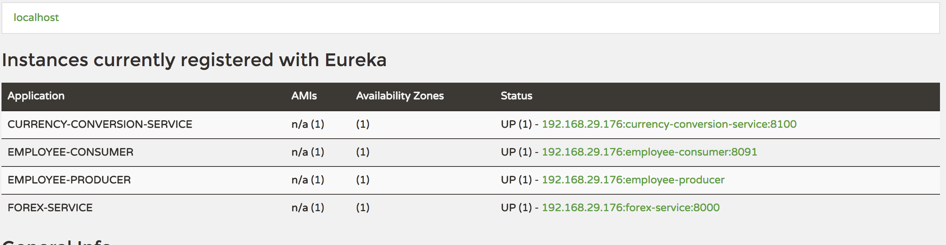
Services Registered
Notes:
Eureka – 8761
CCS – 8100
FS - 8000
EmpProducer – 8080
EmpConsumer - 8091

Slide 27
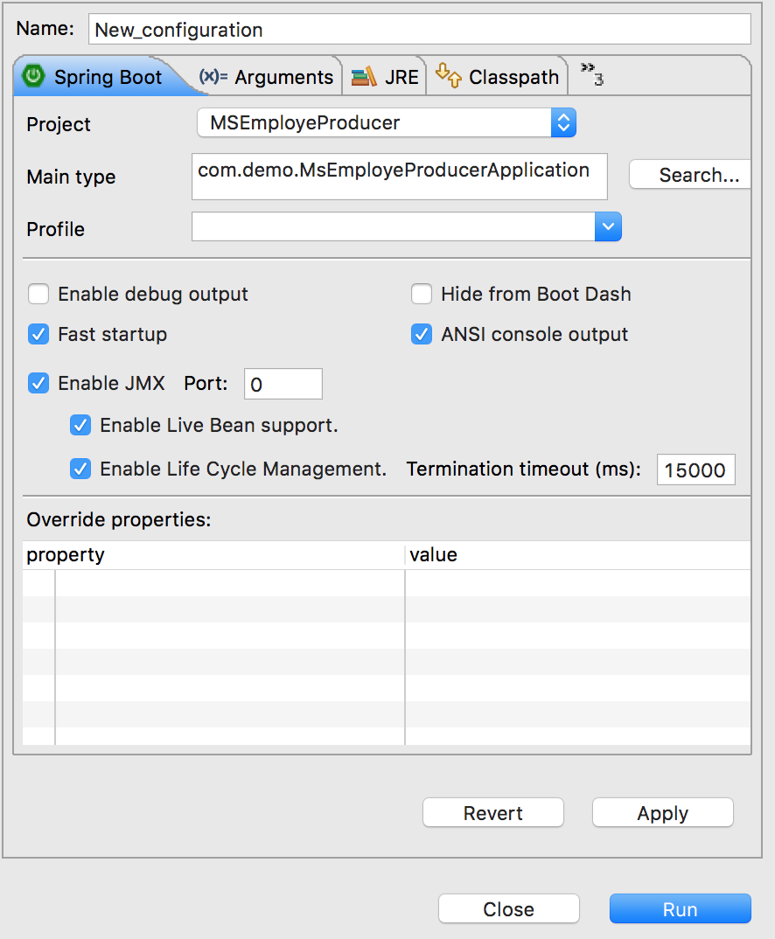
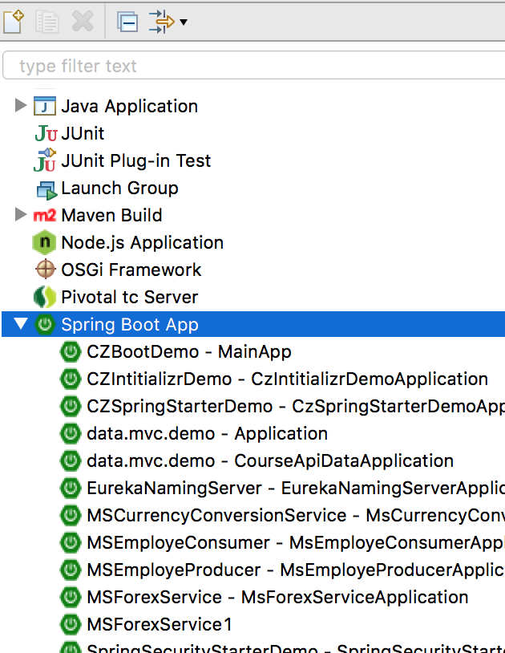
To start one more instance -
Open Run Configurations
and select Spring Boot App-> New
Add VM argument :
-Dserver.port=8001
Notes:
http://www.springboottutorial.com/microservices-with-spring-boot-part-5-eureka-naming-server

Slide 28
Load balancers
load balancing improves the distribution of workloads across multiple computing resources, such as computers, a computer cluster, network links, central processing units, or disk drives.
Load balancing aims to optimize resource use, maximize throughput, minimize response time, and avoid overload of any single resource.
Using multiple components with load balancing instead of a single component may increase reliability and availability through redundancy.
Load balancing usually involves dedicated software or hardware, such as a multilayer switch or a Domain Name System server process.
Suppose other modules are also calling and consuming employee-producer module services. So the load at employee-producer is high. To deal with this we this we deploy multiple instances of employee-producer. Suppose two in this case. Now we will have to use a Load Balancer to route any incoming requests to either one of these two services.
Notes:
http://www.springboottutorial.com/microservices-with-spring-boot-part-5-eureka-naming-server

Slide 29
Add Load balancer
Add cloud dependency
Change consumer controller to include LoadBalancer
Notes:
http://www.springboottutorial.com/microservices-with-spring-boot-part-5-eureka-naming-server

Slide 30
ThankYou
shalini06mittal@gmail.com
7738460004

