Slide 1
RetailPulse Analytics 2025
Retail Sales Data Analysis & Business Intelligence Project
Tools Used: Excel • Oracle SQL • Python • Power BI
Prepared by: Ruchika Sharma
Year: 2025

Slide 2
Project Overview
RetailPulse is a retail sales data analysis and business intelligence project.
The project analyzes sales, profit, customers, products, discounts, payments, and regional performance.
The dataset was analyzed using Excel, Oracle SQL, Python, and Power BI.
The objective is to identify key business trends and generate actionable insights.
The analysis also includes What-If Analysis and Sensitivity Analysis.

Slide 3
Project Objectives
Analyse overall sales and profitability.
Identify top-performing products and categories.
Analyse customer and regional sales performance.
Examine payment modes and sales channels.
Study monthly sales trends.
Analyse the impact of discounts on profit.
Create an interactive Power BI dashboard.
Generate useful business insights and recommendations.

Slide 4

Dataset & Tools Used
Dataset
RetailPulse retail sales dataset
Contains sales, profit, customer, product, discount, payment, and regional information.
Analytical Tools
Excel — PivotTables, KPIs, What-If & Sensitivity Analysis
Oracle SQL — Data querying and business analysis
Python — Pandas, Matplotlib & Seaborn
Power BI — Interactive dashboard and visualizations

Slide 5
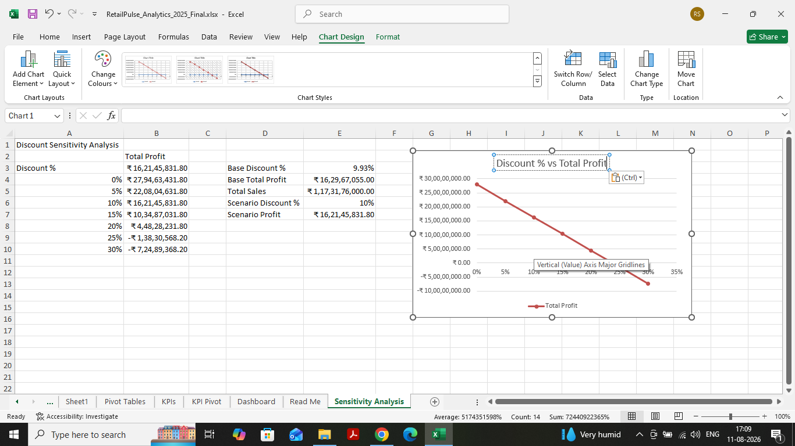
Excel Analysis
Created PivotTables to analyse sales and profit across different dimensions.
Calculated key performance indicators such as total sales, profit, orders, and profit margin.
Analysed category, region, payment mode, and monthly performance.
Performed What-If Analysis to evaluate different business scenarios.
Performed Sensitivity Analysis to examine the impact of discount changes on profit.

Slide 6
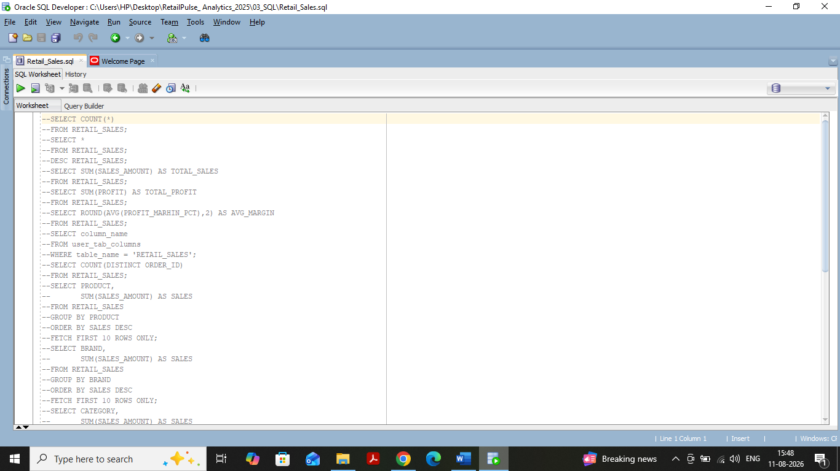
SQL Analysis
Used Oracle SQL to query and analyse the retail sales dataset.
Calculated total sales, total profit, and average profit margin.
Identified top-performing products, brands, categories, and states.
Analysed sales by gender, payment mode, customer segment, and month.
Used aggregation, grouping, sorting, and filtering to generate business insights.

Slide 7
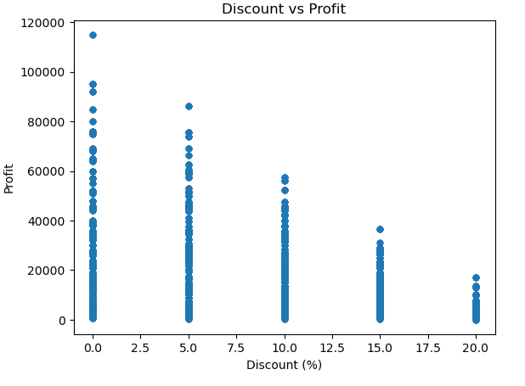
Python Analysis
Used Python for exploratory data analysis and visualization.
Cleaned and examined the dataset using Pandas.
Analysed sales, profit, discount, and other numerical variables.
Studied relationships between variables using correlation analysis.
Created visualizations using Matplotlib and Seaborn.
Identified trends and patterns to support business insights.

Slide 8
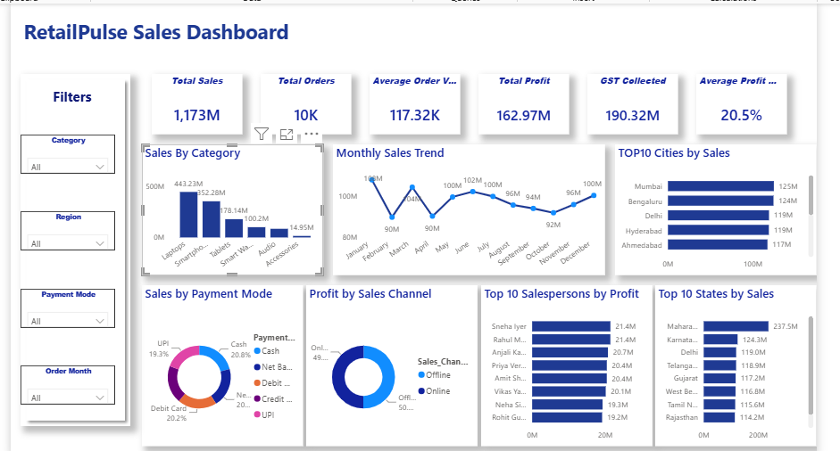
Power BI Dashboard
Developed an interactive RetailPulse Sales Dashboard.
Displayed key KPIs including total sales, orders, profit, and profit margin.
Analysed sales by category, city, state, payment mode, and sales channel.
Visualised monthly sales trends.
Added interactive filters for category, region, payment mode, and order month.
Used the dashboard to support quick business decision-making.

Slide 9
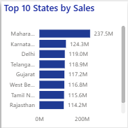
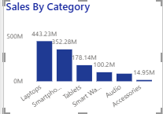
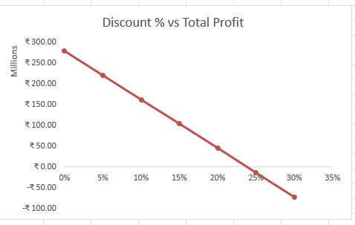
Key Business Insights
Laptops generated the highest sales among product categories.
Maharashtra was the top-performing state by sales.
Mumbai recorded the highest sales among the analysed cities.
Sales showed noticeable monthly fluctuations, with stronger performance in some months.
Online and offline sales channels both contributed significantly to overall sales.
Higher discount levels can negatively affect profit, as shown by the sensitivity analysis.

Slide 10
Recommendations & Conclusion
Focus on high-performing products, cities, and states to sustain sales growth.
Monitor discount levels carefully to protect profit margins.
Use monthly sales trends for better sales and inventory planning.
Strengthen both online and offline sales channels based on performance.
Use interactive dashboards and analytical tools for data-driven decision-making.
Overall, the project demonstrates how Excel, SQL, Python, and Power BI can be combined to
analyse retail performance and generate actionable insights.
Thank You

