Slide 1




Slide 2




Founded in San Francisco in 2008
Founders:
Brian Chesky, Nathan Blecharczyk, Joe Gebbia
Over 6,000,000 listings in 191 countries and 81,000 cities

Slide 3

Background
Airbnb listing sampled data for Singapore, with approximately 7.9K listings by different hosts.
The dataset provides information about the listing as well as the price.
The following information is available for the listings apart from the price
Listing Id & Host Id
Neighborhood and Neighborhood group
Room Type
Minimum number of nights required to stay
Number of reviews
Last Review Date
Number of listings per host

Slide 4
Project Goal
Use the data to understand what impacts the pricing of Airbnb listings.
Create a model to predict price using available features most accurately.
Identify missing features that could improve the model and analysis.
Recommend few applications using your data science project which AirBnB can implement.

Slide 5
Outliers & Calculated field.
Outliers:
Reviewed zscores and box plots to remove outliers. On further inspection, used a lower outlier limit for price.
Removed outliers for other variables based on zscores.
Calculated field
I assigned numbers to room type and neighborhood group to create a dummy variable
# of reviewed/ reviewed per month = how long this apartment has been on airbnb

Slide 6
Price overview of all listings
Without outlier removal
With outlier removal ( < 1%), price seems a little right skewed. More than 90% listings are priced less than 300 dollars

Slide 7
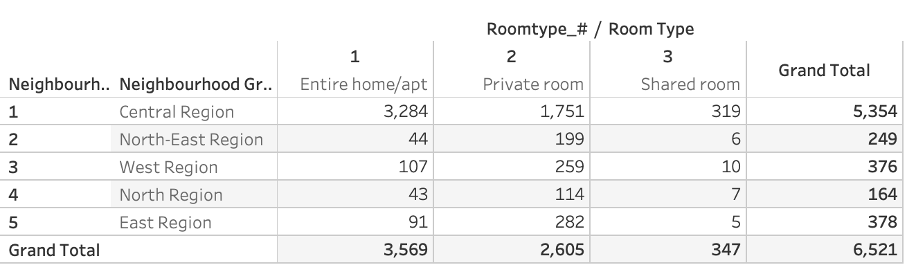
Category Overview
Hypothesis: Different Region will have different quantity of room availability
We found out that the majority of the rooms are located in Central Region. Most of the rooms are Entire home/apt. There is very little shared room in all region.
We should be promoting Entire home/apt as a strategy for Airbnb.

Slide 8
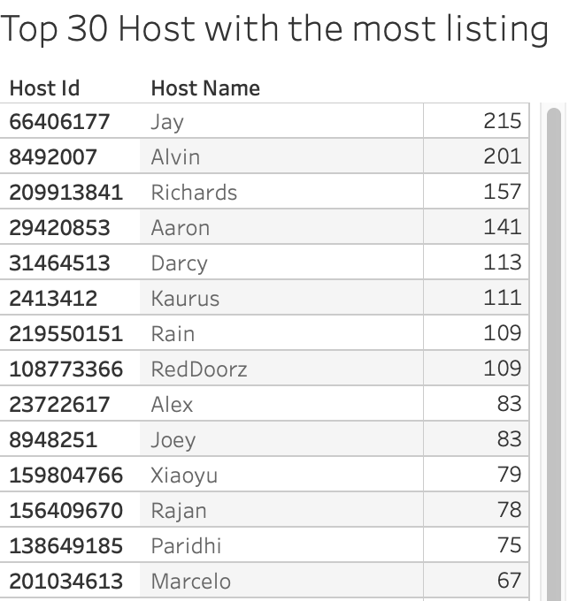
Top 30 Host
Hypothesis: Host with more apartments will become more popular as they are experienced host
Surprisingly, Some host have over 200 listing. I think the top 20 host might be a third party company. Airbnb should look into this and understand why such things happened and avoid competition in the future

Slide 9
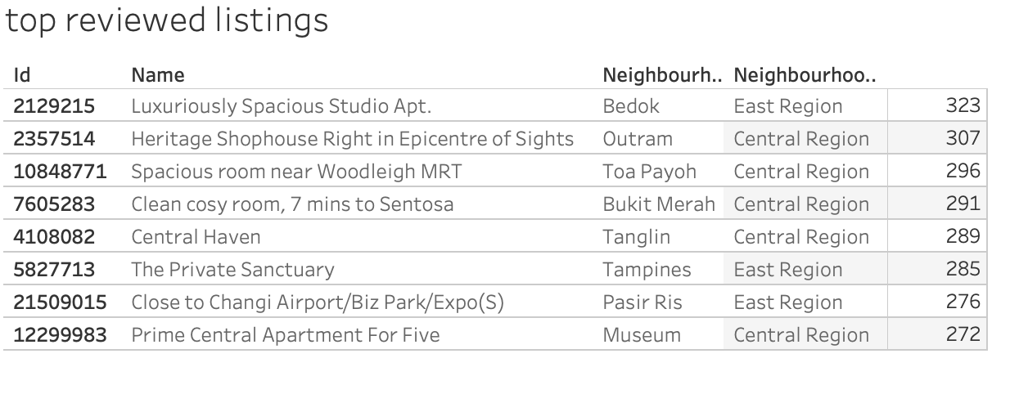
Top Reviewed
Hypothesis: Apartment with certain attribute might attract customers to review them
Looking at these names of the apartment, the first apartment have 323 reviews which is pretty high. Words like Luxurious, Heritage, spacious will track more reviews. Therefore, Airbnb can suggest host to have adjective to their name to attract more customers

Slide 10
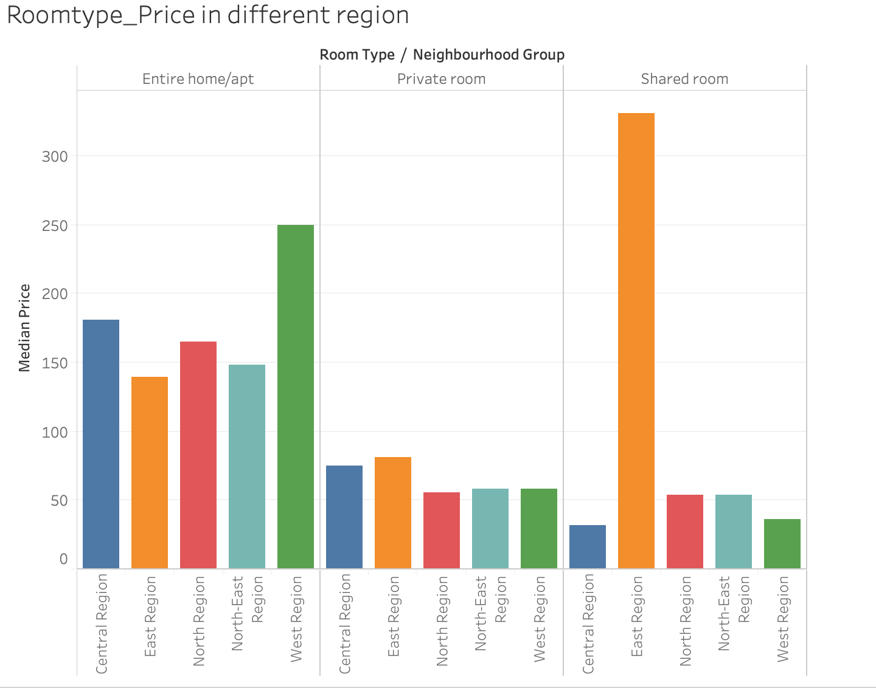
Roomtype & Neighborhood vs. Price
Hypothesis: We think that different locations will have a different median price. For example, the housing price in Manhattan will be different for those in Montana
Although share room in East region is way over the top, when we look at the data, we did not exclude them as outliers because we do not know how many people can that room accommodate.
In General, Central and East were able to charge a high price.
Entire home is able to charge a higher price compare to private room and shared room

Slide 11

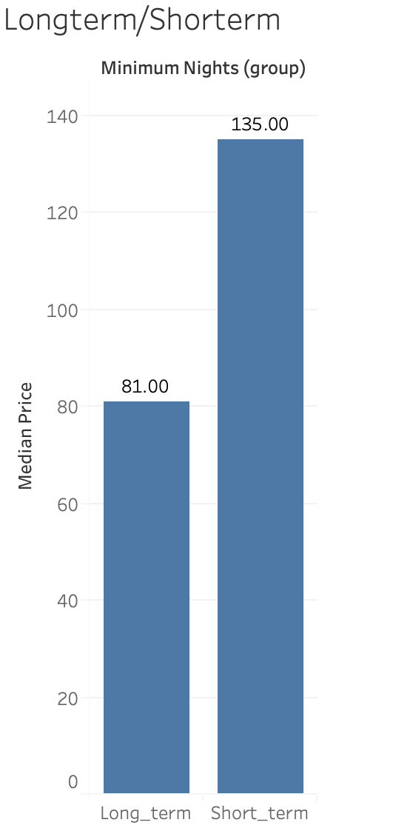
Long Term/Short Term Stay
Hypothesis: Short term stay will affect a higher price.
I define short term stay with days less than 2 months (60 days)
I found out that short stay charge a median price of $135 and long term stay charge a median price of 81 which is a pretty significant differences. Significance checked using z test in python code.

Slide 12
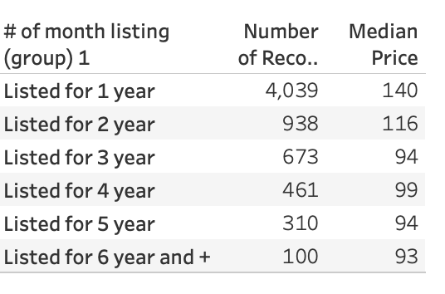
# of month been listed
Hypothesis: I think the longer it has been on the airbnb list, the higher price they should charge because they are more experienced
By looking at these groups. Most listings are created less than a year. However, is able to charge a higher price.
Therefore, it rejected my hypothesis and we need looking into the data to find out if total reviews /reviews per month = total month listed.

Slide 13
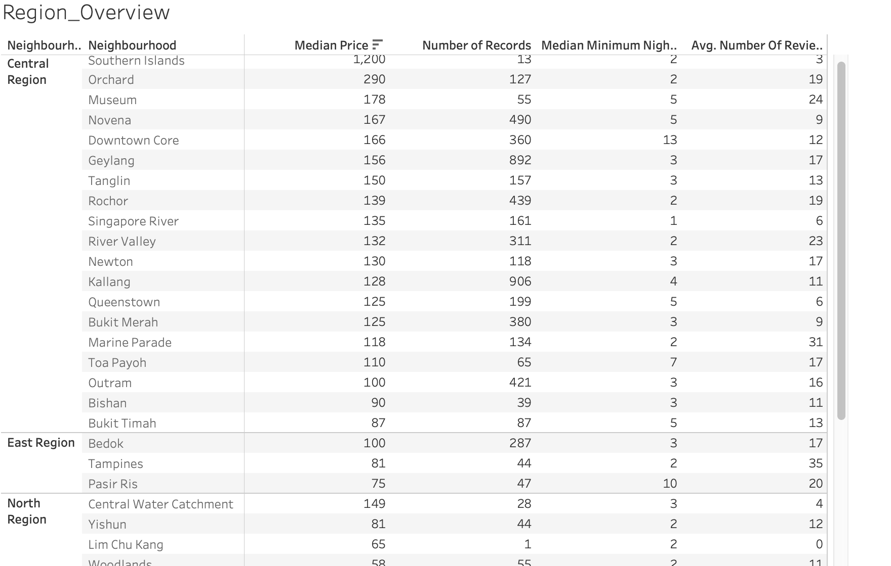
Region Overview
Hypothesis: We think that different locations will have a different median price.
Some locations in certain region will have a higher median price. For example in central region, southern islands have a median price of 1200. This means that this is probably in equivalent to the upper east side of New York.

Slide 14
Price vs. Room Type
Entire home/apt as expected are more expensive than shared rooms which are least priced. These variables may be slightly correlated.
Private rooms are also highly priced for several instanced.

Slide 15
Price vs. Neighborhood Group
Central region is much more expensive than other regions.
Likely the tourist hub. As seen above it also has most number of entire home apartments which leads it to be more expensive

Slide 16
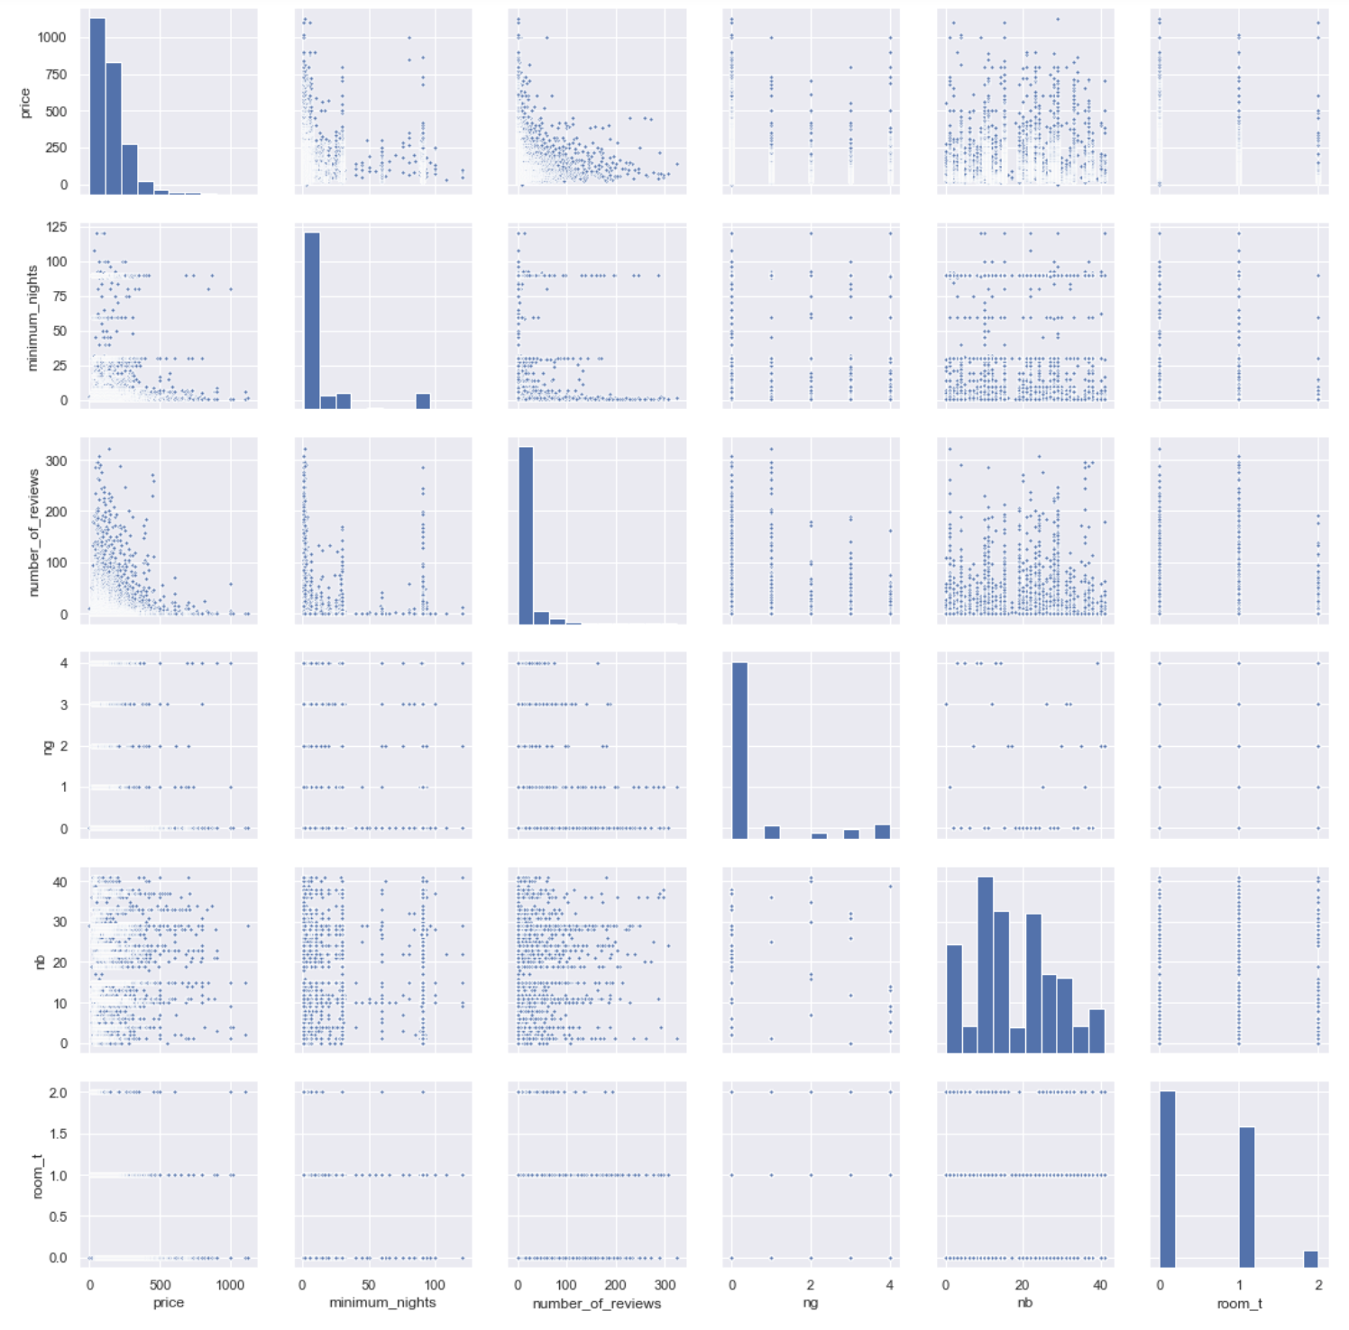
Correlation Table
It seems like room type and price may have a specific relationship as room 2 on visual inspection room type 2 seems to have a lower price index than other room types. to be checked if this relationship is significant.
There also seems to be a relationship between review count and price, indicating that lower priced listings get more review. but this relationship is probably because of the availability factor.

Slide 17
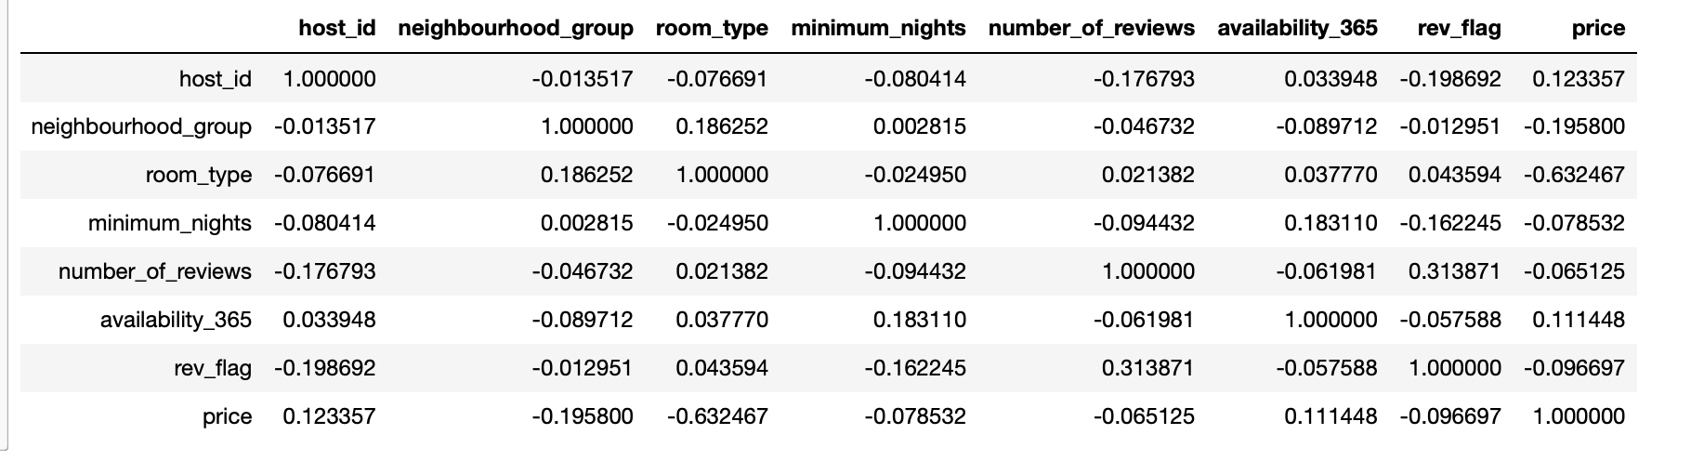
Validating above with correlation matrix
It seems like room type and price may have a specific relationship with a 0.63 correlation

Slide 18
Price Prediction using Linear Reg

Slide 19
Linear model training approach
Coded categorical variables using label encoder
Removed outliers
Trained model using scikit learn.
Validated using test-train split and K-fold cross validation.
Reviewed residual plots
Tuned parameters by looping kfold validation over +1 incremental parameters
Log transformed variables for additional enhancement
Analyzed correlation matrix for removing collinearity
Also test statsmodel package in addition to scikit

Slide 20
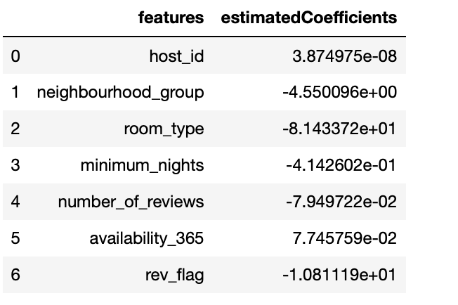
Linear model findings.
Model has high RMSE/ MAE when using the dataset after just removing outliers.
Trained model on 92% of dataset ( for listings priced less than 300 Dollars)
RMSE reduced by 50%
R square = 0.43
Key variables impacting price - >
Lasso also gave similar results.

Slide 21
Future recommendations for model improvement
Build a logistic regression to predict if a listing is high priced or low priced ( < 300 or >300.
If listing is high priced use another set of features ( not available in the dataset).
If listing is low priced this model.

Slide 22
Other features that should be gathered for model improvement
Area Sqft of listing
Host Rating
Verified/Non-Verified host flag
Distance from public transport
Ratings
Review text
# times booked in last 3 months

Slide 23
Potential applications of the model
Use this model to identify the right price for new listings that get added to inventory.
Create a feature in airbnb site to estimate avg price based on visitors’ search criteria.
Use this to change price of listings dynamically based on new features added or removed in listing description.

Slide 24
Below is the model flowchart recommended to predict price using available factors so that it can be used in practical business applications with higher confidence
New Slide
Use another model to predict price intervals for higher priced listings.
This model needs to be built in future.
Use a classification model to predict if listing is high priced or low priced ( > 300 or less than 300 dollars)
Logistic regression model to be optimized and used.
Use the built regression model to predict lower priced listings.
A model with RMSE 49 is built and predicts price intervals with a r square of 0.47

