Slide 1


Transformers
Workshop- Part 1
Ruchik Mishra,
PhD candidate,
Department of Electrical and Computer engineering

Slide 2
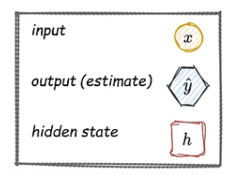
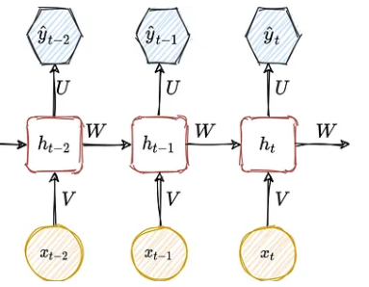
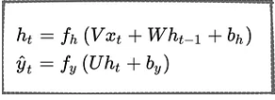
Introduction
Sequential Models
RNN
Predicted next word
Input words
Image Courtsey: https://medium.com/metaor-artificial-intelligence/the-exploding-and-vanishing-gradients-problem-in-time-series-6b87d558d22
Source:
https://www.youtube.com/watch?v=lWPkNkShNbo&list=PLuhqtP7jdD8ARBnzj8SZwNFhwWT89fAFr
https://medium.com/metaor-artificial-intelligence/the-exploding-and-vanishing-gradients-problem-in-time-series-6b87d558d22
https://towardsdatascience.com/learn-how-recurrent-neural-networks-work-84e975feaaf7

Slide 3
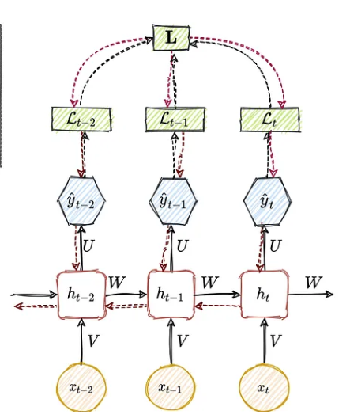
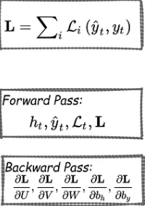
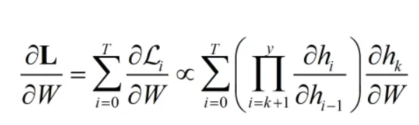
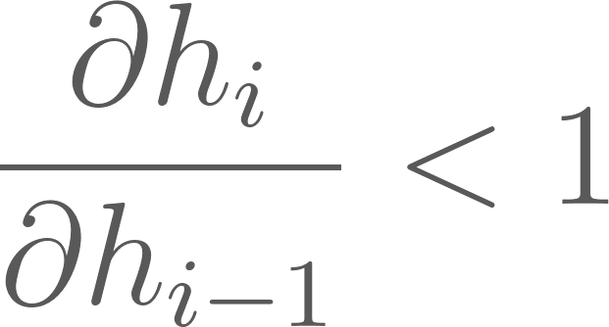
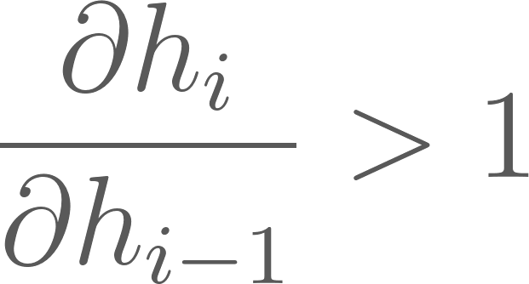
Limitations
Vanishing and Exploding gradients
Exploding
Vanishing
Image Courtsey: https://medium.com/metaor-artificial-intelligence/the-exploding-and-vanishing-gradients-problem-in-time-series-6b87d558d22
Source:
https://medium.com/metaor-artificial-intelligence/the-exploding-and-vanishing-gradients-problem-in-time-series-6b87d558d22
https://www.youtube.com/watch?v=nLPRvGogtrI

Slide 4
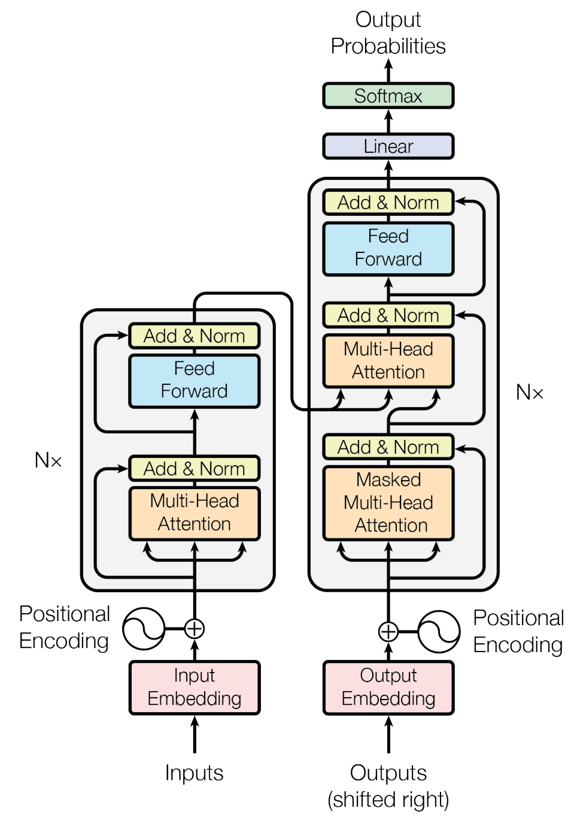
Attention is All you Need
Decoder
Encoder
Image taken from the original paper cited
Source: Vaswani, A., Shazeer, N., Parmar, N., Uszkoreit, J., Jones, L., Gomez, A.N., Kaiser, Ł. and Polosukhin, I., 2017. Attention is all you need. Advances in neural information processing systems, 30.

Slide 5
Encoder
1
Inputs
2
Input embedding
3
Positional Encoding
4
MultiHead Attention
5
Add & Norm
6
Feedforward network

Slide 6
Inputs and Input Embedding
Corpus: collection of texts Vocabulary: unique set of tokens in the corpus
“I am a student.”
125 | 8874 | 1452 | 523
tokens
Tokens into vectors
Source: https://medium.com/@saschametzger/what-are-tokens-vectors-and-embeddings-how-do-you-create-them-e2a3e698e037#:~:text=Tokens%20in%20Natural%20Language%20Processing,'%2C%20'outside'%5D.

Slide 7


Input embeddings
Text vector —> Embedding matrix
Represents text vectors in a higher dimensional space
Purpose: to capture the semantic similarity of the words
cake
Cake, bake, tree
bake
tree
Source: https://medium.com/@saschametzger/what-are-tokens-vectors-and-embeddings-how-do-you-create-them-e2a3e698e037#:~:text=Tokens%20in%20Natural%20Language%20Processing,'%2C%20'outside'%5D.

Slide 8

Positional embedding
“I am a student.”
I | am | a | student
p.e
p.e
p.e
p.e
i=0
i=1
i=2
i=3
i=4
w.e
w.e
w.e
w.e
Pos = 0
Pos = 1
Pos = 2
Pos = 3

Slide 9




Input + Positional embedding
Model dimension
(d_{model})
Sequence length (seq)
p.e
p.e
p.e
p.e
w.e
w.e
w.e
w.e
I
am
a
student
I | am | a | student

Slide 10
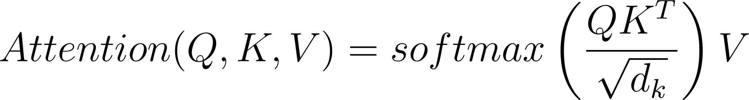

Multi-Head Attention
Self-attention
Q: Query K: Keys V: Values
Query
Search text
Key
Video title
Value
Video contents
Source:
https://www.youtube.com/watch?v=mMa2PmYJlCo&t=14s

Slide 11
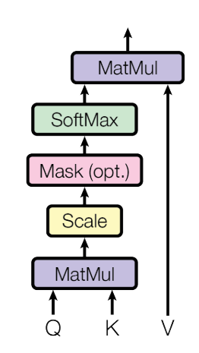

Multi-Head Attention
d_{model}
Self-attention
seq
I
am
Q’
a
student
4 x 5
(seq x d_{model})
5 x 5
(d_{model} x d_{model})
Image taken from the original paper cited
Source: Vaswani, A., Shazeer, N., Parmar, N., Uszkoreit, J., Jones, L., Gomez, A.N., Kaiser, Ł. and Polosukhin, I., 2017. Attention is all you need. Advances in neural information processing systems, 30.

Slide 12

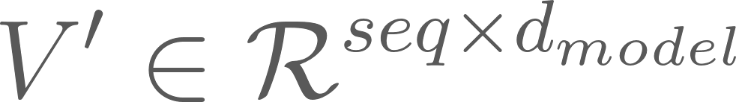
Multi-Head Attention
I
am
K’
a
student
I
am
V’
a
student
4 x 5
(seq x d_{model})
5 x 5
(d_{model} x d_{model})

Slide 13
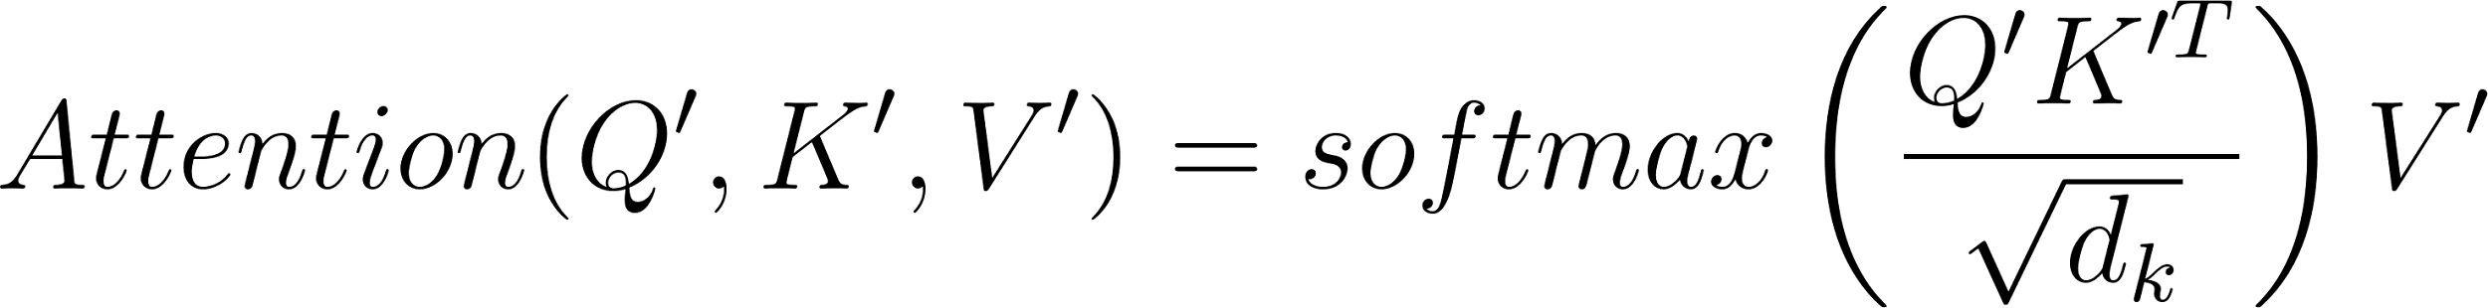

Multi-Head Attention
Self-attention

Slide 14
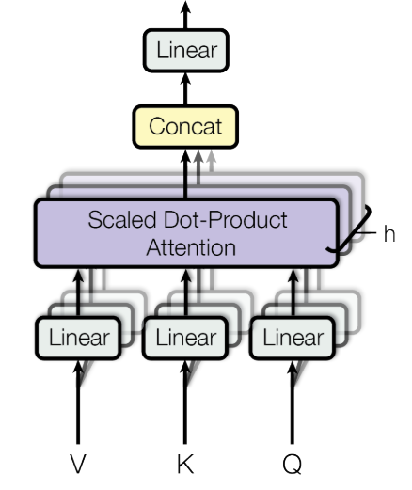
Multi-Head Attention
Scaled dot product attention
Multi-Head attention
Images taken from the original paper cited
Source: Vaswani, A., Shazeer, N., Parmar, N., Uszkoreit, J., Jones, L., Gomez, A.N., Kaiser, Ł. and Polosukhin, I., 2017. Attention is all you need. Advances in neural information processing systems, 30.

Slide 15
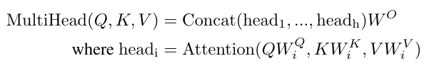
Multi-Head Attention
d_{model}
d_{k}
Q’
seq
h₁
h₂
h₃
d_{k}
seq
K’
H
(seq, h x d_{k} )
Wº
(h x d_{k}, d_{model})
V’
MultiHead
(seq,d_{model})
Source: https://www.youtube.com/watch?v=ISNdQcPhsts

Slide 16
Add & Norm
Add the residual connection:
residual_connection =
x + Sublayer(x)
Sublayer(x)
Multi-Head
Attention
Reason for residual connection:
Knowledge preservation
Vanishing gradient problem
Q
K
V
x

Slide 17
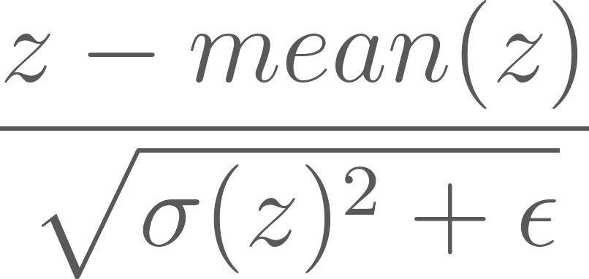
Add & Norm
Sublayer(x)
z = x + Sublayer(x)
Norm(z) =
Multi-Head
Attention
Q
K
V
x

Slide 18

Feed Forward layer
ReLU activation
Source: Vaswani, A., Shazeer, N., Parmar, N., Uszkoreit, J., Jones, L., Gomez, A.N., Kaiser, Ł. and Polosukhin, I., 2017. Attention is all you need. Advances in neural information processing systems, 30.

Slide 19
Decoder
1
Outputs
2
Output embedding
3
Positional Encoding
4
Masked Multi-Head Attention
5
Masked Multi-Head Attention
7
Linear
6
Feedforward network
Source: Vaswani, A., Shazeer, N., Parmar, N., Uszkoreit, J., Jones, L., Gomez, A.N., Kaiser, Ł. and Polosukhin, I., 2017. Attention is all you need. Advances in neural information processing systems, 30.

Slide 20

Outputs and output embedding
Consider a task of text generation
How are you?
<start> I am good. <end>
W_{q}
Q’
W_{k}
K’
W_{v}
V’
Source: Vaswani, A., Shazeer, N., Parmar, N., Uszkoreit, J., Jones, L., Gomez, A.N., Kaiser, Ł. and Polosukhin, I., 2017. Attention is all you need. Advances in neural information processing systems, 30.

Slide 21
Masked Multi-Head Attention
<start> | I | am | good | <end>
<start>
I
am
good
<end>
Q’
K’^{T}
Attention filter
Source: Vaswani, A., Shazeer, N., Parmar, N., Uszkoreit, J., Jones, L., Gomez, A.N., Kaiser, Ł. and Polosukhin, I., 2017. Attention is all you need. Advances in neural information processing systems, 30.

Slide 22
Masked Multi-Head Attention
<start> | I | am | good | <end>
<start>
I
am
good
<end>
 | -inf | -inf | -inf | -inf
 |  | -inf | -inf | -inf
 |  |  | -inf | -inf
 |  |  |  | -inf
Attention filter
Mask filter
Source: Vaswani, A., Shazeer, N., Parmar, N., Uszkoreit, J., Jones, L., Gomez, A.N., Kaiser, Ł. and Polosukhin, I., 2017. Attention is all you need. Advances in neural information processing systems, 30.

Slide 23
Masked Multi-Head Attention
<start> | I | am | good | <end>
<start>
I
am
good
<end>
 | -inf | -inf | -inf | -inf
 |  | -inf | -inf | -inf
 |  |  | -inf | -inf
 |  |  |  | -inf
softmax
Source: Vaswani, A., Shazeer, N., Parmar, N., Uszkoreit, J., Jones, L., Gomez, A.N., Kaiser, Ł. and Polosukhin, I., 2017. Attention is all you need. Advances in neural information processing systems, 30.

Slide 24
Masked Multi-Head Attention
Add the residual connection:
residual_connection =
x + Sublayer(x)
Sublayer(x)
Multi-Head
Attention
Reason for residual connection:
Knowledge preservation
Vanishing gradient problem
Q
K
V
x
Source: Vaswani, A., Shazeer, N., Parmar, N., Uszkoreit, J., Jones, L., Gomez, A.N., Kaiser, Ł. and Polosukhin, I., 2017. Attention is all you need. Advances in neural information processing systems, 30.

Slide 25
Masked Multi-Head Attention
Q
K
V
Source: Vaswani, A., Shazeer, N., Parmar, N., Uszkoreit, J., Jones, L., Gomez, A.N., Kaiser, Ł. and Polosukhin, I., 2017. Attention is all you need. Advances in neural information processing systems, 30.

Slide 26
Linear layer
The output of the Add and Norm has dimension: (seq, d_{model}).
d_{model}
I
am
good
seq
Flatten
Linear layer
Logits
2.8
1.5
-1.8
4
6.1
-1.5
-10
-5.3

Slide 27
Linear layer
d_{model}
I
am
good
seq
Flatten
Linear layer
2.8
1.5
-1.8
4
6.1
-1.5
-10
-5.3
Logits
Softmax
Prob. of each word in vocabulary

Slide 28
Large Language Models
Pre-trained transformer models
Encoder only
Encoder-Decoder
Decoder only
BERT
ALBERT
RoBERTa
DIstilBERT
BART
Pegasus
T5
Switch
GPT-x
Gopher
Gato
PaLM

Slide 29
Large Language Models
Predicting next token,
Masked Language Modeling
General theme:
Pre-training
Training objective
Loss function
Corpus
Tokenization
Vocabulary creation
Model type
Fine-tuning
Task specific training
Loss function
Sentiment analysis,
Question answering

Slide 30
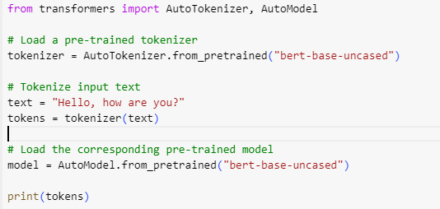
Large Language Models
Predicting next token,
Masked Language Modeling
General theme:
Pre-training
Training objective
Loss function
Corpus
Tokenization
Vocabulary creation
Model type
Fine-tuning
Task specific training
Loss function
Sentiment analysis,
Question answering
Hello , how are you ?
[CLS]
[SEP]

Slide 31
Next time …
Vision transformers
BERT
Theory and formulation
Implementation from scratch
Theory and formulation
Fine tuning for sentiment analysis

Slide 32

Thanks!

