Slide 1
TATA MOTORS INTEGRATED OPERATIONS ANALYSIS
Data Engineering & BI Strategy | PostgreSQL · Excel · Power BI · n8n + GenAI
DOMAIN: MANUFACTURING & LOGISTICS
COMPANY: TATA MOTORS LTD
TEAM: Husnain Khan · Neha Lahene · Nithin V Anil · Ruchi Nailwal · Sachin Singh · Sayeed Ahmed
DATE: May 2026
Notes:
Good morning everyone. Today we present our Integrated Operations Analysis for Tata Motors — a complete data engineering and business intelligence strategy spanning PostgreSQL database design, SQL ETL pipelines, Excel analytical workbooks, interactive Power BI dashboards, and automated operational workflows using n8n with Generative AI. Over the next 25 slides, we will demonstrate how these tools work together to optimize manufacturing operations, track logistics efficiency, and drive a projected 26 percent profit growth for one of India's largest automotive companies. This presentation covers all three weeks of our project: business understanding and DBMS foundations, SQL ETL and Excel analytics, and Power BI dashboarding with GenAI automation.

Slide 2
Executive Presentation Agenda
TABLE OF CONTENTS
01
02
03
04
05
BUSINESS CASE
DBMS & SCHEMA
SQL ETL
ANALYTICS & BI
AI AUTOMATION
▸ Company Profile & KPIs
▸ Schema Design & ER Model
▸ ETL Pipeline Architecture
▸ Excel Formula Engine
▸ n8n Pipeline System
▸ Product Dissection
▸ Guesstimates & Forecasts
▸ Data Cleaning & Features
▸ Excel Dashboard
▸ AI Shipment Reasoner
▸ Challenges & Solutions
▸ Cohort & A/B Testing
▸ IDE Workspace Demo
▸ Power BI Architecture
▸ Recommendations
▸ Profit Growth Strategy
▸ ACID · Index · Partition
▸ Power BI Dashboard Gallery
▸ Roadmap & Risks
Slides 3–7
Slides 8–12
Slides 13–16
Slides 17–24
Slides 25–30
TATA MOTORS | Integrated Operations Analysis | May 2026
Slide 2
Notes:
Our presentation follows a five-part consulting narrative. We begin with the business case — Tata Motors' profile, product dissection, operational challenges, and profit growth strategies. Next, we cover database foundations including schema design, guesstimates, cohort analysis, and A/B testing. The third section walks through our SQL ETL pipeline — extraction, cleaning, and feature engineering. Section four presents our Excel and Power BI analytical dashboards. Finally, we conclude with n8n automation workflows, GenAI-powered shipment reasoners, strategic recommendations, and our implementation roadmap. Each section builds on the previous one, demonstrating a complete end-to-end data engineering lifecycle.

Slide 3
Tata Motors: Business Context & Scale
COMPANY PROFILE
$42B+
Pune & Sanand
70%+ EV Share
100K+ Staff
Annual Revenue
Manufacturing Hubs
India EV Leader
Global Workforce
Global automotive revenues spanning passenger, commercial, and Jaguar Land Rover luxury brands.
Core production sites with high-precision robotic welding cells and sensor-mapped assembly lines.
Nexon EV, Tiago EV, Punch EV powering India's electric vehicle transition at scale.
Engineers, factory operators, and dealer support teams connected via integrated CRM pipelines.
Manufacturing Industry Context
• Industry 4.0 Transformation: IoT-connected machinery, robotic cells, and cloud-native datastores replacing legacy assembly lines. • Predictive Operations: Machine vibration telemetry and AI vision systems detecting defects before they escape the line. • Data-Driven Supply Chains: Real-time database tracking across global sourcing networks to identify supplier delays instantly.
TATA MOTORS | Integrated Operations Analysis | May 2026
Slide 3
Notes:
Tata Motors is a 42-billion-dollar global automotive leader. The company operates core manufacturing plants in Pune and Sanand, featuring high-precision robotic welding and sensor-mapped assembly lines. Tata Motors holds over 70 percent of India's passenger electric vehicle market, with models like Nexon EV and Tiago EV leading the transition. With over 100,000 employees across engineering centers, factories, and dealerships, the company generates millions of transactional data points daily. The manufacturing industry itself is undergoing an Industry 4.0 transformation — moving from isolated automation to integrated data networks that enable predictive maintenance, AI-based quality inspection, and real-time supply chain monitoring.

Slide 4
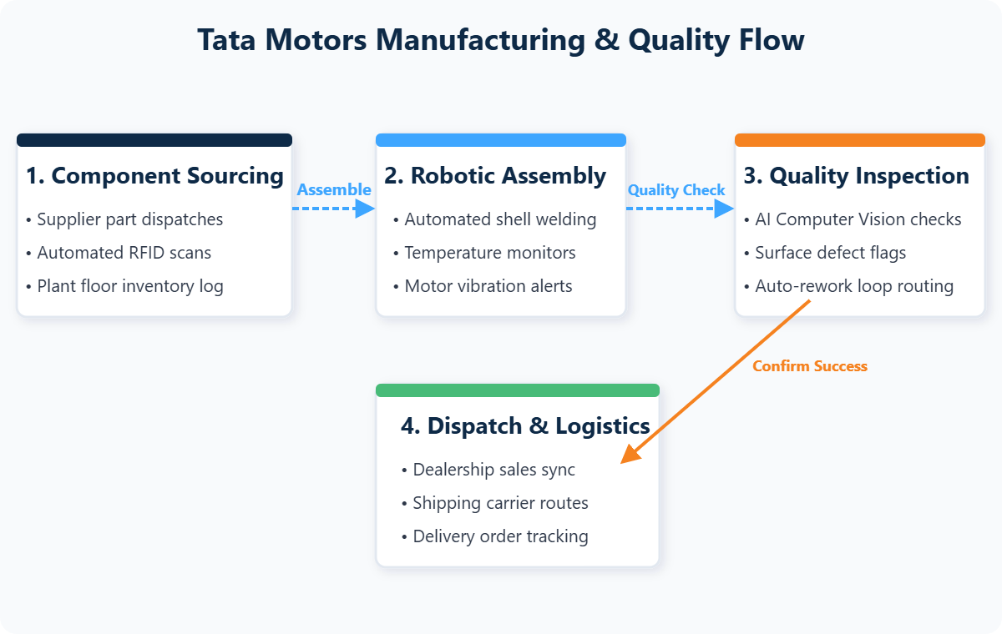
Product Dissection: Tata Motors Operations
DEEP DIVE
Core Manufacturing Layers
Manufacturing Workflow
Advanced Assembly
Robotic logistics loaders transferring components across production bays with real-time RFID tracking.
EV Production Blocks
Specialized environments for battery packs, wiring looms, and electric drive unit assembly.
Precision R&D
Continuous prototyping and crash testing arrays optimizing durability and component lifetimes.
Smart Quality Control
AI computer vision scanning castings on assembly feeds, cutting human oversight errors by 12%.
TATA MOTORS | Integrated Operations Analysis | May 2026
Slide 4
Notes:
This slide dissects Tata Motors' manufacturing process into four core layers. Advanced Assembly uses robotic logistics loaders with RFID tracking to move components efficiently. Dedicated EV Production Blocks handle the specialized requirements of battery packs and electric drivetrains. Precision R and D facilities run continuous prototyping and crash testing. Smart Quality Control deploys AI computer vision to inspect castings during assembly, reducing defect escape rates by 12 percent. The workflow diagram on the right shows how these layers connect — from component sourcing through robotic assembly, quality inspection, and final dispatch.

Slide 5
Real-World Manufacturing Challenges
PROBLEM STATEMENTS
Unplanned Downtime
Logistics Delays
ASSEMBLY LINE
EXTERNAL LOGISTICS
Motor breakdowns halt entire production lines, reducing daily output volumes and increasing maintenance costs.
Domestic shipments average 118 days transit — longer than international routes — impacting dealer satisfaction.
Inventory Holding Costs
Quality Escape Defects
WAREHOUSE OPS
QUALITY ASSURANCE
Over-stocking ties up working capital while under-stocking causes idle shifts and production stoppages.
Human visual inspectors miss micro-defects in cast components, leading to warranty returns and field rework.
TATA MOTORS | Integrated Operations Analysis | May 2026
Slide 5
Notes:
Tata Motors faces four critical manufacturing challenges. First, unplanned downtime from unexpected motor breakdowns can halt entire production lines. Second, domestic logistics take an average of 118 days — longer than international routes — creating dealer dissatisfaction. Third, inventory imbalances tie up working capital or cause production stoppages. Fourth, human visual inspectors miss micro-defects, leading to costly warranty returns. Our database design, dashboards, and automation systems are specifically engineered to address each of these pain points through real-time monitoring, predictive alerts, and automated escalation.

Slide 6
Strategic Remediation System
SOLUTIONS ARCHITECTURE
INTERNAL
INTERNAL
INTERNAL
Predictive Maintenance
SAP IBP Integration
AI Vision Quality
Vibration sensors on robot arms detect wear patterns, preventing breakdowns before they occur.
Dealer demand forecasts synced with supplier schedules for just-in-time logistics.
Computer vision inspects castings at assembly speed, cutting human inspection errors.
EXTERNAL
EXTERNAL
EXTERNAL
Battery Localization
Charging Network
Modular EV Platforms
Regional gigafactories securing battery supply and reducing unit costs by 20%.
Tata Power partnership building fast-charging hubs across national highway corridors.
Gen 2/3 flexible architecture supporting multiple body styles on shared production lines.
TATA MOTORS | Integrated Operations Analysis | May 2026
Slide 6
Notes:
To counter these operational bottlenecks, Tata Motors deploys six remediation strategies across internal and external domains. Internally: predictive maintenance via vibration sensors, SAP IBP integration for demand-supply synchronization, and AI computer vision for automated quality inspection. Externally: battery localization through regional gigafactories, Tata Power charging network expansion, and modular EV platforms enabling multi-body-style production. Our database tracks each remediation project, giving management clear visibility into milestones.

Slide 7
Strategies for 25%+ Profit Growth
FINANCIAL ROADMAP
Profit Contribution Breakdown
+8.0%
Predictive Maintenance
Reducing unplanned assembly downtime via IoT alerts
+6.0%
EV Manufacturing Scale
Expanding product lines with localized battery supply
+5.0%
Quality Defect Reduction
Automating inspections with computer vision systems
+4.0%
Inventory Optimization
Lowering component storage overhead costs
+3.0%
Supply Chain Efficiency
Improving supplier lead times and route planning
TATA MOTORS | Integrated Operations Analysis | May 2026
Slide 7
Notes:
We have modeled five core initiatives projected to deliver a cumulative 26 percent profit margin increase. Predictive maintenance leads with an 8 percent contribution by minimizing unplanned shutdowns. EV manufacturing expansion adds 6 percent through new product lines and localized battery supply. Quality defect reduction via automated inspection contributes 5 percent. Inventory optimization reduces storage overhead for 4 percent, and supply chain improvements add 3 percent. The horizontal bar chart on the right visualizes this waterfall breakdown, clearly showing the relative impact of each initiative.

Slide 8
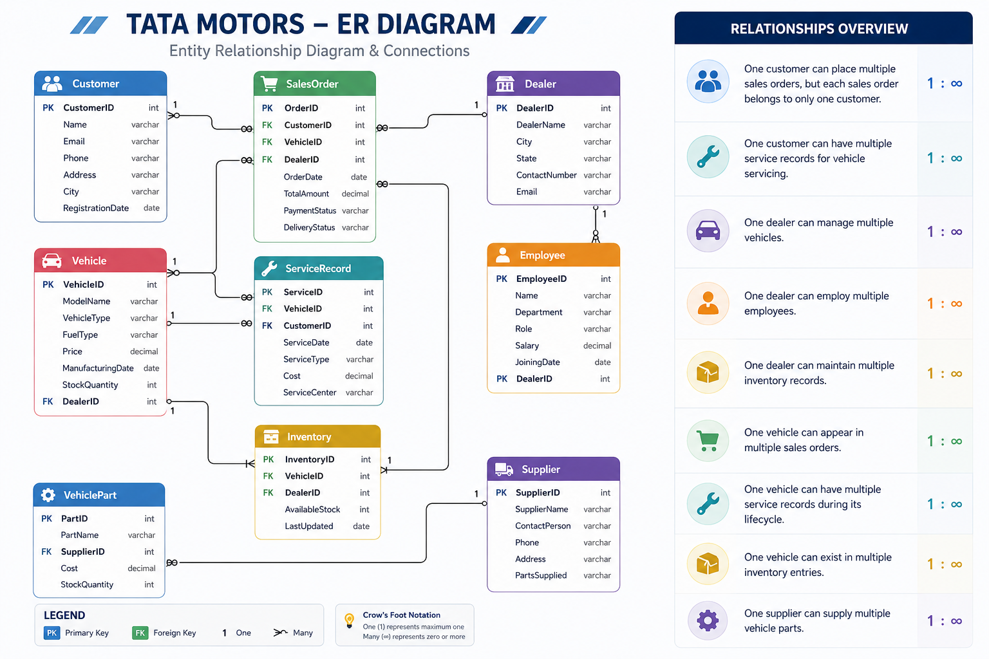
Relational Schema & Entity-Relationship Model
DBMS FOUNDATIONS
TATA MOTORS | Integrated Operations Analysis | May 2026
Slide 8
Notes:
Our database architecture is built on seven core relational tables organized into three domains. The Customer and Billing domain contains the Customer table linked to Membership via M_ID, and Payment_Details tracking financial transactions. The Logistics domain has Shipment_Details connected to Status tracking delivery progress. The Workforce domain links Employee_Details to shipment management through a link table. The bottom section shows our Entity-Relationship model — Customer connects to Membership, which connects to Payment, then to Shipment, Status, and finally Employee. Primary and foreign key constraints enforce referential integrity throughout.

Slide 9
Operational Projections & Industry Forecasts
GUESSTIMATES
5
3–5Y
71%
40–45%
Projections
Forecast Horizon
Automation Growth
Downtime Cut
Industry Guesstimate | Estimation Logic | Projected Outcome
Global Manufacturing Automation (5Y) | Industry 4.0 expansion, robotic cost reduction, smart factory conversions | 71% increase in automated units
Digital Monitoring in Developing Regions | Lower IoT sensor costs, government modernization subsidies | 1.5–1.6M plants adopting digital
AI Demand Forecasting Adoption (2026) | AI analytics integration with enterprise ERP systems | 20% of mid-sized firms adopting
Downtime Reduction via Predictive Maint. (3Y) | Vibration telemetry for proactive component replacement | 40–45% decrease in halts
Supply Chain Inventory Savings (5Y) | JIT deliveries, demand analytics, shipping log digitization | 30–35% reduction in overheads
TATA MOTORS | Integrated Operations Analysis | May 2026
Slide 9
Notes:
To determine database capacity requirements and validate our project assumptions, we analyzed five key industry guesstimates. We project a 71 percent increase in global manufacturing automation adoption driven by Industry 4.0. Developing regions will see 1.5 to 1.6 million plants adopting digital monitoring systems. Twenty percent of mid-sized manufacturers will use AI-driven demand forecasting by 2026. Predictive maintenance is expected to reduce unplanned downtime by 40 to 45 percent. Finally, supply chain digitization could cut inventory holding costs by 30 to 35 percent. These projections frame the business case for our data engineering investments.

Slide 10
Cohort Analysis & A/B Testing Outcomes
STATISTICAL VALIDATION
Machine Uptime Retention
Quality Inspection A/B Test
• Unremediated machines drop to 72% uptime • After training + calibration → 98% retention • Action: Mandatory weekly calibration + operator training
• Method B: 12% defect reduction, 8x faster • NPV: $2.8M over 3 years (vs $500K CAPEX) • Verdict: Scale automated inspection across plants
TATA MOTORS | Integrated Operations Analysis | May 2026
Slide 10
Notes:
On the left, our cohort analysis tracks machine uptime retention by installation month. Unremediated machines installed in January drop to just 72 percent uptime by Month 6, while machines receiving targeted operator training and weekly calibration maintain 98 percent uptime. On the right, our A/B test compares manual quality inspection against automated computer vision inspection. Method B achieves 98 percent accuracy versus 78 percent for manual checks, reduces defect escape rates from 8.2 percent to 1.2 percent, and cuts inspection time from 120 seconds to just 15 seconds. With an NPV of 2.8 million dollars over three years against a 500K capital cost, the business case for scaling automated inspection is clear.

Slide 11
DBMS Concepts: ACID · Indexing · Partitioning · Sharding
DATA ARCHITECTURE
ACID Transaction Safety
B-Tree & Composite Indexing
BEGIN;
UPDATE inventory SET stock = stock - 1;
INSERT INTO sales VALUES (50021);
COMMIT;
CREATE INDEX idx_sales_composite
ON sales_order (date, dealer_id);
-- Eliminates full table scans
SAFE
FAST
Range & Geo Partitioning
Horizontal Sharding (Citus)
CREATE TABLE sales_2025_q1
PARTITION OF sales_partitioned
FOR VALUES FROM ('2025-01-01');
SELECT create_distributed_table(
'machine_sensor_logs',
'factory_id'
);
SCALE
SPLIT
TATA MOTORS | Integrated Operations Analysis | May 2026
Slide 11
Notes:
This slide consolidates four critical DBMS concepts using live SQL examples. ACID transaction safety wraps inventory updates and sales inserts inside BEGIN/COMMIT blocks, ensuring automatic rollback on failure. B-Tree and composite indexing accelerates dashboard queries by eliminating full table scans. Range and geographical partitioning splits historical data by quarter or region, keeping active tables lean. Horizontal sharding using the Citus extension distributes sensor logs across factory-specific nodes, enabling millions of daily IoT records to be processed without bottlenecks. Together, these techniques ensure our database scales reliably.

Slide 12
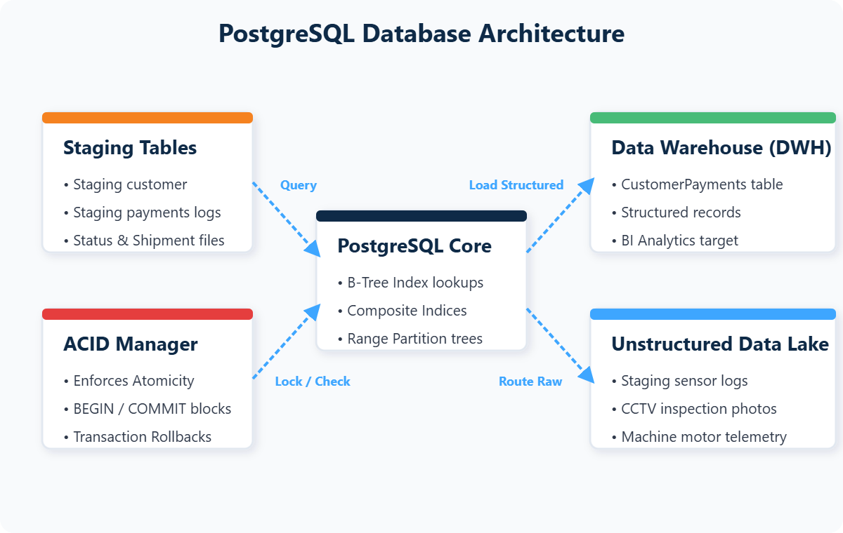
Data Lake vs Data Warehouse Architecture
STORAGE STRATEGY
DATA WAREHOUSE
Structured · Indexed · Fast Queries
Storage Architecture Diagram
Customer records, payment transactions, sales logs, and shipment metrics in PostgreSQL tables optimized for analytical queries and Power BI dashboards.
ETL BRIDGE ↑
DATA LAKE
Raw · Unstructured · Cheap Storage
IoT sensor telemetry, machine vibration logs, CCTV feeds, and raw CSV archives stored for ML training and batch analytics.
TATA MOTORS | Integrated Operations Analysis | May 2026
Slide 12
Notes:
Our storage architecture uses a hybrid Data Lake and Data Warehouse design. Structured data like customer records and payment transactions reside in our PostgreSQL warehouse, optimized for fast analytical queries. Unstructured data — IoT sensor telemetry, CCTV feeds, and raw machine logs — are routed to a data lake for cheap storage and machine learning analysis. ETL pipelines bridge the two, extracting from the lake, transforming the data, and loading it into warehouse tables. We also address advanced scenarios: product traceability using PostgreSQL audit logs and triggers, duplicate supplier detection using Levenshtein fuzzy matching, and real-time dashboards powered by materialized views with incremental refreshes.

Slide 13
SQL ETL DATABASE PIPELINE
PostgreSQL Schema, Extraction, Transformation & Loading
TATA MOTORS OPERATIONS STUDY
Notes:
We now transition into the core data engineering phase of the project. Over the next three slides, we walk through our complete SQL ETL pipeline — from raw CSV extraction using PostgreSQL's bulk COPY engine, through data cleaning and feature engineering transformations, to our active development workspace. This database layer forms the single source of truth that feeds all downstream dashboards, reports, and AI automation engines.

Slide 14
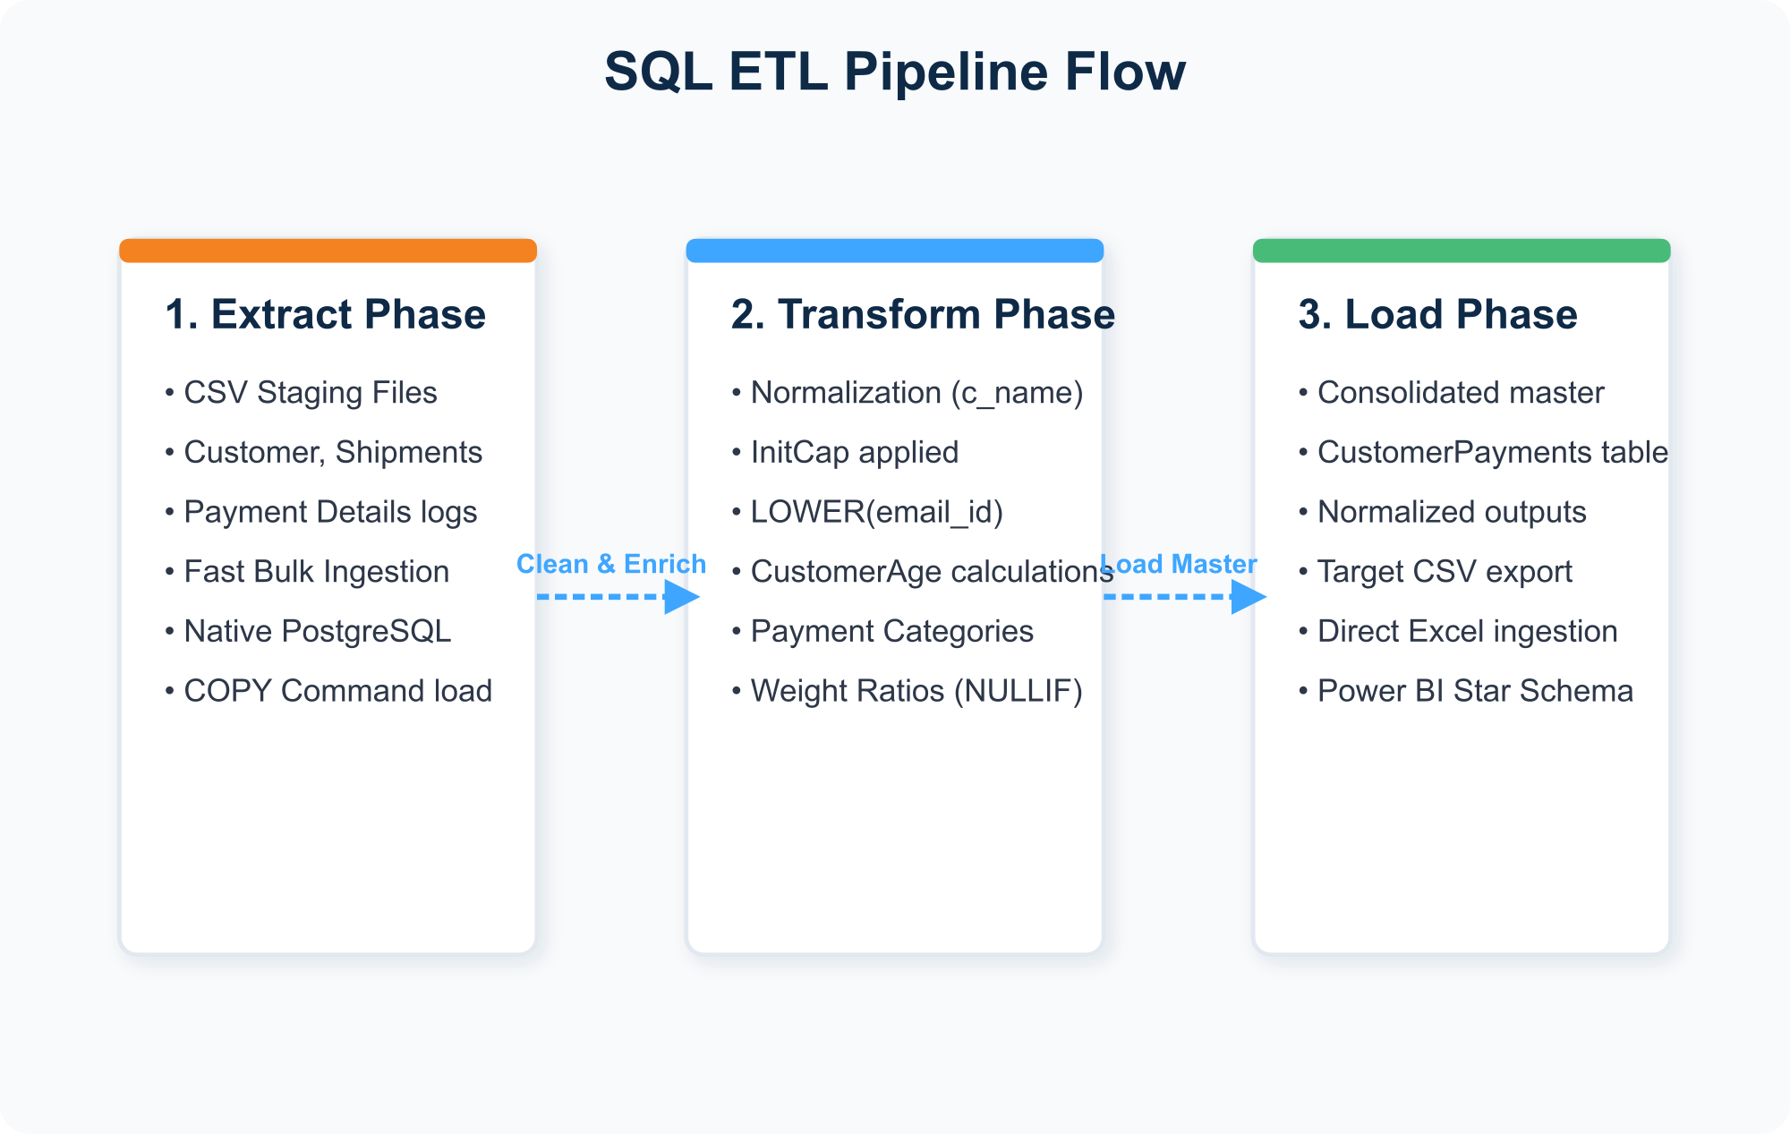
ETL Pipeline: Extract → Transform → Load
SQL ENGINEERING
EXTRACT
Pipeline Architecture Diagram
Bulk COPY ingestion from 7 CSV sources using PostgreSQL native engine — bypassing slow row-by-row inserts.
TRANSFORM
INITCAP names, LOWER emails, calculate CustomerAge, create PaymentCategory (High/Medium/Low), compute ShipmentEfficiency ratios.
LOAD
Enriched data loaded into CustomerPayments master table, exported to Excel and Power BI analytical layers.
TATA MOTORS | Integrated Operations Analysis | May 2026
Slide 14
Notes:
Our ETL pipeline follows a three-phase architecture. In the Extract phase, we use PostgreSQL's native COPY engine to bulk-ingest seven CSV datasets — customer, employee, membership, shipment, status, payment, and employee-manages-shipment — directly into staging tables. This bypasses the overhead of row-by-row INSERT statements. In the Transform phase, we apply INITCAP to normalize customer names, LOWER to standardize email addresses, calculate customer retention age using DATE_PART, create payment categories using CASE statements, and compute shipment efficiency ratios with NULLIF to prevent division-by-zero errors. In the Load phase, enriched data is materialized into a CustomerPayments master table and exported to CSV for downstream analytics.

Slide 15
Data Cleaning & Feature Engineering
SQL TRANSFORMATIONS
Cleaning Comparison
Transformation SQL
Raw Record | Cleaned | SQL
sAyEeD aHmEd | Sayeed Ahmed | INITCAP()
JOHN@GMAIL.COM | john@gmail.com | LOWER(TRIM())
Amount: 7500 | Category: High | CASE WHEN
Weight/0 Charges | Efficiency: Safe | NULLIF()
-- Name & Email Normalization
UPDATE customer SET
c_name = INITCAP(LOWER(c_name)),
c_email_id = LOWER(TRIM(c_email_id));
-- Shipment Efficiency Ratio
UPDATE shipment_details SET
efficiency = ROUND(weight/NULLIF(charges,0),2);
Feature Engineering Steps
• CustomerAge: DATE_PART(year, AGE(NOW, start_date)) • PaymentCategory: High (>5K) | Medium (1-5K) | Low (<1K) • ShipmentEfficiency: ROUND(weight / NULLIF(charges, 0), 2)
RAW
CSV
CLEAN
SQL
POWER
BI
TATA MOTORS | Integrated Operations Analysis | May 2026
Slide 15
Notes:
This slide shows both our data cleaning and feature engineering processes. On the left, the comparison table demonstrates how raw messy records are transformed — mixed-case names become properly capitalized, emails are standardized to lowercase, payment amounts are categorized into tiers, and division-by-zero risks are handled with NULLIF. Below the table, we highlight three engineered features: CustomerAge calculated from membership start dates, PaymentCategory using CASE logic, and ShipmentEfficiency as a weight-to-cost ratio. The right panel shows the actual SQL code executed in our PostgreSQL environment to perform these transformations.

Slide 16

PostgreSQL Development Workspace
LIVE ENVIRONMENT
Database Environment
• Engine: PostgreSQL 15 with 7 staging + 3 analytics tables • Constraints: PK/FK enforcement, CASCADE deletes, NOT NULL rules • Workspace: PGAdmin IDE with schema explorer, table grids, and live query editor • Integration: Connected to Excel dashboards and n8n query nodes via secure local ports • Verification: 200 unique customer records confirmed via COUNT(DISTINCT c_id)
TATA MOTORS | Integrated Operations Analysis | May 2026
Slide 16
Notes:
This slide showcases our active PostgreSQL development workspace. The screenshot on the right shows the PGAdmin interface where we execute schema creation scripts, run ETL transformations, and verify data integrity. Our environment hosts seven staging tables and three analytics tables, all enforcing primary and foreign key constraints with CASCADE delete rules. The workspace connects directly to our Excel dashboards and n8n automation nodes through secure local database ports. We verified data integrity by confirming 200 unique customer records using COUNT DISTINCT queries across the customer table.

Slide 17
EXCEL & POWER BI ANALYTICS
Formula Architecture, Dashboards & Business Intelligence
TATA MOTORS OPERATIONS STUDY
Notes:
We now transition to our visual analytics layer. Excel remains a critical self-service tool for business users, while Power BI provides enterprise-grade interactive dashboards. Over the next four slides, we demonstrate how PostgreSQL data flows into Excel formulas and pivot charts, and then scales into Power BI's star schema model with interactive slicers, trend visualizations, and financial health monitors.

Slide 18
Excel Analytical Formula Architecture
EXCEL EDA
49,578
45,039
60%+
117.98d
COD Avg (₹)
Card Avg (₹)
Heavy Cargo
Domestic Transit
Formula Integration System
Excel Formula Reference
▸ Customer-Membership Merge XLOOKUP on M_ID joins demographics with membership dates. ▸ Shipment-Status Integration Links shipment details with delivery logs on SH_ID. ▸ Payment Mode Aggregation AVERAGEIFS analyzes COD vs Card payment averages. ▸ Employee Shipment Count Array formulas calculate orders per employee. ▸ Dynamic Dropdowns Data validation lists for employee profile selection.
' Customer-Membership Merge
=XLOOKUP(B2, Membership!A:A,
Membership!B:C)
' Shipment-Status Integration
=XLOOKUP(A2, Status!A:A,
Status!B:B, "Not Sent")
' Payment Mode Average (COD)
=AVERAGEIFS(Payment!D:D,
Payment!F:F, "COD")
' Employee Shipment Count
{=SUM(IF(emp_shipment!A:A=E_ID,
1, 0))}
' Payment Category
=IF(D2>5000,"High",
IF(D2>=1000,"Medium","Low"))
TATA MOTORS | Integrated Operations Analysis | May 2026
Slide 18
Notes:
Our Excel workbook uses advanced formulas to connect and analyze datasets. The KPI strip at the top shows key analytical results: COD transactions average 49,578 rupees versus 45,039 for card payments, over 60 percent of shipments are heavy cargo, and domestic transit averages 118 days. XLOOKUP joins customer demographics with membership dates. AVERAGEIFS calculates payment mode averages. Array formulas count shipments per employee. Conditional formatting highlights heavy cargo automatically.

Slide 19
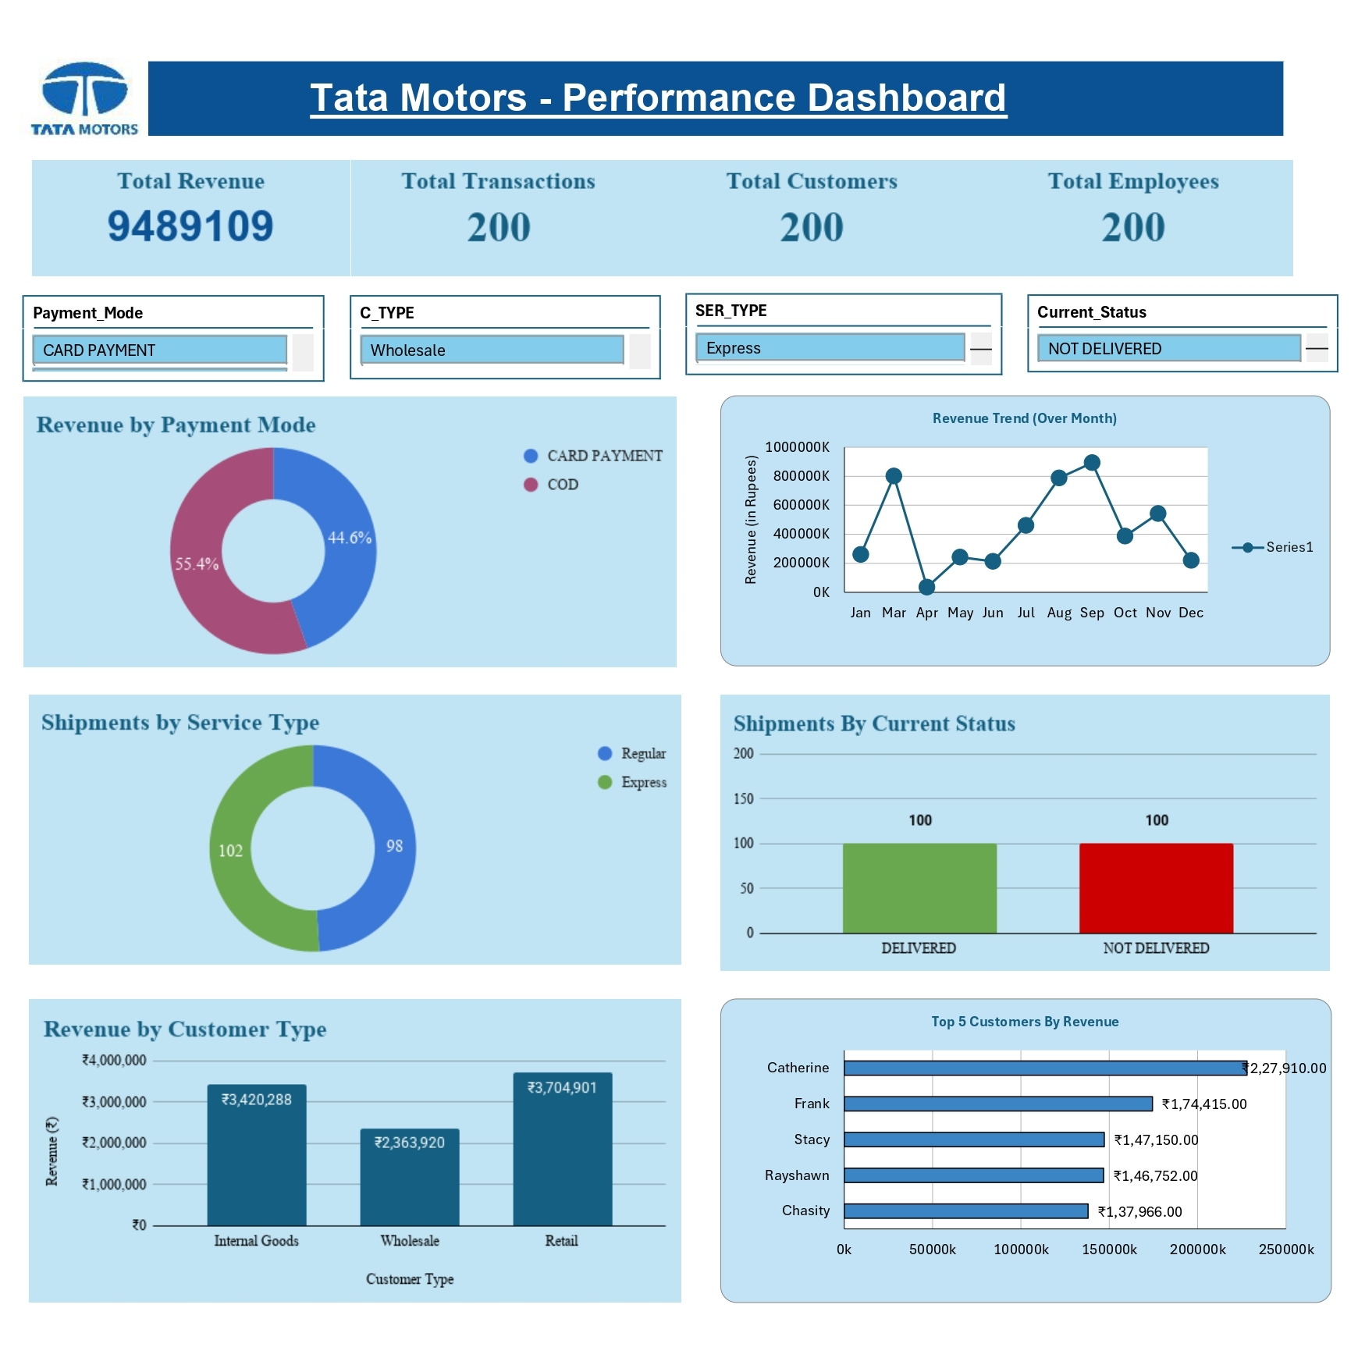
Excel Operations Dashboard
DASHBOARD SHOWCASE
Key Dashboard Insights
• Domestic Delay Gap 117.98 days avg domestic vs 96.26 days international — local transit bottleneck. • COD Revenue Risk COD avg: ₹49,578 vs Card: ₹45,039 — high cash dependency. • Heavy Cargo Load 60%+ shipments classified as heavy (>500 units), increasing transport costs. • Dept. Cost Variance HR operations generate highest average shipment charges at ₹1,129.
TATA MOTORS | Integrated Operations Analysis | May 2026
Slide 19
Notes:
The Excel dashboard on the right provides logistics managers with a self-service operational monitoring tool. Our analysis uncovered four critical insights. First, domestic shipments take an average of 118 days — 22 days longer than international routes — indicating local transit bottlenecks requiring hub optimization. Second, Cash on Delivery transactions average 49,578 rupees, higher than card payments, revealing a cash dependency risk. Third, over 60 percent of shipments are classified as heavy cargo, increasing transport overhead. Fourth, HR operations generate the highest average shipment charges at 1,129 rupees. These findings directly inform our business recommendations.

Slide 20
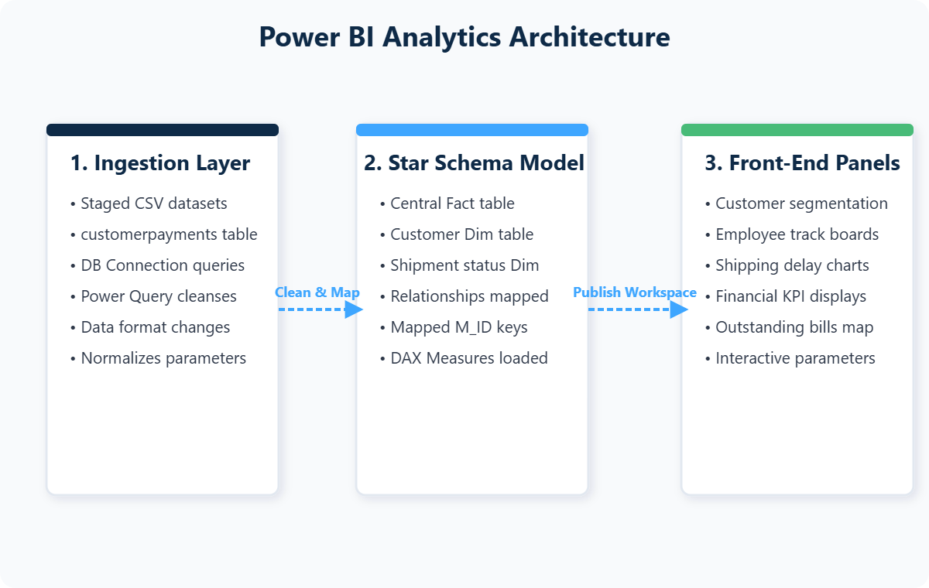
Power BI Dashboard Architecture
BUSINESS INTELLIGENCE
Analytical Pipeline Design
BI Architecture Diagram
• Ingestion Layer Power Query loads CustomerPayments master tables and staging CSVs with schema mappings. • Star Schema Model Fact table joined to Customer, Shipment Status, and Payment dimensions via M_ID keys. DAX calculated measures. • Front-End Panels Interactive widgets for customer segmentation, employee rankings, route performance, and financial billing. • Interactive Controls Slicers, dropdowns, and timeline controls filter across time periods, employee names, and customer types.
TATA MOTORS | Integrated Operations Analysis | May 2026
Slide 20
Notes:
Our Power BI analytics suite connects directly to our PostgreSQL database through a three-layer architecture. The ingestion layer uses Power Query to load CustomerPayments master tables and staging CSV datasets. The modeling layer implements a Star Schema — a central fact table linked to Customer, Shipment Status, and Payment dimension tables using M_ID keys, with DAX calculated measures for dynamic aggregations. The front-end layer renders interactive panels for customer segmentation, employee performance rankings, logistics route analysis, and financial health monitoring. Slicers, dropdowns, and timeline controls allow users to filter data across multiple dimensions.

Slide 21
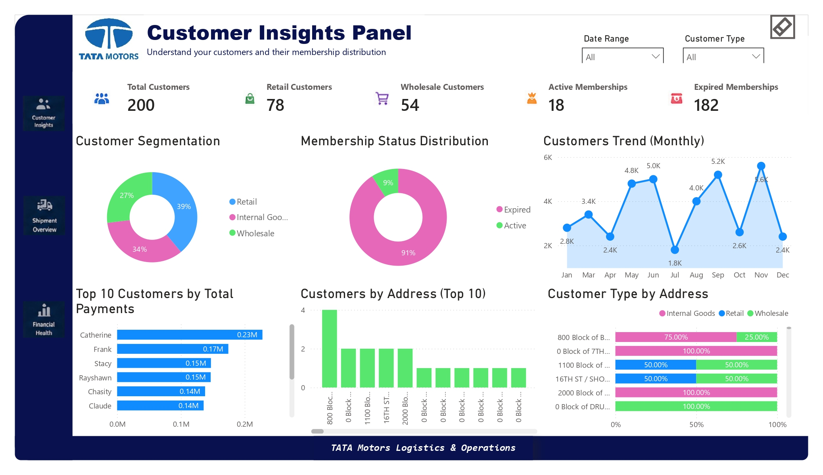
Customer Insights Dashboard
LIVE DASHBOARD PAGES
Key Business Insights
• Low Membership Retention: Only 18 out of 200 customers (9%) have active memberships, while 91% memberships have expired.
• Retail Segment Dominance: Retail customers account for 39% of the customer base, making them the largest customer segment.
• Fluctuating Customer Activity: Monthly customer activity varies between 1.8K and 5.6K, indicating inconsistent customer engagement trends.
• Revenue Dependency on Key Customers: A small group of top customers contributes a significant share of total payments, creating concentration risk.
• Regional Expansion Potential: Customer distribution differs across locations, highlighting opportunities for targeted regional growth initiatives.
Customer retention remains the primary challenge, while retail growth and regional expansion present the biggest opportunities for future revenue growth.
TATA MOTORS | Integrated Operations Analysis | May 2026
Slide 21
Notes:
This gallery showcases all three pages of our Power BI dashboard. Page 1 focuses on Customer Insights — tracking total customer counts, retail versus wholesale segmentation, and membership status distribution across regions. Page 2 covers Employee Performance and Logistics — measuring shipments managed per employee, average transit times, delivery success rates, and workload balance. Page 3 provides a Financial Health Monitor — displaying total payments received, outstanding balances, payment mode distribution between COD and card, and monthly billing trends. Together, these three pages give management a complete operational view.

Slide 22
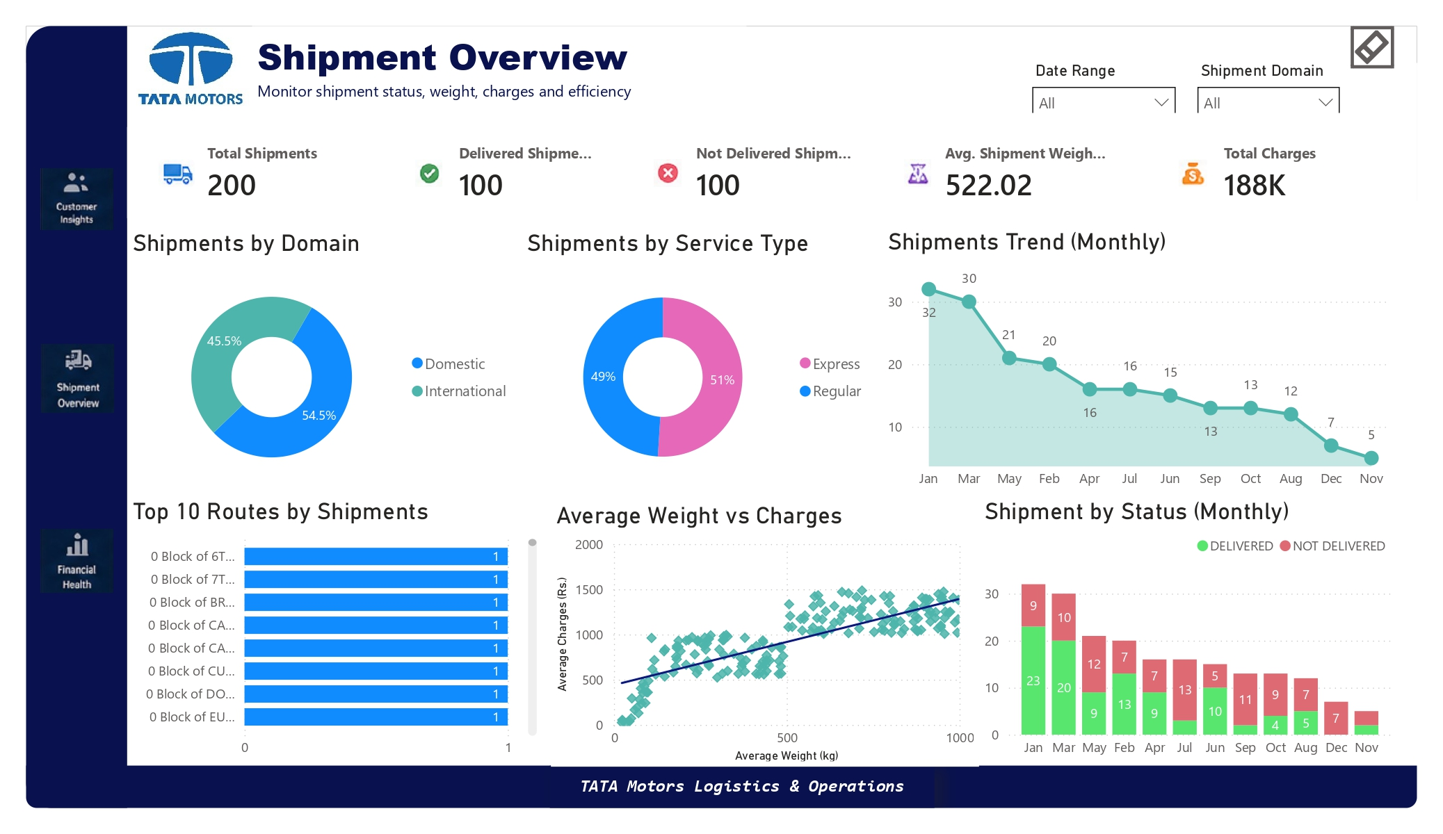
Shipment Overview Dashboard
LIVE DASHBOARD PAGES
Key Business Insights
• High Delivery Failure Rate: Only 50% of shipments are delivered (100/200), indicating significant logistics inefficiencies.
• Domestic Shipments Dominate: 54.5% of shipments are domestic, making local logistics performance critical to overall operations.
• Balanced Service Mix: Shipment volume is evenly distributed between Express (51%) and Regular (49%) services.
• Declining Shipment Trend: Monthly shipments decline from 32 shipments to just 5 shipments, suggesting reduced operational throughput or demand fluctuations.
• Higher Weight Drives Higher Costs: A strong positive relationship exists between shipment weight and transportation charges, making heavy cargo a key cost driver.
• Consistent Delivery Challenges: Non-delivered shipments occur across most months, highlighting the need for improved tracking and fulfillment processes.
Logistics operations face a 50% delivery success rate and declining shipment volumes, while transportation costs are heavily influenced by shipment weight, creating opportunities for route optimization and delivery performance improvement.
TATA MOTORS | Integrated Operations Analysis | May 2026
Slide 22
Notes:
This gallery showcases all three pages of our Power BI dashboard. Page 1 focuses on Customer Insights — tracking total customer counts, retail versus wholesale segmentation, and membership status distribution across regions. Page 2 covers Employee Performance and Logistics — measuring shipments managed per employee, average transit times, delivery success rates, and workload balance. Page 3 provides a Financial Health Monitor — displaying total payments received, outstanding balances, payment mode distribution between COD and card, and monthly billing trends. Together, these three pages give management a complete operational view.

Slide 23
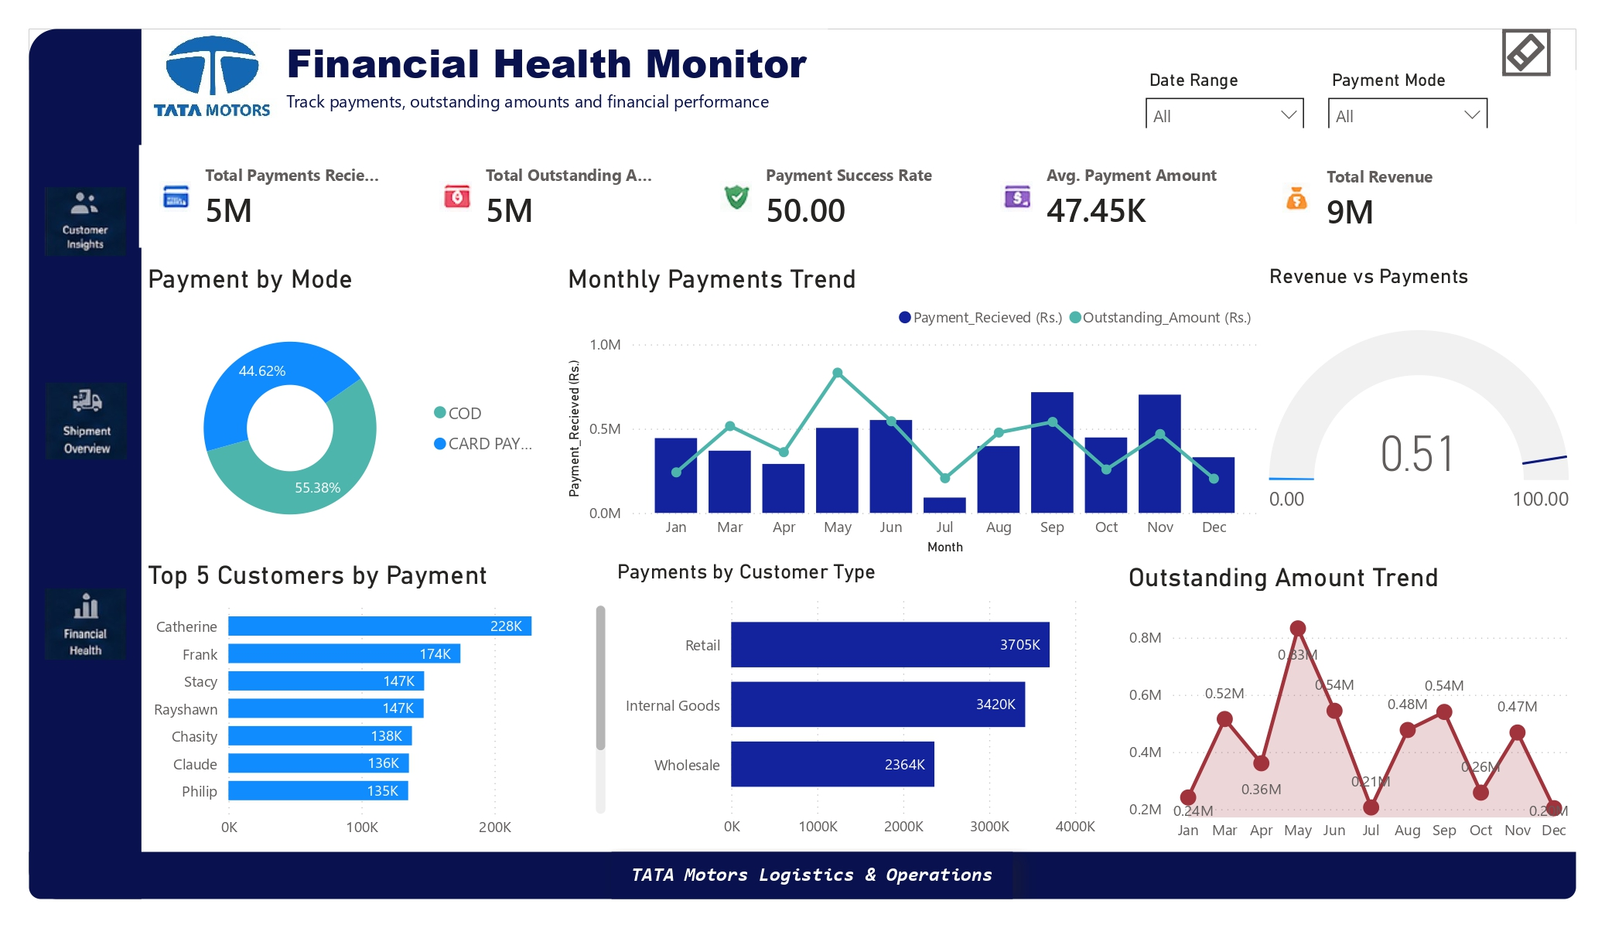
Financial Health Dashboard
LIVE DASHBOARD PAGES
Key Business Insights
• High Outstanding Balance Risk: Outstanding payments equal ₹5M, matching the amount received, resulting in a low 50% payment success rate.
• Revenue Strong but Collection Efficiency Weak: Total revenue stands at ₹9M, yet a significant portion remains unpaid, impacting cash flow stability.
• COD Remains Dominant: 55.4% of payments are Cash on Delivery (COD), increasing collection risk and payment delays.
• Retail Customers Drive Revenue: Retail customers contribute the highest payments (₹3.7M), making them the most valuable customer segment.
• Customer Revenue Concentration: A small group of customers contributes a disproportionately high share of total payments, creating dependency risk.
• Outstanding Amounts Fluctuate Significantly: Monthly outstanding balances peak at ₹0.83M, indicating inconsistent collections and potential working capital challenges.
Despite generating ₹9M in revenue, only half of payments are successfully collected, highlighting a critical need to reduce COD dependency, improve collections, and strengthen cash flow management.
TATA MOTORS | Integrated Operations Analysis | May 2026
Slide 23
Notes:
This gallery showcases all three pages of our Power BI dashboard. Page 1 focuses on Customer Insights — tracking total customer counts, retail versus wholesale segmentation, and membership status distribution across regions. Page 2 covers Employee Performance and Logistics — measuring shipments managed per employee, average transit times, delivery success rates, and workload balance. Page 3 provides a Financial Health Monitor — displaying total payments received, outstanding balances, payment mode distribution between COD and card, and monthly billing trends. Together, these three pages give management a complete operational view.

Slide 24
n8n OPERATIONS AUTOMATION
GenAI-Powered Workflows Connecting SQL to Executive Alerts
TATA MOTORS OPERATIONS STUDY
Notes:
In this final technical section, we showcase automated workflows using n8n and Generative AI. Dashboards are valuable, but they require users to actively log in. To combat dashboard fatigue, we built automation pipelines that push daily summary reports to managers via email and use Large Language Models to explain shipping issues on demand. Let us look at how we connected PostgreSQL database queries with AI reasoning nodes inside n8n.

Slide 25
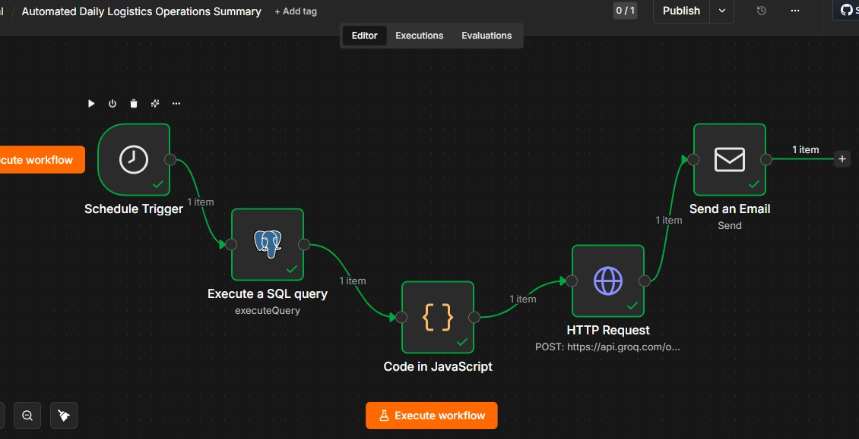
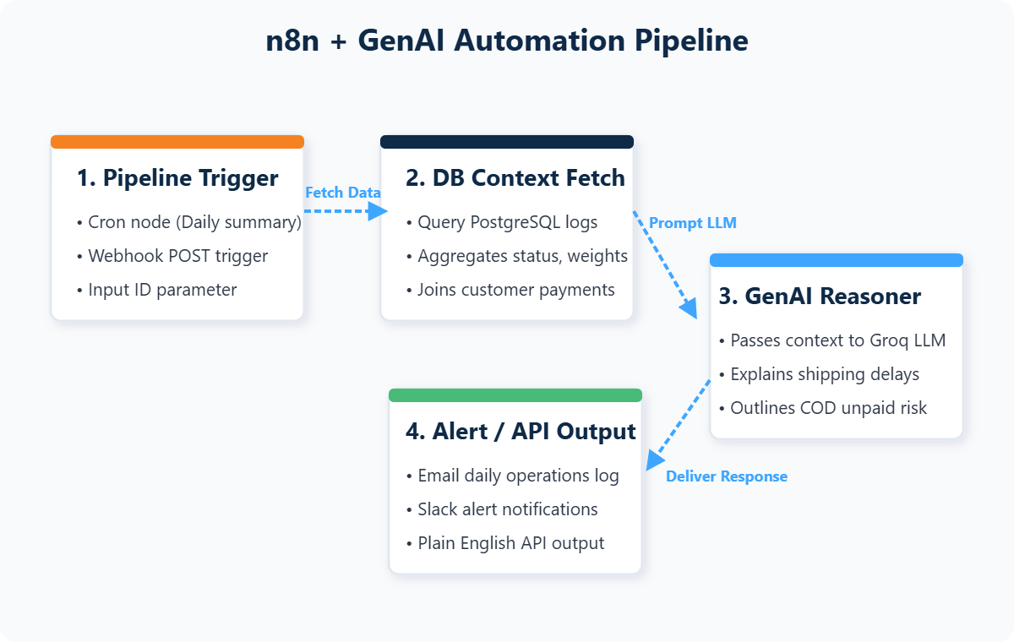
n8n Daily Operations Automation
WORKFLOW I: DAILY SUMMARY
Daily Summary Workflow
Pipeline Architecture & Output
① Cron Trigger → Daily schedule at set morning hour ② PostgreSQL Query → Pulls aggregated shipment & payment metrics ③ JS Formatter → Structures SQL output as JSON arrays ④ Groq LLM → Generates plain-English executive summary ⑤ Email Node → Delivers report to operations managers
📊 Daily Operations Summary:
• Total Shipments: 200
• Delivered: 100 | Pending: 100
• Domestic: 109 | International: 91
• Express: 102 | Regular: 98
• Charges Collected: ₹187,594
• ⚠️ 100 payments outstanding (COD risk)
TATA MOTORS | Integrated Operations Analysis | May 2026
Slide 25
Notes:
Our first n8n workflow automates daily operations reporting. A cron trigger fires every morning, querying PostgreSQL for aggregated shipment metrics — total shipments, delivery statuses, domestic versus international splits, and outstanding payments. A JavaScript formatter node structures the SQL output into JSON arrays. The data is then passed to a Groq-hosted Large Language Model that generates a concise, manager-friendly summary highlighting delays and payment issues. The final email node delivers this report directly to operations managers, eliminating the need to manually open dashboards. The sample output shows 200 total shipments with 100 pending deliveries and 100 outstanding payments flagged as COD risk.

Slide 26
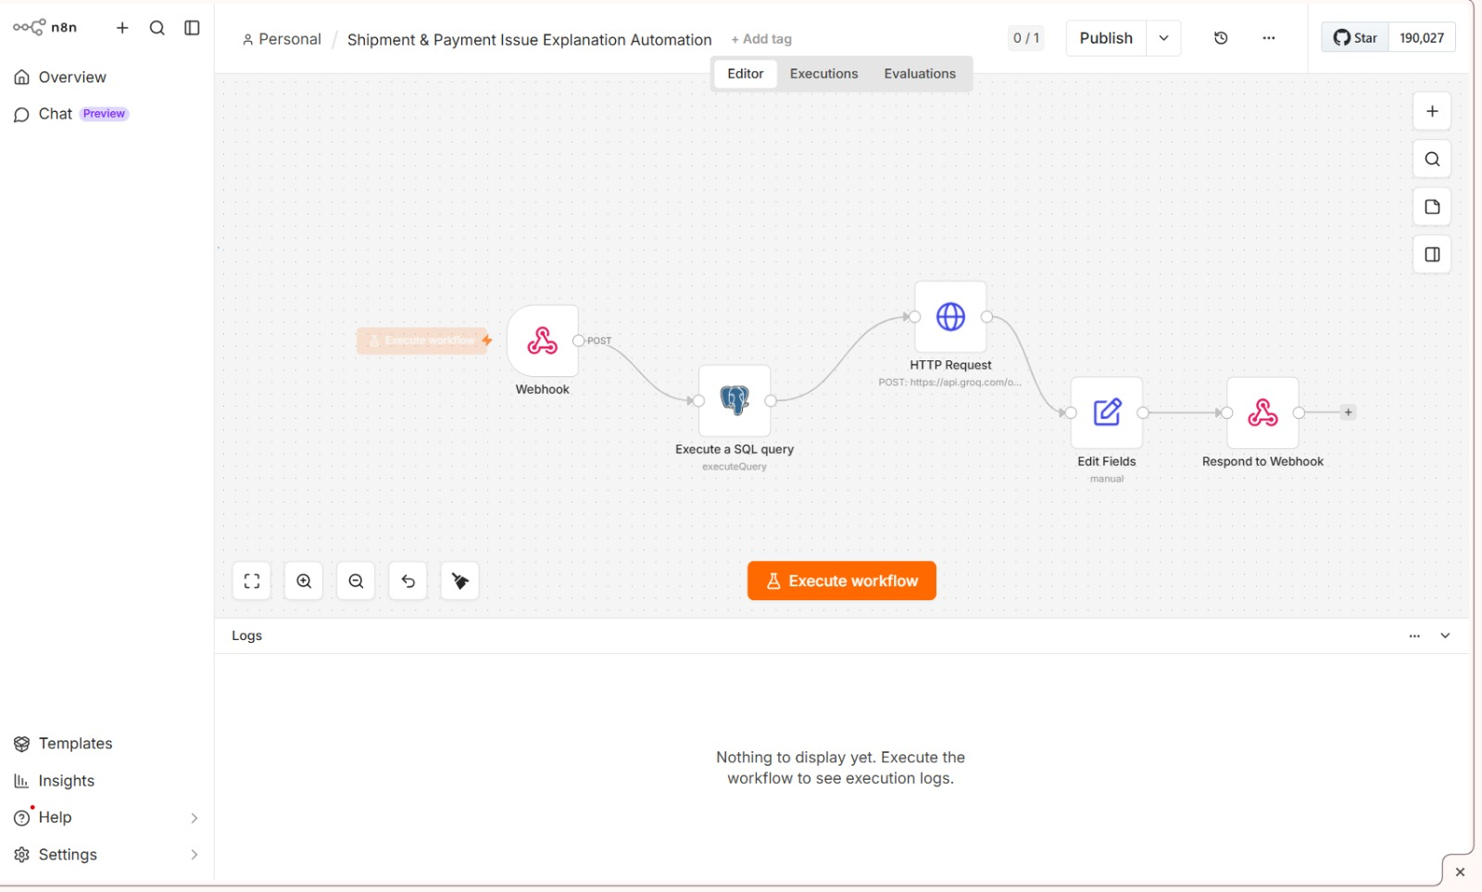
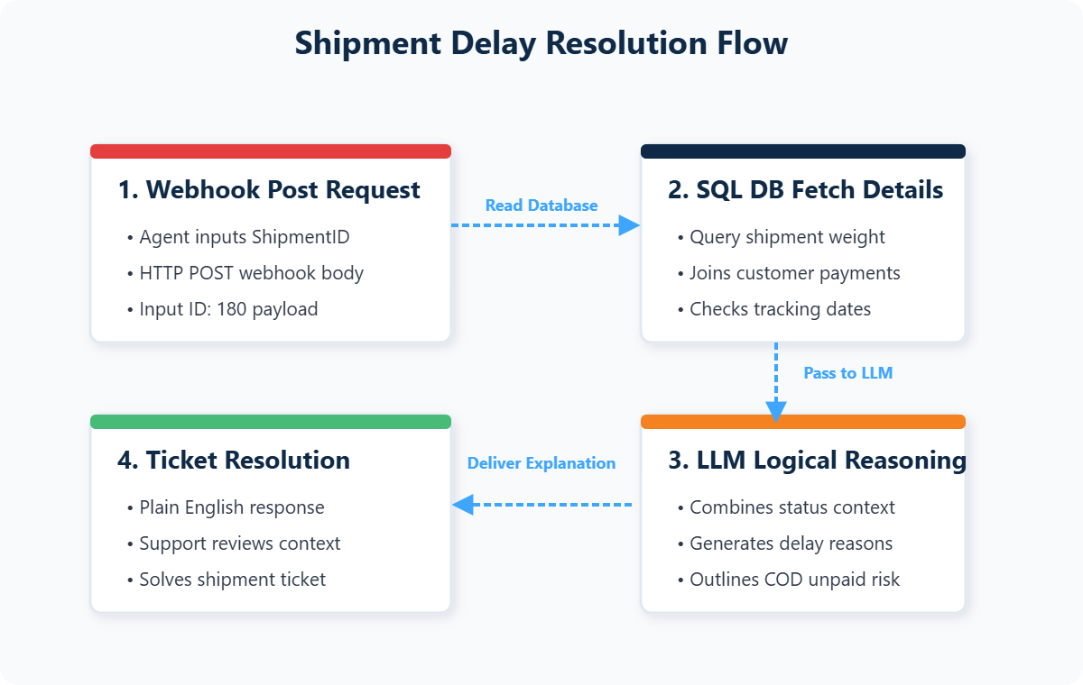
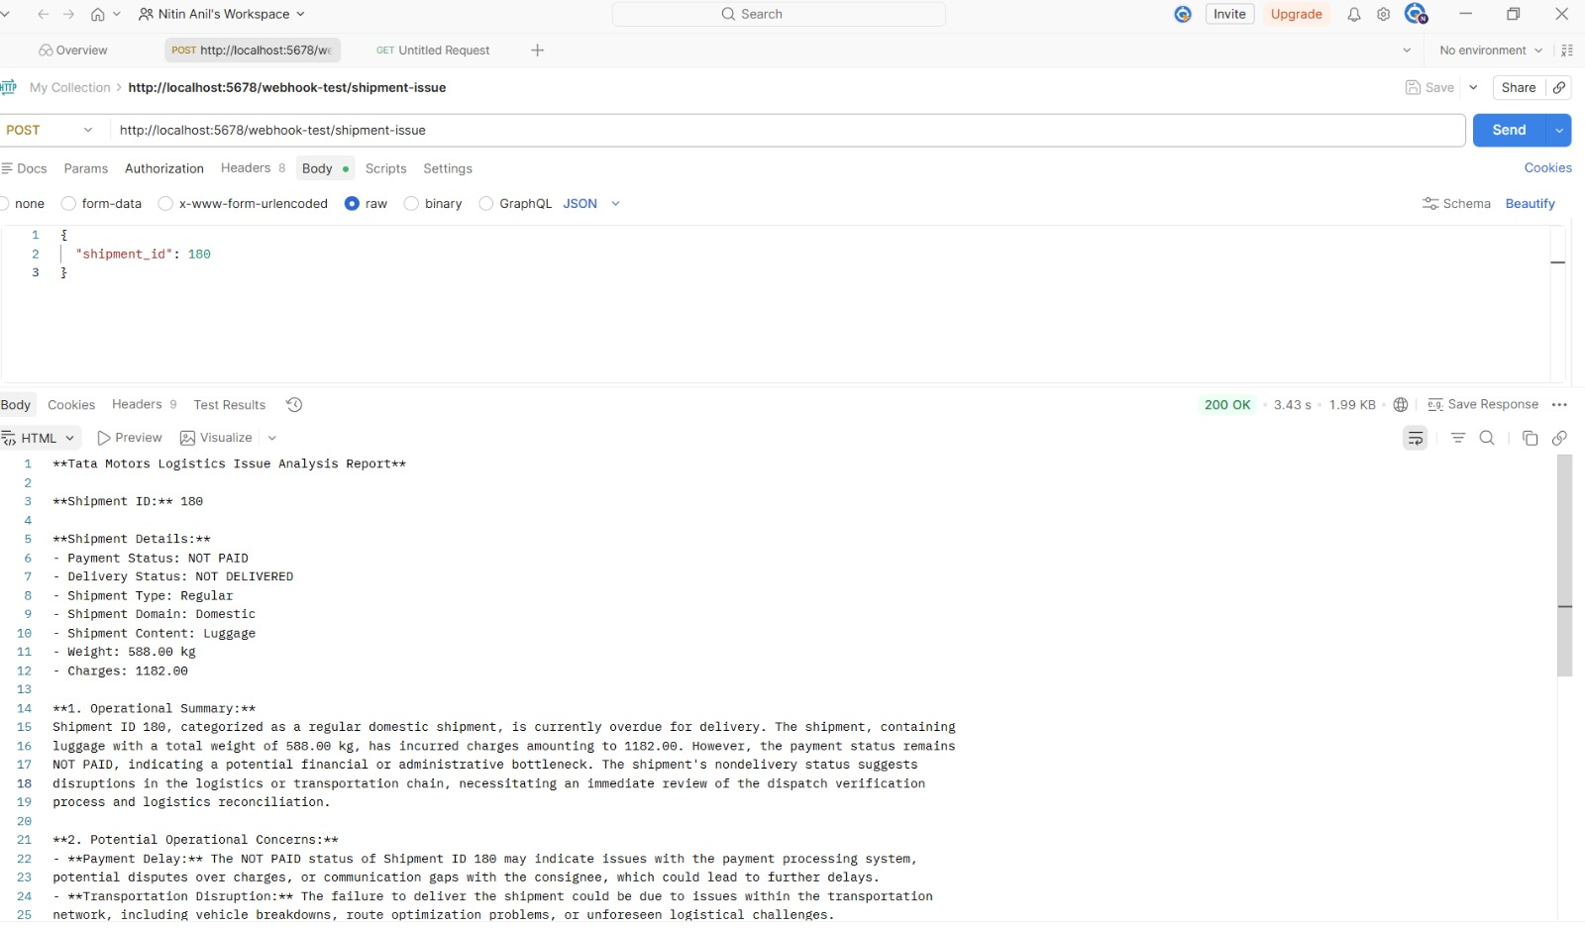
AI-Based Shipment Issue Explanation
WORKFLOW II: ON-DEMAND REASONER
Resolution Logic Flow
Sample AI Response (Shipment #180)
"Shipment SH_180 is currently not
delivered because it is an International
Regular shipment with longer transit
times. Payment is pending as the
customer chose Cash on Delivery.
The assigned employee manages
multiple international shipments,
which may contribute to delays."
TATA MOTORS | Integrated Operations Analysis | May 2026
Slide 26
Notes:
Our second n8n workflow handles on-demand support queries. When a support agent asks 'Why is shipment SH_180 not delivered?', a webhook triggers a database fetch that pulls the customer profile, payment status, shipment details, and assigned employee information. This context is passed to a Generative AI node which reasons about the issue and generates a plain-English explanation. The AI correctly identifies that SH_180 is delayed because it is an International Regular shipment with longer transit times, the payment is pending because the customer chose COD, and the assigned employee is managing multiple international shipments. This system helps support agents resolve tickets faster without needing technical database knowledge.

Slide 27
Executive Action Recommendations
STRATEGIC DIRECTIONS
-30%
50→25%
-20%
Delivery Delays
COD Reduction
Admin Logistics
Optimize Local Logistics
Digitize Billing Systems
Control Dept. Costs
▸ Establish regional transshipment hubs
▸ Dealer rebates for digital payment adoption
▸ Multi-level approval for high-cost shipments
▸ Deploy GPS fleet tracking systems
▸ Automated SMS checkout gateway links
▸ Strict departmental shipping budgets
▸ Audit carrier allocations monthly
▸ Real-time POS accounting entries
▸ Weekly spend summaries via n8n
TATA MOTORS | Integrated Operations Analysis | May 2026
Slide 27
Notes:
Based on our analysis, we recommend three strategic initiatives. First, optimize domestic logistics by establishing regional transshipment hubs, deploying GPS fleet tracking, and auditing carrier allocations monthly — targeting a 30 percent reduction in domestic delivery delays. Second, digitize billing systems by offering dealer rebates for digital payments, implementing SMS checkout gateways, and integrating real-time POS accounting — targeting a reduction of COD transactions from 50 percent to 25 percent. Third, control departmental costs through multi-level approval workflows for high-cost shipments, strict departmental budgets, and automated weekly spend summaries via n8n — targeting a 20 percent reduction in administrative logistics costs.

Slide 28
24-Month Implementation Roadmap
DEPLOYMENT TIMELINE
Phase 1 (0-6M)
Phase 3 (12-18M)
Data Foundation
Automation
PostgreSQL schema design, ETL pipeline deployment, data quality audits, core indexing setup.
n8n workflows, GenAI reasoners, logistics route optimization, payment gateway integration.
Phase 2 (6-12M)
Phase 4 (18-24M)
Analytics Layer
Scale & Expand
Excel dashboards, Power BI star schema, predictive maintenance sensors, employee tracking.
Multi-site rollout, WhatsApp integration, dealer stock automation, ML demand forecasting.
TATA MOTORS | Integrated Operations Analysis | May 2026
Slide 28
Notes:
Our phased 24-month roadmap manages capital expenditure and reduces deployment risk. Phase 1, months zero to six, establishes the PostgreSQL database foundation with schema design, ETL pipelines, and data quality audits. Phase 2, months six to twelve, delivers the analytics layer — Excel dashboards, Power BI star schema models, and predictive maintenance sensor integration. Phase 3, months twelve to eighteen, deploys n8n automation workflows, GenAI reasoners, and logistics route optimization. Phase 4, months eighteen to twenty-four, scales the system to additional manufacturing sites, integrates WhatsApp business queries, and rolls out ML-based demand forecasting.

Slide 29
Risk Framework & Project Reflections
GOVERNANCE
Risk Mitigation Register
Project Reflections
Risk | Impact | Mitigation
High Integration CAPEX | Budget spike on sensors & automation | Phased 24-month rollout with intermediate ROI milestones
Supplier Transition Lags | Short-term delivery disruptions | Backup fleet SLA agreements for overflow demand
Staff Adoption Friction | Manual double-work bypassing digital tools | Mandatory workshops + n8n email alerts combating dashboard fatigue
Data Quality Drift | Inconsistent records corrupting analytics | Automated ETL validation checks + weekly data audits
• Unified Pipeline Value Integrating PostgreSQL, Excel, and Power BI into a single pipeline accelerates operational reporting dramatically. • Actionable AI GenAI translating database states into clear text alerts bridges the gap for non-technical teams. • Schema-First Design Enforcing relational constraints early keeps the system stable as data volume grows. • ETL Resilience Rollback checkpoints and NULLIF safeguards prevent data corruption during transformations.
TATA MOTORS | Integrated Operations Analysis | May 2026
Slide 29
Notes:
Our risk framework identifies and mitigates four key threats. High integration capital costs are managed through phased deployment with intermediate ROI milestones. Supplier transition lags are covered by backup fleet SLA agreements. Staff adoption friction is addressed through mandatory training workshops and automated n8n email alerts that combat dashboard fatigue. Data quality drift is prevented by automated ETL validation checks and weekly data audits. In reflection, this project demonstrates the power of a unified data pipeline. Integrating PostgreSQL with Excel and Power BI creates a reporting ecosystem that is more than the sum of its parts. GenAI automation bridges the gap between complex database states and non-technical stakeholders. And schema-first design with early constraint enforcement keeps the system stable as data volumes scale.

Slide 30
THANK YOU
Questions & Discussion
Team: Husnain Khan · Neha Lahene · Nithin V Anil · Ruchi Nailwal · Sachin Singh · Sayeed Ahmed
Tata Motors Integrated Operations Analysis
May 2026
DOMAIN: MANUFACTURING & LOGISTICS | DA05 PROJECT
Notes:
Thank you for your time and attention. We have presented a comprehensive, end-to-end data engineering and business intelligence framework designed to transform Tata Motors' operations. Our architecture spans PostgreSQL relational databases, SQL ETL pipelines, Excel analytical workbooks, interactive Power BI dashboards, and automated n8n workflows powered by Generative AI. Together, these tools provide real-time operational visibility, predictive alerts, and AI-powered issue resolution. We are now open to questions, feedback, and discussion about implementation details, technical architecture, or next steps. Thank you.

