Slide 1
Team Members: Shruti Patel (12539) Vidit Mody (12602) Ruchir Kute (12457) Rakhi Partani (12255) Mihirsinh Raol (13844) Ashutosh Patel (13893)
Vehicle Tracking & Safety Services (VTSS)

Slide 2

PROJECT CONTENTS
Project Description
Building Blocks - VTSS
Application Modules
Application Features
Application Services
VTSS Client (Main Application) Screen
VTSS Transmitter (GPS Device) Screen
Project Workflow
Credits

Slide 3

PROJECT DESCRIPTION
VTSS application is designed to Track Vehicles and provide Safety Services in case of an emergency with single button click
Services to locate Hospitals & Garages near your current location
Services for sending SMS & Current Location to registered SOS numbers
Services to call Police, Ambulance & Fire Department

Slide 4

BUILDING BLOCKS - VTSS
Google AI
Google API
GPS
Intents
SQLite
External Storage
MySQL

Slide 5
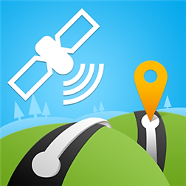

OUR APPLICATION MODULES
VTSS (Main Module)
Transmitter Module (GPS Device)

Slide 6








APPLICATION FEATURES

Slide 7







APPLICATION SERVICES
Vehicle Tracking
Track your vehicle and get instant updates about it’s location.
Hospital Locator
Locate all hospitals near your location in case of an emergency.
Garage Locator
Locate all garages near your location in case of an emergency.
911 Calling
Call police by pressing a single button if you need any help.
Ambulance Calling
Call ambulance by pressing a single button if you need any medical help.
Fire Department Calling
Call fire brigade by pressing a single button in case of fire.
SOS Services
Send SMS and your current location to your registered emergency numbers in case of any emergency just with a single click.
SOS Number Registration
Register your emergency phone numbers for hassle free SOS services.

Slide 8
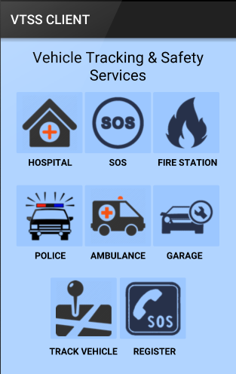
VTSS CLIENT (MAIN APPLICATION)
This is the main client application which user need to install on his/her mobile to get benefits of tracking his/her vehicle and other safety services.

Slide 9
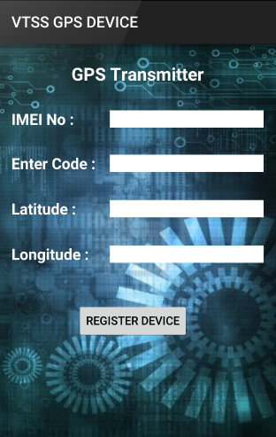
VTSS TRANSMITTER (GPS DEVICE)
This is the transmitter application which will fill in for a GPS device. In our case we are using a mobile instead of a GPS device. This application will be installed on a mobile and the mobile will be kept inside the car for tracking.

Slide 10




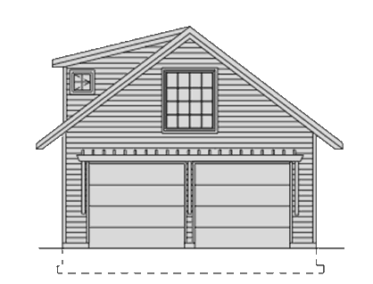
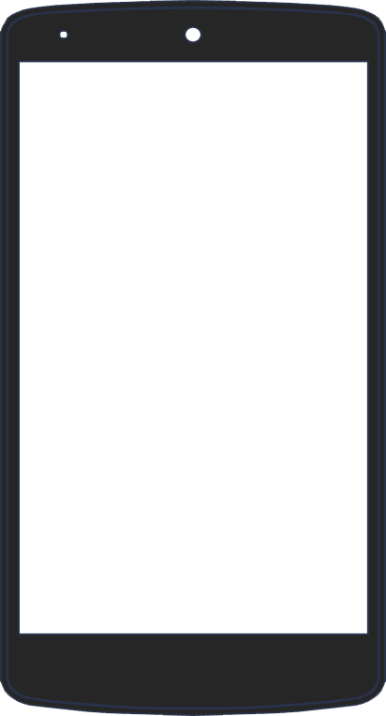







Where is my car? :o
Let me track it.
Here is your car sir.
G
A
R
A
G
E
Messaging my emergency contacts with current location and informing 911.
Oh no!
I bumped my car.
Let me find nearby Hospitals and Auto Garages.
Let’s go for a drive Ha! Ha!
HOSPITAL

Slide 11
CREDITS
Special thanks to all the people who made this application for free:
Shruti Patel
Vidit Mody
Ruchir Kute
Rakhi Partani
Mihirsinh Raol
Ashutosh Patel

Slide 12
THANK YOU!
Any Questions?

