Slide 1
Decarbonizing Travel
Sustainability Capstone Project
Ruchismita Pradhan
Summer Analytics 2026, Consulting & Analytics Club, IIT Guwahati

Slide 2
Executive Summary
Celonis spent $140.5 million on business travel last year, producing 178 million kg of CO2e. A large part of this pollution is avoidable, and it mostly comes down to one habit: booking trips too close to the travel date.
Top 3 Insights
Top 3 Recommendations
1. Trips booked less than 3 days before travel emit 83% more CO2e on average, because employees end up in Business Class flights instead of trains or economy fares.
2. Sales is the biggest emitter, responsible for 34% of all emissions.
3. Out-of-policy trips of any kind emit 44% more CO2e on average than compliant ones.
1. Require travel requests at least 3 days before departure.
2. Set a lower carbon cap on Sales team travel, with pre-approval needed for Business Class on short routes.
3. Flag out-of-policy trips at the approval stage, not after booking.
Why it matters: business travel is Celonis's largest Scope 3 emissions source, meaning it is pollution the company does not directly control but is still responsible for. Fixing the booking timeline alone could remove close to 50 million kg of CO2e over the next three years.

Slide 3
Results at a Glance
Total emissions
178,090,088 kg CO2e
Total travel spend
$140,479,200
Total trips analyzed
65,289
Average emissions per trip
2,728 kg CO2e
Share of emissions from Sales, the biggest emitting team
34%
Share of emissions from Customer Visits and Conferences combined
79%
Higher emissions for trips booked less than 3 days before travel
+83%
Higher emissions for out-of-policy trips overall
+44%

Slide 4
Emissions Profile and Benchmarking
Business Question 1: What does the current carbon footprint look like? Business Question 2: How do processes compare across regions?
1. Across 65,289 trips, Celonis produced 178 million kg of CO2e, an average of 2,728 kg per trip.
2. Flights make up most of this footprint. Hotels are a very small share by comparison.
3. Note on regions: the data is recorded by home office country, not by continent, so we grouped countries ourselves for comparison rather than using an official region boundary.
4. Germany and Spain are the most carbon efficient offices, a useful internal benchmark for the rest of the company.

Slide 5
Hotspot Analysis
Business Question 3: Which regions, business units, or trip purposes carry disproportionately high emissions?
1. Sales is responsible for 34% of all travel emissions, nearly double the next highest team, Marketing, at 19%.
2. Most of Sales emissions come from Customer Visits, making this team the highest leverage place to introduce lower carbon travel options.
3. Customer Visits (43%) and Conferences (35%) together account for 79% of all emissions, a policy change focused on just these two could move the whole company's footprint.

Slide 6
Inefficiencies Identified
Business Question 4: What bottlenecks or process issues are driving emissions up?
1. We measured the actual time gap between when a trip was requested and when the traveler departed, using the timestamped process data in Celonis.
2. 12.5% of all trips are booked less than 3 days before travel.
3. 100% of these last-minute trips are flagged as out of policy.
4. 84% of last-minute trips are Business Class flights, compared to only 14% for trips planned in advance.
5. Last-minute trips emit 83% more CO2e on average than planned trips (4,514 kg versus 2,472 kg).
6. Why this happens: when a trip is requested with only a day or two of notice, trains and economy fares are usually already unavailable, so travelers get pushed into whatever flight is left, almost always Business Class.
7. Even outside last-minute bookings, out-of-policy trips overall emit 44% more CO2e on average than compliant trips (3,625 kg versus 2,525 kg).
Bottom line: the booking process itself, not employee behavior, is quietly manufacturing high emission trips. Fixing the timeline is the single highest impact change available.

Slide 7
Recommendations and Roadmap
Business Question 5: What specific policy updates should Celonis make, and what value would they generate over 3 years?
1. Set a 3 day minimum booking window
Require travel requests at least 3 days before departure, so travelers have time to book trains or economy fares. Estimated impact: around 50 million kg of CO2e saved over 3 years.
2. Add a carbon cap for Sales customer visits
Introduce a lower emissions limit for Sales team travel, the single biggest emitting team, with mandatory pre-approval for Business Class on routes under 500km. Estimated impact: directly targets the 34% of emissions tied to this one team.
3. Move policy approval before booking, not after
Flag out-of-policy trips automatically at the approval stage instead of after the ticket is already booked. Estimated impact: addresses the 44% emissions gap seen in non-compliant trips.
Looking ahead: as Celonis keeps growing, emissions will rise unless efficiency improves faster than headcount. These three changes are low cost to implement and pay back in both money and carbon within the first year, making them a reasonable first phase of a longer 2030 Net Zero roadmap.

Slide 8
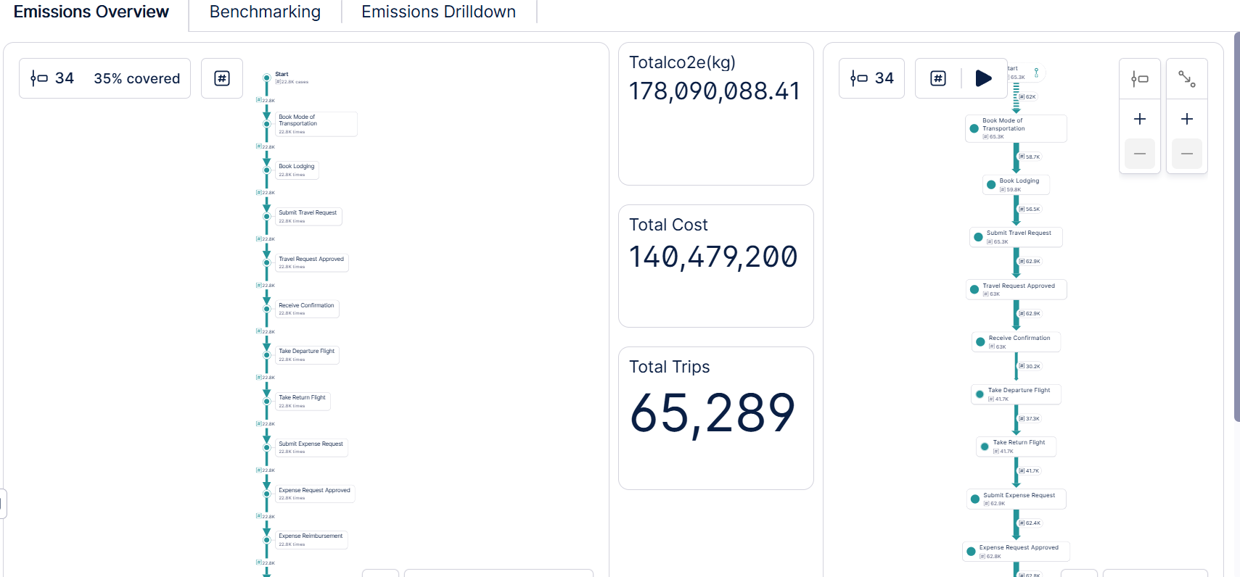
Dashboard: Emissions Overview
Process Explorer, Variant Explorer, and headline KPIs, built in Celonis.

Slide 9
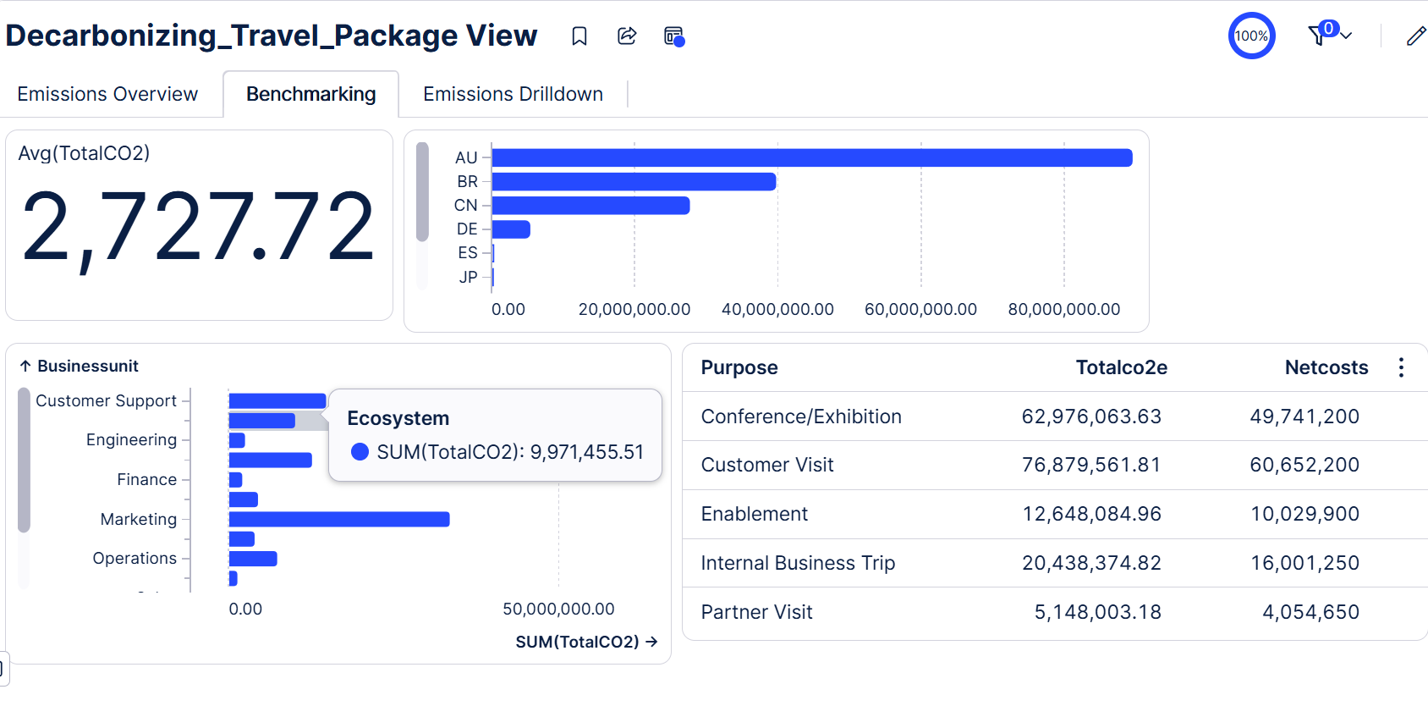
Dashboard: Benchmarking
Average emissions per trip, regional comparison, and breakdown by business unit and purpose.

Slide 10
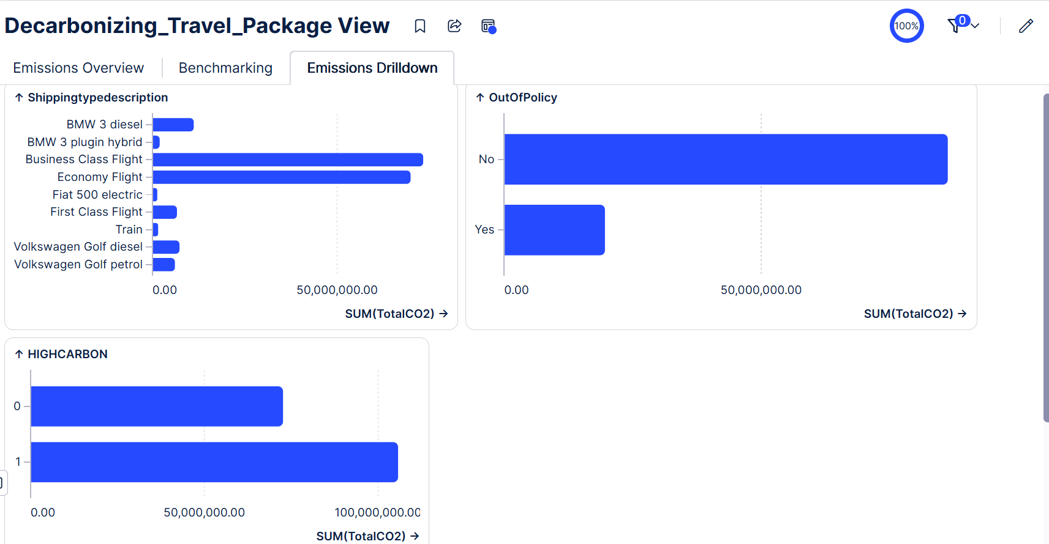
Dashboard: Emissions Drilldown
Emissions by transport type, policy compliance split, and high carbon trip share.

