Slide 1
ES-215 COURSE PROJECT
CACHE SIMULATOR
GROUP CCD
ARYAN GUPTA(20110026)
RAHUL LALANI(20110154)
RUCHIT CHUDASAMA(20110172)

Slide 2
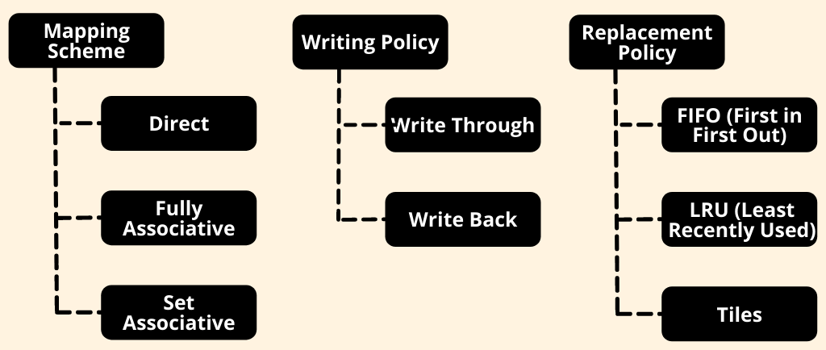

Slide 3
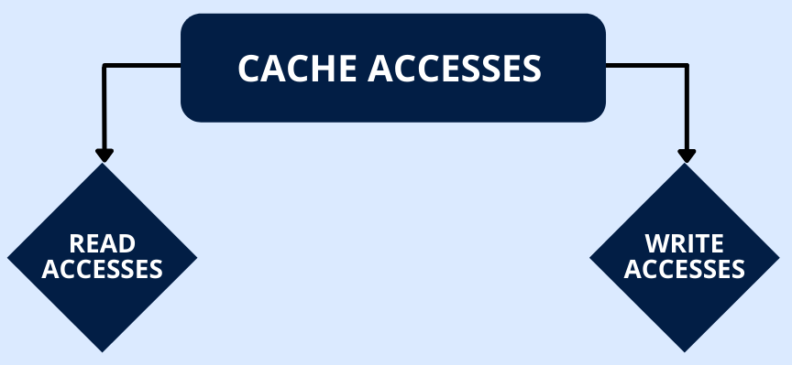

Slide 4
