Slide 1
Malignant-Comments-Classifier
social media data mining project presentation By:
Ruchita Parmar

Slide 2
Introduction
People use social media as a platform to express their opinions and views.
They do this freely and without any reluctance.
With it comes the risk of cyber abuse and harassment, which can put an end to people expressing themselves and giving up on seeking opinions.
To protect the users from cyberbullying, every organization should have an automated system in place to identify such malicious comments and suitable actions against the same.

Slide 3
OBJECTIVE
We have undertaken this project to classify the comments made by different users on social media platforms, like the tweets , to build a model that is capable of detecting and classifying these tweets into various classes like malignant,highly_malignant,rude,threat,
abuse, loathe

Slide 4
PREPROCESSING OF THE DATA
We have performed the following preprocessing on the data:
Removed punctuations
Removed the stop words
Stemming and lemmatization
Splitting the words by space

Slide 5
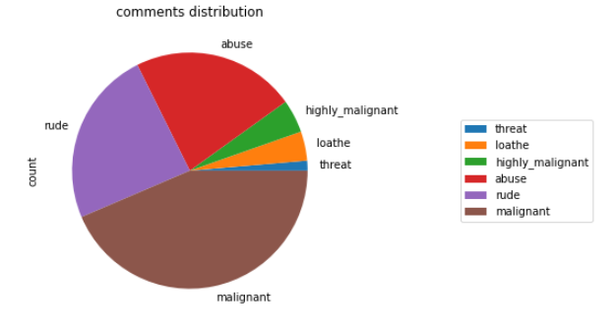
DATA VISUALIZATIONS

Slide 6
ANALYSIS OF RESULTS
Upon testing the models, on the malignant tweets we have analyzed the following:
Most of the tweets are up to 200 characters long.
Most of the tweets fell under the “malignant” class.

Slide 7
CHALLENGES
Multiple labels – For Binary classification we have many models available but for multilabel classification the selection of models decreases drastically.
Collection of USABLE DATA – although we extracted over all records, and get meaning full records were usable among them.
Cleaning the data – Due to the character limit tweets contain a lot of short forms which are different to classify using bag of words model.

Slide 8
FUTURE SCOPE
the current project predicts the type of malignant in the comment
we are add the following features in the feature
analyze which age group is being malignant toward particular group or brand.
add feature to automatically sensitize words which are classified as malignant.
automatically send alerts to the concerned authority if threats are classified as severe.
handle mistakes and short forms of words to get better accuracy of the result.

Slide 9
Thank you

