Slide 1
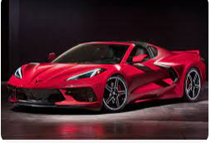
Analyzing the Impact of Car Features on Price and Profitability
Presented by
Ruchita Parmar

Slide 2
Project Description:
The automobile industry is one of the most important drivers of economic growth of a country.
The growth of this sector will support & helped to carve a unique path among the manufacturing sectors.
The automobiles produced in the country uniquely cater to the demands of low- and middle-income groups of population.
This chapter analyzes the roles of Brands, car models, Engine quality, type, cylinders & its power, Market category and other enabling factors in the expansion of the automobile and automotive components.
To meet the future needs of customers including the electrical vehicles and stay ahead of competition, manufacturers are now catching up on up gradation, digitization, and automation.
The chapter also analyzes Company's in light of these developments.

Slide 3
Business problem
In talk in basic business problem, Company need to analyze customer and market demands so as they meet the expectations for its growth.
Below were the main questions and scenario that we need to handle and implement its solutions.
1. Affordability
2. Comfort
3. Efficiency
4. Market trends for customer choice for Engine and its transmission
5. Technology (Automatic or Manual)

Slide 4
Description of the data sources used in the project
The data source used in this Car prediction analysis is provided as dump for market ananlysis.
This data is having multiple informations like Make, Model, Year, Engine, Fuel Type, Engine HP,
Engine Cylinders, Transmission Type, Driven_Wheels, Number of Door, Market Category, Vehicle Size, Vehicle Style
highway MPG, City mpg, Popularity, MSRP through which we were going to understand How a Company can get progressed and manufacture more market demanding cars.

Slide 5
Description of the data cleaning
Remove duplicate or irrelevant observations.
Remove unwanted observations from your dataset, including duplicate observations or irrelevant observations. ...
Handle missing data.

Slide 6
Approach:
Firstly i upload the dataset and try to understand the data and its pattern
I performing analysis on Microsoft Excel using various in-built formula of Excel and we will go step by step in finding out the answers to
the questions asked related to the data set.
create table use paivot,MIN, MAX, AVG, COUNTIF and other statistic formulas.
draw the given task and save my answer sheet

Slide 7
Tech-Stack Used
MS Excel
Internet
MS PowerPoint
Github

Slide 8

Insight/Results

Slide 9
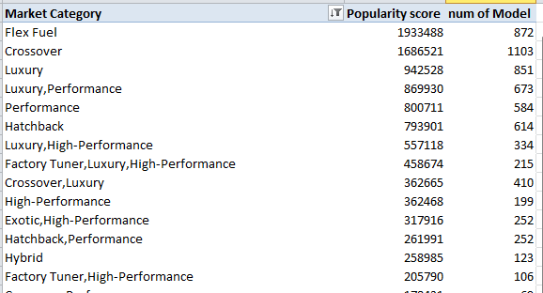
Task 1.A: Create a pivot table that shows the number of car models in each market category and their corresponding popularity scores

Slide 10
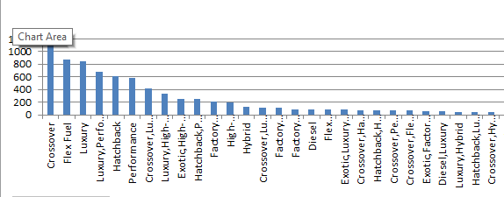
1.1B Relationship between market category and popularity

Slide 11
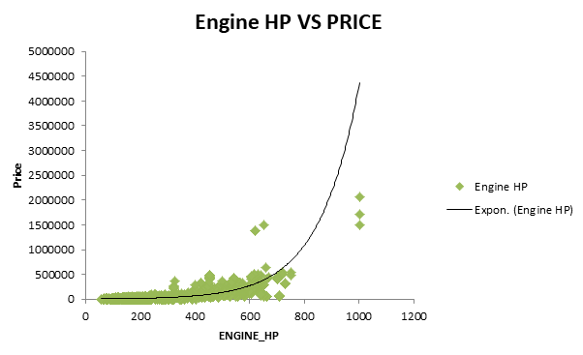
Task 2: Create a scatter chart that plots engine power on the x-axis and price on the y-axis. Add a trendline to the chart to visualize the relationship between these variable
Engine power increase also price increase

Slide 12
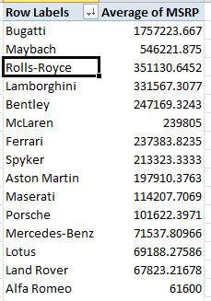
Task 4.A: Create a pivot table that shows the average price of cars for each manufacturer

Slide 13
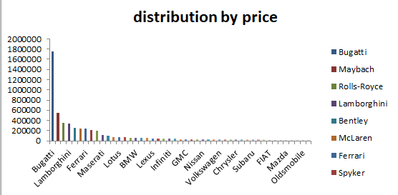
Task 4.B: Create a bar chart or a horizontal stacked bar chart that visualizes the relationship between manufacturer and average price.

Slide 14
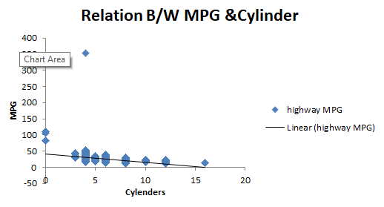
Task 5.A: Create a scatter plot with the number of cylinders on the x-axis and highway MPG on the y-axis. Then create a trendline on the scatter plot to visually estimate the slope of the relationship and assess its significance.
Negative correlation

Slide 15

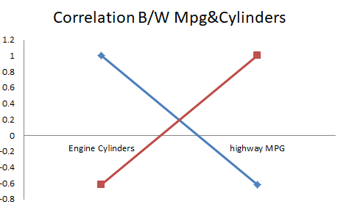
Task 5.B: Calculate the correlation coefficient between the number of cylinders and highway MPG to quantify the strength and direction of the relationship.

Slide 16
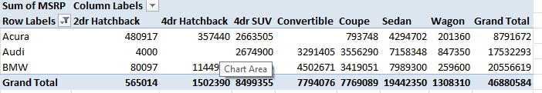
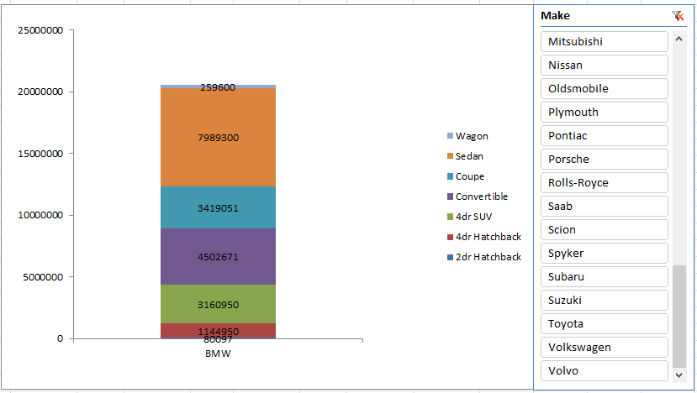
Task 1: How does the distribution of car prices vary by brand and body style?

Slide 17
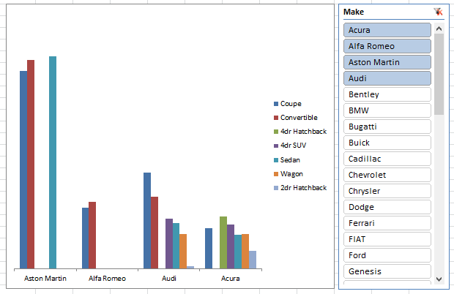
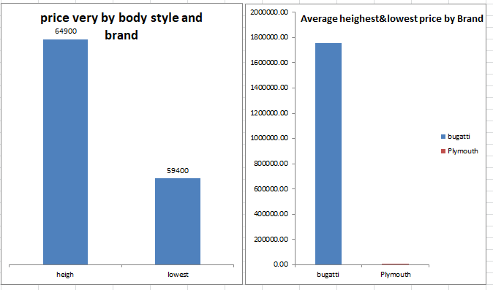
Task 2: Which car brands have the highest and lowest average MSRPs, and how does this vary by body style?

Slide 18
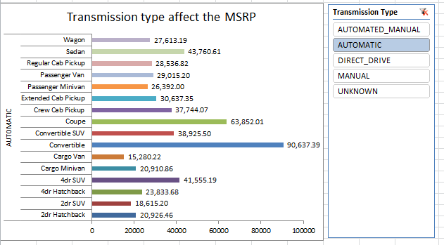
Task 3: How do the different feature such as transmission type affect the MSRP, and how does this vary by body style?

Slide 19
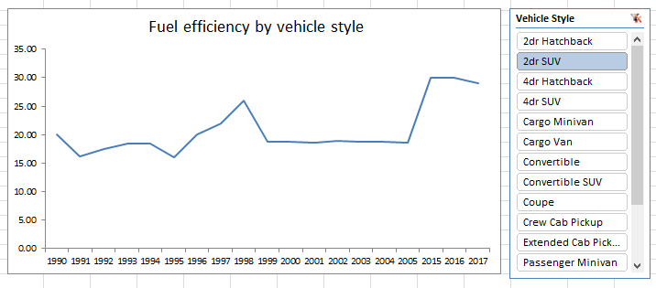
How does the fuel efficiency of cars vary across different body styles and model years?

Slide 20
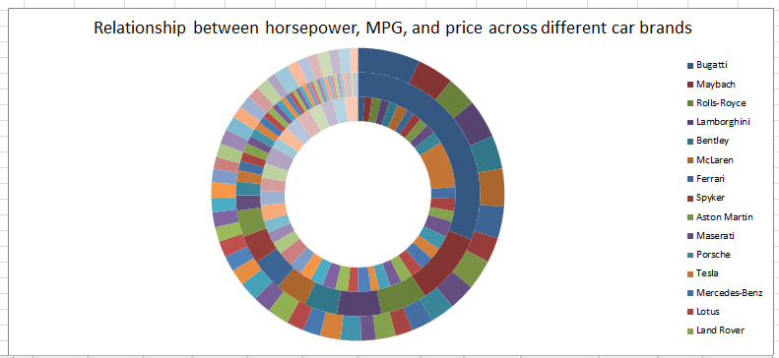
How does the car's horsepower, MPG, and price vary across different Brands?

Slide 21
Dashboard
Please check the below link for Dashboard
https://github.com/ruchita51/Trainity/blob/main/Car_dashboard.xlsx

Slide 22
Thank you

