Slide 1

Bank loan case study
Presented by
Ruchita Parmar

Slide 2
Project description
This project aims at analyzing the risk appetite of banks. When the company receives a loan application, the company must decide for loan approval based on the applicant’s profile.
The data given contains the information about the loan application at the time of applying for the loan.

Slide 3
Tech-stack used
MS Excel
Internet
MS PowerPoint
Github

Slide 4
Approch
Firstly i upload the dataset and try to understand the data and its pattern
I performing analysis on Microsoft Excel using various in-built formula of Excel and we will go step by step in finding out the answers to
the questions asked related to the data set.
create table use MIN, MAX, AVG, COUNTIF and other statistic formulas.
draw the given task and save my answer sheet

Slide 5
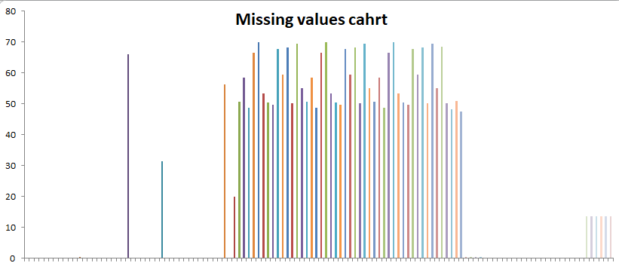
Identify the missing data % wise missing values in columns

Slide 6
In above graph I find the null values % columns wise.
I can drop the columns that have 40% and above null values
I can fill the null value by MEAN, MEDIAN,MODE.

Slide 7
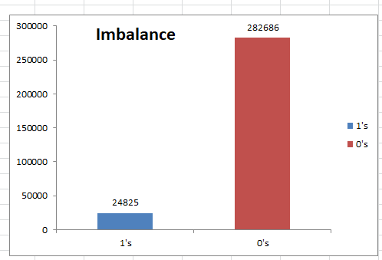
data imbalance
In the excel file attached above the sheet Data imbalance shows the ratio of total applicants with payment difficulties (1) to the total applicants with installments being paid on time (0)

Slide 8
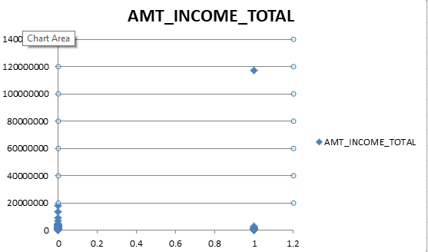
Identify if there are outliers in the dataset
In the income variable majority of income in lac but few income in CORER so this corer outlier

Slide 9
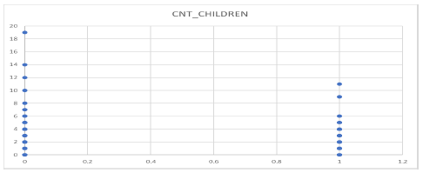
In CNT_CHILDREN columns there are outliers for the target column 0 and as well as 1. The XY Plotter for 0 shows 19 children which is highly unusual these days. The XY plotter for 1 shows more than 7 children.

Slide 10
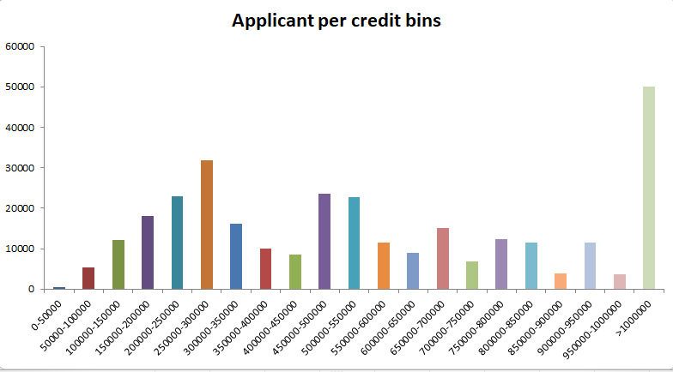
In univariate analysis AMT_CREDIT grouped in different credit bins. Majority of the applicants were offered loans in the credit range of 10 Lac and above .

Slide 11
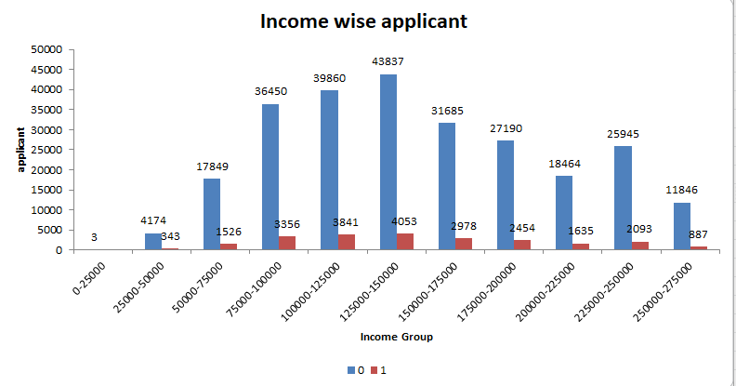
SEGMENTED UNIVARIAITE ANALYSIS

Slide 12
The above graph is an example of univariate segmented analysis which depicts simply the count of segmented applicants (0 & 1) for the variable AMT_TOTAL_INCOME grouped in different income bins.
Also, maximum applicants (0,1) draw an income between 1.25 Lacs to 1.5 Lacs but there are applicants which are having payment difficulties despite belonging to the same income range

Slide 13
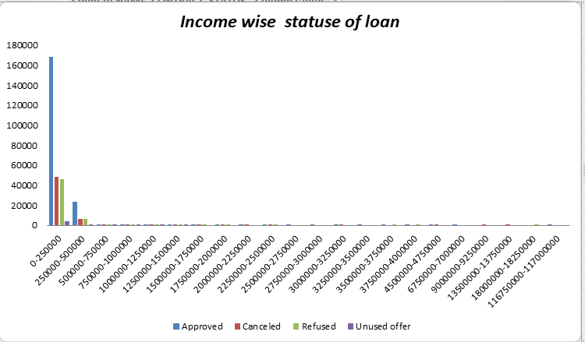
BIVARIAITE ANALYSIS

Slide 14
Thank you

