Slide 1

IMDB Movie Analysis
Project by
Ruchita Parmar

Slide 2
Project description
company providing a dataset having various columns of different IMDB Movies it contain 28 columns and 5044 rows.
Defined the problem and clean the data(remove duplicate and null values) according the requirements.
Create the pie vote table and graph give the answer.

Slide 3
Approach
Import the dataset in excel.
clean the data like remove null values and duplicate.
use pivot, sum, average count if and filter and give the answer of asked quotations.
create charts and bar

Slide 4
Tech-Stack Used
EXCEL
JUPYTER NOTEBOOK
INTERNET
WI-FI
MS POWER POINT
GITHUB

Slide 5
Insights and Result

Slide 6
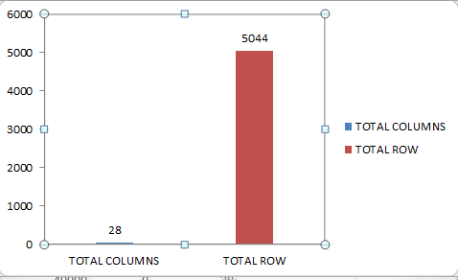
Before clean the data we have 28 columns and 5044 rows

Slide 7
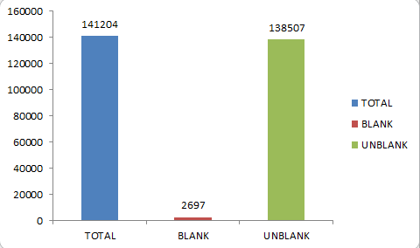
Total values, null values and not null values.

Slide 8
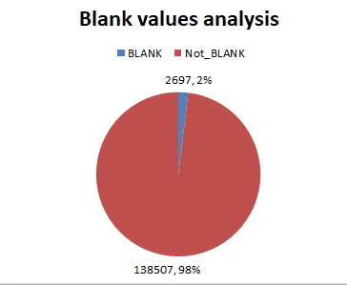
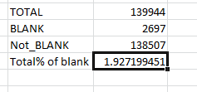
Null values and not null values after remove the duplicate values.

Slide 9
Fill and remove null values
Fill the null value by “mean” for numerical columns
Fill the null values by “most frequently” values in categorical columns
Some null values drop witch is less than 2%(show below the list of null values in percent)

Slide 10
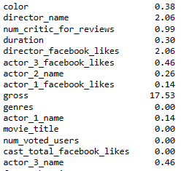
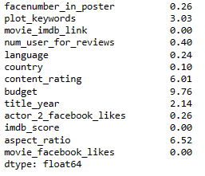
Null values in columns % wise

Slide 11
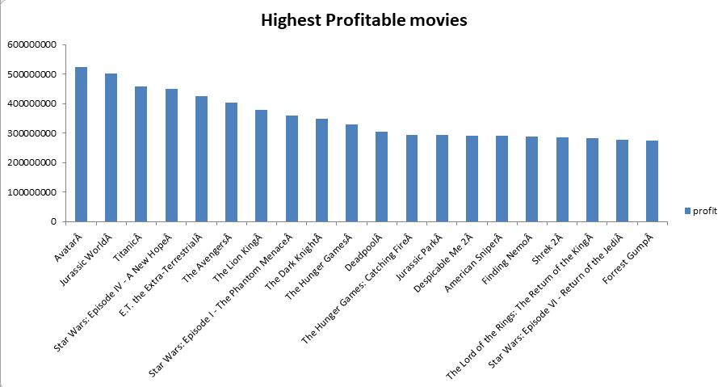
1) Find the movies with the highest profit?

Slide 12
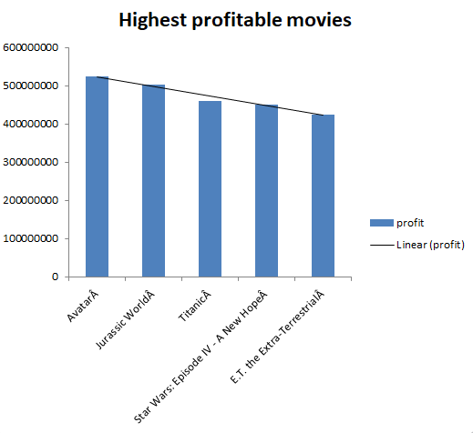

Slide 13
Top 250 movies

Slide 14
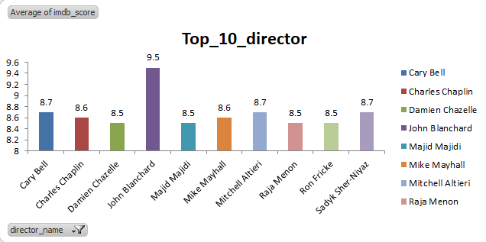
Top 10 director

Slide 15
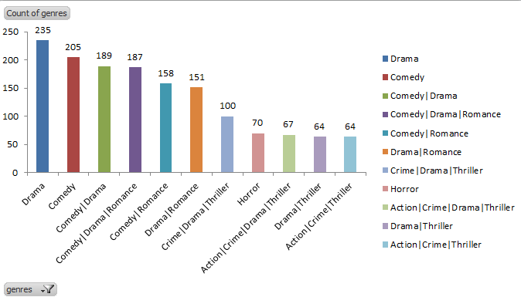
Find popular genres

Slide 16
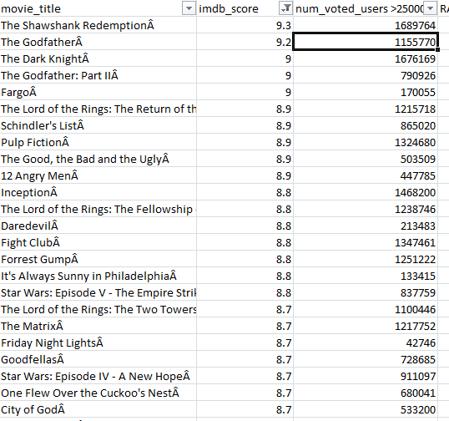
Top 250 MOVIES

Slide 17
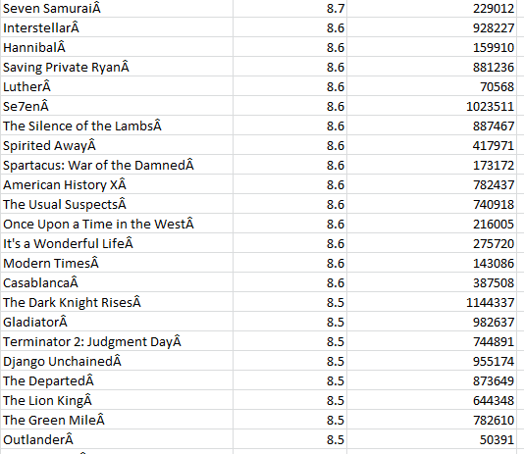
Top 250 movies

Slide 18
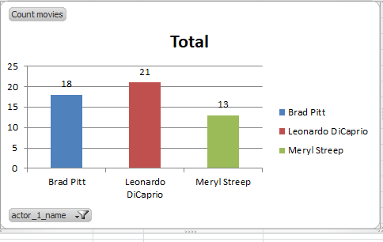
Create 3 new column

Slide 19
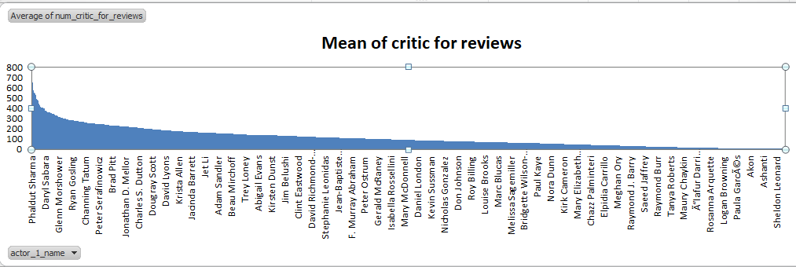
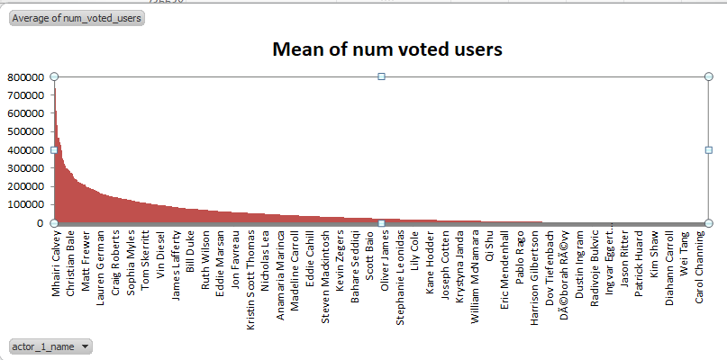
Mean of critic for review

Slide 20
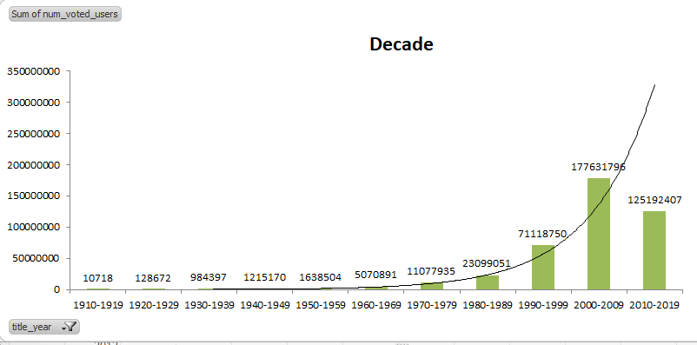
Some of num voted user

Slide 21
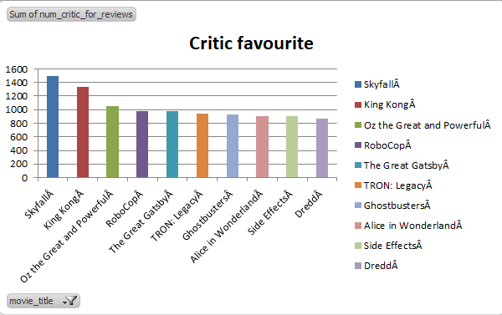
Critic favourite

Slide 22
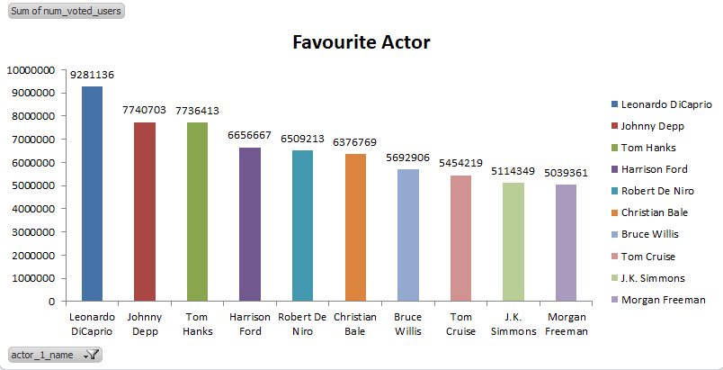
Audience Favourite actor

Slide 23
Please also check my “jupyter notebook” for more clearance
Link given below
https://github.com/ruchita51/Trainity/blob/main/IMDB_ANALYSIS.ipynb

Slide 24
Thank you

