Slide 1

ABC Call Volume Trend Analysis
Presented by:
Ruchita Parmar

Slide 2
Project description
I have a dataset of a Customer Experience (CX) Inbound calling team for 23 days. Dataset contain multiple columns like
Customer_Phone_No, Date_&_Time, Time, Time_Bucket,
Duration(hh:mm:ss),Call_Seconds(s),Call_Status,Wrapped
In the given project we have to calculate the average call duration and total number of call per hour
We had to propose a manpower plan required during each time bucket and reduce the abandon rate to 10%
We also have to propose a manpower plan when calls are received across the 24 hours

Slide 3
Approach
Import the dataset and understand the dataset.
Data cleaning
Understanding the required insight
Create a pivot tables or using formulas and functions to find the required insight
drown Charts for better Visualization.

Slide 4
Tech stack used
I used excel for the project.
Github.
Power point.
Internet connection.

Slide 5

Insights

Slide 6
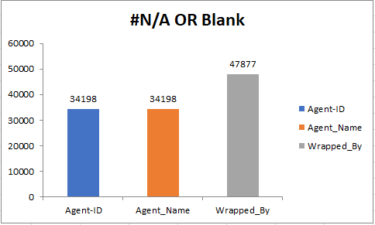
Missing values in our data set

Slide 7
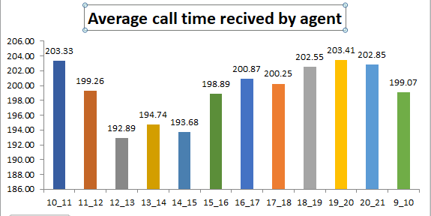
1. Calculate the average call time duration for all incoming calls received by agents(in eachTime_Bucket)

Slide 8
In the above graph we can easily analyse call answered by time_bucket.
total average call time is 198.62 seconds for all incoming call received by agent.
highest received call by agent between 7pm -8pm and followed by 10am-11am, 6pm-7pm.

Slide 9
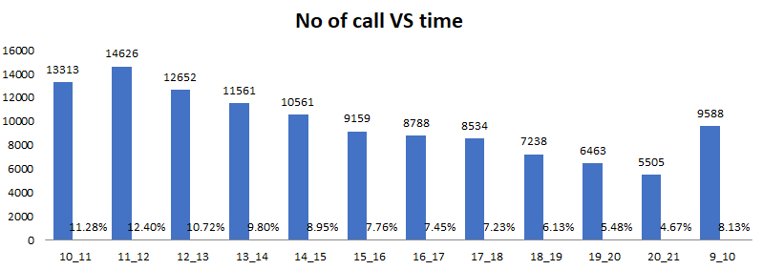
2. Show the total volume/ number of calls coming in via charts/ graphs [Number of calls v/s Time]. You can select time in a bucket form (i.e. 1-2, 2-3, …..)

Slide 10
Create a pie vote table put bucket_time in rows and customer phone no in value column and count the customer phone no.
Maximum customer call in between 11am to12pm
Lowest call in 8pm-9pm
Drown column bar for better visualisation.

Slide 11
3. As you can see current abandon rate is approximately 30%. Propose a manpower plan required during each time bucket [between 9am to 9pm] to reduce the abandon rate to 10%. (i.e. You have to calculate minimum number of agents required in each time bucket so that at least 90 calls should be answered out of 100.)
Assumption: An agent work for 6 days a week; On an average total unplanned leaves per agent is 4 days a month; An agent total working hrs is 9 Hrs out of which 1.5 Hrs goes into lunch and snacks in the office. On average an agent occupied for 60% of his total actual working Hrs (i.e 60% of 7.5 Hrs) on call with customers/ users. Total days in a month is 30 days.

Slide 12
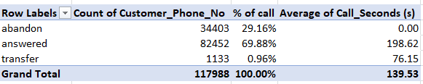
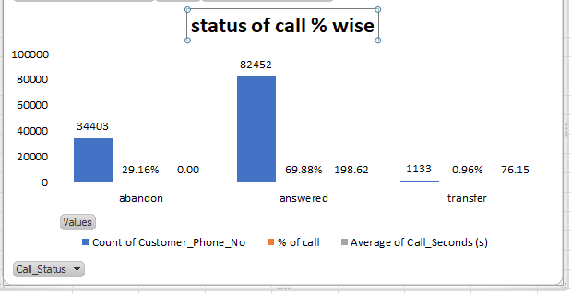

Slide 13
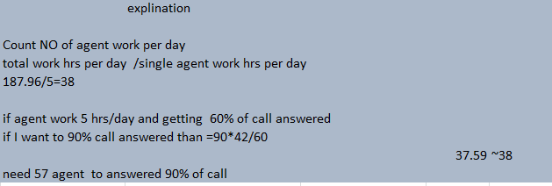

Slide 14
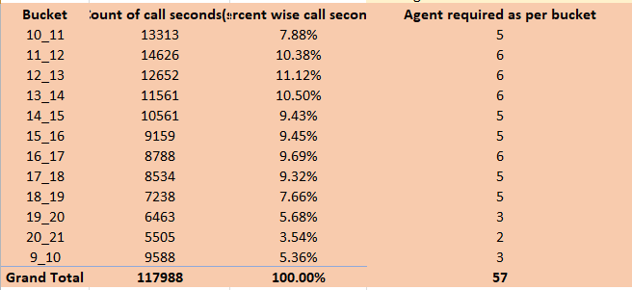

Slide 15
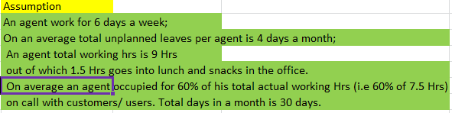
Assumption for Q3&Q4

Slide 16
Create a pie vote table and drag and drop the attribute according the task that I have to done.
Find out the call Status like 69.88% call answered, 29.16% abandoned and 0.96% transferred.
Find total agent required to answered 90% call is ~57.

Slide 17
4. Let’s say customers also call this ABC insurance company in night but didn’t get answer as there are no agents to answer, this creates a bad customer experience for this Insurance company. Suppose every 100 calls that customer made during 9 Am to 9 Pm, customer also made 30 calls in night between interval [9 Pm to 9 Am] and distribution of those 30 calls are as follows:
Now propose a manpower plan required during each time bucket in a day. Maximum Abandon rate assumption would be same 10%.

Slide 18
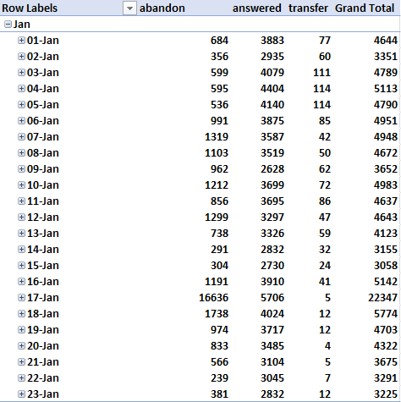

Slide 19
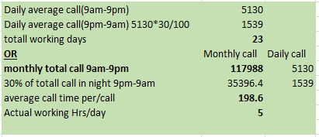


Slide 20
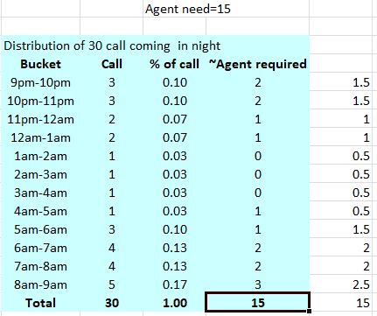

Slide 21
For excel solution please refer the below link
https://github.com/ruchita51/Trainity/blob/main/Call_Trend_Analysis_Project.xlsx

Slide 22
Thank you

