Slide 1
Car price pridection Presented by :- Ruchita Parmar

Slide 2
Contents
Problem statement and understanding.
EDA steps and visualizations.
Assumptions used to complete the project, analysis.
Conclusion.

Slide 3
Problem Statement & Understanding
An automobile company consulting company needs to understand the factors on which the pricing of cars depends. Specifically the factors affecting the pricing of cars in the market.
The company wants to understand: What various factors were significant in predicting the price of a car. How well these factors describe the price.
Background of the study
Model the price of cars with the available independent variables.
This predictive model would enable us and the management to understand how exactly the prices vary with the independent variables.
The management can use the model to accordingly either manipulate the design of the cars, the business strategy etc. to meet different price levels.
The model will be a good way for the management to understand the pricing dynamics of a new market.

Slide 4
Problem Statement & Understanding
Objective
To Identify and Examine the Challenges
To identify price index strategies and policies
Significance of the study
To implement right strategies
Scope and limitations
Scope of Car price prediction is one of the foremost benefit offered by available dataset so as companies do not need to run mass wide marketing campaigns.

Slide 5
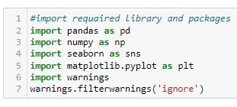
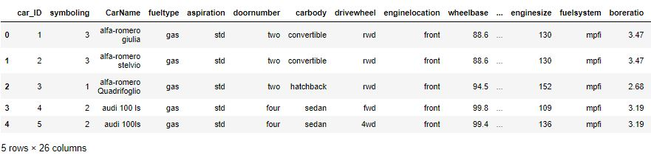
problem statement and understanding
Data Understanding and Exploration
Let us understand the dataset, its size, attributes, etc. first import NumPy and Pandas and read the dataset.

Slide 6
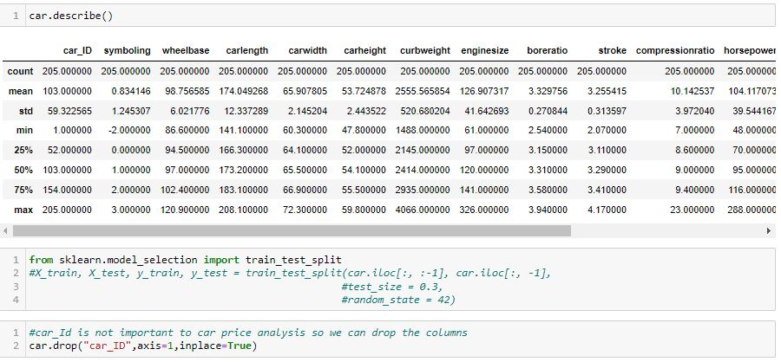

Slide 7
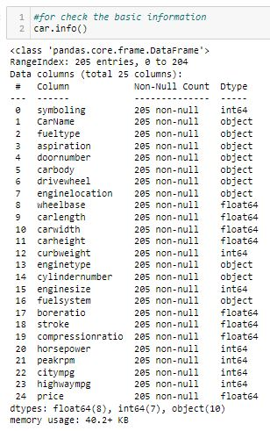

Slide 8
Data Cleaning and Preparation
Data cleaning is one of the processes that increases prediction performance, yet insufficient for the cases of complex data sets as the one in this research. Applying single machine algorithm on the data set accuracy was less than 50%. Therefore, the ensemble of multiple machine learning algorithms has been proposed and this combination of ML methods gains accuracy . This is significant improvement compared to single machine learning method approach. However, the drawback of the proposed system is that it consumes much more computational resources than single machine learning algorithm. Although, this system has achieved astonishing performance in car price prediction problem our aim for the future research is to test this system to work successfully with various data sets. There is no null value in our dataset .

Slide 9
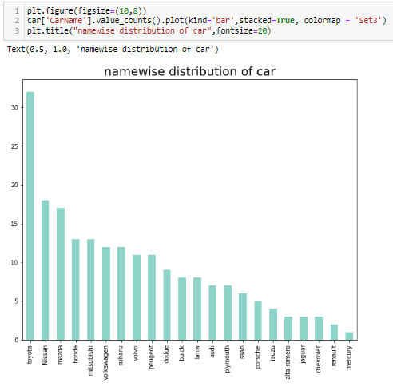
Data Exploration –
To perform linear regression, the (numeric) target variable should be linearly related to at least one another numeric variable.
Data Visualization – With below images we clearly see that most people like Toyota.

Slide 10
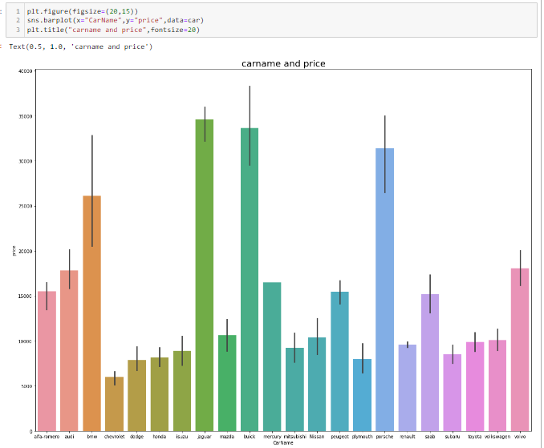
With below we able to check that Jaguar, Buich, Porsche,bmw are most costly car and Chevrolet list price car.

Slide 11
Co-Relation - Correlation of price with independent variables:
Price is highly (positively) correlated with wheelbase, carlength, carwidth, curbweight, enginesize, horsepower (notice how all of these variables represent the size/weight/engine power of the car)
Correlation among independent variables:
Many independent variables are highly correlated (look at the top-left part of matrix): wheelbase, carlength, curbweight, enginesize etc. are all measures of 'size/weight', and are positively correlated
Thus, while building the model, we'll have to pay attention to multi-collinearity (especially linear models, such as linear and logistic regression, suffer more from multi-collinearity).
We'll have to pay attention to multi-collinearity (especially linear models, such as linear and logistic regression, suffer more from multi-collinearity).
Now when extract company name from the column CarName. Notice that the carname is what occurs before a space, e.g. alfa-romero, audi, chevrolet, dodge, bmx etc. Thus, we need to simply extract the string before a space. There are multiple ways to do that.
So let's create a new column to store the company name and check whether it looks okay.

Slide 12
Some car-company names are misspelled - vw and vokswagen should be volkswagen, porcshce should be Porsche, Toyouta should be toyota, Nissan should be nissan, maxda should be mazda etc. This is a data quality issue, let's solve it.

Slide 13
Data Preparation - Let's now prepare the data and build the model.
Model Building and Evaluation –
1. Linear Regression - Let's now try predicting car prices, a dataset using linear regression.
2. Ridge and Lasso Regression - Let's now try predicting car prices, a dataset used in simple linear regression, to perform ridge and lasso regression.
a. Ridge Regression
b. Lasso

Slide 14
EDA steps and visualizations
Data visualization is easy to perform EDA which makes it easy to make others understand our analysis.
Lets start with understanding of Data which directly guide the business for the customers retentions with below steps.
How often customer visiting & switching E-Commerce portal.
When they were visiting like any festive seasons.
Are they looking for Brand products, offers, discounts, etc.
Are they recommending product reviews before finalization.
Preferred mode of payment CoD, debit or credit card, online, UPI, any wallet.
Why did they switching from their first choice product or brand and ordering other available options after comparisons.
Are they looking for any specific sellers
Level of concerned of their personal information i.e Privacy.
What they prefer between Early delivery, best price, quality, reviews, recommendations.

Slide 15
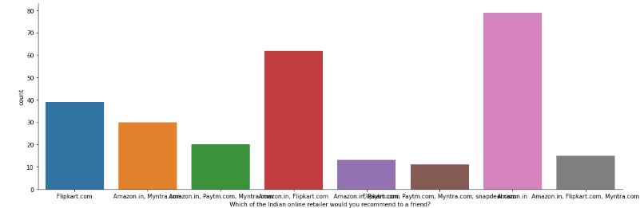
EDA steps and visualizations

Slide 16
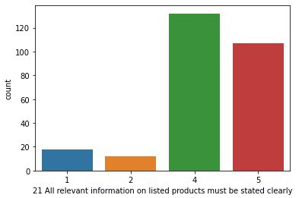
EDA steps and visualizations

Slide 17
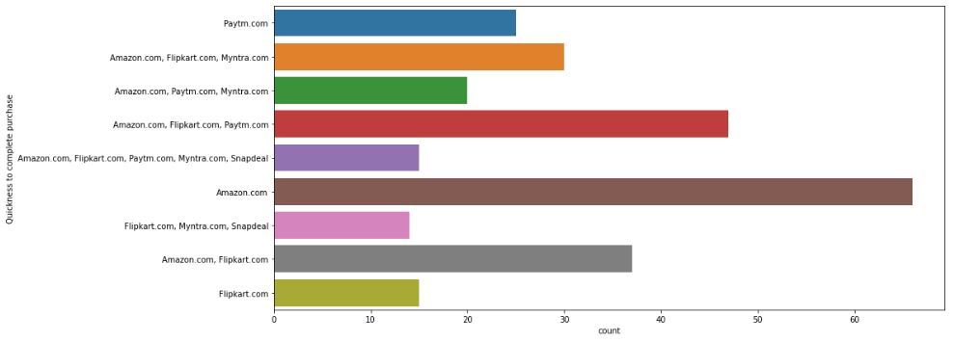
EDA steps and visualizations
Below graph is showing quickly customer is able to complete their purchase

Slide 18

conclusion
Retention’s conclusion is about keeping your current consumers happy, so as they feel more convenient to stay with us than to buy from a competitor.
Hopefully the Strategies above will enlighten us with new ideas to approach the goal of Customer Retention.

