Slide 1

FLIGHT PRICE PREDICTION Presented by :- Ruchita Parmar

Slide 2
Contents
Problem statement and understanding.
EDA steps and visualizations.
Assumptions used to complete the project, analysis.
Conclusion.

Slide 3
Objective
The goal of this article is to predict flight prices based on a variety of variables. The data utilized in this post may be found on webside. Because the price is the target or dependent variable, this will be a regression problem (continuous numeric value)

Slide 4
Problem Statement & Understanding
Background of the study
Anyone who has booked a flight ticket knows how unexpectedly the prices vary. Airlines use using sophisticated quasi-academic tactics known as "revenue management" or "yield management". The cheapest available ticket for a given date gets more or less expensive over time. This usually happens as an attempt to maximize revenue based on - 1. Time of purchase patterns (making sure last-minute purchases are expensive) 2. Keeping the flight as full as they want it (raising prices on a flight which is filling up in order to reduce sales and hold back inventory for those expensive last-minute expensive purchases) So, if we could inform the travellers with the optimal time to buy their flight tickets based on the historic data and also show them various trends in the airline industry we could help them save money on their travels. This would be a practical implementation of a data analysis, statistics and machine learning techniques to solve a daily problem faced by travellers..

Slide 5
Problem Statement & Understanding
Flight ticket prices can be something hard to guess, today we might see a price, check out the price of the same flight tomorrow, and it will be a different story.
To solve this problem, we have been provided with prices of flight tickets for various airlines between the months of March and June of 2019 and between various cities, using which we aim to build a model which predicts the prices of the flights using various input features.

Slide 6
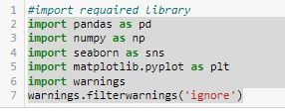
EDA steps and visualizations
Data visualization is easy to perform EDA which makes it easy to make others understand our analysis.
Table of Content for dataset visualization.
1. Study of Variables – At first, let us import the necessary libraries used and then train and test dataset.

Slide 7
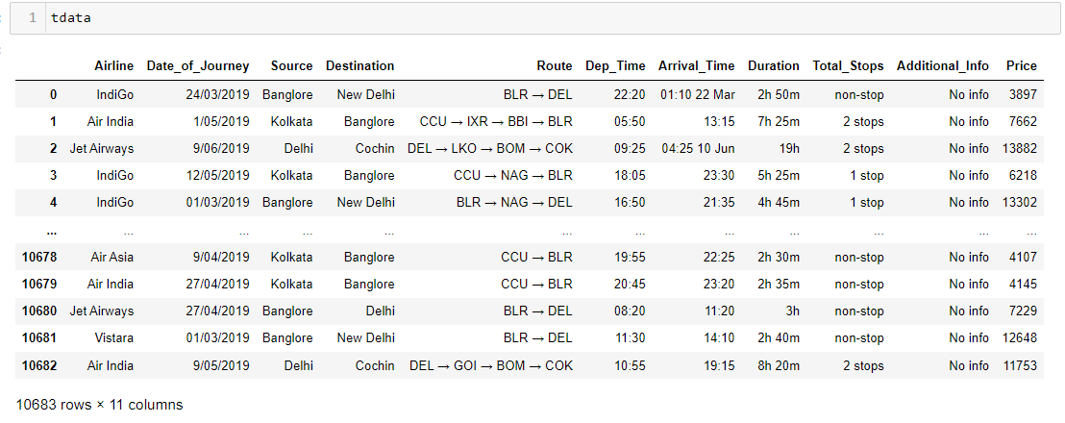
EDA steps and visualizations

Slide 8
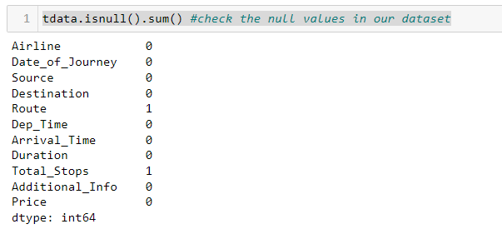
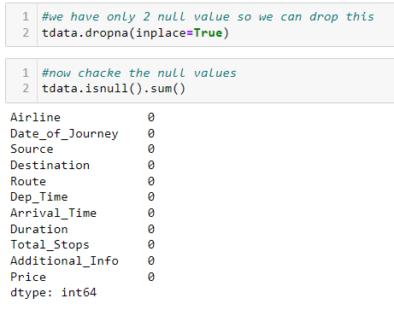
EDA steps and visualizations
Now, let's check the null values in our dataset, We have 2 null values

Slide 9
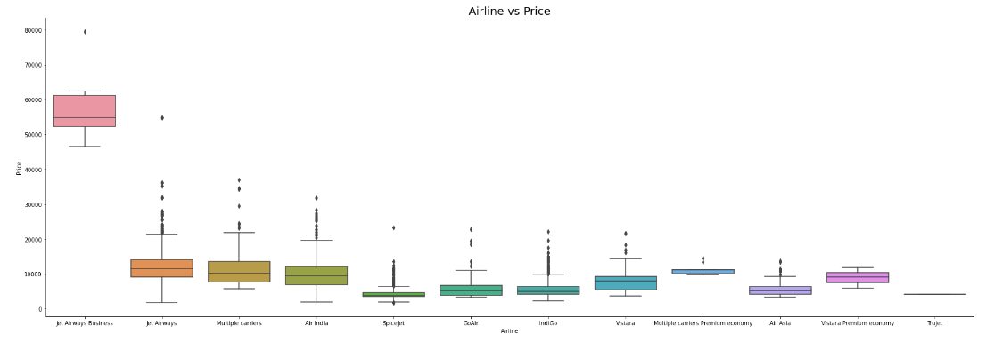
EDA steps and visualizations
Target Variables with Airline – The most expensive option is ‘JetAirways Business.’ The cost of other carriers varies as well’.

Slide 10
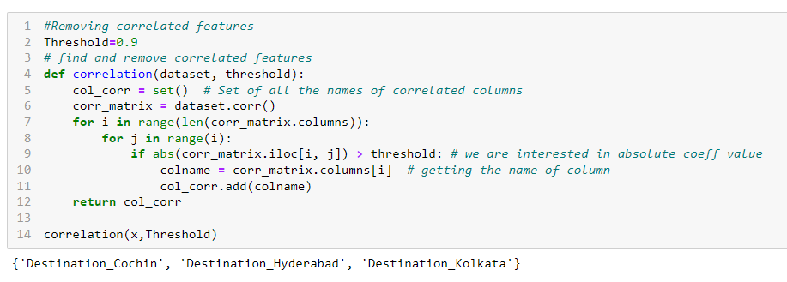
EDA steps and visualizations
Correlation Study - We have 30 columns in our data set. Visualizing all the data takes a lot of time, so we consider the variables which are highly correlated with our target variable “Price”
.

Slide 11
Assumptions
Worked on assumptions that these are all the measurable data that affect a home's price. There were more parameters that matters as well such as house conditions, locations, locality favoritism and etc. But these parameters are more subjective and almost impossible to measure and ignoring them.

Slide 12
conclusion
Conclusion From our detailed analysis of each of the routes, we can determine the following Flight prices almost always remain constant or increase between the major cities Tourist routes and routes that offer services involving Tier-2 cities of the country have uneven trends related to the increase and decrease of airline ticket prices. The model in the worst case almost breaks even with the profits and losses, and most case saves an average of about Rs. 200 per transaction when predicting to wait. Routes with data collected over the longer duration of time tend to facilitate with much more accurate predictions in the model and thus lead to higher average savings

Slide 13
Thank you

