Slide 1
Micro Credit Defaulter-Project Presented by :- Ruchita Parmar

Slide 2
Contents
Problem statement and understanding.
EDA steps and visualizations.
Assumptions used to complete the project, analysis.
Conclusion.

Slide 3
Problem Statement & Understanding
A Microfinance Institution (MFI) is an organization that offers financial services to low income populations. MFS becomes very useful when targeting especially the unbanked poor families living in remote areas with not much sources of income. The Microfinance services (MFS) provided by MFI are Group Loans, Agricultural Loans, Individual Business Loans and so on. They are collaborating with an MFI to provide micro-credit on mobile balances to be paid back in 5 days. The Consumer is believed to be defaulter if he deviates from the path of paying back the loaned amount within the time duration of 5 days. For the loan amount of 5 (in Indonesian Rupiah), payback amount should be 6 (in Indonesian Rupiah), while, for the loan amount of 10 (in Indonesian Rupiah), the payback amount should be 12 (in Indonesian Rupiah).
The problem statement was to predict the label (payer and defaulter in 5 days)from the dataset with features as below:-
'aon', 'daily_decr30', 'daily_decr90', 'rental30', 'rental90', 'last_rech_date_ma', 'last_rech_date_da', etc.

Slide 4
Problem Statement & Understanding
We then apply advanced machine learning algorithms such as Random forests. We need to understand the scope of problems and the benefits related to strategic, conceptual and implementation alternatives as our study and label prediction benefits to an improved approach will extend beyond low-income beneficiaries.
New analytical techniques of machine learning can be used in property research. This study is an exploratory attempt to use three machine learning algorithms in estimating label, and then compare their results.
Many conventional estimation methods produce reasonably good estimates of the coefficients that unveil the relationship between output variable and predictor variables. .

Slide 5
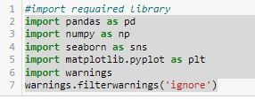
EDA steps and visualizations
Data visualization is easy to perform EDA which makes it easy to make others understand our analysis.
Table of Content for dataset visualization.
1. Study of Variables – At first, let us import the necessary and packege libraries used and then train and test dataset.

Slide 6
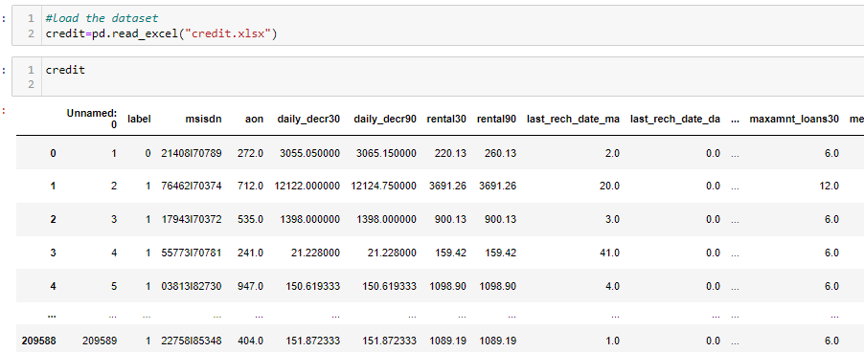
EDA steps and visualizations

Slide 7
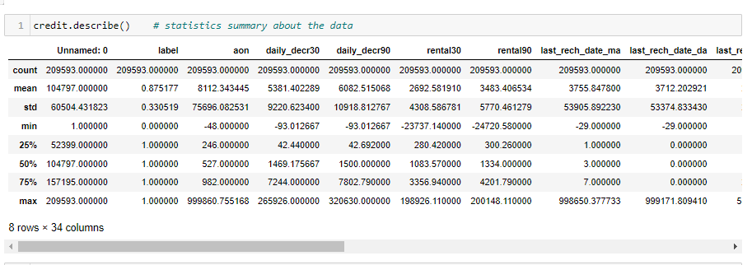
EDA steps and visualizations
Now, let's check the statistical summary of our data set to understand mini,max,std,mean etc.

Slide 8
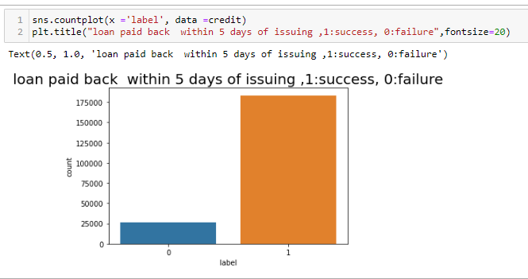
EDA steps and visualizations
Target Variables – lets understand our target variable by graphical visualization our target variable ‘label’ in witch we clearly seen payer is more than the failure.

Slide 9
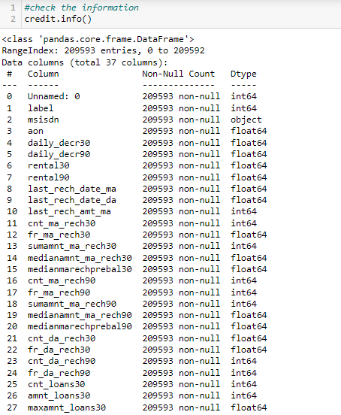
EDA steps and visualizations
Basic infornation about data set

Slide 10
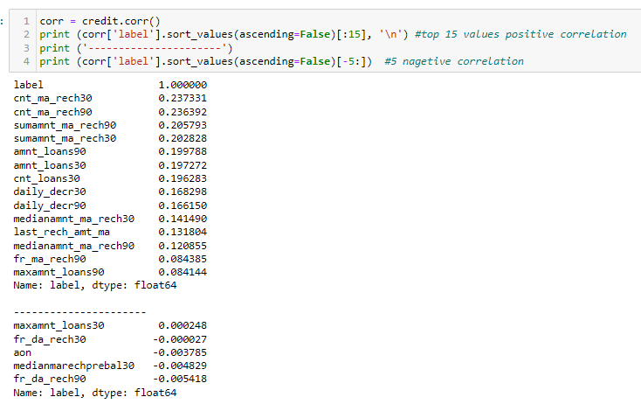
EDA steps and visualizations
Correlation Study - We have 33 columns in our data set. Visualizing all the data takes a lot of time, so we consider the variables which are highly correlated (both positive and negative) with our target variable “label”
.

Slide 11
Assumptions
Worked on assumptions that these are all the measurable data that affect ‘label. To improve defaulter value to send them remainder massage and mail But these parameters are more subjective.

Slide 12
conclusion
The question for this Housing price prediction is to study how well house prices can be predicted by using k-Nearest neighbor and Random forest regression.
We have found that the Random forest regression algorithm performs
better at predicting house prices than the k-Nearest neighbor algorithm. There is still a difference between the actual prices in our testing data and the prices predicted by the Random forest regression algorithm.

Slide 13
conclusion

