Slide 1

Rating Prediction
presentation By:
Ruchita Parmar

Slide 2
Introduction
The rise in online shopping has brought a significant rise in the importance of textual customer reviews. There are thousands of review sites online and massive amounts of reviews for each and every product. Nowadays customers have changed their way of shopping. 60-70 present of customers say that they use rating filters to filter out low rated items in their searches

Slide 3
Introduction
The customer will make a decision to buy a product if he or she sees valuable reviews posted by others, especially the user’s trusted friend. We believe reviews and reviewers will do help to the rating prediction based on the idea that 5-star ratings may greatly be attached with extremely good reviews

Slide 4
OBJECTIVE
Review Rating Prediction aims to predict a user's numeric rating (usually from 1 to 5 stars) in a review from the text of the review. Rating Prediction task can be effectively used to:
Help web users to determine the rating of their reviews
Detect suspicious or fake online reviews
Better understand customers' opinions
Improve the default (5-star) rating system or create proprietary ranking scale for more precise users' feedback representation

Slide 5
PREPROCESSING OF THE DATA
We have performed the following preprocessing on the data:
Removed punctuations
Removed the stop words
Stemming and lemmatization
Splitting the words by space
TF-IDF

Slide 6
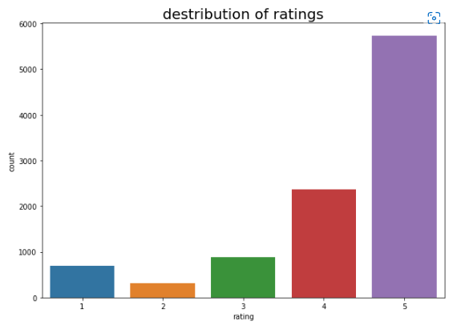
Data Visualizations

Slide 7
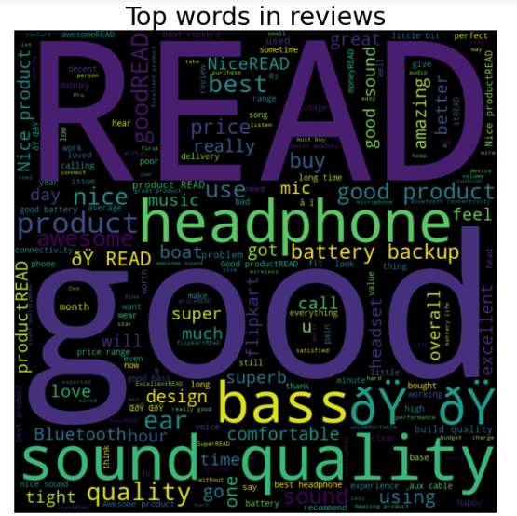
Top Words

Slide 8
ANALYSIS OF RESULTS
Upon testing the models, on the malignant tweets we have analyzed the following:
Most of the tweets are up to 200 characters long.
Most of the tweets fell under the “malignant” class.

Slide 9
CHALLENGES
Recommendation methods have been proved to be successful in eliminating the information overload problem. However, they are still insufficient as far as data sparsity and cold start issues are concerned. Some approaches have attempted to resolve these issues by utilizing relevant information contained in user review text, although, the type of information extracted from the review text and the way such recommendation methods utilize the information affect recommendation accuracy of the models. In this paper, we address such challenges by considering linguistic similarity between review texts and employ it as additional factor in rating prediction, and we propose a recommendation method based on tensor factorization which involves review text semantic similarity.

Slide 10
FUTURE SCOPE
the current project predicts the type of malignant in the comment
we are add the following features in the feature
analyze which age group is being malignant toward particular group or brand.
add feature to automatically sensitize words which are classified as malignant.
automatically send alerts to the concerned authority if threats are classified as severe.
handle mistakes and short forms of words to get better accuracy of the result.

Slide 11
Thank you

