Slide 1
Emergency Department Patient Visits Analysis
Ruchita Patil

Slide 2
Contents
01
02
03
04
05
Introduction
Data Overview
Charts And Graphs
Report
Conclusions

Slide 3
Introduction
Welcome to the Patients Emergency Room Visit Report. This report aims to provide a comprehensive overview and analysis of the emergency room visits recorded in our dataset. The data covers various aspects of patient information, including demographics, department referrals, and wait times. As we explore or investigate deeply into the dataset, our goal is to extract meaningful insights that can inform decision-making and enhance the quality of emergency healthcare services.

Slide 4
Data Overview:
Column | Description
date | Date and time of the emergency room visit
patient_id | Unique identifier for each patient
patient_gender | Gender of the patient (M/F)
patient_age | Age of the patient
patient_sat_score | Patient satisfaction score (if available)
patient_Full_name | Patients Full Name
patient_race | Race or ethnic background of the patient
patient_admin_flag | Flag indicating if the patient was admitted (TRUE/FALSE)
patient_waittime | Time (in minutes) the patient waited before receiving attention
department_referral | Referral to a specific department (if applicable)

Slide 5
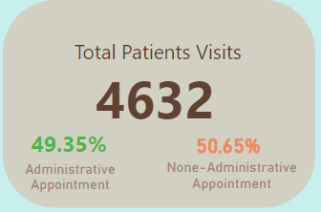
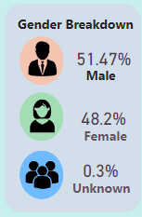
Total Number of Patients:
Provide the total count of patients who visited the emergency room during the analyzed period.
You can simply state the total number of patients in text format or represent it visually using a large numerical value displayed prominently on the slide.
Gender Breakdown:
Present the breakdown of patients by gender, highlighting the distribution of male and female patients.
Include text labels or annotations to specify the exact percentage or count of male and female patients.

Slide 6
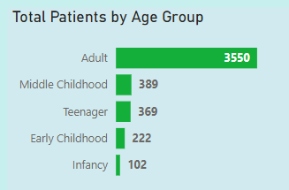
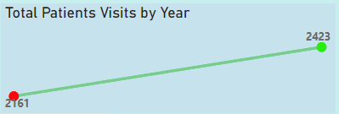
Clustered bar chart
Line Chart

Slide 7
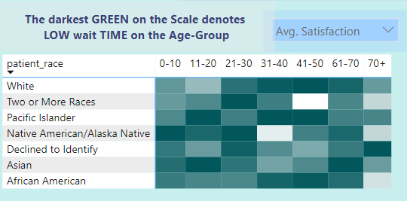
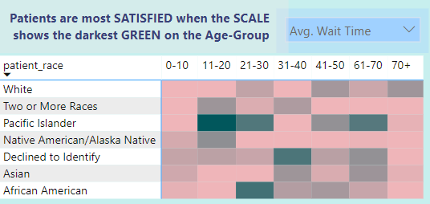
Hitmap:

Slide 8
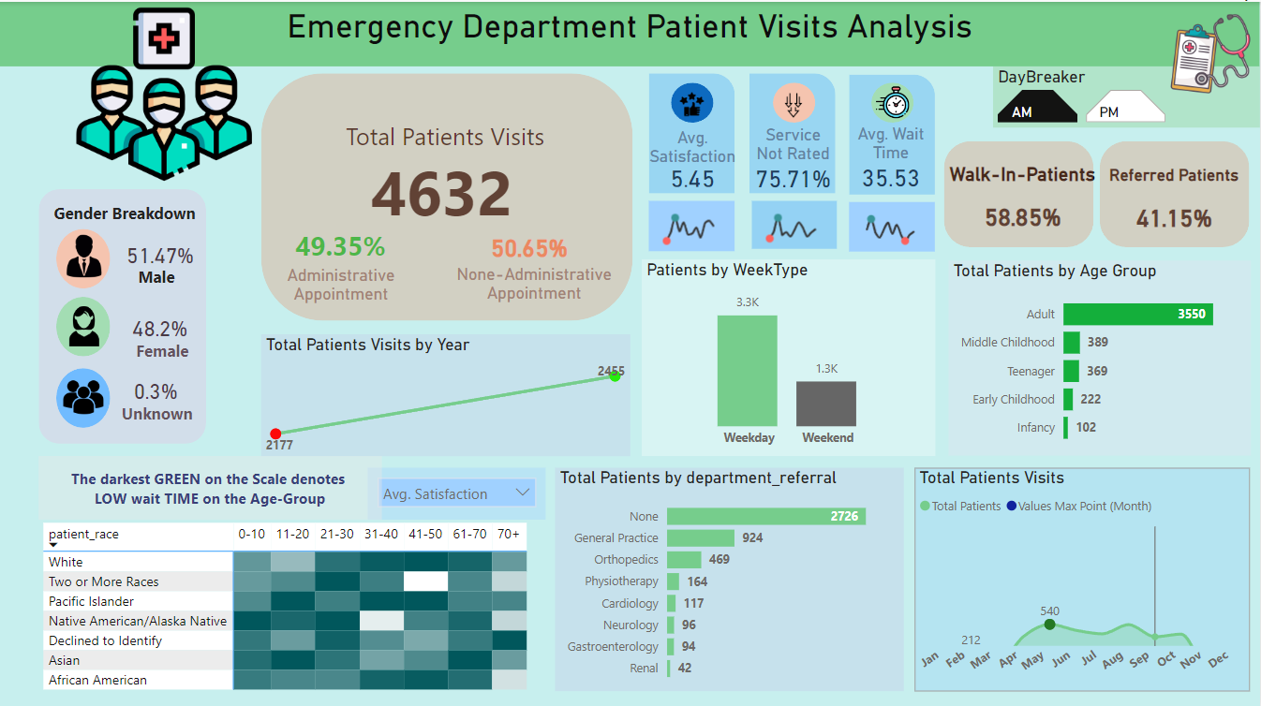

Slide 9
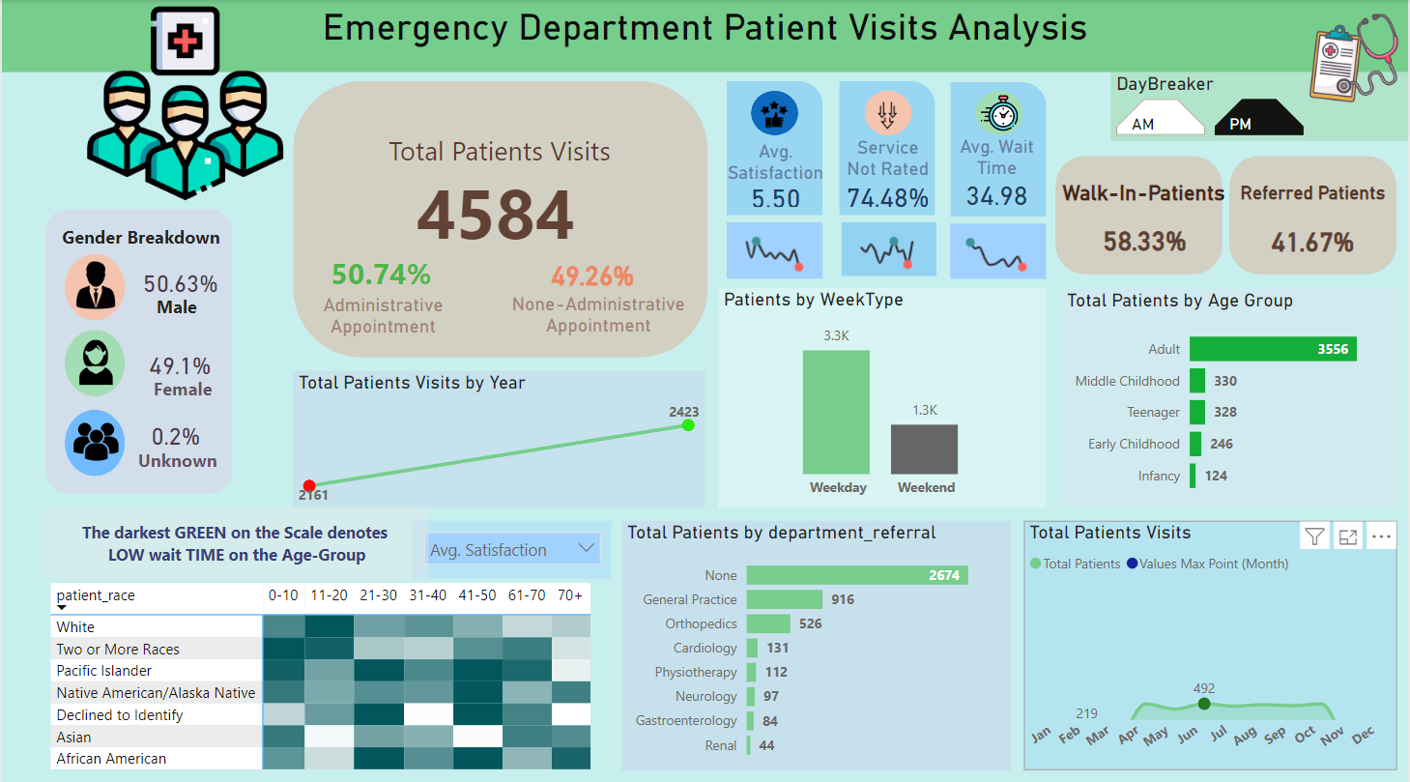

Slide 10
Insights:
Demographic Diversity: Patients exhibit diverse demographics, including variations in gender, age, and race.
Department Referrals: Certain departments receive higher referrals, indicating potential areas for targeted resource allocation. (41.67%)
Wait Times Variability: Average wait times vary across departments, suggesting opportunities for efficiency improvements. (35.53%)
Patient Satisfaction: (5.50%)
These insights provide valuable guidance for optimizing resource allocation, improving departmental efficiency, and enhancing the overall quality of emergency healthcare services.

Slide 11
Conclusions
Our analysis of the dataset has revealed important insights for enhancing emergency healthcare services. Key findings include demographic diversity among patients, variations in department referrals and wait times, and potential areas for improving patient satisfaction.
Recommendations for improvement include optimizing resource allocation, enhancing departmental efficiency, focusing on patient experience initiatives, and implementing continuous monitoring and evaluation processes.
By acting on these insights and recommendations, healthcare providers can enhance the quality of emergency healthcare services, ensuring better outcomes for patients.

Slide 12
Thank You

Slide 13
Alternative Resources

