Slide 1
Ruchita Goti Assignment of soft- skill Subject : Confidence Building

Slide 2
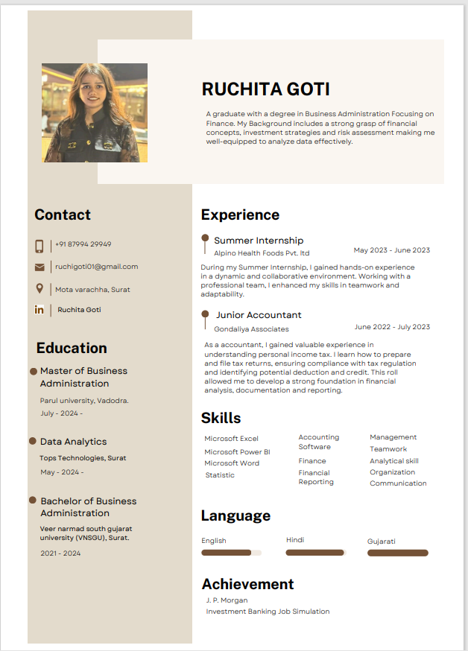
About me :

Slide 3
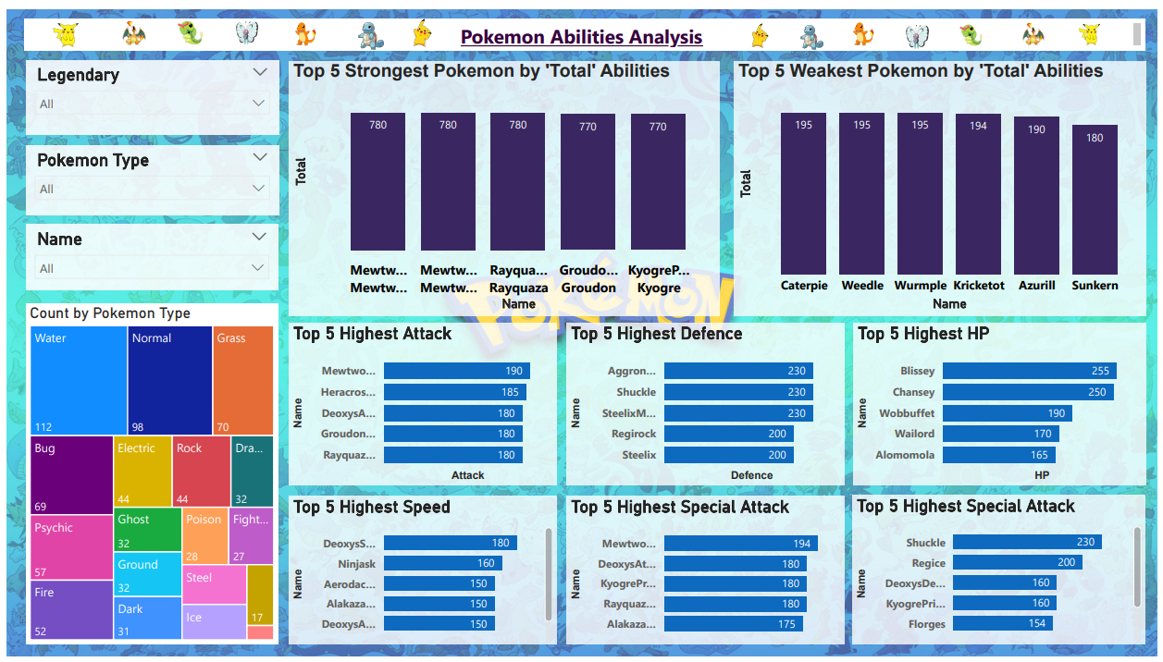
Dashboard :

