Slide 1
ACQUISITION ANALYTICS ASSIGNMENT
Submitted by:
- Ruchita Gupta

Slide 2
Problem statement
Bank Marketing
A Portuguese bank had conducted a telemarketing campaign for a term deposit product somewhere around late 2010.
Through the campaign, the bank had collected data about the prospects' demographics, other financial products they have purchased in the past (loans, deposits, etc.), the number of times they were called, etc. They also recorded the response data, i.e., whether the person had subscribed to the term deposit product, which is the target variable.
The bank's marketing team wants to launch yet another telemarketing campaign for the same product.

Slide 3
Business objective and Goal
Business Objective:
To reduce customer acquisition cost by targeting the ones who are likely to buy
To improve the response rate, i.e., the fraction of prospects who respond to the campaign
To achieving 80% of total responders at the minimum possible cost.
Goal of Data analysis:
To build a logistic regression model using the 2017 data to assign a score between 0 and 1 to each of the prospects and it should be evaluated on the metric chosen in tune with the Business Objective.
Divide the prospects into 10 equal bins on the basis of this score. Then find the Top X% of the responders who should be contacted to meet the Business Objective.
To find the cost of Acquisition of 80% of the responders using the model.

Slide 4
Data understanding
Bank Marketing dataset available for 41188 leads and consists of the following attributes :
Customer data: Demographic data like Age, Marital Status, job, education etc
Campaign data: Data about previous campaigns (number of previous calls, number of days since the last call was made, etc.)
Macroeconomic data : External parameters like price index, employability rate, confidence index etc
Target variable: Response (Yes/No)
Date Cleaning/Preparation : Dataset does not contain any Nulls so no cleaning is required. The duration column is removed since for the new campaign, duration is not available before the call is made. Also, the categorical variables were converted into dummy variables.

Slide 5
Model building using Recursive Feature Elimination (RFE)
RFE is conducted with 15 variables
First model is built using Logistic Regression. It has 15 features: some variables have VIF> 5 and p-values > 5%
Created 5 model iterations, eliminating variables based on high VIF and p-values > 5% . The final model has 10 variables with roc_auc_score as 0.78. The final selected variables are –
job_retired, job_student, contact_telephone, month_dec, month_mar, month_may, previous_Never contacted, poutcome_success, cons.price.idx and euribor3m

Slide 6
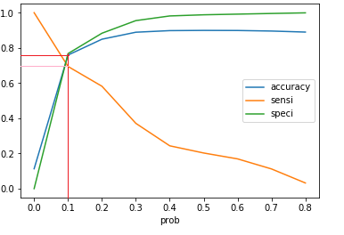
Final Model and Optimal cut-off point
Since we need to target most of the responders and do not want to miss them, we chose sensitivity as our main performance metric.
For achieving sensitivity of 0.69 and specificity 0.77 on the train set, the optimal cutoff was chosen as 0.1
Using this model on the test set we achieved sensitivity of 0.68, specificity as 0.76 and roc_auc_score as 0.77. This clearly tells that our model is neither underfitting nor overfitting.
0.77
0.69

Slide 7
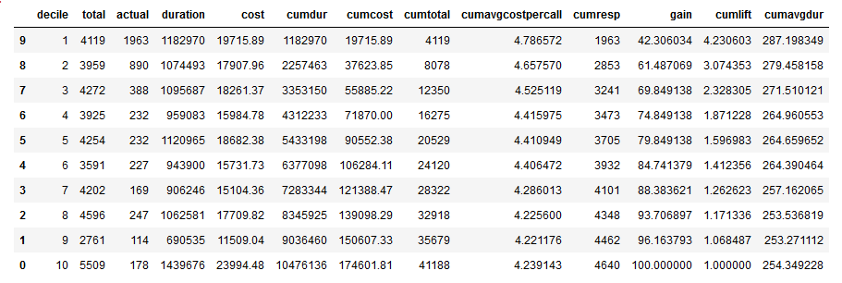
Cost Calculation and Finding X in the top X%
Top 50% prospects for 80% gain
80% gain
Average Call Duration
Cost of contacting 50% prospects
The extraordinary financial benefit of this model: If you market to only the top 5 deciles (50% of the customers), you will capture around 80% of the responders. In other words, you can acquire around 80% of customers at almost 50% cost.
The average call duration for calling 50% of the customers is 265 secs.
The acquisition cost for 80% = cost of calls made = $90552
Without the model, the acquisition cost for 80% would have been 0.8*174602 = $139682
Hence there is a lift of almost 1.6

Slide 8
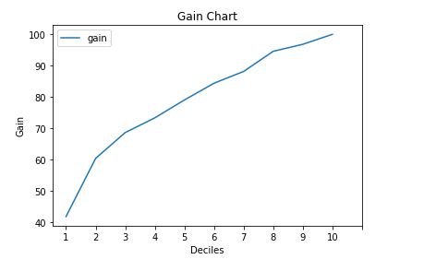
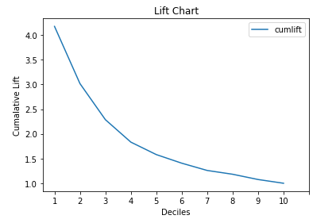
GAIN AND LIFT CHART
1.58
As can be seen from the Gain Chart, on reaching out to 50% of the prospects we are targeting 80% of the responders
As can be seen from the Lift Chart, on reaching out to 50% of the prospects we get a lift of around 1.6 which means, we are targeting 80% of the responders (50 * 1.6 = 80%).

Slide 9
Thank You

