Slide 1
Comparing Collaborative filtering-based recommender and Hybrid recommender system
Team Sigma

Slide 2
Team Members
Hetal Prajapati (C0911591)
Joel Laureta (C0917501)
Ruchita Patel (C0913017)
Simon Shrestha (C0913111)

Slide 3
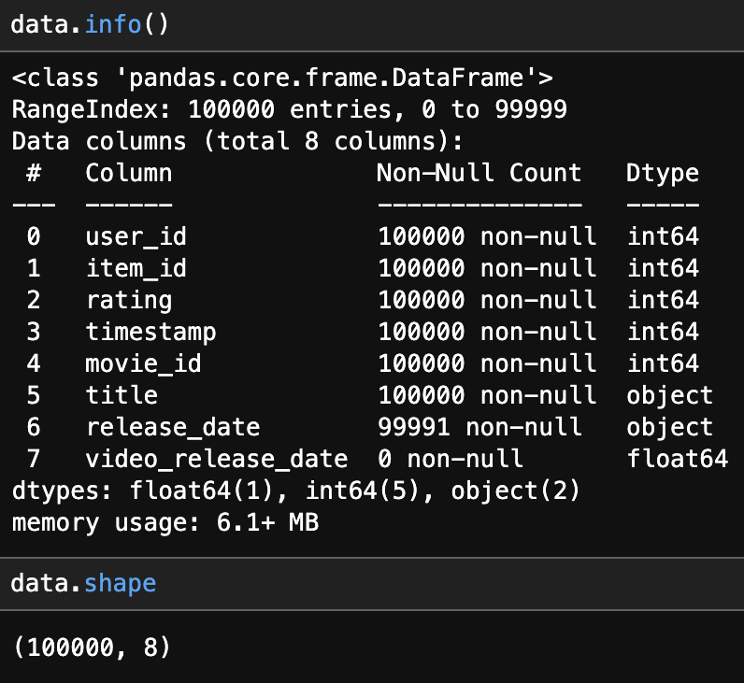
Dataset
Data set consists of 100,000 ratings (1-5) from 943 users on 1682 movies.

Slide 4
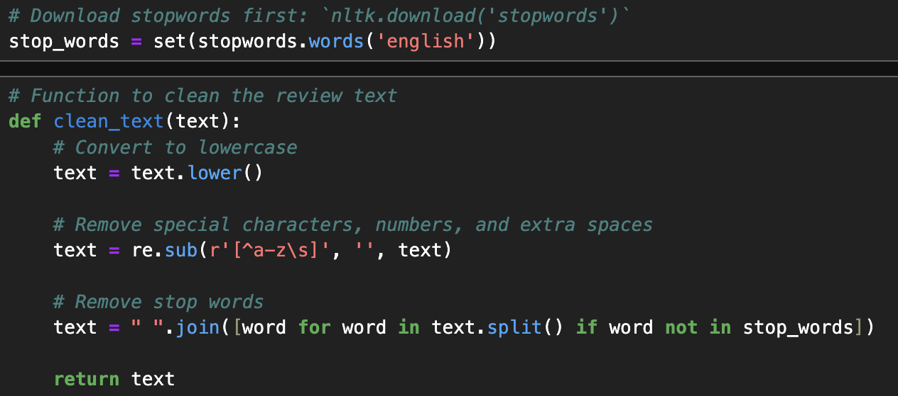
Data Preparation
Stopword removal and regular expression were used for data cleaning.

Slide 5
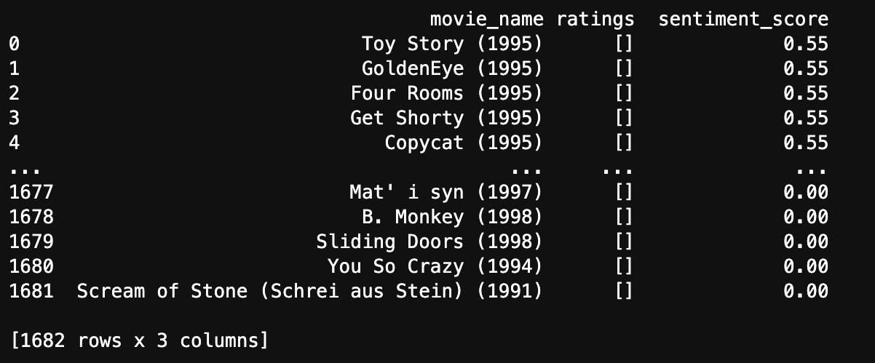
Sentiment Analysis
The data was scraped using OMDB API and calculated the average sentiment score based on ratings and reviews.

Slide 6
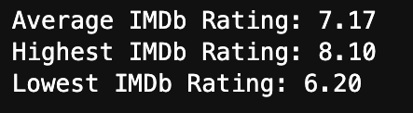
Statistics
Once the sentiment scores were calculated, a statistical analysis of the dataset was performed.

Slide 7
Collaborative Recommender
Dataset used: u.data and u.item

Slide 8
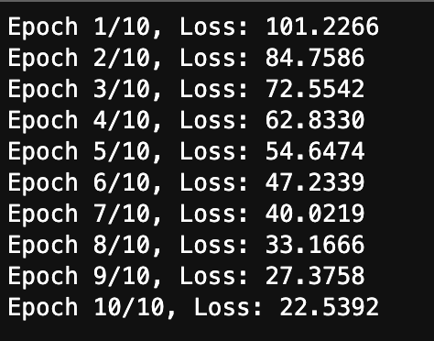
Matrix Factorization
Matrix factorization was used using Regularization to get predictions .
10 epochs were used to train the model.

Slide 9
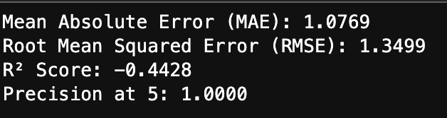
Model Evaluation
After testing the data we calculated MAE, RMSE, R2 score.
Calculated precision score of top 5 recommended movies.

Slide 10
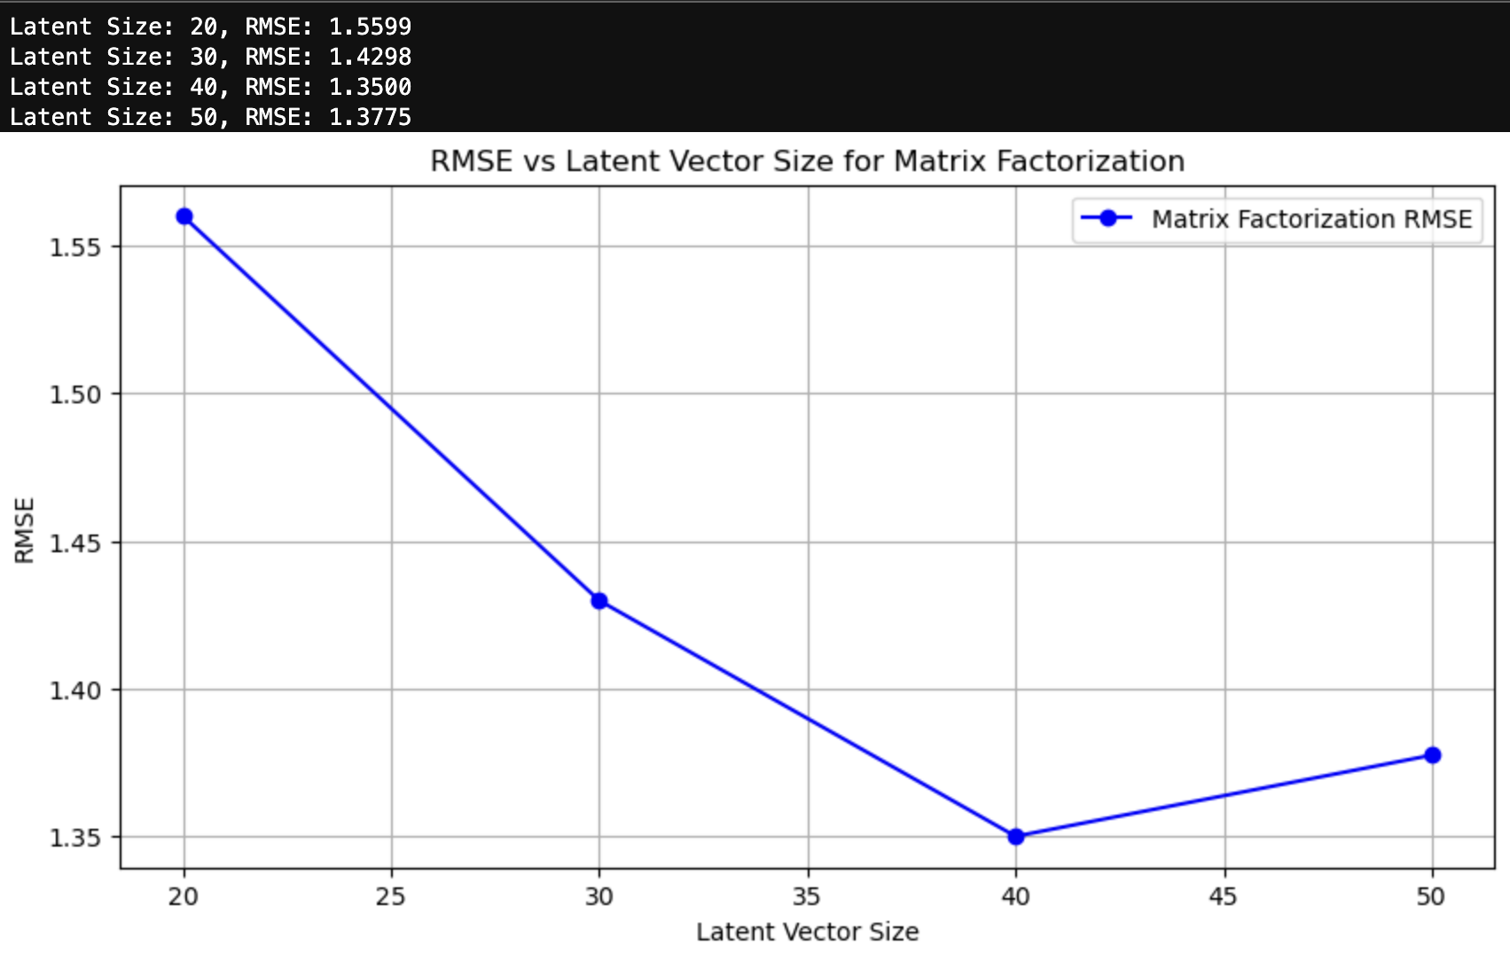
Latent Vector size for Matrix Vectorization
RMSEs for the Matrix Factorization model using 20, 30, 40, and 50 as latent vector sizes.

Slide 11
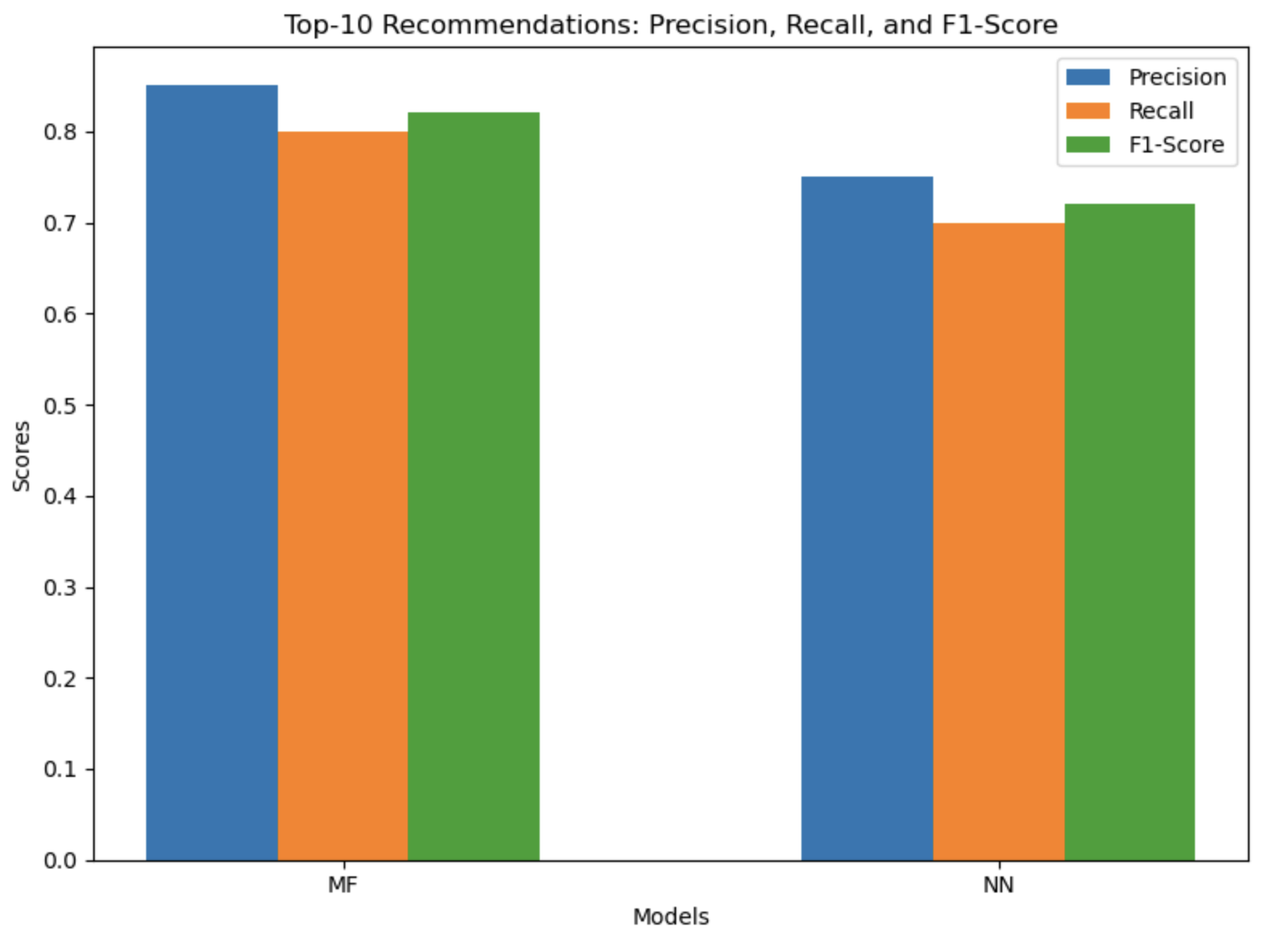
Top 10 Recommendations

Slide 12
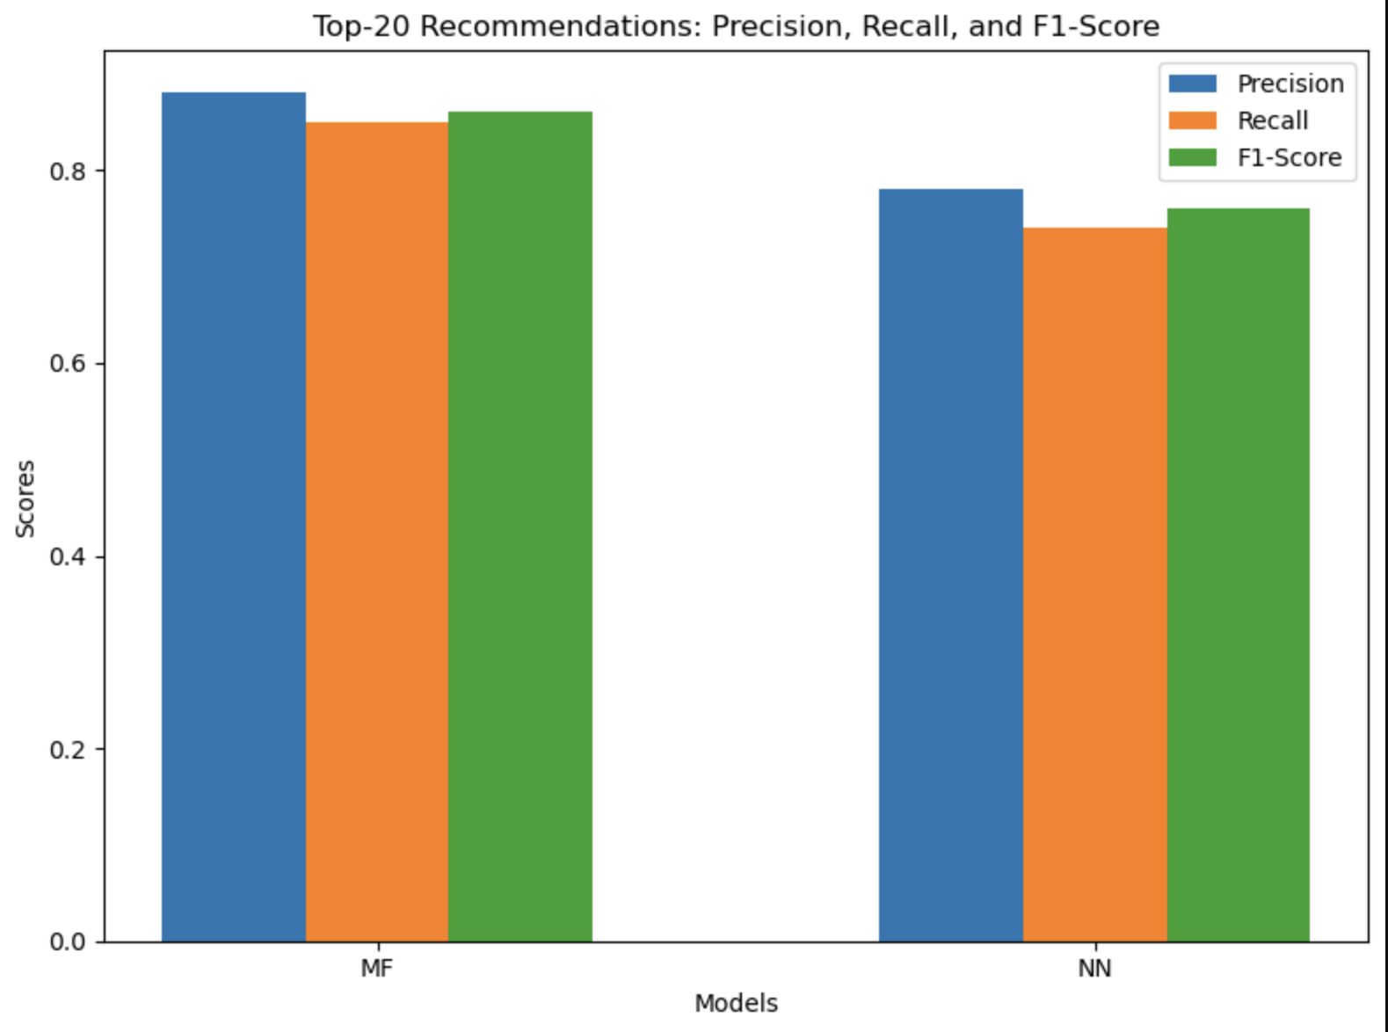
Top 20 Recommendations

Slide 13
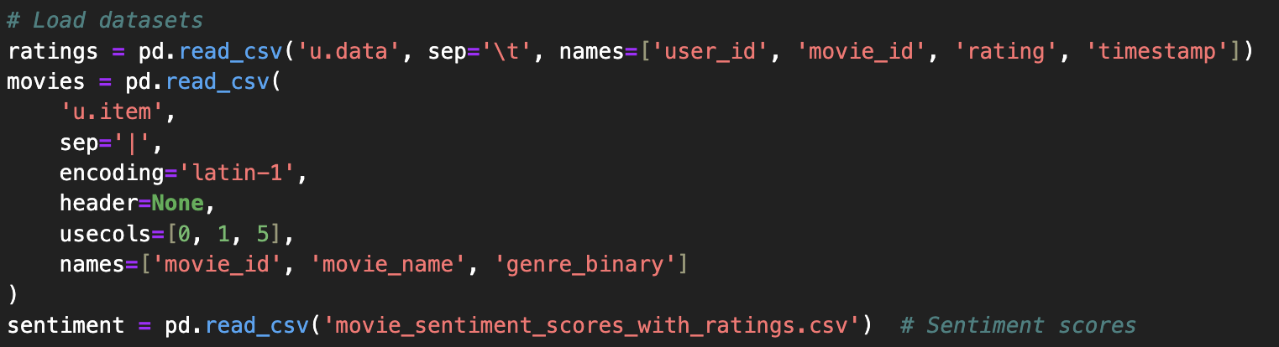
Hybrid Recommender
To build the Hybrid Recommender System, we are combining the following:
Movie Ratings from u.data
Movie genre information from u.item
Movie sentiment calculated using OMDB API.

Slide 14
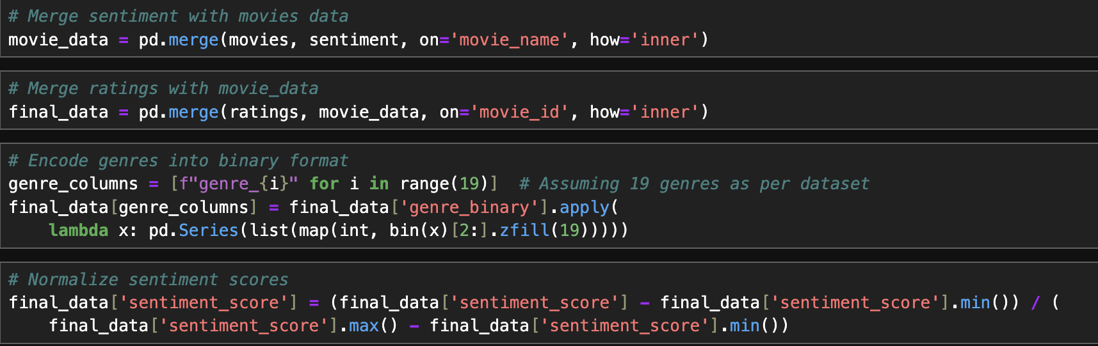
Data Preparation

Slide 15

Model Evaluation
During model evaluation using embedded layers neural network (Pytorch), around 70% accuracy was obtained.

Slide 16
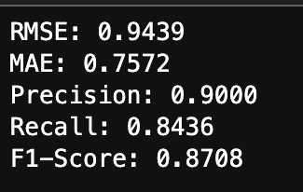
Model Evaluation
Evaluating model performance on test data we calculated RMSE, MAE, Precision, Recall, and F1-score.

Slide 17
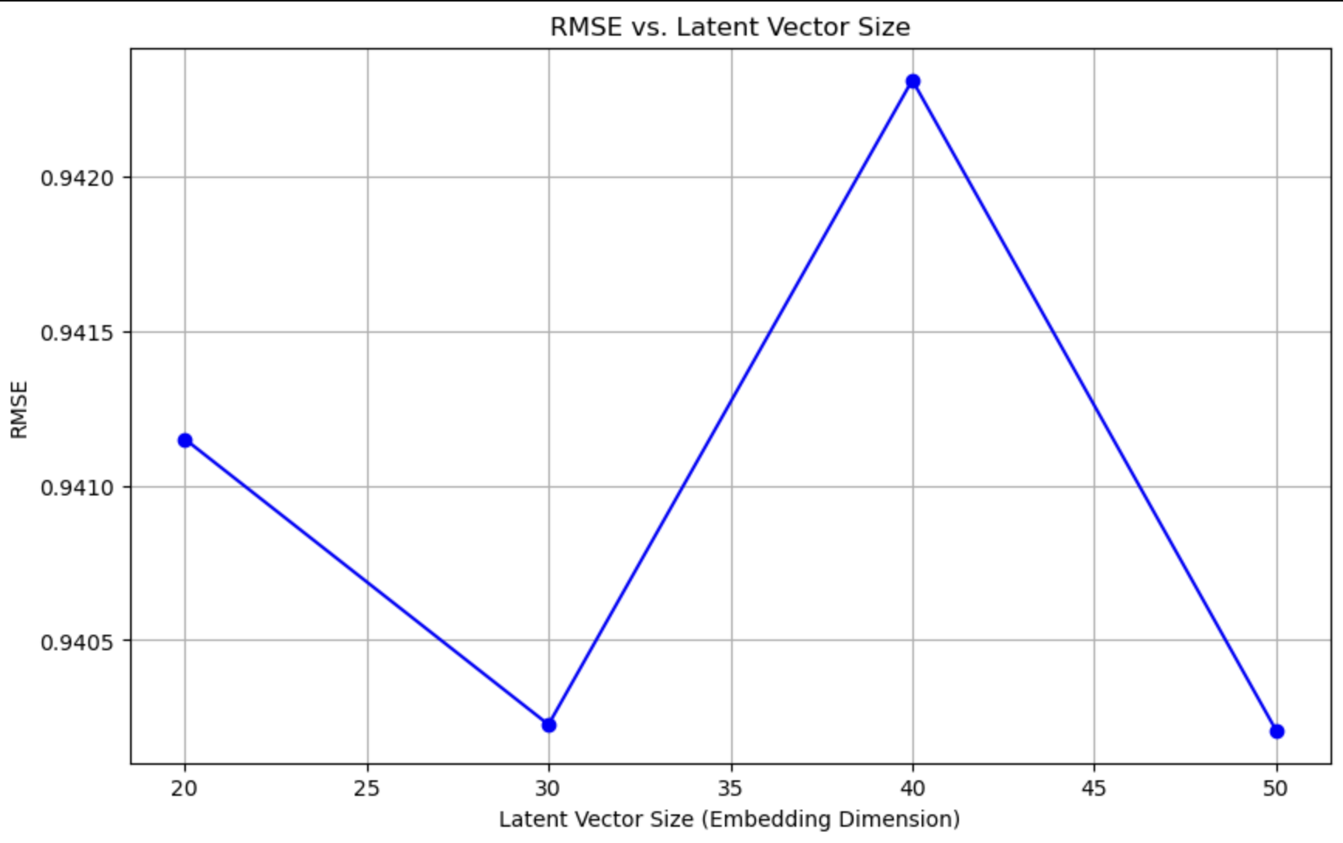
RMSE vs Latent Vector Size

Slide 18
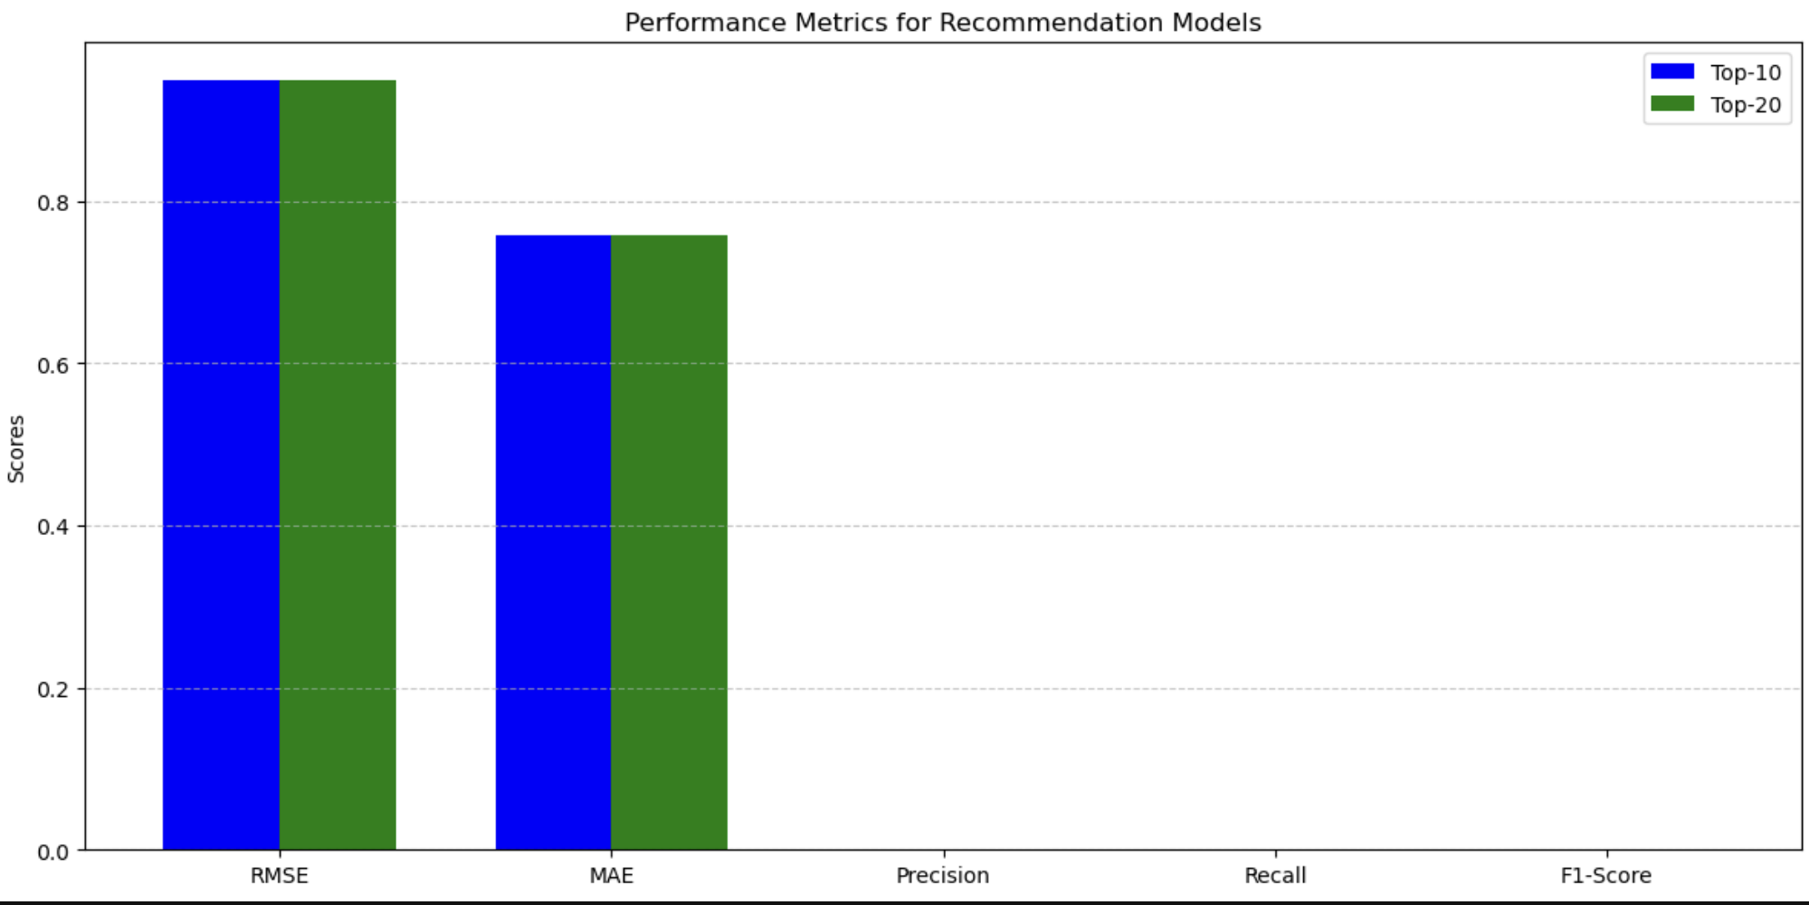
Performance Metrics

Slide 19
Thank you

