Slide 1
User Interface Design
UI, UX, Design, Design Thinking

Slide 2
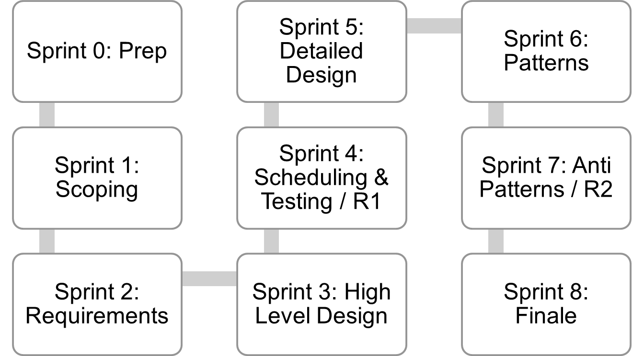
Where are we..
Jan 4
Mar 12
Mar 26
Lecture topics will follow this flow
As the projects tracks these sprints
Submissions due along the way
Guest lectures from startups and Industry leaders
EACH SPRINT IS 2 WEEKS, Friday start.
Jan 15
Feb 26
Apr 9
Jan 29
Feb 12
April 23
April 23+ EVALUATIONS

Slide 3
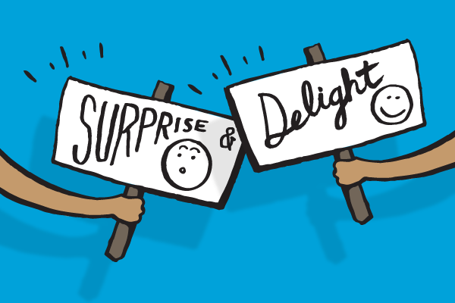
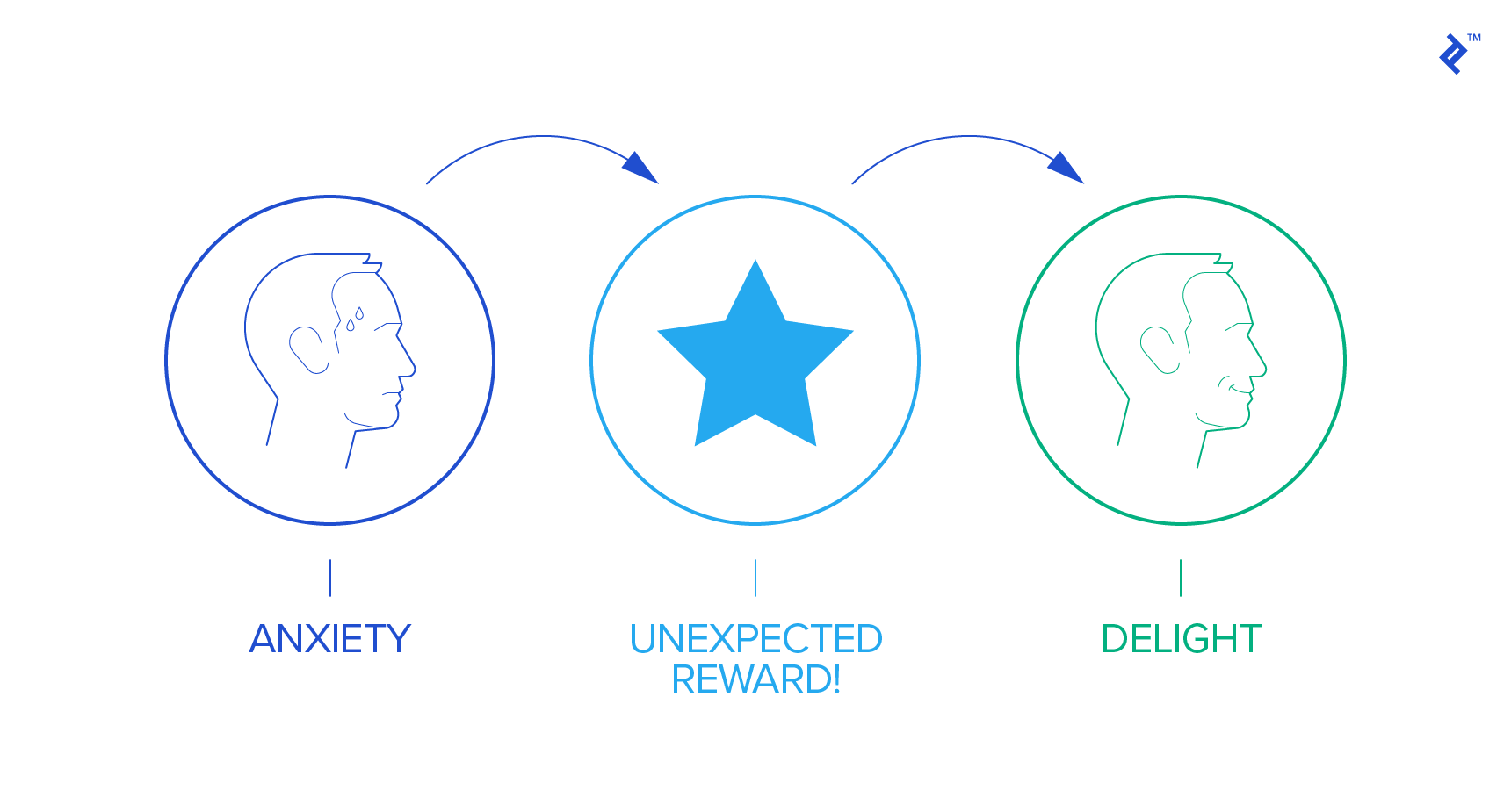
What UI shd help with

Slide 4
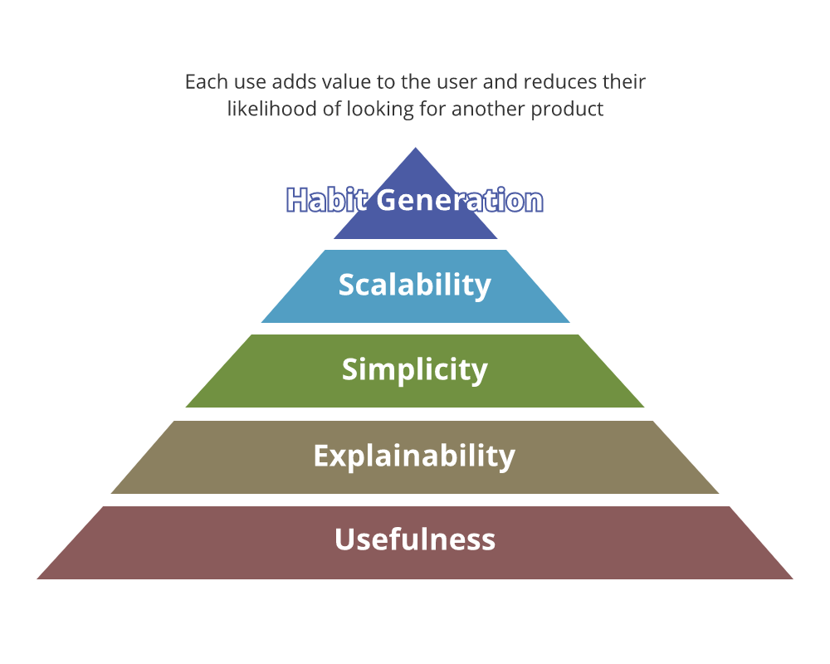
What UI shd enable

Slide 5
Attributes of great UI
Nielsen defines Usability through the following five characteristics; learnability, efficiency, memorability, errors and satisfaction.
Learnability: Can the user complete their tasks with little difficulty?
Efficiency: Does the interface allow the user to complete tasks in a timely manner?
Memorability: After leaving a website, how likely will the user be able to remember how to use it the next time they visit?
Errors: What steps does the interface take to lessen the chance of user error, and how do they let the users correct an error?
Satisfaction: Does the user enjoy interacting with the design?
And on top of those standards, a great UI should also reflect the personality of the brand in order to stand out from the competition and provide users with a delightful experience. So let’s check out a few examples of where I think companies have gotten their website UI design spot on.
Credit: Nielsen Norman Group

Slide 6
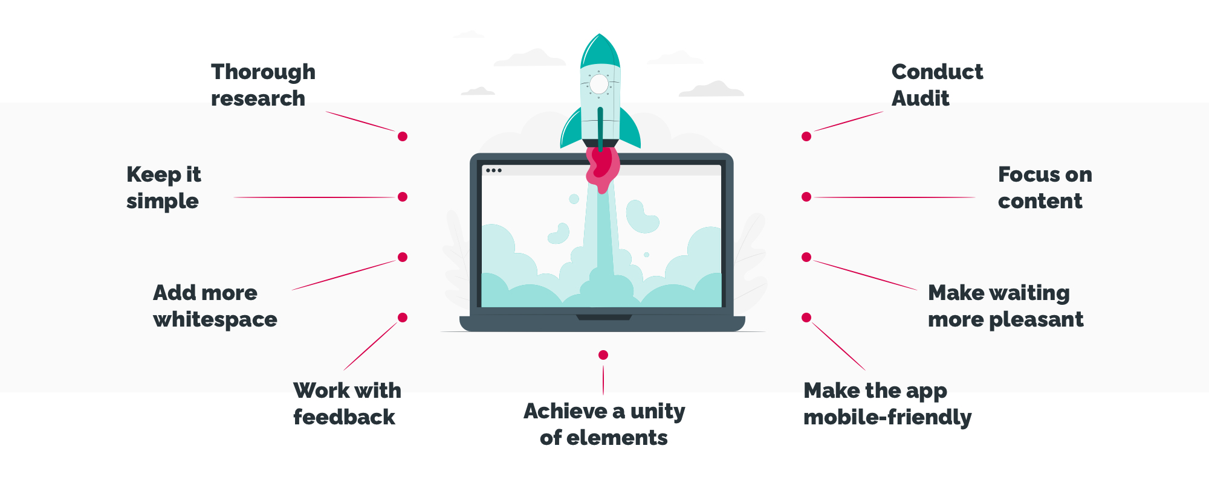
How to make UI better

Slide 7
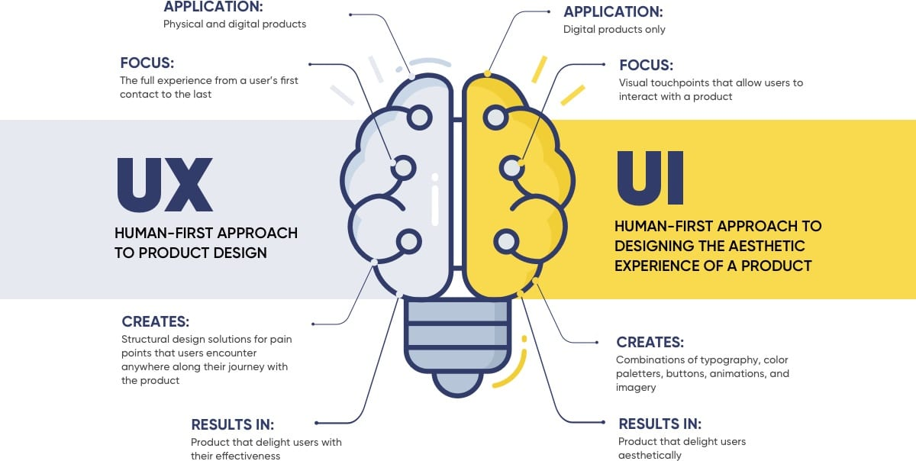
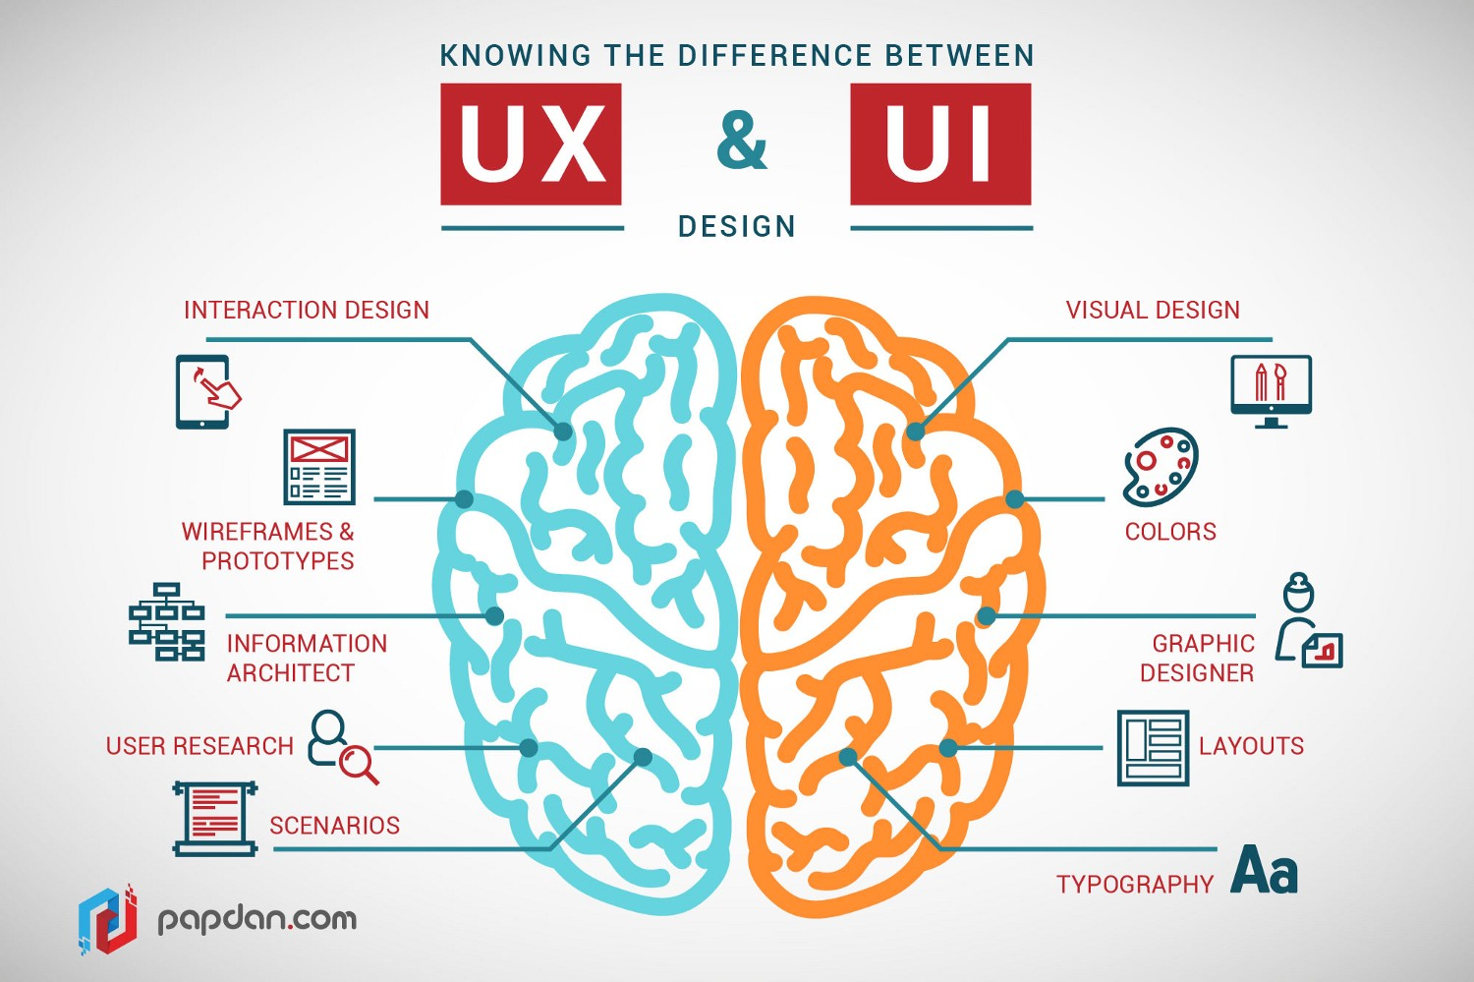
UI? UX?

Slide 8
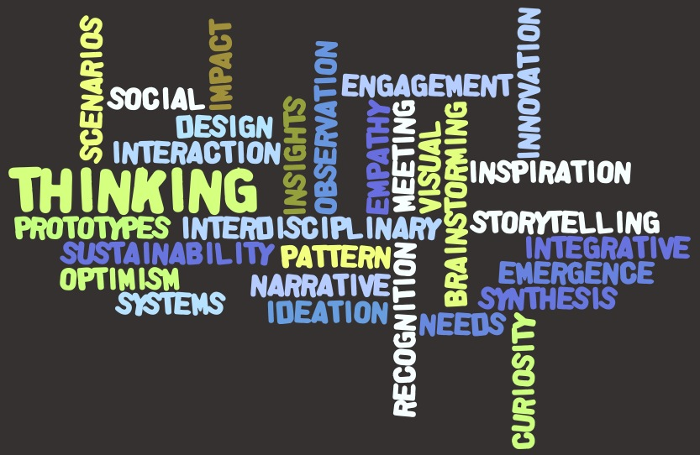
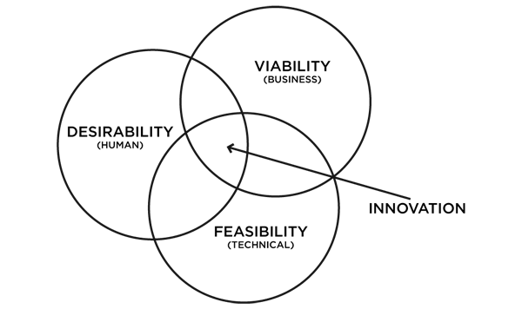
Elements of UX thinking

Slide 9
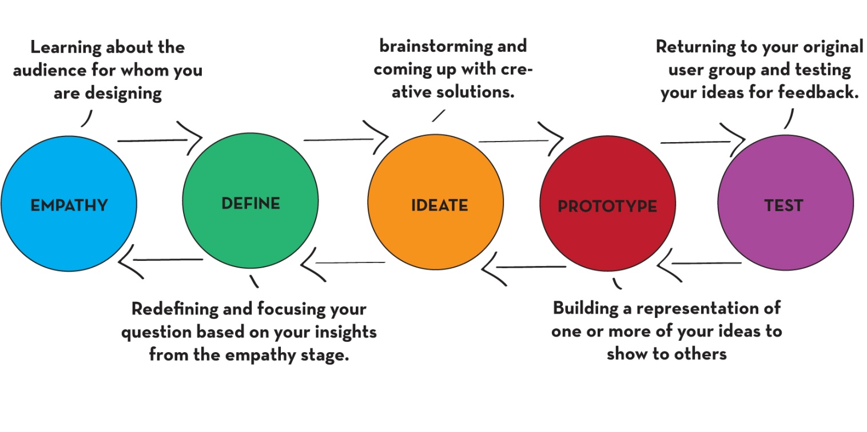
Design thinking Process
https://www.youtube.com/watch?v=yjyutgqoBLo

Slide 10
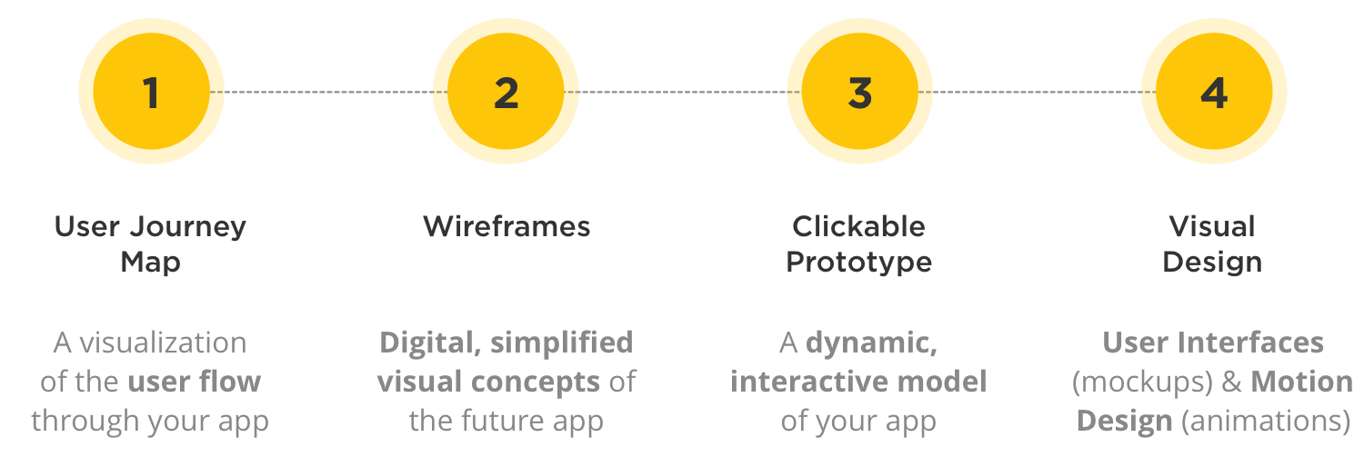
Drilling down ..

Slide 11
GUIs: “bones” vs. cosmetics
A lot of GUI design effort ends up focusing on frills
  Colors, “cool” graphics and icons, fancy widgets
  Online help systems
  Animation, multimedia
These are the “bells and whistles” that are added after the GUI foundation is in place (when appropriate).
The basic experience is created by the underlying structure and concept of the interface
  Start with the basic “bones” before you add the frills.

Slide 12
Best Practices for Designing an Interface
Keep the interface simple. ...
Create consistency and use common UI elements. ...
Be purposeful in page layout. ...
Strategically use color and texture. ...
Use typography to create hierarchy and clarity. ...
Make sure that the system communicates what's happening. ...
Think about the defaults.

Slide 13
User Interface Design
- Some Don’ts

Slide 14
Understanding the users
Need to focus on the profile and characteristics of the users
  Level of expertise using software in general
  Likely frequency of usage
  Capabilities and constraints e.g. young users, users using dialup lines, using public terminals
User background and expectations
  How they think about this problem domain and this application
  The specific expectations they have from the system: get work done quickly? Enjoy using it? Power – lots of different capabilities? Flexibility?

Slide 15
Understanding the tasks
What do they want to do with the software?
What operations will they perform frequently?
  Design to make most frequent tasks most convenient
Do they already have ideas about how to do the operations?
What variations are likely in the way they perform tasks?
E.g. Two contrasting models, each useful for their context:
  Applications such as MS-Word
    perform hundreds of different tasks from the same screen
  Wizards
    perform exactly one task, with minor parameters and variations!

Slide 16
User Interface - the Foundation
Need a consistent concept underlying the entire UI
  Games do a very good job of this: set up a “world” that users move into
  Note how each application type has a model: browsers, spreadsheets, work processors, databases, calendar managers, messengers, mail programs…
  Sometimes the model is a “metaphor” e.g. the desktop, folders and documents “worktable” metaphor
  Sometimes the model is a standard for the application type e.g. graphics programs, first-person shooters, mail programs, …
Using the model consistently throughout makes it easier for users to figure out how to perform tasks

Slide 17
User Interface - Navigation Plan
Group related tasks together
  Grouping levels: Screens, tabs, menus
  Acid test: How easy is it to figure out where to look for functions
Have a consistent navigation scheme between screens
  Match it to user workflow
    Make frequently used tasks easy to access.
    Tradeoff: avoid clutter – packing too much into one screen
Be consistent in grouping and behavior
State transition diagrams often useful to depict navigation schemes

Slide 18
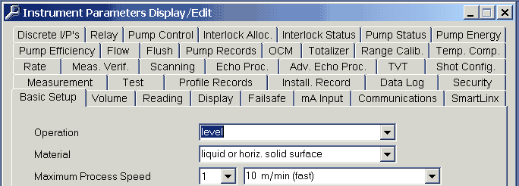
Be Careful -- Extremes
Tabs can be useful in organizing information, but having too many can lead to confusion

Slide 19
Screen Layout & Appearance
Important stuff placed in the “prime” locations
Obvious is good!
  Use of appropriate shapes, colors, icons for your users and the domain
  Match with look-and-feel of similar applications (standards)
  Be consistent with these items as well.
Fancy stuff is distracting and jarring – when used occasionally and carefully, fancy stuff can be eye-catching and attractive

Slide 20
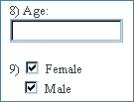

Use of widgets
Different GUI widgets are useful for different purposes
  E.g. push buttons vs. radio buttons vs. checkboxes vs. drop-down lists
  Each has semantics associated with it - educate yourself
  Tradeoffs between different widgets e.g. drop-down lists save space, but less convenient than radio buttons
Use widgets consistently throughout your application

Slide 21
Usability
Ease of learning
  Able to use software with little or no training
  Use of software is faster the second time
Productivity
  Perform tasks quickly and efficiently
Minimal error rates
  Knowing whether operations worked, and if not, why it failed, and what can be done about it
  If error occurs, provide good feedback so user can recover
High user satisfaction
  Users feel like they are driving – they issue the commands and software executes it, rather than it pulling them along and dictating to them
  Includes the ability to customize environment.

Slide 22
Some Don’ts

Slide 23

Keep the users busy doing unnecessary work.
Example: It's a "good" habit to let users enter data that the system already knows and could provide beforehand.
Example: Let users put out a lot of effort to scroll around in text boxes in order to read information.

Slide 24
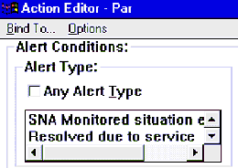
IBM’s NetFinity (supervising networks & remote computers)
Because of their desire to fit everything into a single dialog, IBM's designers made sacrifices.
The designers sacrificed the user's ability to read some of the controls, such as the list of potential alert conditions, shown here.
The user can scroll through the list one alert at a time, and will have to scroll both left and right to view the items.

Slide 25
Do not obey standards
Example: Do not use standard screen elements for a given purpose, such as single selection (e.g. use checkboxes instead of radio buttons because they look nicer).
Example: Do not place menu items into the categories and locations they typically belong to (e.g. place "Save" in the "Edit Menu").

Slide 26
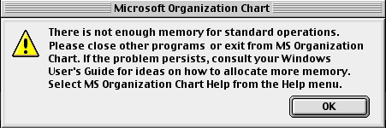
Word 98 for the Macintosh
This image is an error message received from Microsoft's Office 98 on a PowerMac when attempting to add a flow chart to a Word document.

Slide 27
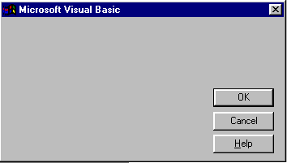
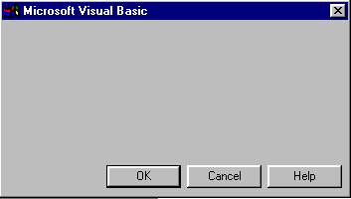
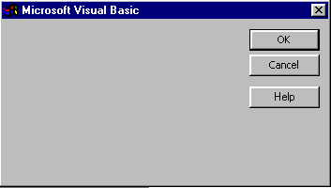
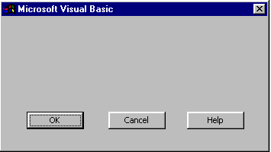
Visual Basic 5 (compilation)

Slide 28
Make it slow!
Example: There are nearly unlimited possibilities of making software slow. For example, you can include long lasting checks or roundtrips after each user input. Or you can force users through long chains of dialog boxes.

Slide 29
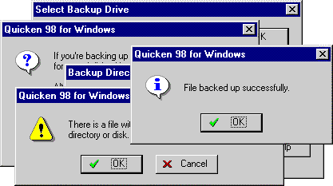
The Backup Process in Quicken98

Slide 30
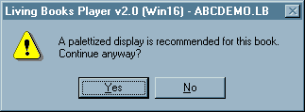
Dr. Seuss’ ABC
While some programmers might readily understand this message, we would consider it beyond the understanding of most computer users, especially for the target population of the particular application that generated the message.
The game is intended for 3 to 5 year-old children. Funny thing though, the message is completely unnecessary, since the program works just as well at any typical display setting.

Slide 31
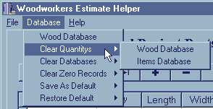
Woodworkers Estimate
The program is "designed for woodworkers and cabinet makers", and purports to assist in the process of calculating price quotes for their projects.
Unfortunately the program uses such esoteric programming terminology as "Databases", "Records", and, if the user attempts to enter a duplicate part name, presents the message "Key Validation Error".

Slide 32
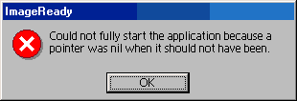
Adobe ImageReady

Slide 33
Hide Important and often-used functionality from the users’ view
Reasoning: This strategy stimulates users to explore your application and learn a lot about it.
Example: Hide important functions in menus where users would never expect them.
Example: Hide functionality in cryptic icons.

Slide 34

ccMail
While some of the images are immediately recognizeable (e.g., the printer, and the trashcan), the functions of many of the images are completely unclear.
To make matters worse, ccMail does not provide ToolTips ("bubble help") for the toolbar images.

Slide 35

WebZip
WebZip utilizes a navigation toolbar.
The navigation toolbar is scrollable, but the designers essentially hid this fact from the user.

Slide 36
Make your application mouse-only - do not offer any keyboard shortcuts
Reason 1: This will make your application completely inaccessible to visually impaired users. Therefore, you can leave out all the other accessibility stuff as well. That will save you a lot of development time.
Reason 2: This will drive many experts crazy who used to accelerate their work with keyboard shortcuts. Now, they will have more empathy for beginners because they are thrown back to their speed.

Slide 37
Make Using Your Application a Real Challenge!
Reasoning: This teaches people to take more risks, which is important particularly when they are under pressure or have other things they could be doing with their time.
Example: Do not offer an Undo function.
Example: Do not warn users if actions can have severe consequences.
Note: If you want to top this and make using your application like playing Russian roulette, change the names of important functions, such as Save and Delete, temporarily from time to time...

Slide 38
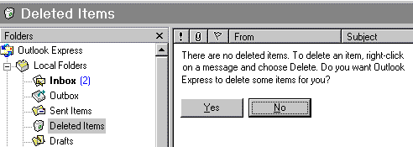
Microsoft Outlook v.5
The message states that there were no items in the Deleted Items folder and do I want Outlook to delete something.
What sort of a message is that?!? Why would you want Outlook to delete a randomly-selected piece of mail?

Slide 39
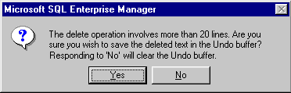
Microsoft SQL Manager
If you select more than 20 lines of text from the query window, and then accidentally hit delete, you get this apparently helpful error message, so that if you change you mind, you can hit "No" to avoid the delete. However, closer inspection of the message reveals a glaring inconsistency. Hitting "No" actually causes the Delete operation to continue, but destroys the Undo buffer in the process, leaving no means of canceling an accidental delete.

Slide 40
If You Can’t Say Anything Useful,
Then Don’t Say Anything At All
Reasoning: This teaches people to be more self-reliant and to pay more attention to what they are doing in the first place.
Example: Do not give users feedback when they deleted something.
Example: Do not offer status when copying files.

Slide 41
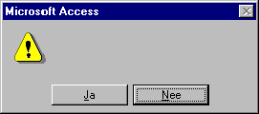
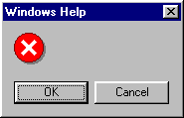
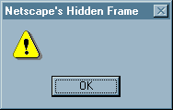
Various Applications

Slide 42
Insult Your Users Rather than Provide Useful Information
Reasoning: This teaches people to keep from making the mistake again by not using the feature at all and will keep customer support calls low (as well as your customer base).
Example: Calling them names
Example: Being general with errors rather then providing useful information.

Slide 43
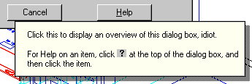
Autocad Mechanical
The author of the message considered it a joke that would never be seen by the users.
As a result of the joke, the employee is now a former employee, and AutoDesk has sent thousands of letters of apology to its customers.

