Slide 1
Requirements Estimation
1

Slide 2
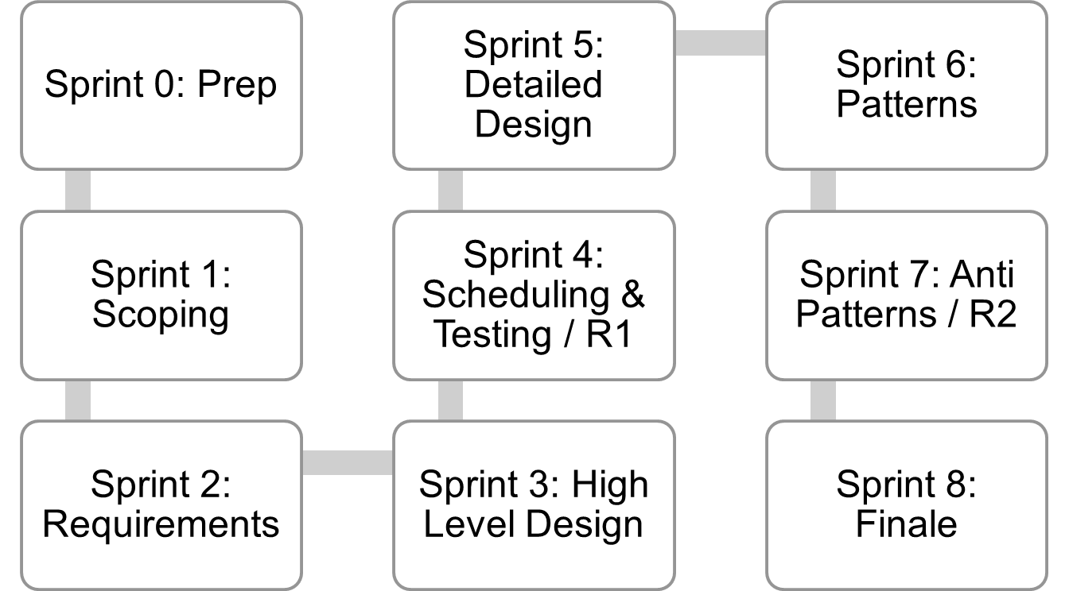
Where are we..
Jan 4
Mar 12
Mar 26
Lecture topics will follow this flow
As the projects tracks these sprints
Submissions due along the way
Guest lectures from startups and Industry leaders
EACH SPRINT IS 2 WEEKS, Friday start.
Jan 15
Feb 26
Apr 9
Jan 29
Feb 12
April 23
April 23+ EVALUATIONS

Slide 3
What is Software Estimation?
Lets take some examples..
Software Estimation
• Predictions are hard, especially about the future
• Two Types of estimates:
– Lucky or Lousy

Slide 4
Can you estimate these?
1.Distance from Diorectors office to OAT
2. Surface temperature of the sun (in degrees C)
3. Latitude of Shanghai (in degrees)
4. Birth date of Alexander The Great (year)
5. Global revenue of “Titanic” (in$)
6. Length of the Pacific coastline (Ca, Or, Wa) (in km) 7. Number of books published in USA, 1776 to 2004 8. Weight of the largest whale (in tonnes)
This is adapted from “Software Estimation” by Steve McConnell

Slide 5
On what basis did you estimate? – Experience right?
(History matters…)
Likely as an “average” probability | For most software projects there is no such ‘average’
Remember, an “exact estimate” is an oxymoron

Slide 6
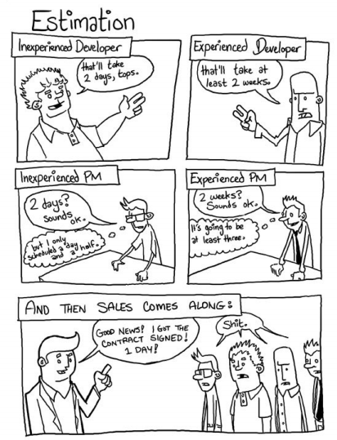
Why Estimate

Slide 7
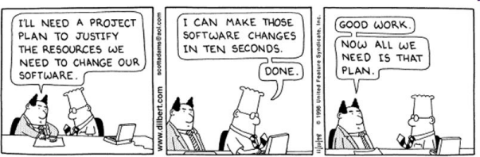
.. Not this way, though

Slide 8
Estimations
• Created, used or refined during
– Strategic planning
– Feasibility study
– Proposals
– Vendor and sub-contractor evaluation
– Project planning (iteratively)
• Basic process
1) Estimate the size of the product
2) Estimate the effort (man-hours/man-months)
3) Estimate the schedule
– NOTE: Not all of these steps are always explicitly performed

Slide 9
# 1: Always give a range Never give them a number
Numbers are for facts; Ranges are for estimates;

Slide 10
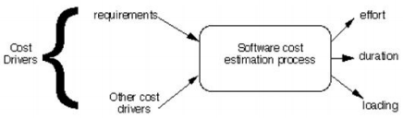
Approach: understand what it “may” take

Slide 11
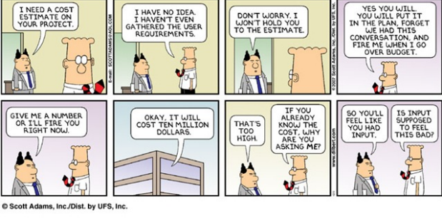
#2 Always ask what the estimate will be used for

Slide 12
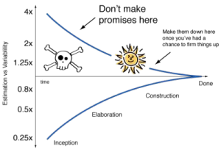
#3 Estimation != Commitment
So, Getting an estimate wrong doesn’t hurt
Iteratively increasing clarity

Slide 13
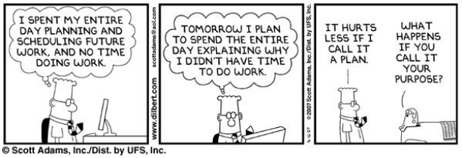
#4 First try to measure, count and compute
Estimate only when necessary
Time to estimate

Slide 14
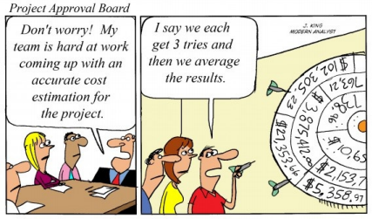
#5 Needs to be Team effort

Slide 15
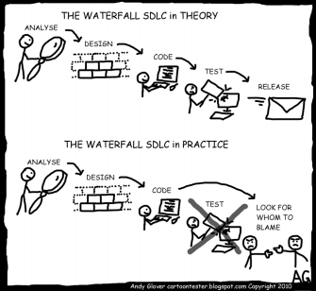
..
Mindful of Reality

Slide 16
#5 Aggregate independent estimates
“Wisdom of the Crowds”
The law of large numbers
(or: statistics is on our side, for once)
• If we estimate with an error of x% • The estimate of each scope item will have an error of x%
But...
• Some items will be over-estimated, others under-estimated (maybe....)
• => The error on the total estimate is < x%

Slide 17
Estimation Methodologies
• Top-down
• Bottom-up
• Analogy
• Expert Judgment
• Priced to Win (request for quote – RFQ)
• Parametric or Algorithmic Method
– Using formulas and equations

Slide 18
Wideband Delphi
• Group consensus approach
• Present experts with a problem and response form
• Conduct group discussion, collect anonymous opinions, then feedback • Conduct another discussion & iterate until consensus
Advantages
– Easy, inexpensive, utilizes expertise of several people – Does not require historical data
Disadvantages
– Difficult to repeat
– May fail to reach consensus, reach wrong one, or all may have same bias

Slide 19
A measure: Function Points
• Software size measured by number & complexity of functions it performs
• More methodical than LOC counts
• House analogy
– House’s Square Feet ~= Software LOC
– # Bedrooms & Baths ~= Function points
– Former is size only, latter is size & function • Six basic steps

Slide 20
Function Point Process
• 1. Count # of business functions per category – Categories: outputs, inputs, DB inquiries, files or data structures, and interfaces
• 2. Establish Complexity Factor for each and apply – Low, Medium, High
– Set a weighting multiplier for each (0 →15)
– This results in the “unadjusted function-point total”
• 3. Compute an “influence multiplier” and apply – It ranges from 0.65 to 1.35; is based on 14 factors
• 4. Results in “function point total”
– This can be used in comparative estimates

Slide 21
Estimation Issues
• Quality estimations needed early but information is limited
• Precise estimation data available at end but not needed – Or is it? What about the next project?
• Best estimates are based on past experience
• Politics of estimation:
– You may anticipate a “cut” by upper management
• For many software projects there is little or none – Technologies change
– Historical data unavailable | – Wide variance in project experiences/types
– Subjective nature of software estimation

Slide 22
Over and Under Estimation
• Over estimation issues
– The project will not be funded
• Conservative estimates guaranteeing 100% success may mean funding probability of zero.
– Danger of feature and scope creep
– Be aware of “double-padding”: team member + manager
• Under estimation issues
– Quality issues (short changing key phases like testing) – Inability to meet deadlines
– Morale and other team motivation issues

Slide 23
Know Your Deadlines
• Are they ‘Real Deadlines’?
– Tied to an external event
– Have to be met for project to be a success – Ex: end of financial year, contractual deadline, Y2K
• Or ‘Artificial Deadlines’?
– Set by arbitrary authority
– May have some flexibility (if pushed)

Slide 24
Project Management
Two over-arching inter-dependent aspects of software projects
– Process
– Project Management
Main responsibilities of a project manager are
– Project planning
– Project monitoring and control

Slide 25
Annexure

Slide 26
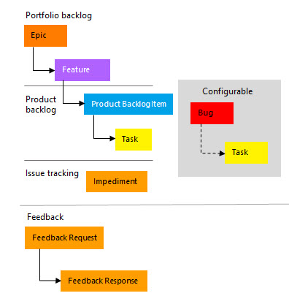
Agile, recap

Slide 27
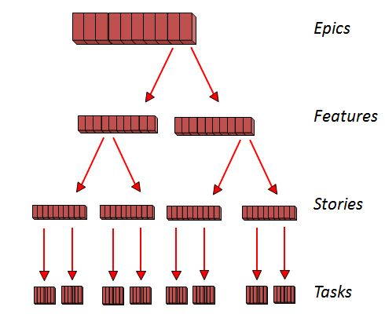
In Agile
Release theme. Summary of what will be in a release (as the end users can see/experience)
List key features in the release
For each feature, list few capabilities that the user can see/do
Work items.. To be setup at start of sprint

Slide 28
UML
UML, short for Unified Modeling Language
A standardized modeling language
As a set of diagrams
To help project teams define, design and deliver projects
Through.. UML Artifacts for
  Specifying
  Visualizing
  Constructing
  Documenting
A standard way to visualize the way a system has been designed. Similar to blueprints used in other fields of engineering.

Slide 29
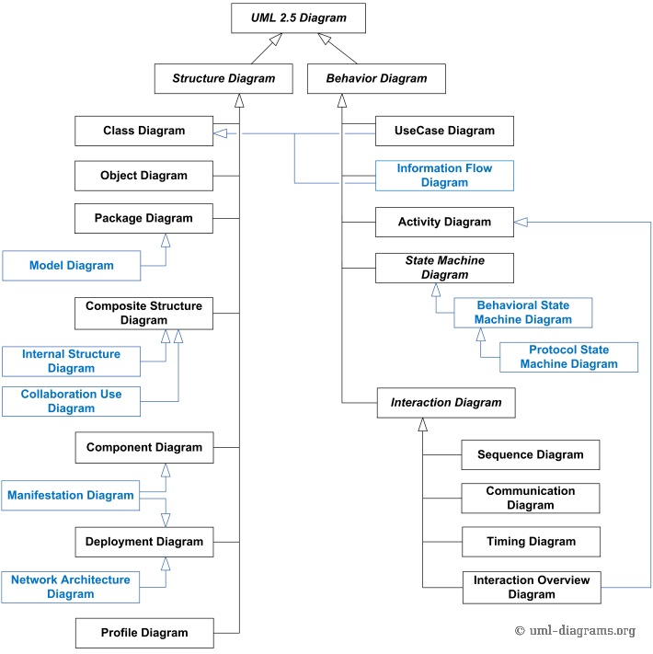
https://www.geeksforgeeks.org/unified-modeling-language-uml-introduction/

Slide 30
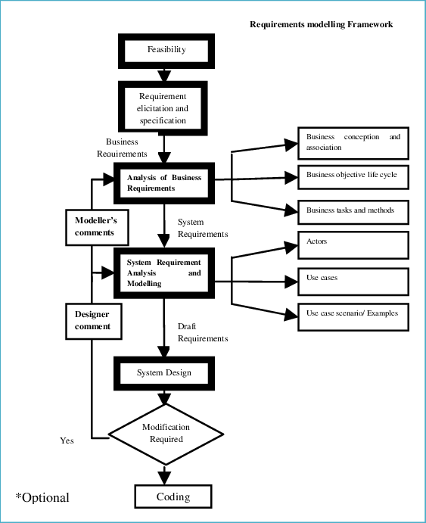

Slide 31
Process of analysing Requirements
For each business process identified to be in scope:
Critical Workflows and/or Use Cases are modeled as UML Action Diagrams.
Analyst documents Action Diagrams.
Stakeholders review documented Action Diagrams.
Use Cases identified in Action Diagrams are further analyzed.
Analyst documents Use Cases, [Entity] Class model, and Business Rules.
Required interfaces and reports are identified and documented.
Analyst drafts Administration Use Cases.

Slide 32
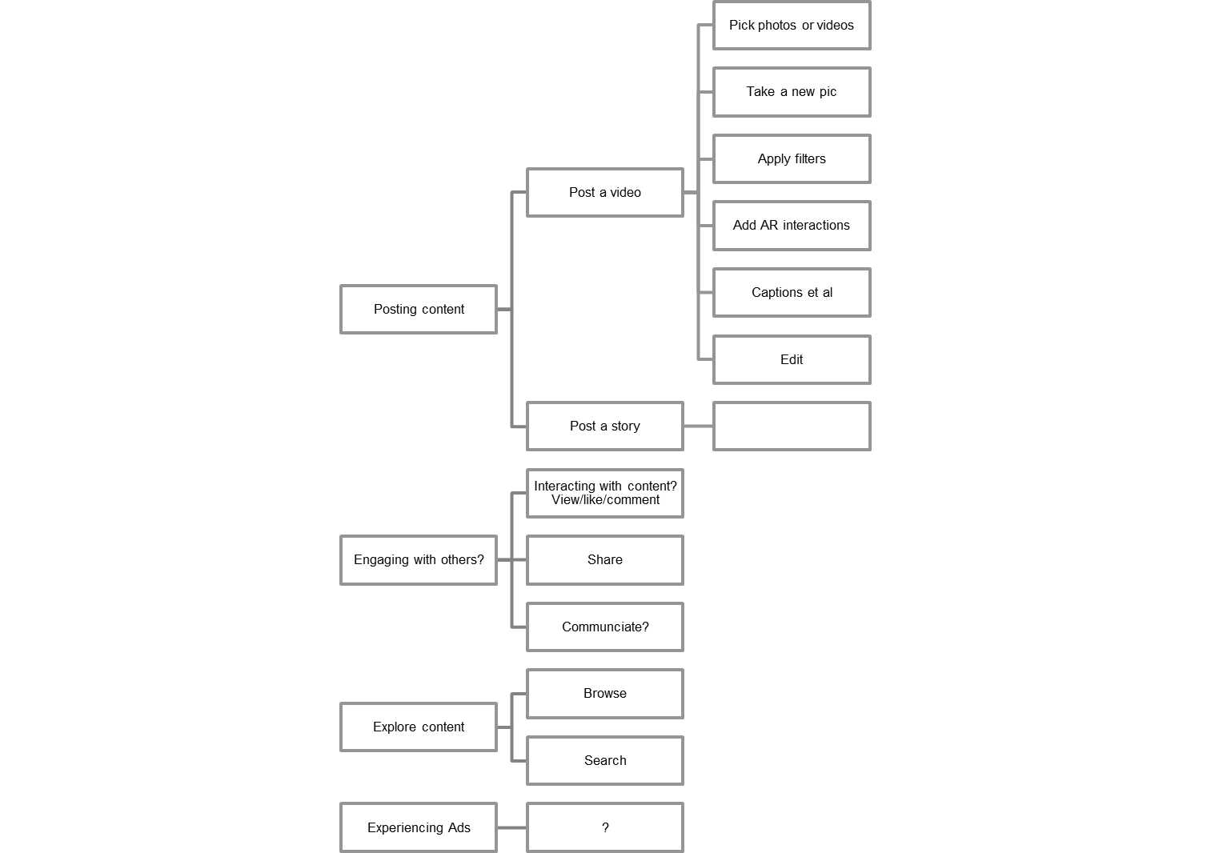
Example Insta
SCENARIO
Set of “related” activities
USECASE
One “Activity”
TASKS
Steps or tasks
Posting Videos
Filters
Communciate with others/ Chat
Create posts & stories
View stories & posts .. Like/react
Reels
Store users pics/videos
Share/Save the posts
Search
Sponsored ads
Manage multiple accts
Biz & verified acvccounts
Network.. Follow Unfollow

Slide 33
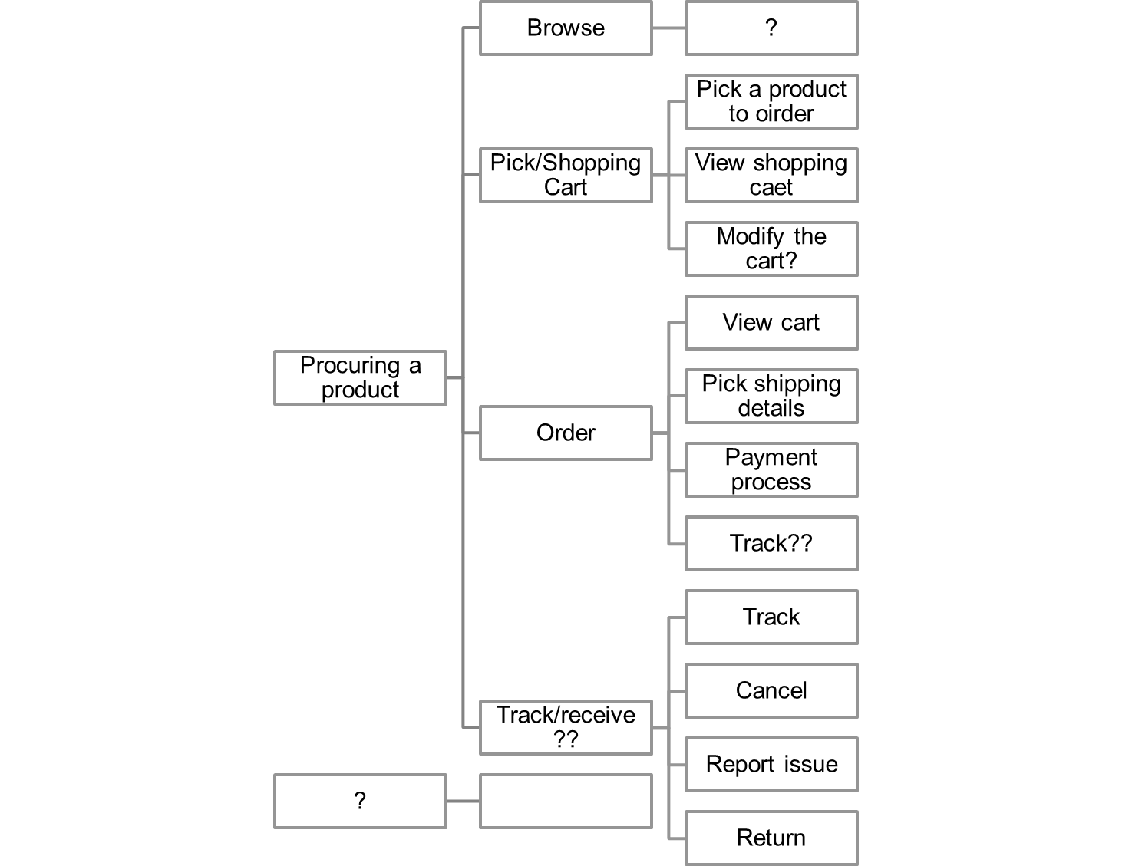
eCom example
SCENARIO
Set of “related” activities
USECASE
One “Activity”
TASKS
Steps or tasks

