Slide 1
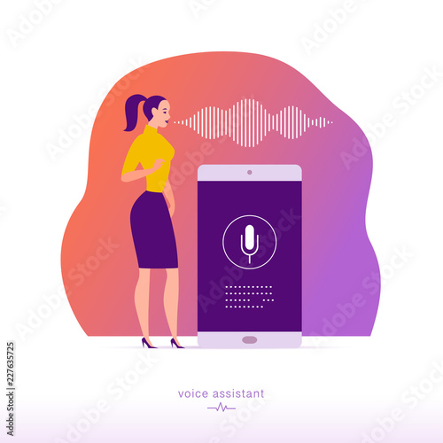
web BASED voice ASSISTANT (NEXA)
Team ID:- SCMF R37
Chintala Sanjay
Rama Krishna
G.Ruchitha Reddy

Slide 2
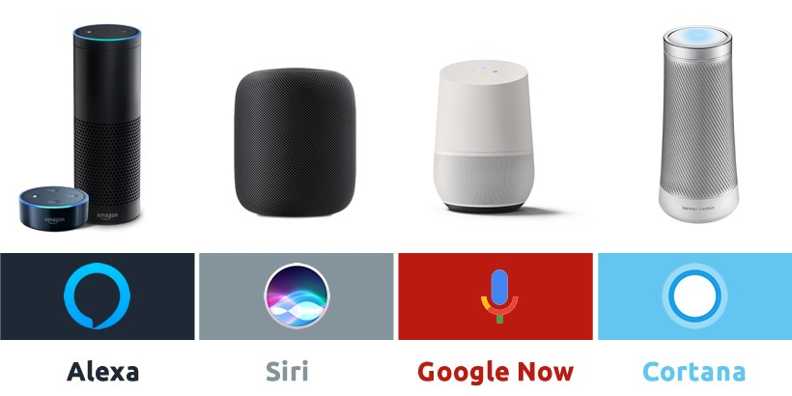
INTRODUCTION:-
Nowadays, as more mobile phone users uses voice assistants such as Siri and Cortana, and as devices such as Amazon Echo and Google Home have been invading our living rooms. These systems are built with speech recognition software that allows their users to issue voice commands.
Our aim is to deploy a voice based assistant in a web browser so that it can be used in any device which supports any web browser(Device Independent).
Now, our web browsers will become familiar with to Web Speech API, which allows users to integrate voice data in web apps.

Slide 3
Existing System
Operating System Dependent voice Assistant.
Siri works only in iOS & OkGoogle works only in Android.
UNABLE to navigate through single web page.
Proposed System
Operating System Independent Voice Assistant
It can able to navigate through different sections in a single web page
Emotion also can detected and it can be respond accordingly.

Slide 4
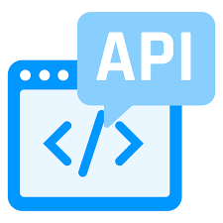



TECHNOLOGIES:-
Speech Synthesis Library:
Speech synthesis is the computer-generated simulation of human speech. It is used to translate written information into aural information where it is more convenient.
SpeechRecognition(API):
The SpeechRecognition interface of the Web Speech API is the controller interface for the recognition service; this also handles the SpeechRecognitionEvent sent from the recognition service.
JavaScript
HTML
CSS(Cascade Style Sheet)
Weather API’s

Slide 5
PROCESS:-
For the voice-enabled world so called smartspeakers have shown to hold a lot of potential. These have a microphone to “hear” and speakers to communicate back to us.
So in our project we give an input in the form of speech, the Speech then will be converted to text using java-script using Speech-Recognition library
This converted text will then be processed in java-script and the result will be returned in the form of text then this text will be converted again to speech output using Speech Synthesis library
And rest of the processes will be executed using their respective API’s (Application Program Interfaces) and conditions.

Slide 6


