Slide 1

Expense Management System
-Ruchitha Medam

Slide 2
The Challenge: Tracking Expenses
Our Solution: Project Objective
Many of us struggle to keep track on our daily spending. Manual tracking is not only tedious but also prone to errors, making it hard to get a clear picture of where our money goes.
This project aims to develop a straightforward, yet effective, expense management system. We leverage Python and MySQL to create an application that simplifies expense tracking and provides valuable insights.
Difficulty in tracking daily expenses
Time-consuming manual methods
"Build a simple Python + MySQL application to manage expenses efficiently."
High potential for errors

Slide 3



Powering Our Application: Technologies Used
Python
MySQL
Key Libraries
The core programming language for our application logic.
Relational database for secure and organized data storage.
mysql.connector for database interaction
csv for data export functionality
datetime for accurate date management

Slide 4
Core Functionality: What It Does
01
02
03
Add New Expense
View All Expenses
Update Existing Expense
Quickly record new spending entries with details.
Access a comprehensive list of all recorded expenses.
Modify or correct previously entered expense details.
04
05
06
Delete Expense
Search Expense
Export Data to CSV
Remove unwanted or incorrect expense records.
Find specific expenses by category or description.
Generate a CSV file for external analysis or record-keeping.
07
Monthly Expense Summary
Gain insights into spending patterns over a month.

Slide 5
Structuring Our Data: Database Design
Our expense management system relies on a clear and efficient database structure to store and retrieve information.
Database Name
expense
Table Name
expenses
Column
Type
Key
Constraints
Description
id
INT
Primary
Auto Increment
Unique identifier for each expense
date
DATE
Date the expense occurred
category
VARCHAR(255)
Category of the expense (e.g., Food, Transport)
amount
FLOAT
Monetary value of the expense
description
TEXT
Brief description of the expense

Slide 6

User Journey: Workflow Diagram
Main Menu
Choose Option
CRUD Ops
Output
This diagram illustrates the intuitive flow a user experiences, from selecting an option in the menu to performing an operation and receiving output, all powered by the robust database interaction.

Slide 7
Behind the Scenes: Code Implementation
Each core feature of our Expense Management System is encapsulated within a dedicated Python function, ensuring modularity and maintainability.
add_expense()
view_expenses()
update_expense()
Handles input for new expense details and inserts into the database.
Retrieves and displays all recorded expenses to the user.
Allows modification of existing expense records by ID.
delete_expense()
search_expense()
Removes an expense record based on its unique ID.
Filters expenses by specific criteria like category or description.
monthly_summary()
Calculates and presents a summary of expenses for a given month.

Slide 8
CODE:
import mysql.connector
import csv
from datetime import datetime
# ---------------- Database Connection ----------------
def get_connection():
return mysql.connector.connect(
host="localhost",
user="root", # change if needed
password="pass@word1", # change if needed
database="expense" ,
use_pure=True
# make sure this DB exists
)

Slide 9
# ---------------- CRUD Functions ----------------
def add_expense():
date = input("Enter date (YYYY-MM-DD): ")
category = input("Enter category (Food, Travel, Bills, etc): ")
amount = float(input("Enter amount: "))
description = input("Enter description: ")
conn = get_connection()
cursor = conn.cursor()
query = "INSERT INTO expenses (date, category, amount, description) VALUES (%s, %s, %s, %s)"
cursor.execute(query, (date, category, amount, description))
conn.commit()
conn.close()
print("Expense added successfully!")
def view_expenses():
conn = get_connection()
cursor = conn.cursor()
query = "SELECT * FROM expenses"
cursor.execute(query)
rows = cursor.fetchall()
conn.close()

Slide 10
print("\n--- Expense List ---")
if rows:
for row in rows:
print(f"ID: {row[0]}, Date: {row[1]}, Category: {row[2]}, Amount: {row[3]}, Description: {row[4]}")
else:
print("No expenses found.")
def update_expense():
exp_id = int(input("Enter expense ID to update: "))
new_amount = float(input("Enter new amount: "))
conn = get_connection()
cursor = conn.cursor()
query = "UPDATE expenses SET amount = %s WHERE id = %s"
cursor.execute(query, (new_amount, exp_id))
conn.commit()
conn.close()
print("Expense updated successfully!")

Slide 11
def delete_expense():
exp_id = int(input("Enter expense ID to delete: "))
conn = get_connection()
cursor = conn.cursor()
query = "DELETE FROM expenses WHERE id = %s"
cursor.execute(query, (exp_id,))
conn.commit()
conn.close()
print("Expense deleted successfully!")
def search_expense():
keyword = input("Enter category or description to search: ")
conn = get_connection()
cursor = conn.cursor()
query = "SELECT * FROM expenses WHERE category LIKE %s OR description LIKE %s"
cursor.execute(query, (f"%{keyword}%", f"%{keyword}%"))
rows = cursor.fetchall()
conn.close()
print("\n--- Search Results ---")
if rows:
for row in rows:
print(f"ID: {row[0]}, Date: {row[1]}, Category: {row[2]}, Amount: {row[3]}, Description: {row[4]}")
else:
print("No matching expenses found.")

Slide 12
def export_expenses():
conn = get_connection()
cursor = conn.cursor()
cursor.execute("SELECT * FROM expenses")
rows = cursor.fetchall()
conn.close()
with open("C:\\Users\\Administrator\\Desktop\\ExpenseProj\\expenses.csv", "w", newline="") as f:
writer = csv.writer(f)
writer.writerow(["ID", "Date", "Category", "Amount", "Description"])
writer.writerows(rows)
print("Data exported to expenses.csv")
# ---------------- Monthly Summary ----------------
def monthly_summary():
conn = get_connection()
cursor = conn.cursor()
query = """
SELECT DATE_FORMAT(date, '%Y-%m') AS month, SUM(amount)
FROM expenses
GROUP BY month
ORDER BY month;
"""

Slide 13
cursor.execute(query)
rows = cursor.fetchall()
conn.close()
print("\n--- Monthly Expense Summary ---")
if rows:
for row in rows:
print(f"Month: {row[0]}, Total Spent: {row[1]}")
else:
print("No expenses found.")
def main_menu():
while True:
print("\n===== Expense Management System =====")
print("1. Add Expense")
print("2. View Expenses")
print("3. Update Expense")
print("4. Delete Expense")
print("5. Search Expense")
print("6. Export Expenses to CSV")
print("7. Monthly Summary")
print("8. Exit")

Slide 14
choice = input("Enter your choice: ")
if choice == "1":
add_expense()
elif choice == "2":
view_expenses()
elif choice == "3":
update_expense()
elif choice == "4":
delete_expense()
elif choice == "5":
search_expense()
elif choice == "6":
export_expenses()
elif choice == "7":
monthly_summary()
elif choice == "8":
print("Exiting... Goodbye!")
break
else:
print("Invalid choice! Try again.")
if __name__ == "__main__":
main_menu()

Slide 15
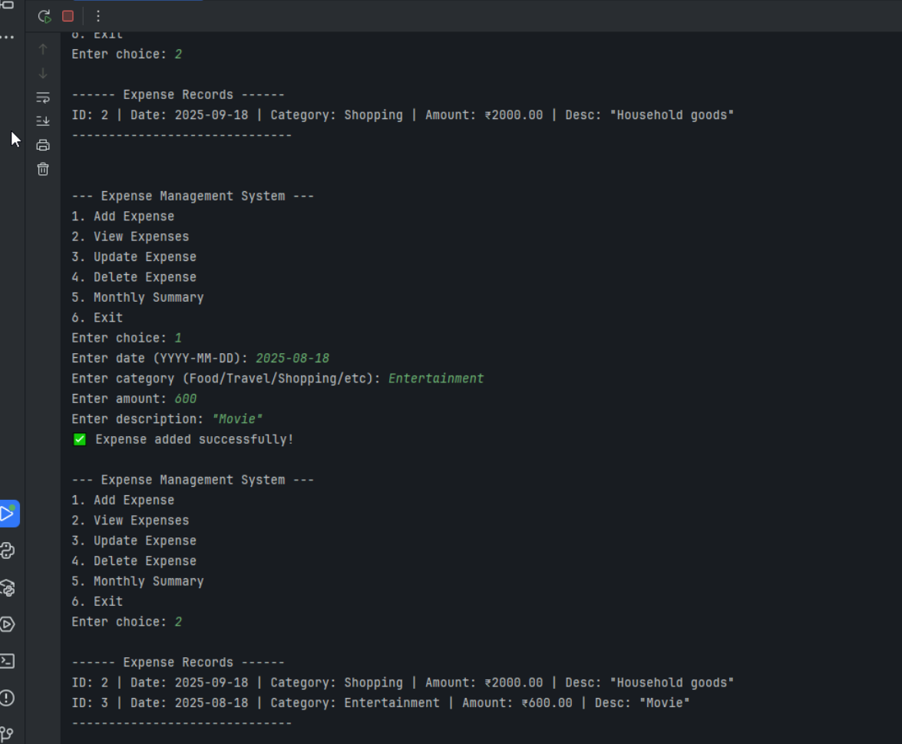
OUTPUT Screenshots

Slide 16
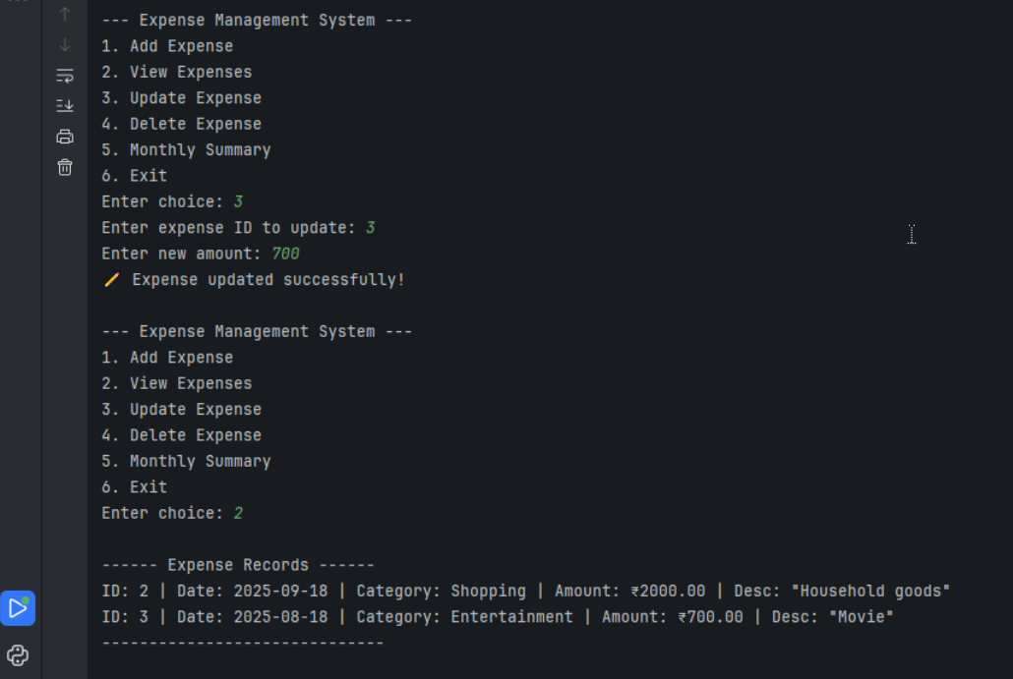

Slide 17
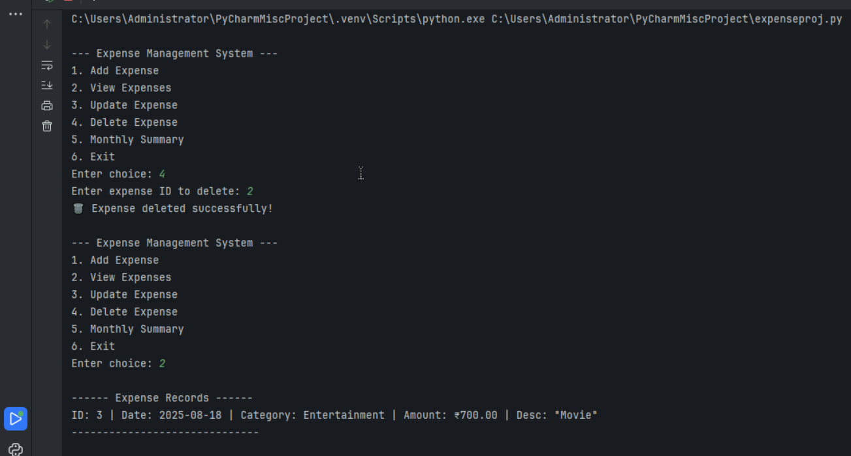

Slide 18
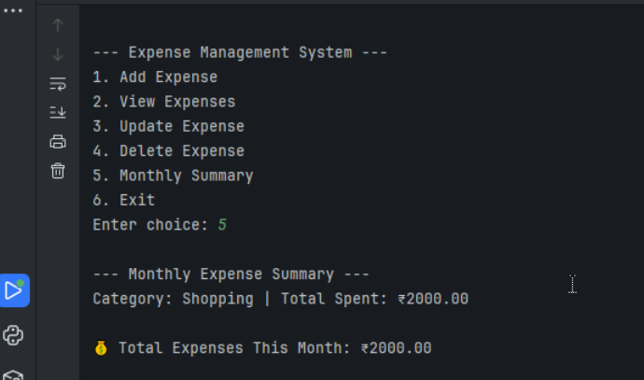
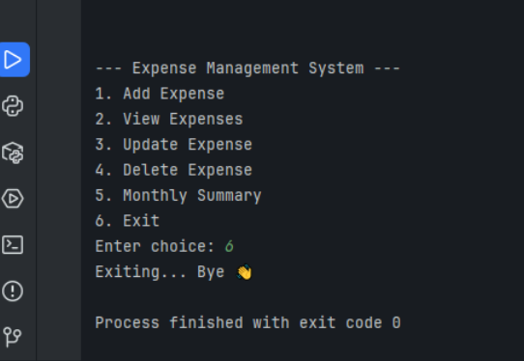

Slide 19
Conclusion & Key Achievements
Reflecting on the successful completion of our Expense Management System project.
Integrated Python + MySQL
Full CRUD Functionality
Working System Developed
Mastered the connection and interaction between Python applications and relational databases, a fundamental skill for backend development.
Successfully implemented Create, Read, Update, and Delete operations, forming the backbone of any data management system.
Built a robust and functional Expense Management System from concept to execution, ready for practical use.

Slide 20
THANK YOU

