Slide 1
Large Language Models for Generative Information Extraction: A Survey
Medium Article: Large Language Models for Generative Information Extraction: A Survey
Paper: Click here to view the Paper
Ruchitha Reddy Koluguri
CMPE-258-Deep Learning
San Jose State University

Slide 2
Introduction
Introduction to Generative Information Extraction (IE)
Role of Large Language Models (LLMs)
Surge of Interest in Generative IE Methods
Exploration of LLMs for IE Tasks
Structure of the Survey

Slide 3
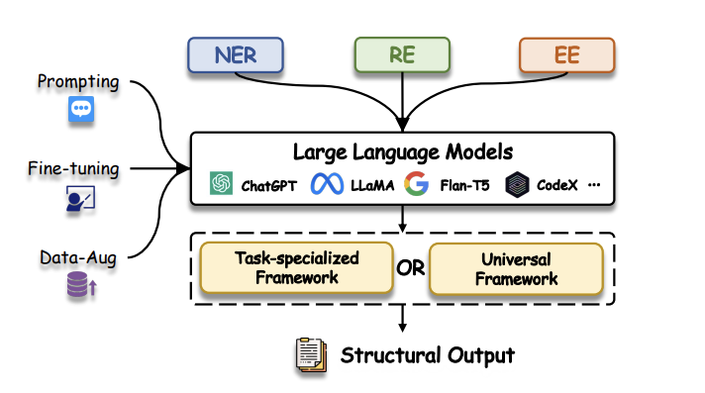

Slide 4
Preliminaries of Generative IE
Named Entity Recognition (NER): NER involves two tasks: Entity Identification and Entity Typing.
Relation Extraction (RE):
Relation Classification
Relation Triplet
Relation Strict
Event Extraction (EE)
Event Detection
Event Arguments Extraction

Slide 5
Information Extraction Tasks
Named Entity Recognition (NER):
NER is crucial in IE and NLP, aiming to identify and classify entities within text.
Relation Extraction (RE):
RE involves identifying relationships between entities in text.
Event Extraction (EE):
EE focuses on extracting specific occurrences or incidents from text, which is vital for various reasoning tasks.
Universal Information Extraction (Uni-IE):
Uni-IE aims to model all IE tasks using a unified framework, considering both natural language-based (NL-LLMs) and code-based (Code-LLMs) approaches:

Slide 6
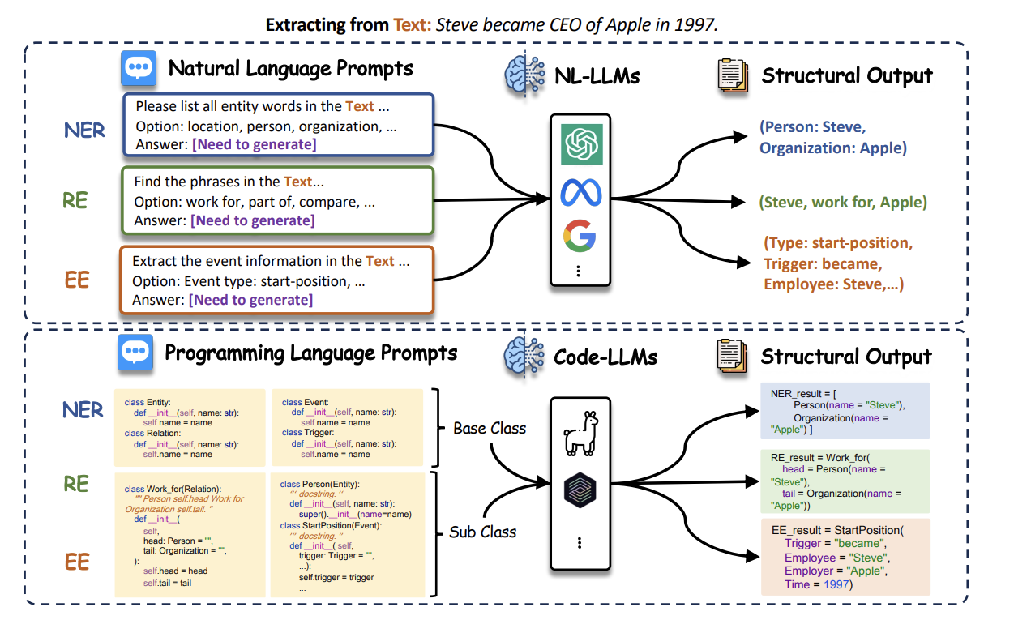

Slide 7
Learning Paradigms
Supervised Fine-tuning
Training LLMs on IE tasks using labeled data.
Few-shot
Generalizing from a small number of labeled examples.
Zero-shot
Generating answers without any training examples.
Data Augmentation
Enhancing information by applying various transformations to existing data.

Slide 8
Specific Domain Exploration
Multimodal Domain
Medical Domain
Scientific Domain
Evaluation & Analysis
Individual Subtasks Evaluation
Comprehensive Analysis

Slide 9
Future Directions
Universal IE
Low-Resource IE
Prompt Design for IE
Open IE

Slide 10
Conclusion
The survey reviews existing studies utilizing LLMs for generative IE tasks, covering subtasks of IE, universal frameworks, learning paradigms, domain-specific applications, and evaluation methods.
It also discusses current challenges and proposes future directions for research in this area, aiming to facilitate more efficient utilization of LLMs for IE.

Slide 11
Reference Article
Paper: Click here to view the Paper

