Slide 1
CAN BUS
CAN BUS INTRUSION
INTRUSION
DETECTION SYSTEM
ID: 0x666
Physical-Layer Authentication for In-Vehicle Networks
DIFF > 350
ESP32 • CAN Bus (TWAI Driver) • Analog Signal Fingerprinting • Real-Time Alert System

Slide 2
THE PROBLEM
✕ No Authentication
⚠ Spoofing Attacks
? No Intrusion Detection
CAN Bus was designed in the 1980s for reliability — not security. Any node on the bus can send any message with any ID, with zero verification.
Attackers can inject malicious CAN frames using unknown node IDs (e.g. 0x666) to manipulate critical vehicle systems like speed or braking.
Standard ECU setups have no mechanism to detect whether a message is from a legitimate ECU or from a rogue attacker node physically plugged into the bus.

Slide 3
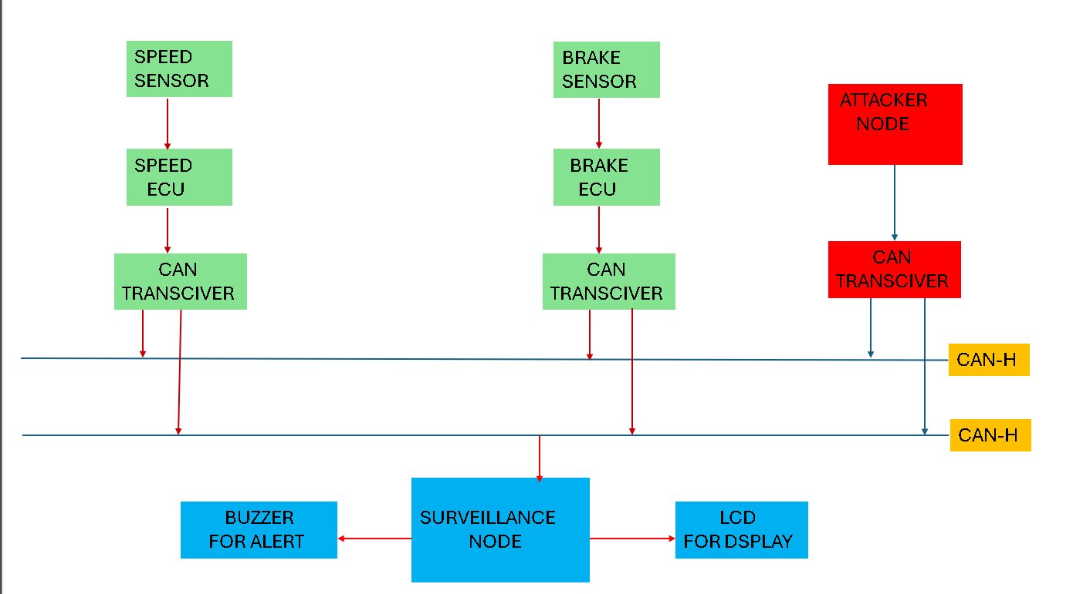
SYSTEM ARCHITECTURE
Green = Legitimate nodes | Red = Attacker node | Blue = Surveillance node | Yellow = CAN Bus lines

Slide 4
HOW CAN BUS COMMUNICATION WORKS
SENSOR
DETECTS
EVENT
ECU
PROCESSES
DATA
CAN
TRANSCEIVER
SENDS FRAME
ALL NODES
RECEIVE
MESSAGE
▶
▶
▶
CAN FRAME STRUCTURE
SOF
1 bit
IDENTIFIER
11 bits
RTR
1 bit
DLC
4 bits
DATA
0–64 bytes
CRC
15 bits
ACK
2 bits
EOF
7 bits
⚠ The IDENTIFIER field determines message priority and source — but CAN protocol has NO authentication to verify it is genuine.

Slide 5
DETECTION METHODOLOGY
PHYSICAL LAYER SAMPLING
AUTHENTICATION LOGIC
ADC pin (GPIO 34) samples the CAN bus voltage in real time
1
Receive CAN frame
50 samples collected over ~1 ms using analogRead() at 12-bit resolution
2
Check if ID is known (0x101 or 0x102)
MAX – MIN voltage difference (DIFF) computed for each received message
3
Compute DIFF from ADC samples
Legitimate ECUs produce consistent, low-noise analog signatures
4
Compare DIFF against trained threshold (350)
Rogue nodes produce higher variance due to different hardware characteristics
5
If DIFF > threshold or unknown ID → increment abnormalCount
6
If abnormalCount ≥ 3 → INTRUSION ALERT

Slide 6
HARDWARE SETUP & NODE ROLES
SPEED ECU NODE
BRAKE ECU NODE
ATTACKER NODE
SURVEILLANCE NODE
CAN ID: 0x101
CAN ID: 0x102
CAN ID: 0x666
IDS Monitor
GPIO 5 (TX) / GPIO 4 (RX)
GPIO 5 (TX) / GPIO 4 (RX)
GPIO 5 (TX) / GPIO 4 (RX)
ADC on GPIO 34
Sends 1-byte payload (speed=60)
Sends 1-byte payload (brake=1)
Sends 0xFF payload
LCD I2C on 0x27
Triggered by button press
Triggered by button press
Aggressive 20ms interval
Buzzer on GPIO 27
500 kbps CAN bus speed
500 kbps CAN bus speed
Unknown/spoofed CAN ID
Monitors CAN-H/CAN-L
Represents legitimate node
Represents legitimate node
Simulates rogue injection
Displays & alerts in real-time

Slide 7
THRESHOLD CALIBRATION & RESULTS
350
350
3×
SPEED THRESHOLD
(ADC DIFF Units)
BRAKE THRESHOLD
(ADC DIFF Units)
CONSECUTIVE HITS
BEFORE ALERT
ANALOG SIGNATURE COMPARISON (ADC DIFF)
520
500
350
← THRESHOLD
210
195
200
0
Speed ECU
(0x101)
Brake ECU
(0x102)
Attacker
(0x666)

Slide 8
ALERT SYSTEM & REAL-TIME OUTPUT
LCD DISPLAY
SERIAL MONITOR
BUZZER ALERT
Normal mode:
OK:
Normal:
"SPEED ECU | STATUS: UPDATED"
"[OK] SPEED ECU | DIFF=210"
Buzzer OFF (GPIO 27 = LOW)
Checking:
OK:
Anomaly 1-2:
"CHECKING..."
"[OK] BRAKE ECU | DIFF=195"
Buzzer OFF — still checking
Alert mode:
Alert:
Anomaly ≥ 3:
"INTRUSION ALERT | UNKNOWN NODE"
"[ALERT] UNKNOWN NODE | ID=0x666 | DIFF=520"
Buzzer ON — sustained alert
16×2 I2C LCD at address 0x27 refreshes on every received frame
115200 baud serial output with timestamped CAN ID and DIFF values
Persistent buzzer activation until legitimate traffic resets abnormal counter

Slide 9
CONCLUSION & FUTURE SCOPE
✓ ACHIEVED
→ FUTURE SCOPE
Physical-layer fingerprinting using ADC differential analysis
Machine learning-based anomaly detection on bus traffic patterns
Real-time detection of spoofed CAN IDs (0x666 attacker)
CAN FD support for next-generation automotive ECUs
Multi-node CAN bus simulation on ESP32 hardware
Cryptographic message authentication (CMAC / AES-based)
Zero-false-positive design with 3-hit confirmation window
OBD-II port deployment for real vehicle integration
Dual alert output: LCD + buzzer for immediate visibility
Cloud dashboard for fleet-wide intrusion monitoring
By combining CAN ID whitelisting with physical-layer analog fingerprinting, this system detects intrusions that purely software-based solutions would miss — adding a critical hardware-level trust boundary to in-vehicle networks.

