Slide 1
Interactive AC Load
Control Solution

Slide 2
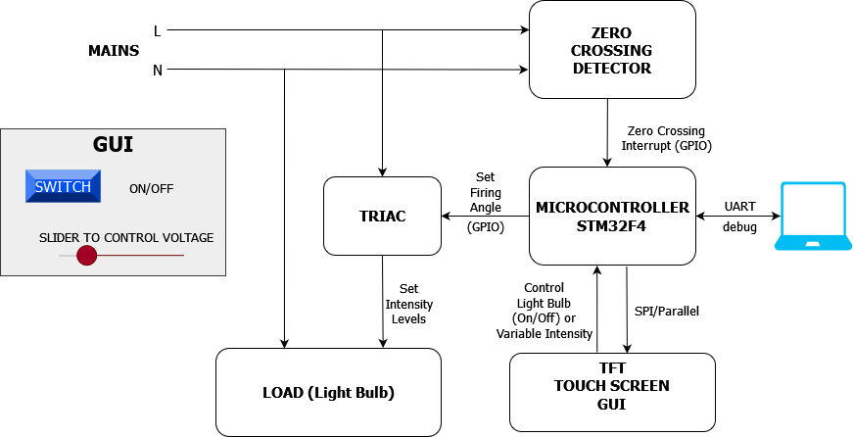
Hardware Elements
STM32F4 variant MCU
Snubber less - TRIAC
Opto-Coupler
Zero Crossing Detector Circuit (ZCD)
3.5” TFT Display Touch Screen
Metering IC (STPM32) : Add-on
Onboard Power Rectifier: Add-on

Slide 3
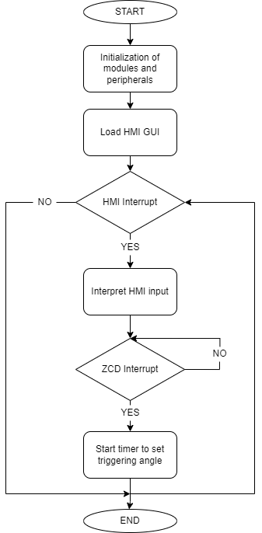
Software Elements
Timer Module for TRIAC triggering angle
SPI Module (for LCD and Touch Screen HMI)
HMI GUI Design for human interaction
UART Module for Debug (or Fall-back plan)

Slide 4
Key Milestones
Key Milestones | Expected Deadline | Current Status
ZCD Circuit Design and Review | 03/10/2022 | Ongoing
TRIAC Control circuit Design and review | 03/14/2022 | Ongoing
Module PCB Schematic and Layout Finalization | 03/18/2022
Hardware inventory | 03/18/2022 | Partially Done (MCU Dev Board, HMI to test)
PCB Fabrication Release | 03/19/2022
PCB assembly | 04/06/2022
Test Hardware assembly (Parallel to PCB fabrication and assembly time) | 03/28/2022
PCB Hardware Testing | 04/13/2022
LCD Integration with STM32F4 (Software) | 03/31/2022
ZCD Interrupt generation test (Software) | 03/31/2022
Timer Control for TRIAC triggering test (Software) | 04/10/2022
ZCD and TRIAC control software integration | 04/15/2022
System Integration with Software (HMI and Control module with MCU) | 04/20/2022
System Testing | 04/23/2022

Slide 5
Project Deliverables
AC Light Dimmer Module using TRIAC and HMI inputs
The intensity of the light bulb shall be controlled through the GUI inputs that is the slider interface controlling the bulb intensity and a button interface to turn on and off the bulb.
Developing a discrete board (test board)
This board shall be used to test the system until the final hardware arrives. The same board could be used if the PCB fails.
HMI integration fail
We plan to include UART based testing routine which can be considered a fallback plan in case HMI is not integrated successfully. In addition, input buttons can be implemented to control the bulb’s intensity level.

Slide 6
Future Scope
Integrate metering IC (STMP32) to measure the electrical parameters on the load and display it on HMI.
Work on a single board solution for the entire system. Integrate all hardware submodules with the MCU circuit to develop a product-oriented application.

