Slide 1
KNOWLEDGE GRAPH
By:
Ruchit Patel
U15CO091

Slide 2
INTRODUCTION
• Semantic descriptions of entities and their relationships.
• Uses graphical form to representation the knowledge.
• Entities: real world objects (things, places, people) and abstract concepts (genres, religions, professions)
• Relationships: graph-based data model where relationships are first-class
• Semantic descriptions: types and properties with a well-defined meaning (e.g. through an ontology)
• Possibly axiomatic knowledge (e.g. rules) to support automated reasoning

Slide 3
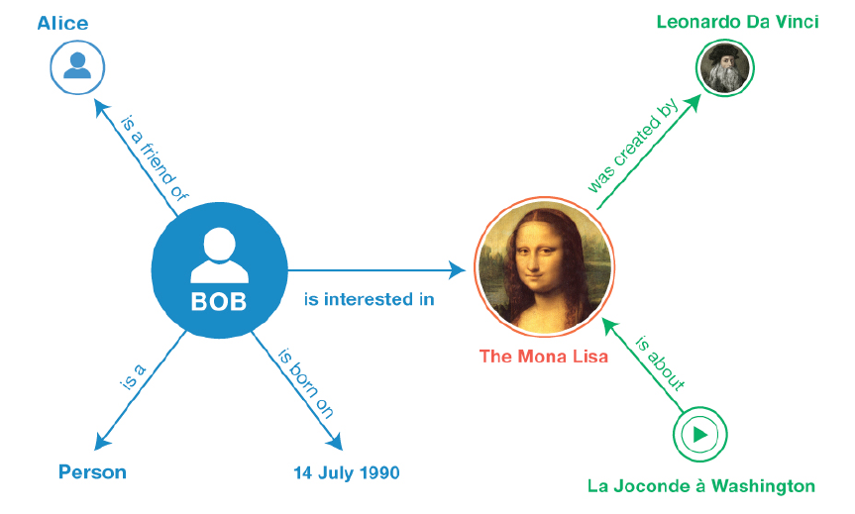
A Simple Knowledge Graph
http://www.w3.org/TR/2014/NOTE-rdf11-primer-20140225/example-graph.jpg

Slide 4
Why Graphs?
• Data is increasingly connected (graph data).
• need a structured and formal representation of knowledge.
• The world is structured: we are surrounded by entities connected by relations.
• Graphs are a natural way to represent entities and their relationships.
• Graphs can be managed efficiently.
• Graphs are well-understood mathematical objects.

Slide 5
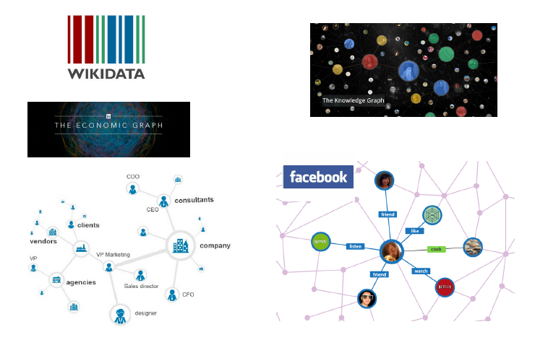
Knowledge Graph in semantic web
• Google.
• Bing.
•Facebook
•Linkedin.
Notes:
There are many search engines that use the knowledge graph to display efficient and relevant query result.

Slide 6
Knowledge Graph in semantic web
1.Google
2012: Google announces addition of knowledge graph to their search
Goal: make search easier for the user
Step toward enabling search engines to understand the world similarly to how humans understand it
Facilitates a broader and deeper search
Notes:
As we know google, is the most popular search engine.
In 2012 google introduced knowledge graph to their search.
Knowledge graph makes the search easier for user.
It also enables the search engines to understand the world similarly to how humans understand it.
It facilitates the user by providing broader and deeper details of search query.

Slide 7
Knowledge Graph in semantic web
2.Bing
2012: Microsoft introduces Satori into their Bing search engine
Goal: improve search by making it the underlying architecture more intelligent
Provide most relevant information and key facts automatically
In 2010 Microsoft releases Graph Engine 1.0: a general purpose distributed graph system over a memory cloud. The goal of the engine is to enable processing of large graphs.
Notes:
Bing is the second most popular search engine according to the latest netmarketshare report (January 2018)
In 2012,Microsoft introduced satori to their search engine bing which is the the extension of Graph engine 1.0 which was released in 2010.
Bing mainly focuses on architecture to be more intelligent to improve the search results.
It automatically provides the most relevant information and key facts about the search.

Slide 8
Knowledge Graph in semantic web
3.Facebook
2013: Facebook introduces “Entity Graph“
Each “entity" (e.g. persons, institutions, restaurants, etc.) is treated as a node in a graph
Relations between entities are modeled by their relationships in real-life (e.g. friendships, alumni, checked in at, etc.)
4.Linkedin
2016: LinkedIn introduces their own knowledge graph
A large knowledge base based on LinkedIn members, jobs, titles, companies, skills, etc.
Goal: Create a large economic graph - a map of the world economy
Notes:
In 2013,Facebook introduced “Entity Graph” in which entity-person, restaurant, institution is treated as a node in a graph.
The relations in this entity graph are modeled by their relationships in real-life
Linkedin also introduced its own knowledge graph in 2016 which is a large knowledge base consists of linkedin members,
jobs, titles, companies, skills, etc.
The goal is to create a good knowledge of economic world.

Slide 9
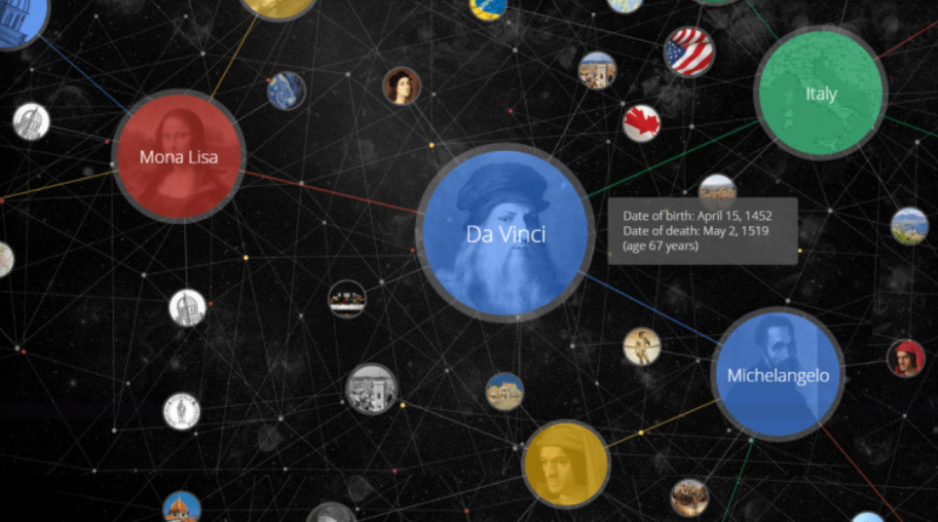
Google Knowledge Graph
https://searchengineland.com/laymans-visual-guide-googles-knowledge-graph-search-api-241935
Notes:
This is how the knowledge graph of google related to Mona lisa and Leonardo da vinci looks like.

Slide 10
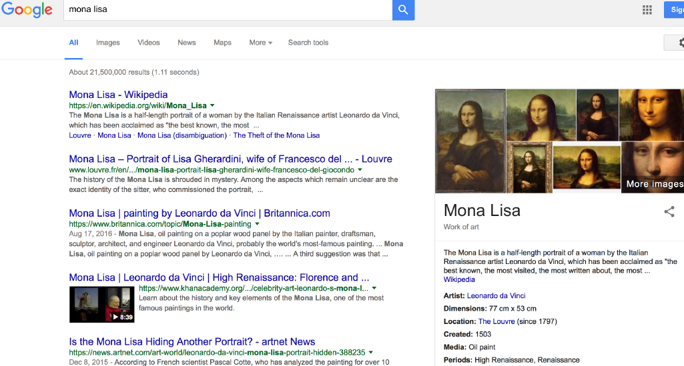
1.Entity Search and summarizations
Notes:
Google’s knowledge graph is used mainly in three things.
The first one is that it provides the facility to search an entity and we can get the summarizations of the entity.

Slide 11
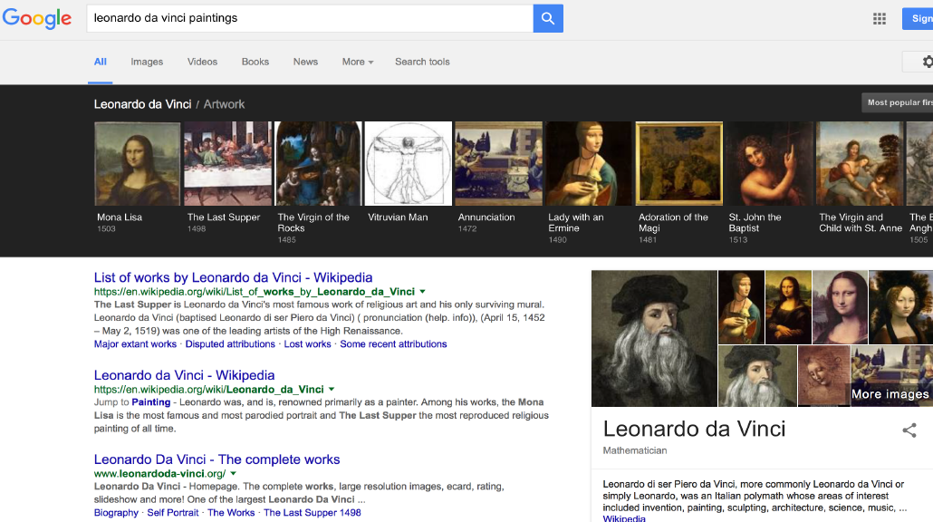
2.Discovering Related Entities
Notes:
It also suggests the related entities that we might be looking for.

Slide 12
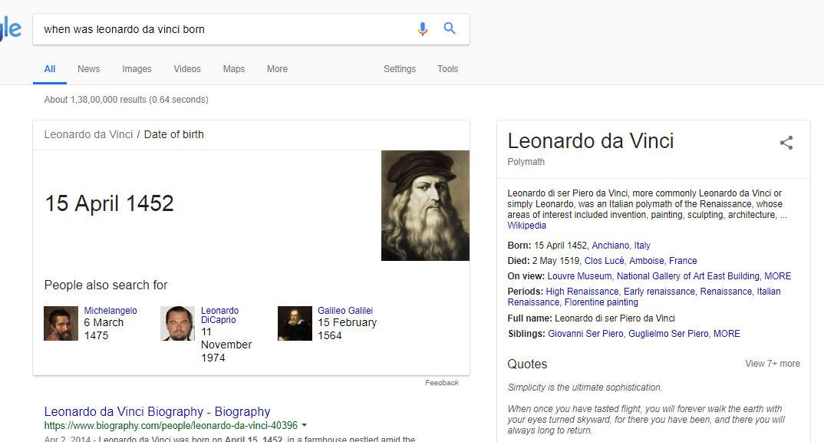
3.Factual Answers
Notes:
It also gives the factual answers to specific search query.
For this it uses the summery of that query.

Slide 13
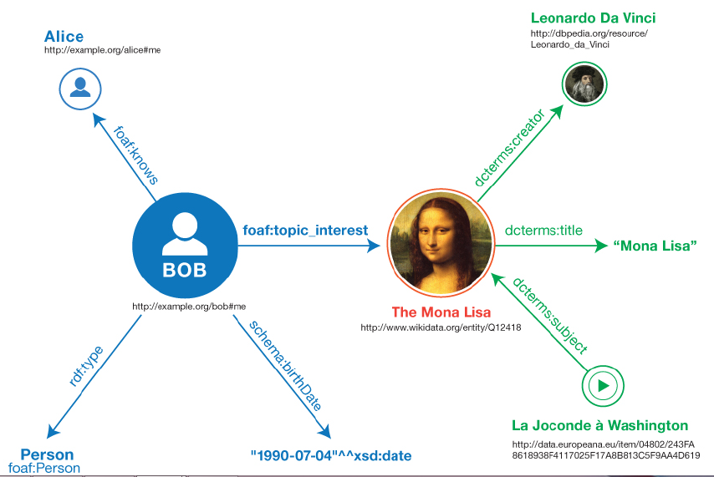
Resource Description Framework (RDF)
An RDF statement consists of:
• Subject: resource identified by a URI
• Predicate: resource identified by a URI
• Object: resource or literal
Literals: data values with data type (URI)
https://www.researchgate.net/figure/Informal-graph-of-the-sample-triples-Reprinted-from-W3C-RDF-11-Primer-2_fig2_326471335
Notes:
So the question is how do they achieve this.
RDF makes it possible.
RDF is collection of defined statements.
An RDF statement consists of subject, predicate and object.
It may have literals too, which are predefined data values with data type.

Slide 14
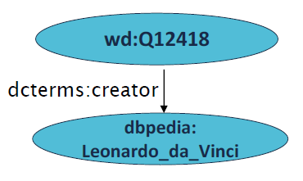
Resource Description Framework (RDF)
Allows one to talk about anything and to express statements.
Uniform Resource Identifier (URI) can be used to identify entities
http:/dbpedia.org/resource/Leonardo_da_Vi-nci is a name for /Leonardo da Vinci
http://www.wikidata.org/entity/Q12418
is a name for the Mona Lisa painting
Notes:
the Framework allows us to talk about everything and to express the statements.
For this uniform resource identifier can be used to identify the entities.
For example of this URI we can create an entity which says that the topic Leonardo_da_vinci is from dbpedia.

Slide 15
RDF-S – RDF Schema
Language for two tasks
Definition of vocabulary
types and properties.
Inference – given a set of assertions, using these classes
and properties, specify what should be inferred about
assertions that are implicitly made.
Notes:
This framework uses RDF Schema which does mainly two tasks.
First is definition of properties.
in rdf schema there are predefined data values with data type and properties.
Second is inference
it makes easy to specify what should be inferred from RDF statements using these classes and properties .

Slide 16
RDF-S – RDF Schema
rdfs:Class – Example:
foaf:Person – Represents the class of persons
rdfs:Property – Class of RDF properties. Example:
foaf:knows – Represents that a person “knows” another
rdfs:domain – States that any resource that has a given property is an instance of one or more classes
foaf:knows rdfs:domain foaf:Person
rdfs:range – States that the values of a property are instances of one
or more classes
foaf:knows rdfs:range foaf:Person
Notes:
Colon
These are the examples how an rdf schema can be defined.
Rdfs domain which states that the resource that has given property is an instance of one or more classes.
Rdfs range which states that the values of a property are instances of one or more classes.

Slide 17
RDF-S – RDF Schema
Schema
foaf:knows
rdfs:range
foaf:Person
(<http://example.org/bob#me> rdf:type foaf:Person.)
foaf:knows
<http://example.org/alice#me>.
Existing fact
Inferences can be drawn that we did not explicitly make.
Inferred fact
<http://example.org/alice#me>
rdf:type
foaf:Person.
Notes:
As example,
Using this schema and existing facts we can infer that alice too is of type person

Slide 18
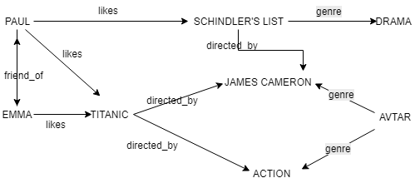
Use Cases of Knowledge Graph
Movie Recommendation.
Notes:
There are many use cases of knowledge graph in real world.
The first one is movie recommendation.
Here is the example of knowledge graph of movie ratings by users.
Based on this we can recommend best movie for a user.
This approach assumes that people like the same movies as people with similar taste
Any user who likes titanic might also like avtar as both movies are directed by same director.

Slide 19
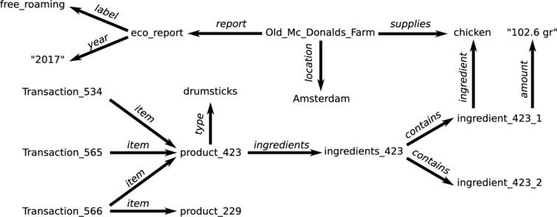
Use Cases
Consumer Buying Behavior Analysis.
Notes:
Second is consumer buying behavior analysis.
For this example, there are more transactions for product drumsticks in old mcdonalds Amsterdam for a specified period
It can be predicted that people of that region are more likely to buy the products which has chicken as ingredient.

Slide 20
Further Research Problems
Growth: knowledge graphs are incomplete!
Knowledge extraction: extract new entities and relations from web/text
Validation: knowledge graphs are not always correct!
Entity resolution: split wrongly merged entities
Error detection: remove false assertions
Fact validation: find evidence for / against facts being true
Interface: how to make it easier to access knowledge?
Question answering: compute answers using the knowledge graph
Intelligence: can AI emerge from knowledge graphs?
Automatic reasoning and planning
Notes:
Apart from this there are some research problems that can be implemented
Growth: we can never say that this knowledge graph is complete there might be some missing entities.
Validation: kg are not always correct
Interface : there is no specific method to implement the best knowledge graph
Intelligence : it will be the best part of data science if AI can be emerged from knowledge graph

Slide 21
In Summary, Knowledge Graphs..
Are applied both in both academic and industry.
Present a natural way of accessing/storing knowledge
Are rapidly adopted by the most popular search engines and social networks
Notes:
So as we have seen
It presents a natural way to accessing knowledge

Slide 22
Thank You

Slide 23
Q&A

