Slide 1
MIE1624H Introduction to data science and analytics
Recommender System Model
Group 21
Nehel Malhotra, Abhi Gandhi, Ayser Choudhury, Dingyi Zhang, Hassan Khalid, Ruchit Shah, Siddharth Kulkarni, Syed Shah

Slide 2




Recommender Systems
Recommender systems are widely used in the industry to get show the customer the products they might be interested in, based on their history or what similar users like.
These models are extremely beneficial for businesses to keep the customers engaged.

Slide 3
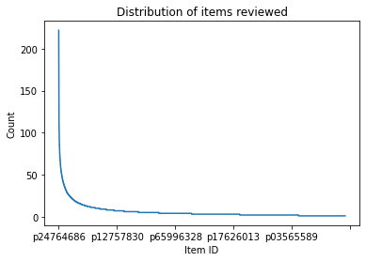
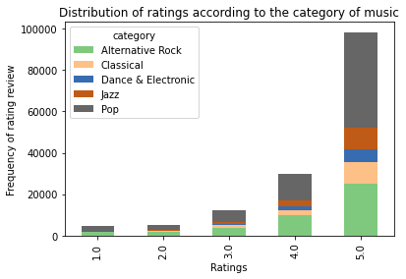
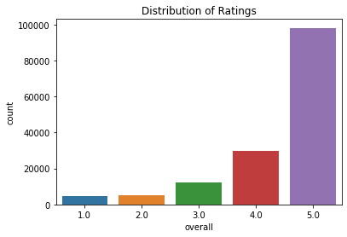
Data Exploration
The data is heavily skewed, both in terms of distribution of star ratings as well as the number of reviews for the items.
Most ratings tend to be positive with 5 stars, but not all items have received equal number of ratings. Some have received over 200 reviews, but the number drastically reduces with majority of items receiving between 1 and 10 reviews.
This could result in uneven prediction with most standard classifier models.

Slide 4
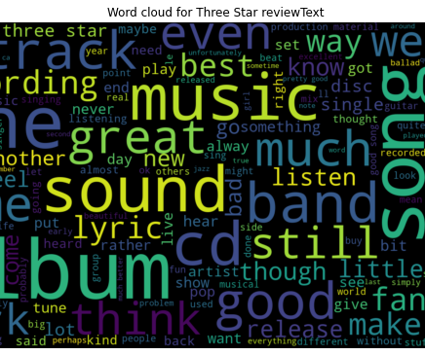
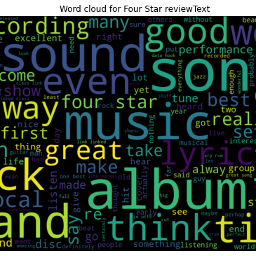
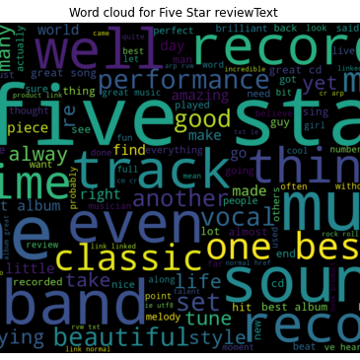
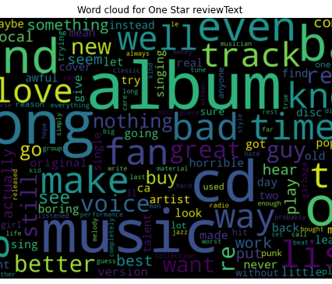
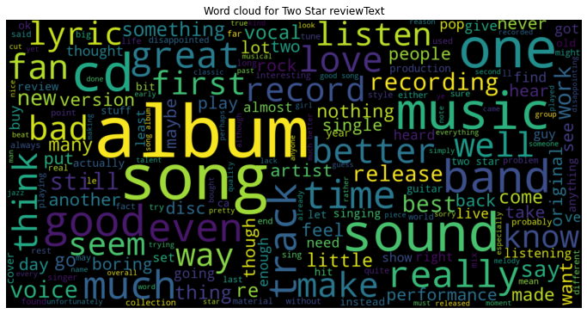
Word Clouds
The word clouds for different ratings have very few unique words.
Words like “song”, “album” and “track” appear in all the ratings and could pose a problem when predicting the ratings using Natural Language Processing

Slide 5

Model Considerations
To prepare a model to predict customer ratings for new products, textual review and summary data is used. This data is vectorized using TF-IDF.
Linear Logistic Regression and Classification models are used but these provide limited insight to the user preferences. This is because they are limited by the assumption that the dependent and independent variables are linearly correlated.

Slide 6

LSTM Neural Network Model
Long Short-Term Memory (LSTM) network is a type of RNN capable of learning order dependence in sequence prediction problems.
One of the limitations of the neural network is that there is no memory associated with the model which is the problem for sequential data. The RNN solves this issue by providing feedback loop. LSTM extends the idea by creating short-term and long-term memory component.
To train the NN model, the review text data is vectorized using word embeddings. In addition, item price and category is also used to help the model predict more accurately.

Slide 7
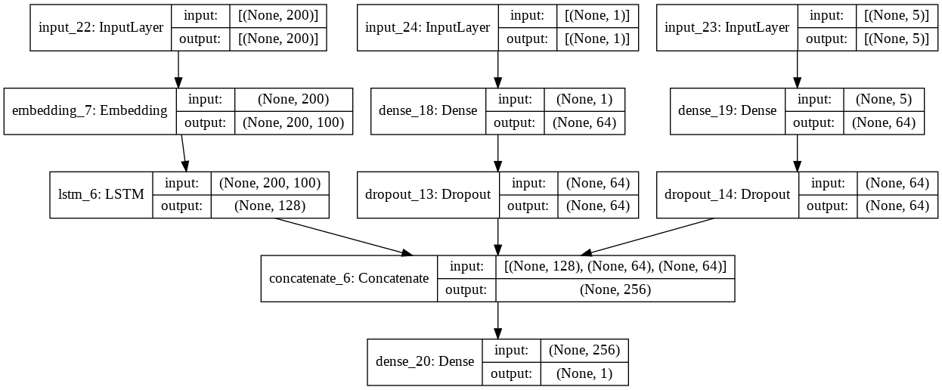
Model Implementation
The three input layers are trained independently, and their outputs are concatenated together to make the final prediction of rating.
Relu activation function is used as it is less expensive to run as compared to tanh or sigmoid activation functions.
The output layer contains only 1 neuron as a regression model was used for prediction.
The output was then cleaned to ensure the values for ratings are from 1 to 5.

Slide 8
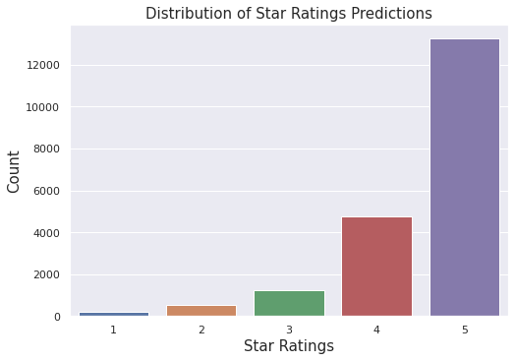
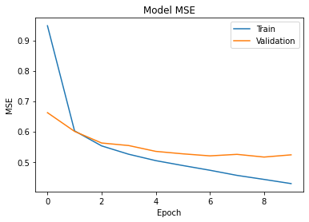
Results
The model showed better results as compared to the linear regression algorithm used previously, giving a MSE of 0.49 on the test dataset.
From the training-validation plot it can be seen that after 10 Epochs the model starts overfitting as it is memorizing the input features.
The model was then used to make predictions on the unseen data. As expected, the highest distribution was 5 stars.

Slide 9

We will now take any questions you may have. Thank you.
Group 21

