Slide 1
Day 08 – Unity Catalog Data Governance
Databricks 14 Days AI Challenge
Presented by: Ruchi Wange
In collaboration with: Databricks | Codebasics | Indian Data Club
Notes:
1

Slide 2
INTRODUCTION
What is Unity Catalog?
Unity Catalog is Databricks' centralized governance layer that manages data access, security, and metadata across the entire platform.
It enables secure, scalable, and enterprise-grade data governance for modern data architectures.
  Unified security model
  Fine-grained access control
  Cross-workspace governance
  Audit and compliance tracking
Notes:
2

Slide 3



ARCHITECTURE
Unity Catalog Hierarchy
Catalog
1
Top-level container
2
Schema
Logical grouping
3
Tables & Views
Data assets
The three-tier namespace structure provides organized, hierarchical data management with granular permission controls at each level.
Notes:
3

Slide 4
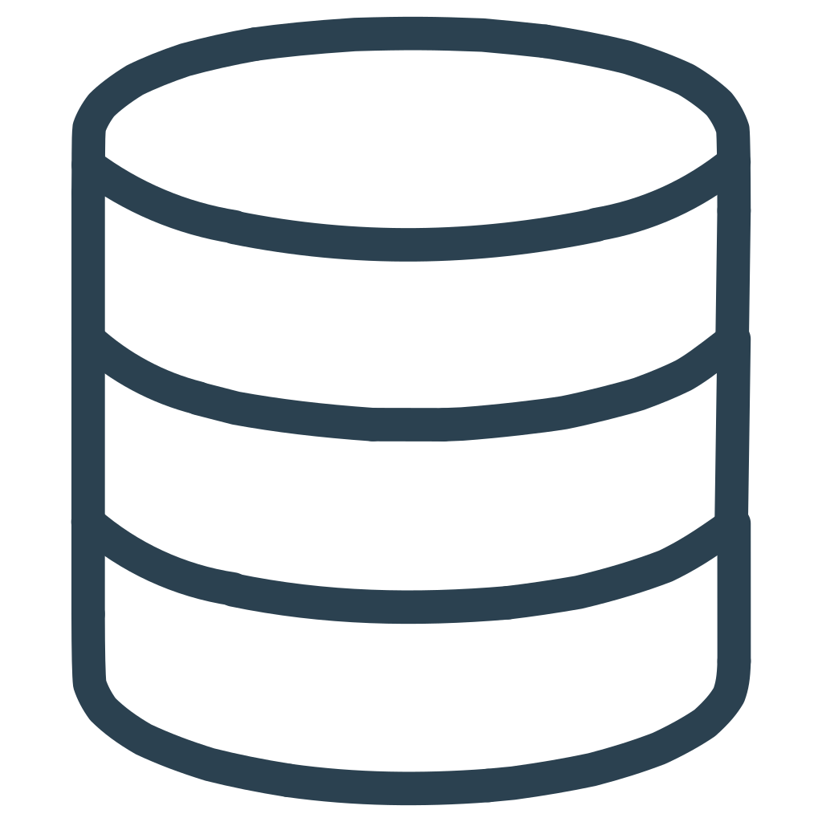
DATA PROCESSING
Combining Multiple Data Sources
01
02
Load CSV Files
Rename DataFrames
Import October and November 2019 e-commerce datasets using Spark
Assign meaningful variable names for clarity
03
04
Union Data
Validate Results
Combine datasets using unionByName for consistent schema
Display sample records to verify data integrity
Notes:
4

Slide 5
Creating Delta Tables
What are Delta Tables?
Create Catalog
Delta tables provide ACID transactions, scalable metadata handling, and time travel capabilities for data lakes.
day08_catalog
  Reliable data storage
  Schema enforcement
Create Schema
  Version control
sales_schema
  Optimized performance
Save Table
ecommerce_data
Notes:
5

Slide 6




SECURITY
Implementing Access Controls
Catalog Permissions
Schema Permissions
Table Permissions
Control access at the highest level for broad governance policies
Grant SELECT on sales_schema to account users for organized access
Fine-grained control on ecommerce_data table for specific operations
"Unity Catalog enables centralized permission management across all data assets with enterprise-grade security."
Notes:
6

Slide 7




Secure Views for Controlled Access
Source Table
Full ecommerce_data with all columns
Create View
Select specific columns only
Controlled Access
Users see filtered data
The secure view exposes only event_time, event_type, product_id, price, and user_id, hiding sensitive information while maintaining data utility.
Notes:
7

Slide 8
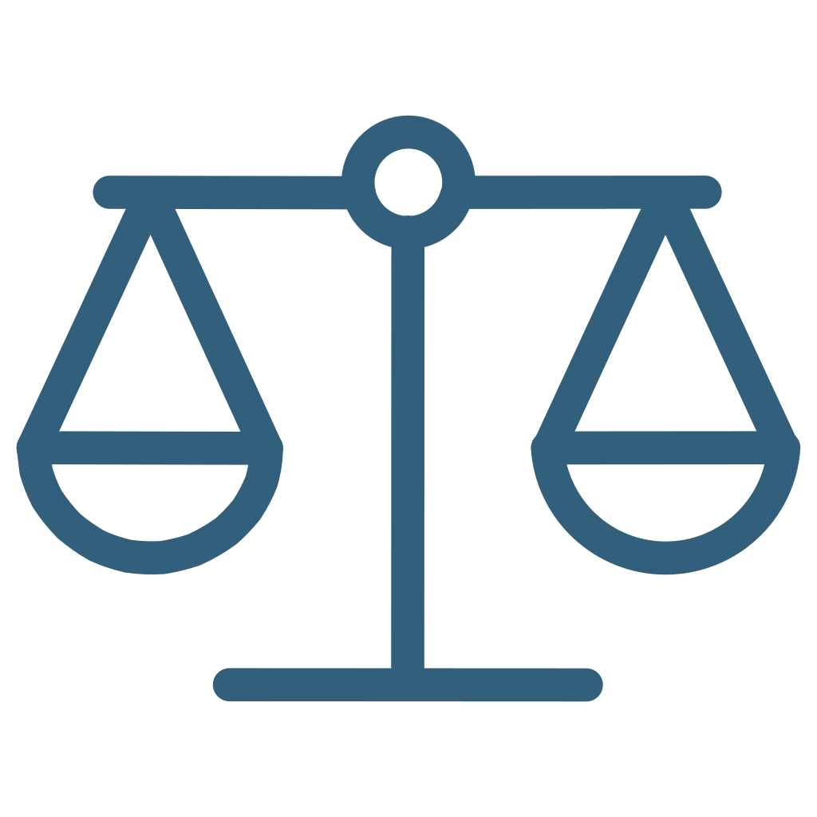



REAL-WORLD IMPACT
Enterprise Data Governance Benefits
Scalability
Compliance
Manage data governance across multiple workspaces and cloud platforms seamlessly
Built-in audit logging and data lineage tracking for regulatory requirements
Collaboration
Efficiency
Secure data sharing between teams while maintaining strict access controls
Centralized metadata management reduces administrative overhead significantly
Notes:
8

Slide 9

SUMMARY
Day 08 Key Takeaways
1
Unified Governance
Unity Catalog provides centralized data governance across the Databricks platform
2
Data Integration
Successfully combined multiple CSV files into a governed Delta table
3
Permission Management
Implemented catalog, schema, and table-level access controls
4
Secure Views
Created controlled data access through filtered views for enhanced security
5
Enterprise Ready
Demonstrated scalable, secure data governance for production environments
Notes:
9

Slide 10
Thank You
Presented by: Ruchi Wange
In collaboration with: Databricks | Codebasics | Indian Data Club
Day 08 – Unity Catalog Data Governance
Databricks 14 Days AI Challenge
Notes:
10

