Slide 1
OpenGL Demo
CS 550000 Computer Graphics
March 21, 2018
CGV Lab, NTHUCS

Slide 2
Outline
Prerequisite & Notice
How to run this project
Goal
Reminders
Appendix

Slide 3
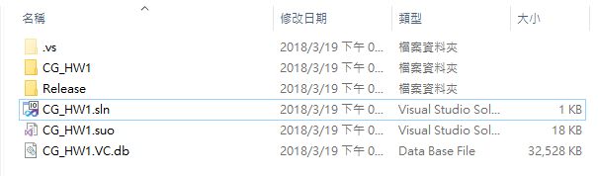
Prerequisite & Notice
Choose one of the solution bellow
Microsoft Visual Studio 2017 ( available from 校務資訊系統)
Visual Studio Community 2017 ( free )
Ensure you have also install C++ package when installing IDE
Open the project with clicking .sln file (solution)

Slide 4
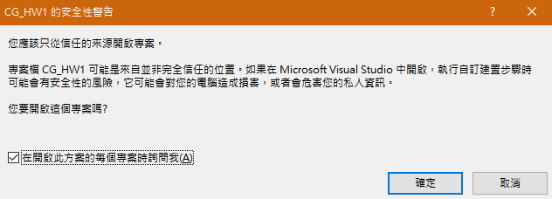
Prerequisite & Notice
DO NOT change the repository or folder unless it’s necessary
When IDE show you this window, please click “confirm”

Slide 5
Prerequisite & Notice
DO NOT change the repository or folder unless it’s necessary
When IDE show you this window, please click “confirm”

Slide 6
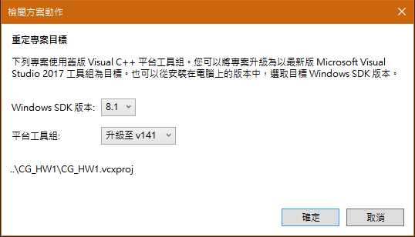
Prerequisite & Notice
When IDE ask you to retarget the project
Ensure your windows SDK version is greater than 8.1
Ensure your platform utility toolkit version is greater than v140
Click “confirm”

Slide 7
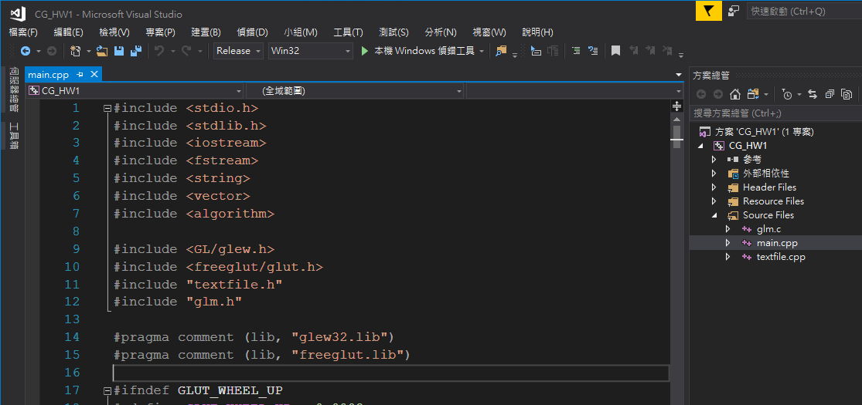
How to run this project
Toggle release mode
Click “local Windows debug tools”
1.
2.

Slide 8
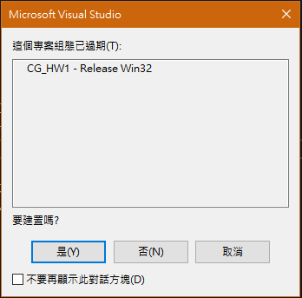
How to run this project
Click “Yes”

Slide 9
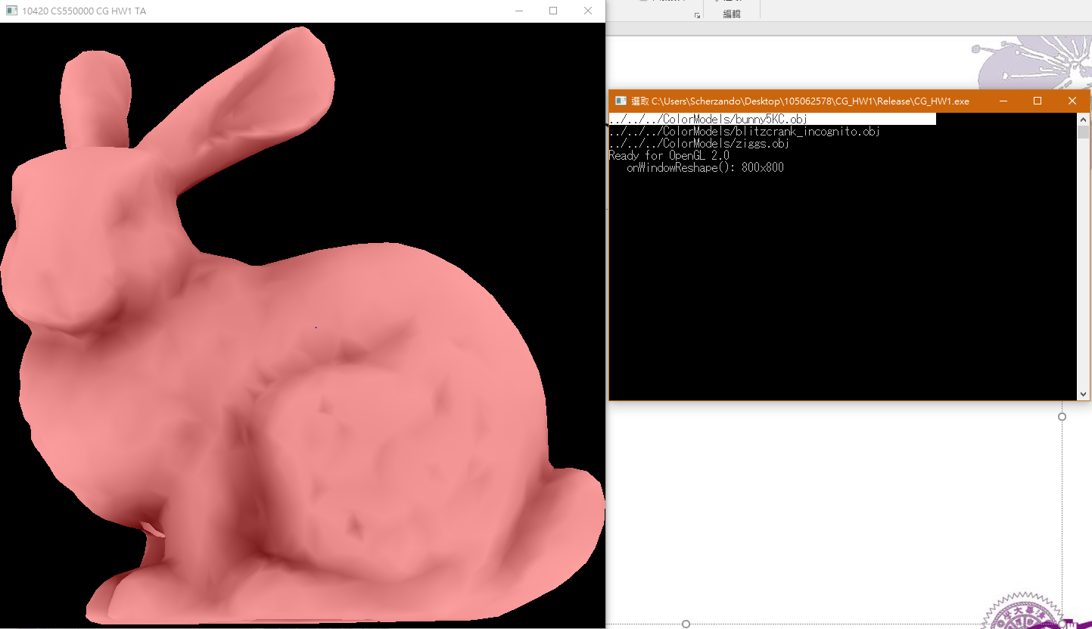
How to run this project
Success
OpenGL window
Console window

Slide 10
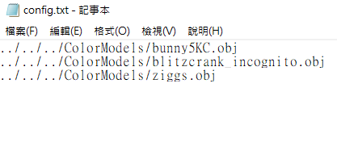
How to run this project
config.txt
list your models route

Slide 11
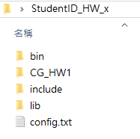
How to run this project
Folder structure
Name: yourStudentID_HW_x/

Slide 12
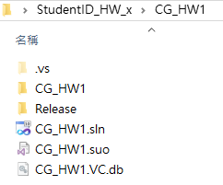
How to run this project
Folder structure
Name: yourStudentID_HW_x/CG_HW1

Slide 13
Goal
Familiar with the OpenGL programming environment
Understand the basic OpenGL framework
Knowing how to render a model as expected
Knowing how to change the attributes of a model
Display the model in solid or in wireframe mode

Slide 14
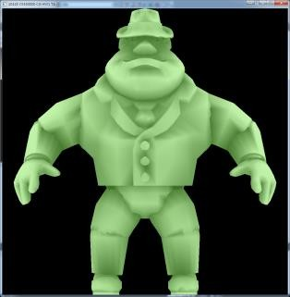
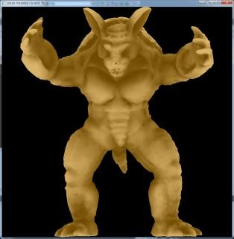
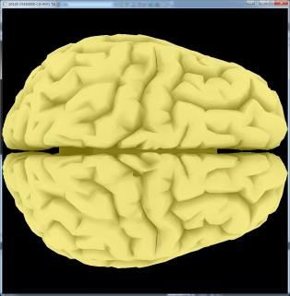
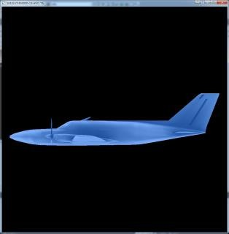
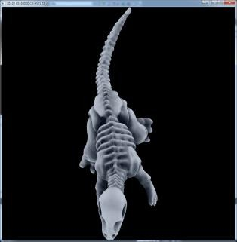
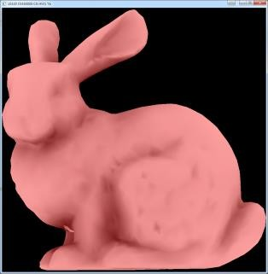
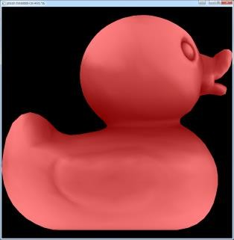
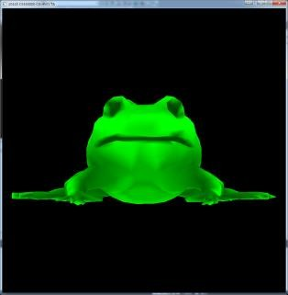
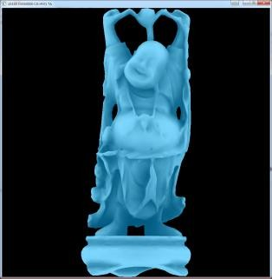
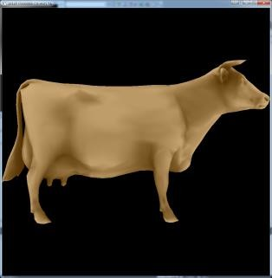
Goal
Render a 3D model properly on the screen

Slide 15

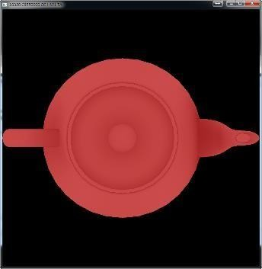
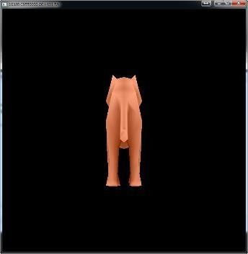


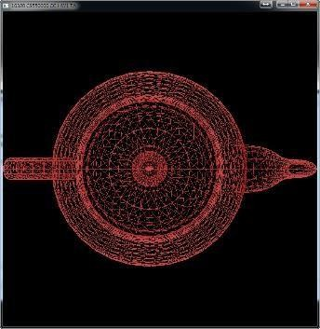
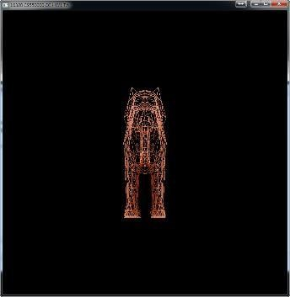
Goal
Render a 3D model properly on the screen.

Slide 16
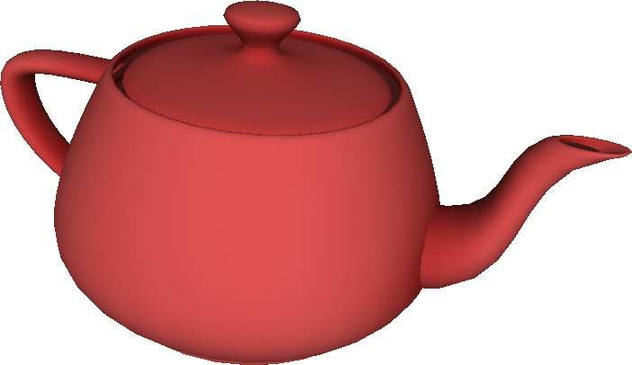
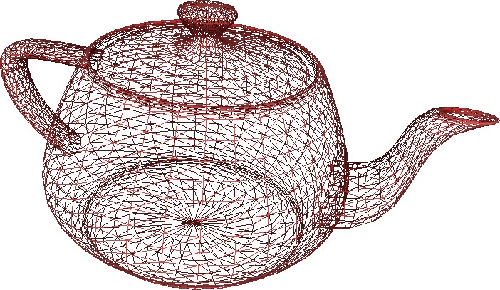
Goal
Using the framework to render some 3D models and display them in solid or in wireframe mode
Solid mode
Wireframe mode

Slide 17
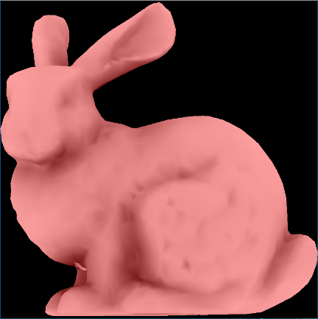
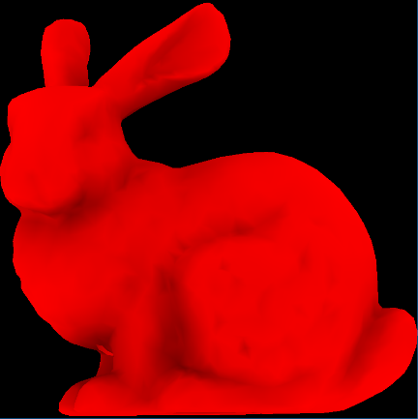
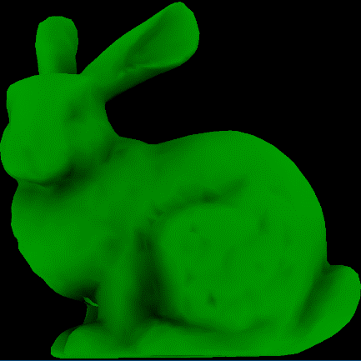
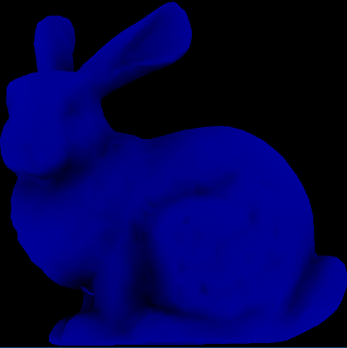
Goal
Use fragment shader to control which color channel to be displayed

Slide 18
Operation (Keyboard)
Lowercase z/x : render previous / next model
Lowercase c : change color channel to display
Lowercase w : toggle wireframe mode

Slide 19
Goal
Render a 3D model properly on the screen.
Step by step
Load model(s) from external *.obj file(s).
Normalize the model into [-1, 1] and show it on the screen.
Add color filtering function into your shader
Reminders
You CANNOT use the existing transform API of OpenGL 1.X.
e.g. glRotate, glTranslate, glScale
You NEED to modify vertex/fragment shaders.

Slide 20










Normalization
1. Translation
2. Scaling
Normalized !

Slide 21
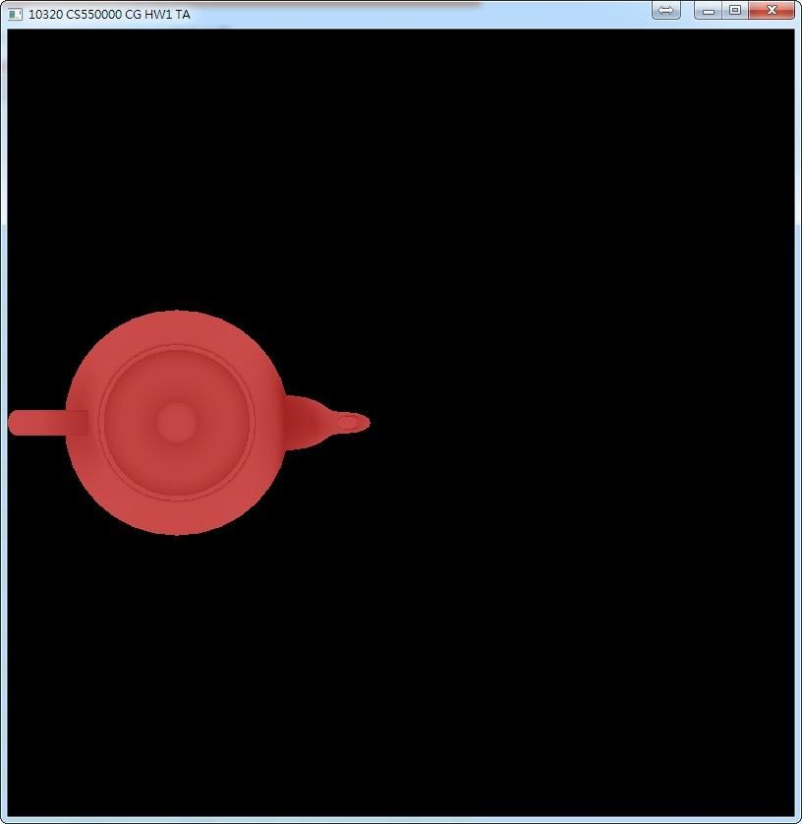
1. Translation
Not Located at Origin (0, 0, 0)
center of model ≠ center of mass
DO NOT set initial value of (max, min) as (0, 0) or (-100, 100)
x ∈ [-263.80969, -146.79413]
y ∈ [-36.36507, 36.39270]
z ∈ [53.82454, 111.12128]

Slide 22
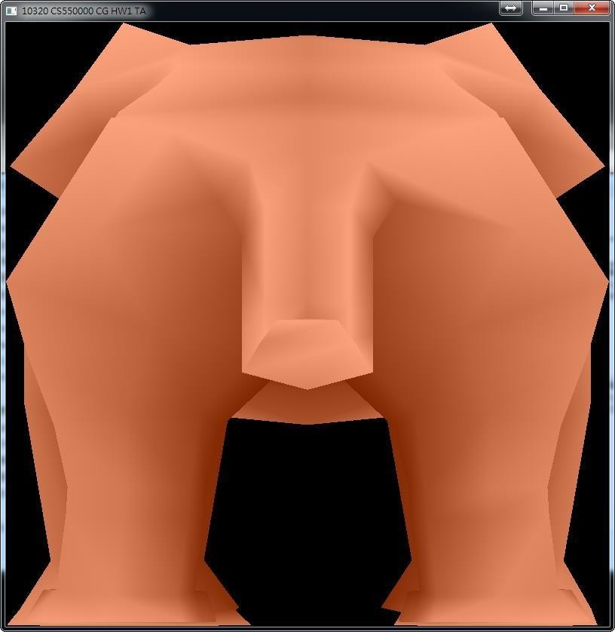
2. Scaling
Non-Uniform Scaling
Set different scaling factor of x, y, z.
Model will deform.

Slide 23
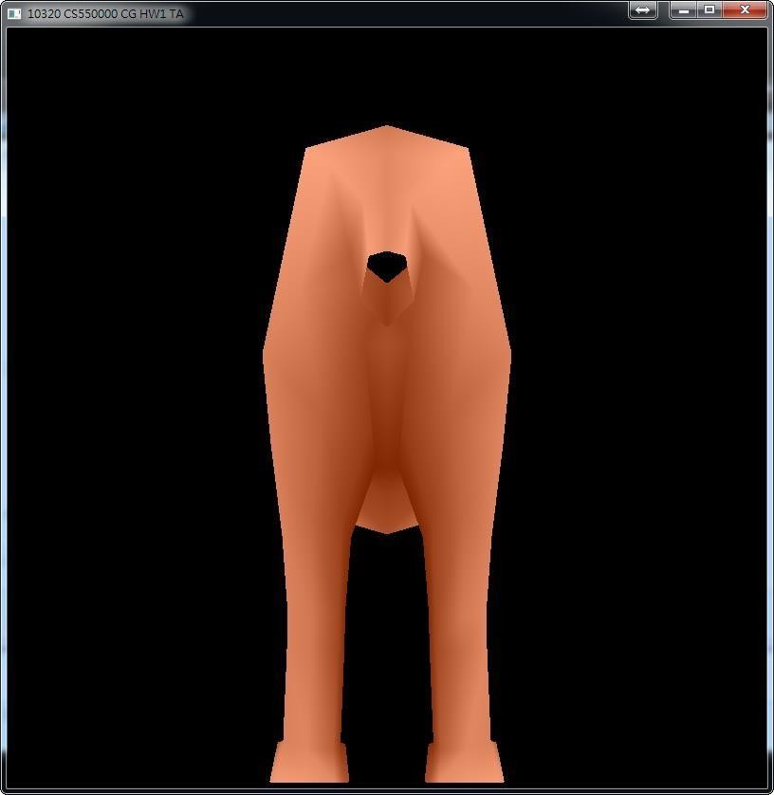
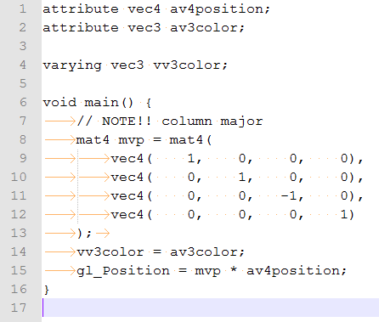
2. Scaling
Not Considering Z-Axis
Vertices may not fit the bounding box
of {(𝑥, 𝑦, 𝑧) | x, y, z ∈ [-1, 1]}
Clipped z within [-1, 1]

Slide 24
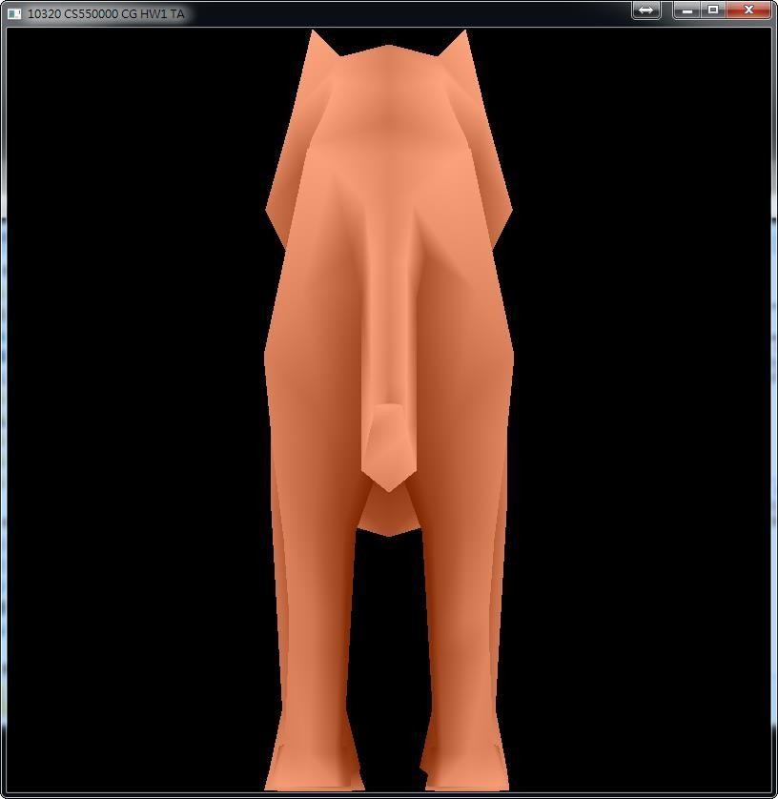
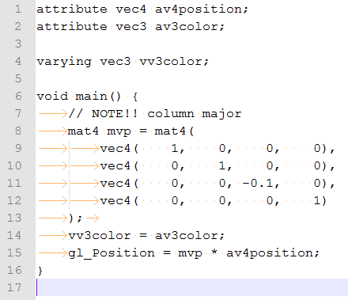
2. Scaling
Not Considering Z-Axis
Vertices may not fit the bounding box
of {(𝑥, 𝑦, 𝑧) | x, y, z ∈ [-1, 1]}
Clipped z within [-10, 10]

Slide 25
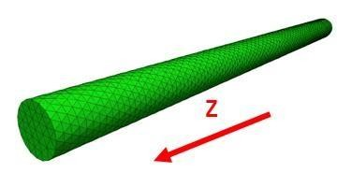


2. Scaling
Not Considering Z-Axis
Vertices may not fit the bounding box
of {(𝑥, 𝑦, 𝑧) | x, y, z ∈ [-1, 1]}
Think of a long z-orientation cylinder

Slide 26
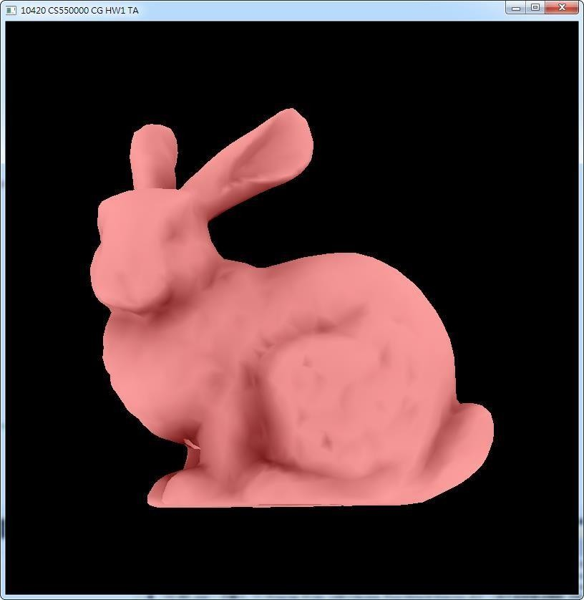
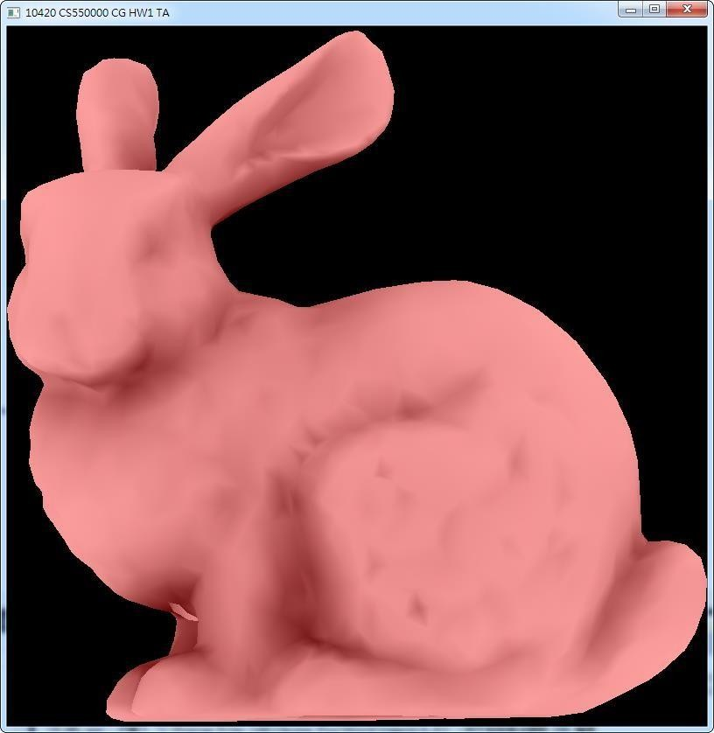






2. Scaling
Absolute value?
Width = abs(maxX) + abs(minX) Height = abs(maxY) + abs(minY) Depth = abs(maxZ) + abs(minZ)
Width = maxX - minX Height = maxY - minY Depth = maxZ - minZ

Slide 27








Appendix
Include header files
Initialization for
states, models, textures, shaders… (initialize only once)
State Initialization Routines Models, Textures, …
Define specific callback functions and registered in the main program
Callback Functions (Event Handlers)
int main(int argc, char** argv)
{
Display Mode Setting Window Creation
Set the display and window properties to create a window for display
Trigger specific callback functions when
corresponding events occur
Callback Functions Registration
Initialization Event Handling Loop
}
8

Slide 28
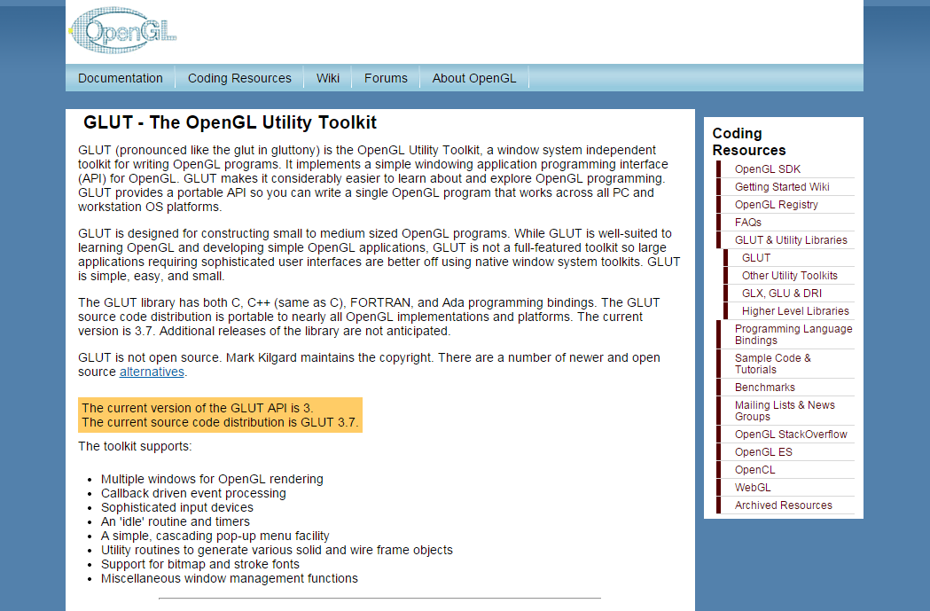
GLUT
The OpenGL Utility Toolkit
– https://www.opengl.org/resources/libraries/glut/

Slide 29
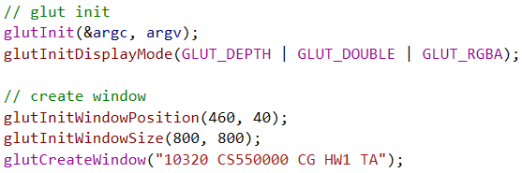
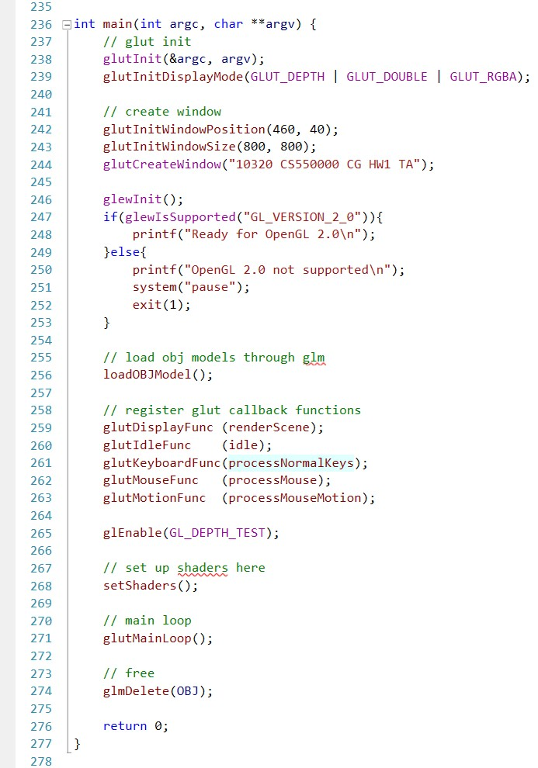
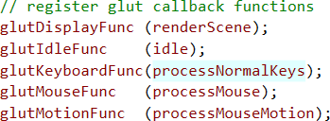


Slide 30
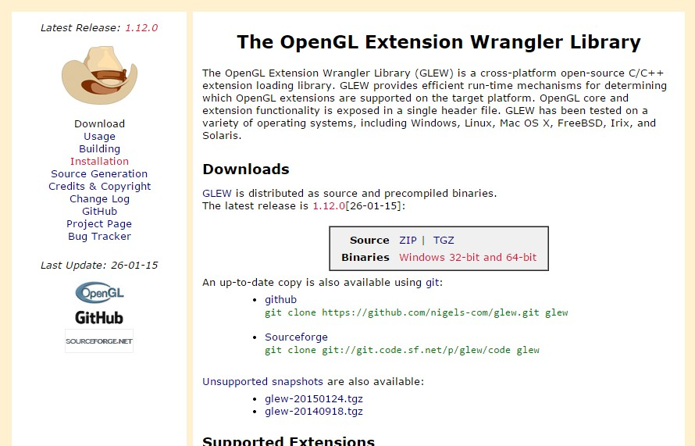
GLEW
The OpenGL Extension Wrangler Library
– http://glew.sourceforge.net/

Slide 31
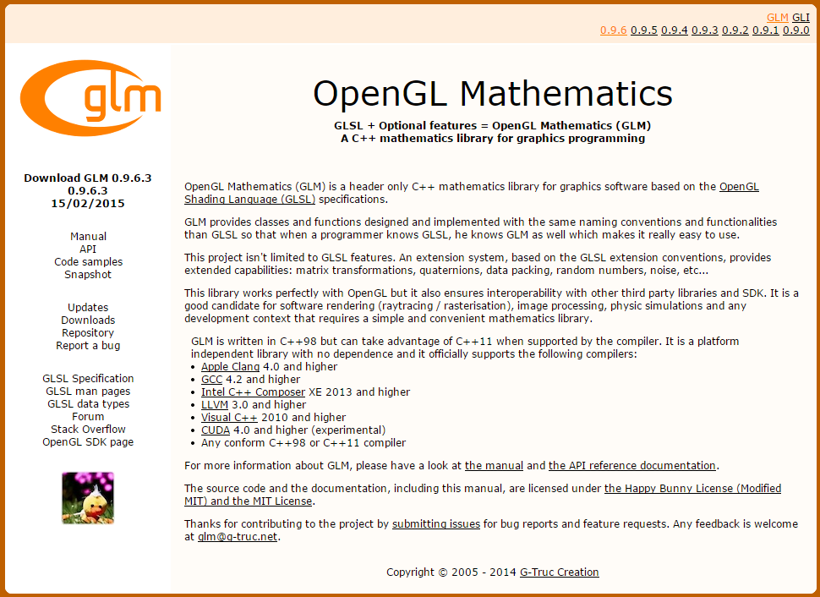
GLM
OpenGL Mathematics
– http://glm.g-truc.net/0.9.6/index.html

Slide 32
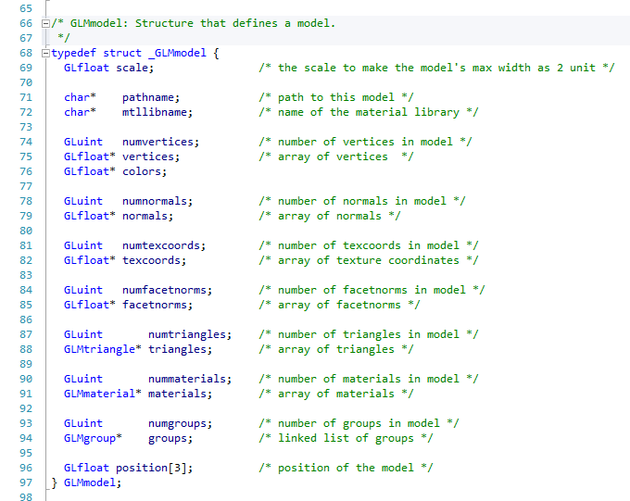
GLMmodel

