Slide 1
Computer Networks: A Systems Approach, 5e
Larry L. Peterson and Bruce S. Davie
Chapter 1
Foundation
Copyright © 2010, Elsevier Inc. All rights Reserved
Notes:
The University of Adelaide, School of Computer Science
Chapter 2 — Instructions: Language of the Computer

Slide 2
Problems
How to build a scalable network that will support different applications?
What is a computer network?
How is a computer network different from other types of networks?
What is a computer network architecture?
Notes:
The University of Adelaide, School of Computer Science
Chapter 2 — Instructions: Language of the Computer

Slide 3
Chapter Outline
Applications
Requirements
Network Architecture
Implementing Network Software
Performance
Notes:
The University of Adelaide, School of Computer Science
Chapter 2 — Instructions: Language of the Computer

Slide 4
Chapter Goal
Exploring the requirements that different applications and different communities place on the computer network
Introducing the idea of network architecture
Introducing some key elements in implementing Network Software
Define key metrics that will be used to evaluate the performance of computer network
Notes:
The University of Adelaide, School of Computer Science
Chapter 2 — Instructions: Language of the Computer

Slide 5
Applications
Most people know about the Internet (a computer network) through applications
  World Wide Web
  Email
  Online Social Network
  Streaming Audio Video
  File Sharing
  Instant Messaging
  …
Notes:
The University of Adelaide, School of Computer Science
Chapter 2 — Instructions: Language of the Computer

Slide 6
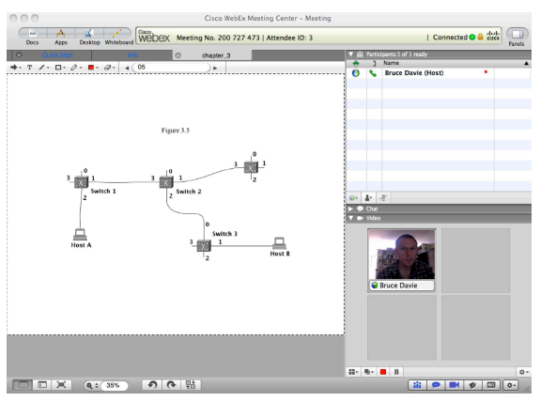
Example of an application
A multimedia application including video-conferencing

Slide 7
Application Protocol
URL
  Uniform resource locater
  http://www.cs.princeton.edu/~llp/index.html
HTTP
  Hyper Text Transfer Protocol
TCP
  Transmission Control Protocol
17 messages for one URL request
  6 to find the IP (Internet Protocol) address
  3 for connection establishment of TCP
  4 for HTTP request and acknowledgement
    Request: I got your request and I will send the data
    Reply: Here is the data you requested; I got the data
  4 messages for tearing down TCP connection
Notes:
The University of Adelaide, School of Computer Science
Chapter 2 — Instructions: Language of the Computer

Slide 8
Requirements
How three groups of people might list their requirements for a network:
Application Programmer
  List the services that his application needs: delay bounded delivery of data
Network Designer
  List the properties of a cost-effective network design
Network Provider
  List the characteristics of a system that is easy to manage
Notes:
The University of Adelaide, School of Computer Science
Chapter 2 — Instructions: Language of the Computer

Slide 9
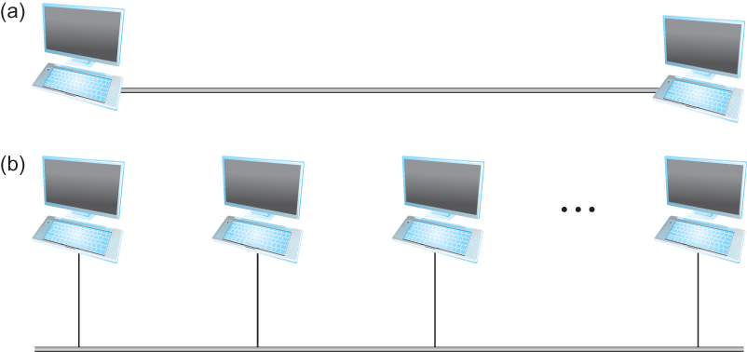
Connectivity
Need to understand the following terminologies
  Scale
  Link
  Nodes
  Point-to-point
  Multiple access
  Switched Network
    Circuit Switched
    Packet Switched
  Packet, message
  Store-and-forward
Point-to-point
Multiple access

Slide 10
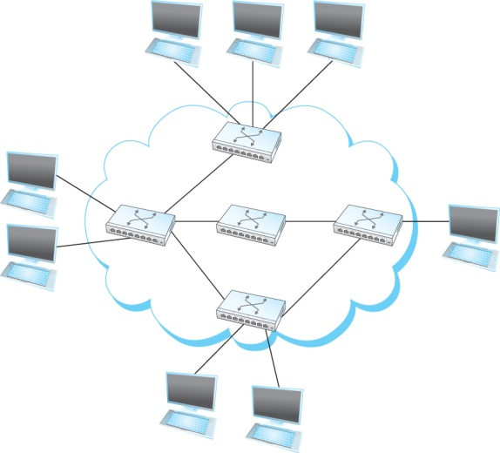
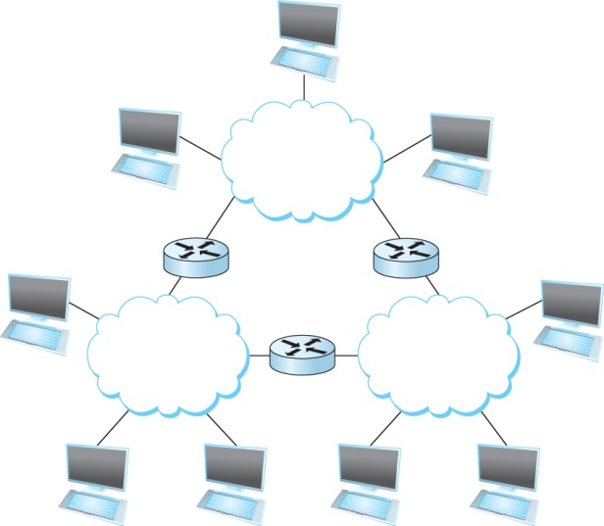
Connectivity
Terminologies (contd.)
  Cloud
  Hosts
  Switches
  internetwork
  Router/gateway
  Host-to-host connectivity
  Address
  Routing
  Unicast/broadcast/multicast
(a)
A switched network
(b)
Interconnection of networks

Slide 11
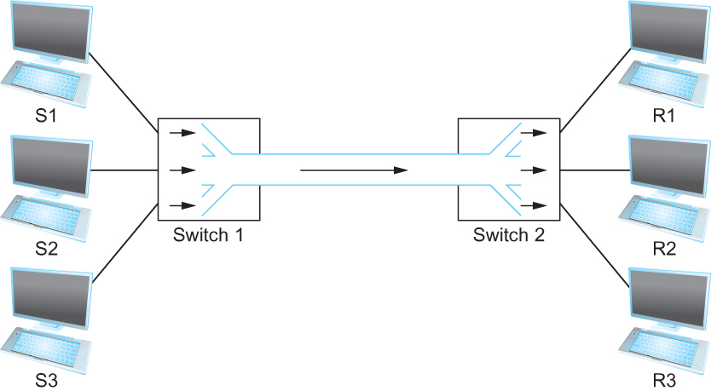
Cost-Effective Resource Sharing
Resource: links and nodes
How to share a link?
  Multiplexing
  De-multiplexing
  Synchronous Time-division Multiplexing (STDM)
    Time slots/data transmitted in predetermined slots
Multiplexing multiple logical flows over a single physical link

Slide 12
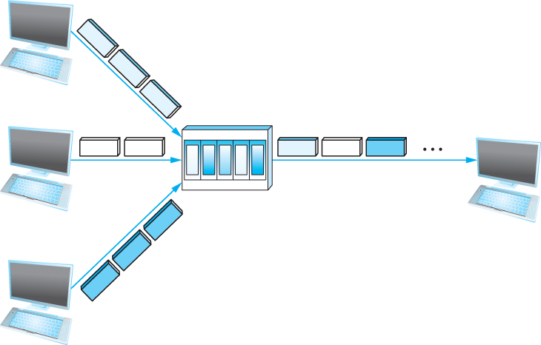
Cost-Effective Resource Sharing
FDM: Frequency Division Multiplexing
Statistical Multiplexing
  Data is transmitted based on demand of each flow.
  What is a flow?
  Packets vs. Messages
  FIFO, Round-Robin, Priorities (Quality-of-Service (QoS))
  Congested?
LAN(Local Area Network), MAN (Metropolitan Area Network), WAN (Wide Area Network),
SAN (System Area Networks
A switch multiplexing packets from multiple sources onto one shared link

Slide 13
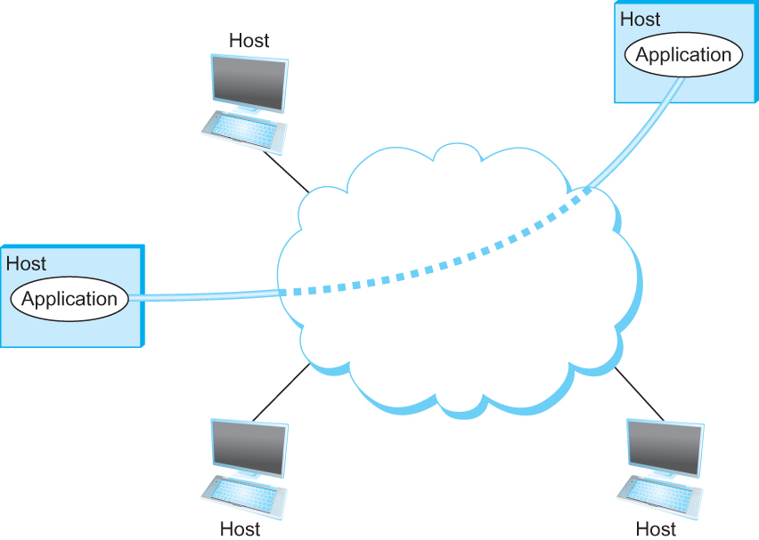
Support for Common Services
Logical Channels
  Application-to-Application communication path or a pipe
Process communicating over an abstract channel

Slide 14
Common Communication Patterns
Client/Server
Two types of communication channel
  Request/Reply Channels
  Message Stream Channels
Notes:
The University of Adelaide, School of Computer Science
Chapter 2 — Instructions: Language of the Computer

Slide 15
Reliability
Network should hide the errors
Bits are lost
  Bit errors (1 to a 0, and vice versa)
  Burst errors – several consecutive errors
Packets are lost (Congestion)
Links and Node failures
Messages are delayed
Messages are delivered out-of-order
Third parties eavesdrop
Notes:
The University of Adelaide, School of Computer Science
Chapter 2 — Instructions: Language of the Computer

Slide 16
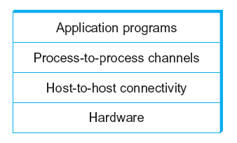
Network Architecture
Layering provides two nice features.
  First, it decomposes the problem of building a network into more manageable components.
  Second, it provides a more modular design
Example of a layered network system

Slide 17
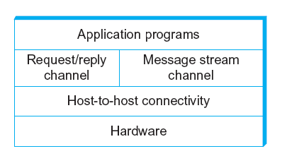
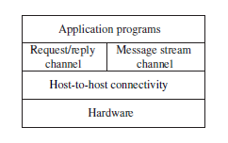
Network Architecture
Layered system with alternative abstractions available at a given layer

Slide 18
Protocols
Protocol defines the interfaces between the layers in the same system and with the layers of peer system
Building blocks of a network architecture
Each protocol object has two different interfaces
  service interface: operations on this protocol
  peer-to-peer interface: messages exchanged with peer
Term “protocol” is overloaded
  specification of peer-to-peer interface
  module that implements this interface
Notes:
The University of Adelaide, School of Computer Science
Chapter 2 — Instructions: Language of the Computer

Slide 19
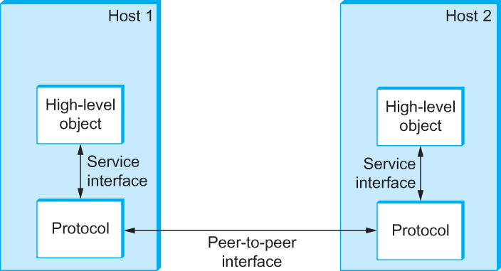
Interfaces
Service and Peer Interfaces

Slide 20
Protocols
Protocol Specification: Specifications are generally expressed using a combination of prose, pseudocode, state transition diagrams, pictures of packet formats, and other abstract notations.
Interoperable: when two or more protocols that implement the specification accurately
Standardization body: IETF (Internet Engineering Task Force)
Notes:
The University of Adelaide, School of Computer Science
Chapter 2 — Instructions: Language of the Computer

Slide 21
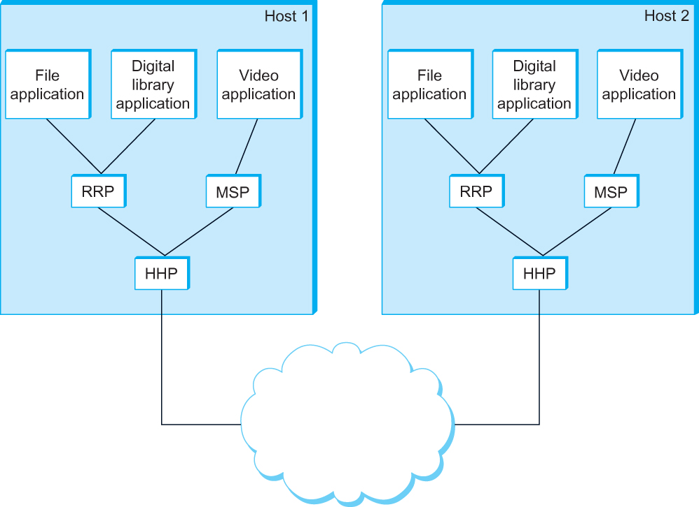
Protocol Graph
A suite of protocols that make up a network system is represented by a protocol graph.
  nodes – protocols
  links - “depends-on” relation
Example of a protocol graph
RRP: Request/Reply Protocol
MSP: Message Stream Protocol
HHP: Host-to-Host Protocol

Slide 22
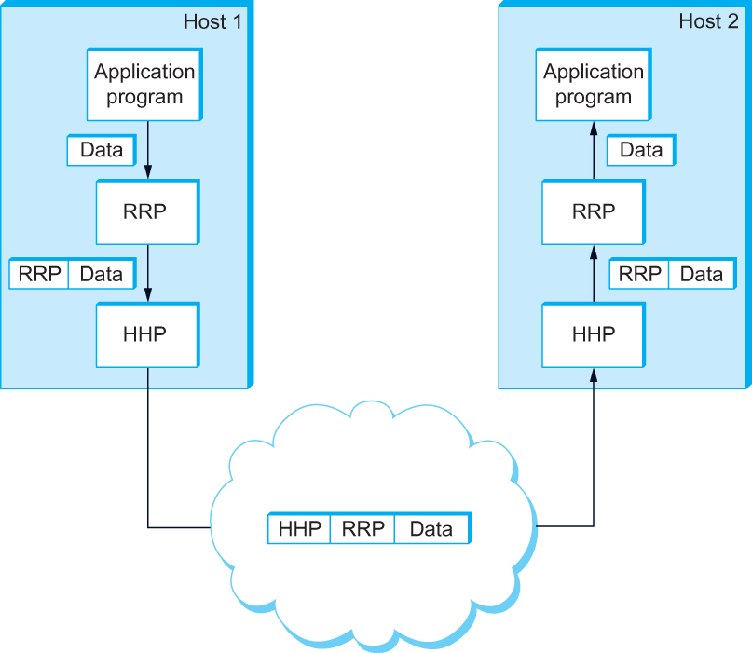
Encapsulation
High-level messages are encapsulated inside of low-level messages
A header is usually attached to each high-level message
In some cases, a trailer is added

Slide 23
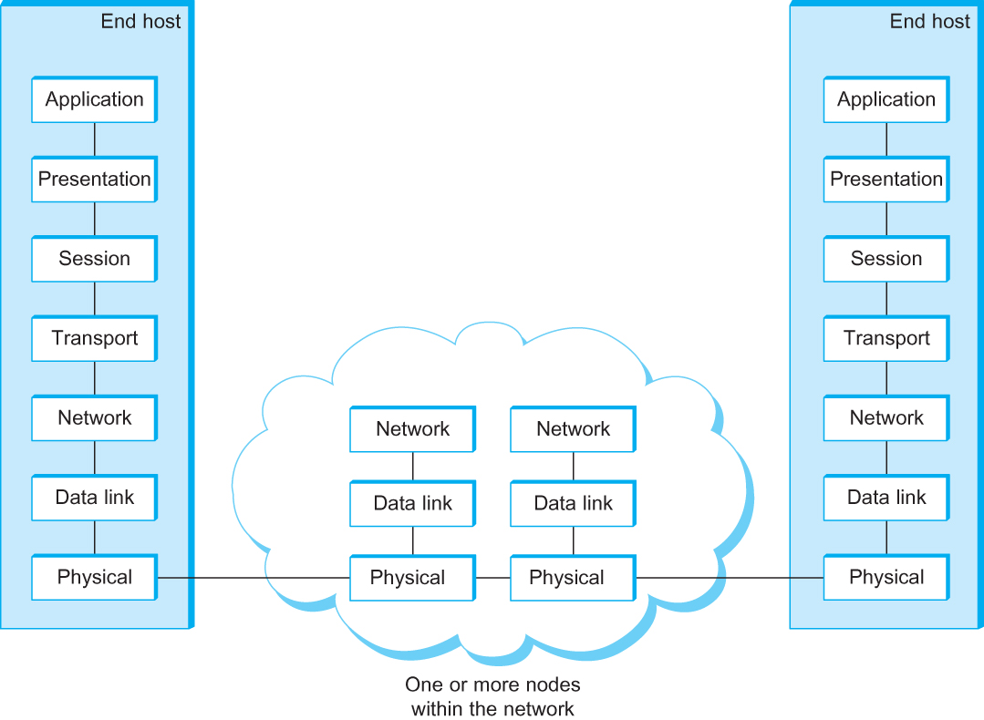
OSI Architecture
The OSI 7-layer Model
OSI – Open Systems Interconnection

Slide 24
Description of Layers
Physical Layer
  Handles the transmission of raw bits over a communication link
Data Link Layer
  Collects a stream of bits into a larger aggregate called a frame
  Network adaptor along with device driver in OS implement the protocol in this layer
  Frames are actually delivered to hosts
Network Layer
  Handles routing among nodes within a packet-switched network
  Unit of data exchanged between nodes in this layer is called a packet
  The lower three layers are implemented on all network nodes
Notes:
The University of Adelaide, School of Computer Science
Chapter 2 — Instructions: Language of the Computer

Slide 25
Description of Layers
Transport Layer
  Implements a process-to-process channel
  Unit of data exchanges in this layer is called a message
Session Layer
  Provides a name space that is used to tie together the potentially different transport streams that are part of a single application
Presentation Layer
  Concerned about the format of data exchanged between peers
Application Layer
  Standardize common type of exchanges
  The transport layer and the higher layers typically run only on end-hosts and not on the intermediate switches and routers
Notes:
The University of Adelaide, School of Computer Science
Chapter 2 — Instructions: Language of the Computer

Slide 26
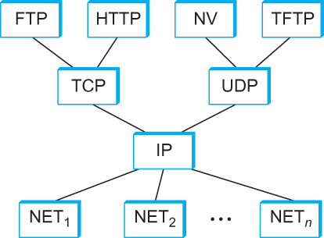
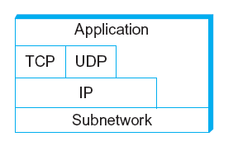
Internet Architecture
Alternative view of the Internet architecture
Internet Protocol Graph

Slide 27
Internet Architecture
Defined by IETF
Three main features
  Does not imply strict layering. The application is free to bypass the defined transport layers and to directly use IP or other underlying networks
  An hour-glass shape – wide at the top, narrow in the middle and wide at the bottom. IP serves as the focal point for the architecture
  In order for a new protocol to be officially included in the architecture, there needs to be both
    a protocol specification and
    at least one (and preferably two) representative implementations of the specification
Notes:
The University of Adelaide, School of Computer Science
Chapter 2 — Instructions: Language of the Computer

Slide 28
Application Programming Interface
Interface exported by the network
Since most network protocols are implemented (those in the high protocol stack) in software and nearly all computer systems implement their network protocols as part of the operating system, when we refer to the interface “exported by the network”, we are generally referring to the interface that the OS provides to its networking subsystem
The interface is called the network Application Programming Interface (API)
Notes:
The University of Adelaide, School of Computer Science
Chapter 2 — Instructions: Language of the Computer

Slide 29
Application Programming Interface (Sockets)
Socket Interface was originally provided by the Berkeley distribution of Unix
  - Now supported in virtually all operating systems
Each protocol provides a certain set of services, and the API provides a syntax by which those services can be invoked in this particular OS
Notes:
The University of Adelaide, School of Computer Science
Chapter 2 — Instructions: Language of the Computer

Slide 30
Socket
What is a socket?
  The point where a local application process attaches to the network
  An interface between an application and the network
  An application creates the socket
The interface defines operations for
  Creating a socket
  Attaching a socket to the network
  Sending and receiving messages through the socket
  Closing the socket
Notes:
The University of Adelaide, School of Computer Science
Chapter 2 — Instructions: Language of the Computer

Slide 31
Socket
Socket Family
  PF_INET denotes the Internet family
  PF_UNIX denotes the Unix pipe facility
  PF_PACKET denotes direct access to the network interface (i.e., it bypasses the TCP/IP protocol stack)
Socket Type
  SOCK_STREAM is used to denote a byte stream
  SOCK_DGRAM is an alternative that denotes a message oriented service, such as that provided by UDP
Notes:
The University of Adelaide, School of Computer Science
Chapter 2 — Instructions: Language of the Computer

Slide 32
Creating a Socket
int sockfd = socket(address_family, type, protocol);
The socket number returned is the socket descriptor for the newly created socket
int sockfd = socket (PF_INET, SOCK_STREAM, 0);
int sockfd = socket (PF_INET, SOCK_DGRAM, 0);
The combination of PF_INET and SOCK_STREAM implies TCP
Notes:
The University of Adelaide, School of Computer Science
Chapter 2 — Instructions: Language of the Computer

Slide 33
Client-Serve Model with TCP
Server
  Passive open
  Prepares to accept connection, does not actually establish a connection
Server invokes
int bind (int socket, struct sockaddr *address,
int addr_len)
int listen (int socket, int backlog)
int accept (int socket, struct sockaddr *address,
int *addr_len)
Notes:
The University of Adelaide, School of Computer Science
Chapter 2 — Instructions: Language of the Computer

Slide 34
Client-Serve Model with TCP
Bind
  Binds the newly created socket to the specified address i.e. the network address of the local participant (the server)
  Address is a data structure which combines IP and port
Listen
  Defines how many connections can be pending on the specified socket
Notes:
The University of Adelaide, School of Computer Science
Chapter 2 — Instructions: Language of the Computer

Slide 35
Client-Serve Model with TCP
Accept
  Carries out the passive open
  Blocking operation
    Does not return until a remote participant has established a connection
    When it does, it returns a new socket that corresponds to the new established connection and the address argument contains the remote participant’s address
Notes:
The University of Adelaide, School of Computer Science
Chapter 2 — Instructions: Language of the Computer

Slide 36
Client-Serve Model with TCP
Client
  Application performs active open
  It says who it wants to communicate with
Client invokes
int connect (int socket, struct sockaddr *address,
int addr_len)
Connect
  Does not return until TCP has successfully established a connection at which application is free to begin sending data
  Address contains remote machine’s address
Notes:
The University of Adelaide, School of Computer Science
Chapter 2 — Instructions: Language of the Computer

Slide 37
Client-Serve Model with TCP
In practice
  The client usually specifies only remote participant’s address and let’s the system fill in the local information
  Whereas a server usually listens for messages on a well-known port
  A client does not care which port it uses for itself, the OS simply selects an unused one
Notes:
The University of Adelaide, School of Computer Science
Chapter 2 — Instructions: Language of the Computer

Slide 38
Client-Serve Model with TCP
Once a connection is established, the application process invokes two operation
int send (int socket, char *msg, int msg_len,
int flags)
int recv (int socket, char *buff, int buff_len,
int flags)
Notes:
The University of Adelaide, School of Computer Science
Chapter 2 — Instructions: Language of the Computer

Slide 39
Example Application: Client
#include <stdio.h>
#include <sys/types.h>
#include <sys/socket.h>
#include <netinet/in.h>
#include <netdb.h>
#define SERVER_PORT 5432
#define MAX_LINE 256
int main(int argc, char * argv[])
{
FILE *fp;
struct hostent *hp;
struct sockaddr_in sin;
char *host;
char buf[MAX_LINE];
int s;
int len;
if (argc==2) {
host = argv[1];
}
else {
fprintf(stderr, "usage: simplex-talk host\n");
exit(1);
}
Notes:
The University of Adelaide, School of Computer Science
Chapter 2 — Instructions: Language of the Computer

Slide 40
Example Application: Client
/* translate host name into peer’s IP address */
hp = gethostbyname(host);
if (!hp) {
fprintf(stderr, "simplex-talk: unknown host: %s\n", host);
exit(1);
}
/* build address data structure */
bzero((char *)&sin, sizeof(sin));
sin.sin_family = AF_INET;
bcopy(hp->h_addr, (char *)&sin.sin_addr, hp->h_length);
sin.sin_port = htons(SERVER_PORT);
/* active open */
if ((s = socket(PF_INET, SOCK_STREAM, 0)) < 0) {
perror("simplex-talk: socket");
exit(1);
}
if (connect(s, (struct sockaddr *)&sin, sizeof(sin)) < 0) {
perror("simplex-talk: connect");
close(s);
exit(1);
}
/* main loop: get and send lines of text */
while (fgets(buf, sizeof(buf), stdin)) {
buf[MAX_LINE-1] = ’\0’;
len = strlen(buf) + 1;
send(s, buf, len, 0);
}
}
Notes:
The University of Adelaide, School of Computer Science
Chapter 2 — Instructions: Language of the Computer

Slide 41
Example Application: Server
#include <stdio.h>
#include <sys/types.h>
#include <sys/socket.h>
#include <netinet/in.h>
#include <netdb.h>
#define SERVER_PORT 5432
#define MAX_PENDING 5
#define MAX_LINE 256
int main()
{
struct sockaddr_in sin;
char buf[MAX_LINE];
int len;
int s, new_s;
/* build address data structure */
bzero((char *)&sin, sizeof(sin));
sin.sin_family = AF_INET;
sin.sin_addr.s_addr = INADDR_ANY;
sin.sin_port = htons(SERVER_PORT);
/* setup passive open */
if ((s = socket(PF_INET, SOCK_STREAM, 0)) < 0) {
perror("simplex-talk: socket");
exit(1);
}
Notes:
The University of Adelaide, School of Computer Science
Chapter 2 — Instructions: Language of the Computer

Slide 42
Example Application: Server
if ((bind(s, (struct sockaddr *)&sin, sizeof(sin))) < 0) {
perror("simplex-talk: bind");
exit(1);
}
listen(s, MAX_PENDING);
/* wait for connection, then receive and print text */
while(1) {
if ((new_s = accept(s, (struct sockaddr *)&sin, &len)) < 0) {
perror("simplex-talk: accept");
exit(1);
}
while (len = recv(new_s, buf, sizeof(buf), 0))
fputs(buf, stdout);
close(new_s);
}
}
Notes:
The University of Adelaide, School of Computer Science
Chapter 2 — Instructions: Language of the Computer

Slide 43
Performance
Network performance is measured in two fundamental ways: bandwidth (also called throughput) and latency (also called delay).
Bandwidth
  Width of the frequency band
  Number of bits per second that can be transmitted over a communication link
1 Mbps: 1 x 10⁶ bits/second = 1x2²⁰ bits/sec
  each bit occupies 1 micro second space on a timeline.
On a 2 Mbps link the width is 0.5 micro second.
The more sophisticated the transmitting and receiving technology, the narrower each bit can become and, thus, the higher the bandwidth.
Notes:
The University of Adelaide, School of Computer Science
Chapter 2 — Instructions: Language of the Computer

Slide 44
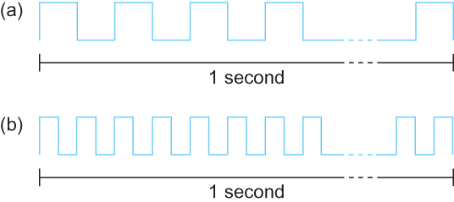
Bandwidth
Bits transmitted at a particular bandwidth can be regarded as having some width:
(a) bits transmitted at 1Mbps (each bit 1 μs wide);
(b) bits transmitted at 2Mbps (each bit 0.5 μs wide).

Slide 45
Performance
Latency
Latency = Propagation delay + transmission delay + queuing delay
Propagation delay = distance/speed of light
Transmission delay = size/bandwidth
One bit transmission => propagation is important
Large bytes transmission => bandwidth is important
Notes:
The University of Adelaide, School of Computer Science
Chapter 2 — Instructions: Language of the Computer

Slide 46
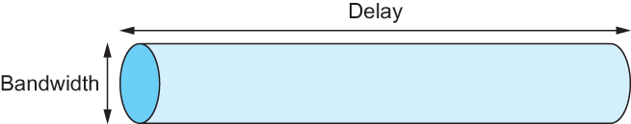
Delay X Bandwidth Product
We think the channel between a pair of processes as a hollow pipe
Latency (delay) length of the pipe and bandwidth the width of the pipe
delay×bandwidth product the maximum number of bits that could be in transit through the pipe at any given instant.
Delay of 50 ms and bandwidth of 45 Mbps
50 x 10⁻³ seconds x 45 x 10⁶ bits/second
2.25 x 10⁶ bits = 280 KB data.
Network as a pipe
Notes:
The University of Adelaide, School of Computer Science
Chapter 2 — Instructions: Language of the Computer

Slide 47
Delay X Bandwidth Product
Relative importance of bandwidth and latency depends on application
  For large file transfer, bandwidth is critical
  For small messages (HTTP, NFS, etc.), latency is critical
  Variance in latency (jitter) can also affect some applications (e.g., audio/video conferencing)
Notes:
The University of Adelaide, School of Computer Science
Chapter 2 — Instructions: Language of the Computer

Slide 48
Delay X Bandwidth Product
  The sender can send one delay×bandwidth worth of data before the first bit arrives at the receiver if the sender keeps the pipe full.
  Takes another one-way latency to receive a response from the receiver
  The sender can send one RTT×bandwidth worth of data before hearing from the receiver that the first bit has been received.
  If the sender does not fill the pipe—send a whole delay × bandwidth product’s worth of data before it stops to wait for a signal—the sender will not fully utilize the network
Notes:
The University of Adelaide, School of Computer Science
Chapter 2 — Instructions: Language of the Computer

Slide 49
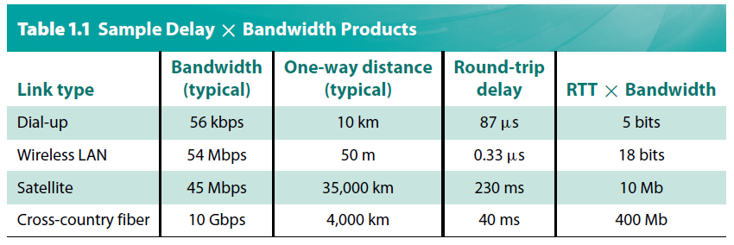
Delay X Bandwidth Product
Notes:
The University of Adelaide, School of Computer Science
Chapter 2 — Instructions: Language of the Computer

Slide 50
High-Speed Networks
Large bandwidth
  RTT dominates
  ResponseTime = RTT + 1/Bandwidth x TransferSize
Its all relative
  1-MB file to 1-Gbps link looks like a 1-KB packet to 1-Mbps link
Notes:
The University of Adelaide, School of Computer Science
Chapter 2 — Instructions: Language of the Computer

Slide 51
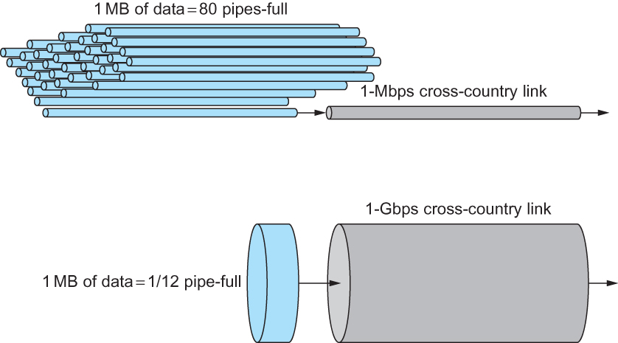
High-Speed Networks
A 1-MB file would fill the 1-Mbps link 80 times,
but only fill the 1-Gbps link 1/12 of one time

Slide 52
Summary
We have identified what we expect from a computer network
We have defined a layered architecture for computer network that will serve as a blueprint for our design
We have discussed the socket interface which will be used by applications for invoking the services of the network subsystem
We have discussed two performance metrics using which we can analyze the performance of computer networks
Notes:
The University of Adelaide, School of Computer Science
Chapter 2 — Instructions: Language of the Computer

