Slide 1
Chapter 4
Advanced Internetworking
Copyright © 2010, Elsevier Inc. All rights Reserved
Notes:
The University of Adelaide, School of Computer Science
Chapter 2 — Instructions: Language of the Computer

Slide 2
Problems
How do we build a routing system that can handle hundreds of thousands of networks and billions of end nodes?
How to handle address space exhaustion of IPV4?
How to enhance the functionalities of Internet?
Notes:
The University of Adelaide, School of Computer Science
Chapter 2 — Instructions: Language of the Computer

Slide 3
Chapter Outline
Global Internet
Multicast
Mobile IP
Notes:
The University of Adelaide, School of Computer Science
Chapter 2 — Instructions: Language of the Computer

Slide 4
Chapter Goal
Understanding the scalability of routing in the Internet
Discussing IPv6
Understanding the concept of multicasting
Discussing Mobile IP
Notes:
The University of Adelaide, School of Computer Science
Chapter 2 — Instructions: Language of the Computer

Slide 5
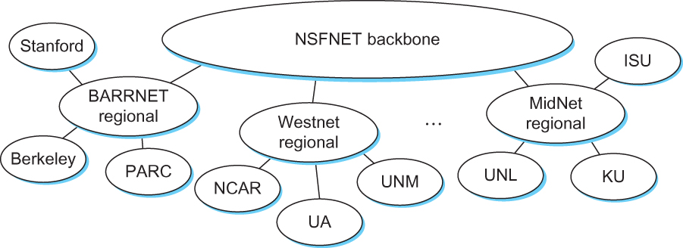
The Global Internet
The tree structure of the Internet in 1990
NSF - National Science Foundation
Notes:
The University of Adelaide, School of Computer Science
Chapter 2 — Instructions: Language of the Computer

Slide 6
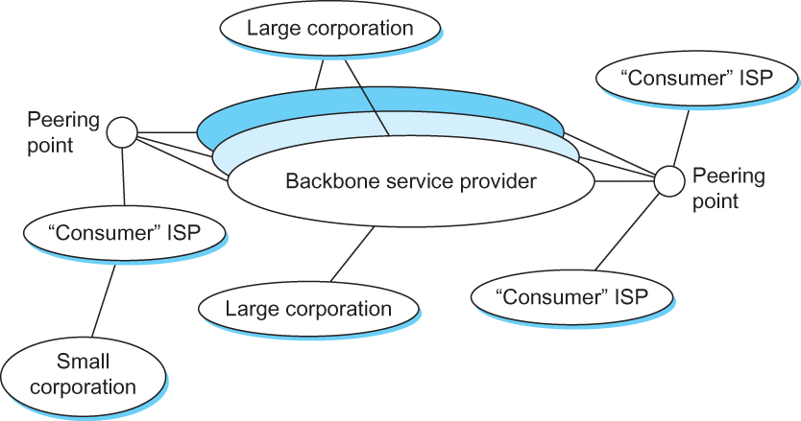
The Global Internet
A simple multi-provider Internet
Notes:
The University of Adelaide, School of Computer Science
Chapter 2 — Instructions: Language of the Computer

Slide 7
The Global Internet
Internet is organized as autonomous systems (AS) each of which is under the control of a single administrative entity
Autonomous System (AS)
  corresponds to an administrative domain
  examples: University, company, backbone network
A corporation’s internal network might be a single AS, as may the network of a single Internet service provider
It is quite likely that different providers will have different ideas about the best routing protocol to use within their networks and on how metrics should be assigned to links in their network

Slide 8
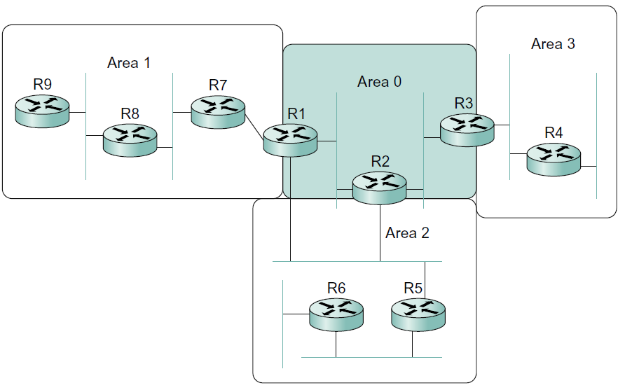
Routing Areas
Hierarchical routing can be used to improve scalability to some extent
A routing domain can be partitioned into hierarchical subdomains called routing areas.
For example, link-state routing protocols (such as OSPF and IS-IS)
Nonbackbone area
Backbone area
area border router (ABR)

Slide 9
Routing Areas
All the routers in one area send link-state advertisements to each other and thus develop a complete, consistent map of the area.
However, the link-state advertisements of routers that are not area border routers do not leave the area in which they originated.
The area border routers summarize routing information that they have learned from one area and make it available in their advertisements to other areas.
This has the effect of making the flooding and route calculation processes considerably more scalable.
Backbone area
area border router (ABR)

Slide 10
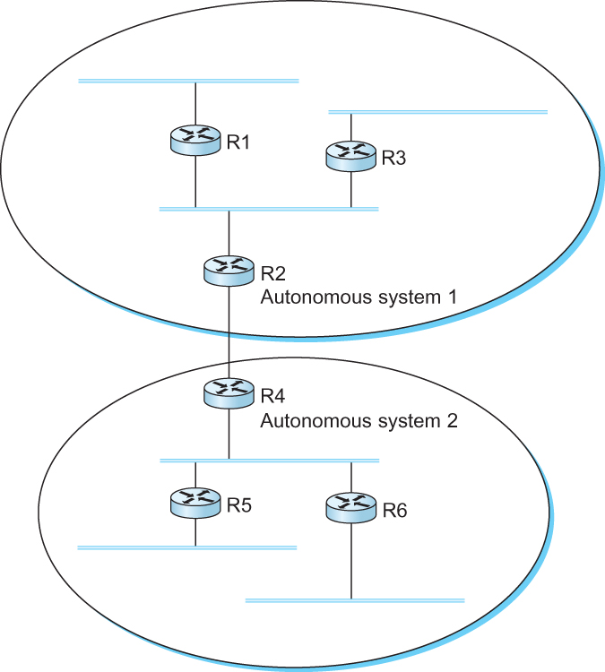
Interdomain Routing
Organized the Internet into autonomous systems (AS) and use inter-domain routing to provide scalability
A network with two autonomous system

Slide 11
Interdomain Routing
Idea: Provide an additional way to hierarchically aggregate routing information in a large internet.
  Improves scalability
Divide the routing problem in two parts:
  Routing within a single autonomous system
  Routing between autonomous systems
Another name for autonomous systems in the Internet is routing domains
  Two-level route propagation hierarchy
    Inter-domain routing protocol (Internet-wide standard)
    Intra-domain routing protocol (each AS selects its own)

Slide 12
Interdomain Routing
Intra-domain focuses on a well-defined problem of optimizing the scalar cost of the path
Inter-domain focuses on finding a non-looping, policy-compliant path
Example routing policy
  Customer AS does not allow transit traffic from AS X to AS Y or vice versa
AS X
peering
AS Y
x
x
Customer AS

Slide 13
EGP and BGP
Two major Inter-domain Routing Protocols
  Exterior Gateway Protocol (EGP)
    EGP was designed when the Internet had a treelike topology
    Did not allow for the topology to become general
      Tree like structure: there is a single backbone and autonomous systems are connected only as parents and children and not as peers
  Border Gateway Protocol (BGP)
    No assumptions about how autonomous systems are interconnected – can be arbitrarily interconnected set of ASs.
    Today’s Internet consists of an interconnection of multiple backbone networks (they are usually called service provider networks, and they are operated by private companies rather than the government)
    Sites are connected to each other in arbitrary ways
    The current version of BGP is version 4 (BGP-4)

Slide 14
BGP-4: Border Gateway Protocol
Assumes the Internet is an arbitrarily interconnected set of AS's.
Define local traffic as traffic that originates at or terminates on nodes within an AS, and transit traffic as traffic that passes through an AS.
Autonomous systems can be classified into three types:
  Stub AS: an AS that has only a single connection to one other AS; such an AS will only carry local traffic (small corporation).
  Multihomed AS: an AS that has connections to more than one other AS, but refuses to carry transit traffic (large corporation).
  Transit AS: an AS that has connections to more than one other AS, and is designed to carry both transit and local traffic (backbone providers).

Slide 15
BGP
The goal of Inter-domain routing is to find any path to the intended destination that is loop free
  We are concerned with reachability than optimality
  Finding path anywhere close to optimal is considered to be a great achievement

Slide 16
BGP
Scalability: An Internet backbone router must be able to forward any packet destined anywhere in the Internet
Autonomous nature of the domains
  Note that each domain may run its own interior routing protocol and use any scheme it chooses to assign metrics to paths.
  It is impossible to calculate meaningful path costs for a path that crosses multiple ASs
Issues of trust
  Provider A might be unwilling to believe certain advertisements from provider B

Slide 17
BGP
Each AS has:
  One or more border routers through which packets enter and leave the AS.
  One BGP speaker that advertises:
    local networks
    other reachable networks (transit AS only)
    gives path information
It is common to find that border routers are also BGP speakers, but that does not have to be the case.

Slide 18
BGP
BGP does not belong to either of the two main classes of routing protocols (distance vectors and link-state protocols)
BGP advertises complete paths as an enumerated lists of ASs to reach a particular network

Slide 19
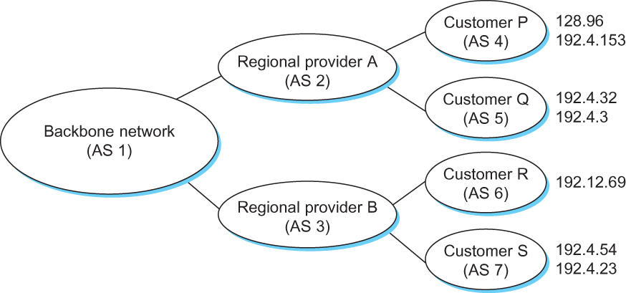
BGP Example
Speaker for AS 2 advertises reachability to P and Q
  Network 128.96, 192.4.153, 192.4.32, and 192.4.3, can be reached directly from AS 2.
Speaker for backbone network then advertises
  Networks 128.96, 192.4.153, 192.4.32, and 192.4.3 can be reached along the path <AS 1, AS 2>.
Speaker can also cancel previously advertised paths
Example of a network running BGP

Slide 20
BGP Issues
An important job of BGP is to prevent the establishment of looping paths.
It should be apparent that the AS numbers carried in BGP advertisement need to be unique to prevent forming a loop
If a router sees its own AS number on the AS_PATH list, it drops the route.
AS numbers are 16-bit numbers assigned by a central authority

Slide 21
BGP Issues
If a BGP speaker has a choice of several different routes to a destination, it will choose the best one according to its own local policies, and then that will be the route it advertises.
Furthermore, a BGP speaker is under no obligation to advertise any route to a destination, even if it has one.
This is how an AS can implement a policy of not providing transit—by refusing to advertise routes to prefixes that are not within that AS, even if it knows how to reach them.

Slide 22
BGP Issues
BGP is defined to run on top of TCP
BGP speakers can count on TCP to be reliable, this means that any information that has been sent from one speaker to another does not need to be sent again.
A BGP speaker sends an occasional keepalive message that says, “I’m still here and nothing has changed.”
If that router were to crash or become disconnected from its peer, it would stop sending the keepalive messages, and the other routers that had learned routes from it would assume that those routes were no longer valid.

Slide 23
Integrating Interdomain and Intradomain Routing
Injecting a default route into the intradomain routing protocol
  In the case of a stub AS that only connects to other autonomous systems at a single point, the border router is clearly the only choice for all routes that are outside the AS.
  The border router can inject a default route into the intradomain routing protocol.

Slide 24
Integrating Interdomain and Intradomain Routing
Injecting specific routes learned from outside the AS into the intradomain routing protocol
  Consider the border router of a provider AS that connects to a customer AS.
  That router could learn that the network prefix 192.4.54/24 is located inside the customer AS, either through BGP or because the information is configured into the border router.
  It could inject a route to that prefix into the intradomain routing protocol running inside the provider AS.
  This would be an advertisement of the sort, “I have a link to 192.4.54/24 of cost X.”
  This would cause other routers in the provider AS to learn that this border router is the place to send packets destined for that prefix.

Slide 25
Integrating Interdomain and Intradomain Routing
Using interior BGP (iBGP) to redistribute the information that is learned by the BGP speakers at the edges of the AS to all the other routers in the AS.
  In backbone networks, which learn so much routing information from BGP that it becomes too costly to inject it into the intradomain protocol.
  iBGP enables any router in the AS to learn the best border router to use when sending a packet to any address.
  Each router in the AS keeps track of how to get to each border router using a intradomain protocol
  By combining these two sets of information, each router in the AS is able to determine the appropriate next hop for all prefixes.

Slide 26
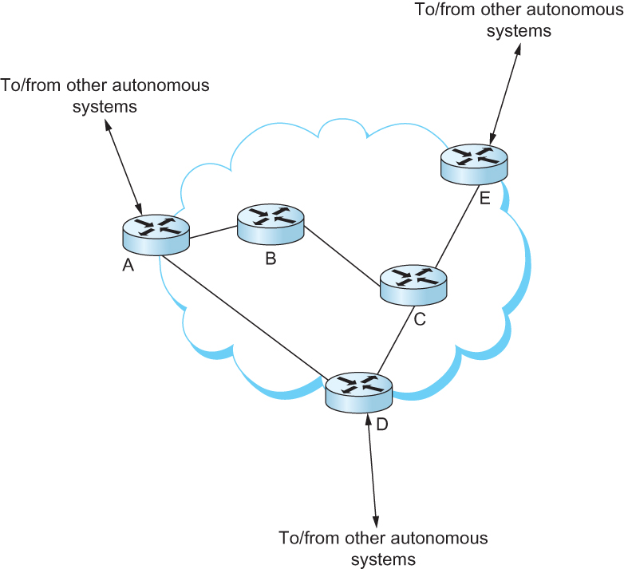
Integrating Interdomain and Intradomain Routing
eBGP
eBGP
iBGP
iBGP
iBGP
iBGP
eBGP
All routers run iBGP and an intradomain routing protocol. Border routers (A, D, E) also run eBGP to other ASs

Slide 27
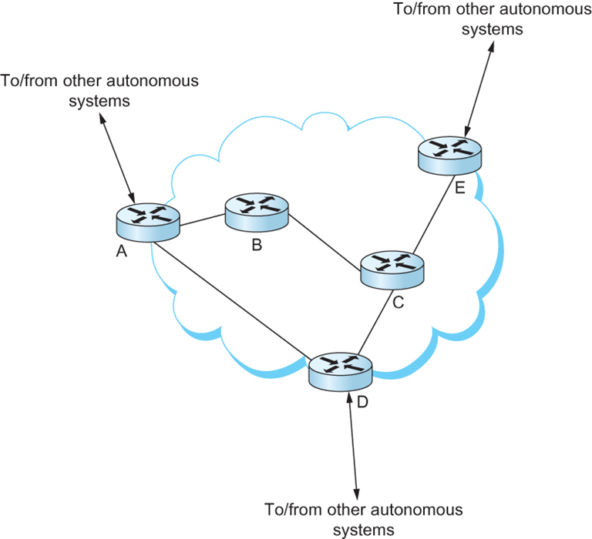
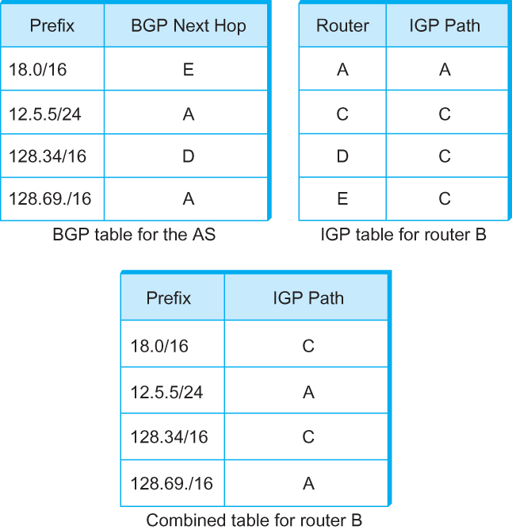
Integrating Interdomain and Intradomain Routing
BGP routing table, IGP routing table, and combined table at router B

Slide 28
Next Generation IP (IPv6)

Slide 29
Motivation and Major Features
Motivation: to deal with exhaustion of the IP address space.
Major features
    128-bit addresses - over 1500 addresses per square foot of the Earth’s surface
    Multicast
    Real-time service
    Authentication and security
    Auto-configuration
    Enhanced routing functionality, including support for mobile hosts

Slide 30
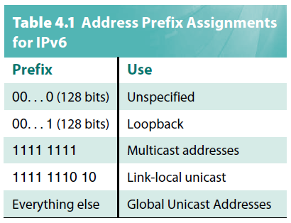
IPv6 Addresses
Address space allocation
Link-local unicast addresses
  To enable a host to construct an address that will work on the network to which it is connected without being concerned about the global uniqueness of the address.
  This may be useful for autoconfiguration.
  The site-local use addresses are intended to allow valid addresses to be constructed on a site (e.g., a private corporate network) that is not connected to the larger Internet.

Slide 31


IPv6 Addresses
Address space allocation
IPv4-compatible IPv6 address
IPv4-mapped IPv6 address
Special types of global unicast addresses
  A node may be assigned an IPv4-compatible IPv6 address by zero-extending a 32-bit IPv4 address to 128 bits.
  A node that is only capable of understanding IPv4 can be assigned an IPv4-mapped IPv6 address by prefixing the 32-bit IPv4 address with 2 bytes of all 1s and then zero-extending the result to 128 bits.

Slide 32
IPv6 Addresses
Address Notation
  Classless addressing/routing (similar to CIDR)
  Standard Notation: x:x:x:x:x:x:x:x (x = 16-bit hex number)
    47CD:1234:4422:ACO2:0022:1234:A456:0124
  Some special notations
    Contiguous 0s are compressed:
      47CD:0000:0000:0000:0000:0000:A456:0124
      47CD::A456:0124
    IPv6-compatible IPv4 address: ::128.42.1.87
    IPv4-mapped IPv6 address: ::FFFF:128.96.33.81

Slide 33
IPv6 Addresses
Address assignment
  Assign an address prefix to a direct provider and
  then for that direct provider to assign longer prefixes that begin with that prefix to its subscribers.
  Subscriber: a nontransit AS (i.e., a stub or multihomed AS)
  Direct provider: a provider directly connected to subscribers
  Indirect provider: a provider connects other providers (not connected directly to subscribers) and is often known as a backbone network

Slide 34
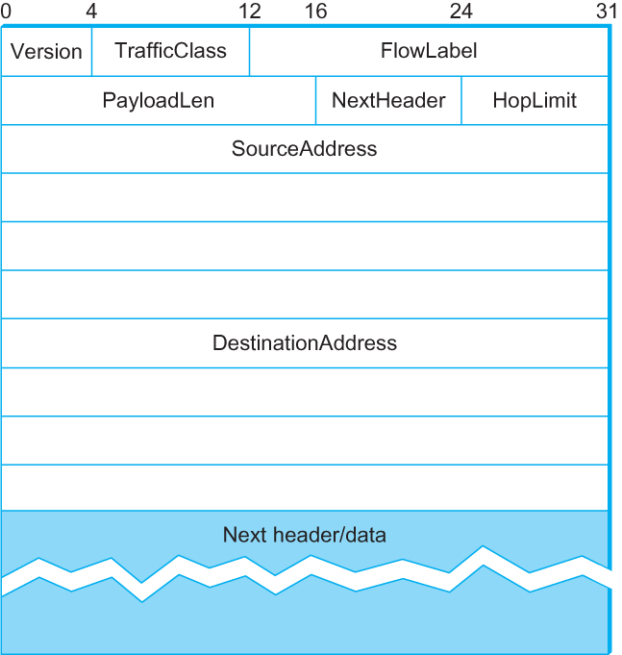
IPv6 Packet Format
40-byte “base” header
The TrafficClass and FlowLabel fields both relate to quality of service issues
PayloadLen - length of the packet, excluding the IPv6 header, measured in bytes.

Slide 35
IPv6 Packet Format
NextHeader - replaces both the IP options and the Protocol field of IPv4.
  If options are required, then they are carried in one or more special headers following the IP header, and this is indicated by the value of the NextHeader field.
  If no option is needed (there are no special headers) the NextHeader field is the demux key identifying the higher-level protocol running over IP (e.g., TCP or UDP)

Slide 36
IPv6 Packet Format
Fragmentation is now handled as an optional header, which means that the fragmentation related fields of IPv4 are not included in the IPv6 header.
The HopLimit field is simply the TTL of IPv4.
Source and destination addresses - 16 bytes (128 bits) long

Slide 37
IPv6 Packet Format
The type of each extension header is identified by the value of the NextHeader field in the header that precedes it, and
each extension header contains a NextHeader field to identify the header following it.
The last extension header will be followed by a transport-layer header (e.g., TCP) and in this case the value of the NextHeader field is the same as the value of the Protocol field would be in an IPv4 header.

Slide 38
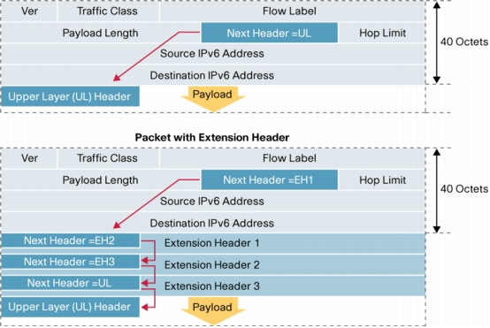
IPv6 Packet Format
An example: extension header
UL: upper layer protocol number
e.g. TCP = 6
Packet without extension header
Next header code
e.g. fragmentation extension header = 44
Packet with extension header
UL: upper layer protocol number
e.g. TCP = 6
TCP header

Slide 39
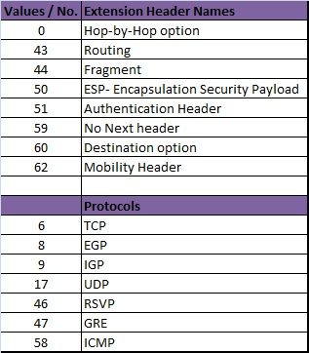
IPv6 Packet Format
Types of extension headers (fixed order, mostly fixed length)

Slide 40
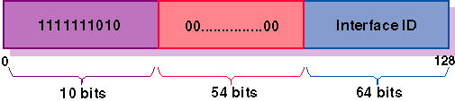
IPv6 Stateless Address Autoconfiguration
IPv6 provide a useful, new form of autoconfiguration called stateless autoconfiguration, which does not require a server.
A node forms a link-local address whenever an interface becomes enabled as follows:
  The left-most 'prefix length' bits of the address are those of the link-local prefix 1111 1110 10.
  The bits in the address to the right of the link-local prefix are set to all zeroes.
  If the length of the interface identifier is N bits (48 bits for MAC address), the right-most N bits of the address are replaced by the interface identifier.
N bits

Slide 41
IPv6 Stateless Address Autoconfiguration
IPv6 stateless autoconfiguration (continued)
Those devices that need a globally valid address the Neighbor Discovery Protocol is used to create a globally routable unicast address:
  the host sends router solicitation requests and an IPv6 router responds with a prefix assignment.
  The bits in the address to the right of the prefix are set to all zeroes.
  If the length of the interface identifier is N bits (48 bits for MAC address), the right-most N bits of the address are replaced by the interface identifier.

Slide 42
Internet Multicast

Slide 43
Overview
IPv4
  class D addresses
  demonstrated with MBone
  uses tunneling
Integral part of IPv6
  problem is making it scale

Slide 44
Overview
One-to-many
  Radio station broadcast
  Transmitting news, stock-price
  Software updates to multiple hosts
Many-to-many
  Multimedia teleconferencing
  Online multi-player games
  Distributed simulations

Slide 45
Overview
Without support for multicast
  A source needs to send a separate packet with the identical data to each member of the group
    This redundancy consumes more bandwidth
    Redundant traffic is not evenly distributed, concentrated near the sending host
  Source needs to keep track of the IP address of each member in the group
    Group may be dynamic
To support many-to-many and one-to-many communications, IP provides an IP-level multicast

Slide 46
Overview
Basic IP multicast model is many-to-many based on multicast groups
  Each group has its own IP multicast address
  Hosts that are members of a group receive copies of any packets sent to that group’s multicast address
  A host can be in multiple groups
  A host can join and leave groups

Slide 47
Overview
Using IP multicast to send the identical packet to each member of the group
  A host sends a single copy of the packet addressed to the group’s multicast address
  The sending host does not need to know the individual unicast IP address of each member
  Sending host does not send multiple copies of the packet

Slide 48
Overview
IP’s original many-to-many multicast has been supplemented with support for a form of one-to-many multicast
One-to-many multicast
  Source specific multicast (SSM)
  A receiving host specifies both a multicast group and a specific sending host
Many-to-many model
  Any source multicast (ASM)

Slide 49
Overview
A host signals its desire to join or leave a multicast group by communicating with its local router using a special protocol
  In IPv4, the protocol is Internet Group Management Protocol (IGMP)
  In IPv6, the protocol is Multicast Listener Discovery (MLD)
The router has the responsibility for making multicast behave correctly with regard to the host
A host may fail to leave a multicast group when it should (after a crash or other failure, for example), the router periodically polls the LAN to determine which groups are still of interest to the attached hosts.

Slide 50
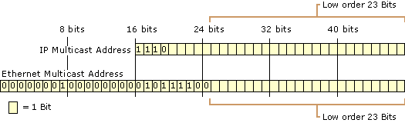
Multicast Addresses
IPv4 multicast addresses
  28bits, 224.0.0.0/4, 224.0.0.0 - 239.255.255.255
Ethernet multicast addresses for IPv4 multicast
  23bits, 01:00:5e:00:00:00–01:00:5e:7f:ff:ff
A 28-bit IPv4 multicast address has to map into a 23-bit Ethernet multicast address.
This is implemented by taking the low-order 23 bits of any IP multicast address to use as its Ethernet multicast address and ignoring the high order 5 bits.
Mapping IPv4 Multicast Addresses to Ethernet multicast MAC Addresses

Slide 51
Multicast Addresses
When a host on an Ethernet joins an IP multicast group, it configures its Ethernet interface to receive any packets with the corresponding Ethernet multicast address.
IP protocol at the receiving host must examine the IP header of any multicast packet to determine whether the packet really belongs to the desired group.
The mismatch of multicast address sizes means that multicast traffic may place a burden on hosts that are not even interested in the group to which the traffic was sent.
In some switched networks (such as switched Ethernet) this problem can be mitigated by schemes wherein the switches recognize unwanted packets and discard them.

Slide 52
Multicast Routing
A router’s unicast forwarding table indicates for any IP address, which link to use to forward the unicast packet
To support multicast, a router must additionally have multicast forwarding table that indicates, based on multicast address, which links to use to forward the multicast packet
Unicast forwarding tables collectively specify a set of paths
Multicast forwarding tables collectively specify a set of trees
  Multicast distribution trees

Slide 53
Multicast Routing
To support source specific multicast, the multicast forwarding tables must indicate which links to use based on the combination of multicast address and the unicast IP address of the source
Multicast routing -- the process of determining multicast distribution trees

Slide 54
Distance-Vector Multicast Routing Protocol (DVMRP)
Support multicast by a two-stage process:
  First, we create a broadcast mechanism that allows a packet to be forwarded to all the networks on the internet.
  Second, we need to refine this mechanism so that it prunes back networks that do not have hosts that belong to the multicast group.
DVMRP is one of several multicast routing protocols described as flood-and-prune protocols.

Slide 55
Distance-Vector Multicast Routing Protocol (DVMRP)
Flood
Each router already knows that shortest path to source S (the reverse path of the multicast packet)
When receive multicast packet from S, forward on all outgoing links (except the one on which the packet arrived), iff packet arrived from the link that is on the shortest path to S.
When a LAN is connected to two or more routers, eliminate duplicate broadcast packets by only allowing “parent router” relative to S to forward
    The router that has the shortest path to source S is selected as the parent router;
    A tie between two routers would be broken according to which router has the smallest address
This is called Reverse Path Broadcast (RPB) or Reverse Path Forwarding (RPF)

Slide 56
Distance-Vector Multicast Routing Protocol (DVMRP)
Reverse Path Broadcast (RPB) or Reverse Path Forwarding (RPF)
S
S
X
X
X
X
X
X
X
X
X
X
X
X
X
X
X
X

Slide 57
Distance-Vector Multicast Routing Protocol (DVMRP)
Prune
Goal: Prune networks that have no hosts in group G
Step 1: Determine of LAN is a leaf with no members in G
  LAN is a leaf if the parent router is the only router on the LAN
  determine if any hosts are members of G using IGMP
Step 2: Propagate “no members of G here” information
  augment <Destination, Cost> update sent to neighbors with set of groups for which this network is interested in receiving multicast packets.
  only happens when multicast address becomes active, i.e., some source starts sending packets to that group.

Slide 58
Distance-Vector Multicast Routing Protocol (DVMRP)
Prune
S
S
Prune message

Slide 59
Protocol Independent Multicast (PIM)
The “protocol independent” aspect of PIM, by the way, refers to the fact that, unlike earlier protocols such as DVMRP, PIM does not depend on any particular sort of unicast routing—it can be used with any unicast routing protocol.
PIM divides the multicast problem space into sparse mode and dense mode, where sparse and dense refer to the proportion of routers that will participate in the multicast.
PIM dense mode (PIM-DM) uses a flood-and-prune algorithm like DVMRP and suffers from the same scalability problem.

Slide 60
Protocol Independent Multicast (PIM)
PIM sparse mode (PIM-SM)
PIM-SM assigns to each group a special router known as the rendezvous point (RP).
A multicast forwarding tree is built as a result of routers sending Join messages to the RP.
PIM-SM allows two types of trees to be constructed:
  a shared tree, which may be used by all senders, and
  a source-specific tree, which may be used only by a specific sending host.
The normal mode of operation creates the shared tree first, followed by one or more source-specific trees if there is enough traffic to warrant it.

Slide 61
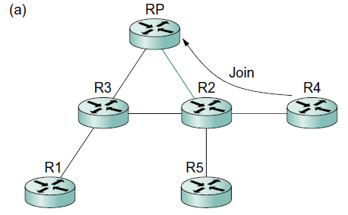
Protocol Independent Multicast (PIM)
PIM sparse mode (PIM-SM)
When a router sends a Join message toward the RP for a group G, it is sent using normal IP unicast transmission.
This is illustrated in Figure 4.14(a), in which router R4 is sending a Join to the rendezvous point for some group.
Eventually, the message arrives at the RP, completing the construction of the tree branch.

Slide 62
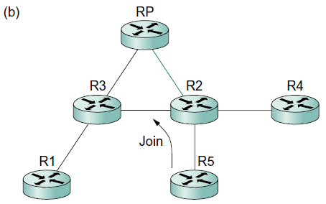
Protocol Independent Multicast (PIM)
PIM sparse mode (PIM-SM)
As more routers send Joins toward the RP, they cause new branches to be added to the tree, as illustrated in Figure 4.14(b).
Note that, in this case, the Join only needs to travel to R2, which can add the new branch to the tree.
R2 need not forward the Join on to the RP.

Slide 63
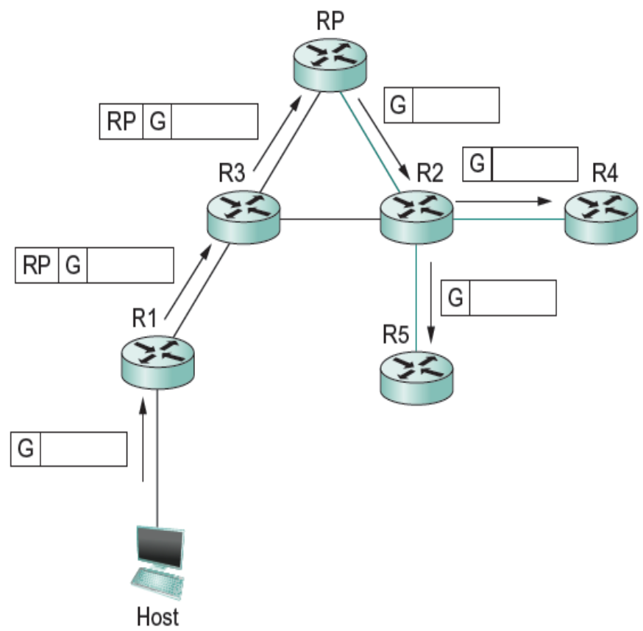
Protocol Independent Multicast (PIM)
PIM sparse mode (PIM-SM)
At this point, suppose a host wishes to send a message to the group
It sends the message to a router on its local network known as the designated router (DR).
Suppose the DR is R1.
R1 tunnels the message to the RP
The RP sends the message out onto the shared tree.

Slide 64
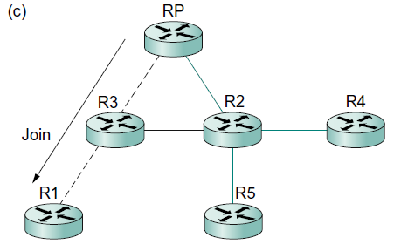
Protocol Independent Multicast (PIM)
PIM sparse mode (PIM-SM)
However, there is some bandwidth inefficiency and processing cost in the encapsulation and decapsulation of packets on the way to the RP
The RP sends a Join message toward the sending host
As this Join travels toward the host, it causes the routers along the path (R3) to learn about the group, so that it will be possible for the DR to send the packet to the group as native (i.e., not tunneled) multicast packets.
Sheared tree
Source-specific tree for source R1

Slide 65
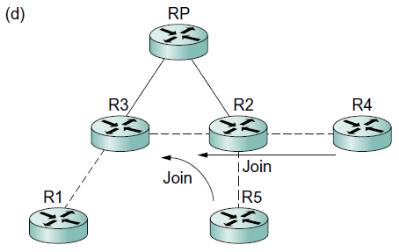
Protocol Independent Multicast (PIM)
PIM sparse mode (PIM-SM)
The path from sender to receiver via the RP might be significantly longer than the shortest possible path.
The next possible optimization is to replace the entire shared tree with a source-specific tree.
The router at the downstream end of the tree — say, R4 , R5, in our example—sends a source-specific Join toward the source.
As it follows the shortest path toward the source, the routers along the way create state for this tree, and the result is a tree that has its root at the source.
Source-specific tree for source R1

Slide 66
Protocol Independent Multicast (PIM)
PIM sparse mode (PIM-SM)
All of its mechanisms for building and maintaining trees take advantage of unicast routing without depending on any particular unicast routing protocol.
The formation of trees is entirely determined by the paths that Join messages follow, which is determined by the choice of shortest paths made by unicast routing.
The shared tree is certainly more scalable than a source-specific tree, in the sense that it reduces the total state in routers to be on the order of the number of groups rather than the number of senders times the number of groups.
The source-specific tree is likely to be necessary to achieve efficient routing and effective use of link bandwidth.

Slide 67
Inter-domain Multicast
Multicast Source Discovery Protocol (MSDP)
The PIM-SM protocol is typically not used across domains, only within a domain.
To extend multicast across domains using PIM-SM, the Multicast Source Discovery Protocol (MSDP) was devised.
MSDP is used to connect different domains — each running PIM-SM internally, with its own RPs — by connecting the RPs of the different domains.
Each RP has one or more MSDP peer RPs in other domains.
Each pair of MSDP peers is connected by a TCP connection over which the MSDP protocol runs.
Together, all the MSDP peers form a given multicast group form a loose mesh that is used as a broadcast network.
MSDP messages are broadcast through the mesh of peer RPs using the Reverse Path Broadcast algorithm.

Slide 68
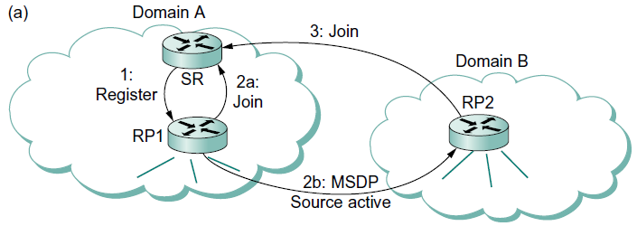
Inter-domain Multicast
Multicast Source Discovery Protocol (MSDP)
Each RP knows the sources in its own domain because it receives a Register message whenever a new source arises.
Each RP periodically uses MSDP to broadcast Source Active messages to its peers, giving the IP address of the source, the multicast group address, and the IP address of the originating RP.
If an MSDP peer RP that receives one of these Source Active messages has active receivers for that multicast group, it sends a source-specific Join to the source host.

Slide 69
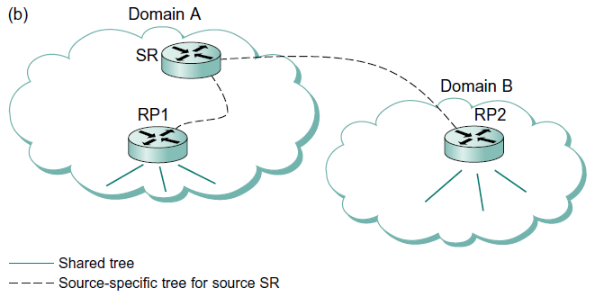
Inter-domain Multicast
Multicast Source Discovery Protocol (MSDP)
The Join message builds a branch of the source-specific tree to this RP.

Slide 70
Source-Specific Multicast (PIM-SSM)
PIM-SSM introduces a new concept, the channel, which is the combination of a source address S and a group address G.
To use PIM-SSM, a host specifies both the group and the source in an IGMP Membership Report message to its local router.
That router then sends a PIM-SM source-specific Join message toward the source, thereby adding a branch to itself in the source-specific tree
No need to build a shared tree

Slide 71
Source-Specific Multicast (PIM-SSM)
PIM-SSM has provided some significant benefits, particularly since there is relatively high demand for one-to-many multicasting:
  The address of a channel is effectively a multicast group address plus a source address. Therefore, multiple domains can use the same multicast group address independently and without conflict, as long as they use it only with sources in their own domains.
  Because only the specified source can send to an SSM group, there is less risk of attacks based on malicious hosts overwhelming the routers or receivers with bogus multicast traffic.
  PIM-SSM can be used across domains exactly as it is used within a domain, without reliance on anything like MSDP.

Slide 72
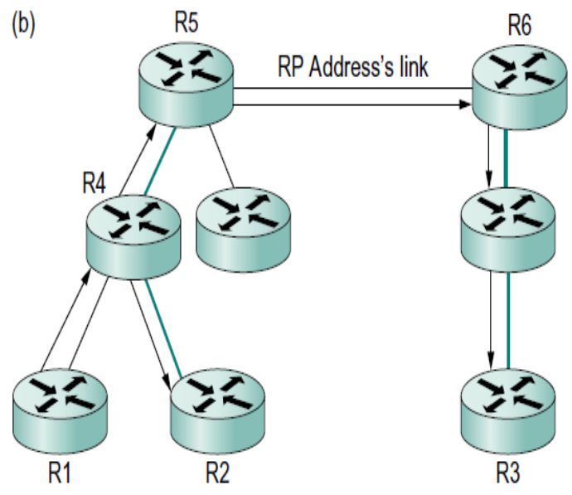
Bidirectional Trees (BIDIR-PIM)
BIDIR-PIM is a variant of PIM-SM that is well suited to many-to-many multicasting within a domain, especially when senders and receivers to a group may be the same, as in a multiparty videoconference, for example.
The shared tree also has branches to the sources.
BIDIR-PIM’s trees are bidirectional — a router that receives a multicast packet from a downstream branch can forward it both up the tree and down other branches.
PIM-SM’s trees are unidirectional
R4 forwards a multicast packet downstream to R2 at the same time that it forwards a copy of the same packet upstream to R5.

Slide 73
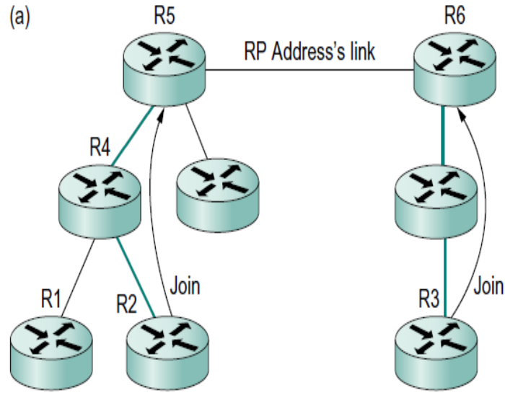
Bidirectional Trees (BIDIR-PIM)
There need not actually be an RP.
All that is needed is a routable address, which is known as an RP address even though it need not be the address of an RP or anything at all.
A Join from a receiver is forwarded toward the RP address until it reaches a router with an interface on the link where the RP address would reside, where the Join terminates.
BIDIR-PIM cannot be used across domains since there is no actual RP.
R2 and R3 send Joins toward the RP address that terminate when they reach a router on the RP address’s link.

Slide 74
Bidirectional Trees (BIDIR-PIM)
BIDIR-PIM has several advantages over PIM-SM for many-to-many multicast within a domain:
  There is no source registration process because the routers already know how to route a multicast packet toward the RP address.
  The routes are more direct than those that use PIM-SM’s shared tree because they go only as far up the tree as necessary, not all the way to the RP.
  Bidirectional trees use much less state than the source-specific trees of PIM-SM because there is never any source-specific state.
  However, the routes will be longer than those of source-specific trees.
  The RP cannot be a bottleneck, and indeed no actual RP is needed.

Slide 75
Multiprotocol Label Switching (MPLS)
MPLS-enabled routers forward packets by examining relatively short, fixed-length labels, and these labels have local scope, just like in a virtual circuit network.
Three main things MPLS is used for:
  To enable IP capabilities on devices that do not have the capability to forward IP datagrams in the normal manner
  To forward IP packets along explicit routes—precalculated routes that don’t necessarily match those that normal IP routing protocols would select
  To support certain types of virtual private network services

Slide 76
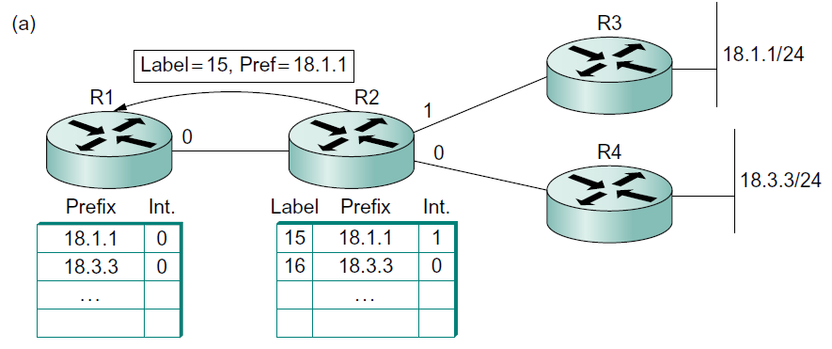
Multiprotocol Label Switching (MPLS)
Destination-Based Forwarding
When MPLS is enabled on a router, the router allocates a label for each prefix in its routing table and advertises both the label and the prefix that it represents to its neighboring routers.
This advertisement is carried in the Label Distribution Protocol.
R2 allocates labels and advertises bindings to R1.

Slide 77
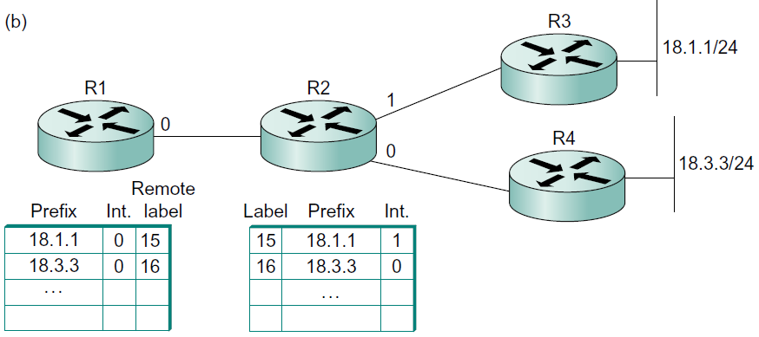
Multiprotocol Label Switching (MPLS)
Destination-Based Forwarding
R1 stores the label in a table alongside the prefix that it represents as the remote or outgoing label for any packets that it sends to that prefix.
R1 stores the received labels in a table.

Slide 78
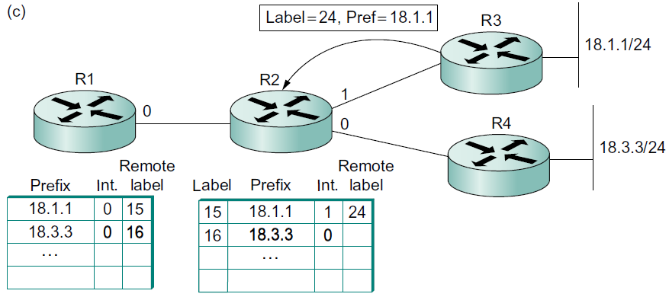
Multiprotocol Label Switching (MPLS)
Destination-Based Forwarding
Another label advertisement from router R3 to R2 for the prefix 18.1.1, and R2 places the remote label that it learned from R3 in the appropriate place in its table.
R3 advertises another binding, and R2 stores the received label in a table.

Slide 79
Multiprotocol Label Switching (MPLS)
Destination-Based Forwarding
Suppose a packet destined to the IP address 18.1.1.5 arrives at router R1. (R1 is referred to as a Label Edge Router (LER))
An LER performs a complete IP lookup on arriving IP packets and then applies labels to them as a result of the lookup.
R1 would see that 18.1.1.5 matches the prefix 18.1.1 in its forwarding table and that this entry contains both an outgoing interface and a remote label value.
R1 attaches the remote label 15 to the packet before sending it.

Slide 80
Multiprotocol Label Switching (MPLS)
Destination-Based Forwarding
When the packet arrives at R2, R2 looks only at the label in the packet, not the IP address.
The forwarding table at R2 indicates that packets arriving with a label value of 15 should be sent out interface 1 and that they should carry the label value 24.
R2 rewrites, or swaps, the label and forwards it on to R3.

Slide 81
Multiprotocol Label Switching (MPLS)
Efficient destination lookup
  The normal IP destination address lookup is replaced by with a label lookup.
  IP destination address lookup algorithm needs to find the longest match
  The label forwarding mechanism just described is an exact match algorithm. It is possible to implement a very simple exact match algorithm
Devices that previously didn’t know how to forward IP packets can be used to forward IP traffic in an MPLS network.

Slide 82
Multiprotocol Label Switching (MPLS)
Explicit Routing
MPLS provides a convenient way to add capabilities similar to source routing to IP networks, although the capability is more often referred to as explicit routing rather than source routing.
One reason for the distinction is that it usually isn’t the real source of the packet that picks the route.
More often it is one of the routers inside a service provider’s network.

Slide 83
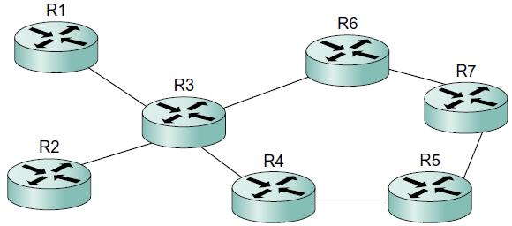
Multiprotocol Label Switching (MPLS)
Explicit Routing
Suppose that the operator of the network in Figure 4.22 has determined that any traffic flowing from R1 to R7 should follow the path R1-R3-R6-R7 and that any traffic going from R2 to R7 should follow the path R2-R3- R4-R5-R7.
One reason for such a choice would be to make good use of the capacity available along the two distinct paths fromR3 to R7.
We can think of the R1-to-R7 traffic as constituting one forwarding equivalence class (FEC), and the R2-to-R7 traffic constitutes a second FEC.
Every MPLS label is associated with a FEC — a set of packets that are to receive the same forwarding treatment in a particular router.

Slide 84
Multiprotocol Label Switching (MPLS)
Explicit Routing
How do all the routers in the network agree on what labels to use and how to forward packets with particular labels?
It is possible to send an RSVP message along an explicitly specified path (e.g., R1-R3-R6-R7) and use it to set up label forwarding table entries all along that path.

Slide 85
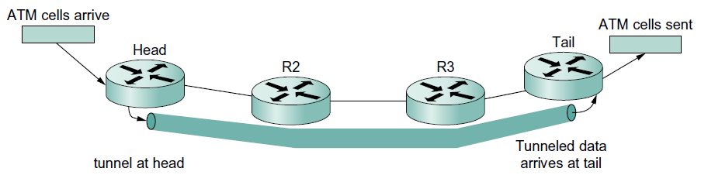
Multiprotocol Label Switching (MPLS)
Virtual Private Networks and Tunnels
MPLS can be thought of as a way to build tunnels, and this makes it suitable for building VPNs of various types.
The simplest form of MPLS VPN to understand is a layer 2 VPN.
In this type of VPN, MPLS is used to tunnel layer 2 data (such as Ethernet frames or ATM cells) across a network of MPLS-enabled routers.
The term for this technique within the IETF is pseudowire emulation.
An ATM circuit is emulated by a tunnel.

Slide 86
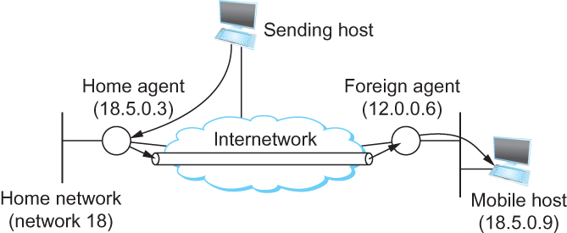
Routing for Mobile Hosts
Mobile IP
  home agent
    Router located on the home network of the mobile hosts
  home address
    The permanent IP address of the mobile host.
    Has a network number equal to that of the home network and thus of the home agent
  foreign agent
    Router located on a network to which the mobile node attaches itself when it is away from its home network

Slide 87
Routing for Mobile Hosts
Mobile IP
Both home and foreign agents periodically announce their presence on the networks to which they are attached using agent advertisement messages.
A mobile host may also solicit an advertisement when it attaches to a new network.
The advertisement by the home agent enables a mobile host to learn the address of its home agent before it leaves its home network.
When the mobile host attaches to a foreign network, it hears an advertisement from a foreign agent and registers with the foreign agent, providing the address of its home agent.
The foreign agent then contacts the home agent, providing a care-of address.
This is usually the IP address of the foreign agent.

Slide 88
Routing for Mobile Hosts
Mobile IP
Any host that tries to send a packet to the mobile host will send it with a destination address equal to the home address of that node.
Normal IP forwarding will cause that packet to arrive on the home network of the mobile node on which the home agent is sitting.
Problem of delivering a packet to the mobile node
  How does the home agent intercept a packet that is destined for the mobile node?
    Proxy ARP
  How does the home agent then deliver the packet to the foreign agent?
    IP tunnel
    Care-of-address
  How does the foreign agent deliver the packet to the mobile node?

Slide 89
Routing for Mobile Hosts
Mobile IP
How does the home agent intercept a packet that is destined for the mobile node?
  The home agent actually impersonates the mobile node, using a technique called proxy ARP.
  The home agent provides its own hardware address in the ARP messages, so that all the nodes on the same network learn to associate the hardware address of the home agent with the IP address of the mobile node.
  One subtle aspect of this process is the fact that ARP information may be cached in other nodes on the network.
  To make sure that these caches are invalidated in a timely way, the home agent issues an ARP message as soon as the mobile node registers with a foreign agent.
  Because the ARP message is not a response to a normal ARP request, it is termed a gratuitous ARP.

Slide 90
Routing for Mobile Hosts
Mobile IP
How does the home agent then deliver the packet to the foreign agent?
  The home agent simply wraps the packet inside an IP header that is destined for the foreign agent and transmits it into the internetwork. (tunneling)
  When a packet finally arrives at the foreign agent, it strips the extra IP header and finds inside an IP packet destined for the home address of the mobile node.
  The foreign agent has to recognize the address as that of a registered mobile node.
  It then delivers the packet to the hardware address of the mobile node (e.g., its Ethernet address), which was learned as part of the registration process.
  It is possible that a mobile node can perform the foreign agent function itself.
    This approach has the desirable feature of allowing mobile nodes to attach to networks that don’t have foreign agent.

Slide 91
Routing for Mobile Hosts
Mobile IP
How does the mobile node deliver a packet to a fixed node?
  The mobile node just puts the IP address of the fixed node in the destination field of its IP packets while putting its permanent address in the source field, and the packets are forwarded to the fixed node using normal means.
If both nodes in a conversation are mobile, then the procedures described above are used in each direction.

Slide 92
Routing for Mobile Hosts
Route optimization in Mobile IP
  The route from the sending node to mobile node can be significantly sub-optimal
  One extreme example
    The mobile node and the sending node are on the same network, but the home network for the mobile node is on the far side of the Internet
      Triangle Routing Problem
  Solution
    When a home agent sees a packet destined for one of the mobile nodes that it supports, it can deduce that the sender is not using the optimal route.
    Home agent sends binding update message to the source, in addition to forwarding the data packet to the foreign agent.
    The sending node creates an entry in the binding cache
    The next time this source has a data packet to send to that mobile node, it will find the binding in the cache and can tunnel the packet directly to the foreign agent.

Slide 93
Routing for Mobile Hosts
Route optimization in Mobile IP
  The binding cache may become out-of-date if he mobile node moved to a different network
    If an out-of-date cache entry is used, the foreign agent will receive tunneled packets for a mobile node that is no longer registered on its network.
    In this case, the foreign agent sends a binding warning message back to the sender to tell it to stop using this cache entry.
    This scheme works only in the case where the foreign agent is not the mobile node itself.
    For this reason, cache entries need to be deleted after some period of time

Slide 94
Summary
# Chapter Subtitle
We have looked at the issues of scalability in routing in the Internet
We have discussed IPV6
We have discussed Multicasting
We have discussed Multiprotocol label switching (MPLS)
We have discussed Mobile IP
Notes:
The University of Adelaide, School of Computer Science
Chapter 2 — Instructions: Language of the Computer

