Slide 1
Chapter 5
End-to-End Protocols
Copyright © 2010, Elsevier Inc. All rights Reserved
Notes:
The University of Adelaide, School of Computer Science
Chapter 2 — Instructions: Language of the Computer

Slide 2
Problem
How to turn this host-to-host packet delivery service into a process-to-process communication channel
Notes:
The University of Adelaide, School of Computer Science
Chapter 2 — Instructions: Language of the Computer

Slide 3
Chapter Outline
Simple Demultiplexer (UDP)
Reliable Byte Stream (TCP)
Notes:
The University of Adelaide, School of Computer Science
Chapter 2 — Instructions: Language of the Computer

Slide 4
Chapter Goal
Understanding the demultipexing service
Discussing simple byte stream protocol
Notes:
The University of Adelaide, School of Computer Science
Chapter 2 — Instructions: Language of the Computer

Slide 5
End-to-end Protocols
Common properties that a transport protocol can be expected to provide
  Guarantees message delivery
  Delivers messages in the same order they were sent
  Delivers at most one copy of each message
  Supports arbitrarily large messages
  Supports synchronization between the sender and the receiver
  Allows the receiver to apply flow control to the sender
  Supports multiple application processes on each host

Slide 6
End-to-end Protocols
Typical limitations of the network on which transport protocol will operate
  Drop messages
  Reorder messages
  Limit messages to some finite size
  Deliver messages after an arbitrarily long delay

Slide 7
End-to-end Protocols
Challenge for Transport Protocols
  Develop algorithms that turn the less-than-desirable properties of the underlying network into the high level of service required by application programs

Slide 8
Simple Demultiplexer (UDP)
Extends host-to-host delivery service of the underlying network into a process-to-process communication service
Adds a level of demultiplexing which allows multiple application processes on each host to share the network

Slide 9
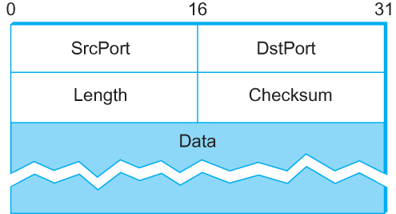
Simple Demultiplexer (UDP)
Source port, destination port: 16 bits, identify a process at the host
Length: the length in bytes of the UDP header and UDP data
Checksum: calculated over
  the UDP header and data
  the pseudoheader: 3 fields from IP header (protocol number, source IP address, and destination IP address) plus the UDP length field.
Format for UDP header

Slide 10
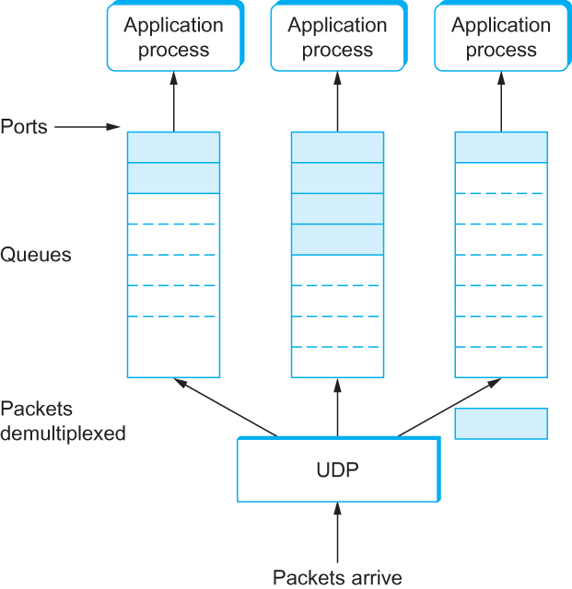
Simple Demultiplexer (UDP)
UDP Message Queue

Slide 11
Reliable Byte Stream (TCP)
In contrast to UDP, Transmission Control Protocol (TCP) offers the following services
  Reliable
  Connection oriented
  Byte-stream service
  Flow control
  Congestion control

Slide 12
Flow control VS Congestion control
Flow control involves preventing senders from overrunning the capacity of the receivers
Congestion control involves preventing too much data from being injected into the network, thereby causing switches or links to become overloaded

Slide 13
End-to-end Issues
At the heart of TCP is the sliding window algorithm (discussed in Chapter 2)
As TCP runs over the Internet rather than a point-to-point link, the following issues need to be addressed by the sliding window algorithm
  TCP supports logical connections between processes that are running on two different computers in the Internet
  TCP connections are likely to have widely different RTT times
  Packets may get reordered in the Internet

Slide 14
End-to-end Issues
  TCP needs a mechanism using which sending side of a connection will learn what resources the receiving side is able to apply to the connection
  TCP needs a mechanism using which the sending side will learn the capacity of the network

Slide 15
TCP Segment
TCP is a byte-oriented protocol, which means that the sender writes bytes into a TCP connection and the receiver reads bytes out of the TCP connection.
Although “byte stream” describes the service TCP offers to application processes, TCP does not, itself, transmit individual bytes over the Internet.

Slide 16
TCP Segment
TCP on the source host buffers enough bytes from the sending process to fill a reasonably sized packet and then sends this packet to its peer on the destination host.
TCP on the destination host then empties the contents of the packet into a receive buffer, and the receiving process reads from this buffer at its leisure.
The packets exchanged between TCP peers are called segments.

Slide 17
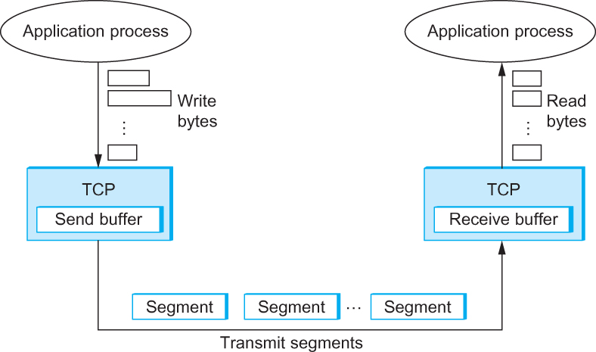
TCP Segment
How TCP manages a byte stream.

Slide 18
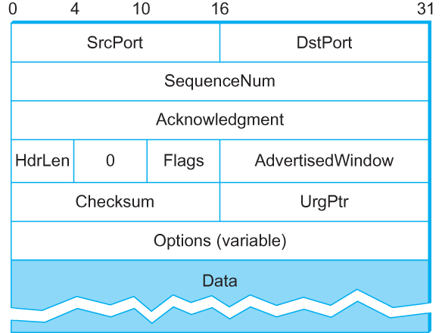
TCP Header
TCP Header Format

Slide 19
TCP Header
The SrcPort and DstPort fields identify the source and destination ports, respectively.
The Acknowledgment, SequenceNum, and AdvertisedWindow fields are all involved in TCP’s sliding window algorithm.
Because TCP is a byte-oriented protocol, each byte of data has a sequence number; the SequenceNum field contains the sequence number for the first byte of data carried in that segment.
The Acknowledgment field contains next sequence number that the sending side is expecting
AdvertisedWindow field specifies the number of bytes that the sender of this segment is currently willing to receive

Slide 20
TCP Header
Hdrlen – the length of the header in 32-bit words
The 6-bit Flags field is used to relay control information between TCP peers.
The possible flags include SYN, FIN, RESET, PUSH, URG, and ACK.
The SYN and FIN flags are used when establishing and terminating a TCP connection, respectively.
The ACK flag is set any time the Acknowledgment field is valid, implying that the receiver should pay attention to it.

Slide 21
TCP Header
The URG flag signifies that this segment contains urgent data. When this flag is set, the UrgPtr field is an offset from the sequence number indicating the last urgent data byte.
The urgent data is contained at the front of the segment body, up to and including a value of UrgPtr bytes into the segment.
The PUSH flag signifies that the sender invoked the push operation, which indicates to the receiving side of TCP that it should notify the receiving process of this fact.

Slide 22
TCP Header
The RESET flag signifies that the receiver has become confused, it received a segment it did not expect to receive—and so wants to abort the connection.
Finally, the Checksum field is used in exactly the same way as for UDP — it is computed over the TCP header, the TCP data, and the pseudoheader,
  The pseudoheader is made up of
    the source IP address, destination IP address, and protocol number from the IP header, plus
    the TCP length (header and data)

Slide 23
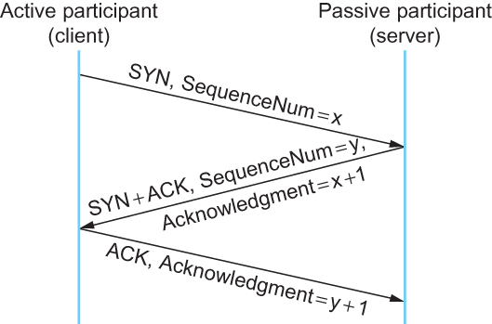
Connection Establishment/Termination in TCP
Connection establishment
Timeline for three-way handshake algorithm

Slide 24
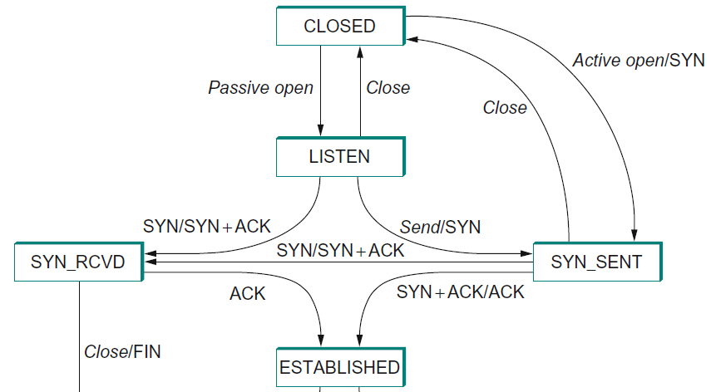
Connection Establishment/Termination in TCP
TCP state-transition diagram for establishing connection
2
1
3
5
4
The server first invokes a passive open operation on TCP, which causes TCP to move to the LISTEN state.
The client does an active open, which causes its end of the connection to send a SYN segment to the server and to move to the SYN SENT state.

Slide 25
Connection Establishment/Termination in TCP
TCP state-transition diagram for establishing connection
2
1
3
5
4
When the SYN segment arrives at the server, it moves to the SYN RCVD state and responds with a SYN+ACK segment.
The arrival of this SYN+ACK segment causes the client to move to the ESTABLISHED state and to send an ACK back to the server.
When client’s ACK arrives, the server finally moves to the ESTABLISHED state.

Slide 26
Connection Establishment/Termination in TCP
TCP state-transition diagram for establishing connection
2
1
Established
3
X
Established
5
4
If the client’s ACK to the server is lost, the connection still functions correctly since the client side is already in the ESTABLISHED state.
The client application process can start sending data to the server.
Each of these data segments will have the ACK flag set, and the correct value in the Acknowledgment field.
The server will move to the ESTABLISHED state when the first data segment arrives.

Slide 27
Connection Establishment/Termination in TCP
TCP state-transition diagram for establishing connection
2
1
2’
3
3’
5
4
2’) It is possible for the server to send a SYN to the client and enter the SYN_SENT state
3’) When the client receives the SYN, it responses with a SYN+ACK and enters the SYN_RCVD state

Slide 28
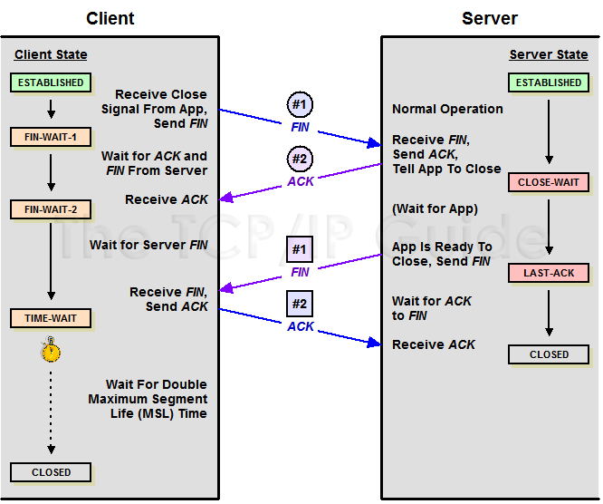
Connection Establishment/Termination in TCP
TCP state-transition diagram for closing connection
This side closes first: ESTABLISHED
→FIN WAIT 1
→FIN WAIT 2
→TIME WAIT
→CLOSED.
The other side replies with a FIN & ACK and this side replies with an ACK.

Slide 29
Connection Establishment/Termination in TCP
TCP state-transition diagram for closing connection
The other side closes first:
ESTABLISHED
→CLOSE WAIT
→LAST ACK
→CLOSED.

Slide 30
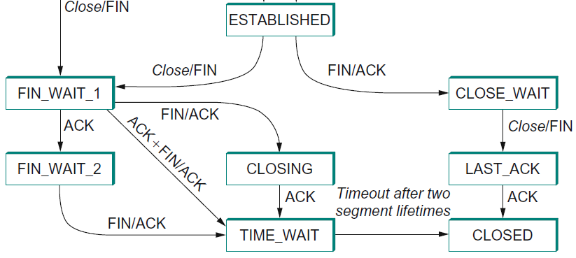
Connection Establishment/Termination in TCP
TCP state-transition diagram for closing connection
Both sides close at the same time:
ESTABLISHED
→FIN WAIT 1
→CLOSING
→TIME WAIT
→CLOSED.

Slide 31
Connection Establishment/Termination in TCP
TCP state-transition diagram for closing connection
TIME_WAIT
The reason for waiting for two times the maximum amount of time an IP datagram might live in the Internet (i.e., 120 seconds):
  Local side of the connection has sent an ACK in response to the other side’s FIN segment, it does not know that the ACK was successfully delivered (the ACK might be lost).
  The other side might retransmit its FIN segment, and this second FIN segment might be delayed in the network.
  If the connection were allowed to move directly to the CLOSED state, then
  another pair of application processes might come along and open the same connection (i.e., use the same pair of port numbers), and
  the delayed FIN segment from the earlier incarnation of the connection would immediately initiate the termination of the later incarnation of that connection.

Slide 32
Sliding Window Revisited
TCP’s variant of the sliding window algorithm, which serves several purposes:
  (1) it guarantees the reliable delivery of data,
  (2) it ensures that data is delivered in order, and
  (3) it enforces flow control between the sender and the receiver.
  (4) it regulates the rate at which the sender send data to the receiver according the condition of the network (congestion control)

Slide 33
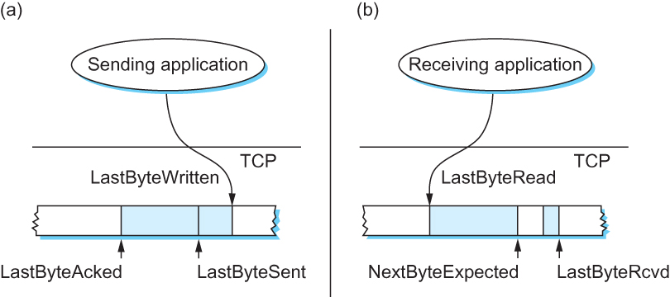
Sliding Window Revisited
Relationship between TCP send buffer (a) and receive buffer (b).
Sending Side
  LastByteAcked ≤ LastByteSent
  LastByteSent ≤ LastByteWritten
Receiving Side
  LastByteRead < NextByteExpected
  NextByteExpected ≤ LastByteRcvd + 1

Slide 34
TCP Flow Control
Send buffer
Receive buffer
LastByteRcvd − LastByteRead ≤ MaxRcvBuffer
AdvertisedWindow = MaxRcvBuffer − ((NextByteExpected − 1) − LastByteRead)
LastByteSent − LastByteAcked ≤ AdvertisedWindow
EffectiveWindow = AdvertisedWindow − (LastByteSent − LastByteAcked)
LastByteWritten − LastByteAcked ≤ MaxSendBuffer
receiver
sender

Slide 35
TCP Flow Control
Send buffer
Receive buffer
If the sending process tries to write y bytes to TCP, but
(LastByteWritten − LastByteAcked) + y > MaxSendBuffer
then TCP blocks the sending process and does not allow it to generate more data.

Slide 36
Protecting against Wraparound
SequenceNum: 32 bits longs
AdvertisedWindow: 16 bits long
  TCP has satisfied the requirement of the sliding window algorithm that is the sequence number space be twice as big as the window size
  2³² >> 2 × 2¹⁶

Slide 37
Protecting against Wraparound
Relevance of the 32-bit sequence number space
  The sequence number used on a given connection might wraparound
  A byte with sequence number x could be sent at one time, and then at a later time a second byte with the same sequence number x could be sent
  Packets cannot survive in the Internet for longer than the Maximum Segment Lifetime (MSL)
  MSL is set to 120 sec
  We need to make sure that the sequence number does not wrap around within a 120-second period of time
  Depends on how fast data can be transmitted over the Internet

Slide 38
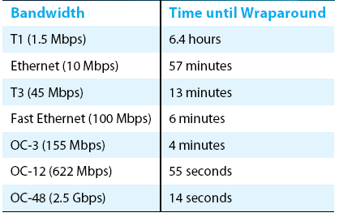
Protecting against Wraparound
Time until 32-bit sequence number space wraps around.

Slide 39
Keeping the Pipe Full
16-bit AdvertisedWindow field must be big enough to allow the sender to keep the pipe full
Clearly the receiver is free not to open the window as large as the AdvertisedWindow field allows
If the receiver has enough buffer space
  The window needs to be opened far enough to allow a full
  delay × bandwidth product’s worth of data
  Assuming an RTT of 100 ms

Slide 40
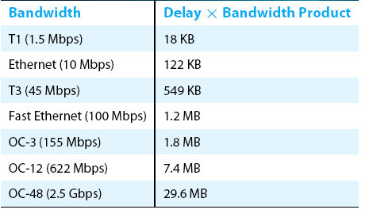
Keeping the Pipe Full
Required window size for 100-ms RTT.

Slide 41
Triggering Transmission
How does TCP decide to transmit a segment?
  TCP supports a byte stream abstraction
  Application programs write bytes into streams
  It is up to TCP to decide that it has enough bytes to send a segment

Slide 42
Triggering Transmission
What factors governs this decision
  Ignore flow control: window is wide open, as would be the case when the connection starts
  TCP has three mechanism to trigger the transmission of a segment
    1) TCP maintains a variable MSS and sends a segment as soon as it has collected MSS bytes from the sending process
      MSS is usually set to the size of the largest segment TCP can send without causing local IP to fragment.
      MSS: MTU of directly connected network – (TCP header + and IP header)
    2) Sending process has explicitly asked TCP to send it
      TCP supports push operation
    3) When a timer fires
      Resulting segment contains as many bytes as are currently buffered for transmission

Slide 43
Silly Window Syndrome
If you think of a TCP stream as a conveyer belt with “full” containers (data segments) going in one direction and empty containers (ACKs) going in the reverse direction, then MSS-sized segments correspond to large containers and 1-byte segments correspond to very small containers.
If the sender aggressively fills an empty container as soon as it arrives, then any small container introduced into the system remains in the system indefinitely.
That is, it is immediately filled and emptied at each end, and never coalesced with adjacent containers to create larger containers.

Slide 44
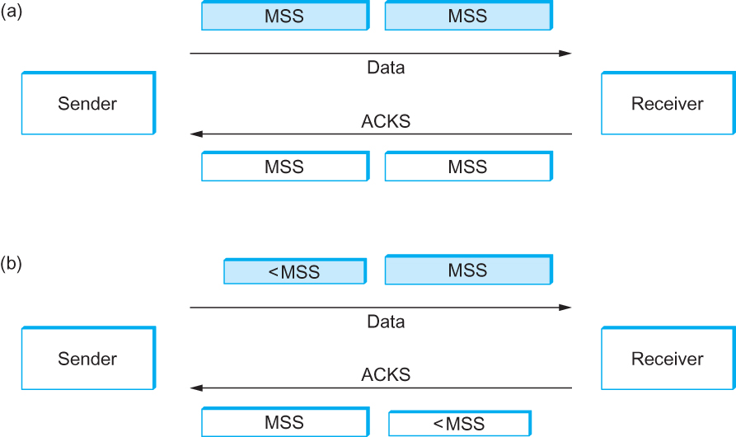
Silly Window Syndrome
Silly Window Syndrome

Slide 45
Nagle’s Algorithm
If there is data to send but the window is open less than MSS, then we may want to wait some amount of time before sending the available data
But how long?
If we wait too long, then we hurt interactive applications like Telnet
If we don’t wait long enough, then we risk sending a bunch of tiny packets and falling into the silly window syndrome
  The solution is to introduce a timer and to transmit when the timer expires

Slide 46
Nagle’s Algorithm
We could use a clock-based timer, for example one that fires every 100 ms
Nagle introduced an elegant self-clocking solution
Key Idea
  As long as TCP has any data in flight, the sender will eventually receive an ACK
  This ACK can be treated like a timer firing, triggering the transmission of more data

Slide 47
Nagle’s Algorithm
When the application produces data to send
if both the available data and the window ≥ MSS
send a full segment
else
if there is unACKed data in flight
buffer the new data until an ACK arrives
else
send all the new data now

Slide 48
Adaptive Retransmission
How does TCP choose timeout value for retransmission?
Original Algorithm
  Measure SampleRTT for each segment/ACK pair
  Compute weighted average of RTT
    EstRTT = α x EstRTT + (1 - α )x SampleRTT
    α between 0.8 and 0.9
  Set timeout based on EstRTT
    TimeOut = 2 x EstRTT

Slide 49
Original Algorithm
Problem
  When a segment is retransmitted and then an ACK arrives at the sender
    It is impossible to decide if this ACK should be associated with the first or the second transmission for calculating RTTs

Slide 50
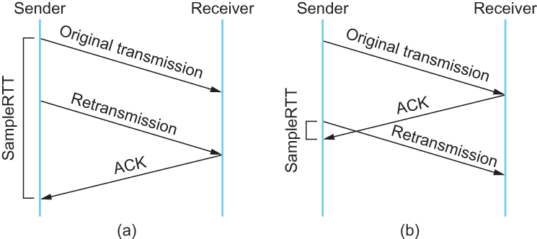
Karn/Partridge Algorithm
Associating the ACK with (a) original transmission versus (b) retransmission

Slide 51
Karn/Partridge Algorithm
Do not sample RTT when retransmitting
  Only measures SampleRTT for segments that have been sent only once
Double timeout after each retransmission

Slide 52
Karn/Partridge Algorithm
Karn-Partridge algorithm was an improvement over the original approach, but it does not eliminate congestion
We need to understand how timeout is related to congestion
  If you timeout too soon, you may unnecessarily retransmit a segment which adds load to the network

Slide 53
Karn/Partridge Algorithm
Main problem with the original computation is that it does not take variance of Sample RTTs into consideration.
If the variance among Sample RTTs is small
  Then the Estimated RTT can be better trusted
  There is no need to multiply this by 2 to compute the timeout

Slide 54
Karn/Partridge Algorithm
On the other hand, a large variance in the samples suggest that timeout value should not be tightly coupled to the Estimated RTT
Jacobson/Karels proposed a new scheme for TCP retransmission

Slide 55
Jacobson/Karels Algorithm
EstimatedRTT = (1-α) EstimatedRTT + α × SampleRTT
Deviation = (1-β) Deviation +
β × | EstimatedRTT – SampleRTT |
α = 0.125, β = 0.25
TimeOut = EstimatedRTT + 4 × Deviation
  Thus, when the variance is small, TimeOut is close to EstimatedRTT; a large variance causes the deviation term to dominate the calculation.

Slide 56
Record Boundaries
TCP is a byte-stream protocol, it has two features that can be used by the sender to insert record boundaries into the byte stream
  URG flag and the UrgPtr field in the TCP header
    Over time, this feature has not been used, so instead of signifying “urgent” data,
    it has come to be used to signify “special” data, such as a record marker.
  The push operation
    the push operation can be used to break the TCP stream into records.
The application program is always free to insert record boundaries without any assistance from TCP.
  The application can use a field to indicate the length of a record that is to follow
  The application insert its own record boundary markers into the data stream

Slide 57
TCP Extensions
Improve TCP’s timeout mechanism
On typical Unix implementations at the time, the clock granularity was as large as 500 ms, which is significantly larger than the average cross-country RTT of somewhere between 100 and 200 ms.
Instead of measuring the RTT using a coarse-grained event, TCP can read the actual system clock when it is about to send a segment, and
put this time in the segment’s header.
The receiver echoes this timestamp back to the sender in its acknowledgment, and
the sender subtracts this timestamp from the current time to measure the RTT.

Slide 58
TCP Extensions
Solve the problem of TCP’s 32-bit Sequence-Num field wrapping around too soon on a high-speed network.
TCP decides whether to accept or reject a segment based on a 64-bit identifier that has the SequenceNum field in the low-order 32 bits and the timestamp in the high-order 32 bits.
Since the timestamp is always increasing, it serves to distinguish between two different incarnations of the same sequence number.
Note that the timestamp is being used in this setting only to protect against wraparound;
Timestamp is not treated as part of the sequence number for the purpose of ordering or acknowledging data.

Slide 59
TCP Extensions
Allows TCP to advertise a larger window, thereby allowing it to fill larger (delay × bandwidth) pipes that are made possible by high-speed networks.
an option that defines a scaling factor for the advertised window.
this option allows the two sides of TCP to agree that the AdvertisedWindow field counts larger chunks (e.g., how many 16-byte units of data the sender can have unacknowledged).
In other words, the window scaling option specifies how many bits each side should left-shift the AdvertisedWindow field before using its contents to compute an effective window.

Slide 60
TCP Extensions
selective acknowledgment, or SACK, option
Allows TCP to augment its cumulative acknowledgment with selective acknowledgments of any additional segments that have been received but aren’t contiguous with all previously received segments.
When the SACK option is used, the receiver continues to acknowledge segments normally — the meaning of the Acknowledge field does not change — but
it also uses optional fields in the header to acknowledge any additional blocks of received data.
This allows the sender to retransmit just the segments that are missing according to the selective acknowledgment.

Slide 61
Remote Procedure Call (Skip)

Slide 62
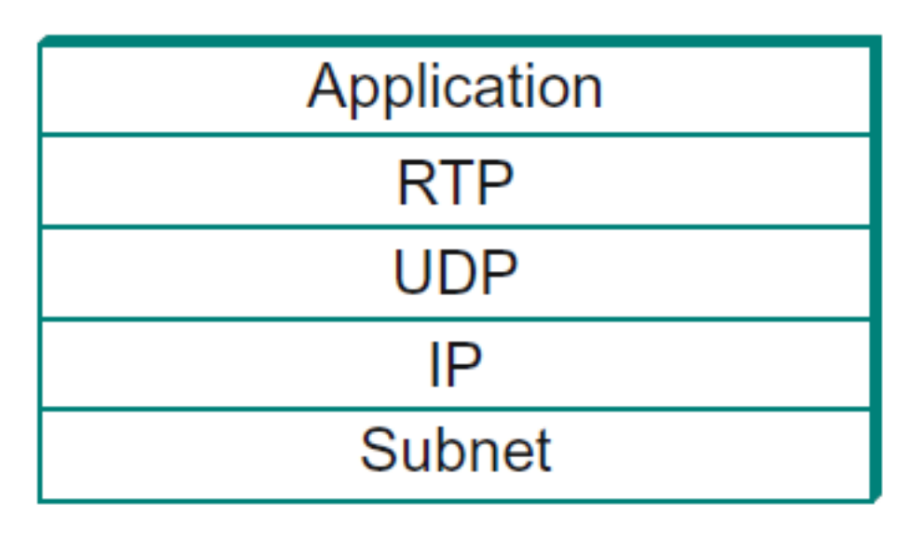
Transport for Real-Time Applications (RTP)
Real-time applications -- strong requirements for the timely delivery of information, e.g., Voice over IP (VoIP)
Real-time Transport Protocol (RTP) can run over many lower-layer protocols, but still commonly runs over UDP.

Slide 63
Transport for Real-Time Applications (RTP)
Requirements for a general-purpose multimedia protocol
  The ability to communicate choice of coding scheme
  Enable the recipient of a data stream to determine the timing relationship among the received data
  Synchronization of multiple media in a conference
  Provide an indication of packet loss -- the receiver needs to notify the sender that losses are occurring so that the sender can adjust its coding parameters.
  Frame boundary indication -- A frame in this context is application specific.
    For example, it may be helpful to notify a video application that a certain set of packets correspond to a single frame.
    In an audio application it is helpful to mark the beginning of a “talkspurt,” which is a collection of sounds or words followed by silence.
  Support the association of a display string with a data stream
  Make efficient use of bandwidth -- keep the header short

Slide 64
Transport for Real-Time Applications (RTP)
RTP Design
RTP includes a pair of protocols, RTP and the Real-time Transport Control Protocol (RTCP)
RTP is used for the exchange of multimedia data
RTCP is used to periodically send control information associated with a certain data flow
The RTP data stream and the associated RTCP control stream use consecutive transport-layer ports.
The RTP data uses an even port number and the RTCP control information uses the next higher (odd) port number.

Slide 65
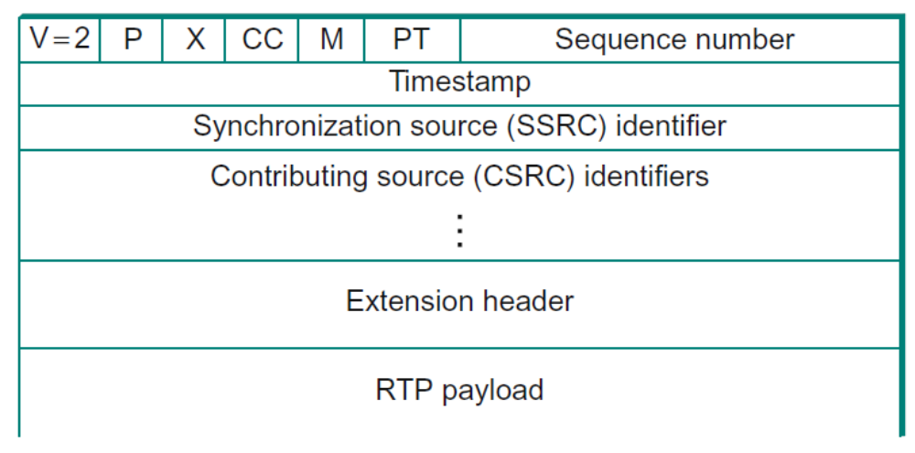
Transport for Real-Time Applications (RTP)
RTP Design -- RTP header format
  Two bits version identifier -- the version is 2
  One padding (P) bit, which is set in circumstances in which the RTP payload has been padded for some reason.
    RTP data might be padded to fill up a block of a certain size as required by an encryption algorithm
  The extension (X) bit is used to indicate the presence of an extension header -- rarely used, since it is generally possible to define a payload-specific header as part of the payload format definition for a particular application.
  4-bit CC field -- counts the number of contributing sources,

Slide 66
Transport for Real-Time Applications (RTP)
RTP Design -- RTP header format
  The marker (M) bit – used for frame indication
  7-bit payload type field -- indicates what type of multimedia data is carried in this packet
    One possible use of this field would be to enable an application to switch from one coding scheme to another based on information about resource availability in the network or feedback on application quality.
    The exact usage of the payload type is also determined by the application profile.

Slide 67
Transport for Real-Time Applications (RTP)
RTP Design -- RTP header format
  The sequence number is used to enable the receiver of an RTP stream to detect missing and misordered packets.
    Note that RTP does not do anything when it detects a lost packet
    It is left to the application to decide what to do when a packet is lost because this decision is likely to be highly application dependent.

Slide 68
Transport for Real-Time Applications (RTP)
RTP Design -- RTP header format
  The timestamp field is used to enable the receiver to play back samples at the appropriate intervals and to enable different media streams to be synchronized.
    RTP itself does not specify the units in which time is measured.
    The timestamp is just a counter of “ticks,” where the time between ticks is dependent on the encoding in use.
    The clock granularity is one of the details that is specified in the RTP profile or payload format for an application.
    The timestamp value in the packet is a number representing the time at which the first sample in the packet was generated

Slide 69
Transport for Real-Time Applications (RTP)
RTP Design -- RTP header format
  The synchronization source (SSRC) is a 32-bit number that uniquely identifies a single source of an RTP stream.
  The contributing source (CSRC) is used only when a number of RTP streams pass through a mixer.
    A mixer can be used to reduce the bandwidth requirements for a conference by receiving data from many sources and sending it as a single stream.
    In this case, the mixer lists itself as the synchronization source but also lists the contributing sources — the SSRC values of the speakers who contributed to the packet in question.

Slide 70
Transport for Real-Time Applications (RTP)
RTP Design – Real-time Transport Control Protocol (RTCP)
Provides three main functions:
  Feedback on the performance of the application and the network
    For examples, send a higher-quality stream when there is little congestion, diagnose network problems.
  A way to correlate and synchronize different media streams that have come from the same sender
  A way to convey the identity of a sender for display on a user interface
Intermedia synchronization
  Different streams may have completely different clocks (with different granularities and even different amounts of inaccuracy, or drift), there needs to be a way to accurately synchronize streams with each other.
  RTCP addresses this problem by conveying timing information that correlates actual time of day with the clock-rate dependent timestamps

Slide 71
Transport for Real-Time Applications (RTP)
RTP Design – Real-time Transport Control Protocol (RTCP)
RTCP defines a number of different packet types:
  Sender reports, which enable active senders to a session to report transmission statistics
  Receiver reports, which receivers who are not senders use to report reception statistics
  Source descriptions, which carry CNAMEs and other sender description information
  Application-specific control packets
Several RTCP packets can be packed into a single lower-level protocol, typically the PDU.
It is required that at least two RTCP packets are sent in every lower-level PDU:
  One of these is a report packet;
  the other is a source description packet.
Other packets may be included up to the size limits imposed by the lower-layer protocols.

Slide 72
Transport for Real-Time Applications (RTP)
RTP Design – Real-time Transport Control Protocol (RTCP)
Limit the amount of control RTCP traffic
  There is a potential problem with every member of a multicast group sending periodic control traffic.
  This control traffic has the potential to be a significant consumer of bandwidth.
  RTCP has a set of mechanisms by which the participants scale back their reporting frequency as the number of participants increases.
  The basic goal is this: Limit the total amount of RTCP traffic to a small percentage (typically 5%) of the RTP data traffic.

Slide 73
Transport for Real-Time Applications (RTP)
RTP Design – Real-time Transport Control Protocol (RTCP)
Sender reports and receiver reports differ only in that the former include some extra information about the sender.
The extra information in a sender report consists of
  A timestamp containing the actual time of day when this report was generated
  The RTP timestamp corresponding to the time when the report was generated
  Cumulative counts of the packets and bytes sent by this sender since it began transmission
The first two quantities can be used to enable synchronization of different media streams from the same source

Slide 74
Summary
We have discussed how to convert host-to-host packet delivery service to process-to-process communication channel.
We have discussed UDP
We have discussed TCP
We have discussed Real-time Transport Protocol (RTP)

