Slide 1
Chapter 6
Congestion Control and Resource Allocation
Copyright © 2010, Elsevier Inc. All rights Reserved
Notes:
The University of Adelaide, School of Computer Science
Chapter 2 — Instructions: Language of the Computer

Slide 2
Problem
We have seen enough layers of protocol hierarchy to understand how data can be transferred among processes across heterogeneous networks
Problem
  How to effectively and fairly allocate resources among a collection of competing users?
Notes:
The University of Adelaide, School of Computer Science
Chapter 2 — Instructions: Language of the Computer

Slide 3
Chapter Outline
Issues in Resource Allocation
Queuing Disciplines
TCP Congestion Control
Congestion Avoidance Mechanism
Quality of Service
Notes:
The University of Adelaide, School of Computer Science
Chapter 2 — Instructions: Language of the Computer

Slide 4
Congestion Control and Resource Allocation
Resources
  Bandwidth of the links
  Buffers at the routers and switches
Packets contend at a router for the use of a link, with each contending packet placed in a queue waiting for its turn to be transmitted over the link

Slide 5
Congestion Control and Resource Allocation
When too many packets are contending for the same link
  The queue overflows
  Packets get dropped
    Network is congested!
Network should provide a congestion control mechanism to deal with such a situation

Slide 6
Congestion Control and Resource Allocation
Congestion control and Resource Allocation
  Two sides of the same coin
If the network takes active role in allocating resources
  The congestion may be avoided
  No need for congestion control

Slide 7
Congestion Control and Resource Allocation
Allocating resources with any precision is difficult
  Resources are distributed throughout the network
On the other hand, we can always let the sources send as much data as they want
  Then recover from the congestion when it occurs
  Easier approach but it can be disruptive because many packets may be discarded by the network before congestions can be controlled

Slide 8
Congestion Control and Resource Allocation
Congestion control and resource allocations involve both hosts and network elements such as routers
In network elements
  Various queuing disciplines can be used to control the order in which packets get transmitted and which packets get dropped
At the hosts
  The congestion control mechanism paces how fast sources are allowed to send packets

Slide 9
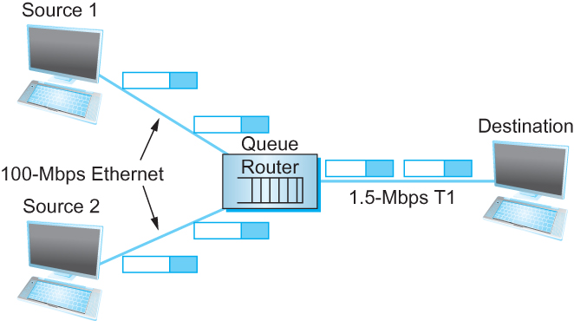
Issues in Resource Allocation
Network Model
  Packet Switched Network
    In such an environment, a given source may have more than enough capacity on the immediate outgoing link to send a packet, but somewhere in the middle of a network, its packets encounter a link that is being used by many different traffic sources
A potential bottleneck router.
Notes:
The University of Adelaide, School of Computer Science
Chapter 2 — Instructions: Language of the Computer

Slide 10
Issues in Resource Allocation
Network Model
  Connectionless Flows
    For much of our discussion, we assume that the network is essentially connectionless, with any connection-oriented service implemented in the transport protocol that is running on the end hosts.
    a flow — a sequence of packets sent between a source/destination pair and following the same route through the network
Notes:
The University of Adelaide, School of Computer Science
Chapter 2 — Instructions: Language of the Computer

Slide 11
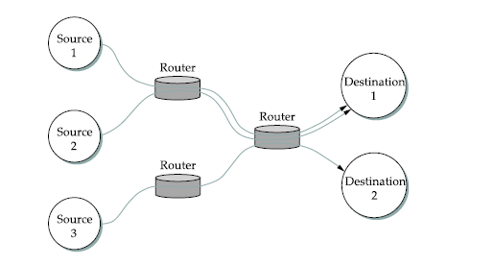
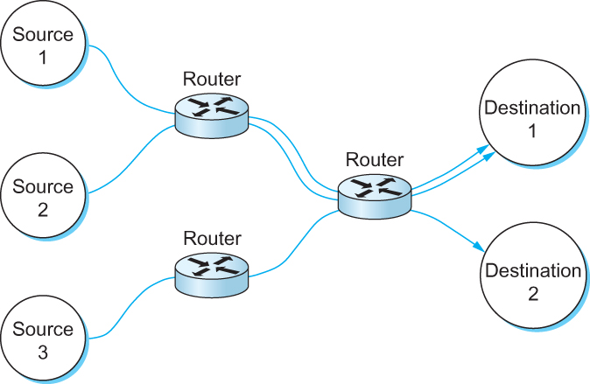
Issues in Resource Allocation
Network Model
  Connectionless Flows
Multiple flows passing through a set of routers
Notes:
The University of Adelaide, School of Computer Science
Chapter 2 — Instructions: Language of the Computer

Slide 12
Issues in Resource Allocation
Three ways for classifying resource allocation mechanisms
Router-centric versus Host-centric
    In a router-centric design, each router takes responsibility for deciding when packets are forwarded and selecting which packets are to dropped, as well as for informing the hosts that are generating the network traffic how many packets they are allowed to send.
    In a host-centric design, the end hosts observe the network conditions (e.g., how many packets they are successfully getting through the network) and adjust their behavior accordingly.
    Note that these two groups are not mutually exclusive.
Notes:
The University of Adelaide, School of Computer Science
Chapter 2 — Instructions: Language of the Computer

Slide 13
Issues in Resource Allocation
Reservation-based versus Feedback-based
  In a reservation-based system, some entity (e.g., the end host) asks the network for a certain amount of capacity to be allocated for a flow.
    Each router then allocates enough resources (buffers and/or percentage of the link’s bandwidth) to satisfy this request.
    If the request cannot be satisfied at some router, because doing so would overcommit its resources, then the router rejects the reservation.
  In a feedback-based approach, the end hosts begin sending data without first reserving any capacity and then adjust their sending rate according to the feedback they receive.
    This feedback can either be explicit (i.e., a congested router sends a “please slow down” message to the host) or
    it can be implicit (i.e., the end host adjusts its sending rate according to the externally observable behavior of the network, such as packet losses).
Notes:
The University of Adelaide, School of Computer Science
Chapter 2 — Instructions: Language of the Computer

Slide 14
Issues in Resource Allocation
Window-based versus Rate-based
  Window advertisement is used within the network to reserve buffer space.
  Control sender’s behavior using a rate, how many bit per second the receiver or network is able to absorb.
Notes:
The University of Adelaide, School of Computer Science
Chapter 2 — Instructions: Language of the Computer

Slide 15
Issues in Resource Allocation
Evaluation Criteria
  Effective Resource Allocation
    consider the two principal metrics of networking: throughput and delay
      Clearly, we want as much throughput and as little delay as possible.
      Unfortunately, these goals are often somewhat at odds with each other.
      One sure way for a resource allocation algorithm to increase throughput is to allow as many packets into the network as possible, so as to drive the utilization of all the links up to 100%.
      The problem with this strategy is that increasing the number of packets in the network also increases the length of the queues at each router. Longer queues, in turn, mean packets are delayed longer in the network
Notes:
The University of Adelaide, School of Computer Science
Chapter 2 — Instructions: Language of the Computer

Slide 16
Issues in Resource Allocation
Evaluation Criteria
  Effective Resource Allocation
    To describe this relationship, some network designers have proposed using the ratio of throughput to delay as a metric for evaluating the effectiveness of a resource allocation scheme.
    This ratio is sometimes referred to as the power of the network.
    Power = Throughput / Delay
    The objective is to maximize this ratio
Notes:
The University of Adelaide, School of Computer Science
Chapter 2 — Instructions: Language of the Computer

Slide 17
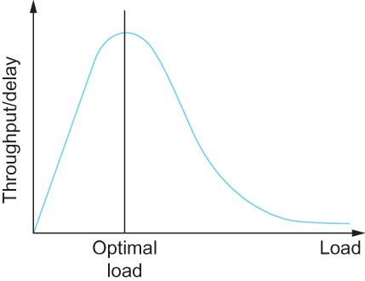
Issues in Resource Allocation
Evaluation Criteria
  Effective Resource Allocation
Ratio of throughput to delay as a function of load
Notes:
The University of Adelaide, School of Computer Science
Chapter 2 — Instructions: Language of the Computer

Slide 18
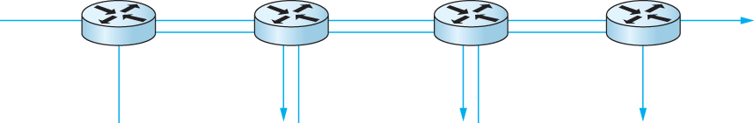
Issues in Resource Allocation
Evaluation Criteria
  Fair Resource Allocation
    In addition to effective resource allocation, we must also consider the issue of fairness.
    However, we quickly get into murky waters when we try to define what exactly constitutes fair resource allocation.
    When several flows share a particular link, we would like for each flow to receive an equal share of the bandwidth.
    However, equal shares may not equate to fair shares
    Should we also consider the length of the paths being compared?
One four-hop flow competing with three one-hop flows
Notes:
The University of Adelaide, School of Computer Science
Chapter 2 — Instructions: Language of the Computer

Slide 19
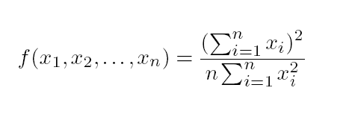
Issues in Resource Allocation
Evaluation Criteria
  Fair Resource Allocation
    Assuming that fair implies equal and that all paths are of equal length, networking researcher Raj Jain proposed a metric that can be used to quantify the fairness of a congestion-control mechanism.
      Jain’s fairness index is defined as follows. Given a set of flow throughputs (x₁, x₂, . . . , x_{n}) (measured in consistent units such as bits/second), the following function assigns a fairness index to the flows:
      The fairness index always results in a number between 0 and 1, with 1 representing greatest fairness.
Notes:
The University of Adelaide, School of Computer Science
Chapter 2 — Instructions: Language of the Computer

Slide 20
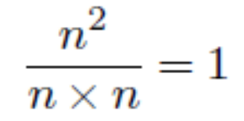
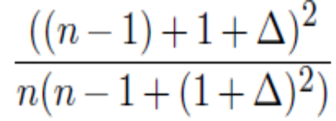
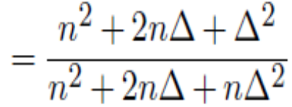
Issues in Resource Allocation
Evaluation Criteria
  Fair Resource Allocation
All n flows receive a throughput of 1 unit of data per second. The fairness index in this case is
One flow receives a throughput of 1+Δ. The fairness index is
< 1
k of the n flows receive equal throughput, and the remaining n − k users receive zero throughput. The fairness index drops to k²/nk = k/n.
Notes:
The University of Adelaide, School of Computer Science
Chapter 2 — Instructions: Language of the Computer

Slide 21
Queuing Disciplines
Two common queuing disciplines — first-in, first-out (FIFO) and fair queuing (FQ)
FIFO queuing:
  The first packet that arrives at a router is the first packet to be transmitted
  Given that the amount of buffer space at each router is finite, if a packet arrives and the queue (buffer space) is full, then the router discards that packet
  This is done without regard to which flow the packet belongs to or how important the packet is. This is sometimes called tail drop.
  Note that tail drop and FIFO are two separable ideas.
    FIFO is a scheduling discipline — it determines the order in which packets are transmitted.
    Tail drop is a drop policy — it determines which packets get dropped

Slide 22
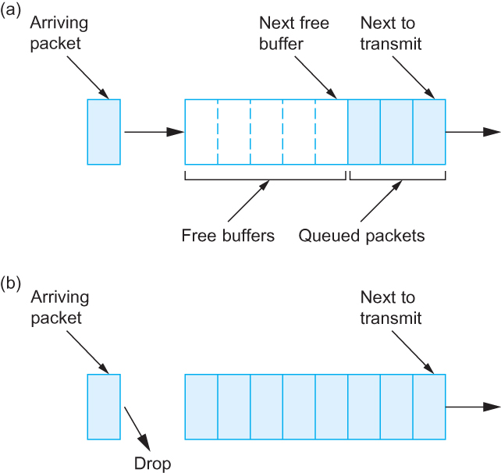
Queuing Disciplines
(a) FIFO queuing; (b) tail drop at a FIFO queue.

Slide 23
Queuing Disciplines
A simple variation on basic FIFO queuing is priority queuing.
The idea is to mark each packet with a priority; the mark could be carried, for example, in the IP header.
The routers then implement multiple FIFO queues, one for each priority class.
The router always transmits packets out of the highest-priority queue if that queue is nonempty before moving on to the next priority queue.
Within each priority, packets are still managed in a FIFO manner.

Slide 24
Queuing Disciplines
Fair Queuing
  The main problem with FIFO queuing is that it does not discriminate between different traffic sources, or it does not separate packets according to the flow to which they belong.
  Fair queuing (FQ) is an algorithm that has been proposed to address this problem.
    The idea of FQ is to maintain a separate queue for each flow currently being handled by the router.
    The router then services these queues in a sort of round-robin fashion

Slide 25
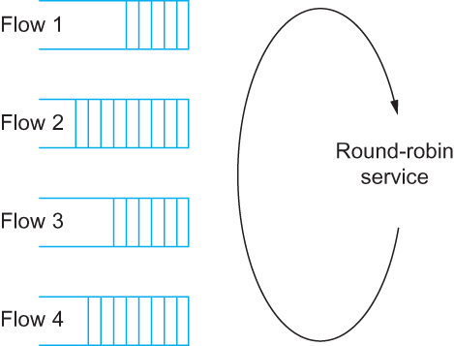
Queuing Disciplines
Fair Queuing
Round-robin service of four flows at a router

Slide 26
Queuing Disciplines
Fair Queuing
  The main complication with Fair Queuing is that the packets being processed at a router are not necessarily the same length.
  To truly allocate the bandwidth of the outgoing link in a fair manner, it is necessary to take packet length into consideration.
    For example, if a router is managing two flows, one with 1000-byte packets and the other with 500-byte packets (perhaps because of fragmentation upstream from this router), then a simple round-robin servicing of packets from each flow’s queue will give the first flow two thirds of the link’s bandwidth and the second flow only one-third of its bandwidth.

Slide 27
Queuing Disciplines
Fair Queuing
  What we really want is bit-by-bit round-robin
  Clearly, it is not feasible to interleave the bits from different packets.
  The FQ mechanism therefore simulates this behavior by
    first determining when a given packet would finish being transmitted if it were being sent using bit-by-bit round-robin, and
    then using this finishing time to sequence the packets for transmission.

Slide 28
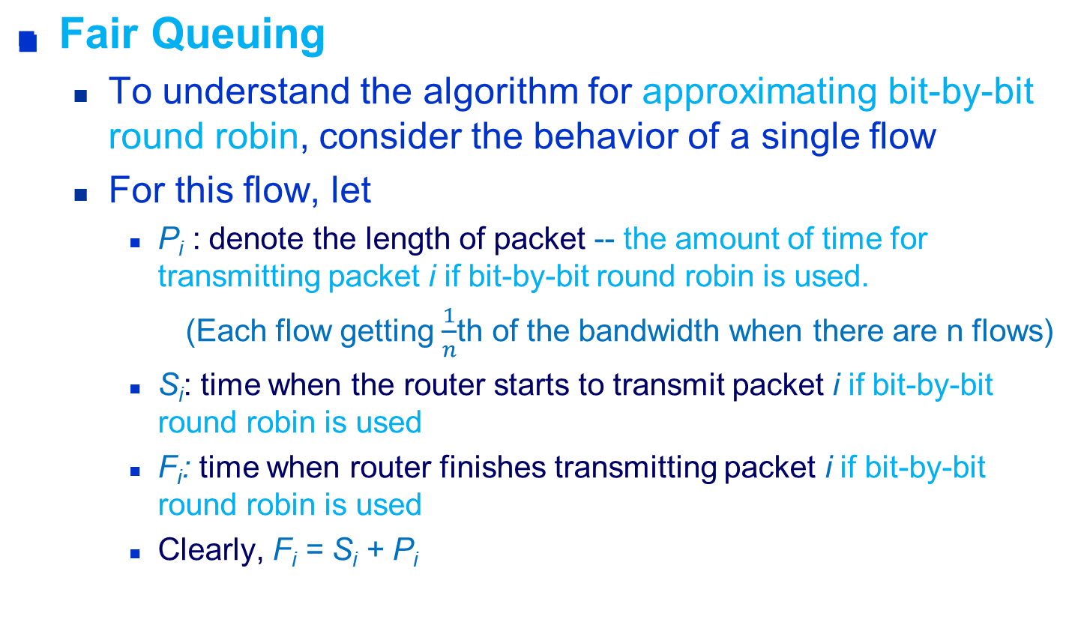
Queuing Disciplines

Slide 29
Queuing Disciplines
Fair Queuing
  When do we start transmitting packet i if bit-by-bit round robin is used?
    Depends on whether packet i arrived before or after the router finishes transmitting packet i-1 for the flow
  Let A_{i} denote the time that packet i arrives at the router
  Then S_{i} = max(F_{i-1}, A_{i})
  F_{i} = max(F_{i-1}, A_{i}) + P_{i}

Slide 30
Queuing Disciplines
Fair Queuing
  Now for every flow, we calculate F_{i} for each packet that arrives using our formula
  We then treat all the F_{i} as timestamps
  Next packet to transmit is always the packet that has the lowest timestamp

Slide 31
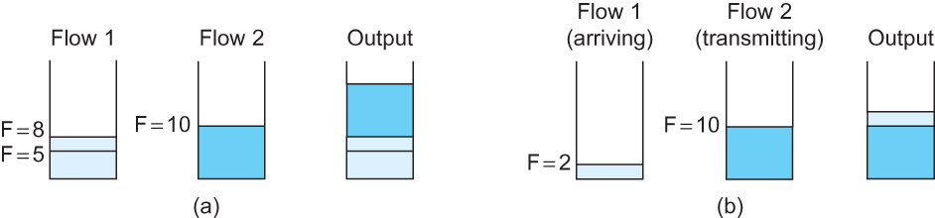
Queuing Disciplines
Fair Queuing
(a) packets with earlier finishing times are sent first
(b) An arriving packet has to wait until a packet already in progress is completed

Slide 32
Queuing Disciplines
Weighted fair queuing (WFQ) -- a variation of FQ
  Allows a weight to be assigned to each flow (queue)
  This weight logically specifies how many bits to transmit each time the router services that queue
  Example:
  One queue might have a weight of 2, a second queue might have a weight of 1, and a third queue might have a weight of 3
  Assuming that each queue always contains a packet waiting to be transmitted, the first flow will get one-third of the available bandwidth, the second will get one-sixth of the available bandwidth, and the third will get one-half of the available bandwidth.

Slide 33
TCP Congestion Control
TCP congestion control was introduced into the Internet in the late 1980s by Van Jacobson, roughly eight years after the TCP/IP protocol stack had become operational.
Immediately preceding this time, the Internet was suffering from congestion collapse —
  hosts would send their packets into the Internet as fast as the advertised window would allow, congestion would occur at some router (causing packets to be dropped), and the hosts would time out and retransmit their packets, resulting in even more congestion

Slide 34
TCP Congestion Control
Congestion window
TCP maintains a new state variable for each connection, called CongestionWindow, which is used by the source to limit how much data it is allowed to have in transit at a given time.
  TCP is modified such that the maximum number of bytes of unacknowledged data allowed is now the minimum of the congestion window and the advertised window
  TCP’s effective window is revised as follows:
    MaxWindow = MIN(CongestionWindow, AdvertisedWindow)
    EffectiveWindow = MaxWindow − (LastByteSent − LastByteAcked).
  Thus, a TCP source is allowed to send no faster than the network or the destination host can accommodate.

Slide 35
TCP Congestion Control
Additive Increase Multiplicative Decrease
  How does TCP set an appropriate value for CongestionWindow?
    The answer is that the TCP source sets the CongestionWindow based on the level of congestion it perceives to exist in the network.
    This involves decreasing the congestion window when the level of congestion goes up and
    increasing the congestion window when the level of congestion goes down.
    Taken together, the mechanism is commonly called additive increase / multiplicative decrease (AIMD)

Slide 36
TCP Congestion Control
Additive Increase Multiplicative Decrease
  Multiplicative decrease
  How does the source determine that the network is congested and that it should decrease the congestion window?
    Each time a loss event occurs, the source sets CongestionWindow to half of its previous value.
    This halving of the CongestionWindow for each loss event corresponds to the “multiplicative decrease” part of AIMD
    loss event – triple duplicate ACK

Slide 37
TCP Congestion Control
Additive Increase Multiplicative Decrease
  Although CongestionWindow is defined in terms of bytes, it is easier to understand multiplicative decrease if we think in terms of whole packets.
    For example, suppose the CongestionWindow is currently set to 16 packets. If a loss is detected, CongestionWindow is set to 8 packets
    CongestionWindow is not allowed to fall below the size of a single packet, or in TCP terminology, the maximum segment size (MSS).

Slide 38
TCP Congestion Control
Additive Increase Multiplicative Decrease
  The “additive increase” part of AIMD works as follows
    Every time the source sends a CongestionWindow’s worth of packets (i.e., one RTT), one packet is added to the CongestionWindow
    Increment = MSS × (MSS / CongestionWindow)
    CongestionWindow = CongestionWindow + Increment
  That is, rather than incrementing CongestionWindow by an entire MSS bytes each RTT, we increment it by a fraction of MSS every time an ACK is received.
  Assuming that each ACK acknowledges the receipt of MSS bytes, then that fraction is MSS/CongestionWindow.

Slide 39
TCP Congestion Control
Slow Start
  The additive increase mechanism just described is the right approach to use when the source is operating close to the available capacity of the network, but it takes too long to ramp up a connection when it is starting from scratch.
  TCP therefore provides a second mechanism, ironically called slow start, that is used to increase the congestion window rapidly from a cold start.
  Slow start effectively increases the congestion window exponentially, rather than linearly.

Slide 40
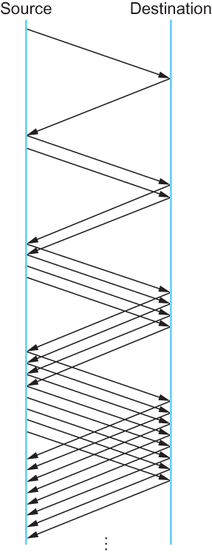
TCP Congestion Control
Slow Start
  Specifically, the source starts out by setting CongestionWindow to one packet.
  When the ACK for this packet arrives, TCP adds 1 MSS to CongestionWindow and then sends two packets.
  Upon receiving the corresponding two ACKs, TCP increments CongestionWindow by 2 MSS — one for each ACK — and next sends four packets.
  Double the CongestionWindow every RTT
Packets in transit during slow start.

Slide 41
TCP Congestion Control
Slow Start
  There are actually two different situations in which slow start runs.
    The first situation is at the very beginning of a connection, at which time the source has no idea how many packets it is going to be able to have in transit at a given time.
      In this situation, slow start continues to double CongestionWindow each RTT until there is a loss (triple duplicate ACKs) which causes multiplicative decrease to divide CongestionWindow by 2

Slide 42
TCP Congestion Control
Slow Start
  The second situation in which slow start is used is a timeout
  The source has a current (and useful) value of CongestionWindow
  The current value of CongestionWindow is divided by 2 and stored in a temporary variable CongestionThreshold
  We can think of CongestionThreshold as the “target” congestion window.
  Slow start is used to rapidly increase the sending rate up to CongestionThreshold, and then additive increase is used beyond this point.

Slide 43
TCP Congestion Control
Slow Start
  The variable CongestionWindow is reset to one packet, and it is incremented by one packet for every ACK that is received until it reaches CongestionThreshold.
  Then, CongestionWindow is incremented linearly by one packet per RTT defined by the following code fragment:
u_int cw = state->CongestionWindow;
u_int incr = state->maxseg;
if (cw > state->CongestionThreshold)
incr = incr * incr / cw;
state->CongestionWindow = MIN(cw + incr, TCP_MAXWIN);
state represents the state of a particular TCP connection and
TCP MAXWIN defines an upper bound on how large the congestion window is allowed to grow.

Slide 44
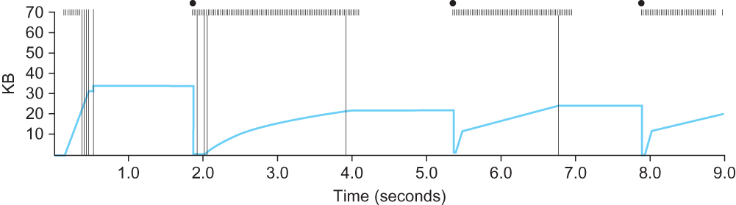
TCP Congestion Control
Slow Start
No ACK arriving
Time out
Time out
Time out
34KB
22KB
22/2=11KB
Slow start
Additive increase
Behavior of TCP congestion control.
Colored line = value of CongestionWindow over time;
solid bullets at top of graph = timeouts;
hash marks at top of graph = time when each packet is transmitted;
vertical bars = time when a packet that was eventually retransmitted was first transmitted.

Slide 45
TCP Congestion Control
Fast Retransmit
  TCP timeouts led to long periods of time during which the connection is not transmitting packets while waiting for a timer to expire.
  Because of this, a new mechanism called fast retransmit was added to TCP.
  Fast retransmit is a heuristic that sometimes triggers the retransmission of a dropped packet sooner than the regular timeout mechanism.

Slide 46
TCP Congestion Control
Fast Retransmit
  When a packet arrives out of order — that is, TCP cannot yet acknowledge the data the packet contains because earlier data has not yet arrived — TCP resends the same acknowledgment it sent the last time.
  This second transmission of the same acknowledgment is called a duplicate ACK.
  An earlier packet might have been lost
  It is also possible that the earlier packet has only been delayed
  TCP waits until it has seen three duplicate ACKs before retransmitting the packet (i.e., fast retransmit).

Slide 47
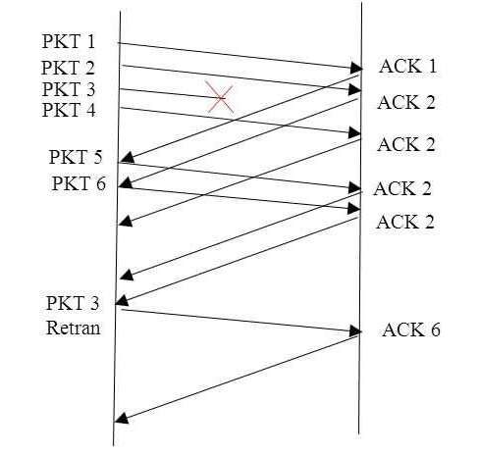
TCP Congestion Control
Fast Retransmit
  Triple duplicate ACKs

Slide 48
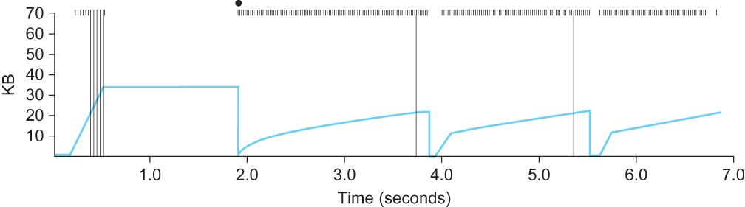
TCP Congestion Control
Fast Retransmit
  The long period during which the congestion window stays flat and no packets are sent has been eliminated.
Colored line = value of CongestionWindow over time;
solid bullets at top of graph = timeouts;
hash marks at top of graph = time when each packet is transmitted;
vertical bars = time when a packet that was eventually retransmitted was first transmitted.

Slide 49
TCP Congestion Control
Fast Retransmit
  There is not enough packets in transit to cause enough duplicate ACKs to be delivered.
Colored line = value of CongestionWindow over time;
solid bullets at top of graph = timeouts;
hash marks at top of graph = time when each packet is transmitted;
vertical bars = time when a packet that was eventually retransmitted was first transmitted.

Slide 50
TCP Congestion Control
Fast Recovery
  When the fast retransmit mechanism signals congestion, rather than drop the congestion window all the way back to one packet and run slow start, the congestion window is cut in half and increased linearly.
  This mechanism, which is called fast recovery, effectively removes the slow start phase that happens between when fast retransmit detects a lost packet and additive increase begins.

Slide 51
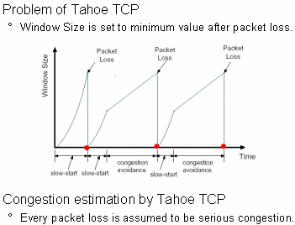
TCP Congestion Control
Without fast recovery
Triple duplicate ACKs

Slide 52
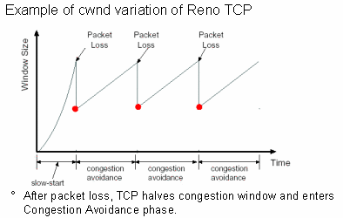
TCP Congestion Control
With fast recovery
Triple duplicate ACKs

Slide 53
Congestion Avoidance Mechanism
It is important to understand that TCP’s strategy is to control congestion once it happens, as opposed to trying to avoid congestion in the first place.
TCP needs to create losses to find the available bandwidth of the connection.
An appealing alternative, but one that has not yet been widely adopted, is to predict when congestion is about to happen and then to reduce the rate at which hosts send data just before packets start being discarded.
We call such a strategy congestion avoidance, to distinguish it from congestion control.

Slide 54
Congestion Avoidance Mechanism
DEC Bit
  DEC Bit was developed for use on the Digital Network Architecture (DNA), a connectionless network with a connection-oriented transport protocol.
  This mechanism could also be applied to TCP and IP.
  Put a small amount of additional functionality into the router to assist the end node in the anticipation of congestion.

Slide 55
Congestion Avoidance Mechanism
DEC Bit
  Each router monitors the load it is experiencing and explicitly notifies the end nodes when congestion is about to occur.
  This notification is implemented by setting a binary congestion bit in the packets that flow through the router; hence the name DECbit.
  The destination host then copies this congestion bit into the ACK it sends back to the source.
  Finally, the source adjusts its sending rate so as to avoid congestion

Slide 56
Congestion Avoidance Mechanism
DEC Bit
  A single congestion bit is added to the packet header. A router sets this bit in a packet if its average queue length is greater than or equal to 1 at the time the packet arrives.
  This average queue length is measured over a time interval that spans the last busy+idle cycle, plus the current busy cycle.

Slide 57
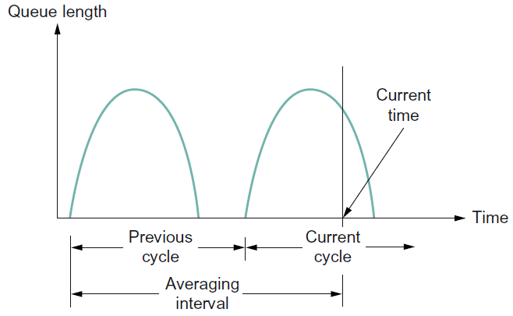
Congestion Avoidance Mechanism
DEC Bit
  Computation of average queue length
  average queue length =
  area under the curve / averaging interval

Slide 58
Congestion Avoidance Mechanism
DEC Bit
  The source maintains a congestion window, just as in TCP, and watches to see what fraction of the last window’s worth of packets resulted in the bit being set.
  If less than 50% of the packets had the bit set, then the source increases its congestion window by one packet.
  If 50% or more of the last window’s worth of packets had the congestion bit set, then the source decreases its congestion window to 0.875 times the previous value.

Slide 59
Congestion Avoidance Mechanism
DEC Bit
  The value 50% was chosen as the threshold based on analysis that showed it to correspond to the peak of the power curve (power = throughput / delay).
  The “increase by 1, decrease by 0.875” rule was selected because additive increase/multiplicative decrease makes the mechanism stable.

Slide 60
Congestion Avoidance Mechanism
Random Early Detection (RED)
  Invented by Sally Floyd and Van Jacobson in the early 1990s
  Each router is monitor its own queue length and notify the source to adjust its congestion window when it detects that congestion is imminent
  RED is designed to be used in conjunction with TCP

Slide 61
Congestion Avoidance Mechanism
Random Early Detection (RED)
  Differs from the DECbit scheme in two major ways
  The first difference is that rather than explicitly sending a congestion notification message to the source, RED is most commonly implemented such that it implicitly notifies the source of congestion by dropping one of its packets.
  The source is effectively notified by the subsequent timeout or duplicate ACK.
  The TCP protocol at the source reduces its window size when there is a timeout or triple duplicate ACKs.

Slide 62
Congestion Avoidance Mechanism
Random Early Detection (RED)
  As the “early” part of the RED acronym suggests, the router drops the packet earlier than it would have to, so as to notify the source that it should decrease its congestion window sooner than it would normally have.
  In other words, the router drops a few packets before it has exhausted its buffer space completely, so as to cause the source to slow down, with the hope that this will mean it does not have to drop lots of packets later on.

Slide 63
Congestion Avoidance Mechanism
Random Early Detection (RED)
  The second difference between RED and DECbit is in the details of how RED decides when to drop a packet and what packet it decides to drop.
  Drop each arriving packet with some drop probability whenever the queue length exceeds some drop level.
  This idea is called early random drop. The RED algorithm defines the details of how to monitor the queue length and when to drop a packet.

Slide 64
Congestion Avoidance Mechanism
Random Early Detection (RED)
  RED computes an average queue length using a weighted running average. That is, AvgLen is computed as
    AvgLen = (1 − Weight) × AvgLen + Weight × SampleLen
    where 0 < Weight < 1 and SampleLen is the length of the queue when a sample measurement is made.
  In most software implementations, the queue length is measured every time a new packet arrives at the router.
  In hardware, it might be calculated at some fixed sampling interval.

Slide 65
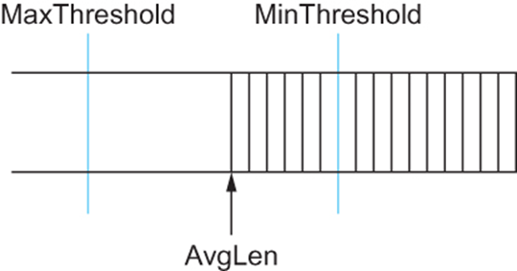
Congestion Avoidance Mechanism
Random Early Detection (RED)
  RED has two queue length thresholds that trigger certain activity: MinThreshold and MaxThreshold.
  When a packet arrives at the router, RED compares the current AvgLen with these two thresholds, according to the following rules:
    if AvgLen ≤ MinThreshold
      → queue the packet
    if MinThreshold < AvgLen < MaxThreshold
      → calculate probability P
      → drop the arriving packet with probability P
    if MaxThreshold ≤ AvgLen
      → drop the arriving packet

Slide 66
Congestion Avoidance Mechanism
Random Early Detection (RED)
  Probability P is a function of both AvgLen and how long it has been since the last packet was dropped.
  Specifically, it is computed as follows:
    TempP = MaxP × (AvgLen − MinThreshold)
    / (MaxThreshold − MinThreshold)
    P = TempP / (1 − count × TempP)
    count is the number of newly arriving packets have been queued since last drop.

Slide 67
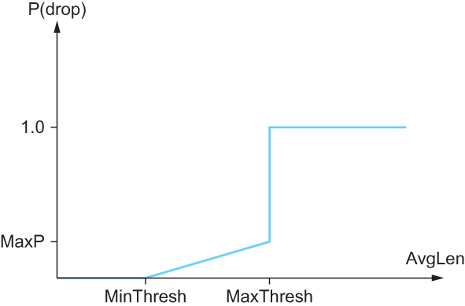
Congestion Avoidance Mechanism
Random Early Detection (RED)
TempP
Examples:
AvgLen = MinThreshold ⇒ TempP=0 ⇒ P=0
AvgLen -> MaxThreshold ⇒ TempP -> MaxP
if count = 0 ⇒ P = TempP / (1 − count × TempP) -> MaxP
3) P increases as count increases

Slide 68
Congestion Avoidance Mechanism
Source-based Congestion Avoidance
  The general idea of these techniques is to watch for some sign from the network that some router’s queue is building up and that congestion will happen soon if nothing is done about it.
  For example, the source might notice that as packet queues build up in the network’s routers, there is a measurable increase in the RTT for each successive packet it sends.

Slide 69
Congestion Avoidance Mechanism
Source-based Congestion Avoidance
  One particular algorithm exploits this observation as follows:
    if (the current RTT > the average of the minimum and maximum RTTs seen so far),
    then decreases the congestion window by one-eighth.

Slide 70
Congestion Avoidance Mechanism
Source-based Congestion Avoidance
  A second algorithm does something similar.
  The decision as to whether or not to change the current window size is based on changes to both the RTT and the window size.
  The window is adjusted once every two round-trip delays based on the product:
  (CurrentWindow − OldWindow)×(CurrentRTT − OldRTT)
    If the result is positive, the source decreases the window size by one-eighth;
    if the result is negative or 0, the source increases the window by one maximum packet size.

Slide 71
Congestion Avoidance Mechanism
Source-based Congestion Avoidance
  A third scheme
  Every RTT, it increases the window size by one packet and
  compares the throughput achieved to the throughput when the window was one packet smaller.
  If the difference is less than one-half the throughput achieved when only one packet was in transit — as was the case at the beginning of the connection — the algorithm decreases the window by one packet.
  This scheme calculates the throughput by dividing the number of bytes outstanding in the network by the RTT.

Slide 72
Congestion Avoidance Mechanism
Source-based Congestion Avoidance
  A fourth mechanism – used in TCP Vegas
  Compares the measured throughput rate with an expected throughput rate

Slide 73
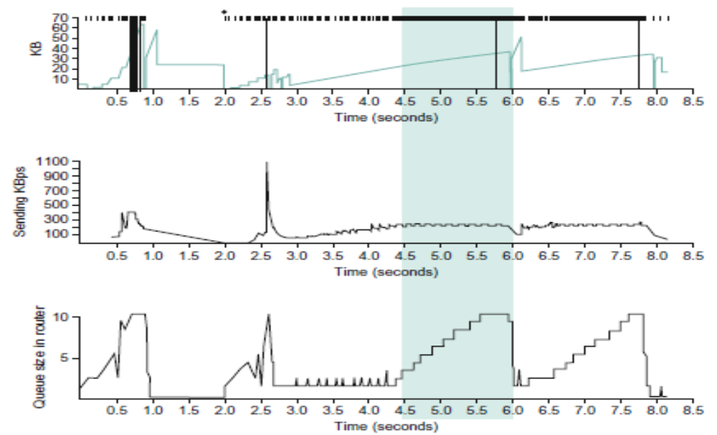
Congestion Avoidance Mechanism
Source-based Congestion Avoidance
  Standard TCP
Congestion window
Average sending rate at the source
Average queue at the bottleneck router

Slide 74
Congestion Avoidance Mechanism
Source-based Congestion Avoidance
  Standard TCP
  In the period between 4.5 and 6.0 seconds (shaded region), the congestion window increases (top graph).
  We expect the observed throughput to also increase, but instead throughput stays flat (middle graph).
  This is because the throughput cannot increase beyond the available bandwidth.
  Beyond this point, any increase in the window size only results in packets taking up buffer space at the bottleneck router (bottom graph).

Slide 75
Congestion Avoidance Mechanism
Source-based Congestion Avoidance
  A fourth mechanism – used in TCP Vegas
  The goal of TCP Vegas is to maintain the “right” amount of extra data in the network.
  if a source is sending too much extra data, it will cause long delays and possibly lead to congestion.
  if a connection is sending too little extra data, it cannot respond rapidly enough to transient increases in the available network bandwidth.

Slide 76
Congestion Avoidance Mechanism
Source-based Congestion Avoidance
  A fourth mechanism – used in TCP Vegas
  TCP Vegas sets BaseRTT to the minimum of all measured round-trip times
  the expected throughput is given by
  ExpectedRate = CongestionWindow / BaseRTT
  the current sending rate, ActualRate
  ActualRate = number of bytes transmitted / sample RTT

Slide 77
Congestion Avoidance Mechanism
Source-based Congestion Avoidance
  A fourth mechanism – used in TCP Vegas
  let Diff = ExpectedRate − ActualRate
  define two thresholds α < β
  Diff < α, increases the congestion window linearly during the next RTT
  Diff > β, decreases the congestion window linearly during the next RTT.
  α ≤ Diff ≤ β, leaves the congestion window unchanged
  The overall goal is to keep extra bytes in the network between α and β.
Increase window
Window
unchanged
Decrease window
Diff
0
α
β

Slide 78
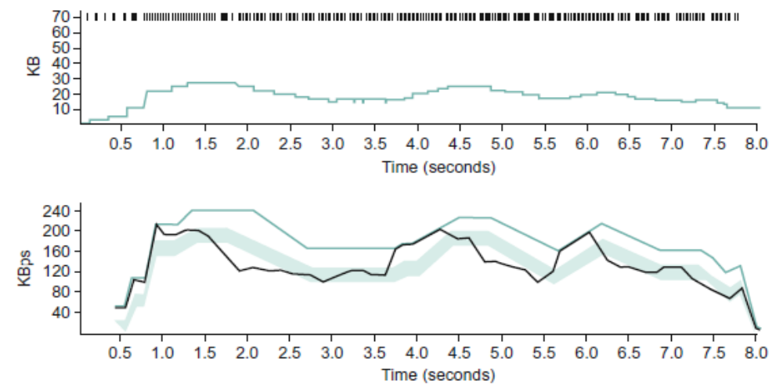
Congestion Avoidance Mechanism
Source-based Congestion Avoidance
  Goal is to keep α ≤ Diff ≤ β =>
  ExpectedRate - β ≤ ActualRate ≤ ExpectedRate - α
congestion window
ExpectedRate
ExpectedRate - α
ActualRate
ExpectedRate - β

Slide 79
Quality of Service
The timeliness of delivery can be very important. We refer to applications that are sensitive to the timeliness of data as real-time applications.
The best-effort model, in which the network tries to deliver your data but makes no promises and leaves the cleanup operation to the edges, is not sufficient for real-time applications.
The network should treat some packets differently from others — something that is not done in the best-effort model.
A network that can provide these different levels of service is often said to support quality of service (QoS).

Slide 80
Quality of Service
Taxonomy of Real-Time Applications
  The first characteristic by which we can categorize applications is their tolerance of loss of data, where “loss” might occur because a packet arrived too late to be played back as well as arising from the usual causes in the network.
  One lost audio sample can be interpolated from the surrounding samples with relatively little effect on the perceived audio quality.
  As more and more samples are lost, the quality will decline to the point that the speech becomes incomprehensible.

Slide 81
Quality of Service
Taxonomy of Real-Time Applications
  A robot control program is likely to be an example of a real-time application that cannot tolerate loss — losing the packet that contains the command instructing the robot arm to stop is unacceptable.
  Thus, we can categorize real-time applications as loss tolerant or loss intolerant depending on whether they can tolerate occasional loss

Slide 82
Quality of Service
Taxonomy of Real-Time Applications
  A second way to characterize real-time applications is by their adaptability.
  An audio application might be able to adjust its playback point to adapt to the amount of delay that packets experience as they traverse the network.
  We call applications that can adjust their playback point delay-adaptive applications.

Slide 83
Quality of Service
Taxonomy of Real-Time Applications
  Another class of adaptive applications are rate adaptive.
  Many video coding algorithms can trade off bit rate versus quality.
  Set coding parameters according to the bandwidth that the network can support
  If more bandwidth becomes available later, the parameters can be changed to increase the quality.

Slide 84
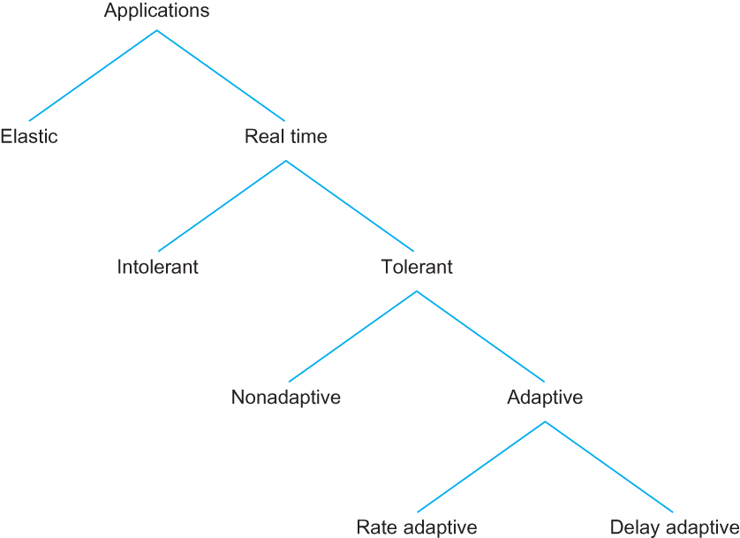
Quality of Service
Taxonomy of Real-Time Applications
(Best effort)
loss
loss

Slide 85
Quality of Service
Two categories of approaches to QoS Support
  fine-grained approaches, which provide QoS to individual applications or flows
    “Integrated Services” developed in the IETF and often associated with RSVP (Resource Reservation Protocol).
  coarse-grained approaches, which provide QoS to large classes of data or aggregated traffic
    “Differentiated Services” is probably the most widely deployed QoS mechanism.

Slide 86
Quality of Service
Integrated Services (RSVP)
  The term “Integrated Services” (often called IntServ for short) refers to a body of work that was produced by the IETF around 1995–97.
  The IntServ working group developed specifications of a number of service classes designed to meet the needs of some of the application types
  It also defined how RSVP could be used to make reservations using these service classes.

Slide 87
Quality of Service
Integrated Services (RSVP)
  Service Classes
    Guaranteed Service for delay intolerant applications
      The network should guarantee that the maximum delay that any packet will experience has some specified value
    Controlled Load Service for tolerant, adaptive applications
      Use a queuing mechanism such as WFQ (see Section 6.2) to isolate the controlled load traffic from the other traffic
      Use some form of admission control to limit the total amount of controlled load traffic on a link such that the load is kept reasonably low.

Slide 88
Quality of Service
Integrated Services (RSVP)
  Overview of Mechanisms for implementing theses services
    Flowspec
      The set of information such as maximum delay, bandwidth requirement, provided to the network is referred to as a flowspec.
    Admission Control
      The network needs to decide whether it can provide service to a flow.
      The process of deciding when to say yes or no is called admission control.

Slide 89
Quality of Service
Integrated Services (RSVP)
  Overview of Mechanisms for implementing theses services
    Resource Reservation
      A mechanism by which the users of the network and the components of the network itself exchange information such as requests for service, flowspecs, and admission control decisions.
      This process is referred to as resource reservation
    Packet Scheduling
      The way packets are queued and scheduled for transmission in the switches and routers.
      This mechanism is packet scheduling.

Slide 90
Quality of Service
Integrated Services (RSVP)
  Flowspec
    There are two separable parts to the flowspec:
      Tspec: The part that describes the flow’s traffic characteristics (called the TSpec)
      Rspec: The part that describes the service requested from the network (the RSpec).

Slide 91
Quality of Service
Integrated Services (RSVP)
  Flowspec
    RSpec
      The RSpec is very service specific and relatively easy to describe.
      For a controlled load service, the RSpec is trivial: The application just requests controlled load service with no additional parameters.
      For a guaranteed service, a delay target or bound can be specified.

Slide 92
Quality of Service
Integrated Services (RSVP)
  Flowspec
    TSpec
      One way to describe the Bandwidth characteristics of sources is called a Token Bucket Filter
      The filter is described by two parameters
        A token rate r – average send rate r bytes/sec
        A bucket depth B – no more than B unused tokens can be accumulated
      One token is needed to send a byte
      Unused tokens are accumulated at a rate of at most r per second

Slide 93
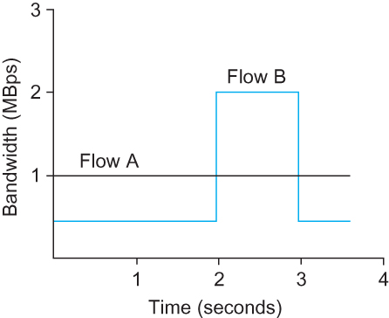
Quality of Service
  Flowspec
TSpec
TSpec for flow A
  A token rate r = 1 MBps
  A bucket depth B = 1 byte
TSpec for flow B
  A token rate r = 1 MBps
  A bucket depth B = 1 Mbyte
  For the first 2 seconds, it can save up 2 × 0.5 = 1 MB of tokens which it spends at the 3rd second

Slide 94
Quality of Service
Integrated Services (RSVP)
  Admission Control
    Given the currently available resources
    When some new flow wants to receive a particular level of service, admission control looks at the TSpec and RSpec of the flow and tries to decide if the desired service can be provided without causing any previously admitted flow to receive worse service than it had requested.
    If it can provide the service, the flow is admitted;
    if not, then it is denied.

Slide 95
Quality of Service
Integrated Services (RSVP)
  Reservation Protocol
    Connectionless networks rely on little or no state being stored in the network itself, it is possible for routers to crash and reboot and for links to go up and down while end-to-end connectivity is still maintained.
    RSVP tries to maintain this robustness by using the idea of soft state in the routers.

Slide 96
Quality of Service
Integrated Services (RSVP)
  Reservation Protocol
    RSVP aims to support multicast flows just as effectively as unicast flows
    Receivers may have different requirements.
      For example, one receiver might want to receive data from only one sender,
      others might wish to receive data from all senders.
    Rather than having the senders keep track of a potentially large number of receivers, it makes more sense to let the receivers keep track of their own needs.
    This suggests the receiver-oriented approach adopted by RSVP.

Slide 97
Quality of Service
Integrated Services (RSVP)
  Reservation Protocol
    Advantages of receiver-oriented approach adopted by RSVP:
      It is easy to increase or decrease the level of resource allocation provided to a receiver since each receiver periodically sends refresh messages to keep the soft state in place

Slide 98
Quality of Service
Integrated Services (RSVP)
  Reservation Protocol
    Sender sends a PATH message to the receiver(s) that contains the Tspec
    Each router figures out the reverse path that will be used to send reservations from the receiver back to the sender
    Having received a PATH message, the receiver sends a reservation back up the multicast tree in a RESV message.
      This RESV message contains the sender’s TSpec and an RSpec describing the requirements of this receiver.

Slide 99
Quality of Service
Integrated Services (RSVP)
  Reservation Protocol
    Each router on the path looks at the reservation request and tries to allocate the necessary resources to satisfy it.
    If the reservation can be made, the RESV request is passed on to the next router.
    If not, an error message is returned to the receiver who made the request.
    If all goes well, the correct reservation is installed at every router between the sender and the receiver.
    As long as the receiver wants to retain the reservation, it sends the same RESV message about once every 30 seconds.

Slide 100
Quality of Service
Integrated Services (RSVP)
  Reservation Protocol
    When a router or link fails
    Routing protocols will adapt to the failure and create a new path from sender to receiver.
    PATH messages are sent about every 30 seconds, and may be sent sooner if a router detects a change in its forwarding table
    The first PATH message after the new route stabilizes will reach the receiver over the new path.
    The receiver’s next RESV message will follow the new path and, if all goes well, establish a new reservation on the new path.
    Meanwhile, the routers that are no longer on the path will stop getting RESV messages, and these reservations will time out and be released.

Slide 101
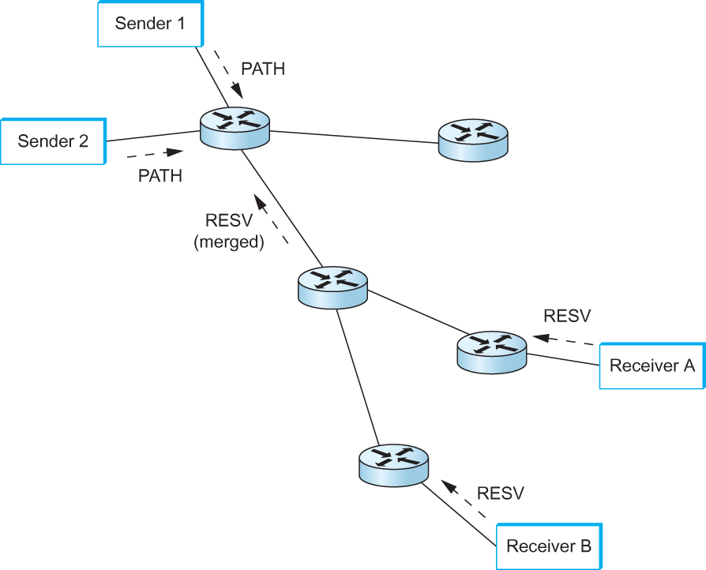
Quality of Service
Integrated Services (RSVP)
  Reservation Protocol
  Example:
Receiver A has already made a reservation that provides for a guaranteed delay of less than 100 ms
Delay<100ms
Delay<100ms
New request from receiver B is for a delay of less than 200 ms, then no new reservation is required
New request were for a delay of less than 50 ms, then the router would first need to see if it could accept the request; if so, it would send the request on upstream.
Delay<200ms
Delay<50ms
Making reservations on a multicast tree

Slide 102
Quality of Service
Integrated Services (RSVP)
  Reservation Protocol
    Multiple senders in the tree
    Receivers need to collect the TSpecs from all senders and make a reservation that is large enough to accommodate the traffic from all senders
    However, this may not mean that the TSpecs need to be added up.
    For example, in an audioconference with 10 speakers, it may be sufficient to make a reservation that is large enough to accommodate two speakers.
    Calculating the correct overall TSpec from all of the sender TSpecs is application specific.

Slide 103
Quality of Service
Integrated Services (RSVP)
  Packet Classifying and Scheduling
    Once a suitable reservation at all the routers on the path has been installed , the only thing that remains is for the routers to actually deliver the requested service to the data packets.
    There are two things that need to be done:
      Packet classification -- Associate each packet with the appropriate reservation so that it can be handled correctly
      Packet scheduling -- Manage the packets in the queues so that they receive the service that has been requested

Slide 104
Quality of Service
Differentiated Services
  The Differentiated Services model (often called DiffServ for short) allocates resources to a small number of classes of traffic.
  Some proposed approaches to DiffServ simply divide traffic into two classes.

Slide 105
Quality of Service
Differentiated Services
  Enhance the best-effort service model by adding just one new class, which we’ll call “premium.”
  Need some way to figure out which packets are premium and which are best effort.
  Using a bit in the packet header — if that bit is a 1, the packet is a premium packet; if it’s a 0, the packet is best effort

Slide 106
Quality of Service
Differentiated Services
  Two questions need to be addressed:
    Who sets the premium bit, and under what circumstances?
    What does a router do differently when it sees a packet with the bit set?

Slide 107
Quality of Service
Differentiated Services
  Who sets the premium bit?
  A common approach is to set the bit at an administrative boundary.
  The Internet service provider might do this because a company has paid for a higher level of service than best effort.

Slide 108
Quality of Service
Differentiated Services
  What does a router do when it encounters marked packets?
  The IETF standardized a set of router behaviors to be applied to marked packets.
  These are called “per-hop behaviors” (PHBs) which define the behavior of individual routers rather than end-to-end services

Slide 109
Quality of Service
Differentiated Services
  The Expedited Forwarding (EF) PHB
    One of the simplest PHBs to explain is known as “expedited forwarding” (EF).
    Packets marked for EF treatment should be forwarded with minimal delay and loss.
    The only way that a router can guarantee this is that the arrival rate of EF packets at the router is strictly limited to be less than the rate at which the router can forward EF packets.
    The rate limiting of EF packets is achieved by configuring the routers at the edge of an administrative domain to allow a certain maximum rate of EF packet arrivals into the domain.
    EF can be implemented using priority queueing or weighted fair queueing

Slide 110
Quality of Service
Differentiated Services
  The Assured Forwarding (AF) PHB
    The “assured forwarding” (AF) PHB allows the operator to provide assurance of delivery as long as the traffic does not exceed some subscribed rate.
    “RED with In and Out” (RIO) or “Weighted RED” are often used to implement “assured forwarding” (AF) PHB
    Both are enhancements to the basic RED algorithm

Slide 111
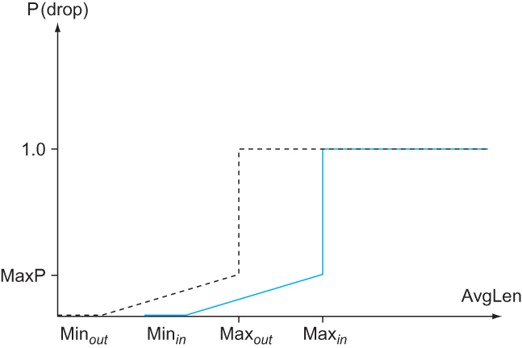
Quality of Service
Differentiated Services
  The Assured Forwarding (AF) PHB
  “RED with In and Out” (RIO)
    Two classes of traffic -- RIO calls the two classes “in” and “out”
    Packets in the assured class are marked as “in” packets
    The rest of the packets are marked as “out” packets
    There are two separate drop probability curves.
TempP
Out
In
RED with In and Out drop probabilities

Slide 112
Quality of Service
Differentiated Services
  The Assured Forwarding (AF) PHB
  “RED with In and Out” (RIO)
    The “out” curve has a lower MinThreshold than the “in” curve
    Under low levels of congestion, only packets marked “out” will be discarded by the RED algorithm.
    If the congestion becomes more serious, a higher percentage of “out” packets are dropped
    If the average queue length exceeds Min_{in}, RED starts to drop “in” packets as well.
TempP
Out
In
RED with In and Out drop probabilities

Slide 113
Quality of Service
Differentiated Services
  The Assured Forwarding (AF) PHB
  “Weighted RED” – generalized RIO to provide three or more classes of traffic
  Three or more sets of separate drop probability curves

Slide 114
Summary
We have discussed different resource allocation mechanisms
We have discussed different queuing mechanisms
We have discussed TCP Congestion Control mechanisms
We have discussed Congestion Avoidance mechanisms
We have discussed Quality of Services

