Slide 1

A Quantitative Model Of The Language Familiarity Effect In Infancy
Craig Thorburn, Naomi Feldman, Thomas Schatz | NECPhon 2019

Slide 2



The Language Familiarity Effect
おはようございます
Good Morning!
Hello!
こんにちは!
English Learner (native)
Japanese Learner (non-native)
English Learner (non-native)
Japanese Learner (native)
Johnson, Westreck & Cutler 2011; Fecher & Johnson 2019
Notes:
What do infants know about their native language in the first year of life?
Has been studied for many years and we have evidence for much learning which takes place in this time.
For example, by one year old infants are able to discriminate between different phonemes of their native language, discriminate between language and discriminate between speakers.
Speakers is what I will focus on today
[Explain LFE]
Found in 4.5 month olds and 7 month olds. Looking closer at the 4.5 month old study.

Slide 3
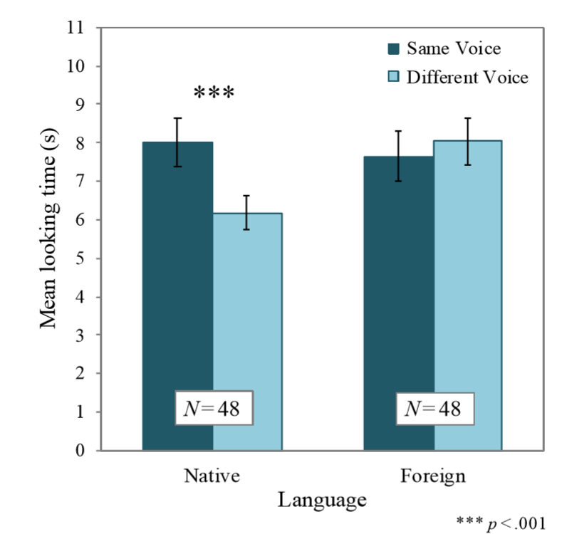
Visual Fixation Procedure
Y | Z | Y | Z
…
A | B | A | B
Same Voice
…
W | V | W | V
…
Different Voice
Habituation Phase
Test Phase
Fecher & Johnson 2019
Notes:
keep happening until they are bored
Talk through this graph
[TODO: Add 3 dots to end of each phase]
[TODO: Make A/B bigger]

Slide 4
Visual Fixation Procedure
Y | Z | Y | Z
…
A | B | A | B
Same Voice
…
W | V | W | V
…
Different Voice
Habituation Phase
Test Phase
Fecher & Johnson 2019
Notes:
keep happening until they are bored
Talk through this graph
[TODO: Add 3 dots to end of each phase]
[TODO: Make A/B bigger]

Slide 5
How could infants learn this?
We can look to adults
Adults are also known to show a language familiarity effect
Thought to require some abstract phonological knowledge or comprehension
We can model this using acoustic properties of input
We will look at higher and lower level features at two timescales
Short timescale
e.g. Phonetic information
Long timescale
e.g. Speaker information
Notes:
how do they do this
If they were perofrming the task in the same way it would be surprising because this conflicts with what we think children know
However we don’t have another theory
Information that children get is structured
Speaker information is one of these things
Could be leveraging this hierarchical structure in the input and this is what I will be modelling. Build a model which knows what the language sounds like at each timescale

Slide 6
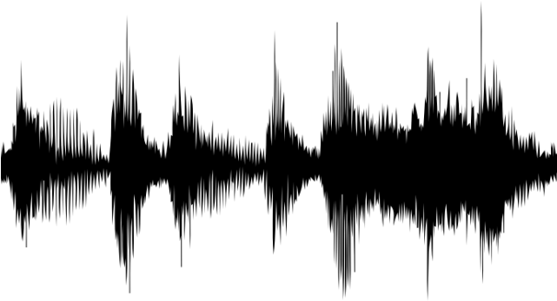
Short Timescale – Phonetic Information
The chairman said that…
Stock prices fell…
The officer resigned from…
Schatz et al 2019
Notes:
Have a whole bunch of speakers together
Model overall distribution of sounds of the language – our background model
Each point here is one 25ms chunk of speech represented by MFCC coefficient.
In reality they are MFCC vectors
MFCC is 39 dimension vector that describes shape of the spectrum of the 25ms frame.
Learn GMM on these chunks of speech
Say each frame is generated from one of a number of Gaussian distributions – in our model this is 2048 so isn’t learning categories
These groups are going to be different for each language
This has been used to model discrimination of phones
Shows native/non-native effects
Gives overall acoustic model - will be language specific. Will still mix all of our speakers together.
Speaker information is not salient in this representational format

Slide 7
Short Timescale – Phonetic Information
The chairman said that…
Stock prices fell…
The officer resigned from…
Schatz et al 2019
Notes:
Have a whole bunch of speakers together
Model overall distribution of sounds of the language – our background model
Each point here is one 25ms chunk of speech represented by MFCC coefficient.
In reality they are MFCC vectors
MFCC is 39 dimension vector that describes shape of the spectrum of the 25ms frame.
Learn GMM on these chunks of speech
Say each frame is generated from one of a number of Gaussian distributions – in our model this is 2048 and I’m showing 3
These groups are going to be different for each language
This has been used to model discrimination of phones
Can explain an infants perceptual tuning the sounds of their native language
Gives overall acoustic model - will be language specific. Will still mix all of our speakers together.
Speaker information is not salient in this representational format

Slide 8
Long Timescale – Speaker Information
The chairman said that…
Stock prices fell…
The officer resigned from…
Dehak et al. 2010
Notes:
There is more structure in the data

Slide 9
Long Timescale – Speaker Information
The chairman said that…
Stock prices fell…
The officer resigned from…
Dehak et al. 2010
Notes:
Switch to looking at one utterance there is a salient structure partly because it is all from the same speaker

Slide 10
Long Timescale – Speaker Information
The chairman said that…
Stock prices fell…
The officer resigned from…
Dehak et al. 2010
Notes:
We can see that if we changed the means of the Gaussian we would be better able to capture the data form this utterance
We want to take that into account in order model by adding a mechanism allowing to adapt means of our Gaussians to each utterance

Slide 11
Long Timescale – Speaker Information
The chairman said that…
Stock prices fell…
The officer resigned from…
Dehak et al. 2010
Notes:
How the means have moved is what we want to capture in our model as the infants representation of utterance

Slide 12
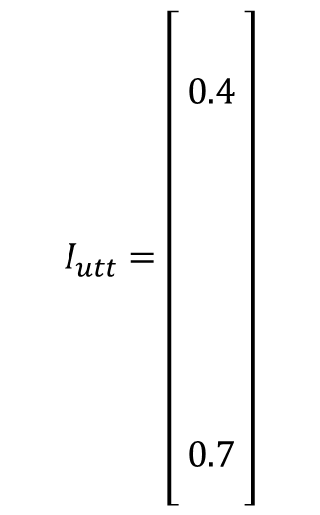
Long Timescale – Speaker Information
$$I_{utt}=\left[\begin{aligned} \\ {\begin{aligned} \\ \\ 0.4 \\ \\ \\ \end{aligned}}_{ } \\ \\ \\ \\ \\ \\ 0.7 \\ \end{aligned}\right]$$
Dehak et al. 2010
Notes:
Expansion contraction axes with i-vector on side add numbers to this
IN one direction you would expand in the opposite you would ocntract
This mechanism has been used in speech technologies for speaker recognition, language identification among other things
This is a good descriptor of one utterance in comparison to other utterances which is going to capture speaker information
We’re going to call this an i-vector and use this as the representation for each utterance
In reality we have 2048 gaussians and 39 dimensions
Our I-vector is 400 dimensions long which is low compared to the number of possible dimensions of movement

Slide 13


Long Timescale – Speaker Information
$$I_{utt}=\left[\begin{aligned}{\begin{aligned} \\ I\end{aligned}}_{1} \\ \\ I_{\begin{aligned}\begin{aligned}2 \\ \end{aligned} \\ \end{aligned}} \\ \\ I_{3} \\ \\ \\ … \\ \\ \\ I_{400} \\ \end{aligned}\right]$$
$${\text{μ} }_{utt}=μ+T∗I_{utt}$$
Weight matrix learned through maximum likelihood mapping
Dehak et al. 2010, Carbajal et al. 2016
Notes:
Expansion contraction axes with i-vector on side add numbers to this
This mechanism has been used in speech technologies for speaker recognition, language identification among other things
This is a good descriptor of one utterance in comparison to other utterances which is going to capture speaker information
We’re going to call this an i-vector and use this as the representation for each utterance
In reality we have 2048 gaussians and 39 dimensions
Our I-vector is 400 dimensions long which is low compared to the number of possible dimensions of movement

Slide 14
Short timescale
Phonetic information
Frame-level Gaussian Activations
Long timescale
Speaker information
Utterance-level
I-Vectors
Infants were able to discriminate between speakers of their native language but not of a non-native language
We have built a model of how infants could represent speech and can now use this to test for a language familiarity effect

Slide 15
Visual Fixation Procedure
Y | Z | Y | Z
…
A | B | A | B
Same Voice
…
W | V | W | V
…
Different Voice
Habituation Phase
Test Phase
Fecher & Johnson 2019
Notes:
keep happening until they are bored
Talk through this graph
[TODO: Add 3 dots to end of each phase]
[TODO: Make A/B bigger]

Slide 16
Visual Fixation Procedure
Y | Z | Y | Z
…
A | B | A | B
Same Voice
…
W | V | W | V
…
Different Voice
Habituation Phase
Test Phase
Fecher & Johnson 2019
Notes:
keep happening until they are bored
Talk through this graph
[TODO: Add 3 dots to end of each phase]
[TODO: Make A/B bigger]

Slide 17
Machine ABX Task
A
X
B
Schatz et al 2013, Schatz 2016
Notes:
This is much simpler – we don’t need to model the fine details of the experiment
Doesn’t require fitting any parameter

Slide 18
Machine ABX Task
A
X
B
X is closer to A in i-vector space. Success!
Schatz et al 2013, Schatz 2016

Slide 19
Predicted Results
100%
ABX Trials Performed Correctly (%)
50%
0%
Native
Non-Native
Notes:
50% is chance

Slide 20
Predicted Results
100%
ABX Error Rate (%)
Probability of incorrect judgement
50%
0%
Native
Non-Native
Notes:
Because our error rates our low this will be easy to visualize with error rate

Slide 21
Experimental Paradigm
Train models on four corpora
English and Japanese
Read and Spontaneous
Test on utterances from all corpora
 |  | Training Language
 |  | English | Japanese
Test Language | English | Native | Non-Native
 | Japanese | Non-Native | Native
Notes:
We have two registers useful to control for robustness

Slide 22
Results

Slide 23
Conclusion
Language Familiarity Effect is found in infants at 4.5 months old
This is the first model to account for this effect
We propose that the infant uses acoustic variability hierarchically at multiple timescales
No sophisticated linguistic knowledge required
Notes:
No sophisticated knowledge – this is reassuring as we don’t need to assume a lot of knowledge for the infants
Have a lot more reasonable explanation

Slide 24
Next Steps
Validating against languages and conditions used in infant experiments (ie. Reversed speech)
Investigating robustness to amount of training data
Confirming this model empirically in other paradigms
Connecting this model to the adult mechanism
Showing other infant native language biases with this model
Notes:
We think that we can capture different effects with the same model (refer back to beginning)
Remember all the things that the infant can learn

Slide 25

Acknowledgements
Thomas Schatz
Naomi Feldman
Thanks to Elizabeth Johnson and the Maryland Phonology Circle for helpful discussions
NSF grant BCS-1734245
ESRC grant ES/R006660/1
Notes:
More generally what does this mean abut what infants learn/ implciations

Slide 26
References
Carbajal, M. J., Fer, R., & Dupoux, E. (2016). Modeling language discrimination in infants using i-vector representations. In Proceedings of the 38th Annual Conference of the Cognitive Science Society (pp. 889–894).
Dehak, N., Kenny, P. J., Dehak, R., Dumouchel, P., & Ouellet, P. (2010). Front-end factor analysis for speaker verification. IEEE Transactions on Audio, Speech, and Language Processing, 19(4), 788–798.
Fecher, N., & Johnson, E. K. (2019). By 4.5 months, linguistic experience already affects infants talker processing abilities. Child Development.
Johnson, E. K., Westrek, E., Nazzi, T., & Cutler, A. (2011). Infant ability to tell voices apart rests on language experience. Developmental Science, 14(5), 1002–1011.
Schatz, T. (2016). ABX-discriminability measures and applications Doctoral dissertation. Universite Paris 6 (UPMC).
Schatz, T., Feldman, N., Goldwater, S., Cao, X. N., & Dupoux, E. (2019). Early phonetic learning without phonetic categories – Insights from machine learning (preprint). PsyArXiv.
Schatz, T., Peddinti, V., Bach, F., Jansen, A., Hermansky, H., & Dupoux, E. (2013). Evaluating speech features with the minimaln pair ABX task: Analysis of the classical MFC/PLP pipeline. In Proc. INTERSPEECH

