Slide 1




Real
Data
Data
Transformation
x
Real
Sample
Condition $c$
G
Generator
Fake
Sample
D
Discriminator
Noise $z$
Gradients
Condition $c$
28
Male
HS-grad
Sales
<=50K
G
Generator
Fake
Sample
Data
Transformation
Noise $z$

Slide 2
Real
Data
Data
Transformation
x
Real
Sample
Condition $c$
G
Generator
Fake
Sample
D
Discriminator
Noise $z$
Gradients
Condition $c$
28
Male
HS-grad
Sales
<=50K
G
Generator
Fake
Sample
Data
Transformation
Noise $z$

Slide 3
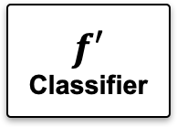
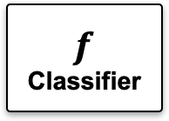
GAN Training
Data Generation
G
Generator
Real
Data
Synthetic
Data
Classifier Training
Classifier Training
Classifier Evaluation
$$f$$
Classifier
$$f′$$
Classifier
Test Data

Slide 4





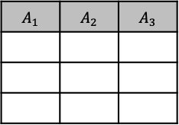
T
Transformer
sample $t$
training data $T$
condition $c$
G
Generator
D
Discriminator
sample $t^{′}$
noise $z$
Gradients

Slide 5














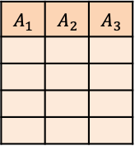

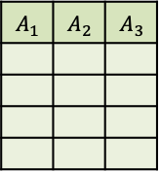
Data Transformation
GAN Model Training
sample $t_{i}$
Synthetic Data Generation
$t_{1}$
$t_{1}^{′}$
Sampler
$t_{2}$
label
$t_{2}^{′}$
$t_{3}$
$t_{3}^{′}$
G
Generator
sample $t^{′}$
D
Discriminator
$…$
$…$
original table
$T$
$t_{n}$
$t_{n}^{′}$
fake table
$$T^{′}$$
samples
noise $z$
Gradients
samples

Slide 6
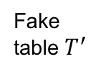
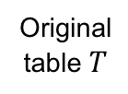









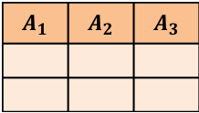
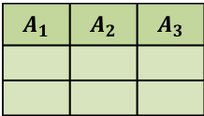
① Data Transformation
③ Synthetic Data Generation
Original table $T$
Fake table $T^{′}$
Samples
Samples
$t_{1}$
$t_{2}$
$…$
$$t_{1}^{′}$$
$$t_{2}^{′}$$
$…$
② GAN Model Training
Sample $t_{i}$
Sampler
Label
G
Generator
Sample $t^{′}$
D
Discriminator
Noise $z$
Gradients

