Slide 1




Condition $c$
Noise $z$
Condition $c$
Data
Transformation
x
Real
Sample
Real
Data
Noise $z$
G
Generator
Fake
Sample
D
Discriminator
Gradients
28
Male
HS-grad
Sales
<=50K
G
Generator
Fake
Sample
Data
Transformation

Slide 2
Condition $c$
Noise $z$
Condition $c$
Data
Transformation
x
Real
Sample
Real
Data
Noise $z$
G
Generator
Fake
Sample
D
Discriminator
Gradients
28
Male
HS-grad
Sales
<=50K
G
Generator
Fake
Sample
Data
Transformation

Slide 3
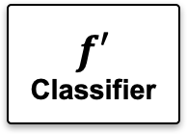
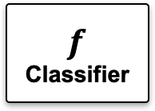
$$f$$
Classifier
$$f′$$
Classifier
GAN Training
G
Generator
Data Generation
Real
Data
Synthetic
Data
Classifier Training
Classifier Training
Classifier Evaluation
Test Data

Slide 4





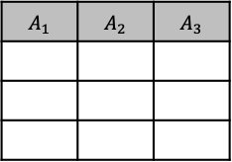
sample $t$
training data $T$
condition $c$
sample $t^{′}$
noise $z$
T
Transformer
G
Generator
D
Discriminator
Gradients

Slide 5





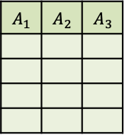
Data Transformation
samples
? |  | ?
 | ? | ?
 | ?
 |  | ?

Slide 6
Target Domain
Source Domain
Mask matrix
Observed data
Clean data
Target data
Source data
Noise
Noise
Mask
Generator
Target mask
Fake mask
Fake mask
Mask
Discriminator
Fake observed
Target Observed
Gradients
Observed
Discriminator
Gradients
Source Domain
Mask
Generator
Target Domain

Slide 7








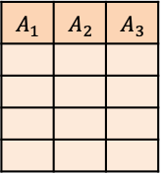


sample $t_{i}$
$t_{1}$
$t_{2}$
$t_{3}$
$…$
sample $t^{′}$
original table
$T$
$t_{n}$
noise $z$
fake table
$$T^{′}$$
GAN Model Training
Data Transformation
Sampler
Synthetic Data Generation
label
$t_{1}^{′}$
G
Generator
D
Discriminator
$t_{2}^{′}$
$t_{3}^{′}$
Gradients
$…$
$t_{n}^{′}$
samples
samples
? |  | ?
 | ? | ?
 | ?
 |  | ?

Slide 8
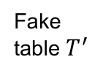
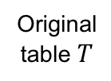









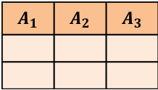
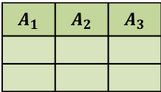
Original table $T$
Fake table $T^{′}$
$t_{1}$
$t_{2}$
$…$
$$t_{1}^{′}$$
$$t_{2}^{′}$$
$…$
Sample $t_{i}$
① Data Transformation
③ Synthetic Data Generation
Sample $t^{′}$
Noise $z$
Samples
Samples
② GAN Model Training
Sampler
Label
G
Generator
D
Discriminator
Gradients

